Slide 1
Asset markets: interest rates, bonds, stocks & real estate

Slide 2
5 topics
Nominal and real interest rates
Bond prices and interest rates
Stocks and the random walk
Asset crashes: are we headed for another one?
The Greek (et al) debt crisis

Slide 3
Nominal and real interest rates
Traditionally, nominal interest rates* are broken down into these elements:
--The “time value of money”
-- A risk premium
-- An inflation premium
* Nominal interest rates (measured in %) are those published by a bank or reported in financial news articles; they determine the $ interest payments made.

Slide 4
1. Time value of money
It measures the difference between money NOW and money LATER (now is better)
Savers give up the use of their money NOW
Borrowers get money NOW
Savers earn something for “sacrificing;” borrowers have to pay something
Monetary policy by the CB affects it

Slide 5
2. Risk premium
If there’s a bigger risk of non-repayment, the lender/saver is typically compensated with higher interest rates.
Risky borrowers (e.g. firms that are close to bankruptcy; households with low incomes) usually have to pay higher interest rates to borrow.
(“Risk” may be subjective and biased.)

Slide 6
3. Inflation premium
And when inflation exists, nominal interest rates tend to be higher, to compensate for erosion in the real value of the principal
Savers want to GET an inflation premium
Borrowers expect to PAY one

Slide 7
Inflation & nominal interest rates

Slide 8
Real interest rates
As with other nominal values such as GDP or salaries, it can be useful to adjust nominal interest rates for inflation
Since interest payments are measured in %, not $ (although we could convert them to $ and deflate in the ordinary way), we can use a simple formula to get close to real interest rates

Slide 9
An approximation of the real (inflation-adjusted) interest rate:
The real interest rate ≈
the nominal interest rate – the inflation rate*
The real interest rate measures how the purchasing power of savings or a debt has changed over time
* This equation is pretty accurate when inflation and interest rates are low, but less accurate when they’re high

Slide 10
Two examples
Nominal interest rate = 5%
Inflation = 3%
Real interest rate ≈ 5% - 3% = 2%
That means a saver’s wealth gains 2% in purchasing power during the year
Nominal interest rate = 5%
Inflation jumps up to 8%
Real interest rate ≈ 5% - 8% = -3%
A saver’s nest egg loses 3% in purchasing power that year

Slide 11
When inflation rises, nominal interest rates tend to rise (along with other prices), regardless of monetary policy
The real value of a $1000 savings account or bond is shrinking during a year of inflation
A higher interest rate offsets that shrinkage so that at the end of the year, the asset PLUS the interest earned > than the asset value at the beginning of the year
That is, the asset has a positive real return/i.r.

Slide 12
(This slide is visiting from the earlier PPT) Selected interest rates: 1982, 2000 and 2018
Interest rates are higher when inflation is higher! 1982: inflation = 6%; also very contractionary monetary policy
2000: inflation = 3.4%; somewhat contractionary monetary policy
2018: inflation = 2.4%; fairly loose monetary policy
Sources: New York Times, Federal Reserve Bank of St. Louis; Bankrates.com

Slide 13
What if interest rates aren’t aligned with inflation?
If inflation rushes ahead of interest rates, real interest rates are low (even negative); savers/lenders lose, and debtors gain
But if interest rates are high compared to inflation, real interest rates are high, savers/lenders gain, and debtors suffer
These redistributions are most likely when inflation is unexpectedly high or low

Slide 14
The real prime rate, 1960-2021

Slide 15
Conclusion: Interest rates are multitudinous, have many roles, and are subject to many influences
Interest rates are income or revenue for one party, and a cost for another party
Both nominal and real rates are affected by
--Monetary policy
--Inflation
--Risk of an asset or loan
--Preferences of savers and borrowers

Slide 16
Bond prices and interest rates
Bonds (let’s say Treasuries, but corporate bonds work the same way) are an agreement between a borrower (e.g. Treasury or the corporation) and a saver. The borrower promises to pay $ later in return for $ now (the Treasury needs $ now to finance its deficit).
Bonds usually come with a “face value”—the amount that will be repaid in 6 months or 10 years or whenever the maturity is.
They also come with a “coupon.”

Slide 17
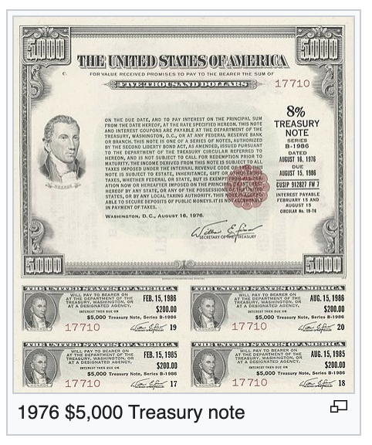
The coupon
It’s the interest payment associated with the bond
It’s denominated in $, not as a %
Example: a bond could have a coupon of $450/year, and that means Treasury pays $450 in interest every year to the owner of the bond

Slide 18
Consols are a special kind of bond
The math is easy with consols
They really exist but are not that common
A consol has no face value or maturity, but it pays interest (a coupon) FOREVER
For instance, $450/year in perpetuity
The market price of a consol, as with all bonds, fluctuates with supply and demand

Slide 19
The bond market and the price of bonds
Let’s say that consol is selling for $9000 today.
Its annual interest rate, in %, would be
$450/$9000 = .05 = 5%
Now suppose overall demand for bonds increases.

Slide 20
The bond market
Price of consols
S
9375 ---------------------------
9000 -----------------------
D’
D
Q of consols

Slide 21
What happened to the interest rate (that is, the rate of return)?
It’s now $450/$9375 = .048 = 4.8%
Observe: when bond prices went up, the interest rate went down (it was mathematically necessary)
This is likely when the CB is buying bonds, increasing demand. There’s also lots of money in the economy.

Slide 22
How about an open-market sale and a general sell-off of bonds?
Price of consols
S S’
9000 ------------------------
8333 ----------------------------
D
Q of consols

Slide 23
What happened to the interest rate this time?
The new interest rate (annual rate of return)
is $450/$8333 = .054 = 5.4%
Again, the interest rate is inversely related to the price of bonds
This relationship holds for any shift in S or D in any bond market
The CB could start the shift, but not necessarily

Slide 24
Summary:
Bond prices rise, interest rates fall
Bond prices fall, interest rates rise
All macro students should know this fact. Never forget!
2022-23: contractionary monetary policy raised interest rates, so bond prices fell
(A problem for Silicon Valley Bank and others who held bonds and needed to sell them)

Slide 25
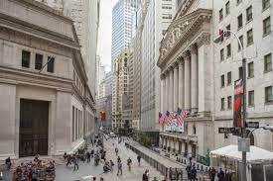
The stock market
Here I present two contradictory views of the stock market
The Random Walk and the efficient markets hypothesis (Burton Malkiel)
Irrationality, including herd behavior, in asset markets (Robert Shiller)

Slide 26
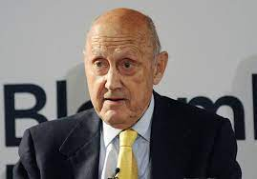
Stock prices: they’re a random walk!
The phrase is from a famous, influential book by Burton Malkiel, 1973
First, some stock market basics:
Owning a share (of stock) means
owning a sliver of a corporation
A stock’s price (its value) should equal the discounted value of profits that the company (your sliver of it) is expected to earn over the future
But the future is unknown!

Slide 27
Information and share prices
Information is very available, very cheaply
Many millions of people have access to information that would help predict company earnings and future stock prices
When new information appears, people jump on it and either buy or sell shares.
The price of the stock will IMMEDIATELY reflect the new information

Slide 28
The price of a stock…
Will fall if negative information appears
Will rise if positive information appears
In the “information age,” this happens virtually instantaneously
Malkiel’s point: all the information relevant to future value is immediately acted on
So “research” won’t help you pick winners—you’ll be too late

Slide 29
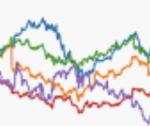
The random walk, summarized
Any changes to stock prices are from random events that occur
By definition, random events can’t be predicted
And so you can’t make money off them by accurately predicting a change in prices
In sum: stock prices move unpredictably, randomly

Slide 30
Efficient markets
The random walk idea is part of a broader approach in Economics called the “Efficient Markets Hypothesis”
It suggests that markets instantly incorporate all relevant information into the prices of goods and assets…
Leaving very minimal opportunities to buy low, sell high, and earn quick easy profits

Slide 31
Tesla’s random walk

Slide 32
Malkiel says don’t bother…
Researching companies
Or hiring a financial adviser who picks stocks for you and charges you fees.
You’ll do just as well throwing darts at the business pages to choose your stocks
More safely/sanely, buy into an index fund that contains stocks in the same proportion as the S&P 500 or another stock price index—because share prices do rise over the long run!

Slide 33
On the same topic… NY Times, April 14, 2023 by Jeff Sommer
“…as a group, actively managed mutual funds fared better against the overall market average than they have since 2009”
“Even so, the average actively managed stock mutual fund failed to beat the S&P 500”… said Anu R. Ganti, sr director of index investment strategy at S&P D J Indices. “Actively managed funds underperformed less badly in 2022 than they have in most years,” she said. “But they still underperformed.”

Slide 34
Big drama: Asset crashes
In 2000, Robert Shiller (Yale, Nobel prize) argued that stocks were overvalued, the market was in a bubble, and the bubble could pop.
The NASDAQ stock price index peaked that year and lost about 80% of its value over the following 2 ½ years. The “tech bubble” had popped. A recession occurred as well.

Slide 35
Jump to 2005
Shiller (Yale) and co-author Case (Wellesley) had constructed a historical index of housing prices
From a NYT interview: “It all points to an unavoidable truth, he [Shiller] says. Every housing boom of the last few centuries has been followed by decades in which home values fell relative to inflation.”
He suggested housing prices could fall more than 40%, given historical patterns
“Even so, Mr. Shiller has little company for his radical notion that house prices could fall by 40 percent. Many economists say that interest rates are low enough and demand for housing in big urban areas is high enough to keep prices from falling very far.”

Slide 36
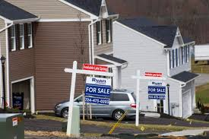
The housing crash
In 2006 U.S. home prices started falling. They bottomed out in mid-2009, down 35%.
Many financial institutions had aggressively acquired mortgage-backed bonds during the early 2000s
These failed at high rates after the bubble burst; the result was, by 2008, a general financial crash, a deep recession and a wave of homeowner foreclosure and misery
Shiller 2, Conventional wisdom 0

Slide 37
Jump to 2021
2021: “The prices of stocks, bonds and real estate, the three major asset classes in the United States, are all extremely high. In fact, the three have never been this overpriced simultaneously in modern history.”
Shiller, NYTimes 10/1/2021

Slide 38
Are stocks overvalued? Look at the price-earnings ratio
The P/E ratio is the price of a company’s stock divided by the current earnings (profits) per share of stock
It’s a common way to evaluate whether a stock is “cheap” or “expensive” (also “undervalued” or “overvalued”)
Shiller created a custom P/E measure called CAPE (cyclically-adjusted P/E ratio)
Notes:
Price divided by 10 year average of real earnings. Instead of current earnings.

Slide 39
Shiller’s CAPE reached 38.6 in November 2021; the historical average since 1881 is 17.1. It had only been higher once: prior to the 2000 stock market collapse
44.2
Green line = historical average

Slide 40
Mass psychology
Shiller’s career is based on incorporating irrational psychological elements into economic modeling
In particular, “herd behavior”
“Everyone” (the herd) believes real estate prices only go up
“Everyone” is selling, so I should sell too.
(This is not rational or efficient)

Slide 41
Asset prices and the macroeconomy
Asset price fluctuations affect GDP and employment only indirectly, by nudging business confidence, consumer confidence, & household wealth => possibly altering spending (AE). Asset price declines don’t destroy jobs directly.
But a full-fledged financial crisis, when even routine lending shuts down, can quickly devastate the macroeconomy, which relies on huge amounts of daily borrowing and lending.

Slide 42
The Greek crisis
Greek p.c. GDP was $31,997 in 2008, while the average for the € area was $42,220 that year.
Greece had a history of low tax collection and high government spending.
Labor productivity was low, making it difficult to export competitively, and the country had a large trade deficit (about 12% of GDP in 2008).
Greece was borrowing heavily to finance the budget and trade deficits. (For convenience’s sake, let’s say the lenders were German savers.)
In late 2009, during the Great Recession, fears that Greece couldn’t service its debt led lenders to halt all lending.
Greece faced a debt crisis.
Eventually, the crisis spread to many EU nations: Spain, Italy, Ireland and Portugal

Slide 43
What is a debt crisis?
Basically, a nation (or other entity) is routinely rolling over foreign debt
But suddenly lenders won’t lend anymore
Or are demanding a much higher interest rate
Lack of €, when lending stops, can paralyze an economy

Slide 44
Eurozone
For lower-productivity members of the zone, the strong € creates difficulties
It means their exports struggle to be competitive
And imports are cheap => trade deficits
Greece and other individual nations have no control over the value of the €
There was discussion over whether Greece should leave the € zone

Slide 45
Interest rate differentials
Higher interest rates in the southern nations encouraged lending from the north (i.e. Germany)
It benefitted both regions, until the debt got too large to be sustainable
Familiar debt-crisis pattern. See Mexico, Argentina, Brazil, Russia, Korea, Thailand, Malaysia, etc

Slide 46
Contagion
Once one country gets in trouble, lenders start looking for weaknesses in others
If the market stops lending, any country can get in trouble
Similar to contagion in banking
Having solid fundamentals isn’t always enough
Including for the U.S., which relies on huge amounts of lending

Slide 47
Austerity
To deal with the disappearance of lending, debt-crisis nations have to cut the spending that was formerly financed by borrowing
C, I, G
Low spending means sharp, painful recession, high unemployment, and no easy solutions to recover

Slide 48
Exit the EZ?
The advantage: a Greek currency (the drachma) would have a much lower value than the €
Easier for Greece to export
Imbalances in exports and imports would be resolved more quickly
But living standards would still take a huge hit

Slide 49
EZ did not want an exit
Provided multiple bailout packages to Greece
In turn, Greece adopted austerity measures
A lot of suffering
And arguably the bailouts benefitted owners of Greek debt, not Greece
Greece averaged -5% real GDP growth between 2008 and 2013

