Slide 1
Connect Student Registration
Moodle

Slide 2
Make the Most of Connect
Stay Organized
Digital Course Planner has all your upcoming Connect assignments in one place, and you can customize calendar alerts
Focus On What Matters
Use Reports to track your performance and your understanding of key concepts
Learn On-the-Go
Download the free ReadAnywhere app to take your eBook* and SmartBook 2.0* with you – online and offline
* ReadAnywhere supports newer eBooks and SmartBook 2.0. May not be available in your Connect course.

Slide 3
Step 1 – Access your Course
Step 1
Login into your Moodle account and navigate to your course.
If you are not sure if you have a Moodle account, check with your instructor.

Slide 4
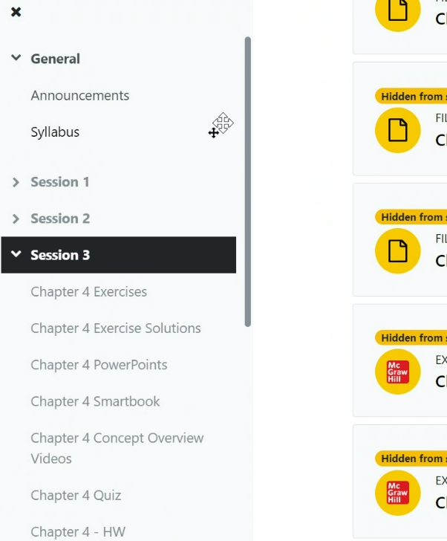
Step 2 - Navigate to Menu and click on Session
Step 2

Slide 5
Step 3 – Click on any assignment with the McGraw Hill logo
Step 2

Slide 6
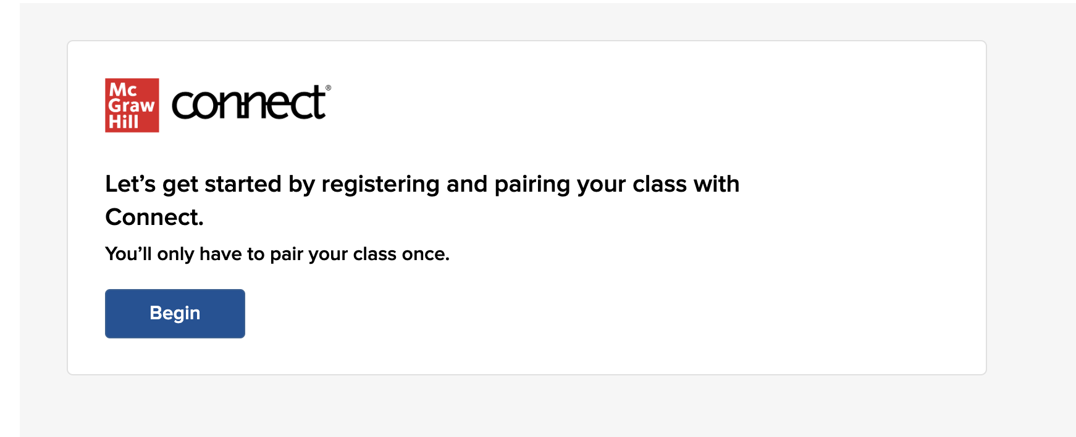
Step 4 – Click Begin.
Step 3

Slide 7
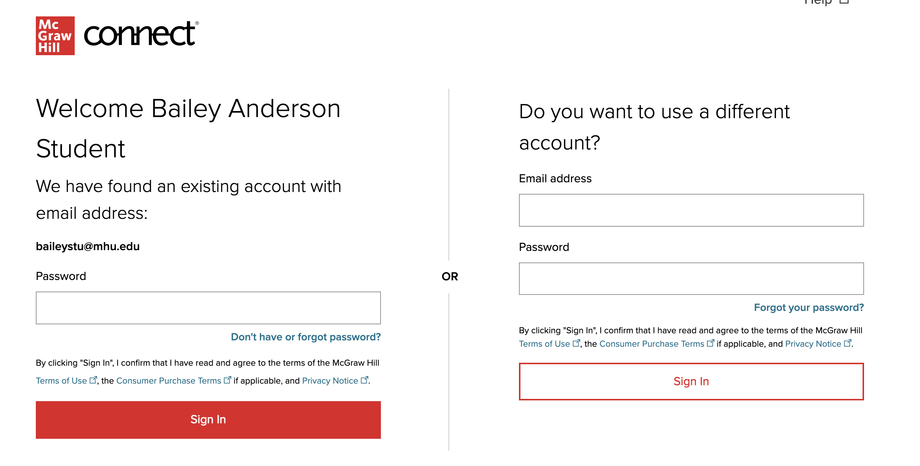
Step 5 - Sign In with an existing Connect account or Create Account.
Step 4

Slide 8
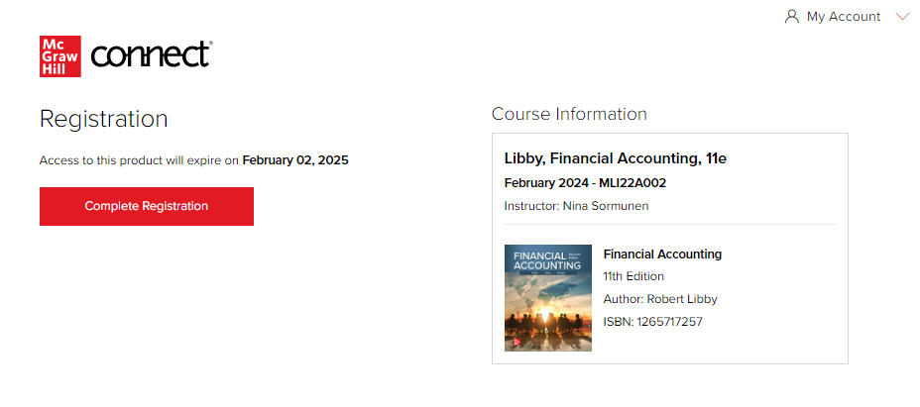
Step 6 - Click Confirm. You are now registered.
Step 5

Slide 9
Tech Support & FAQ:
Support and Resources
CALL: (800) 331-5094
EMAIL & CHAT: mhhe.com/support
MONDAY-THURSDAY: 24 hours
FRIDAY: 12 AM - 9 PM EST
SATURDAY: 10 AM - 8 PM EST
SUNDAY: 12 PM – 12 AM EST

Slide 10
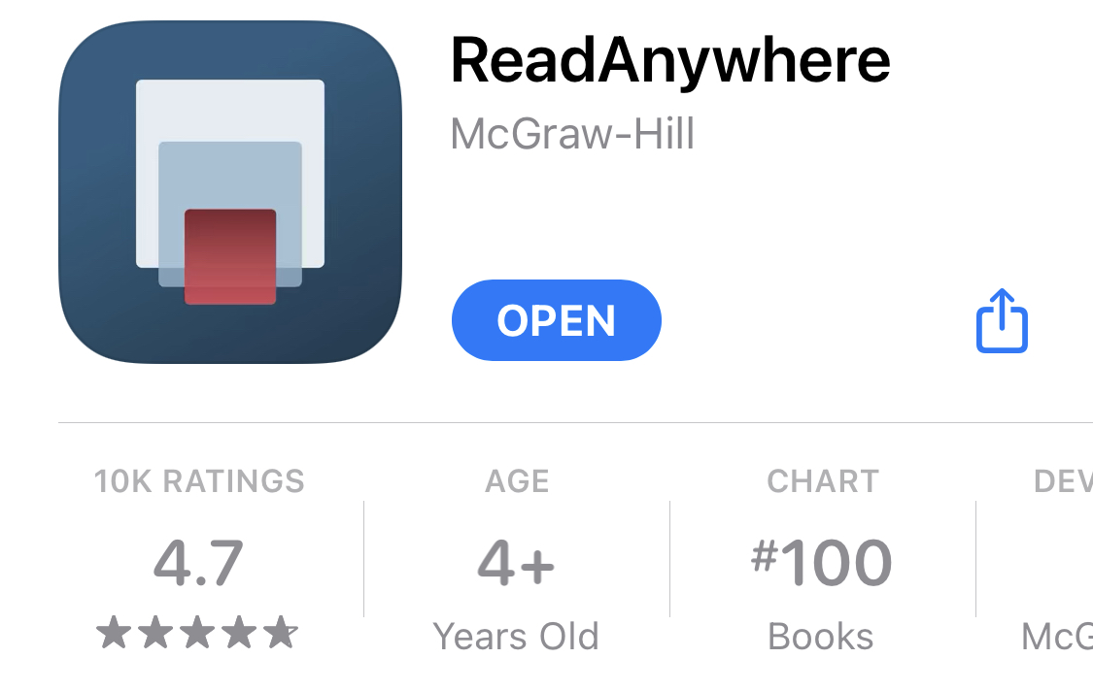
Study on Your Smartphone or Tablet
ReadAnywhere App
ReadAnywhere App
Download the free ReadAnywhere app to your Android or iOS smartphone or tablet and access your course eBook for offline study access anytime, anywhere.
More than 1 million students and instructors have downloaded the ReadAnywhere app that has a 4.7 rating on the App Store.
Connect Tablet App
Login to Connect on your tablet browser and then add it to your home screen to complete assignments with ease – including pinch, pan, and zoom capability as you work.
*The Connect Tablet App is not recommended for smartphone use.
Notes:
Download for iOS: https://apple.co/2JEwQEy
Download for Android: https://bit.ly/30HTWzS

