Slide 1
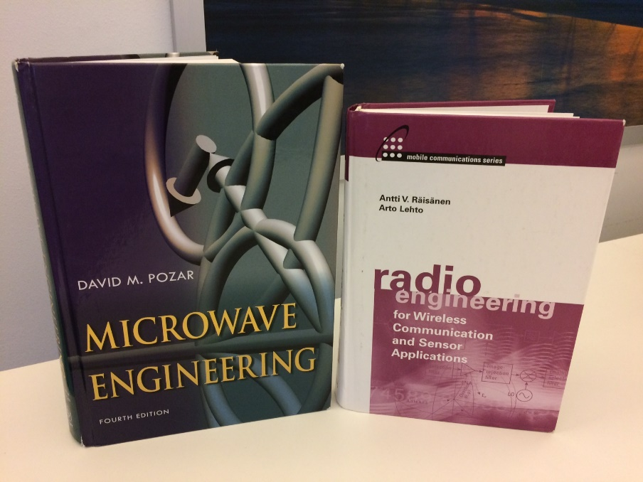
Microwave engineering I (MiWE I)
10 January – 17 March 2022, 5 ECTS
Jari Holopainen, Katsuyuki Haneda, Bing Xue
The main learning outcome is to create
readiness to work in microwave engineering
related tasks and projects and enable
further studies and continuous learning in
microwave engineering.

Slide 2
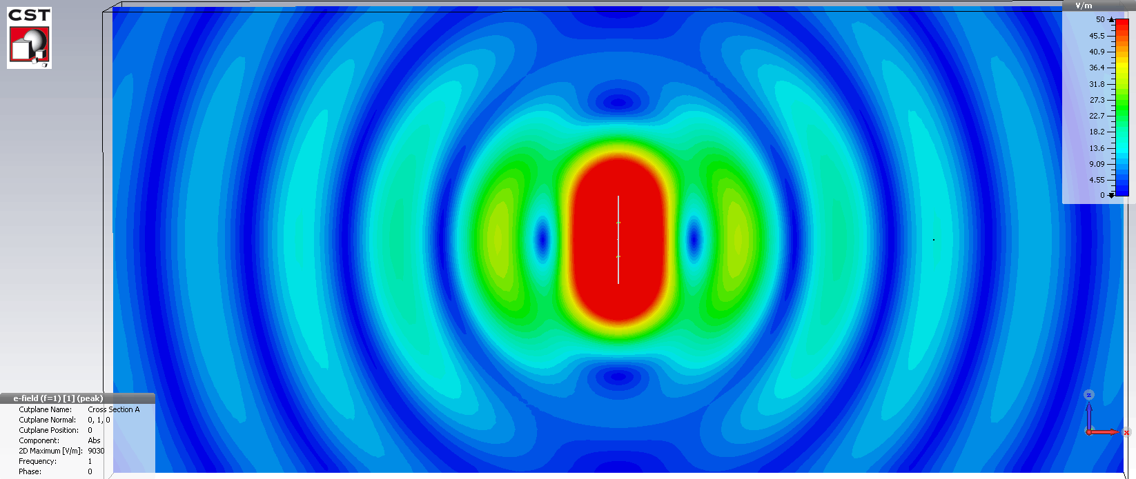
Alternating current in a wire induces radio waves
that propagate to the surrounding free space

Slide 3
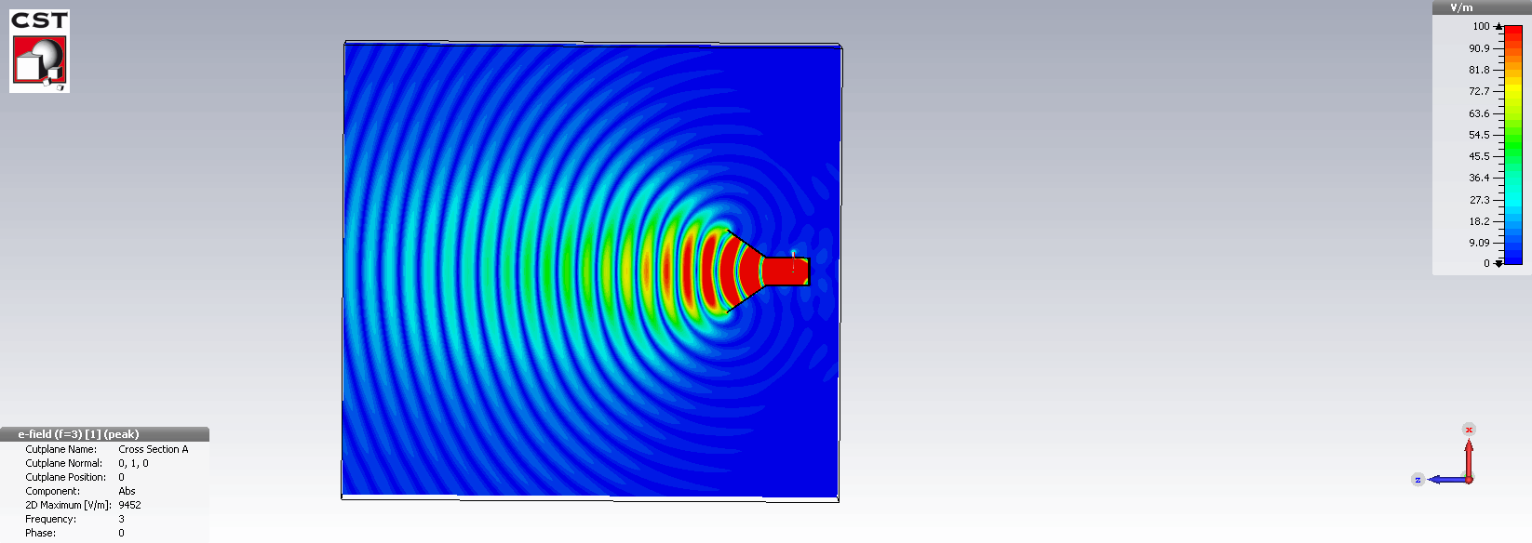
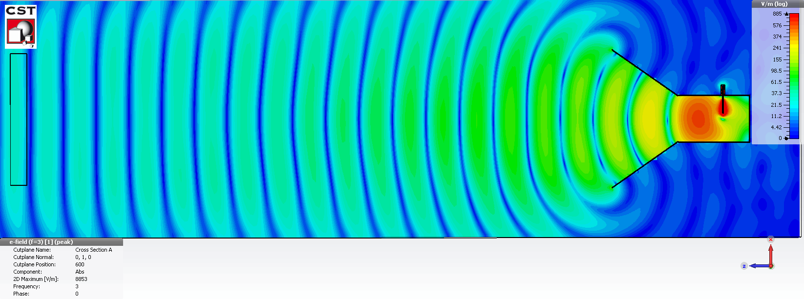
Aperture fields induce radio
waves

Slide 4
Plane or spherical wave?
x
ε = ε₀
z
$$E\left(z\right)=u_{x}E_{0}e^{−jkz}$$
z
When a spherical wave can be considered
as a plane wave?

Slide 5
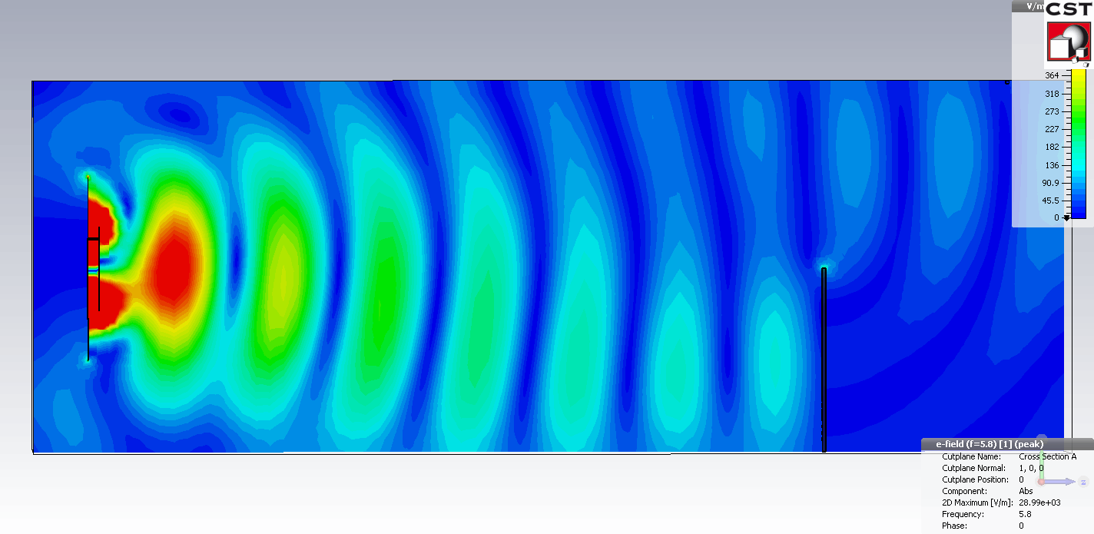
Radio waves do not penetrate through a metal sheet but diffract around a corner
Half metallic sheet

Slide 6
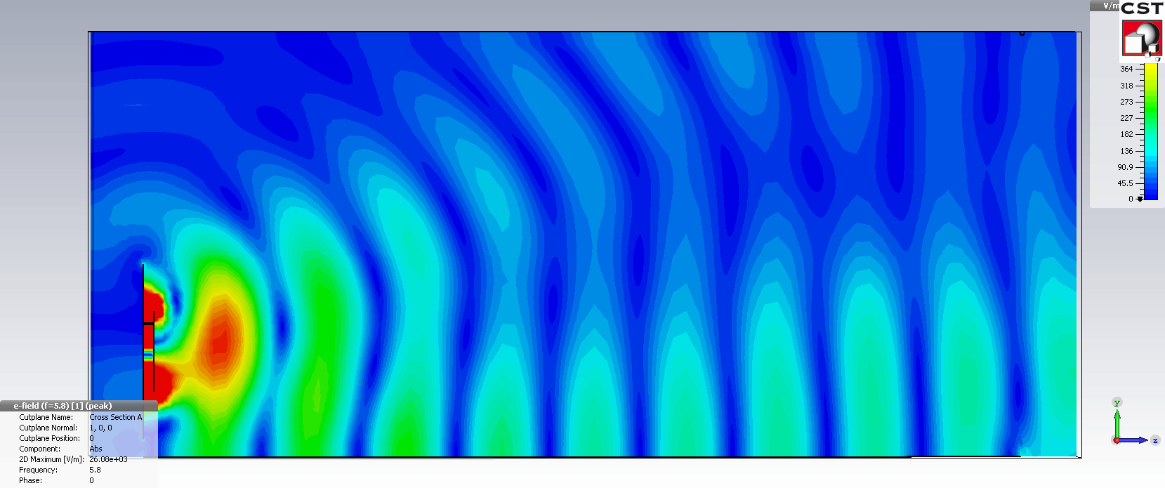
Radio waves can propagate as the ground wave along the interface between free space and conductive surface
conductive ground (PEC)

Slide 7
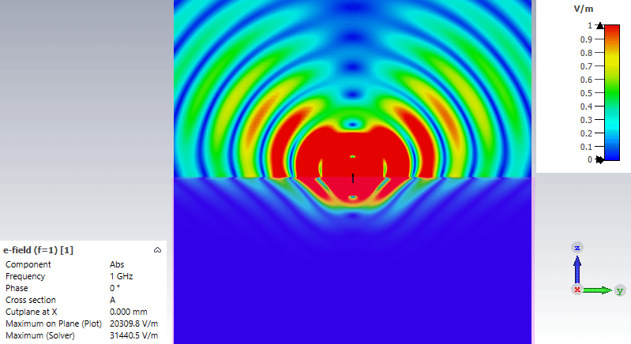
Vertical dipole antenna half in the air, half in lossy medium
air
ε_{r} = 1
interface
lossy medium
ε_{r} = 2 ja σ = 0,10 S/m

Slide 8
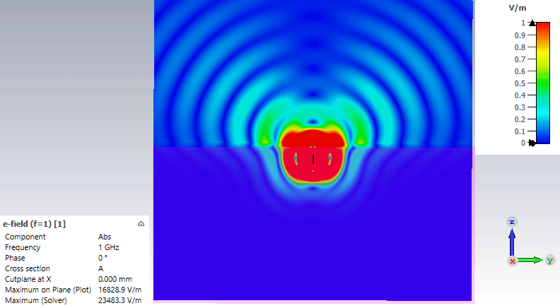
Vertical dipole antenna in lossy medium, top part one dipole length from the interface
air
ε_{r} = 1
interface
colour scale remains the same!
lossy medium
ε_{r} = 2 ja σ = 0,10 S/m

Slide 9
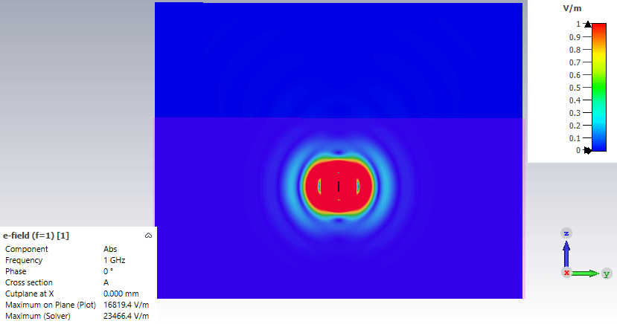
Vertical dipole antenna in lossy medium, top part three dipole lengths from the interface
Radio waves do not propagate in lossy medium such as see water
air
ε_{r} = 1
interface
colour scale remains the same!
lossy medium
ε_{r} = 2 ja σ = 0,10 S/m

