Slide 1
Notes:
IT ALL BEGINS WITH PREPARATION (DECONSTRUCTION)
WHY ARE THINGS AS WE SEE THEM DESIGNED THE WAY THEY ARE?

Slide 2
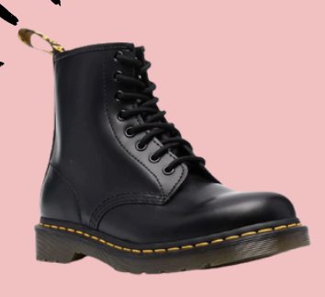
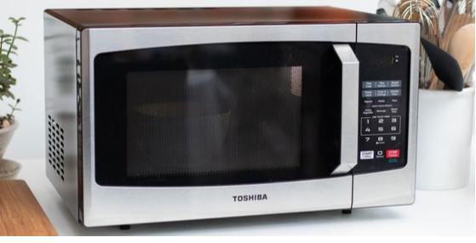
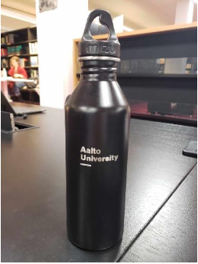
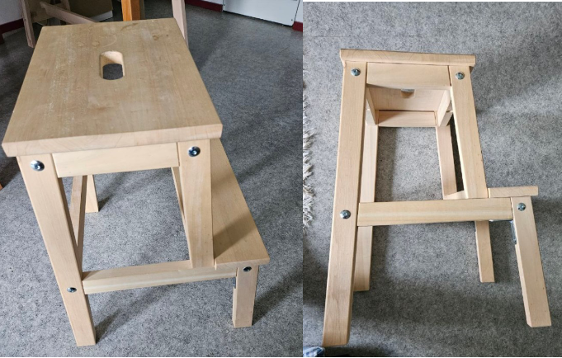

Slide 3
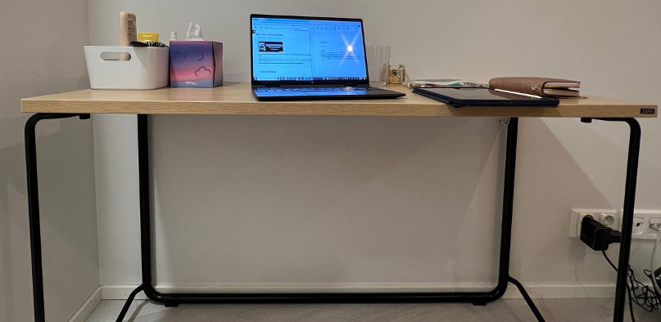
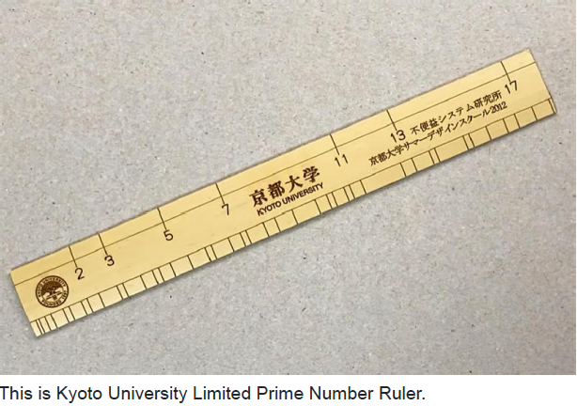
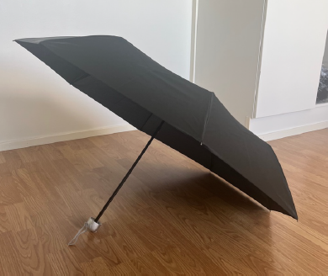
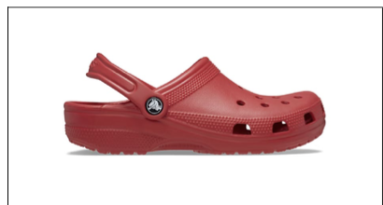
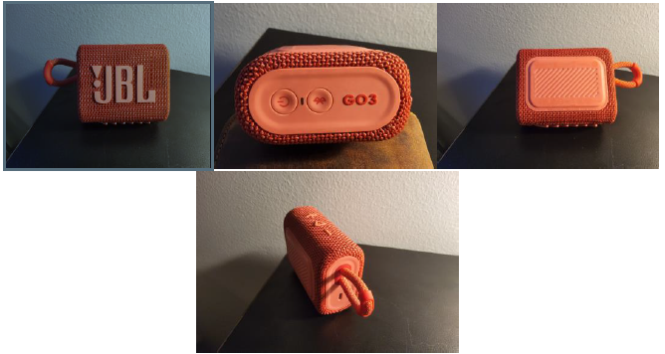

Slide 4
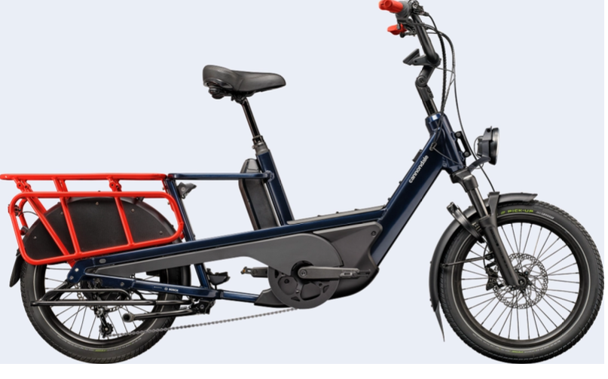
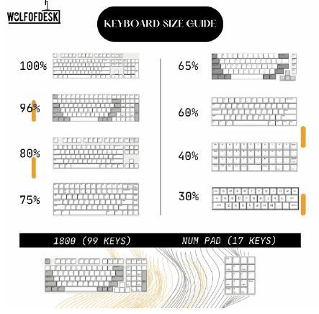
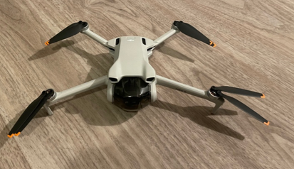
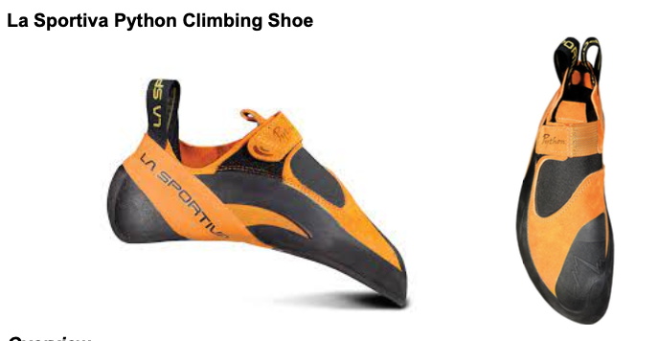

Slide 5
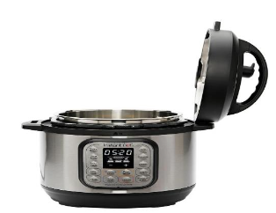
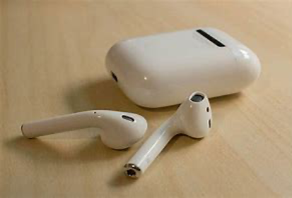
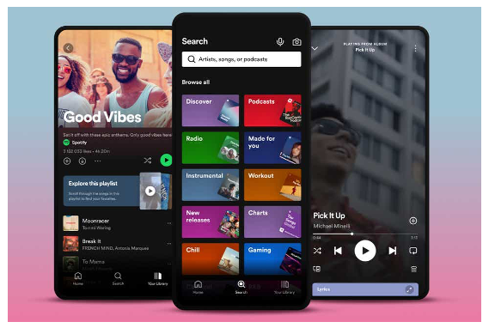
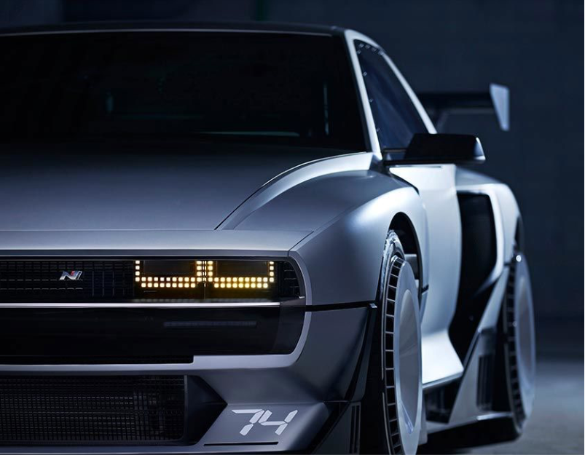
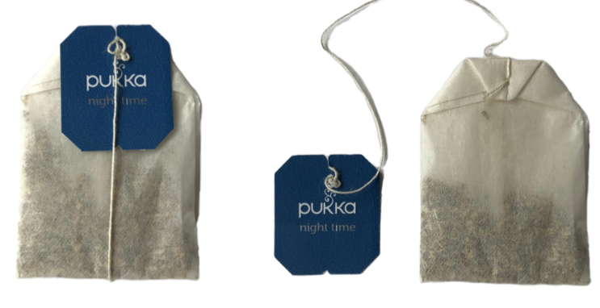
Notes:
BOON – DO YOU OWN ONE? HOW MUCH WOULD THIS COST IN SINGAPORE

Slide 6
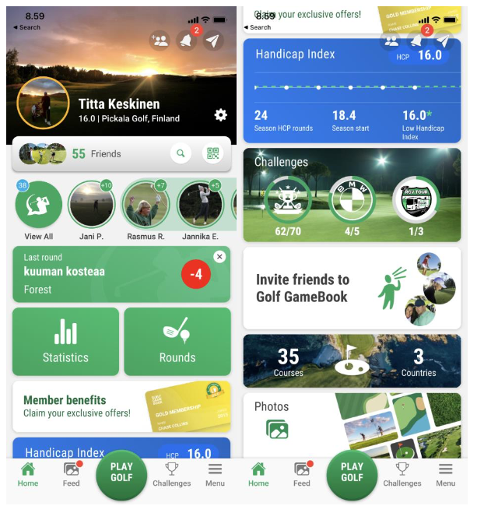
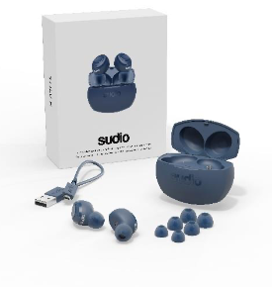
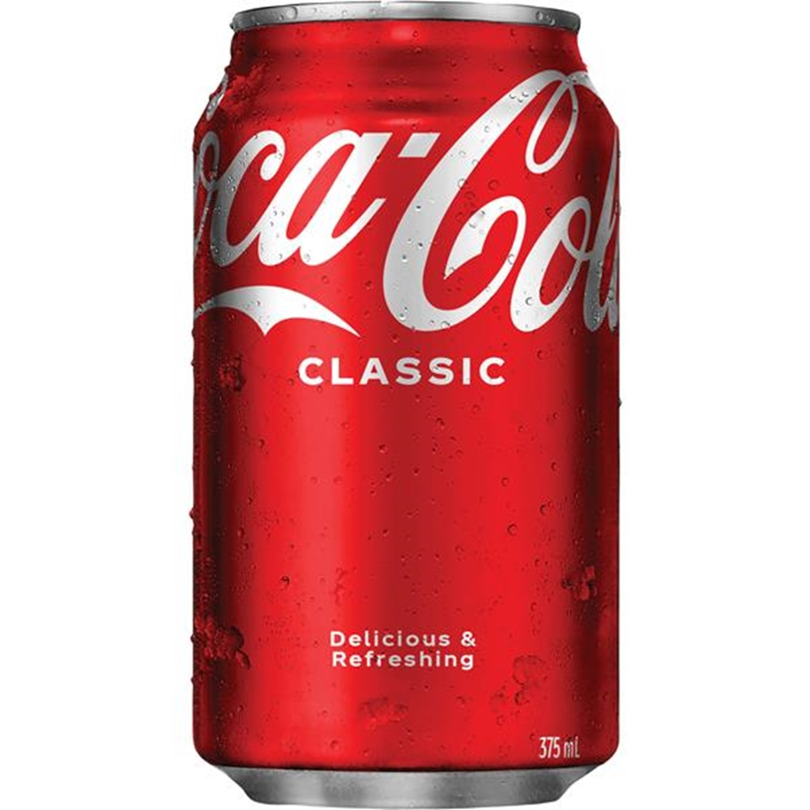
Notes:
LINUS DON’T APPOLOGIZE FOR CRUDITY!

Slide 7
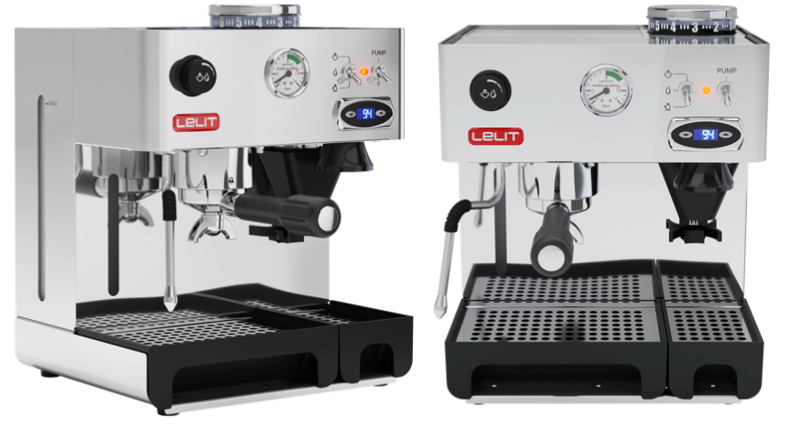
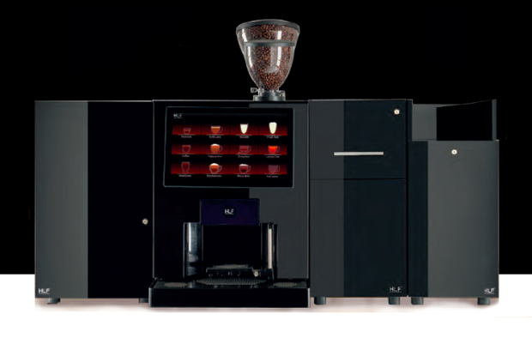
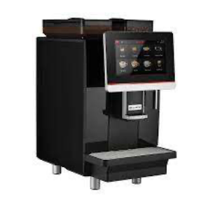
Notes:
PEDRO, OUMNIA, OSKAR, SACHA

Slide 8
Notes:
THEN WE COME TO CRISTIANA …

Slide 9
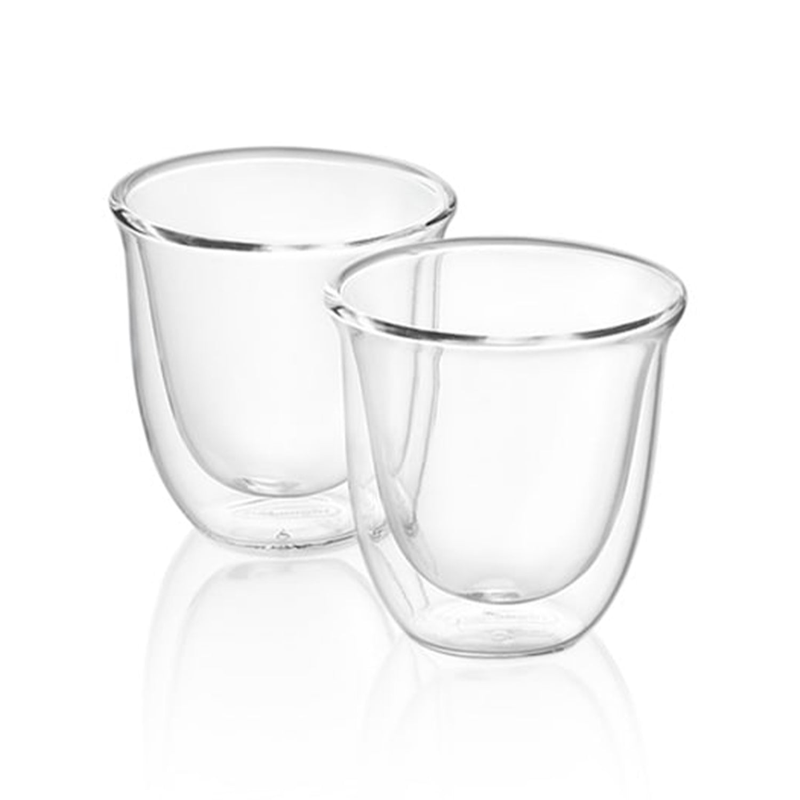
Notes:
THE ITEM I DECONSTRUCTED – HOW WOULD YOU DESCRIBE IT?

Slide 10
stylish
Notes:
HOW SO?

Slide 11
transparent
Notes:
SO WHAT?

Slide 12
functional
Notes:
HOW SO?

Slide 13
fragile
Notes:
WHAT MAKES IT APPEAR FRAGILE?

Slide 14
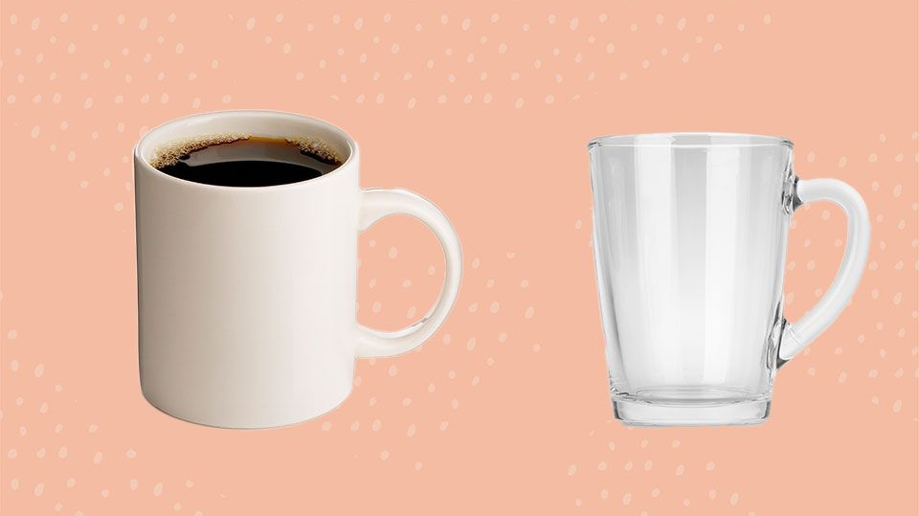
370 g
200 g
Notes:
TIP THE SCALES

Slide 15
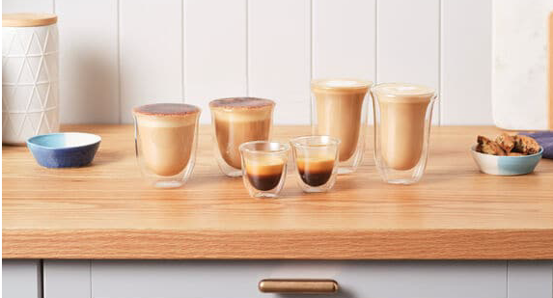
150ml
240ml
30ml
Notes:
IT COMES IT VARIOUS SIZES FOR ESPRESSO, CAPPUCCINO AND LATTE

Slide 16
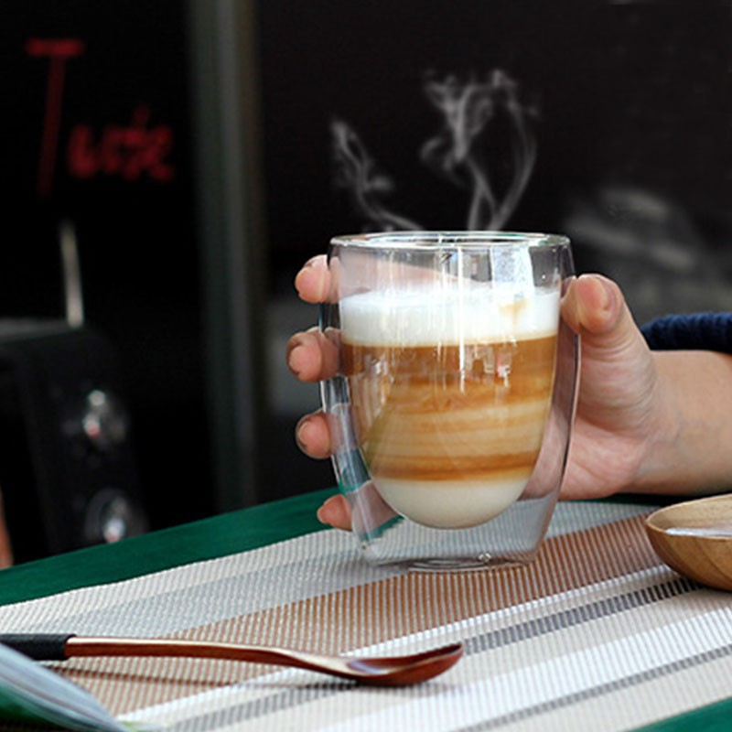
Notes:
IT LOOKS EXPENSIVE AND YOU CAN SEE THE LAYERS

Slide 17
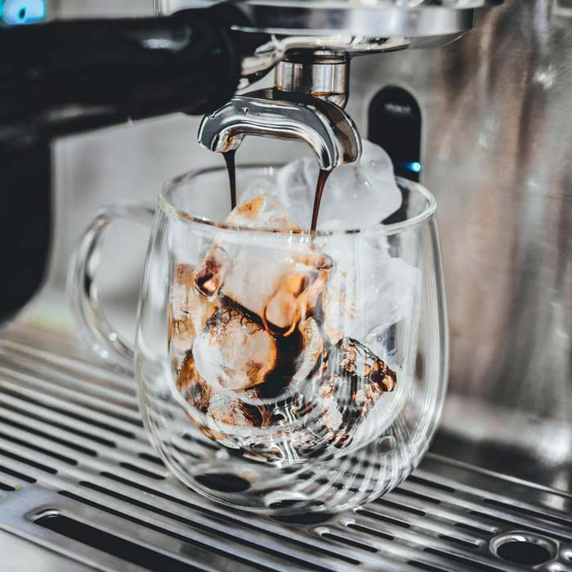
Notes:
-20C to 150C – IT HANDLES BOTH COLD AND HOT

Slide 18
on further
investigation
Notes:
I WANTED TO KNOW MORE …

Slide 19
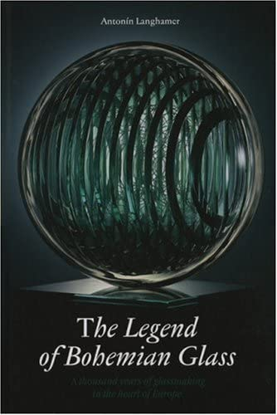
Notes:
DOUBLE WALLED GLASS FIRST APPEARED IN EARLY 1700s – IT IS NOT NEW

Slide 20
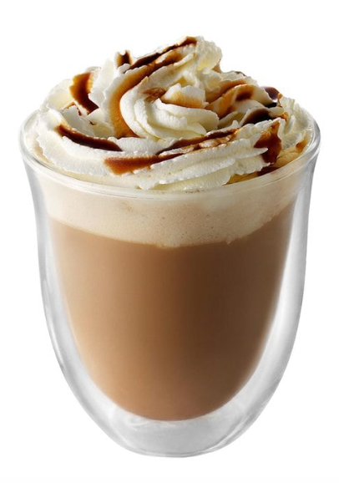
Notes:
LOTS OF FACTORS AND ELEMENTS THAT INTERACT

Slide 21
Notes:
AS OPPOSED TO LIME SODA

Slide 22
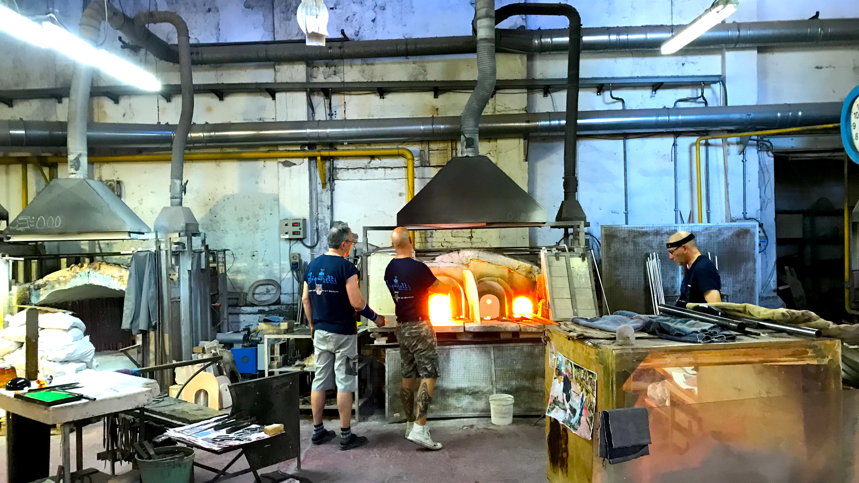
Notes:
IT IS HANDBLOWN
MURANO IS LOCATED IN VENICE REGION AS IS DELONGHI IN TREVISO

Slide 23
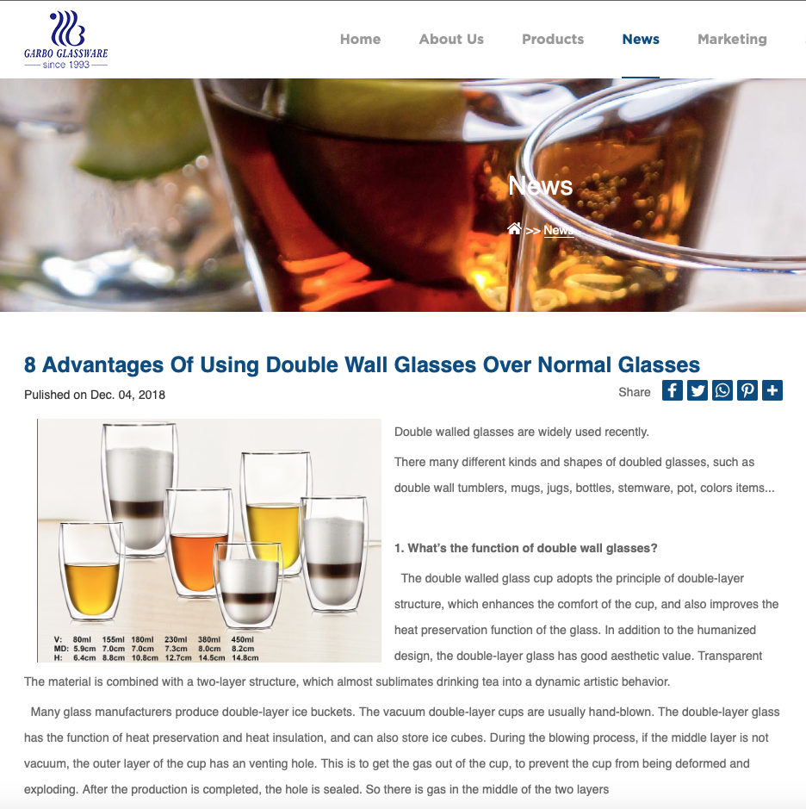
Notes:
IT HAS CERTAIN ADVANTAGES OVER NORMAL GLASS – WHAT IS NORMAL?
REALLY WORRIED WHEN YOU USE FANCY WORDS

Slide 24
How A Ceramic Mug Makes Your Coffee Taste Better
“Using a ceramic cup usually means that you cherish your coffee drinking time of the day
and enjoy a more comfortable environment. Compared to drinking coffee with a paper
cup, drinking from ceramic coffee mugs give you the feeling of a better drinking experience
due to its weight, texture, insulating properties and the location where you usually use it
(home, office, coffee shop). On the other hand, a paper cup feels disposable and temporary
and is most likely used in new environments and unique situations, like an event or an out-
of-state business meeting.”
Notes:
NOTE THE INTERESTS AND WORLD VIEW OF THE POSTER
NOTE WHAT IS NOT COMPARED – NO MENTION OF GLASS

Slide 25
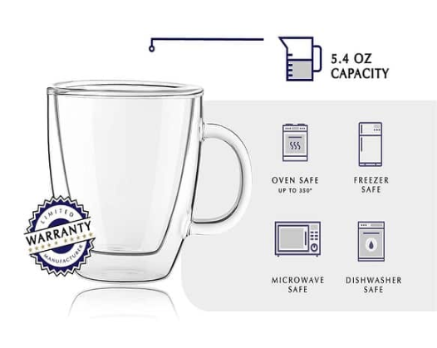
Notes:
STURDY – SOMEWHAT OF A PARADOX GIVEN THE IMPRESSION WHEN IN THE HAND

Slide 26
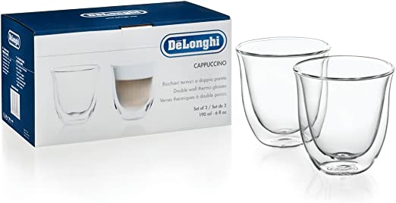
Notes:
BRANDED ON THE BOTTOM – WHAT IS THIS COMPANY ABOUT
WHAT IS THEIR BACKSTORY

Slide 27
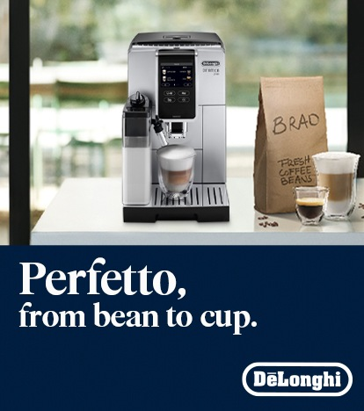
Notes:
FAMILY OWNED BUSINESS ESTABLISHED IN 1902 – 3RD GENERATION – IN TREVISO ITALY NEAR VENICE

Slide 28
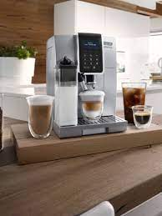
Notes:
FOCUS HAS BEEN ON THE KITCHEN CONTEXT – THERE ARE 34 ITALIAN ESPRESSO MACHINE MANUFACTURERS
AND DELONGHI HAS 36% GLOBAL MARKET SHARE

Slide 29
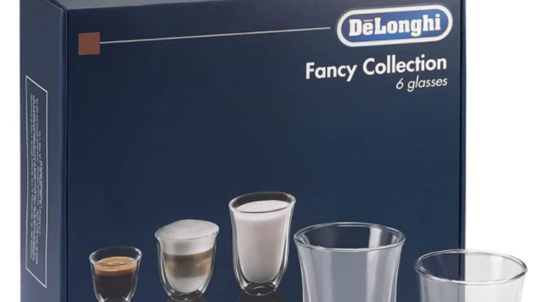
Notes:
I REALIZED THAT I MIGHT NEED TO EXPAND MY COLLECTION – NOT EVERYONE DRINKS CAPPUCCINO (OR COFFEE)

Slide 30
my thoughts
wandered

Slide 31
why all
this fuss?

Slide 32
Notes:
I OFTEN FIND MYSELF STARING AT THE CUP – NUDGE TO SLOW DOWN AND ENJOY

Slide 33
Notes:
LOTS OF FACTORS AND ELEMENTS THAT INTERACT
THE RIGHT MILK AT THE RIGHT TEMPERATURE NEEDS TO INTERACT

Slide 34
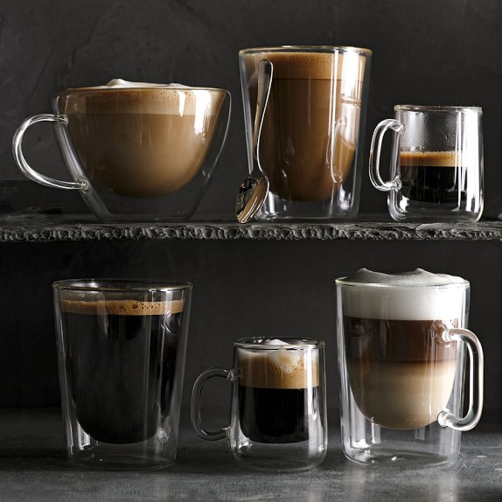
Notes:
LIQUIDS CAN LEAVE LINGERING TASTES TO ”CUP” – MATERIAL NEUTRALITY
THERE IS ALSO COMPLEX SCIENCE INVOLVED BETWEEN THE LAYERS WITHIN A DRINK
BUT NOTICE THE PRESENCE OF FOAM – CREMA FOR ESPRESSO MICROFOAM FOR MILK

Slide 35
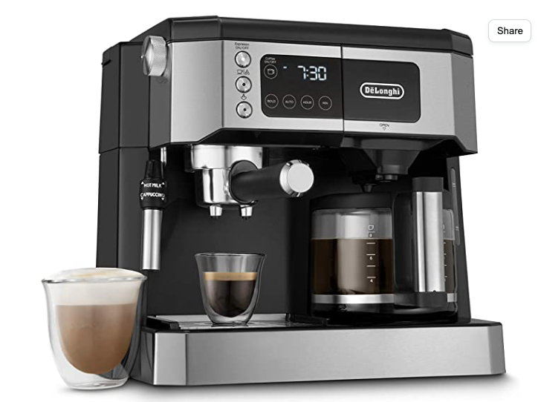
Notes:
FIT – CONGRUENCY ON MANY LEVELS (SPECIAL) – THESE ARE EXPENSIVE SLEEK MACHINES

Slide 36
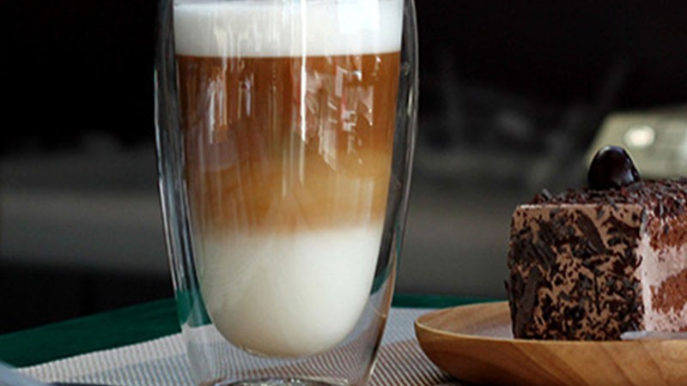
Notes:
SO THERE IS CONGRUENCE TO THE IDEA OF INVESTING IN GLASSES

Slide 37
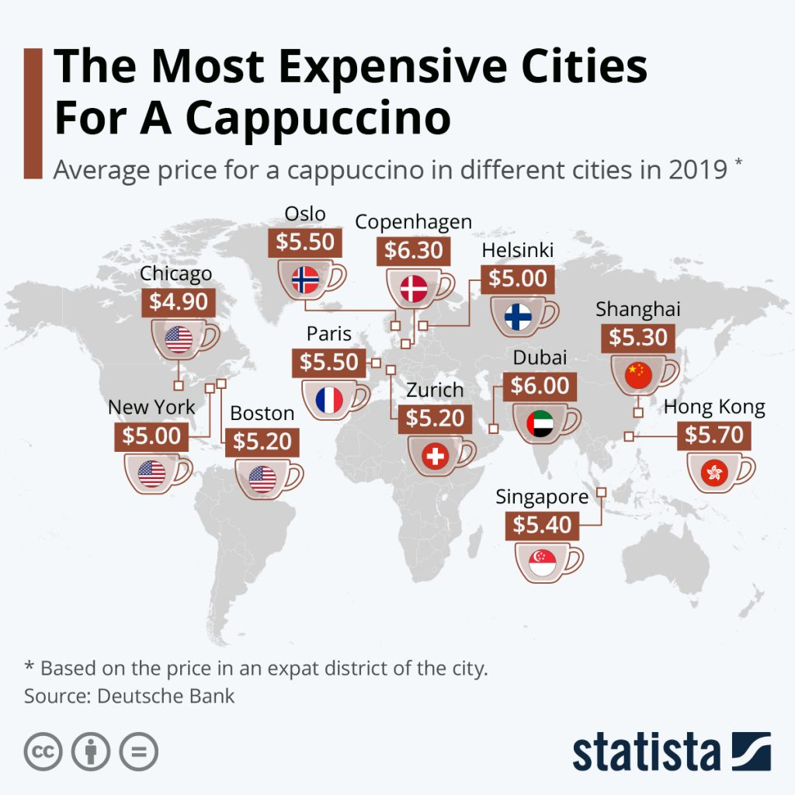
Notes:
CAPPUCCINO IS SPECIAL COFFEE – CONGRUENCE WITH HIGH PRICE POINTS – NICE GLASS

Slide 38
congruency

Slide 39
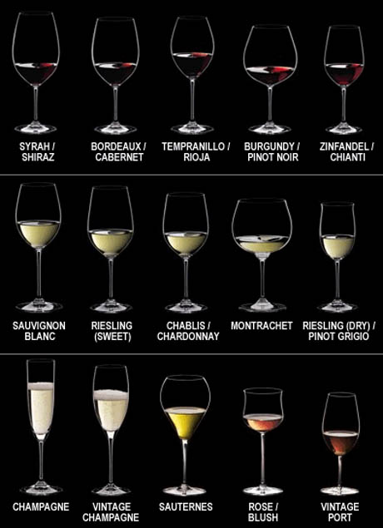
Notes:
RIEDEL HAS DONE THE SAME THING WITH WINE GLASSES

Slide 40
why the
kitchen?

Slide 41
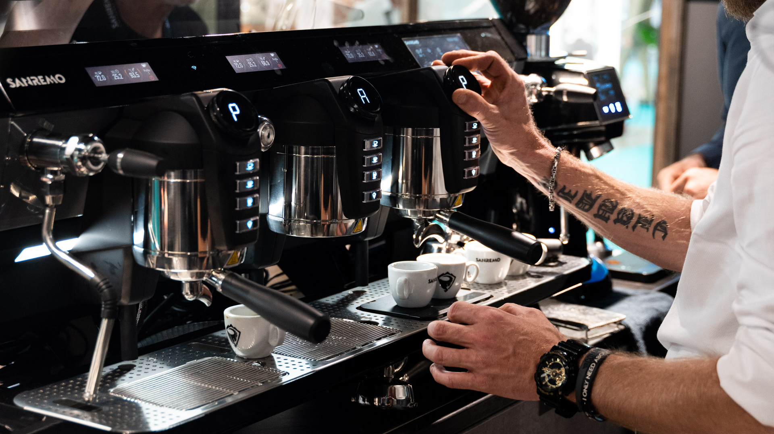
Notes:
FOCUS IS NOT ON THE CONTEXT OF CAFÉS

Slide 42
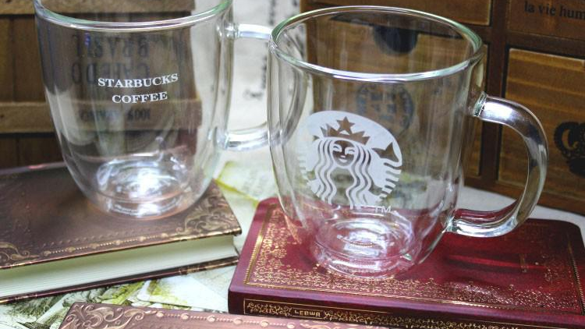
Notes:
WHY DON’T WE SEE THINGS LIKE THIS IN STARBUCKS CONTEXT

Slide 43
interaction is
multilayered

Slide 44
how a product
is used

Slide 45
how it interfaces
with a context
in use

Slide 46
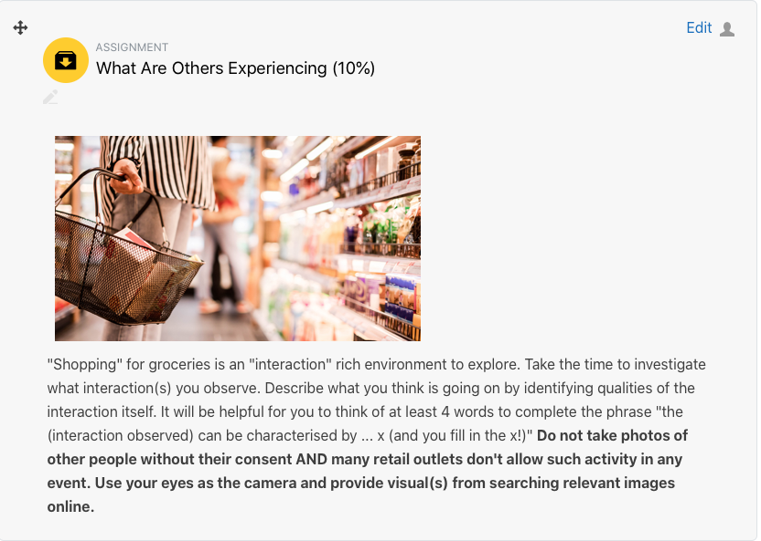
Notes:
20 SEPTEMBER

