Slide 1
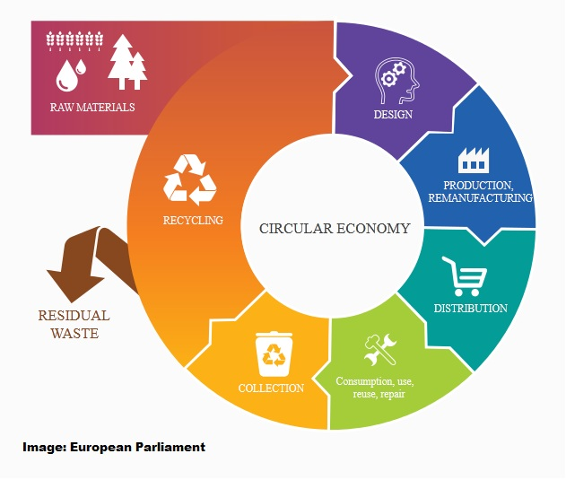
Course Practicalities
AAE-E3121 Circular Economy for Energy Storage
ECTS-3
Neha Garg (Responsible Teacher)
Annukka Santasalo-Aarnio (Responsible Professor)
Simon Jech (Responsible teaching assistant)
Arjun Muralidharan (Teaching assistant)

Slide 2
Learning outcomes
Identify circular economy concepts and the role of energy in recycling
Recognize the material choice effect to degradation mechanisms of the system
Develop new design for recycling approach for energy storage application and justify with scientific argumentation

Slide 3
Module Based Learning
The course has 3 Modules
Module A - Circular Economy and Recycling concept
Module B – New Material Solutions
Module C – Eco-design
Timetable for modules and assignments at MyCourses

Slide 4
Module Based Learning
Each Module has the same tasks (duration around 2 weeks)
2-3 Video Module Lectures
(available in the beginning of the module)
Find individual reading material related to your application and topic of the module
dates will be provided at the front page of MyCourses
Personal task (Lecture journal) where you reflect the videos and readings

Slide 5
Course tasks
Personal Tasks (100 p.)
Lecture Journals (3 x 20 p.) 60 p.
Energy return on energy stored 20 p.
Final project – Eco-design 15 p.
Webropol Feedback 5 p.
In Total 100 p.
You will require min. 60 points to pass the course

Slide 6
Personal tasks

Slide 7
Questions at video modules
The blue boxes have questions, when appear at video lecture, please pause the video and write short notes to your journal
Reflect to your
lecture journal
What do you think…
On your opinion…
These are questions that you can think during your learning journey, but you do NOT need to address these on your journal

Slide 8
Lecture Journals
There is a lecture journal template (please use that) – MyCourses
Lecture journals are your personal reflective work:
Each Lecture Journal markings:
Three video lectures (3*5p)
Journal paper review (3p)
Conclusions from the module (2p)
If you have further questions from the module, please put them at “Questions for the Module” – at the end of each journal assignment (that can be about the videos/reading material) -

Slide 9
Energy return on Energy stored
Calculate how much energy we need for the storage raw materials
You will:
Get an idea how much energy we need
How does it compare with the stored energy over storage lifetime
Understand the potential energy intensity of raw materials

Slide 10
Final Project: Eco-Design
Make an innovation presentation of Eco-Design for your energy storage application
(More information will be provided on Mycourse page)

Slide 11
At this course, we do not go through Energy Storage Systems, therefore you can start with :
A0 Module:
A.R. Dehghani-Sanij et al. Study of energy storage systems and environmental challenges of batteries, Renewable and Sustainable Energy Reviews 104 (2019) 192–208 (MyCourses)
Look at the video module ”A0 Energy Storage Systems”

Slide 12
Welcome to the course
If you decide not to participate, please contact the course staff

