Slide 1
MEC-E5005 Fluid Power Dynamics L (5 cr)
Staff
Jyrki Kajaste
DSc (Tech), University Teacher
jyrki.kajaste@aalto.fi
Time: Fridays 11:15-15:00 o’clock
Schedule:
MEC-E5005 Fluid Power Dynamics L
Week | # | Day | Time | Room | Milestone check
37 | 1 | 11.9.2020 | Fri 11:15 - 15:00 | R001/U344
38 | 2 | 18.9.2020 | Fri 11:15 - 15:00 | R001/U257
39 | 3 | 25.9.2020 | Fri 11:15 - 15:00 | R001/U344 | Cylinder model
40 | 4 | 2.10.2020 | Fri 11:15 - 15:00 | R001/A046a
41 | 5 | 9.10.2020 | Fri 11:15 - 15:00 | R001/A046a | Valve model
42 | 6 | 16.10.2020 | Fri 11:15 - 15:00 | R001/A046a
43 |  | 23.10.2020
44 | 7 | 30.10.2020 | Fri 11:15 - 15:00 | R001/Y344 | Seal model
45 | 8 | 6.11.2020 | Fri 11:15 - 15:00 | R001/Y344 | Personal simulation work
46 | 9 | 13.11.2020 | Fri 11:15 - 15:00 | R001/U351
47 | 10 | 20.11.2020 | Fri 11:15 - 15:00 | R001/U351 | Group assignment check
48 | 11 | 27.11.2020 | Fri 11:15 - 15:00 | R001/U351
49 | 12 | 4.12.2020 | Fri 11:15 - 15:00 | ?
50 | 13 | 11.12.2020 | Fri 11:15 - 15:00 | R001/U351 | Group assignment ready
 |  |  |  |  | Asko Ellman, Tampere University ??

Slide 2
Workload estimate
Workload
5 cr
Lectures 2 h (1 x 2 h) and mini-lessons (12 x 0.5 h)
Modelling and simulation exercises 36 h (12 x 3 h)
Autonomous studying, working on exercises and assignment 91 h

Slide 3
Learning Outcomes
After the course the student is able to:
- Describe the principles of modeling and simulation and the potentials of these in system design and analysis
- Use some modeling and simulation environment/software (Matlab ja Simulink)
- Identify (analyze) dynamic structures of hydraulic systems
- Create models for static and dynamic elements (hydraulic and pneumatic components and systems) and run simulations with them
- Identify (analyze) parameter values for models from component catalogs and measurement results
- Analyze dynamic characteristics of hydraulic systems with the help of measurement data (step and frequency responses)
- Analyze the operation of hydraulic systems by modeling and simulation
- Evaluate critically the quality and deficiencies of a component or system model (i.e. validate the model using measurement data)
- Design and tune an electrohydraulic position, speed and force servo by using modeling and simulation
- Estimate the quality of an electrohydraulic position, speed and force servo by modeling and simulation
- Create well-defined and comprehensive modeling and simulation documents
- Describe the principle of real-time simulation and the special demands of it

Slide 4
Simulation of Fluid Power
Modeling of fluid properties
Modeling of valves
Modeling of actuators
Modeling of fluid power systems

Slide 5
Simulation work
Cylinder system
Hydraulic cylinder (actuator)
Proportional control valve (Regel Ventil)
Load (mass)
Control system (open loop control)
Control system
PID control of systems
Position control

Slide 6
Hydraulic circuit to be modeled 1
M
p_{A}
p_{B}
p/U
p/U
x
CONTROL
U

Slide 7
Hydraulic circuit to be modeled 2
M
p_{A}
p_{B}
p/U
p/U
x
CONTROL
U
POSITION
CONTROL

Slide 8
Hydraulic circuit to be modeled 3 option 1
M
Direct Driven Hydraulics (DDH) system
M

Slide 9
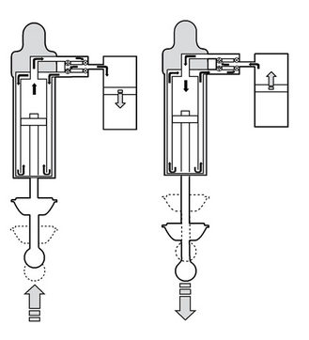
Hydraulic circuit to be modeled 3 option 2
10
8
9
1
https://www.bgmotorsport.co.uk/suspension/ohlins-suspension/ohlins-damper-anatomy/
m
Hardware In the Loop testing arrangement
F_{damper}
HYDRAULIC SERVO ACTUATOR
4
F_{hydr}
Sensors for HIL
Damper force
Mass position
Mass velocity
Other sensors
Cylinder force
Cylinder pressure A
Cylinder pressure B
Pump pressure P
Damper pressure A
Damper pressure B
Damper pressure Accu
Fluid temperature
Valve position signal
Output signals
Valve command U
ON/OFF valve A
ON/OFF valve B
p/U
p_{A}
p_{B}
p/U
5
3
6
2
m_{S}
12
U_{command}
A
$\ddot{x}$,x
(measured)
F_{damper}
p_{P}
Motion control
p/U
m_{U}
virtual mechanics
11
7
Virtual inputs by ”road”
HIL CONTROL

Slide 10
Simulation of dynamics
Phenomena are time dependent
Differential equations are solved
The core of fluid power simulation is solving of the pressure of a fluid volume (pipe, cylinder tms.) by integration
”Hydraulic capacitance”

Slide 11
Simulation of fluid power - variables
Essential variables in fluid power technology are
Flow Rate q_{v} [m³/s]
Pressure p [Pa], [N/m²]
The variables in question define the hydraulic power
P= Δp q_{v} (power of a hydraulic component, pump, valve etc.)
Δp pressure difference over a component
q flow rate through a component

Slide 12
Modeling of a system
p_{OUT}
q_{vOUT}
V
q_{v1IN}
q_{v2IN}
p_{1IN}
p_{2IN}
”Fluid volume”: pressure is solved,
flow rates as inputs
”Valve”: flow rate is solved,
pressures as inputs
Common way to realize a model of a system is to divide it into
Fluid volumes (pressure is essential to these volumes)
Components between fluid volumes (”valves” ja ”pumps”, flow rate is essential to these volumes)

Slide 13
Building up a system of ”fluid volumes” and ”valves” (flow sources)
V₁
V₂
V₃
”pump” – ”pipe” – ”valve” – ”pipe” – ”valve” – ”actutor”

Slide 14
Equation for pressure generation - combination
The mechanisms in fluid power which may alter the pressure in a chamber include a) change in fluid amount b) change in volume.
”Equation for pressure generation” may be expressed as follows:
Ellman & Linjama: Modeling of Fluid Power Systems
a)
b)
Textbook p. 18
Equation 25
Negligible changes in total volume (V₀= constant)
Significant changes in total volume (V)
This equation can be applied in hydraulic cylinder calculations.

Slide 15
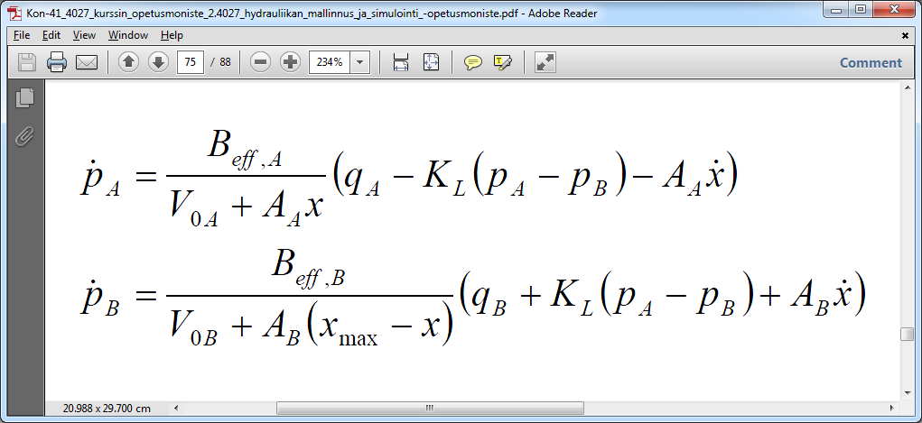
Cylinder – variables
Chamber pressures (time derivatives),
textbook p 75
LEAKAGE
LEAKAGE
p_{A}
x_{max}
p_{B}
x
dx/dt, x
Variables
Input
Flow rates
Piston speed
Absolute position of piston
Output
Chamber pressures
Piston force (net pressure force)
F
q_{vA}
q_{vB}

Slide 16
Cylinder – parameters
LEAKAGE
LEAKAGE
A_{B}(x_{max}-x) volume in chamber B
x_{max}-x length of liquid column
x_{max}
Parameters – constants(?)
A chamber
B_{eff} effective bulk modulus ⇒ K_{f} (new symbol)
pressure, temperature, free air(!) and elasticity of walls
V_{0A} ”dead volume” of chamber + liquid volume in pipes
A_{A} piston area
B chamber
B_{eff} effective bulk modulus ⇒ K_{f} (new symbol)
V_{0B} ”dead volume” of chamber + liquid volume in pipes
A_{B} difference of piston and piston rod areas (annulus)
x
A_{A}x volume in chamber A
x length of liquid column

Slide 17
Cylinder – liquid volumes
LEAKAGE
LEAKAGE
A_{B}(x_{max}-x) volume in chamber B
x_{max}-x length of liquid column
x_{max}
Constant and changing volumes
A chamber
V₀ ”dead volume” of chamber + liquid volume in pipes
A_{A}x piston position dependent extra volume
x ”absolute position of piston”
B chamber
V₀ ”dead volume” of chamber + liquid volume in pipes
A_{B}x_{max} B chamber maximum volume (piston at end position)
A_{B}x liquid volume displaced by annular piston
x ”absolute position of piston”
x
pipes
A_{A}x volume in chamber A
x length of liquid column

Slide 18
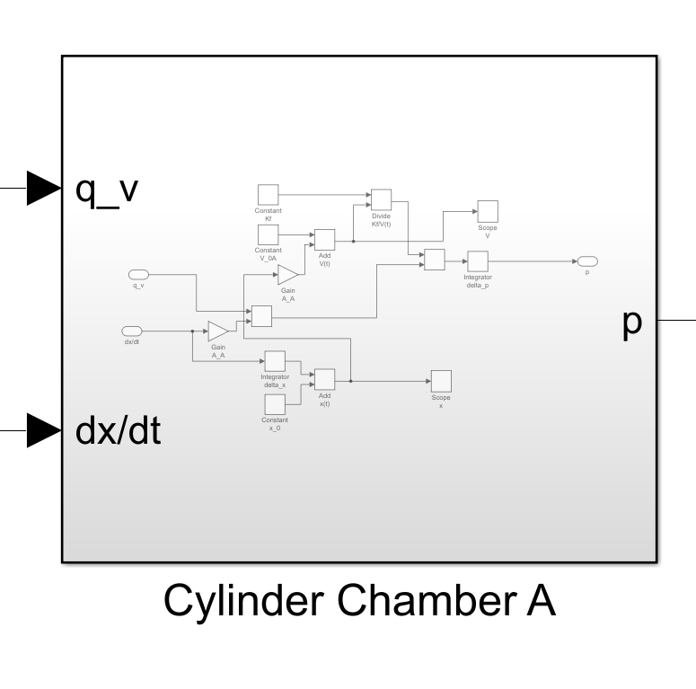
Chamber A realization, example
“paint this area”
3
Subsystem ⇒ Ctrl + G
4
2
Or …
right mouse button click ⇒ Create Subsystem from Selection
1
To get absolute position x for piston
integrate piston velocity to get get change in position related to start point
add start position value.
2
3
5
4
1
5
Piston leakage is not included.

Slide 19
Chamber B realization, example
3
4
2
1
2
3
5
4
1
(x_{max}-x) length of liquid piston
A_{B}(x_{max}-x) volume of liquid piston
5
Piston leakage is not included.

Slide 20
Modeling of a system
p_{OUT}
q_{OUT}
V
q_{1IN}
q_{2IN}
p_{1IN}
p_{2IN}
”Fluid volume”: pressure is solved,
flow rates as inputs
”Valve”: flow rate is solved,
pressures as inputs
Common way to realize a model of a system is to divide it into
Fluid volumes (pressure is essential to these volumes)
Components between fluid volumes (”valves” ja ”pumps”, flow rate is essential to these volumes)

Slide 21
Hydraulic circuit modeling
Phase 2
Cylinder
q_{A}, q_{B}, dx/dt
p_{A}, p_{B}, F
Inertia mass
F
dx/dt, x
in
out
in
out
F
M
(dV/dt)
dx/dt
p_{A}
p_{B}
dx/dt, x
q_{A}
q_{B}
CONTROL
U

Slide 22
Building up a system of ”fluid volumes” and ”valves” (flow sources)
Mechanics
V₁
V₂
V₃
”pump” – ”pipe” – ”valve” – ”pipe” – ”valve” – ”actutor”

Slide 23
Net force of a cylinder
Hydraulic force
F= p_{A}A_{A}-p_{B}A_{B}
Net force is affected also by seal forces:
Spring force related to bending of seals
Friction force related to sliding
Seal model will be constructed later!

Slide 24
Load model
Input: force
connected to: cylinder net force
Output: state of motion (piston velocity dx/dt and position x)
Connected to: state of motion ⇒ cylinder chambers’ volume change
In our simulation work the load is plainly inertia mass. The state of motion can be calculated by applying Newton’s second law.
where m = mass of an object ja a = acceleration”
Multiplication/division by a constant
Initial condition can be OR
included
Initial value
Integrating input signal twice
In our model we are interested in the state of motion of the load and piston (piston velocity dx/dt and position x). Thus …
At first solve the acceleration of load a
Integrate the acceleration -> velocity (change in velocity)
Velocity= 0 at the start of the simulation (unless you give it another initial value)
Inegrate velocity or integrate acceleration twice to get the change in position
At the start of the simulation position = x₀ -> take that into account to get the absolute position value

Slide 25
Cylinder model test
Benchmarking 1
Attention!
Do not connect seal model!
Test values fo parameters
Cylinder size 32/20×1000 ⇒ A_{A} ja A_{B} (check piston area values in the Matlab workspace)
B= 1.6⋅10⁹ Pa
x₀= 0.5 m
Extra liquid volumes at cylinder ends: 3.2 cm³ (piston side), 2.0 cm³ (rod side)
Pipes d_pipe= 0.012 m and L_pipe= 0.75 m
1. ”plug cylinder ports” and ”push/pull” piston with rod, use velocities
a) dx/dt = 1⋅10⁻³ m/s and b) dx/dt = -1⋅10⁻³ m/s
-> test pressure changes using 10 second simulations
-> test force changes using 10 second simulations
2. ”lock” the piston rod (dx/dt= 0) and
2.1 connect to chamber A flow rate input q_{A}= 1⋅10⁻⁶ m³/s
2.2 connect to chamber B flow rate input q_{B}= 1⋅10⁻⁶ m³/s
-> test pressure changes using 10 second simulations
-> test force changes using 10 second simulations
3. connect the following signal values to piston velocity and flow rates
dx/dt = 1⋅10⁻³ m/s
q_{A}= +dx/dt ⋅ A_{A}
q_{B}= -dx/dt ⋅ A_{B}
-> test pressure changes using 10 second simulations
-> test force changes using 10 second simulations

Slide 26
Testing of cylinder model
Use for example Display module to check the end values of signals
Attention!
Do not connect seal model!
Test 1a Test 2
p_A= ________ bar p_A= ________ bar
p_B= ________ bar p_B= ________ bar
F= __________ N F= __________ N
Test 1b Test 3
p_A= ________ bar p_A= ________ bar
p_B= ________ bar p_B= ________ bar
F= __________ N F= __________ N

