Slide 1
Group assignment : Advanced Micro- and Nanotechnology CHEM-E5230001 Fabrication of patterned SOI wafer with thin device layer and large cavities
Dr. Atte Haapalinna, CTO
Dr. Heikki Holmberg, Senior Development Manager, Technology
13.9.2021

Slide 2
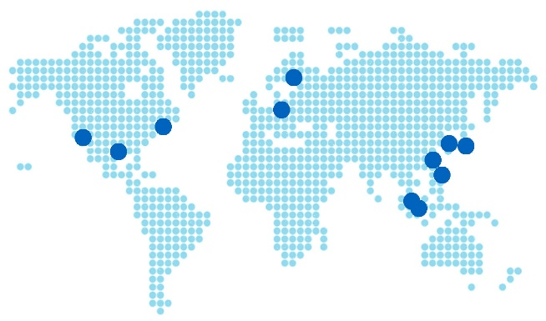
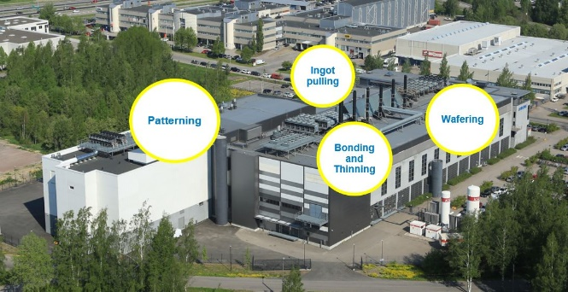
Leading supplier of advanced silicon wafers for MEMS, sensor, RF and power applications
Focusing on bonded SOI and high value-add, specialized 150-200 mm wafers
Magnetic CZ (MCz), A-MCz®
Very Low and Very High Resistivity (RFSi™)
Bonded SOI with & without Cavities
Patterned wafers
Net sales: 108 M€ (2020) Investments: > 100 M€ (2017-2021) Employees: ̴̴ 620,
will increase about 30-50 person per year in future
7th largest wafer manufacturer in world
HQ and production in Finland
Sales and Tech support worldwide
#1 wafer supplier for MEMS and sensors
Over 2 million wafers delivered for the RF market, deliveries to double in 2021
Notes:
Sales office in the US since 1999

Slide 3
Focusing on the niche markets of semiconductor industry
Sensor industry (56% of net sales)
Okmetic is the market leader
Material for MEMS and other sensor applications
Discrete & analog industry (44% of net sales)
Okmetic is a valued and reliable supplier
High resistivity and high voltage SOI materials
3

Slide 4
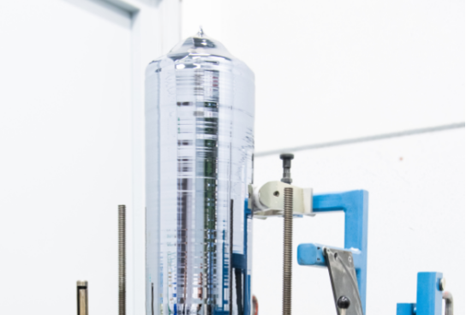
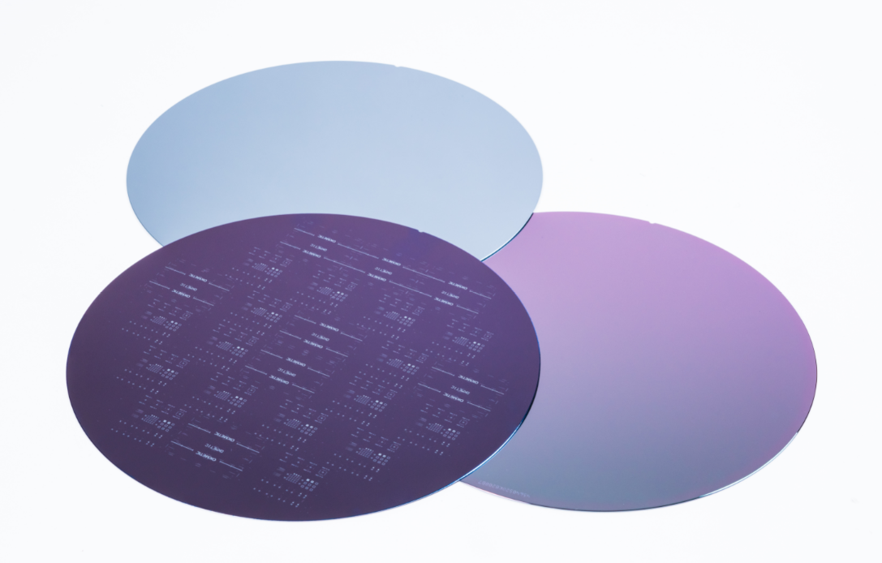
Complete set of 150-200mm wafers enable optimized solutions and freedom of design
Crystals
High resistivities up to and beyond 7 kOhm-cm
Low resistivities below 1 mOhm-cm
Different crystal materials, dopants and orientations
Wafers
Bonded SOI (Silicon-On-Insulator) wafer family
DSP (Double Side Polished) wafers
SSP (Single Side Polished) wafers
RFSi™ wafers (High Resistivity for RF devices)

Slide 5
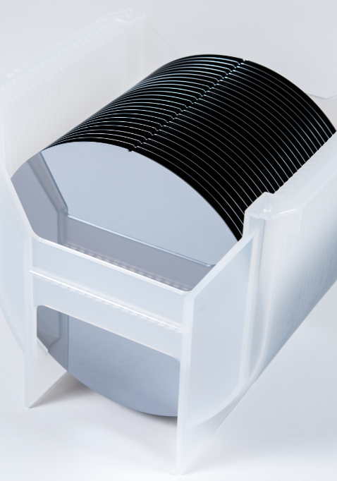
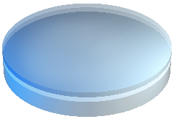
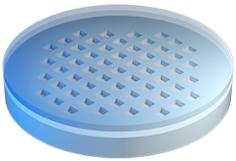
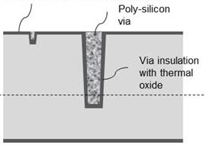
Tailored substrates
BSOI
Fully customizable with starting materials from in-house crystal growth and wafering
C-SOI®
Wafers with pre-etched cavities
E-SOI®
Highly uniform wafers with device layer thickness tolerance ±0.1 µm
TSV
Through silicon vias for sensor interconnects
Tight tolerance

Slide 6
Fabrication of patterned SOI wafer with thin device layer and large cavities
Exclude: Thin device layer of SOI cannot be made by transfering SOI layer from other SOI wafer
Boundary conditions to technology
Wafer level solution
Speed of thinning process at least 1 wafer per hour
Device layer thickness below 5 um
Thickness variation of device layer withing wafer below 0.2 um
Surface quality need to be good enough to pattern structures by litography
Device layer silicon
Box oxide Si02
Cavity: air

Slide 7
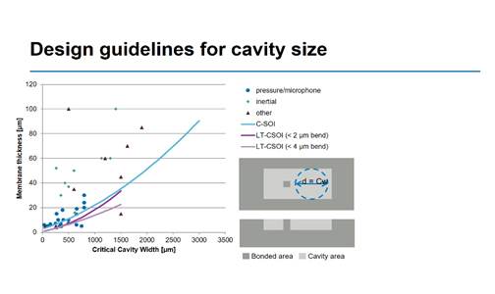
Fabrication of patterned SOI wafer with thin device layer and large cavities
Challenge: bending of membrane need to be below blue line
Typical application: pressure sensor
Interesting aspect: Especially new technologies and estimation of benefits and drawback and maturity of technology

Slide 8
Contact us
^{Okmetic Oy}
P.O.Box 44, FI-01301 Vantaa, Finland
Piitie 2, FI-01510 Vantaa, Finland
^{Telephone +358 9 502 800}
^{Fax +358 9 5028 0500}
^{Okmetic Inc.}
307 South Jupiter Road, Suite 210
^{Allen, TX 75002, USA}
^{sales.usa@okmetic.com}
^{Fax +1 972 747 8611}
^{Okmetic K.K.}
^{Sunrise Mita 8F 3-16-12,}
^{Shiba Minato-ku, Tokyo}
^{105-0014 Japan}
^{Telephone +81 3 3798 1400}
^{Fax +81 3 3798 1402}
^{Shanghai sales office} Unit 711, Tower 1, German Centre,
^{No.88 Ke Yuan Road,}
^{Shanghai, 201203, China}
sales.europe@okmetic.com
sales.asia@okmetic.com
sales.japan@okmetic.com
sales.usa@okmetic.com
www.okmetic.com

