Slide 1
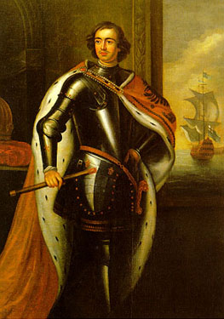
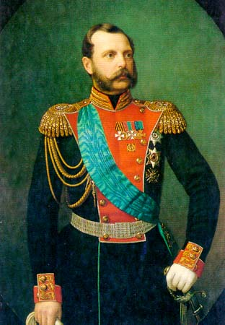
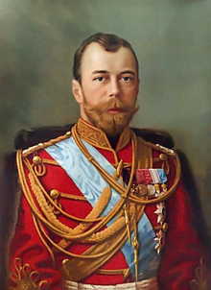
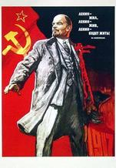
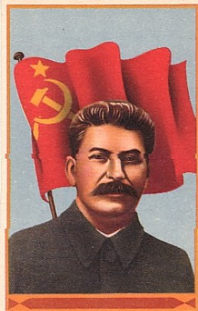
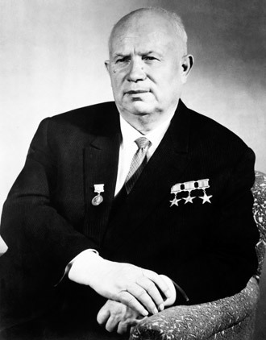
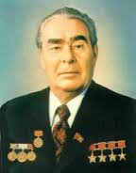
History of the Russian Economy
Svetlana Ledyaeva
Aalto University
School of Business

Slide 2
Learning outcomes of this lecture
Socio-economic development of the Tsar Russia:
From Peter the Great to Nicolas II; from 18th to 20th centuries.
Socio-economic causes of Bolshevik revolution in Russia.
Soviet period of the Russian economy from Lenin and Stalin to Khruschev and Brezhnev.

Slide 3
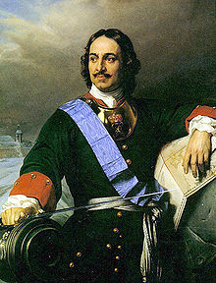
18th century
Peter the Great: 1672 (born) –
1682-1721 (co-reign)-1725 (reign).
Before Peter: Russia is a backward country.
Peter`s modernization of Russia.
1718 - 1788, Russia’s aggregate national income increased fivefold.
In 1700 – 2 000 tonnes of iron produced; in 1720 – 10 000 tonnes!
Living standards have increased.

Slide 4
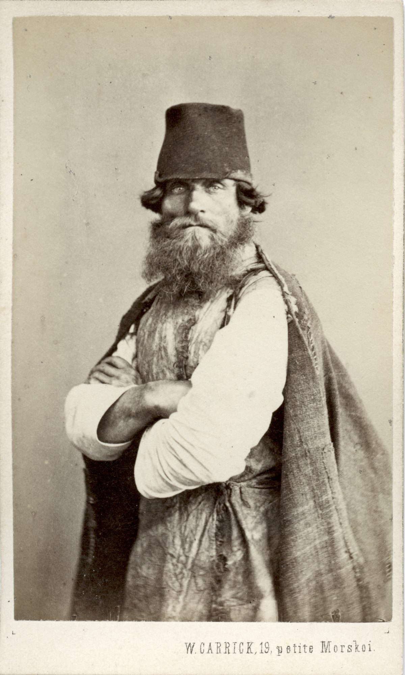
Early 19th century - stagnation
19th Century Portraits Of “Russian Types” by William Carrick
Russia exported large amounts of grain to Europe.
Export revenues were not used as capital to develop an industrialised economy.
Heavy industry was small when compared to Russia’s imperial rivals: Britain, France and Germany.
Little technical innovation; most of Russia’s new technologies were imported from the West.
No adequate railway system.

Slide 5
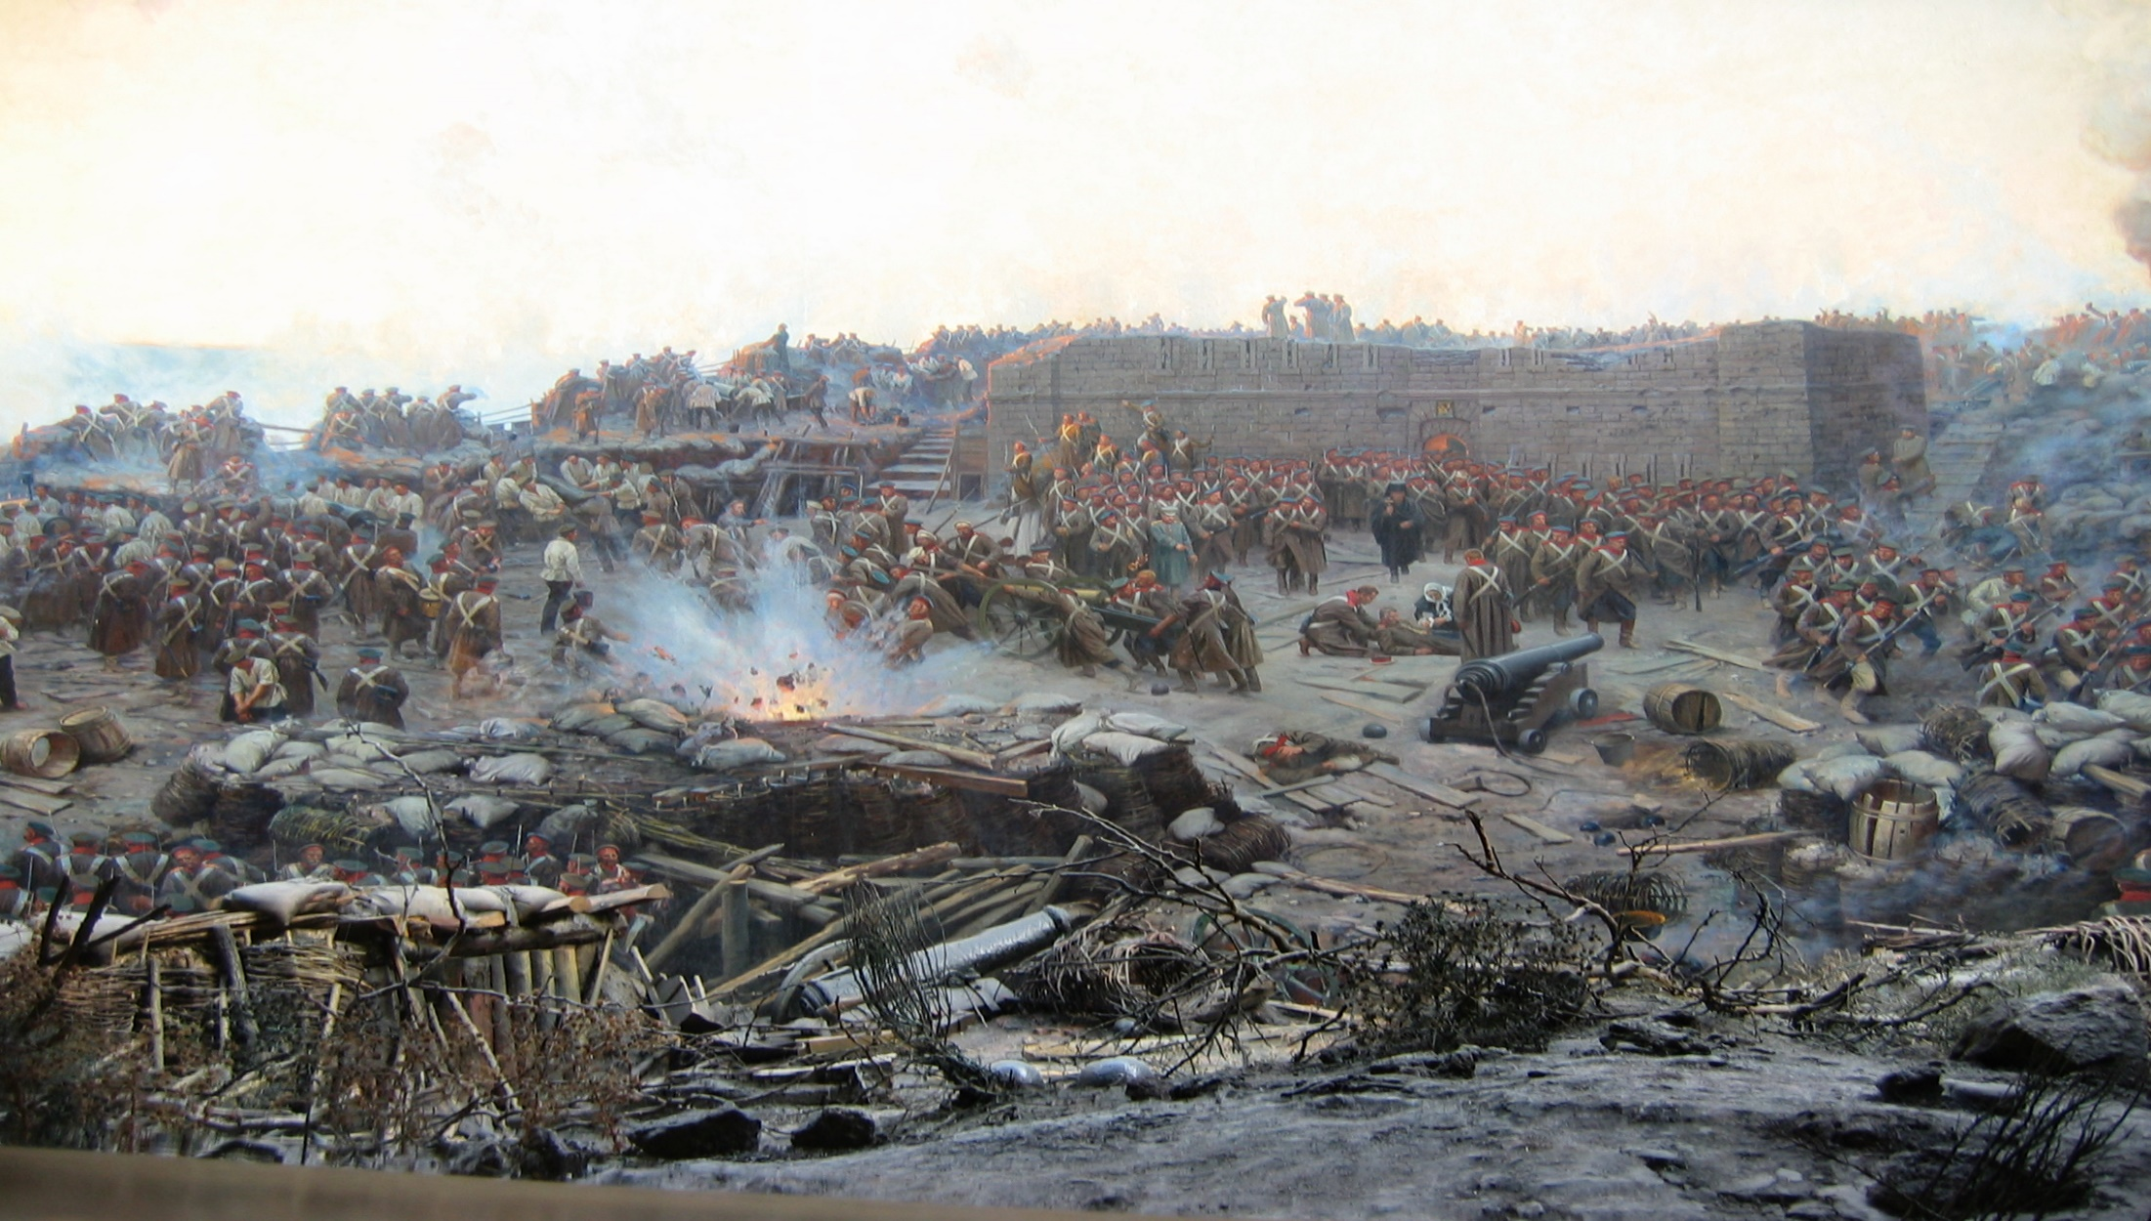
The Crimean War was a military conflict fought from October 1853 to February 1856 in which Russia lost to an alliance of France, the Ottoman Empire, the United Kingdom and Sardinia.
The Crimean War marked a turning point for the Russian Empire.

Slide 6
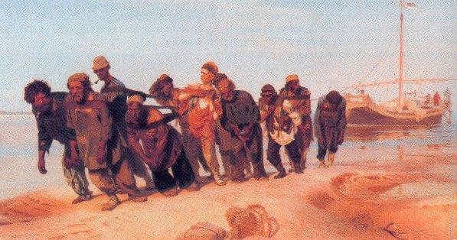
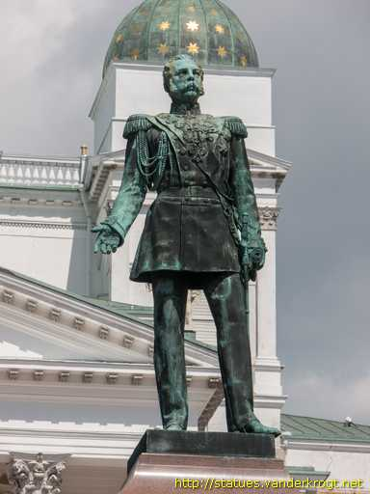
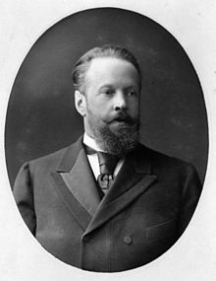
19th century: second half
The “Great reforms” of Alexander II in the early 1860s
➔ modern capitalism and rapid industrialization.
System of serfdom was abolished in 1861.
Sergei Witter (minister) reforms:
1870s: several large infrastructure programs, particularly the construction of railways.
Currency reform: In 1897 the Russian rouble was moved to the gold standard.
Incentives for foreign investment.

Slide 7
Trans-Siberian Railway was built (1891-1904).
Trade benefits:
Russia started to trade with China and Japan.

Slide 8
The end of 19th century: Reforms results
By 1900 around half of Russia’s heavy industries were foreign-owned.
The Russian empire was the world’s fourth-largest producer of steel and its second-largest source of petroleum.
New railways allowed transport into remote parts of the empire, allowing the construction and operation of factories, mines, dams and other projects there.
The Russian economy began to catch up with the leading industrial nations.
Between 1860 and 1910: World industrial production increased by 6%, in the UK by 2.5%, in Germany by 6%, but in Russia it increased by 10.5%. (Poliansky, 1960).

Slide 9
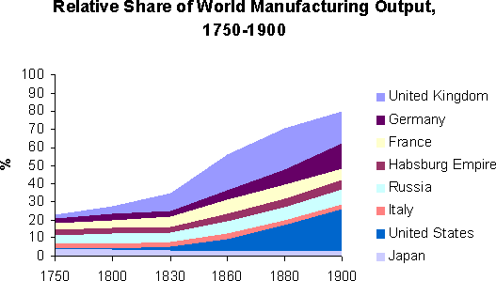

Slide 10
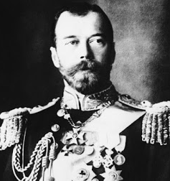
Early 20th century: Basic facts
Massive empire, stretching
from Poland to the Pacific.
In 1914: 165 million people
of many languages, religions and cultures.
Ruled by the Tsar Nicholas II (in power: 1894-1917) –
the last before the revolution in 1917.

Slide 11
Russian empire in 1914: European borders

Slide 12
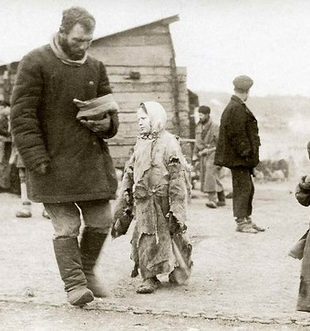
Russian economy before revolution 1917 (Tsar Nicholas II )
Huge economic potential: valuable natural resources and huge labour force.
Hybrid of traditional peasant agriculture and modern industry.
Tsar command economy versus capitalistic economy in the most part of the World.

Slide 13
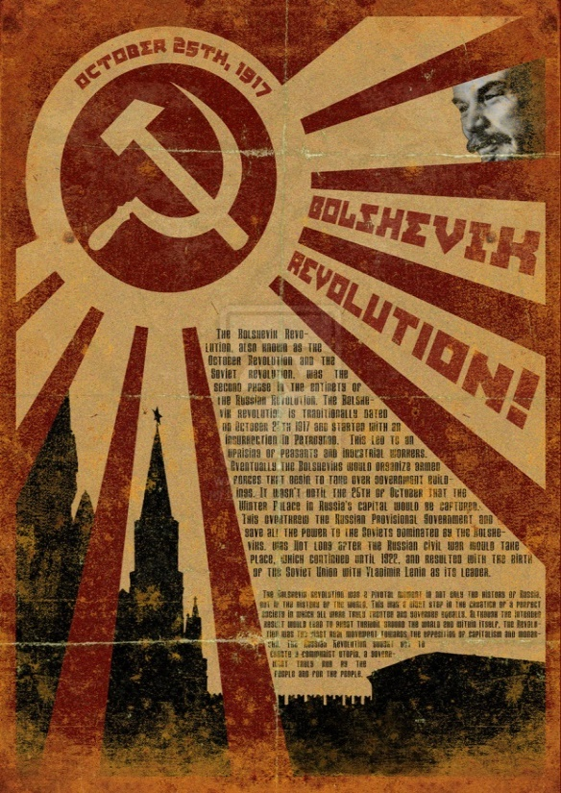
Causes of Bolshevik revolution
Witte’s economic reforms ➔ a new working class that was exploited, poorly treated ➔ clustered together ➔ revolutionary ideas.
Large territory of Russia - made government difficult.
Out-of-date farming economy.
Tsar Nicholas was an autocrat.
World War I (1914-1918).

Slide 14
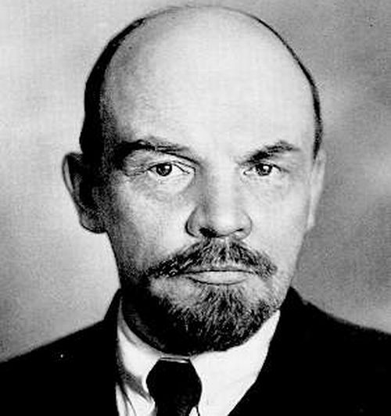
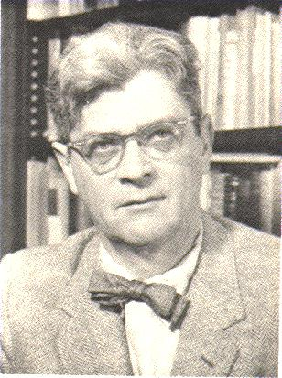
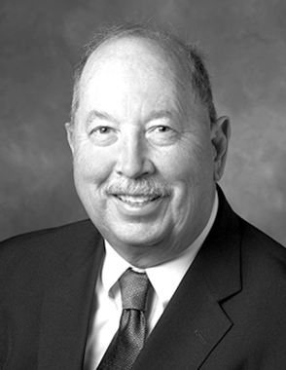
Economic development of Russian Empire before revolution 1917
Long lasting debate on economic development of the late Russian empire: causes of Russian revolution
Pessimists: Vladimir Lenin (1899) and
Alexander Gershenkron (1966):
relative backwardness of
Russian economy and especially agrarian sector
transferred into political unrest.
Optimists: Quantitative reconstruction of
Russian national income between 1883-1913 by Paul Gregory (1983):
Russian economic development looks
rather favourable in international comparisons.

Slide 15
Paul Gregory (1976): Basic characteristics of the Russian industrialization model in 1985-1913
High rates of national saving plus significant foreign saving.
Heavy indirect and other taxes to depress the consumption rate.
Direct state expenditures to promote industrialization are not large (major to defence, too little for human capital).
Heavy tax obligations on the rural population to force agricultural export surpluses.

Slide 16
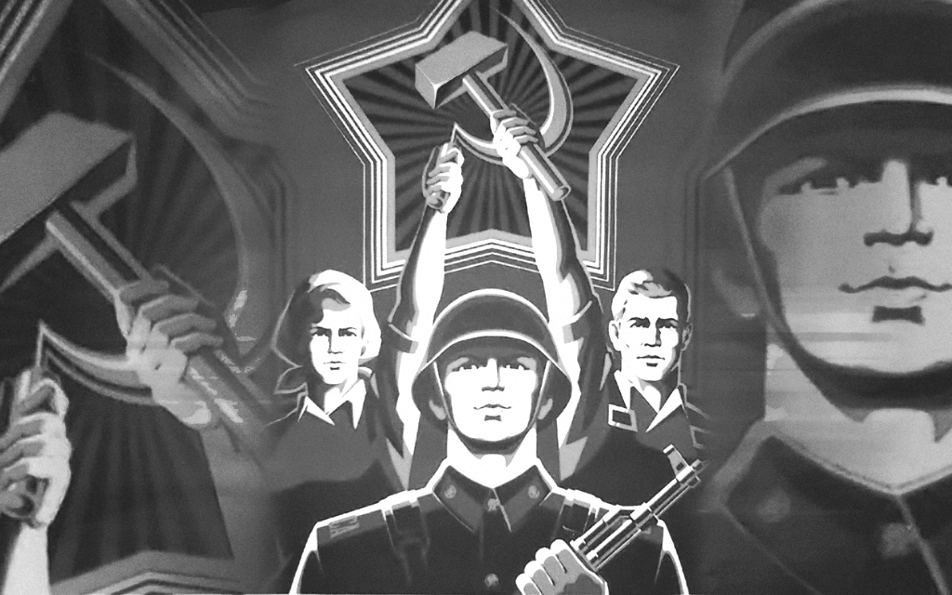
Establishment of Soviet Union: Facts
March 1917: Tsar Nicholas II abdicates/gives up in the face of demonstrations.
October 1917: Russian Revolution – Communists (Bolsheviks) seize power under Lenin’s leadership.
1917-1922 – Civil war.
1922: Formal establishment of Soviet Union.
Consisted of 15 (more or less voluntary) republics; Russia being the leader.
Population almost 300 million.

Slide 17
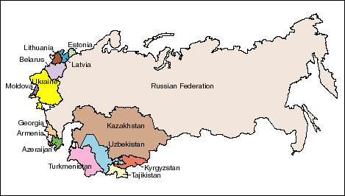
Soviet Union 1917-1991: Map showing countries included in the Former Soviet Union (FSU)

Slide 18
War communism 1918-1921/1922
A combination of emergency measures and socialist dogma:
Nationalisation of factories, industries, land, banks and shipping;
Foreign trade was declared a state monopoly;
All forms of private capitalism have been ended;
Most taxes had been abolished.
Red army soldiers

Slide 19
Six principles of War communism
Production was run by the state.
State control over the labour of every citizen.
Extreme centralisation of economic life. Supreme Economic Council.
The state - the soul distributor as well as the sole producer.
War Communism attempted to abolish money as a means of exchange. BARTERING.

Slide 20
Consequences of War communism
The economic strength of Russia fell below the 1914 level.
Peasant farmers only grew for themselves, as they knew that any extra would be taken by the state. The industrial cities were starved of food.
Between 1916 and 1920, the cities of northern and central Russia lost 33% of their population to the countryside; the number of those working in the factories and mines dropped by 50%.
Small factories were in 1920 producing just 43% of their 1913 total.
Large factories were producing 18% of their 1913 figure.
The Bolshevik hierarchy could blame a lot of Russia’s troubles on the “Whites” (White army) as they controlled the areas, which would have supplied the factories with produce.

Slide 21
QUESTION FOR POINTS
After War communism Lenin introduced the policy that helped to revive the economy significantly.
Please, try to guess what kind of policy it was?
The first student with an answer very close to correct gets 2 extra points.

Slide 22
The New Economic Policy (NEP)
October 1921, Lenin:
“We are in desperate straights. We must buy from whom we can and we must sell to whom we can. The party would have to learn to trade.”
Lenin: “…direct transition to communism had been a mistake…
…had to be the acceptance of small-scale production with state capitalism…
…Russia would then proceed to socialism and then to communism. “

Slide 23
The New Economic Policy (NEP) or State capitalism: 1921(1922)-1928
Not a permanent policy but a temporal retreat:
State retained ownership of large industries.
Private enterprise allowed in small industries and retail trade.
Peasants freed from forced requisitions:
Prodnalog – tax on food: Had to pay tax in kind to government but were otherwise free to sell rest on free market.
The first years of NEP were years of terrible famine in Soviet Russia, but by 1923-1924 the economy started to recover.

Slide 24
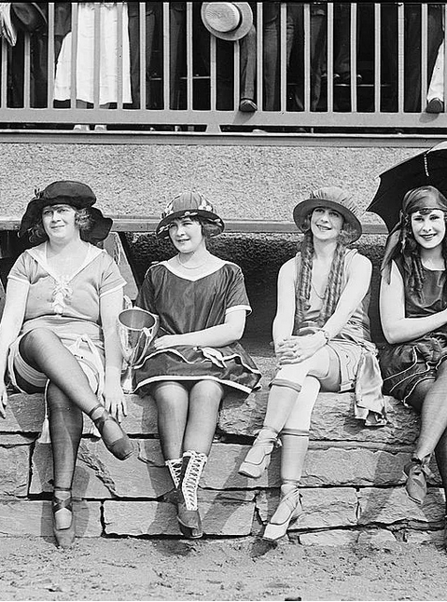
Private restaurant in NEP
Russian women in NEP

Slide 25
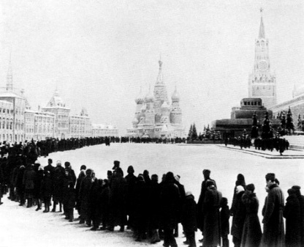
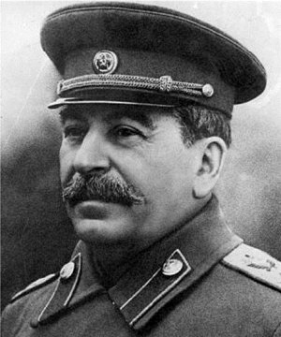
Lenin death. Stalin rise.
Lenin funerals
In January 1924 Lenin died.
A great struggle for power in the Communist Party:
The desire for personal power.
A struggle over what policies the party and state should follow.
Joseph Stalin`s victory

Slide 26
Stalinism Before World War Two
In 1929 Stalin ended NEP and nationalized all property in the USSR.
Stalin established Soviet-style socialism.
Rapid, forced collectivization of all agriculture and rapid industrialization.
Heavy industry was a priority.
"5 year plans" that set targets for the entire economy.
Manager did not meet his or her target – enemy - would be arrested, sent to labor camp [prison], deported to Siberia or Central Asia, or shot.

Slide 27
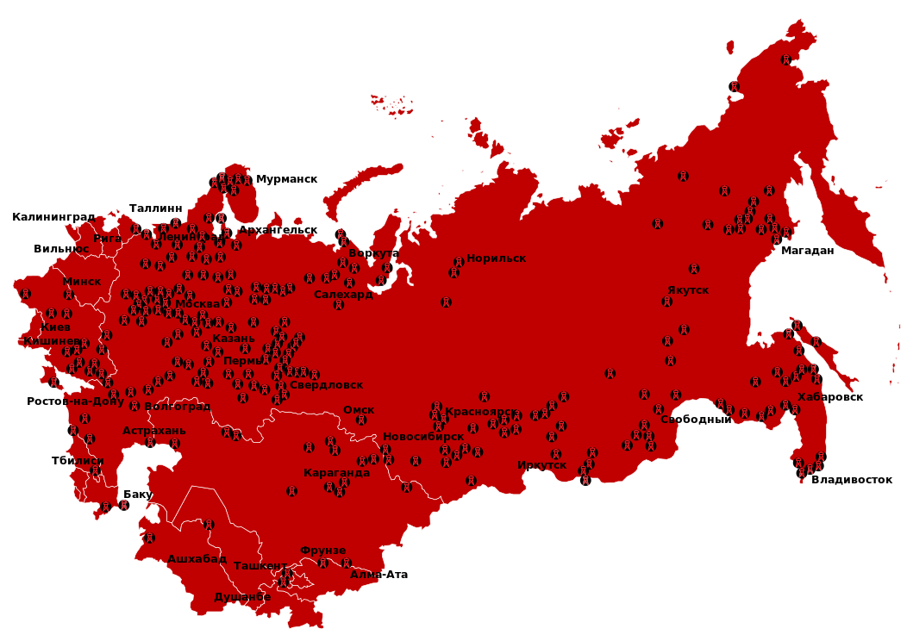
GULAG: labor camps across Russia existed between 1923 and 1960
GULAG map
Murmansk
Kaliningrad
Talinn
Arkhangelsk
Vorkuta
Norilsk
Magadan
Minsk
Yakutsk
Kiev
Ekaterinburg
Krasnoyarsk
Volgograd
Omsk
Khabarovsk
Svobodnyj
Tbilisi
Baku
Karaganda
Irkutsk
Vladivostok
Tashkent
Ashhabad
Bishkek
Novosibrisk
Alma-Ata
Dushanbe

Slide 28
Central Planning Economy established by Stalin
Was based on two political imperatives:
1. Control (state property and planning)
2. Economic growth (rapid industrialization)
Principles of Soviet planning:
State ownership of basically everything.
Political decision of what, to whom and how to produce.
Planning based on mobilizing resources according to priorities: military, heavy industries, resources.
Actual production based on short five year plans.

Slide 29
Stalin`s five year plans
Video:
http://www.youtube.com/watch?v=oXGThPeOJu4

Slide 30
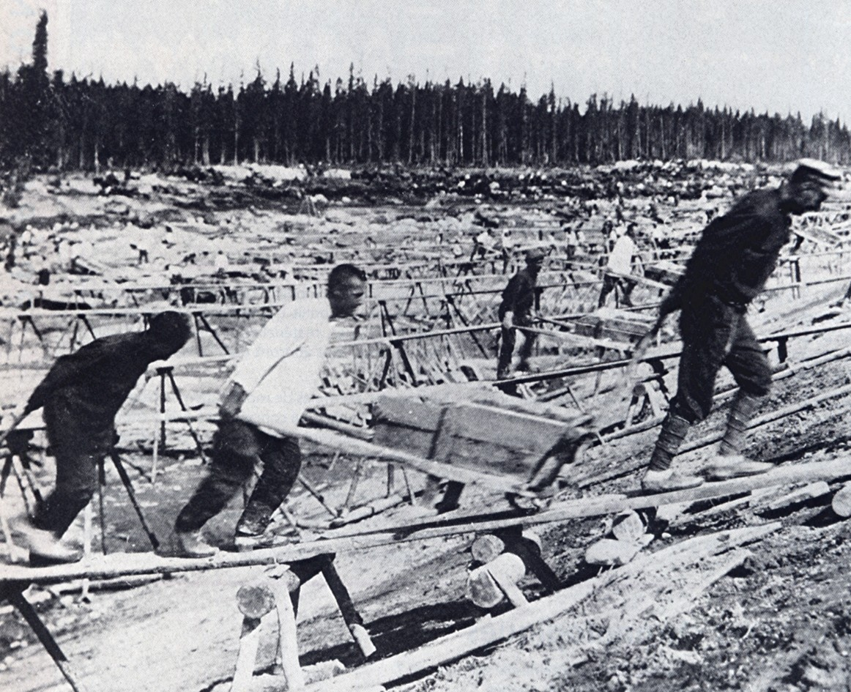
Results of Stalin policy for the Russian economy
Stalin labor camp
Achievements:
In 1930-1941, the USSR did industrialize:
It caught up with the capitalist industrial powers.
Increased literacy rates and improved health care for most of the population.
Costs:
People killed in Stalin's terror: Some estimates are as low as a million, some as high as ten million. (A conservative estimate is 3 million).

Slide 31
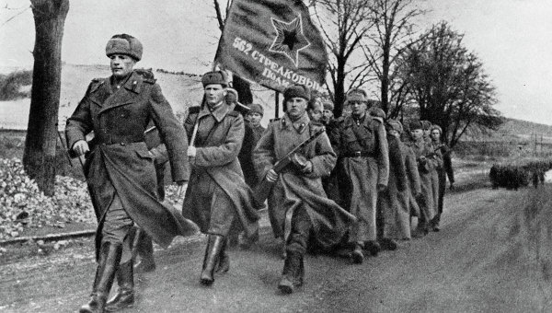
Soviet economy during World War II
The War remodelded Soviet economy to insure victory in the War.
By the time of the Battle of Stalingrad in 1942, the Germans occupied more than half of European Russia.
Stalin decision shortly after German attack: The move of more than 1,500 large industries to the East (Siberia => why million cities are there now!).
3,500 new industries were established, most of them related to wartime production.
➔ production of huge quantities of arms.

Slide 32
Post-War Soviet economy 1
A quarter of the country's capital resources had been destroyed;
Industrial and agricultural output in 1945 fell far below of pre-war levels.
However!: The Soviet economy and polity returned quickly to their previous form: renewed political and economic mobilization.
The rigid hierarchies of party and state control were reinforced while their frontiers were pushed outward to the shores of the Baltic and into central Europe.
A large backlog of unexploited economic potential and more efficient repression ➔ post-war Soviet economic durability.

Slide 33
Post-war Soviet economy 2
The Post-war economy was more militarized than before:
---the Soviet defence industry began to grow again with major boosts
from programs for atomic weapons, rockets, jets, and radar.
---heavier burden to GDP than in USA (due to a smaller GDP).
The dispersal of the population into the remote interior of the Urals and Siberia:
--- Until World War II, the Soviet defence industry was concentrated in European USSR. Wartime evacuation shifted its centre of gravity to the East.
Centralization of the economy, temporarily disrupted by invasion and war mobilization, was restored well before the war ended.

Slide 34
Post-War GDP per capita

Slide 35
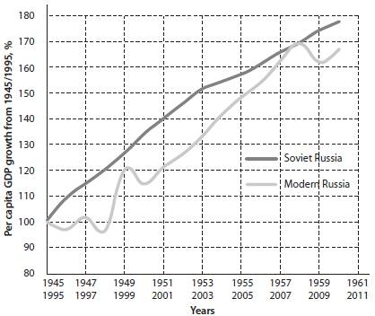
Post-War GDP per capita growth, %

Slide 36
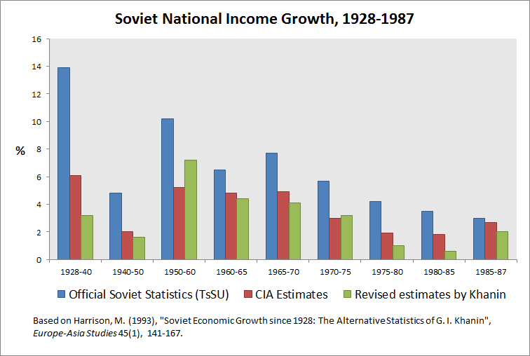
Soviet National Income growth, %
Note: CIA-Central Intelligence Agency (USA)

Slide 37
Stalin versus Lenin
Was ”Stalinism” is just a follow-up of ”Leninism” or ”bad” Stalin ”bumbled a job” of ”good” Lenin?
Richard Pipes, well-known American historian:
“Stalin was a true Leninist in that he faithfully followed his patron’s political philosophy and practices. Every ingredient of what has come to be known as Stalinism save one – murdering fellow Communists – he had learned from Lenin.”
The Red Terror: a campaign of mass killings and systematic oppression conducted by the Bolsheviks during the Civil War (1918–1922). Estimates for the total number of people killed in the Red Terror range from 10 000 to 1 500 000.

Slide 38
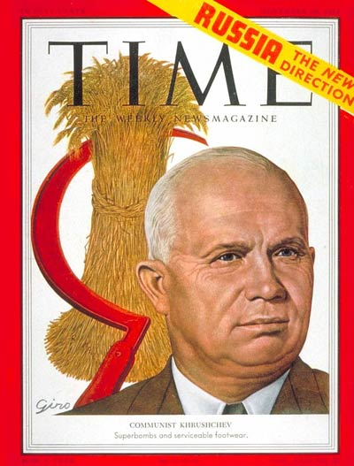
The Khrushchev “thaw/snowbreak” (1953-1964)
Khrushchev, an agricultural specialist, had grown up in Ukraine.
Policy of “Reform Communism” to humanize the Soviet system:
- public disavowal/rejection of Stalinism;
the greater flexibility in Soviet leadership after a long period of monolithic terror;
Rehabilitation of repressed.
A greater emphasis on consumer goods.

Slide 40
Most known achievments in Khrushchev term
Sergey Koroljov: He is regarded by many as the father of practical astronautics. He was involved into the development of Sputnik 1 on which Yuri Gagarin went into Space.

Slide 41
Results of the Khrushchev term
”+”:
Softening domestic and foreign regime;
Raising living standards;
Scientific and cultural achievements.
“-”:
His plans for growing corn and increasing meat and dairy production failed.
His reorganization of collective farms into larger units produced confusion in the countryside.
-Inconsistency, incoherence, populism.
The decentralization of industry ➔ led to disruption and inefficiency.

Slide 42
End in power
By 1964:
Industrial growth had slowed;
Agriculture showed no new progress.
In October 1964, while Khrushchev was vacationing in Crimea, the Presidium voted him out of office.

Slide 43
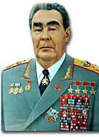
Leonid Brezhnev`s Era (1964-1982). Basic facts
Brezhnev was born in 1906 in the Ukraine. Ukraine-Russian origin.
Brezhnev led the USSR as the Cold War developed throughout the 1960’s.
It was a dangerous era as a result of the nuclear arms race between the USA and USSR.
Leonid Brezhnev died on November 10th 1982.

Slide 44
Leonid Brezhnev`s Era (1964-1982). Socio-economic achievements
Under Brezhnev, Russia dominated the U.S.S.R. as never before.
Three-fourths of the defence industries, the priority sector, were in Russia.
Russia accounted for about three-fourths of the Soviet gross national product.
The rapid expansion of the chemical, oil, and gas industries boosted exports ➔
Russia earned most of the union’s hard-currency income.
The middle class grew in size, as did its average salary: more than doubled in two decades.
Ownership of consumer goods, such as refrigerators and cars, became a realistic expectation for a growing part of the population.
The availability of medical care, higher education, and decent accommodation reached levels unprecedented in the Soviet context.

Slide 45
Brezhnev`s failures
Income from the sale of Russia’s natural resources ➔ no need of structural economic reforms.
By the mid-1970s, growth in the non-natural resource sector of the economy had slowed greatly.
The Soviet economy suffered from a lack of technological advances, poor-quality products, low worker productivity, and highly inefficient factories.
The agricultural sector of the economy was in crisis. ➔The government was spending an increasing amount of its money trying to feed the country. ➔ Radical reforms required.
By the 1970s, continued economic stagnation posed a serious threat to the world standing of the U.S.S.R. and to the regime’s legitimacy at home.

Slide 46
The end of Brezhnev Era – beginning of the collapse of Soviet system
Crisis in agriculture continued in the 1980s: Necessity to buy grain in the international market:
While the price of petroleum was high - financing the purchase of grain from internal sources was possible.
When the price of petroleum fell in the last 1980's ➔
the Soviet Union needed to borrow the funds from Western banks to purchase the needed grain. ➔
This severely restricted the international activities of the Soviet Union.
HYPOTHESIS: The reason for the decline in petroleum prices in the late 1980's: the Soviet Union invasion of Afghanistan. ➔
Saudi Arabia increased its production of petroleum drastically (to punish SU) and consequently the price of petroleum fell.

