Slide 1
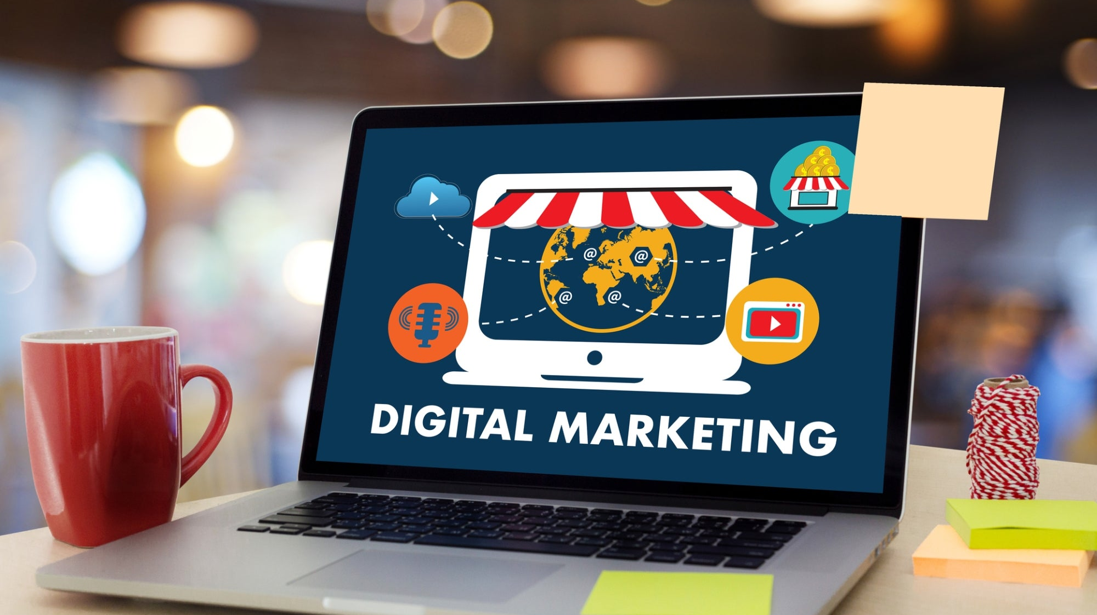
Technological Innovation in Service
Technological Innovation in Service
Class 6

Slide 2
Digitalization of Promotion (part II)

Slide 3
Social Media Plan
Determine the objective
Choose the platform
Plan the content
Distribute and promote content
Measure success
LAST CLASS
THIS CLASS
Notes:
This slide simply provides a refresher/overview of those parts. The last four lecture slides provide an opportunity to discuss these steps in the context of the ideal social media practices for a variety of companies.

Slide 4
Social Media Plan
Determine the objective
Choose the platform
Plan the content
Distribute and promote content
Measure success
Notes:
This slide simply provides a refresher/overview of those parts. The last four lecture slides provide an opportunity to discuss these steps in the context of the ideal social media practices for a variety of companies.

Slide 5
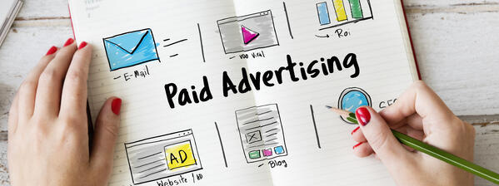
Paid advertising is a digital marketing strategy where businesses bid against each other for ad space on various online platforms or networks. Advertisers are charged only when their ads are clicked, and the ultimate goal is to increase visibility and drive traffic to their website or landing page.
Paid Advertising

Slide 6
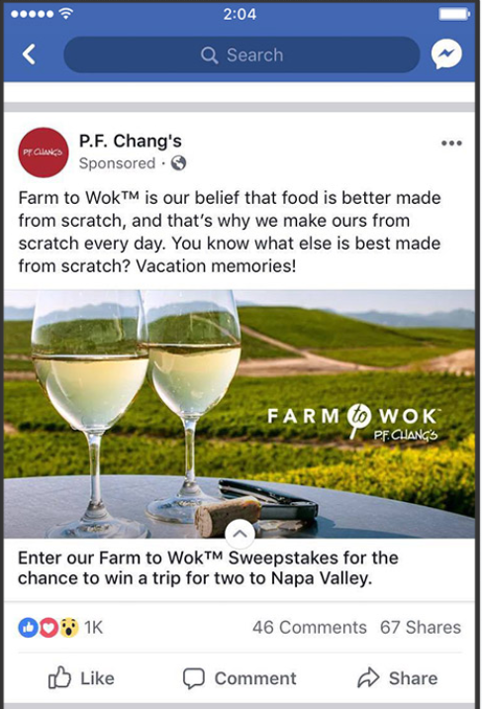
Most platforms offering paid advertising services use algorithms to run real-time auctions. The algorithms decide which ad to place within an available slot online. Platforms don’t always make the criteria transparent.
Source:https://www.innovationvisual.com/knowledge/everything-you-need-to-know-about-paid-advertising

Slide 7
Targeted Ad
Common demographic targeting options
Age
Gender
Relationship Status
Location
Ethnicity
Occupation
Education
Facebook allows to target behaviors in the following categories:
Automotive
Charitable Donations
Digital Activities
Financial
Mobile Device User
Purchase Behavior
Residential Profiles
Travel

Slide 8
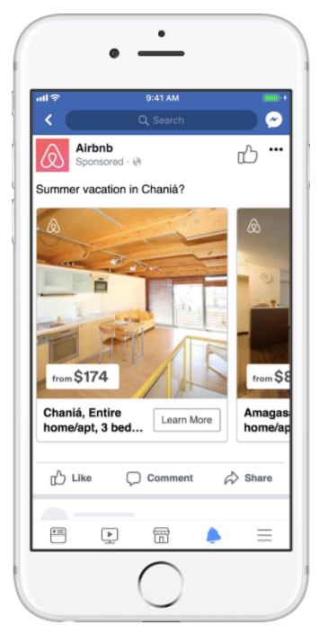
someone fitting specific targeting criteria such as demographics or interests
Search ads
Display ads
someone actively searching for specific keywords

Slide 9
Benefits of paid adv??

Slide 10
Benefits of paid adv
Ads are targets to a more specific audience
When creating ads across the paid advertising platforms, you need to target the ads to an audience that will result in the ads being clicked on. These audiences are fine-tuned over time but in order for paid advertising to be effective, properly defining this target audience is crucial!
Prospects are more likely to re-engage with your products or services
Paid advertising strategy allows you to re-engage with prospects that have previously visited your website. The timing and relevance of these ads will be what turns prospects into customers.
Helps promote brand awareness and familiarity
Most types of paid advertising can be used to promote your brand. Creating brand awareness helps your audience become familiar with your products and services by placing them on popular channels such as Google and Facebook, helping you keep up with the competition.
The ads are measurable and affordable
All paid advertising platforms offer users enough data to analyze the performance of the ads for users to make decisions on whether or not the ads are working
Paid advertising is an affordable way to advertise or remarket your products or services to the right audience.
Souce: https://www.oviond.com/the-importance-of-paid-advertising-in-digital-marketing
Notes:
YOU SHOULD INCREASE ROI

Slide 11
Risks of paid adv??

Slide 12
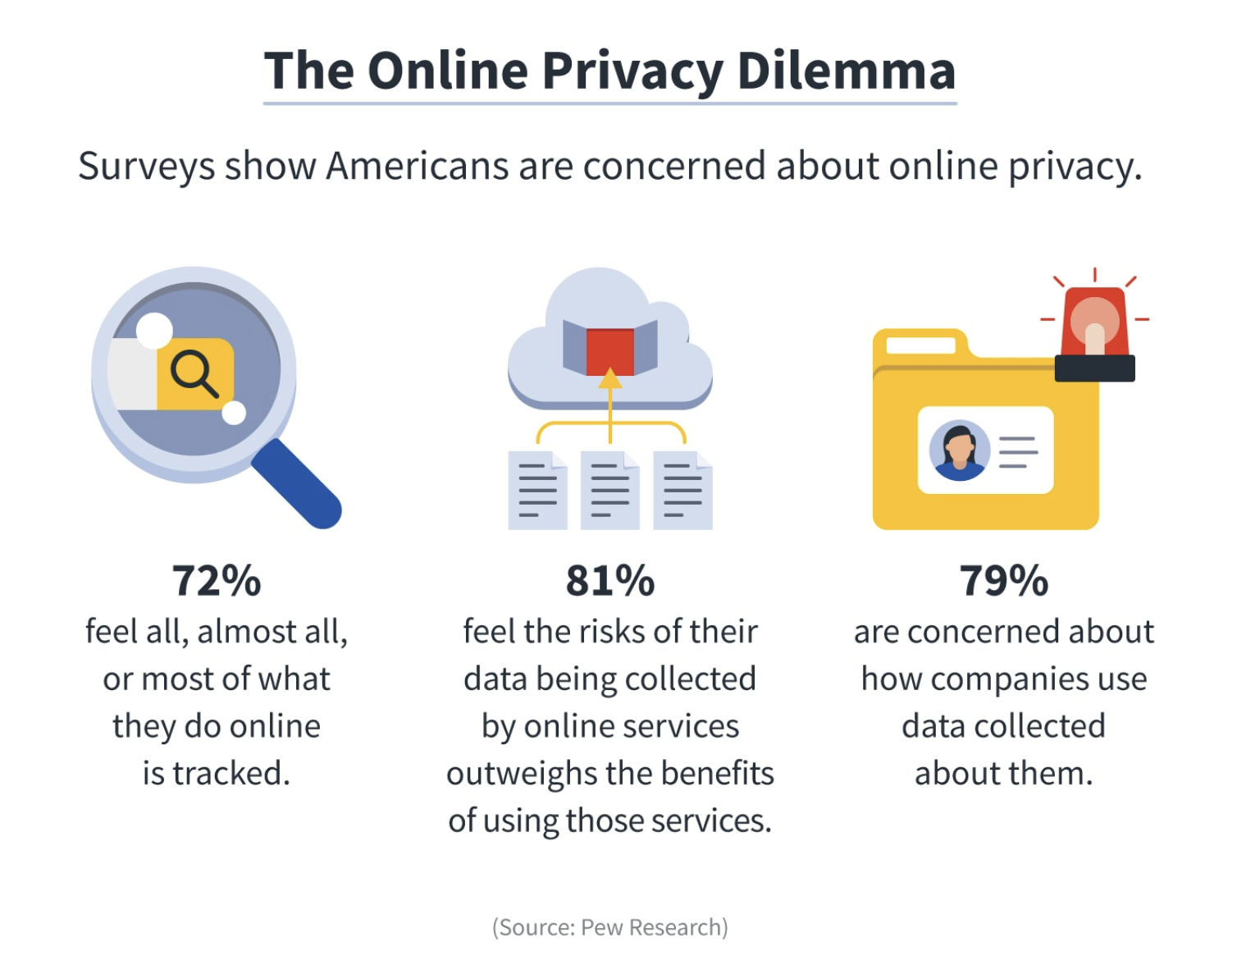
1
Customers’ concerns
about their privacy

Slide 13
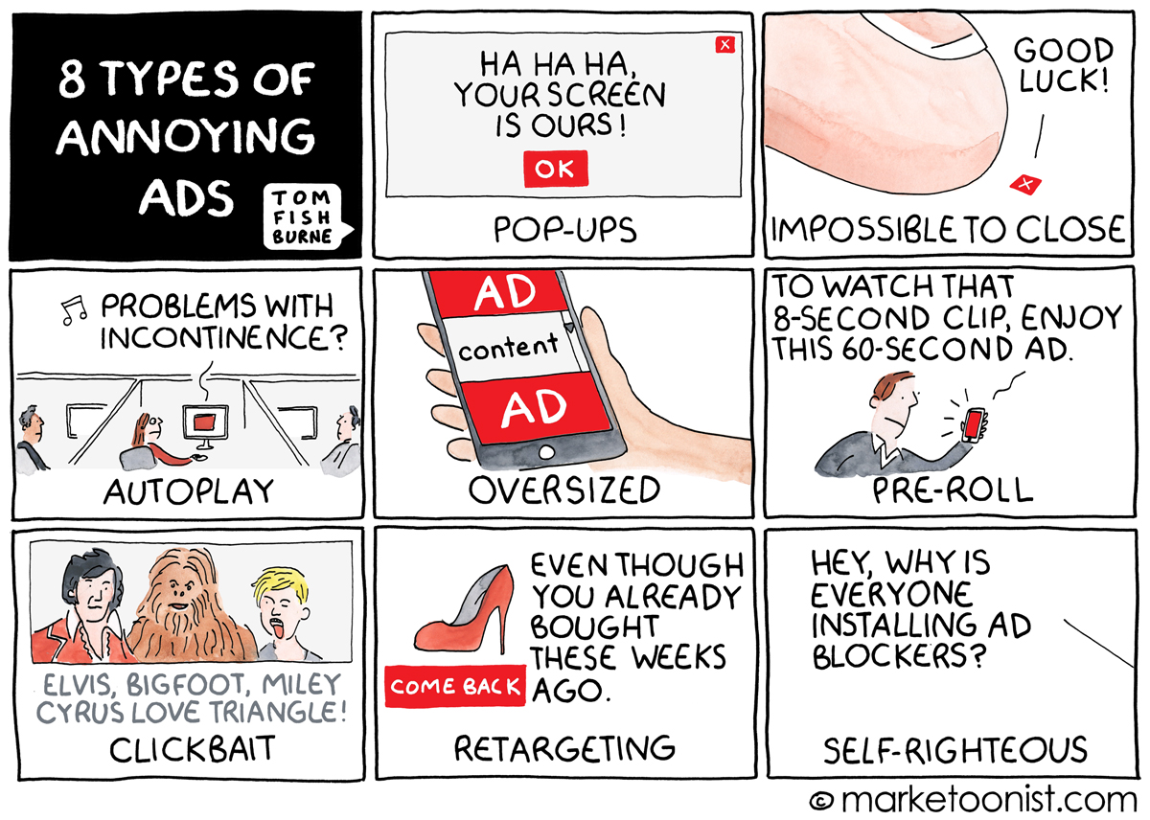
2
Customers’
adversion to ad

Slide 14
Information overload
There are ads everywhere, consumers are both frustrated and desensitized – not exactly what marketers are aiming for!
Marc Pritchard, chief brand officer at Proctor & Gamble said in a recent New York Times article that sometimes ads are “just silly, ridiculous, or stupid.” Pritchard sums up this overwhelming issue well when he says:
“We tried to change the advertising ecosystem by doing more ads, and all that did was create more noise.”
2
Customers’
adversion to ad
Source: https://marketinginsidergroup.com/content-marketing/why-too-much-advertising-can-hold-back-business-growth/

Slide 15
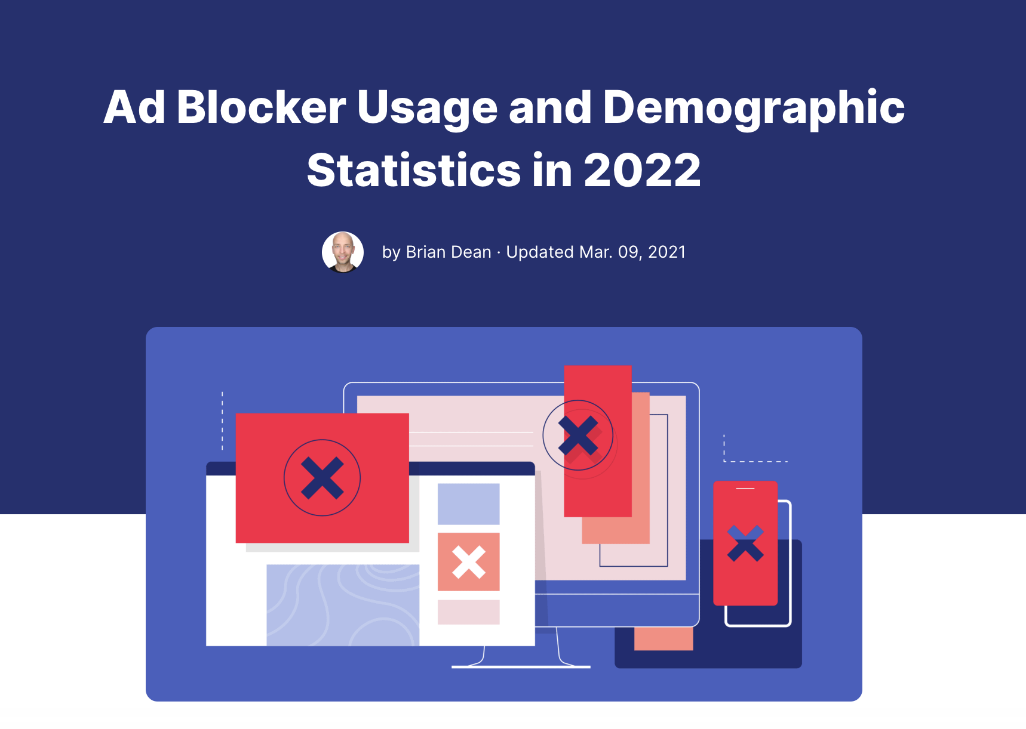
Trends?
Source: https://backlinko.com/ad-blockers-users

Slide 16
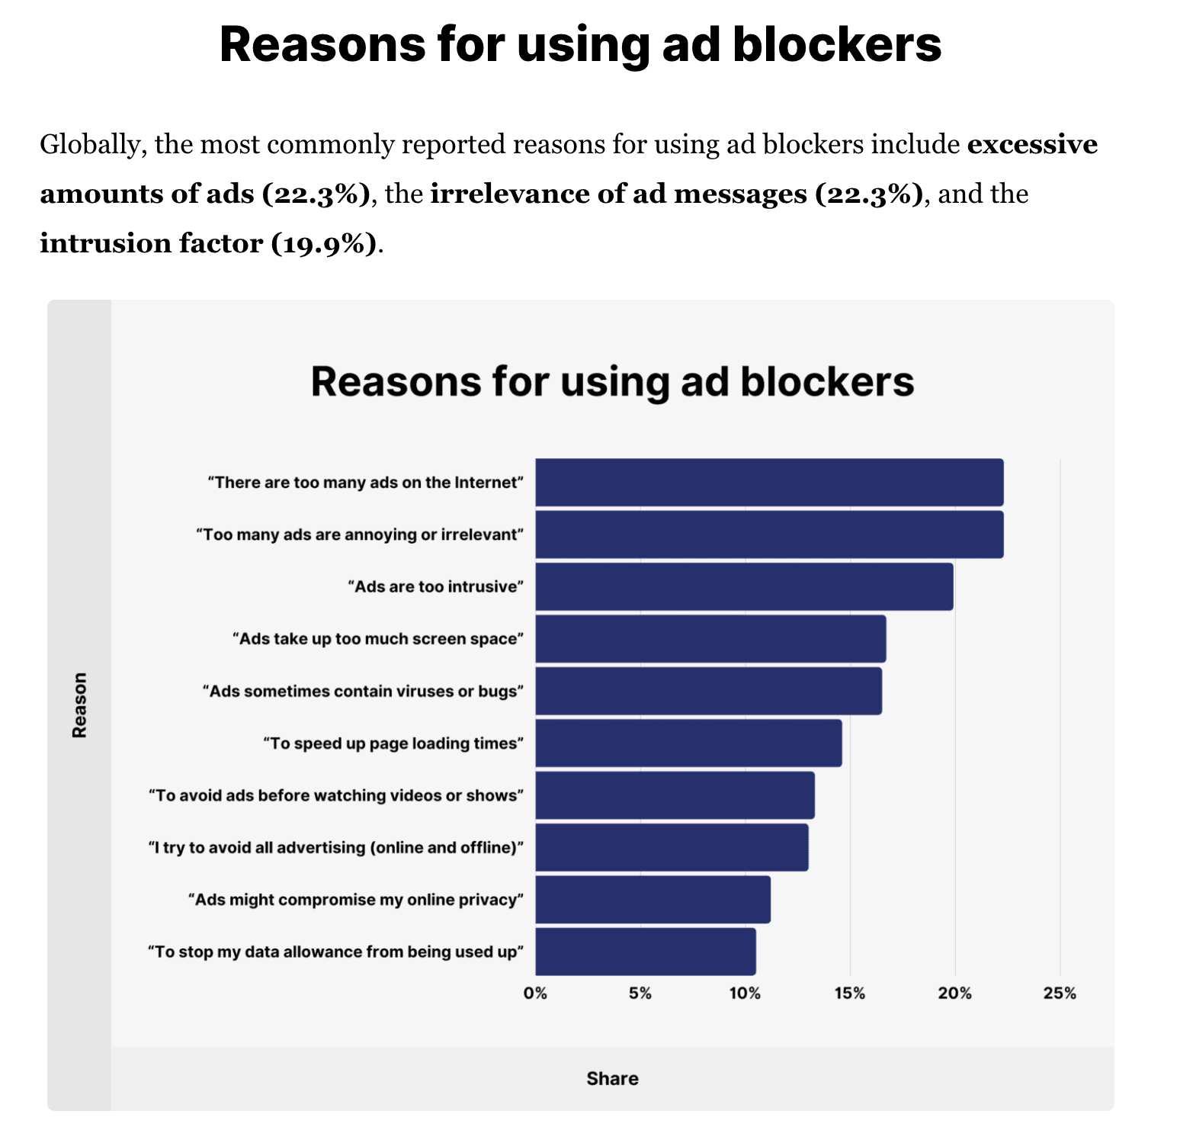
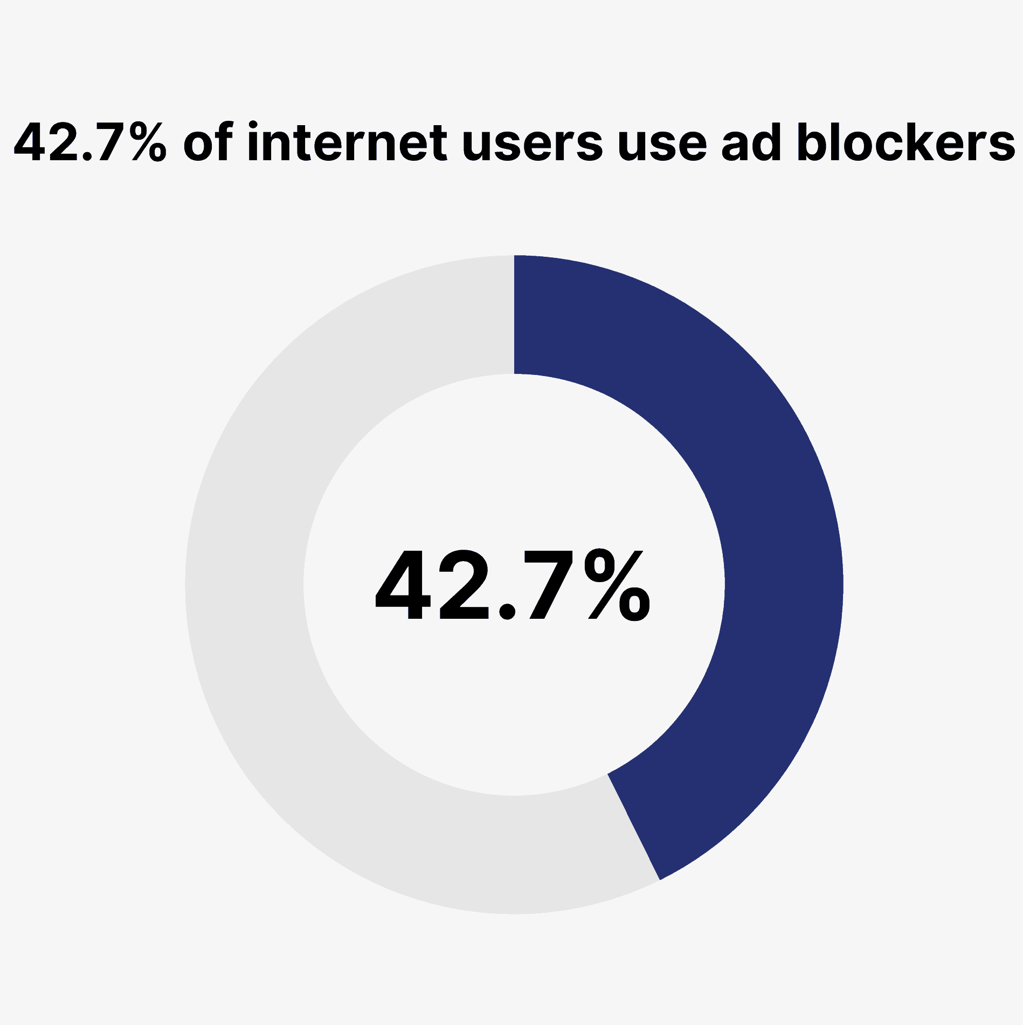
Source: https://backlinko.com/ad-blockers-users

Slide 17
Social Media Plan
Determine the objective
Choose the platform
Plan the content
Distribute and promote content
Measure success
Notes:
This slide simply provides a refresher/overview of those parts. The last four lecture slides provide an opportunity to discuss these steps in the context of the ideal social media practices for a variety of companies.

Slide 18
Social Media Metrics
Volume
Total followers
Impressions (total and per post)
Engagement
Re-post/re-tweet
Total likes/comments
Engagement rate (likes/followers)
Conversion
Click-through rate
Conversion rate
Percentage of followers who purchased
Notes:
Here are some metrics that are valuable in determining the quality of performance of a company’s organic social media content. Keep in mind that none of these metrics is without problems. Total followers is considered a vanity metric, because it often does not correlate strongly with true performance (the extent to which the social media is improving profit). Total impressions measures the amount of exposure your content is generating for the company, though exposure does not necessarily translate to increased purchasing.
Engagement measures whether social media users are interacting with your content. Engagement is important both because it’s a more reliable indicator (compared to volume) that your social media efforts are influencing purchase behavior and because high engagement tends to produce other positive behavior within the social media platform (exposure to new user, continued exposure to followers, etc.).
In the end, the purpose of social media posting is to facilitate additional purchases, so we’d like to measure the extent to which our social media activity is generating additional purchases. For posts meant to directly generate a purchase, we can measure the clicks and conversions that result directly from that post. But not all posts are meant to produce an immediate purchase–some posts are just meant to generate a positive engagement with the company’s profile. So the same expectations for clicks and conversions should not be applied to posts that are not meant to directly stimulate a purchase. The last metric, the percentage of social media followers who are purchasing within a particular time frame, can indicate whether your social media is affecting purchase behavior. But it could just as easily just be measuring how loyal the customers already were who decided to follow your social media profile.

Slide 19
Virality
1 person watching the video = X more views
X = p_{f} * N * p_{v}
p_{f} is the probability of forwarding
N is the number who receive or see the forward
p_{v} is the probability of viewing the forward
Notes:
The reason earned media can sometimes produce enormous returns is that content can sometimes “go viral,” meaning it people share the content with each other, or spread it like a virus. If a piece of content is so funny/useful/clever/unique/interesting that many people want to share it with others (through social media, in-person conversation, email, or any other communication venue), then it could potentially go viral, because the people who have that content shared with them could subsequently share it with others, who then share it with others, and so on and so on, until the content has reached market saturation. This slide provides a simplistic formula for calculating virality. (To be clear, viral spreading through a network is immensely complex and cannot be summarized sufficiently through any 3-parameter formula, but this formula provides a simplistic overview of viral spreading.)
Discussion points:
What gives a video/infographic/article a high p_{f}? (Surprising, humorous, timely, controversial; but also, requests that you share with friends or provides a link to share it on social media)
How can you increase the size of N? (You almost never have control over this. Facebook and Twitter allow you to pay to advertise content, which will increase N.)
How can you increase p_{v}? (Good thumbnail image for the video; choose a good title)
Which of these three makes the biggest difference in whether a video goes viral or not? (Almost all viral videos are viral precisely because of their high p_{f}.)
It is also worthwhile to discuss what the major shortcoming of this formula is (because it’s a simplification, so it can’t represent real life fully). Perhaps the biggest shortcoming is the fact that it does not say anything about the tightness of a network. That is, once someone re-shares a piece of content that they saw on social media, many of their friends have likely already been exposed to the content. So many pieces of content may “go viral” within a network, but will not expand beyond that network. For example, a piece of content about life at a particular university may go viral within the university, but will not be shared by anyone who does not attend that university.

Slide 20
Catherine Tucker of M.I.T. conducted a study to measure the persuasiveness of viral video ads and how that persuasiveness related to the virality of those video ads.
The videos that were more likely to go viral were more humorous, outrageous, over-the-top, etc. By making the video more viral, the advertiser had to reduce the persuasive appeals in favor of more share-inducing content.
Tucker’s study generated additional insights that advertisers can use to get the best of both worlds. She found that humorous content and visual content tends not to show this tradeoff as dramatically. That is, highly humorous content can still be quite persuasive, as can very visual content. Outrageous content, on the other hand, tends to be less persuasive.

Slide 21
Let’s think together!

Slide 22
How do social media platforms make money?

Slide 23
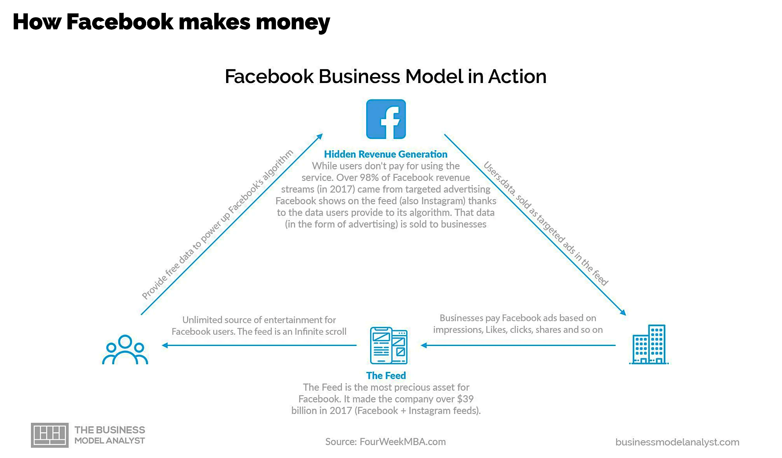

Slide 24
“there is another kind of business, the so-called
attention- economy business,
typically an ad-based business—where (…) the user’s attention is the product, and this product in turn is sold to advertisers or other buyers (Williams, 2018) (…)the most valuable and influential form of attention-economy businesses are social media companies, such as Facebook (including Instagram),
Snap Inc., and Twitter (PwC, 2018)”
(Bhargava and Velasquez 2021)
Business Ethics Quarterly (Cambridge University Press)
Notes:
we are concerned with an issue that is fundamental to the way attention-economy businesses on the internet—in particular,
social media companies—operate. We focus on how social media businesses design their products and platforms in ways that render them addictive.

Slide 25
USERS´S ATTENTION
IS THE PRODUCT SOCIAL MEDIA PLATFORMS SELL

Slide 26
HOW TO
MANUFACTURE ATTENTION?

Slide 27
«We are concerned with an issue that is fundamental to the way attention-economy businesses on the internet—in particular, social media companies—operate.
We focus on how social media businesses design their products and platforms
in ways that render them addictive."
(Bhargava and Velasquez 2021)
Business Ethics Quarterly (Cambridge University Press)

Slide 28
So risks…
for users?

Slide 29
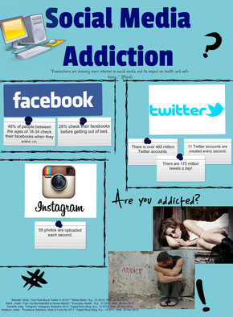
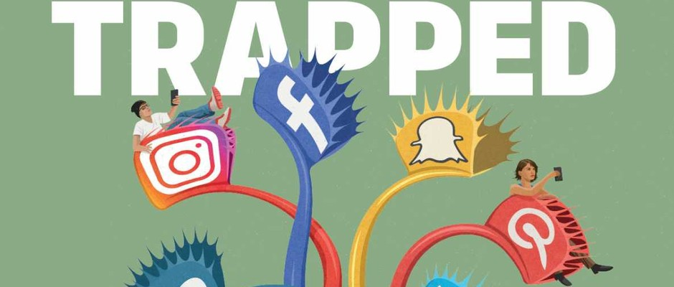
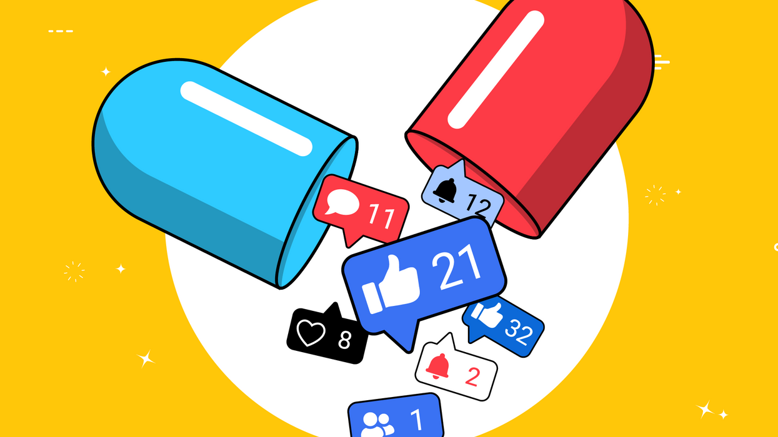
“Studies found that addictive social media use is associated with negative consequences such as reduced productivity, unhealthy social relationships, and reduced life-satisfaction"
Sun and Zhang, 2021
“The impact of social media on mental health is underemphasized. Social media presents us with an internal struggle.
Social media intensifies the reinforcement behaviors of social reward and punishment that we already have within us”
www.hopementalhealth.com
Source: https://www.. hopementalhealthcom/blog/social-media-addiction

Slide 30
A recent study from Facebook found Instagram to have harmful effects among a portion of its millions of young users, particularly teenage girls. Findings indicated that Instagram makes body image issues worse for one in three teenage girls. And among teenagers who reported suicidal thoughts, 6 percent in the U.S. traced them back to Instagram.

Slide 31
So risks…
for social media platforms?

Slide 32
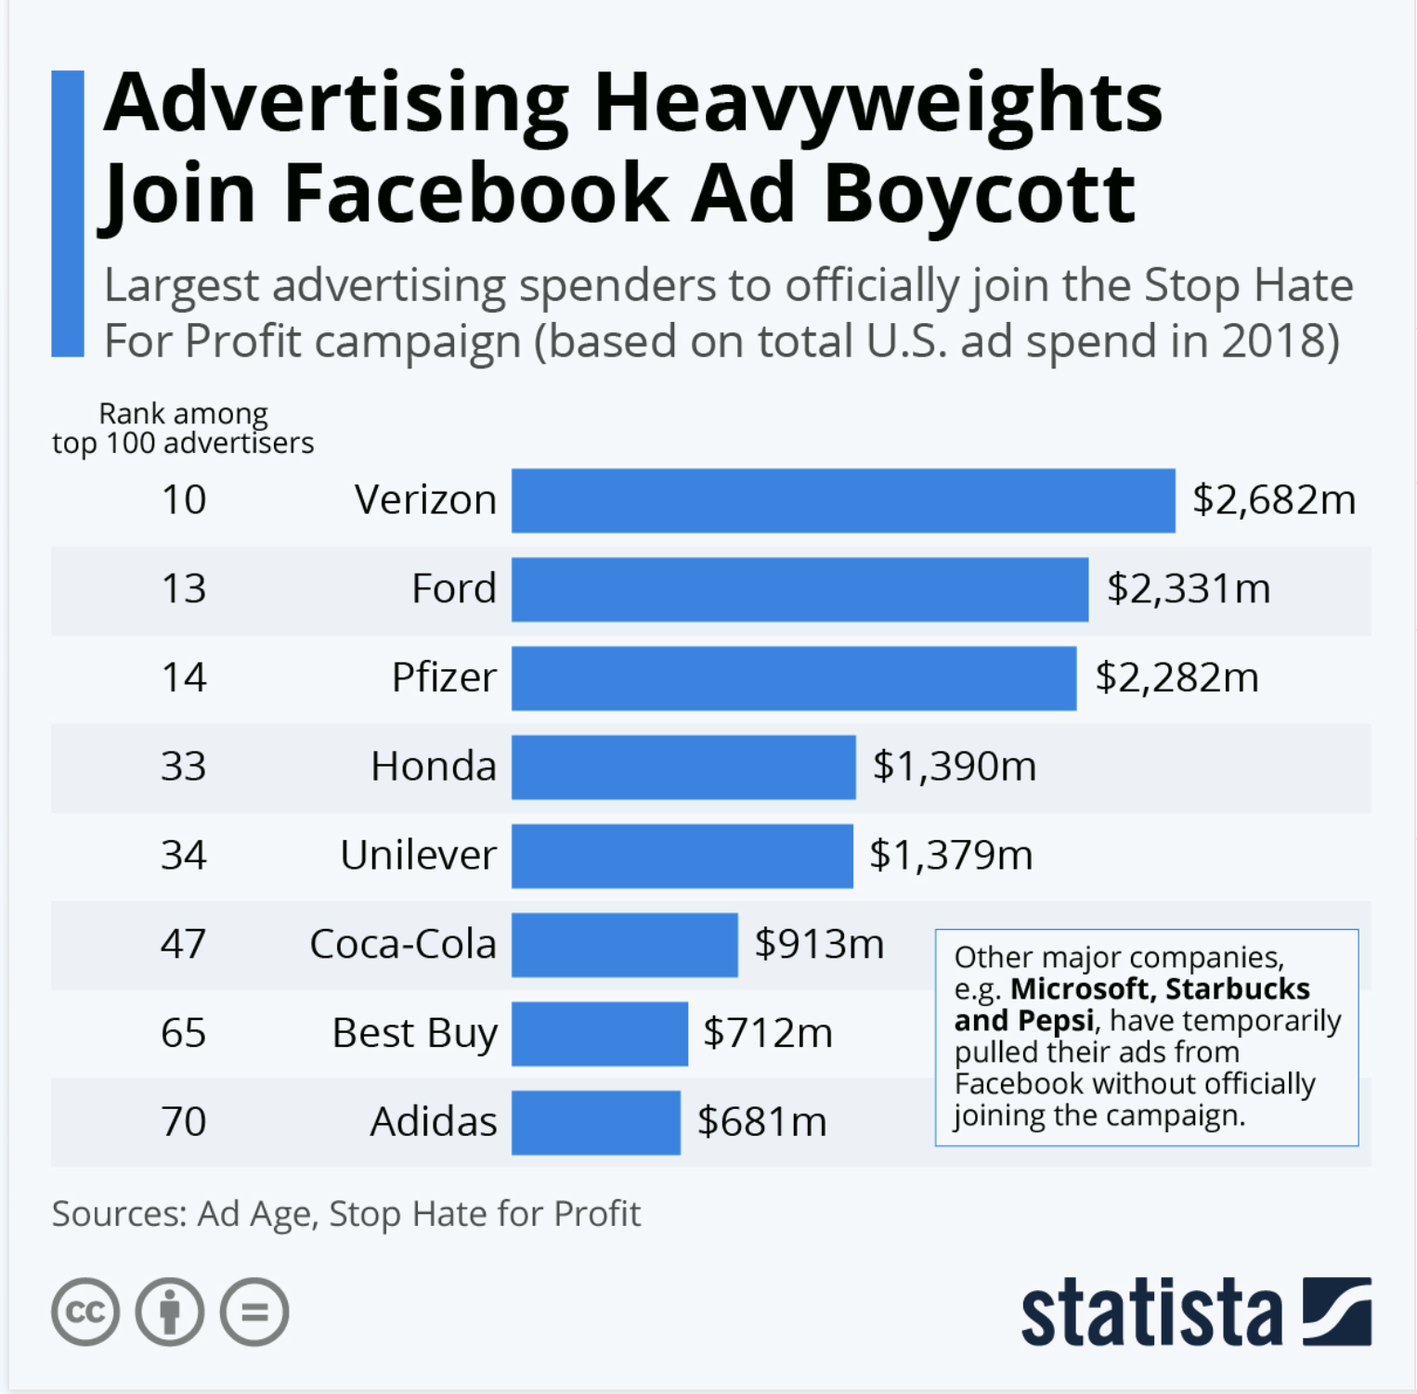
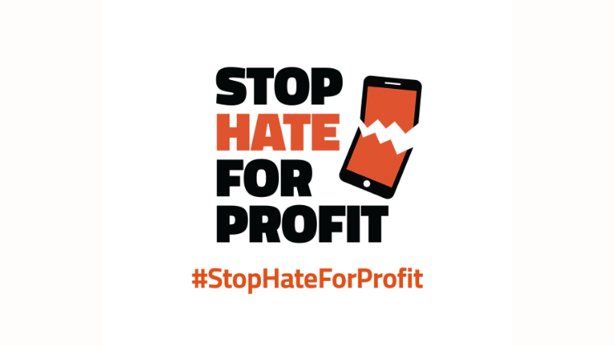
“Stop Hate for Profit is an ongoing campaign to hold social media companies accountable for hate on their platforms. Social media must prioritize people over profit, and they must do it now.
With the support of more than 1,200 businesses and non-profits and countless consumers, we sent a clear message to Facebook in July 2020 with our ad pause: stop valuing profits over hate, bigotry, racism, antisemitism, and disinformation.
We continue to demand change and that Facebook stop hate for profit.”
Campaigns such as #StopHateForProfit

Slide 33
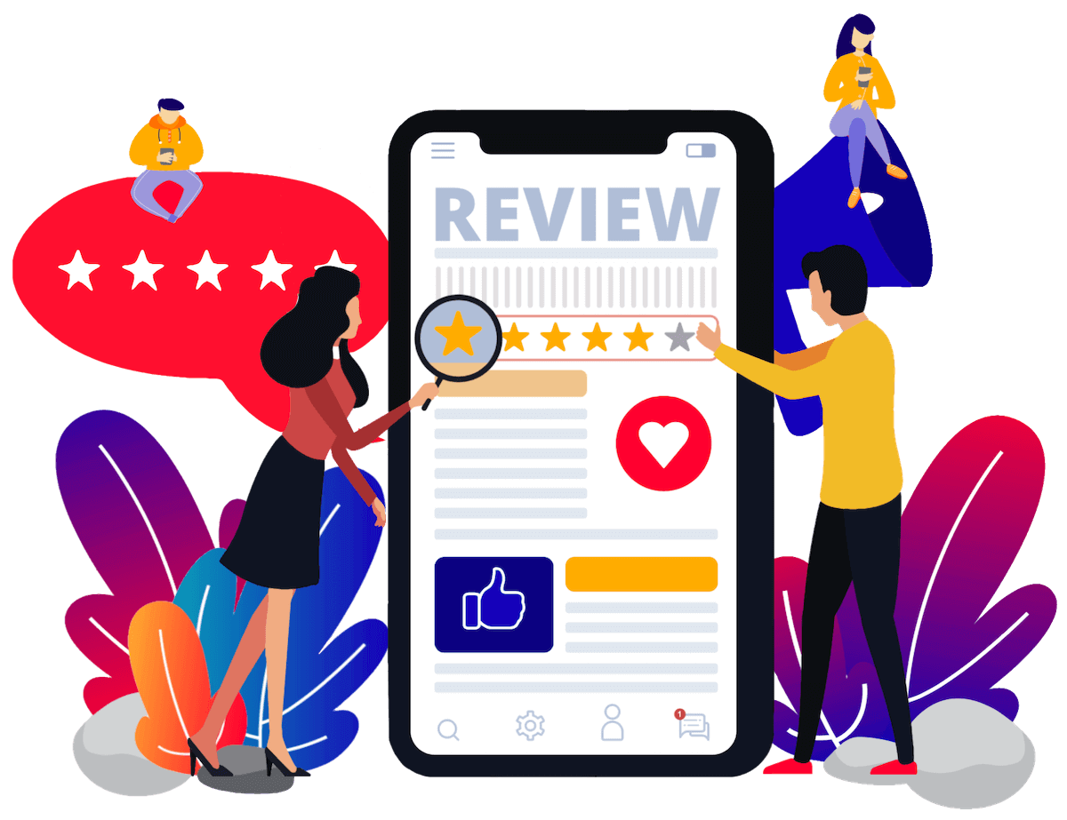
Online reputation management

Slide 34
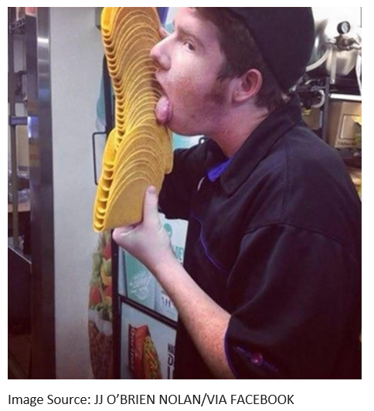
The Taco Bell ORM Emergency
Notes:
Ask the students what they would do if they were the boss of this employee. After they list off their ideas, ask the students to get in groups and create a plan to help Taco Bell handle the negative media that comes from a picture like this that goes viral on social media. Remind the students to consider all of the different online resources that may be affected by an image like this. Have two volunteers share their emergency plans with the class.

Slide 35
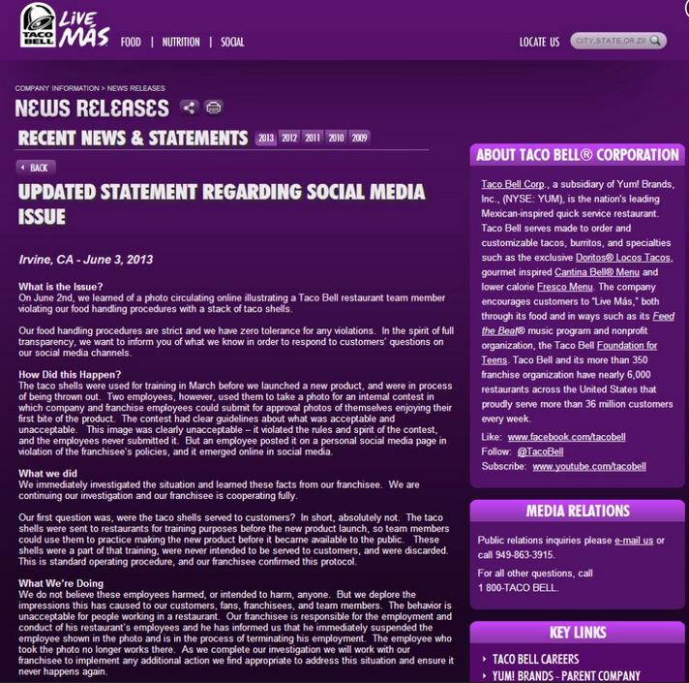
Taco Bell’s Response
Notes:
Point out to the students that while it is important to monitor all of the negative publicity, sometimes it isn’t always best to respond to every source. By creating a Press Release, Taco Bell was able respond to everyone at once. This allows Taco Bell’s Online Rep and PR teams the ability to respond and share a link to their official response. Having an official response helps avoid an employee or franchisee saying something that just fuels the media fire. Ask the students if they would do anything different or additional above and beyond what Taco Bell did.

Slide 36
Online reputation management
The practice of promoting a positive brand image online by increasing the visibility of positive information and managing negative information.

Slide 37
Online reputation management
Reputation Management
Find and gather information about company online
Promote positive information and limit negative information

Slide 38
Let’s watch a video

Slide 39
“..within four days of the song going online, the gathering thunderclouds of bad PR caused United Airlines’ stock price to suffer a mid-flight stall, and it plunged by 10 per cent, costing shareholders $180 million. Which, incidentally, would have bought Carroll more than 51,000 replacement guitars.” (The Times, UK)
United Airlines refused to spend $1200 to repair a passenger’s guitar that was carelessly broken
The passenger did not make a claim within 24-hour timeframe and vented his frustration by creating a song entitled “United Breaks Guitars” (YouTube)
As of 2022, it garnered almost 22 million views and may have cost United Airlines $180 million.

Slide 40
Online reputation management
Is that ethical?

Slide 41
Ethical ORM
ORM is a method for avoiding responsibility for bad business practices?
ORM recognizes that negative online content can have unnecessarily damaging repercussions long after the underlying issues have been addressed.
Notes:
Students that agree it is wrong to hide negative information about a business online will feel validated.
At this point you can end this discussion by reviewing with the students some of the reasons there is value in managing and maintaining a healthy and positive online reputation.

Slide 42
Some reasons to do ORM
People like to do business with reputable companies
Savvy, potential customers do their research
News outlets will look for information about your company
Positive press reflects well on the brand
Employees and potential new hires want to work with a brand with a clean reputation
Shareholders and investors invest in, trust in, and work with reputable companies

