Slide 1
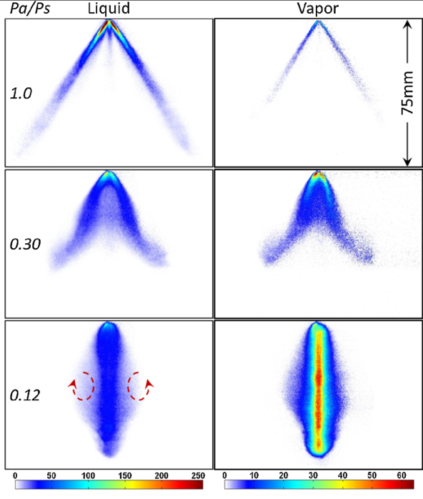
Thermodynamics
An Engineering Approach
Lecture 3: Properties of Pure Substance
Qiang Cheng (Jonny)

Slide 2
Learning Outcomes
When you complete your study of this chapter, you will be able to…
explain key concepts, including phase and pure substance, state principle for simple compressible systems, p–ν–T surface, saturation temperature and saturation pressure, two-phase liquid–vapor mixture, quality, enthalpy, and specific heats.
analyze closed systems, including applying the energy balance with property data.
sketch T–v, p–v, and phase diagrams, and locate states on these diagrams.
Demonstrate the procedures for determining thermodynamic properties of pure substances from tables of property data.
Describe the hypothetical substance “ideal gas” and the ideal-gas equation of state.
Apply the ideal-gas equation of state in the solution of typical problems.
Introduce the compressibility factor, which accounts for the deviation of real gases from ideal-gas behavior.
Present some of the best-known equations of state.
Notes:
Heat is energy can be converted from one form to another, or transferred from one object to another. For example, a stove burner converts electrical energy to heat and conducts that energy through the pot to the water. This increases the kinetic energy of the water molecules, causing them to move faster and faster. At a certain temperature (the boiling point), the atoms have gained enough energy to break free of the molecular bonds of the liquid and escape as vapor.

Slide 3
Phase and Pure Substance
phase
The term phase refers to a quantity of matter that is homogeneous throughout in
both chemical composition and physical structure.
Homogeneity in physical structure means that the matter is all solid, or all liquid, or all vapor (or equivalently all gas). A system can contain one or more phases.
pure substance
A pure substance is one that is uniform and invariable in chemical composition.
A pure substance can exist in more than one phase, but its chemical composition must
be the same in each phase.

Slide 4
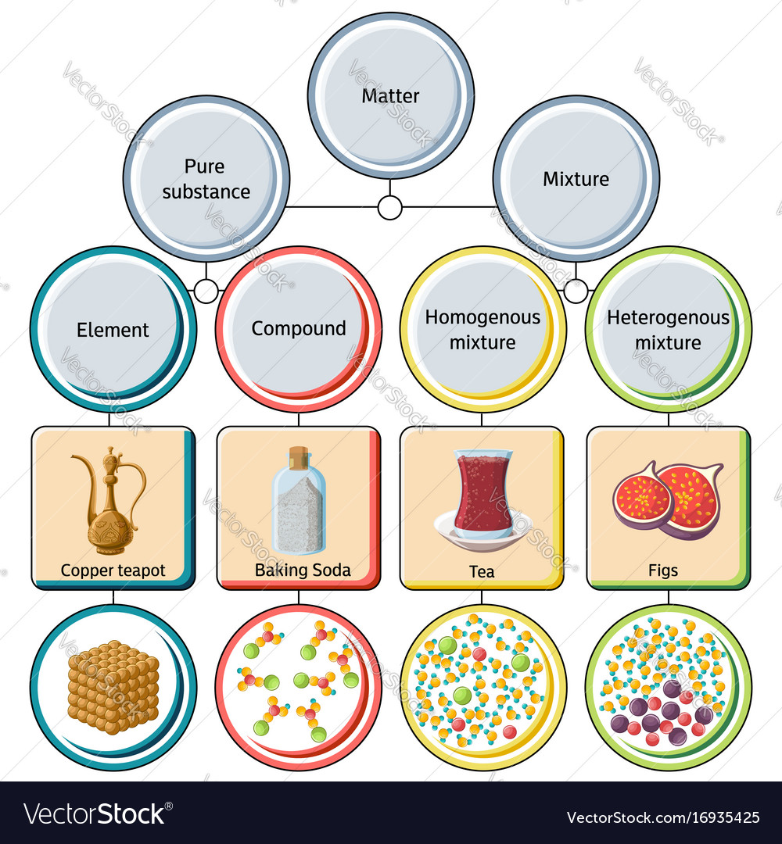
Pure Substance
A pure substance does not have to be of a single chemical element or compound, however. A mixture of various chemical elements or compounds also qualifies as a pure substance as long as the mixture is homogeneous. Air, for example, is a mixture of several gases, but it is often considered to be a pure substance because it has a uniform chemical composition.
A mixture of two or more phases of a pure substance is still a pure substance as long as the chemical composition of all phases is the same. (water and ice)
A mixture of liquid air and gaseous air, however, is not a pure substance since the composition of liquid air is different from the composition of gaseous air, and thus the mixture is no longer chemically homogeneous. This is due to different components in air condensing at different temperatures at a specified pressure.

Slide 5
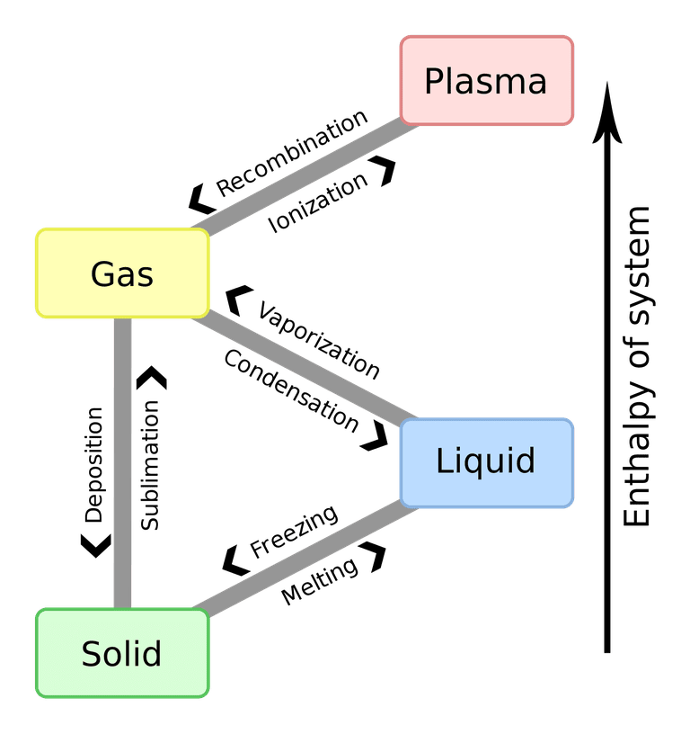
Pahse of Pure Substance
The most commonly known phase changes are those six between solids, liquids, and gasses. However, plasma also is a state of matter, so a complete list requires all eight total phase changes.
Phase changes typically occur when the temperature or pressure of a system is altered.
Phase Changes of States of Matter
Solids: Solids can melt into liquids or sublime into gases. Solids form by deposition from gases or freezing of liquids.
Liquids: Liquids can vaporize into gases or freeze into solids. Liquids form by condensation of gases and melting of solids.
Gases: Gases can ionize into plasma, condense into liquids, or undergo deposition into solids. Gases form from the sublimation of solids, vaporization of liquids, and recombination of plasma.
Plasma: Plasma can recombine to form a gas. Plasma most often forms from ionization of a gas, although if sufficient energy and enough space are available, it's presumably possible for a liquid or solid to ionize directly into a gas.
Fig. 2. Schematic of electron temperature and number density for different discharges, Corona, direct current (DC) discharge, microwave (MW) discharge; dielectric barrier discharge (DBD), radio-frequency discharge (RF), glow discharge, gliding arc, nanosecond pulsed discharge (NSD), arc, magneto-hydrodynamic discharge (MHD), and flame.
Notes:
https://www.thoughtco.com/list-of-phase-changes-of-matter-608361

Slide 6
Fixing the State
The intensive state of a closed system at equilibrium is its condition as described by the values of its intensive thermodynamic properties.
From observation of many thermodynamic systems, we know that not all of these properties are independent of one another, and the state can be uniquely determined by giving the values of a subset of the independent intensive properties.
Values for all other intensive thermodynamic properties are determined once this independent subset is specified.
state principle
the state principle has been developed as a guide in determining the number of independent properties required to fix the state of a system.
simple compressible
systems
The simple compressible system is descripted as the state principle about the intensive states of systems of commonly encountered pure substances, such as water or a uniform mixture of nonreacting gases.
Experience shows simple compressible systems occur in a wide range of engineering applications. For such systems, the state principle indicates that specification of the values for any two independent intensive thermodynamic properties will fix the values of all other intensive thermodynamic properties.

Slide 7
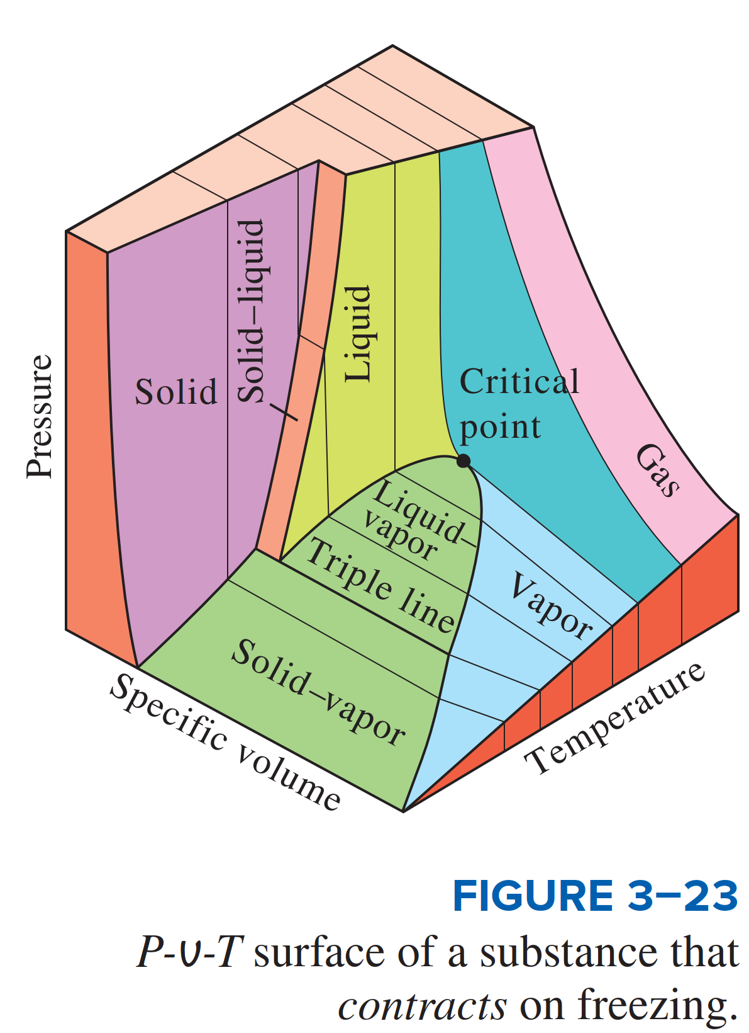
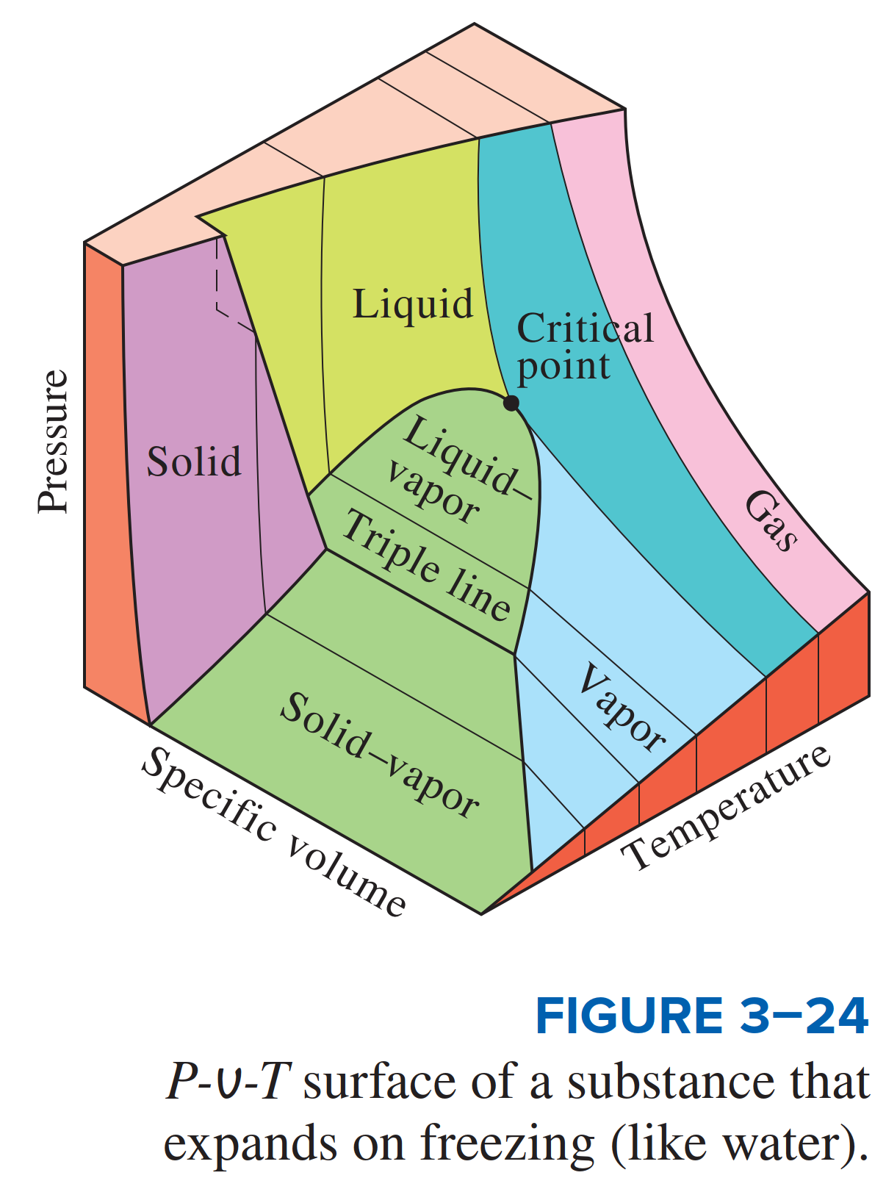
Evaluating Properties: General
Considerations
as independent and pressure determined as a function of these two: $p=p\left(T,ν\right)$. The graph of such a function is a surface, the $p−ν−T$ surface.
$p−ν−T$ Relation
The state of a simple compressible substance is fixed by any two independent, intensive properties. Once the two appropriate properties are fixed, all the other properties become dependent properties.

Slide 8
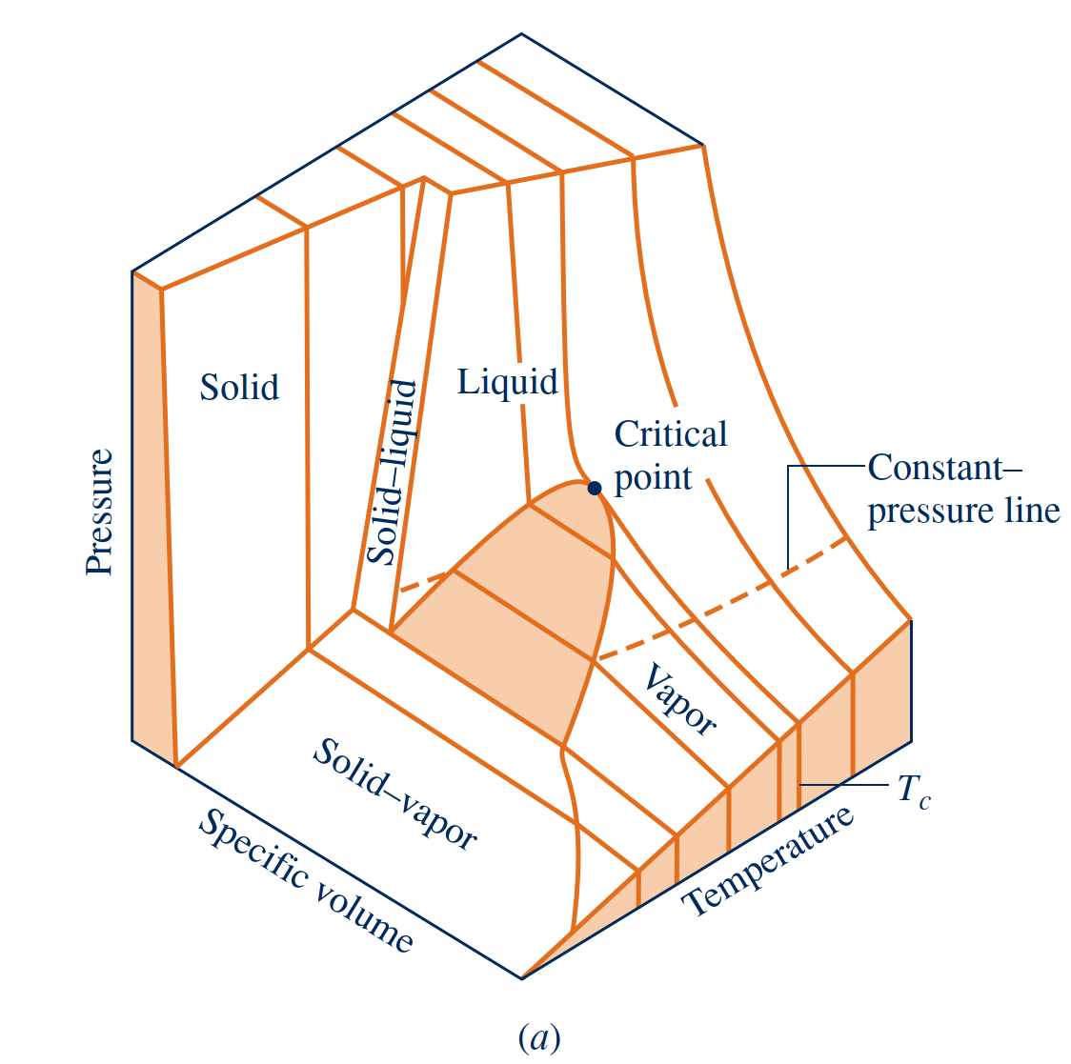
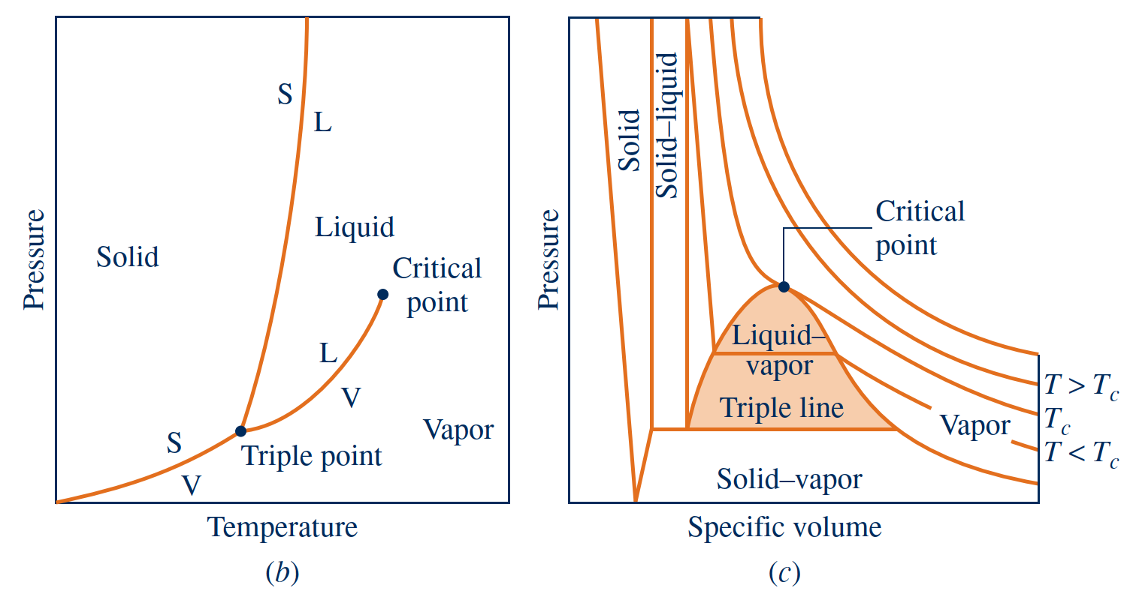
Evaluating Properties: General
Considerations
In these single-phase regions, the state is fixed by any two of the properties: pressure, specific volume, and temperature, since all of these are independent when there is a single phase present.
$$single−phase regions$$
Located between the single-phase regions are two-phase regions where two phases exist in equilibrium: liquid–vapor, solid–liquid, and solid–vapor. Two phases can coexist during changes in phase such as vaporization, melting, and sublimation.
$$two−phase regions$$
Within the two-phase regions pressure and temperature are not independent; one cannot be changed without changing the other. In these regions the state cannot be fixed by temperature and pressure alone; however, the state can be fixed by specific volume and either pressure or temperature.
$$triple line$$
Three phases can exist in equilibrium along the line labeled triple line.
At the top of the vapor dome, where the saturated liquid and saturated vapor lines meet, is the critical point. The critical temperature Tc of a pure substance is the maximum temperature at which liquid and vapor phases can coexist in equilibrium.
critical point
saturation state
A state at which a phase change begins or ends is called a saturation state.

Slide 9
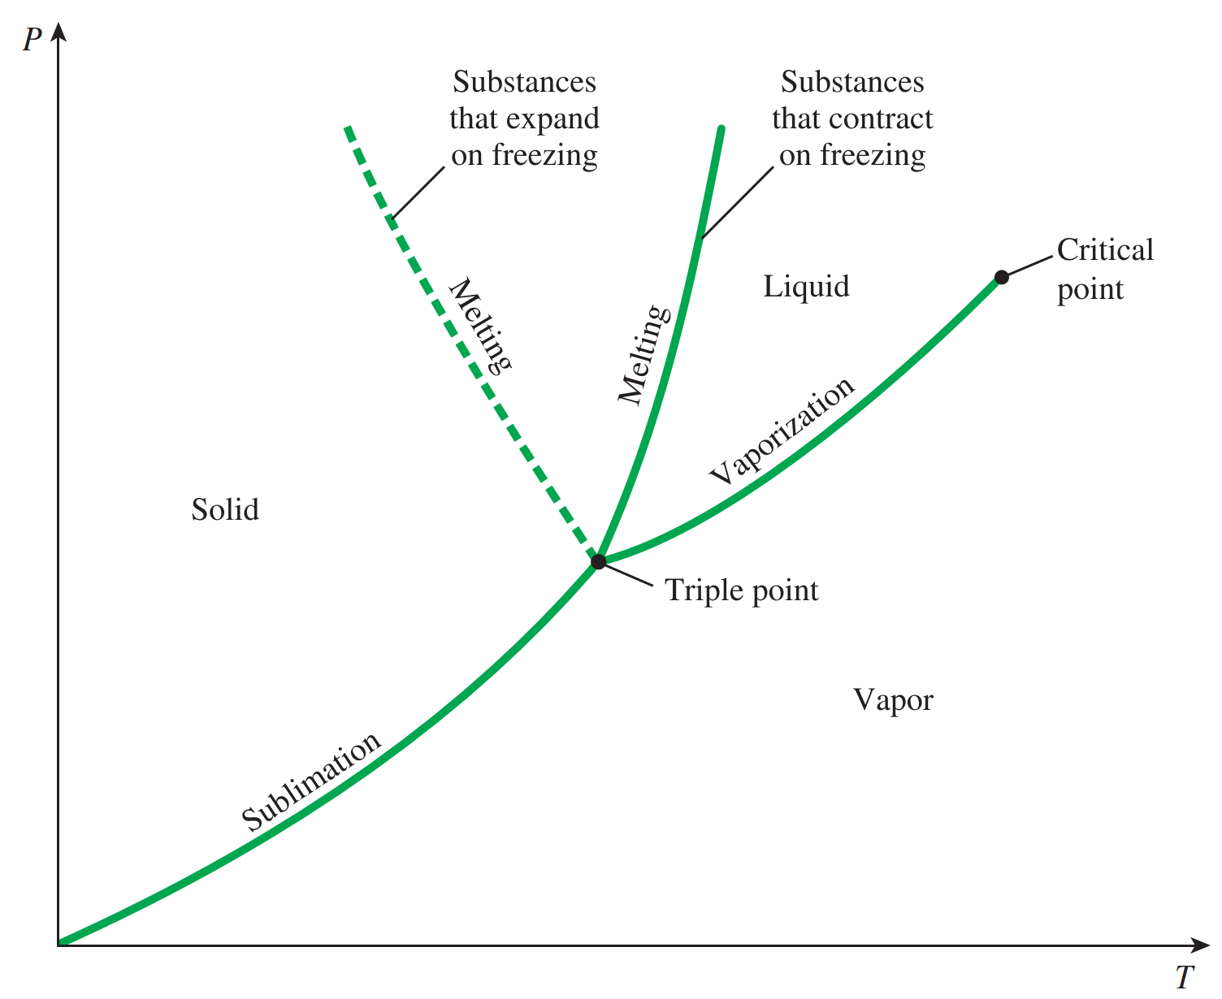
Projections of the p–ν–T Surface
phase diagram
If the p–ν–T surface is projected onto the pressure–temperature plane, a property diagram known as a phase diagram results.
when the surface is projected in this way, the two-phase regions reduce to lines. A point on any of these lines represents all two-phase mixtures at that particular temperature and pressure.
saturation temperature and pressure
The term saturation temperature designates the temperature at which a phase
change takes place at a given pressure, and this pressure is called the saturation pressure for the given temperature.
The triple line of the three-dimensional p–ν–T surface projects onto a point on the phase diagram. This is called the triple point.
triple point

Slide 10
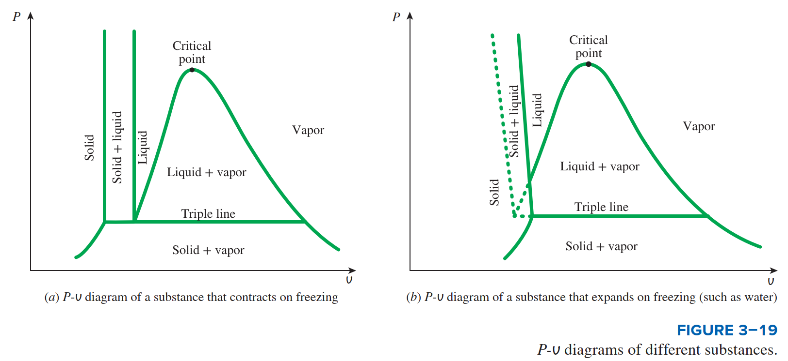
Projections of the p–ν–T Surface
p–ν diagram
If the p–ν–T surface is projected onto the pressure–specific volume plane results in a p–ν diagram.
When solving problems, a sketch of the p–ν diagram is frequently convenient.

Slide 11
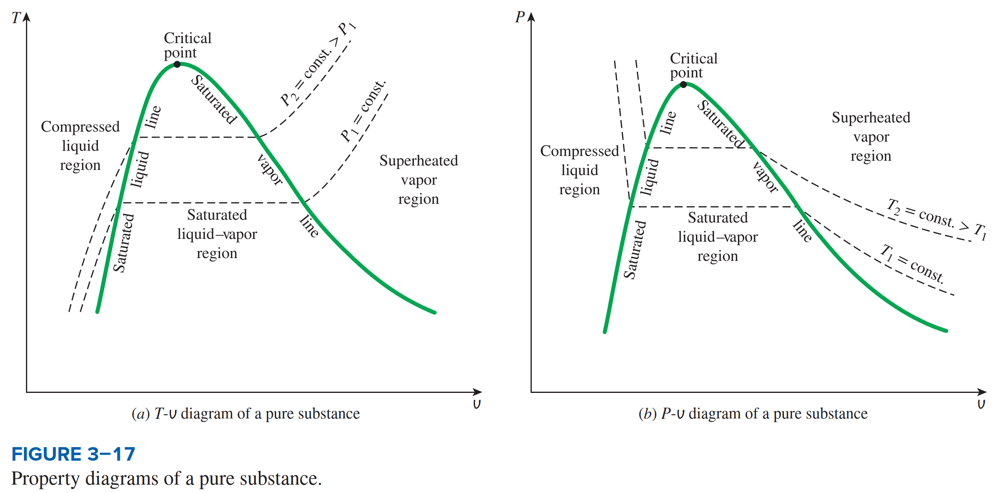
Projections of the p–ν–T Surface
T–ν diagram
Projecting the liquid, two-phase liquid–vapor, and vapor regions of the p–ν–T surface onto the temperature–specific volume plane results in a T–ν diagram

Slide 12
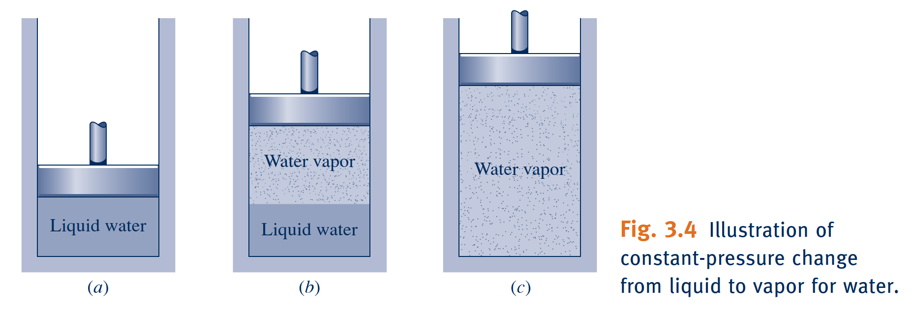
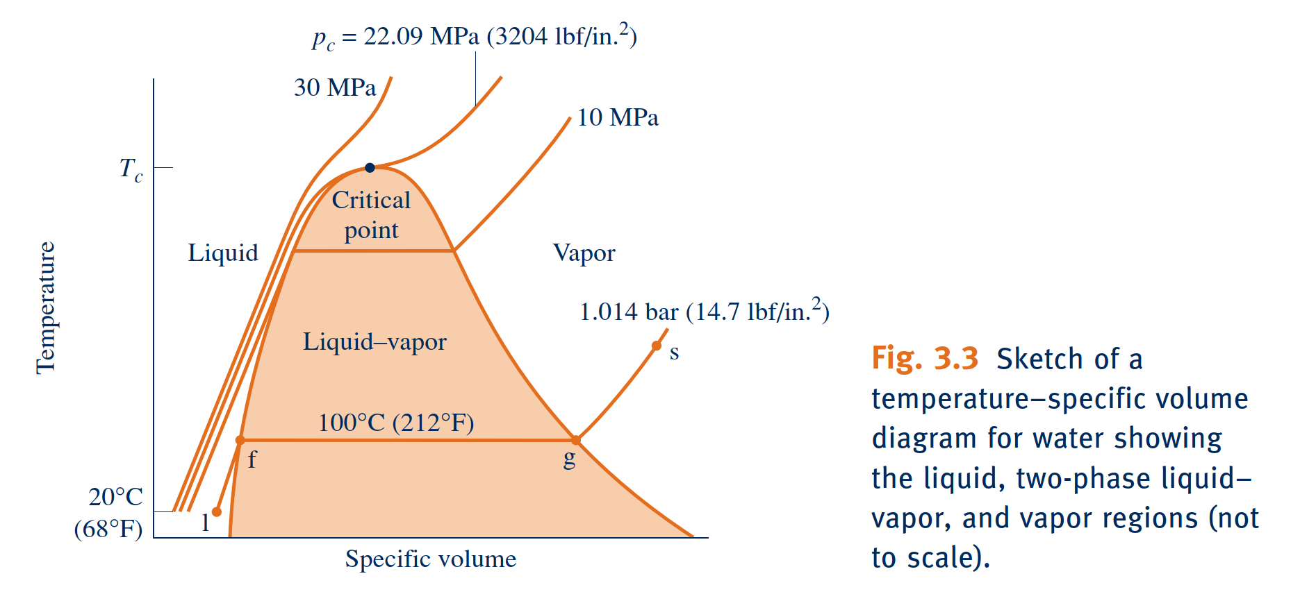
Studying Phase Change
As the system is heated at constant pressure, the temperature increases considerably
while the specific volume increases slightly. Eventually, the system is brought to the
state represented by f on Fig. 3.3. This is the saturated liquid state corresponding to
the specified pressure. For water at 1.014 bar the saturation temperature is 100ºC.
Liquid States
subcooled liquid
At subcooled liquid state, the temperature is less than the saturation temperature at the given pressure.
These states are also referred to as compressed liquid states because the pressure at each state is higher than the saturation pressure corresponding to the temperature at the state. The names liquid, subcooled liquid, and compressed liquid are used interchangeably.
compressed liquid

Slide 13
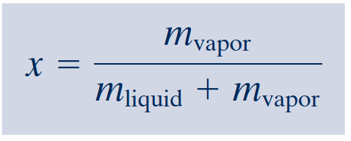
Studying Phase Change
When a mixture of liquid and vapor exists in equilibrium, the liquid phase is a saturated
liquid and the vapor phase is a saturated vapor. If the system is heated further until the last bit of liquid has vaporized, it is brought to point g on Fig. 3.3, the saturated vapor state. The intervening two-phase liquid–vapor mixture states can be distinguished from one another by the quality, an intensive property.
Two-Phase Liquid–Vapor Mixture
quality
For a two-phase liquid–vapor mixture, the ratio of the mass of vapor present to
the total mass of the mixture is its quality, x. In symbols,

Slide 14
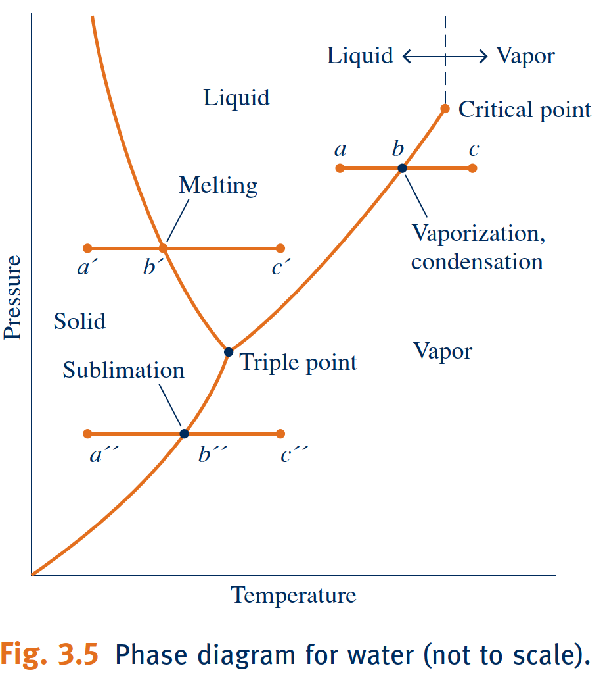
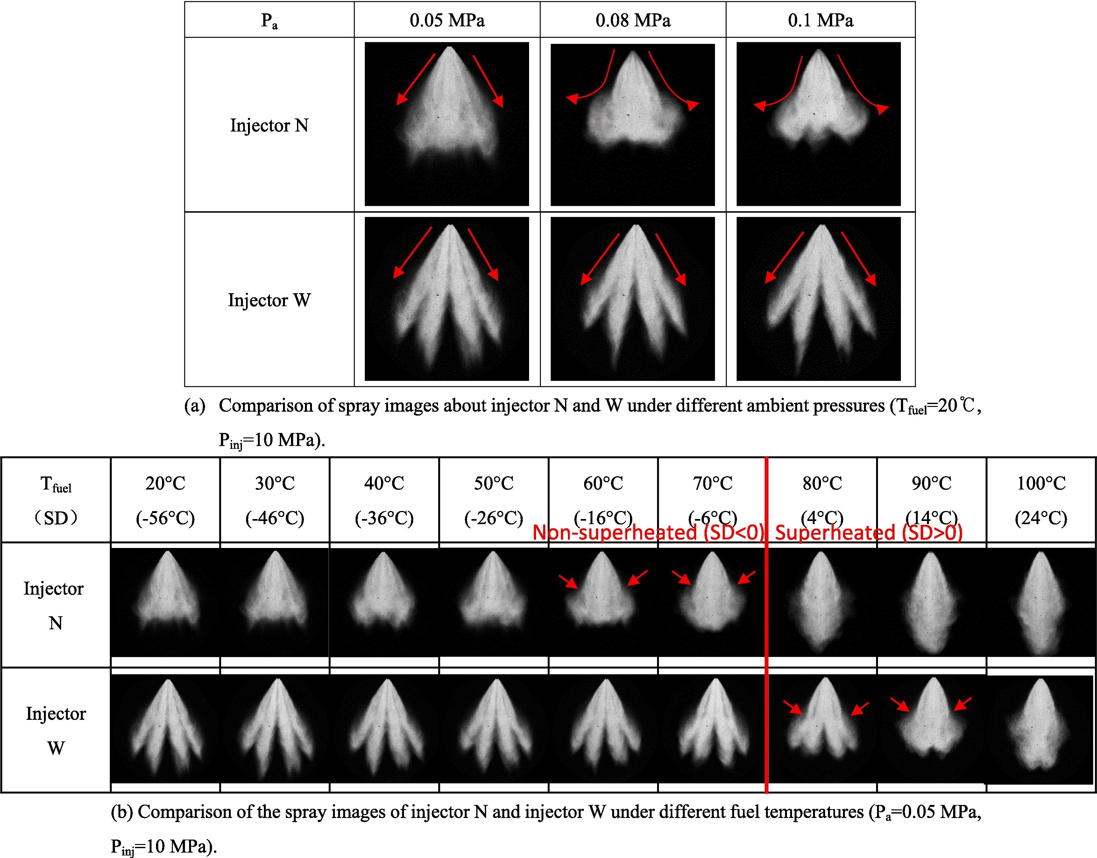
Studying Phase Change
When the system is at the saturated vapor state (state g on Fig. 3.3), further heating at fixed pressure results in increases in both temperature and specific volume. The condition of the system would now be as shown in Fig. 3.4c. The state labeled s on Fig. 3.3 is representative of the states that would be attained by further heating while keeping the pressure constant. A state such as s is often referred to as a superheated vapor state because the system would be at a temperature greater than the saturation temperature corresponding to the given pressure.
Vapor States

Slide 15
Retrieving Thermodynamic Properties
For most substances, the relationships among thermodynamic properties are too complex to be expressed by simple equations. Therefore, properties are frequently presented in the form of tables.
Table A–13 Superheated refrigerant-134a 903
Figure A–14 P-h diagram for refrigerant-134a 905
Figure A–15 Nelson–Obert generalized compressibility charts 906
Table A–16 Properties of the atmosphere at high altitude 907
Table A–17 Ideal-gas properties of air 908
Table A–18 Ideal-gas properties of nitrogen, N2 910
Table A–19 Ideal-gas properties of oxygen, O2 912
Table A–20 Ideal-gas properties of carbon dioxide, CO2 914
Table A–21 Ideal-gas properties of carbon monoxide, CO 916
Table A–22 Ideal-gas properties of hydrogen, H2 918
Table A–23 Ideal-gas properties of water vapor, H2O 919
Table A–24 Ideal-gas properties of monatomic oxygen, O 921
Table A–25 Ideal-gas properties of hydroxyl, OH 921
Table A–26 Enthalpy of formation, Gibbs function of formation, and
absolute entropy at 25°C, 1 atm 922
Table A–27 Properties of some common fuels and hydrocarbons 923
Table A–28 Natural logarithms of the equilibrium constant Kp 924
Figure A–29 Generalized enthalpy departure chart 925
Figure A–30 Generalized entropy departure chart 926
Figure A–31 Psychrometric chart at 1 atm total pressure 927
Table A–32 One-dimensional isentropic compressible-flow functions
for an ideal gas with k = 1.4 928
Table A–33 One-dimensional normal-shock functions for an ideal gas
with k = 1.4 929
Table A–34 Rayleigh flow functions for an ideal gas with k = 1.4 930
Some thermodynamic properties can be measured easily, but others cannot, and the latter are calculated by using the relations between them and measurable properties.
Table A–1 Molar mass, gas constant, and critical-point properties 882
Table A–2 Ideal-gas specific heats of various common gases 883
Table A–3 Properties of common liquids, solids, and foods 886
Table A–4 Saturated water—Temperature table 888
Table A–5 Saturated water—Pressure table 890
Table A–6 Superheated water 892
Table A–7 Compressed liquid water 896
Table A–8 Saturated ice–water vapor 897
Figure A–9 T-s diagram for water 898
Figure A–10 Mollier diagram for water 899
Table A–11 Saturated refrigerant-134a—Temperature table 900
Table A–12 Saturated refrigerant-134a—Pressure table 902

Slide 16
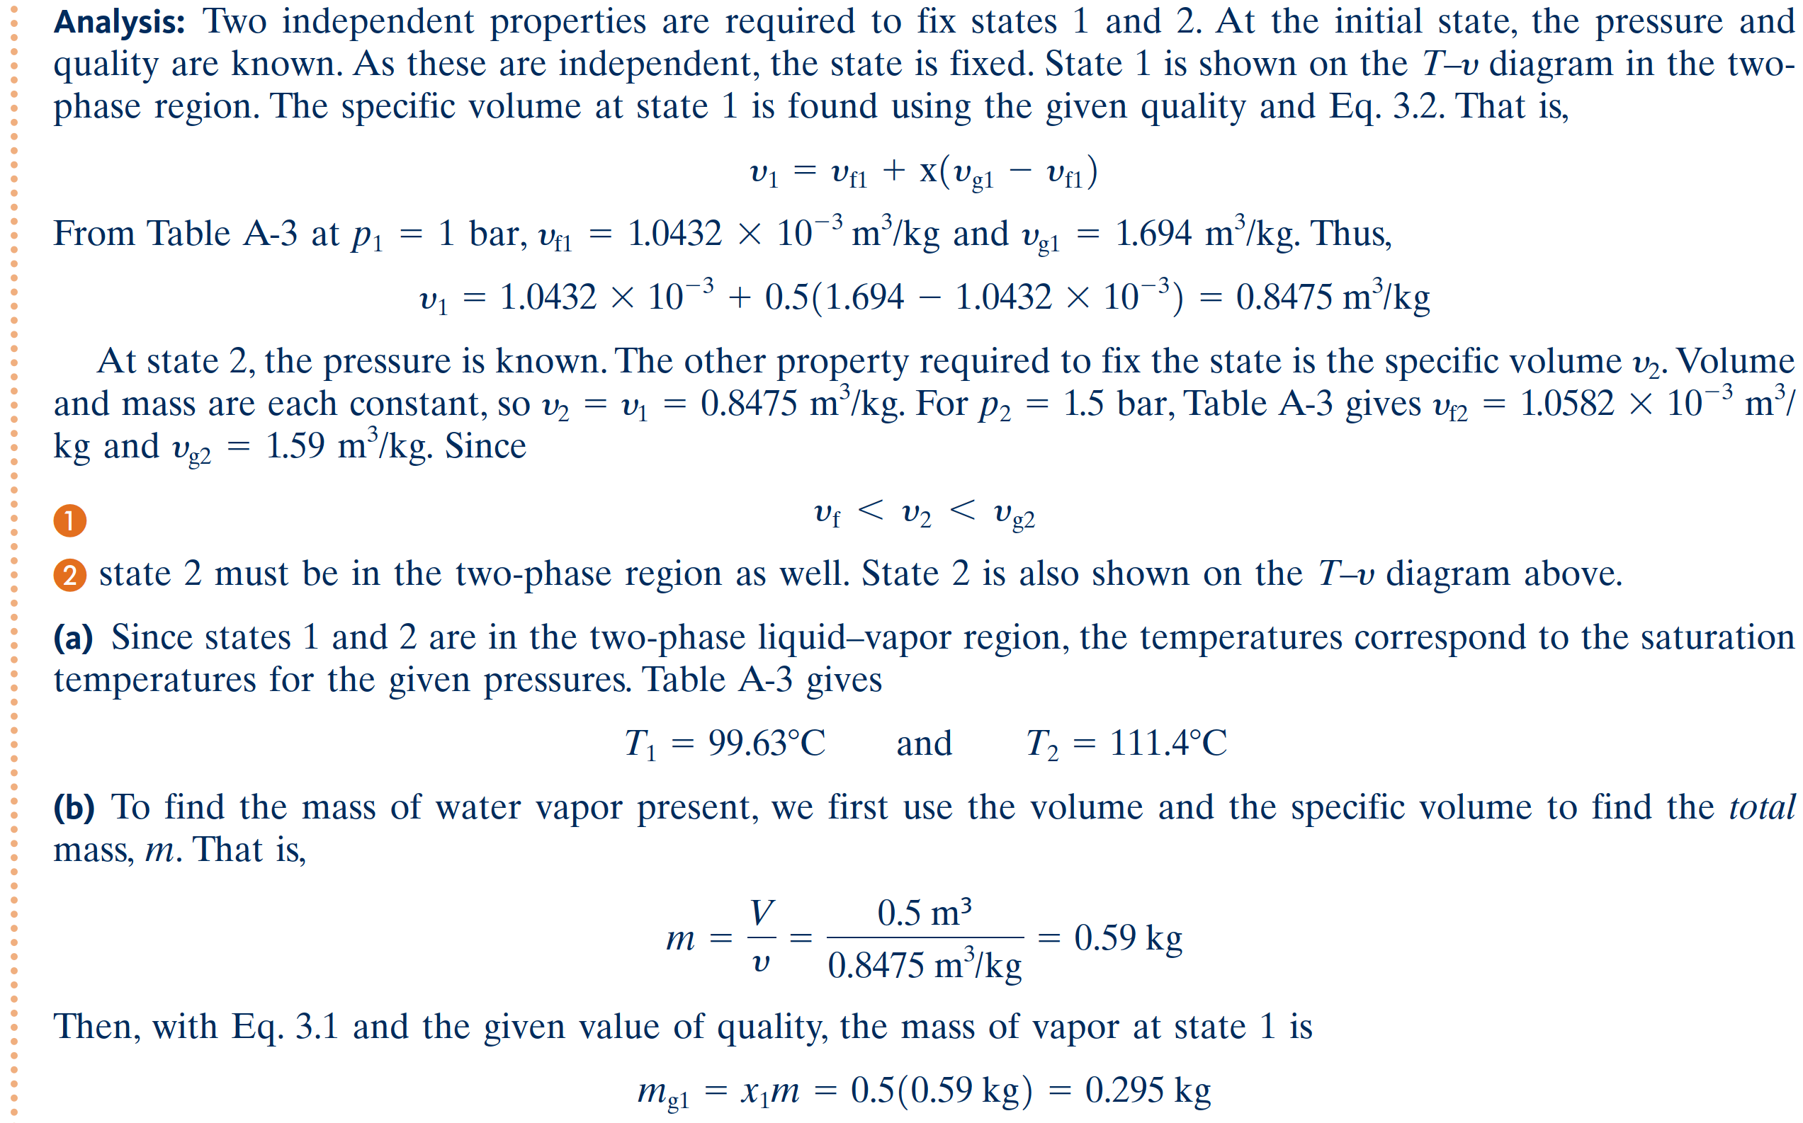

Slide 17
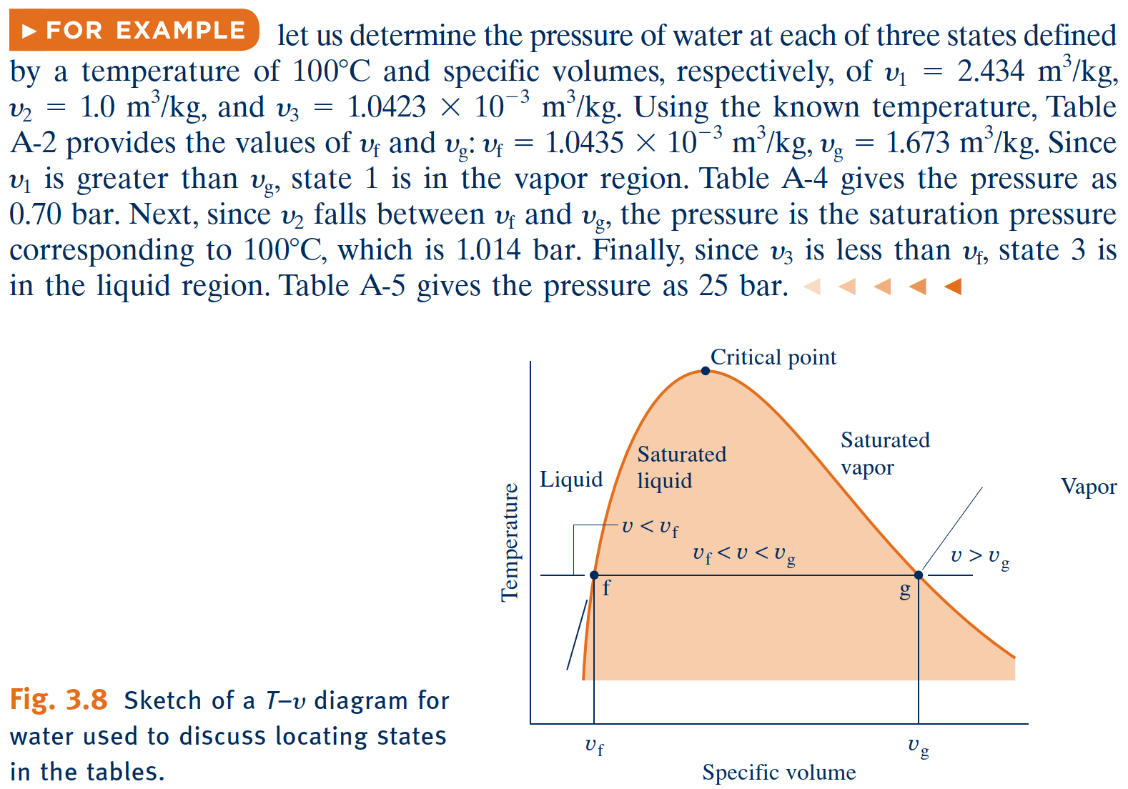
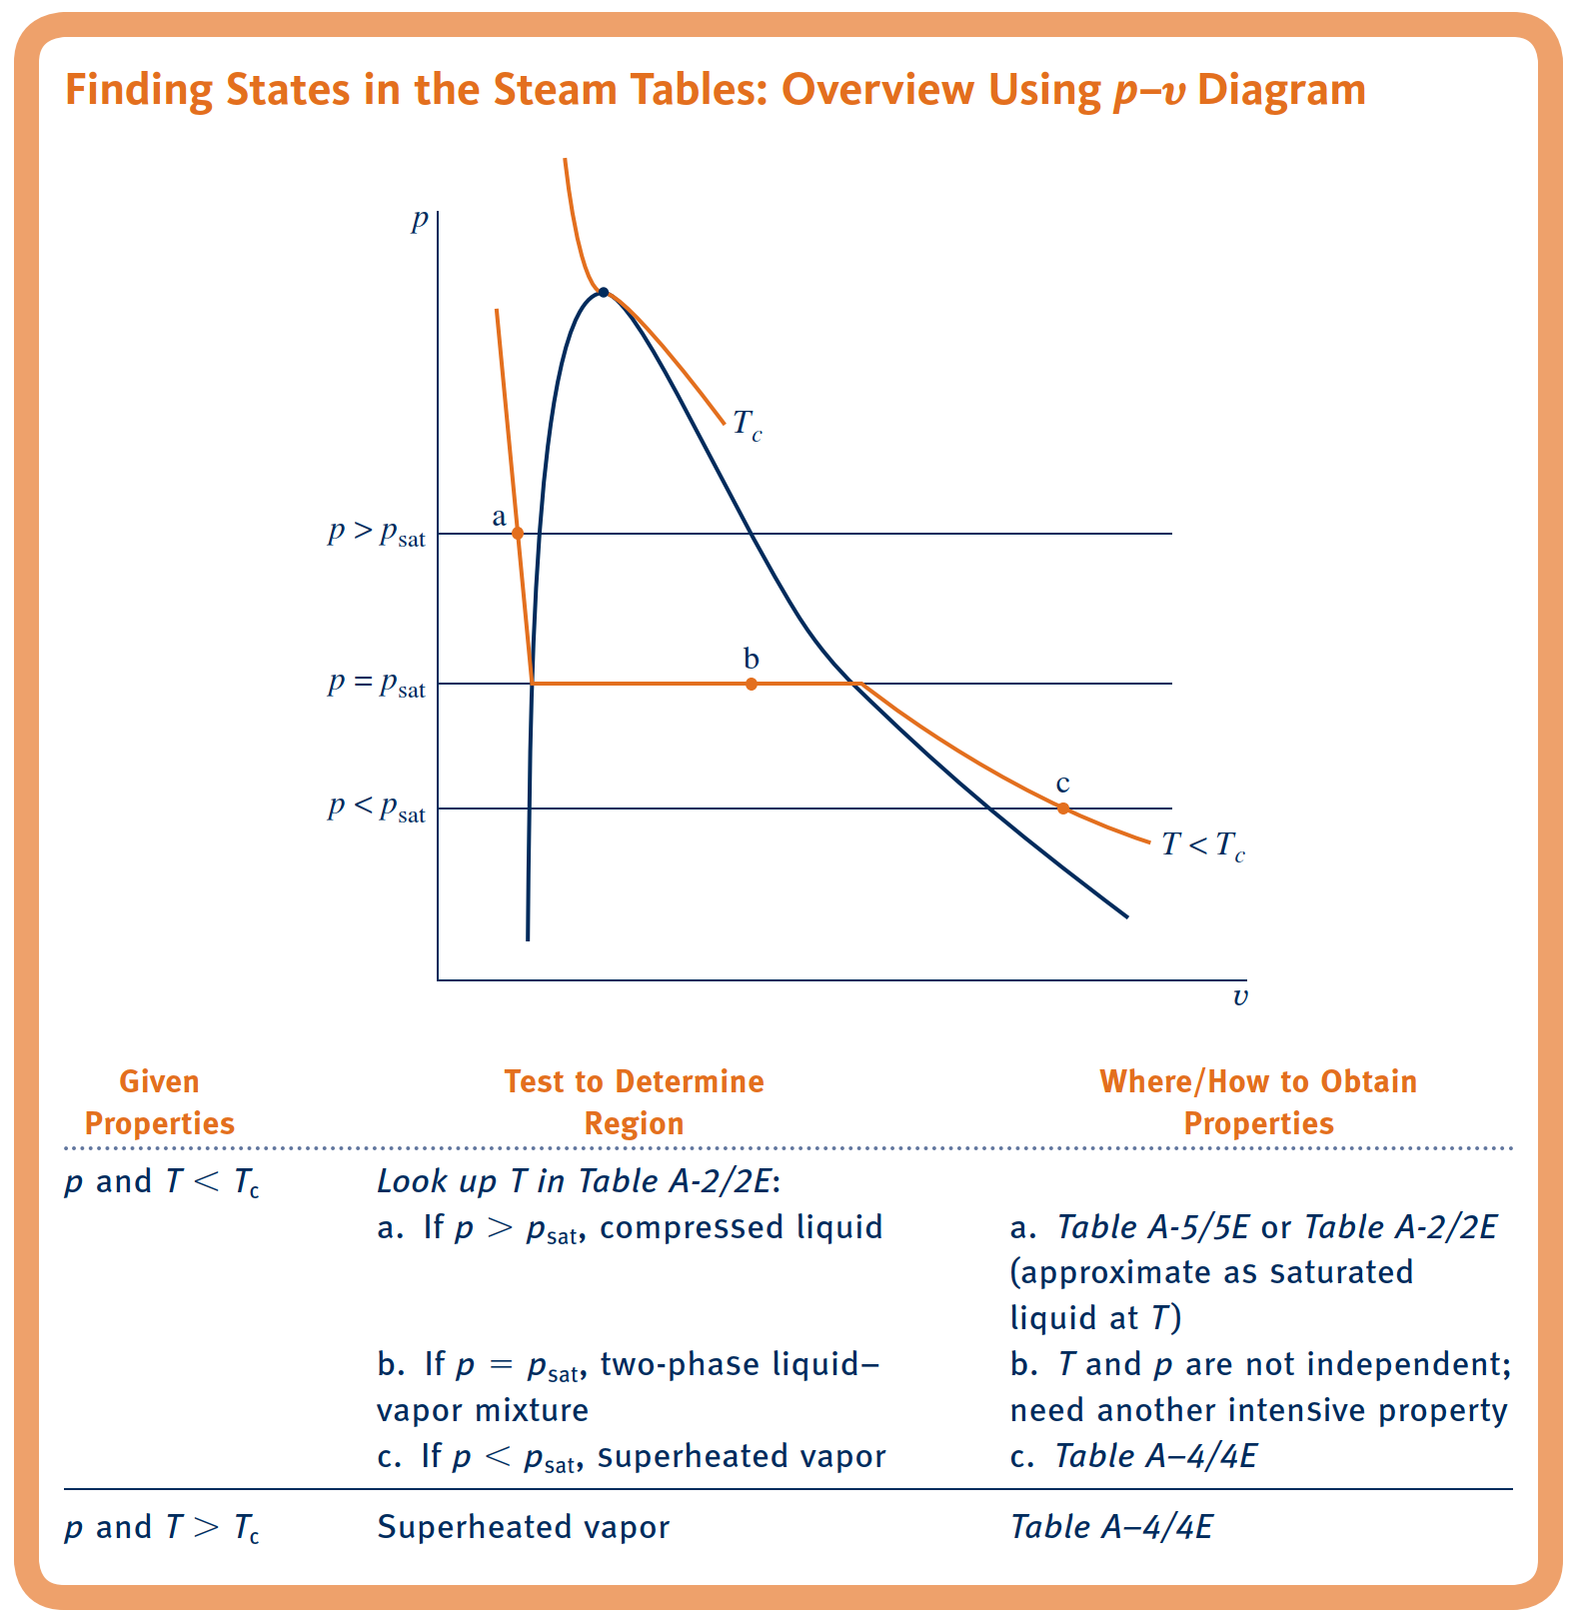
Saturation Tables
Tables A-2, A-3, and A-6 provide property data for water at saturated liquid, saturated vapor, and saturated solid states.
The specific volume of a two-phase liquid–vapor mixture can be determined by using the saturation tables and the definition of quality given by Eq. 3.1 as follows. The total volume of the mixture is the sum of the volumes of the liquid and vapor phases
Dividing by the total mass of the mixture, m, an average specific volume for the mixture is obtained

Slide 18
Evaluating Specific Internal Energy and Enthalpy
Enthalpy
Because the sum $U+pv$ occurs so frequently in subsequent discussions, it is convenient to give the combination a name, enthalpy, and a distinct symbol, $H$. By definition
Data for specific internal energy $u$ and enthalpy $h$ are retrieved from the property tables in the same way as for specific volume. For saturation states, the values of $u_{f}$ and $u_{g},$ as well as $h_{f}$ and $h_{g}$, are tabulated versus both saturation pressure and saturation temperature. The specific internal energy for a two-phase liquid–vapor mixture is calculated for a given quality in the same way the specific volume is calculated:
Similarly, the specific enthalpy for a two-phase liquid–vapor mixture is given in terms of the quality by

Slide 19
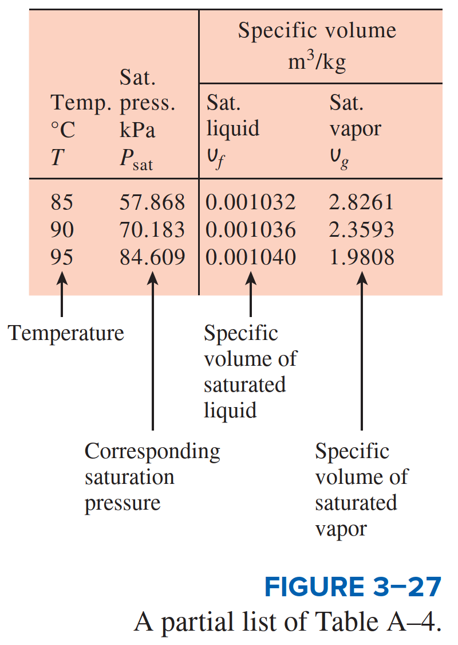
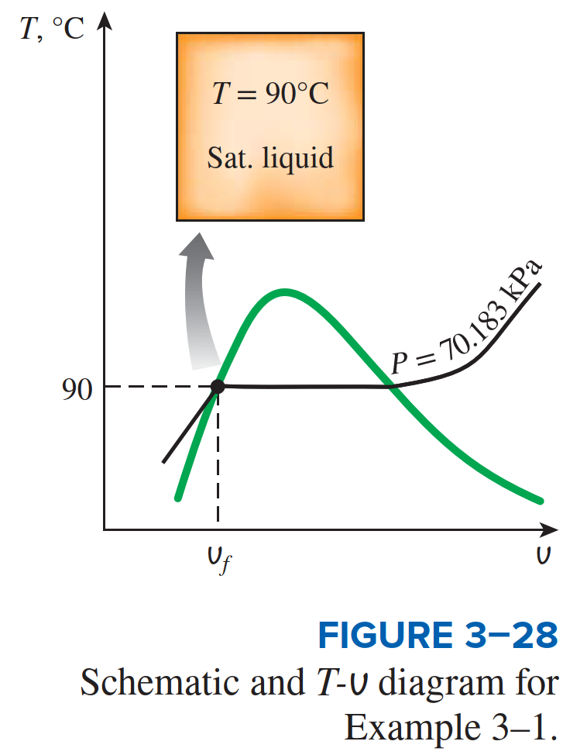
Evaluating Specific Internal Energy and Enthalpy

Slide 20
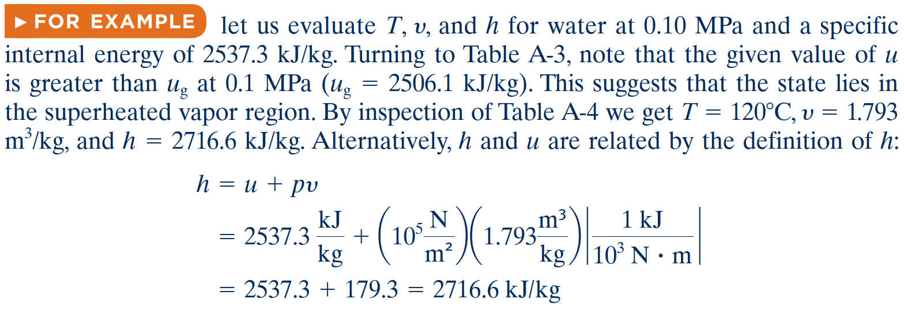
Evaluating Specific Internal Energy and Enthalpy

Slide 21
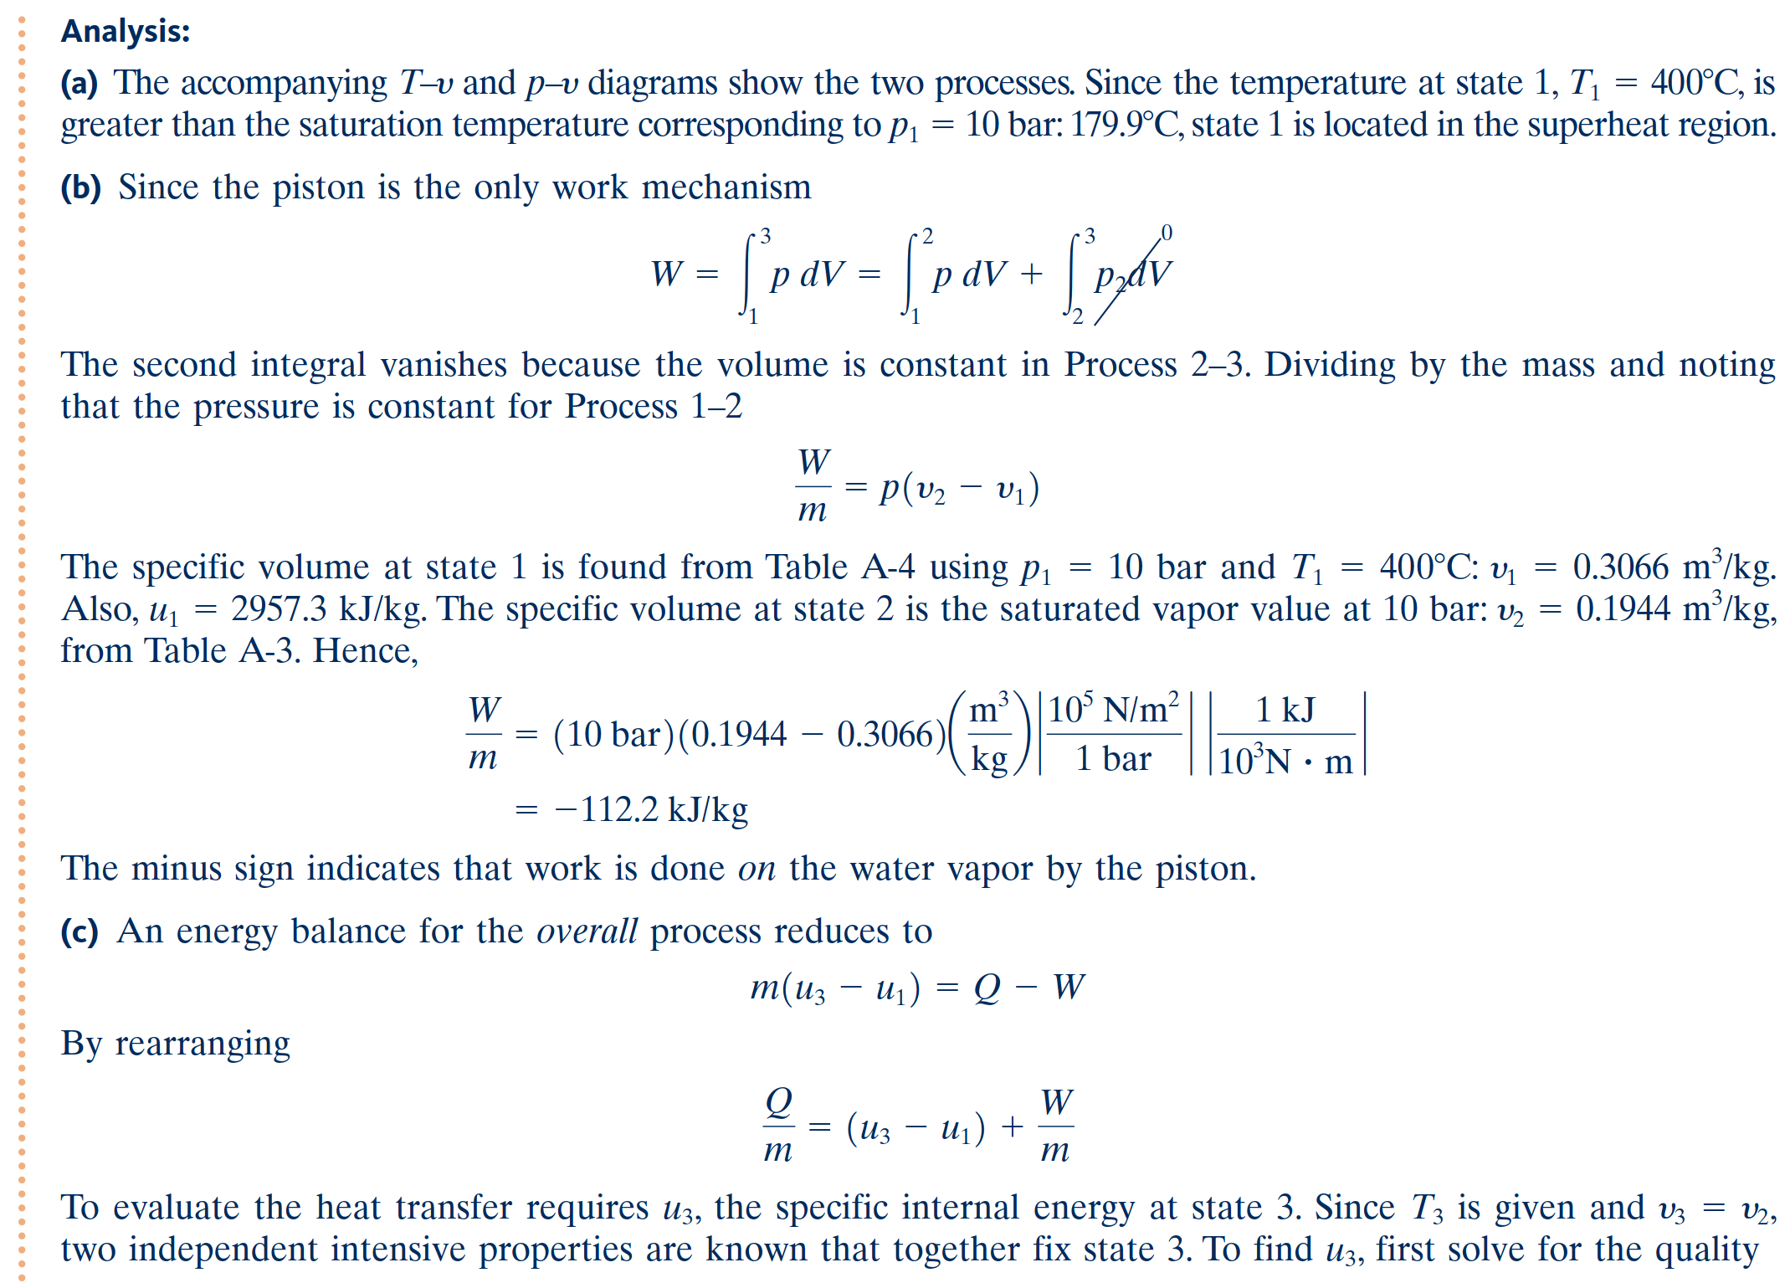

Slide 22
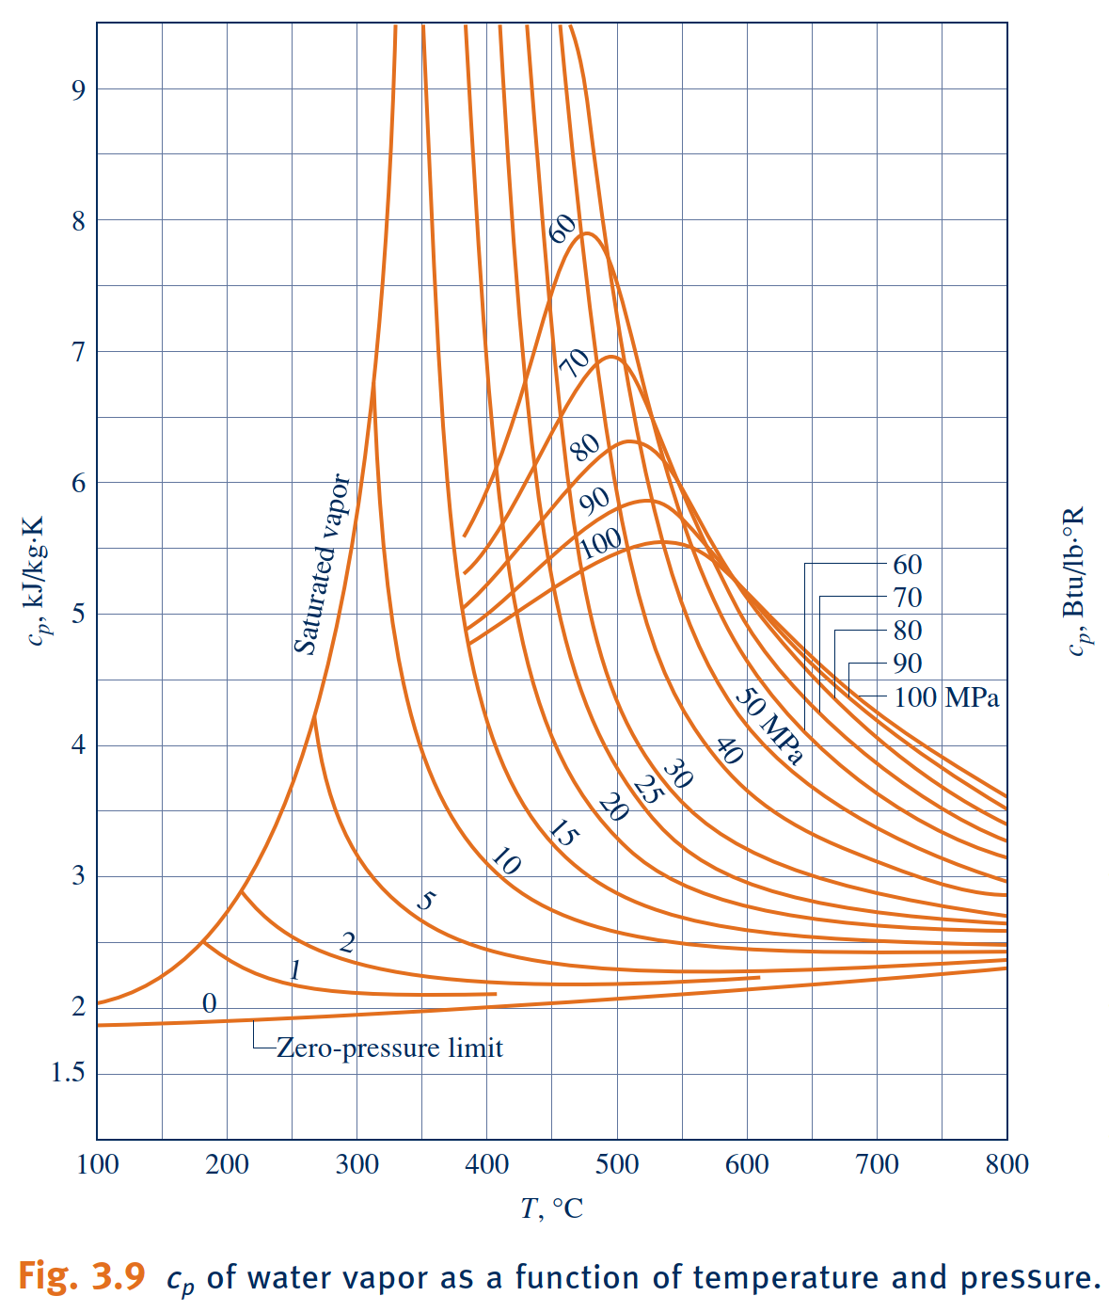
Introducing Specific Heats $c_{v}$and $c_{p}$
specific heats
The specific heats, denoted $c_{v}$and $c_{p}$, are particularly useful for thermodynamic calculations involving the ideal gas model
The intensive properties c and cp are defined for pure, simple compressible substances as partial derivatives of the functions $u\left(T,ν\right)$and $h\left(T,p\right)$, respectively,
specific heat ratio

Slide 23
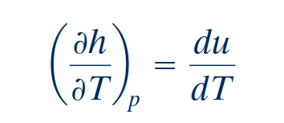
Incompressible Substance Model
Incompressible Substance Model
To simplify evaluations involving liquids or solids, the specific volume (density) is often assumed to be constant and the specific internal energy assumed to vary only with temperature. A substance idealized in this way is called incompressible.
If the specific heat $c$ is taken as constant,

Slide 25
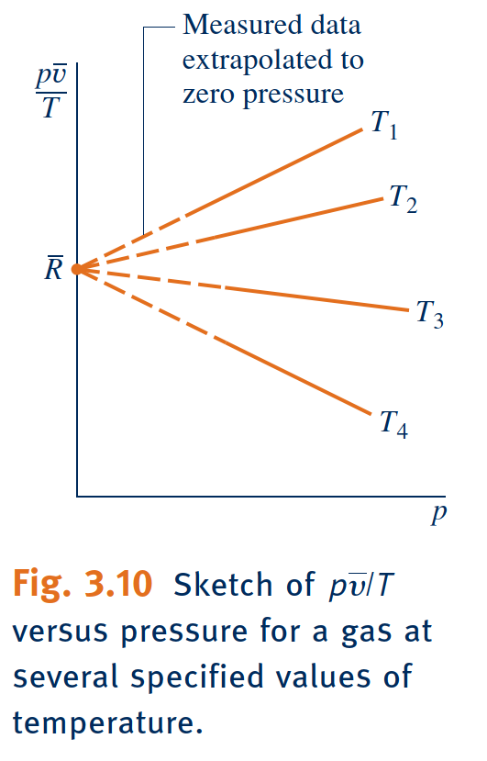
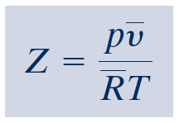
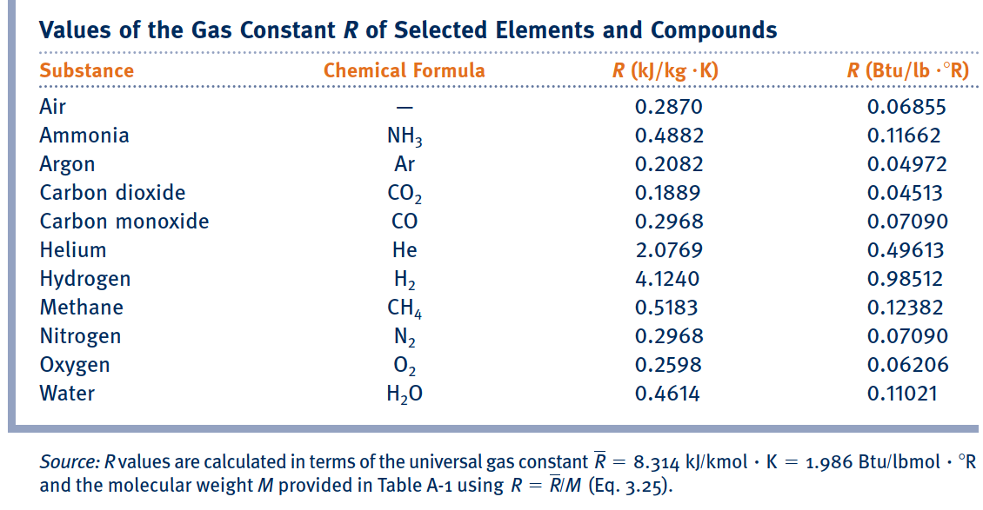
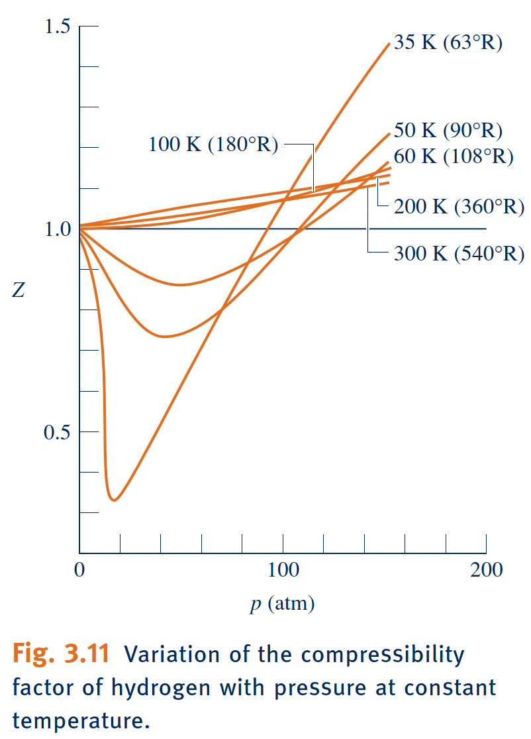
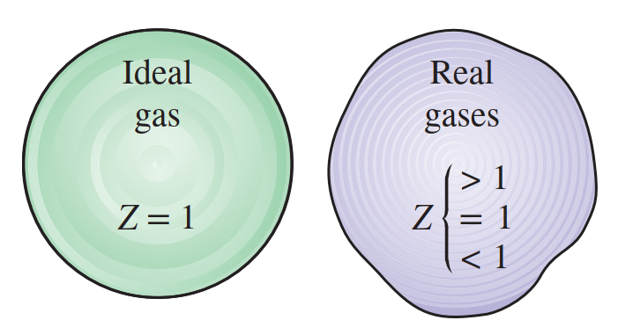
Generalized Compressibility Chart
Universal Gas Constant, $\overline{R}$
Compressibility Factor, Z

Slide 26
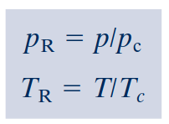
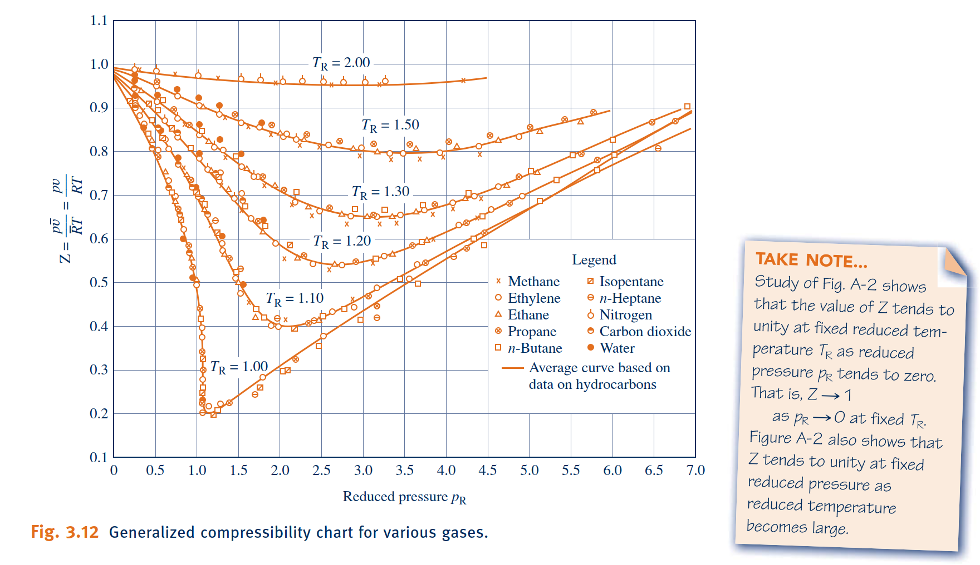
Generalized Compressibility Chart, Z Chart
reduced pressure
$p_{R}$ and reduced temperature $T_{R}$
where $p_{c}$ and $T_{c}$denote the critical pressure and temperature, respectively.
Values of specific volume are included on the generalized chart through the variable $ν_{R}^{′}$, called the pseudoreduced specific volume, defined by
pseudoreduced specific volume
The pseudoreduced specific volume gives a better correlation of the data than does the reduced specific volume $ν_{R}=\frac{\overline{ν}}{{\overline{v}}_{c}}$ , where ${\overline{v}}_{c}$ is the critical specific volume.

Slide 27
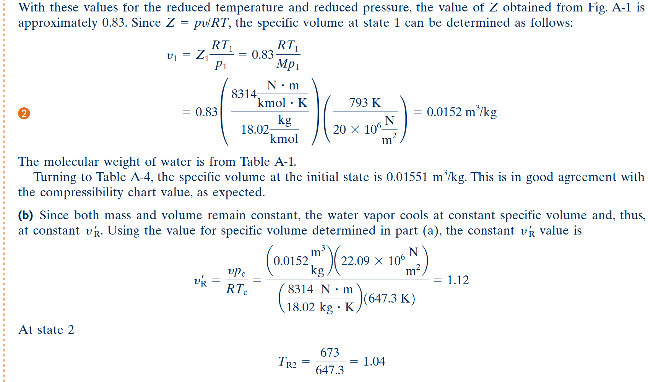

Slide 28
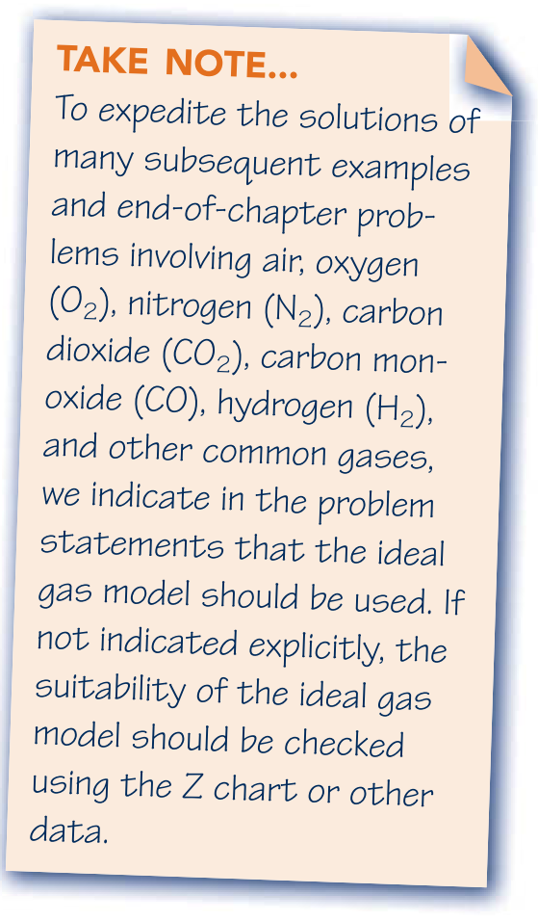
Evaluating Properties Using
the Ideal Gas Model
ideal gas equation of state
ideal gas model

Slide 29
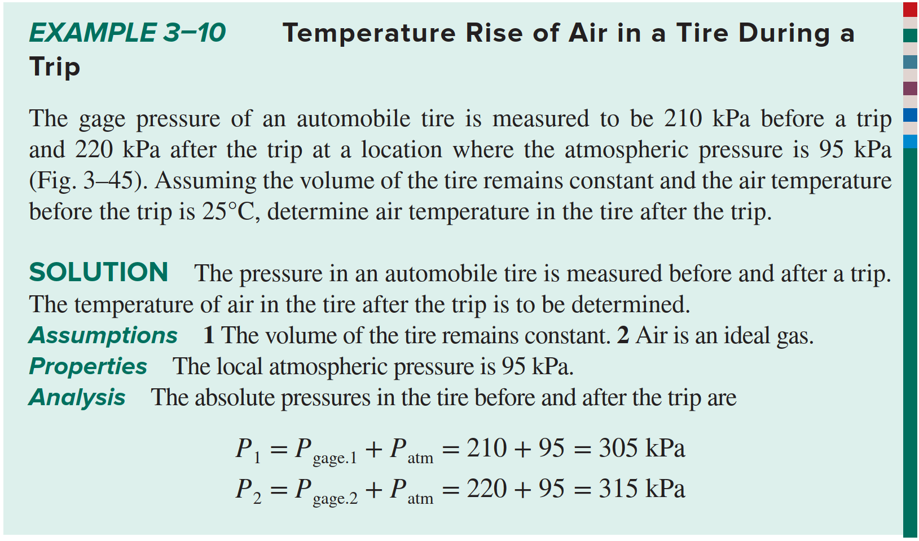
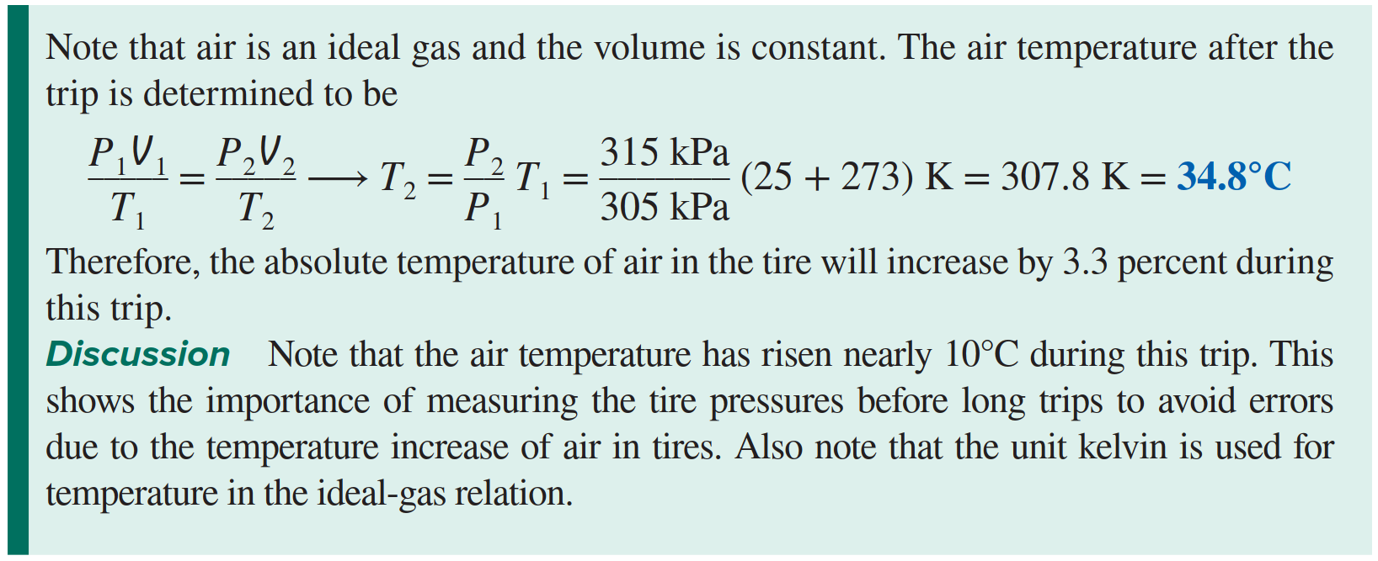

Slide 30
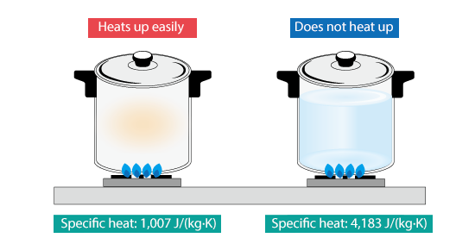
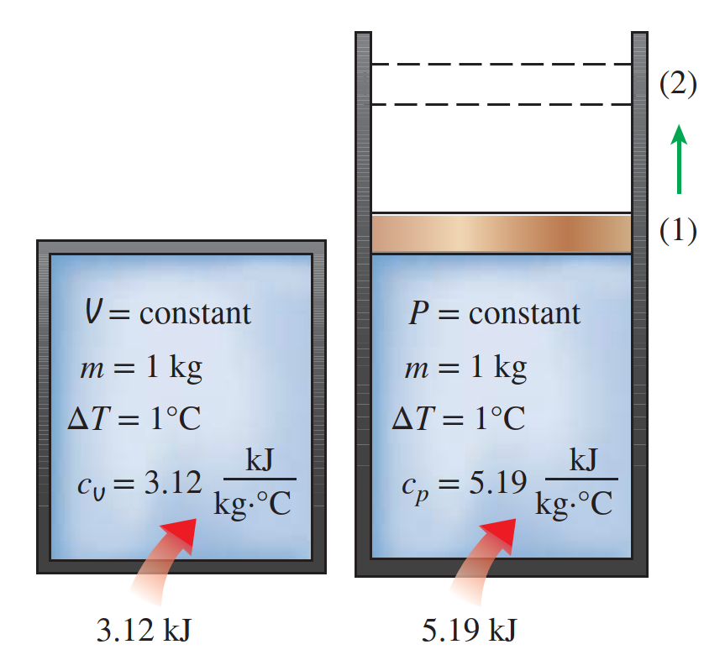
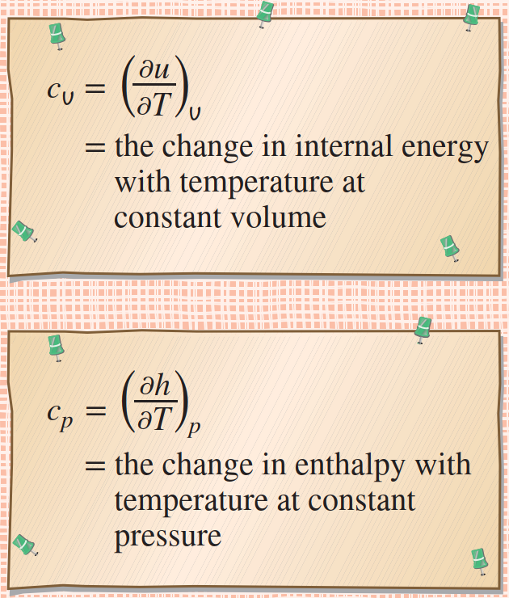
Internal Energy, Enthalpy, and Specific Heats of Ideal Gases
The specific heat is defined as the energy required to raise the temperature of a unit mass of a substance by one degree.
In thermodynamics, we are interested in two kinds of specific heats: specific heat at constant volume c_{v} and specific heat at constant pressure c_{p}.
the specific heat $c_{ν}$
For a gas obeying the ideal gas model, specific internal energy depends only on temperature.
specific heat $c_{p}$
Similarly, for a gas obeying the ideal gas model, the specific enthalpy depends only on temperature

Slide 31
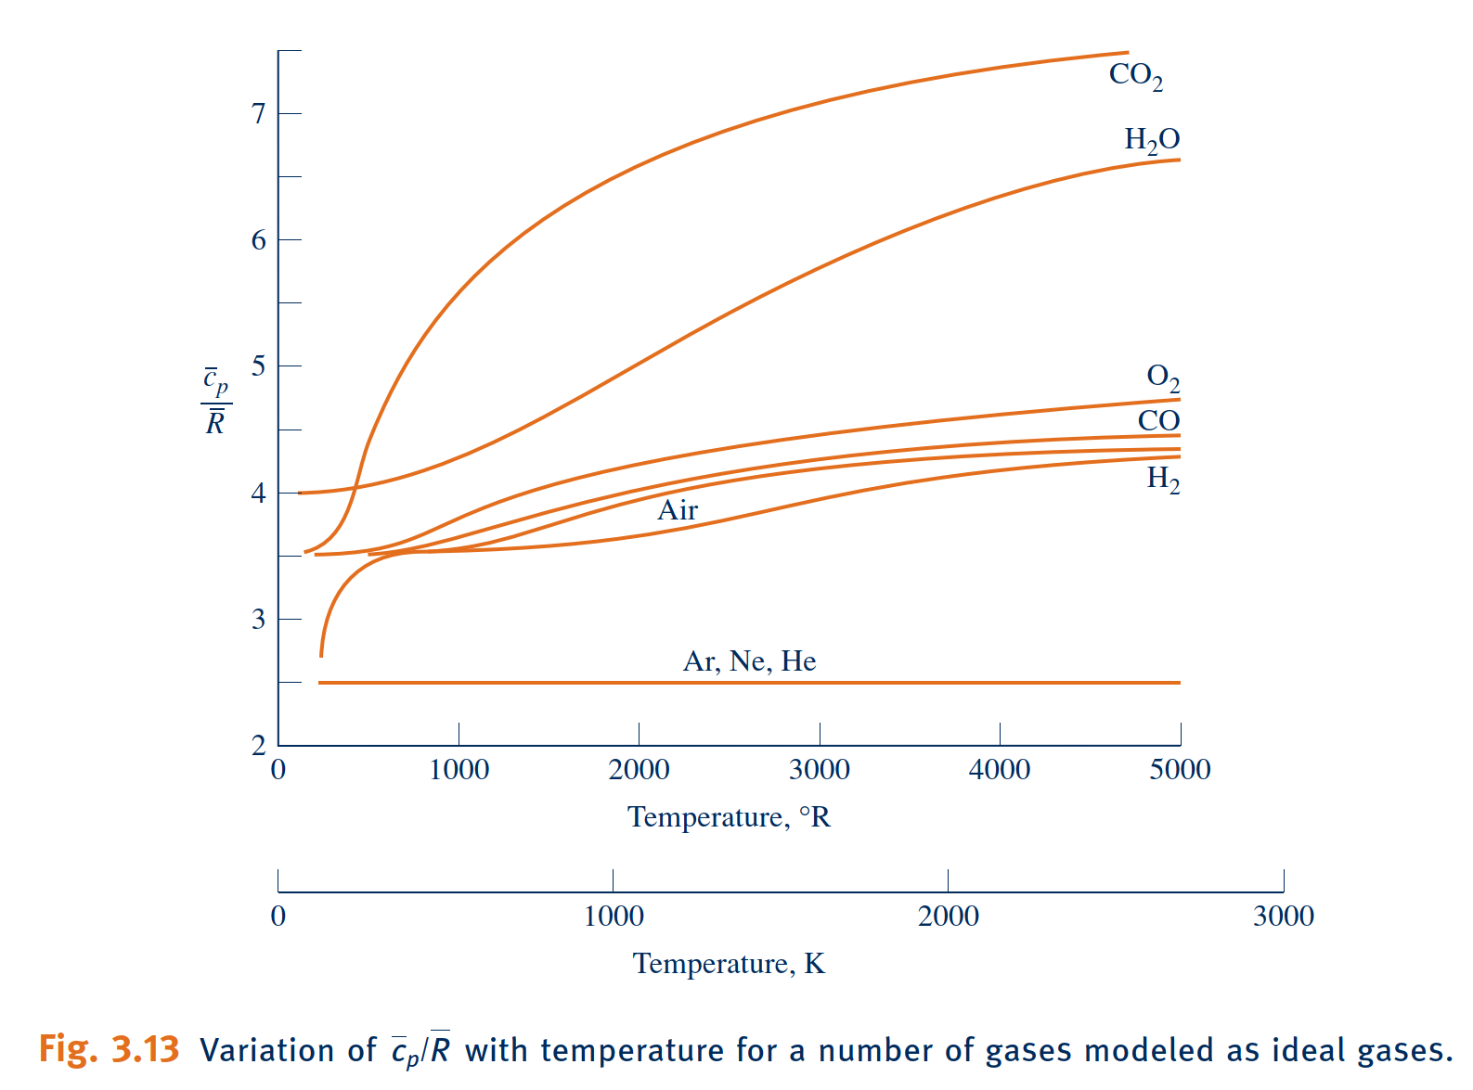
Internal Energy, Enthalpy, and Specific Heats of Ideal Gases
For an ideal gas, the specific heat ratio, $k$, is also a function of temperature only
the change in specific internal energy is
the change in specific enthalpy is

Slide 32
Applying the Energy Balance Using Ideal Gas Tables, Constant Specific Heats
For a number of common gases, evaluations of specific internal energy and enthalpy changes are facilitated by the use of the ideal gas tables, Tables A-22 and A-23, which give $u$ and $h$ (or $\overline{u}$ and $\overline{h}$) versus temperature.
To obtain enthalpy versus temperature,
Accordingly, a tabulation of enthalpy versus temperature is developed through the integral
When the specific heats are taken as constants,

Slide 33
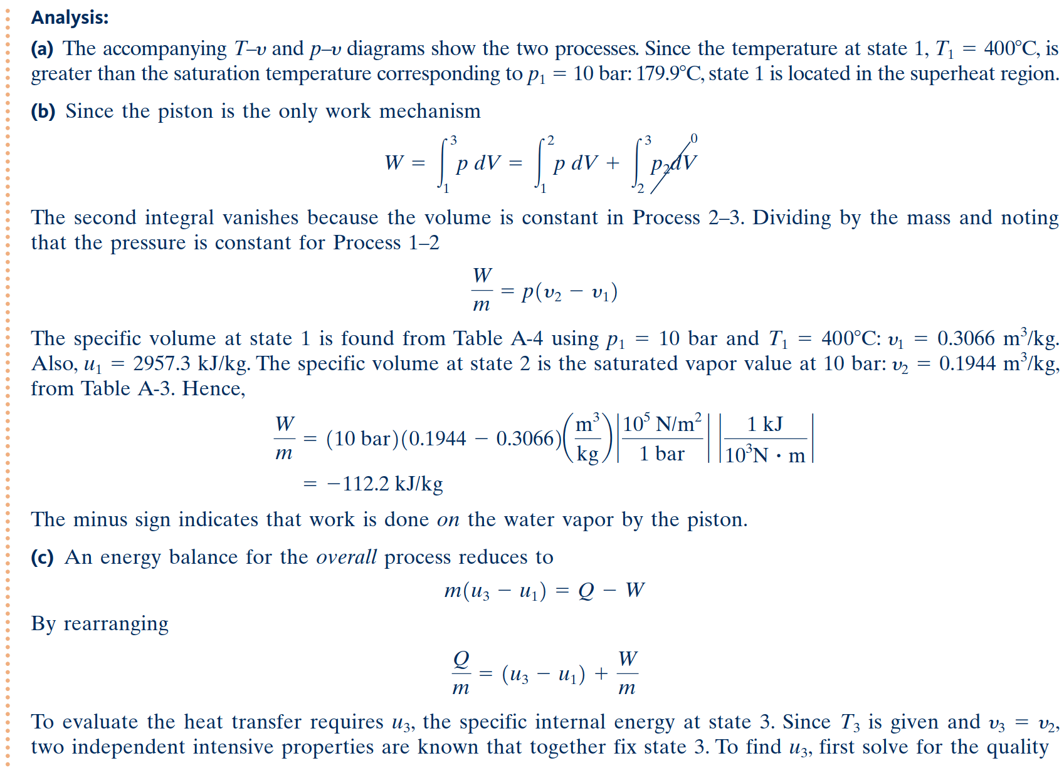

Slide 34
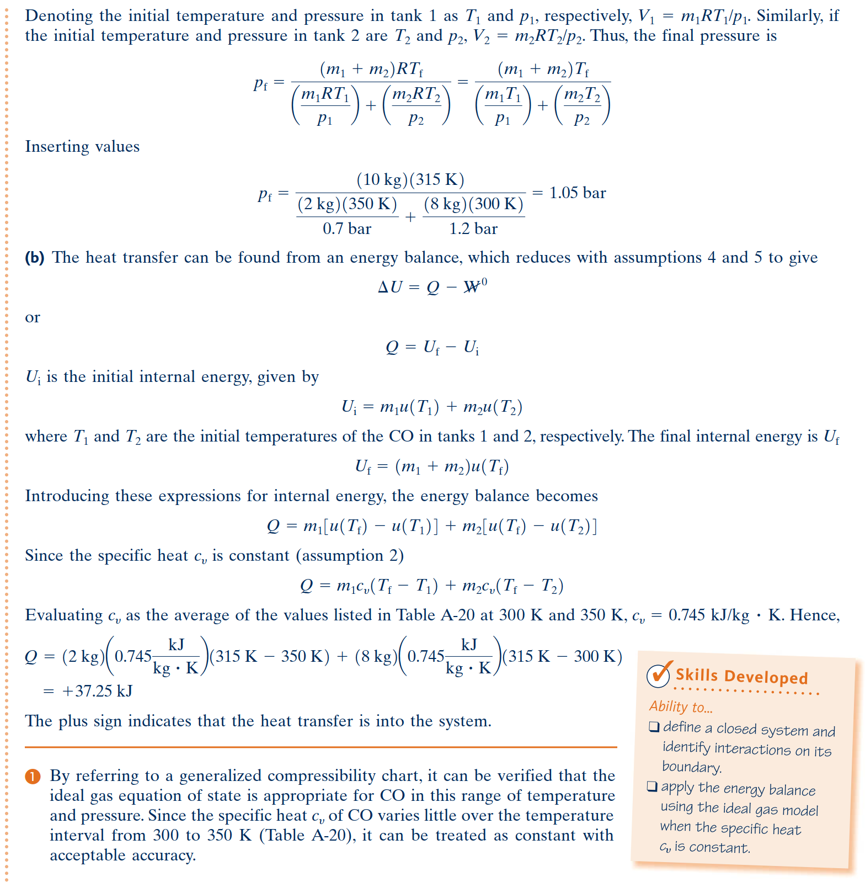

Slide 35
Polytropic Process Relations
polytropic process
For a polytropic process between two states
The exponent $n$ may take on any value from -$∞$ to +$∞$ depending on the particular process. When $n=0$, the process is an isobaric (constant-pressure) process, and when $n=±∞$ the process is an isometric (constant-volume) process.
For a polytropic process, for any exponent $n$ except $n=1$
When $n$=1,

Slide 36
