Slide 1
Observation
DOM-E5082
Dr April Tyack

Slide 2
Observation
A researcher observes a tester's play behaviour while taking notes
Ideally, a second researcher facilitates the session, and the observer is elsewhere (e.g., watching on a separate screen)
Pros
See how 'typical' players actually behave in the game
Can be done early in development
Can provide specific answers to some questions
Cons
Players are rarely as honest as you might like
Presence of observers can bias results
Behaviour requires interpretation
Can be time-consuming
Outliers may be misinterpreted as trends

Slide 7
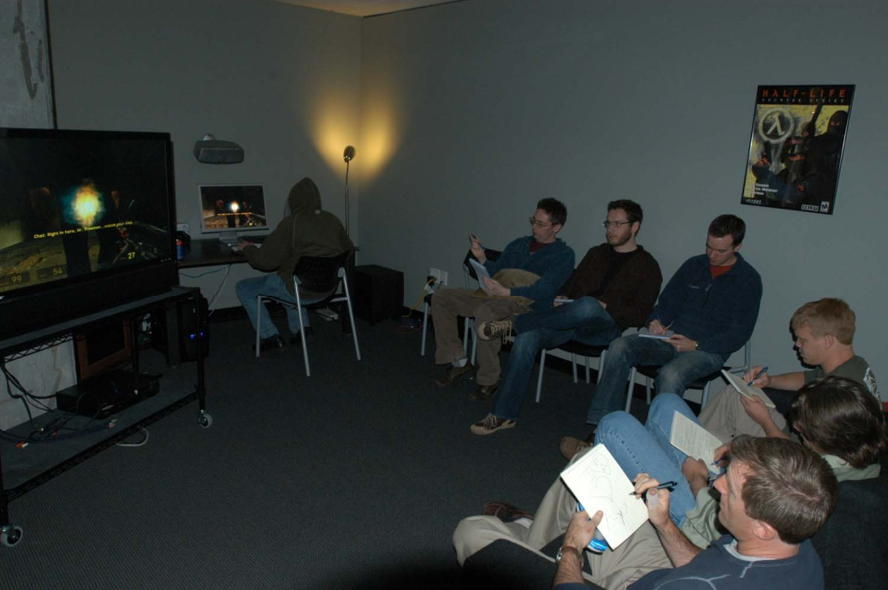

Slide 9
Roles
Moderator
The only person who talks to testers
Makes sure testers are comfortable
Provides necessary information before testing (and during play – only if testers are really stuck)

Slide 10
Moderation
All the setup (NDAs, consent forms, pre-test survey) should occur before testing
Always have a script
Introduce yourself, and anyone else involved in the test
Small talk; help testers relax in the unusual environment
Explain the game's basic premise (e.g., genre, any contextual info players would normally have)
Reminds testers of their expert status (not the developers)
Debriefs afterwards, answers any remaining questions

Slide 11
Observer
Observes the tester playing through the game
Takes detailed notes w.r.t. the design goal
Other topics are de-prioritised, but may be possible to fit in
'Observation' of:
In-game behaviours
Facial expressions
Exclamations / remarks
Emotional reactions
Surprising moments
May have a video record for later review (time-intensive)

Slide 12
Practice
Groups of 3: moderator, observer, tester
All: Select the game to be tested
Your own design, or something from itch.io
Discuss design goal(s)
Write a report of the aggregate findings (afterwards)
Moderator:
Prepare a script
Observer:
Set up note-taking materials
Rotate between each role

