Slide 1
Interactive lecture of AI at Aalto
March 26th 2019 Petri Malmelin

Slide 2
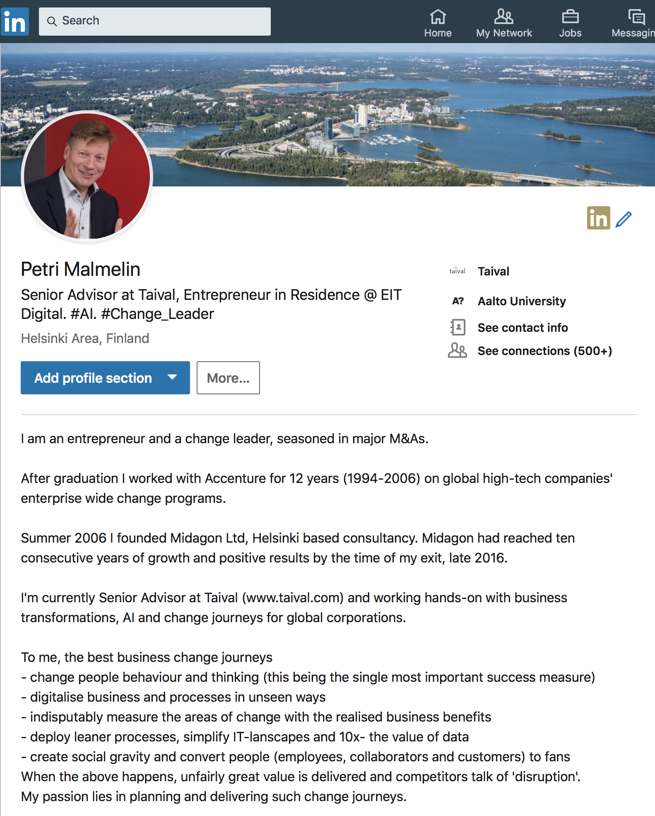

Slide 3
Definition of AI?

Slide 4
… so what would be the y = f(x) function here?
Data
input
Output(s)
2
1
5
8
11
0
Black Box
4
2
10
16
22
0

Slide 5
This can be easily modeled with traditional programming – no need for AI.
Data
input
Output(s)
2
1
5
8
11
0
Black Box
4
2
10
16
22
0

Slide 6
How many chromosomes does a human have?
How many genes does a human have?
23 pairs
20.000

Slide 7
Imagine: A sample of 1000 people to capture a full ‘genome data’ (INPUT = 1000 x 20.000 genes) A 3D scan of the face of each person is captured (OUTPUT = 1000 x 3D face model)
Training: Teach the AI black box by giving the genome of each person as input (red arrows) and the corresponding 3D face model as the output (green arrows). Note: vast majority of the input data is noise (as opposed to the previous example)
What could you get?

Slide 8
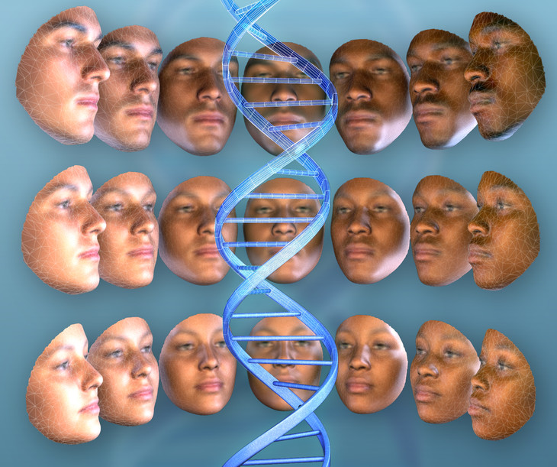
Learning phase …
Black Box
Source: Discover Magazine

Slide 9
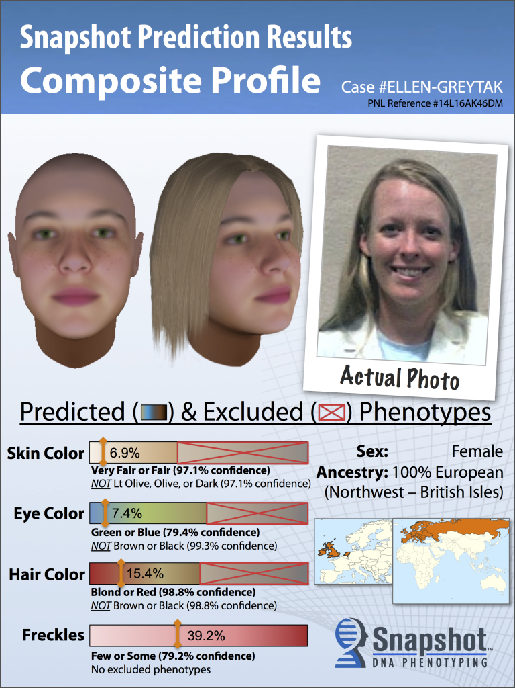
… and ready application …
Black Box
Source: Discover Magazine

Slide 10
AI in business

Slide 11
Business environment – simple or complex?

Slide 12
Three Steps to Data ecosystem?

Slide 13
Three steps to Data Ecosystem
Step 1 – one company transforms to truly data driven enterprise
Mention examples world known data driven companies
Single Enterprise

Slide 14
Three steps to Data Ecosystem
Step 1 – one company transforms to data driven
What does it take to become data driven?
Single Enterprise

Slide 15
Three steps to Data Ecosystem
Step 1 – one company transforms to data driven
HOW?
Single Enterprise

Slide 16
Three steps to Data Ecosystem
Step 2 – two or more organizations form a Data Club
Single Enterprise
Data Club
Think in teams wild ideas of data clubs: what organizations would benefit of each other’s data?

Slide 17
Three steps to Data Ecosystem
Step 2 – two or more organizations form a Data Club
Single Enterprise
Data Club
What practical challenges Data Clubs are likely to face?

Slide 18
Three steps to Data Ecosystem
Step 3 – ecosystem of Data Clubs – unseen competitive advantage
Single Enterprise
Data Club
Data Club Ecosystem

Slide 19
Three steps to Data Ecosystem
Step 3 – ecosystem of Data Clubs – unseen competitive advantage
Single Enterprise
Data Club
Data Club Ecosystem
What would this enable? What competitive advantages?

Slide 20
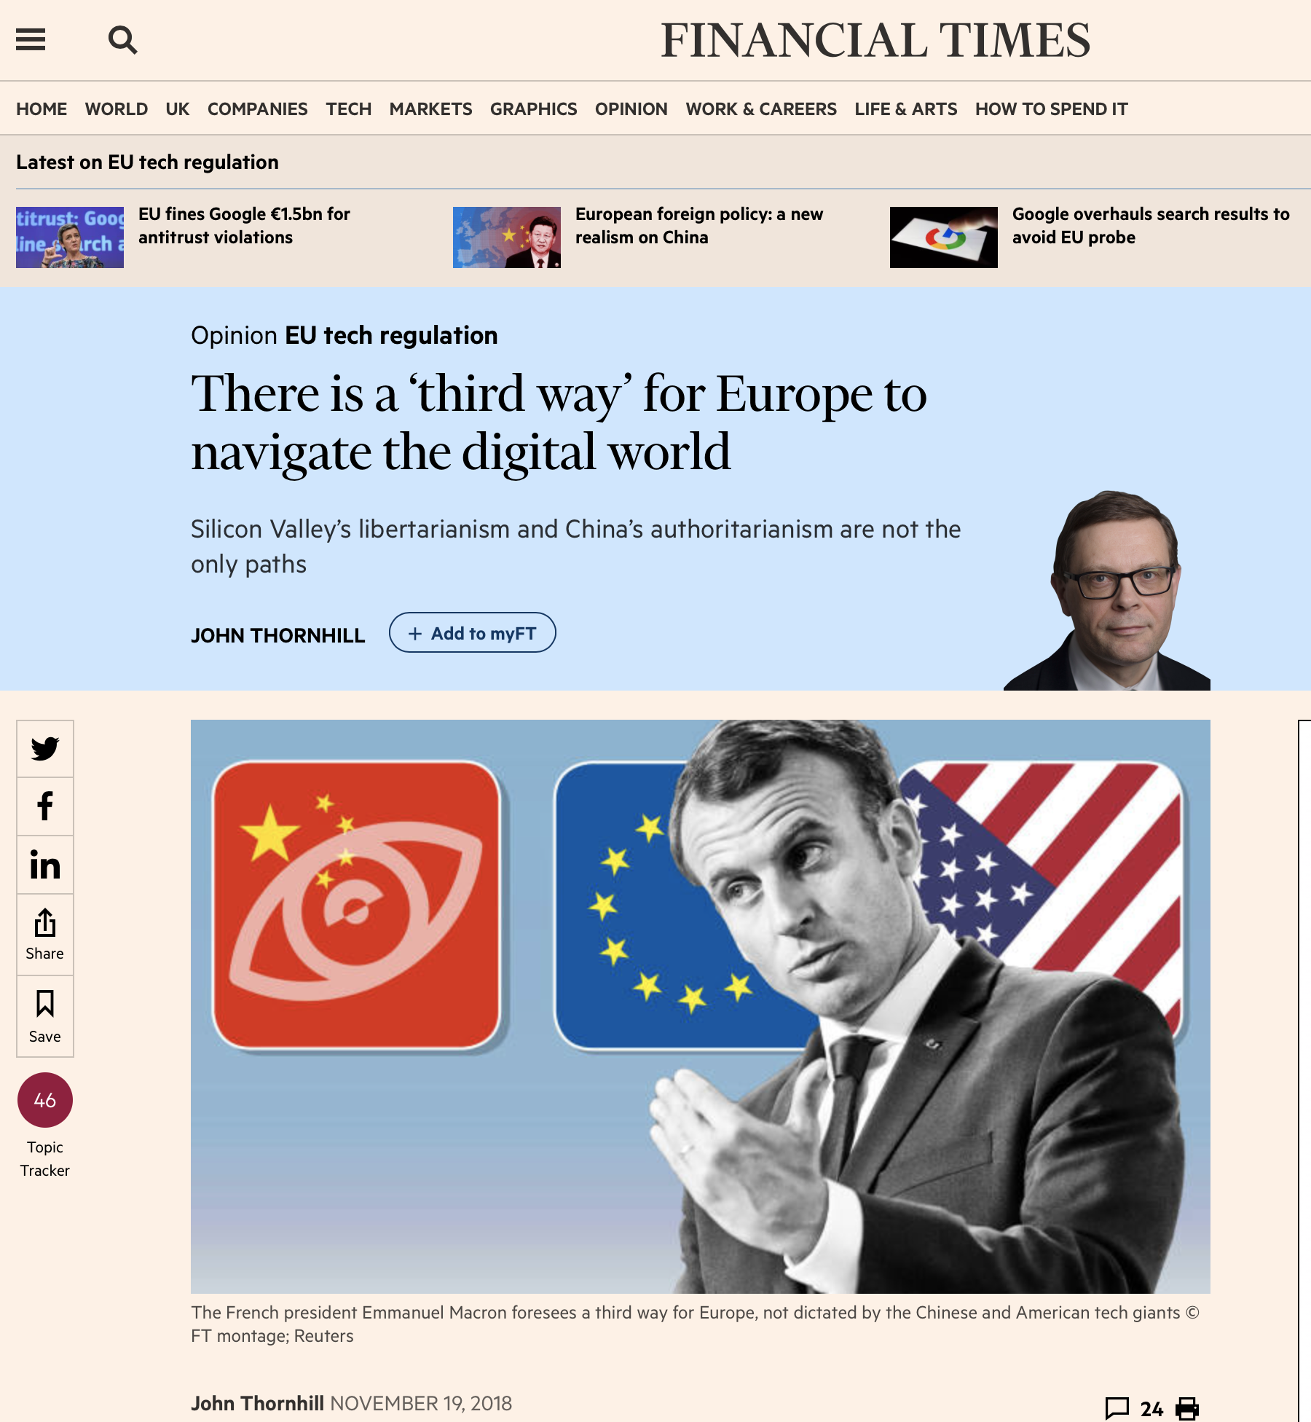

Slide 21
Send me LinkedIn connection. Thank You!

