Slide 1
Markkinoiden juridinen toimintaympäristö Kalvot 3a
Remburssi
Matti Rudanko

Slide 2
Specification of Price, ICC Model International Sale Contract
“Art 4 Price
4.1 If no price has been agreed, the Seller's current list price at the time of the conclusion of the Contract shall apply. In the absence of such a current list price, the price generally charged for such goods at the time of the conclusion of the Contract shall apply.
4.2 Unless otherwise agreed in writing, the price does not include VAT, and is not subject to price adjustment.
4.3 The price indicated under A-2 (contract price) includes any costs which are at the Seller's charge according to this Contract However, should the Seller bear any costs which, according to this Contract, are for the Buyer's account (e.g. for transportation or insurance under EXW or FCA), such sums shall not be considered as having been included in the price under A-2 and shall be reimbursed by the Buyer.”

Slide 3
Payment and Other Risks
ICC A-7 and A-8, B-5
risks:
Credit risk
Financing risk
Country specific risk
Payment risks
Delay
Banking
Currency
Mode of payment

Slide 4
Price Systems and Control of Payment Risks
Price systems
Fixed /
floating price
unit price
cost plus fixed fee
target price
Management of payment risks
Terms of payment
Mode of payment
Place and time of payment
Delay and sanctions for it
Payment systems
E.g.cheque, payment order, letter of credit
Security (collateral) systems
E.g. bank guarantee, credit insurance

Slide 5
Maksuehdot riskienhallinnassa
Art. 6 Interest in case of delayed payment
6.1 If a party does not pay a sum of money when it falls due the other party is entitled to interest upon that sum from the time when payment is due to the time of payment.
6.2 Unless otherwise agreed, the rate of interest shall be 2% above the average bank short-term lending rate to prime borrowers prevailing for the currency of payment at the place of payment,
or where no such rate exists at that place, then the same rate in the State of the currency of payment.
In the absence of such a rate at either place the rate of interest shall be the appropriate rate fixed by the law of the State of the currency of payment.

Slide 6
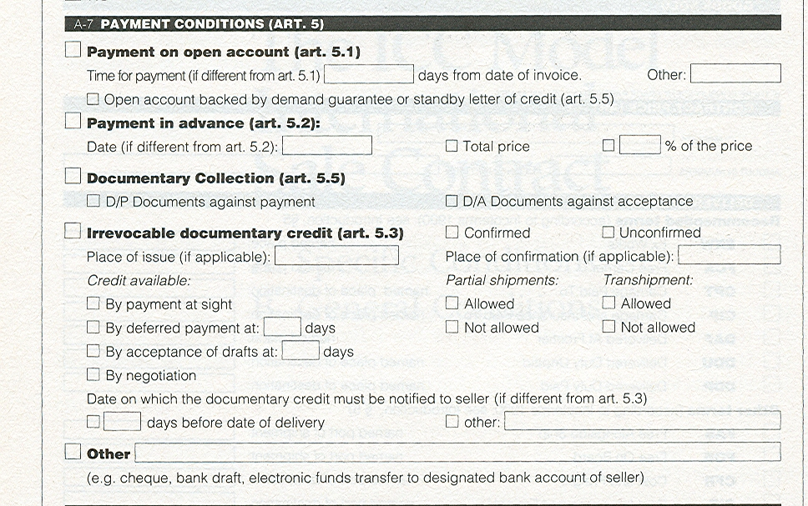
Payment Systems

Slide 7
Documentary Credit (Letter of Credit) I
sales
1. Instruction
2 Opening
3 Notification
4. Delivery of the Goods
5. Presentation of Documents by Seller
6. Control and forwarding of documents; payment
7. Control and surrender of documents; payment
Buyer
Seller
4.
1.
7.
3.
5.
2.
Bank of
buyer
Bank of
seller
Issuing bank
6.
Advising bank
See two transparencies

Slide 8
Documentary Credit II
Buyer
Seller
1. Irrevocable
- the rule; a commitment by the issuing bank
- revocable: can be revoked till the seller has presented the documents
2. Confirmed
- a commitment by the advising bank
Bank of
buyer
Bank of
seller
1. Irrevocability
2. Confirming

Slide 9
Documentary Credits for imports (Nordea) (http://www.nordea.com/Images/33-27594/2014_TP_TF_FACTSHEET_For_Importers_2010_DC_Import_web.pdf )
First you agree with the seller on the terms of the contract (1), in this case that settlement will be made under a DC payable in connection to shipment.
You then apply for the DC to Nordea (2) who issue the DC and send it to the Advising Bank (3). The Advising Bank advises the DC to the seller (4).
The seller now delivers the goods (5) and presents the documentation (6).
The Advising Bank sends the documents to Nordea (7) who releases them to you against payment (8-9).
Finally, Nordea will remit payment to the Advising Bank (10) which will pay the seller (11) in accordance with the structure of the DC.
The banks involved will handle the DC subject to the “Uniform Customs and Practice for Documentary Credits” published by the International Chamber of Commerce (ICC).

Slide 10
The Abstract Nature (autonomy)
B4 has opened an irrevocable confirmed at sight documentary credit in favor of S4.
Can B4 prevent his bank from paying the documentary credit for the poor quality of the cheese?
If not, B4 loses the right to retain own performance
B4 cannot prevent the bank from paying:
the documentary credit is an agreement that is separate from the trade transaction
only the documents and not the object of the sales transaction are concerned

Slide 11
Strict Compliance
B2 has opened an irrevocable documentary credit in favor of S2. The bank paid S2 although the lot of goods was damaged for the flaws in packages.
B2 could not have referred to the liability of the bank unless …
… the documents required provided for a “certificate issued by authorized inspectors” (notice the plurals) on the quality of the goods and
the certificate presented to the bank was signed by only one inspector (!)

Slide 12
Causes of Denying Payment
Related to the documentary credit itself
lacking documents
excess of credit limit or credit time
related to the bill of lading
unclean bill of lading
reference to deck cargo (that is not expressly allowed)
no mention of freight paid by the exporter (if required)
related to the insurance
insurance coverage different from that required by the documentary credit
conflicts between documents

Slide 13
Risk Management by the Documentary Credit
ICC Documentary Credit Rules
the bank checks also the compliance of the documents with the commission (sales)
risk management
delivery risks
credit risks:
irrevocable - revocable
unconfirmed - confirmed

Slide 14
Risk Management by the Documentary Credit
Risks
Country specific risks
Mode of payment risks
Banking risks
Seller
Credit risk
Documentary credit types (incl. stand-by)
Conditions of trade
See ICC A-7, A-8, B-5
Currency risk
Conditions of trade
(Payment) delay risk
Conditions of trade
Buyer
Credit risk
Financing risk
Delivery risks

Slide 15
Negotiating a Documentary Credit
1. S and B make a list of the documents required
2. The list is incorporated into the contract
3. In opening the documentary credit B presents the list to the bank
4. S checks the documentary credit and the list
5. S checks the documents and hands them to the bank

Slide 16
Remburssiasiakirja (ks. myös erillinen kalvo)

Slide 17
Pivotal Points of a Documentary Credit 1
irrevocable / revocable
date and place of expiry of the credit
cf. Transport Information: loading on board at: not later than: for transportation to:
documents to be presented within __ days after the issuance of the documents - -
beneficiary and transferability
confirmation; notice Costs
partial shipments / transshipments allowed

Slide 18
Pivotal Points of a Documentary Credit 2
Description of goods documents
invoice (issued by the beneficiary, advances indicated as reductions)
transport documents
insurance documents (e.g. in CIF)
others: e.g. Certificate of origin, packing list etc.

Slide 19
Pivotal Points of a Documentary Credit 3
Availability of the documentary credit
by sight payment: payment against documents when the conditions of the documentary credit are fulfilled
by deferred payment: due date, e.g. 30 days from shipment / presenting the documents
by acceptance: the bank commits itself e.g. as assigner or guarantor to pay a bill of exchange drawn by S, as a rule to be paid by B
S is paid on due date or before it by discounting the bill
by negotiation (not common): discounting is the only possibility

Slide 20
Vekseli
VEKSELI
Asettamisaika ja -paikka
Maksuaika ja -paikka
Asettaja M (myyjä)
Maksava O (ostaja) / pankki
Vekselin määrä € kymmenentuhatta (10.000)
Maksakaa tästä vekselistä kenelle ___minä__ määrää(n) yllämainittu määrä eräpäivänä .
Hyväksytään (maksava) O / PANKKI
Asettajan allekirjoitus M

Slide 21
Vekseli 2
Vekseli on perusmuodossaan maksukehotus (asete)
Esim. M kehottaa O:ta tai pankkia maksamaan A:lle
Maksavan velvollisuus syntyy vasta allekirjoituksella
ei velvollisuus; esitetään hyväksyttäväksi määräajassa
Allekirjoittamalla maksavasta tulee hyväksyjä
Asettaja, hyväksyjä ja kaikki joiden allekirjoitus on vekselissä, ovat vekselivelallisia: ankara ja muodollinen maksuvelvollisuus
Vekselin siirto:
Siirtäjän allekirjoitus:
vastuu myös hänelle
(vekselin kääntöpuoli)
Siirretään
M (allekirjoitus)
Siirretään
N N
Sopimus- ja arkkinointiuridiikka 4

Slide 22
Remburssin tyyppejä (Sisula-Tulokas: Ulkomaankauppaoikeus 1998)

Slide 23
Remburssitermejä 1 (Sisula-Tulokas 1998, liite 6)

Slide 24
Remburssitermejä 2

Slide 25
Remburssitermejä 3

