Slide 1
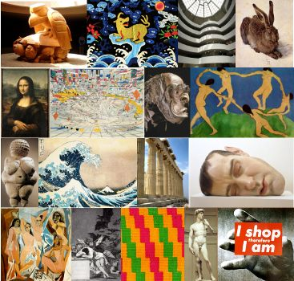
On Arthur Danto’s Philosophy of Art
Petteri Enroth, M.A. (petteri.j.enroth@gmail.com)

Slide 2
The Transfiguration of the Commonplace (1981)
On the definition of art; implications for art history, interpretation and criticism
After the End of Art (1997)
Art as 1) historical 2) progress has ended, it has no discernible direction; age of pluralism, where “one direction is as good as another”
The Abuse of Beauty (2003)
On beauty in contemporary art; why it was dismissed, how it differs from “beatification”, and how it can still live

Slide 3
Danto on the definition of art: context
Philosophy works with concepts – some philosophers and schools have been interested in defining concepts
(rather than e.g. presenting arguments with working definitions or highlighting the historicity of conceptual meaning)
Analytic Philosophy in the Anglophone world (1930’s →) has tried to develop logical definitions for concepts
Philosophical problems are problems of language: the meanings of words and statements must be put through logical analysis and problems reduced into their parts with the help of modern formal logic

Slide 4
Danto on the definition of art: context
Many philosophers and writers have proposed definitions for the concept of art – more or less logical and precise, more or less normative
Analytic aestheticians have aimed for a logical definition of art
Formal analysis of the language used in art criticism → “metacritique”

Slide 5
Danto on the definition of art: context
Examples of normative definitions:
1) Art is about what the maker of an object has intended/experienced
E.g. Leo Tolstoy, What is Art?, 1898
2) Art is about what kind of object is in question
E.g. Clive Bell, Art, 1914
3) Art is about a certain kind of experience of the recipient
E.g. John Dewey, Art as Experience, 1934

Slide 6
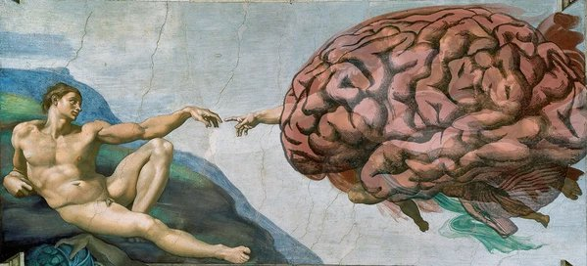
Danto on the definition of art: context
These definitions can also be called essentialist: they denote one or other feature that is essential to art and artworks
Akin to an honorific everyday use of “art”
“Now THIS is art!”

Slide 7
Danto on the definition of art: context
Problems with traditional definitions
Definition only fits some artworks
Definition fits other things than artworks
Hard or impossible to test
The field of art changes constantly
Many became to think that the project of defining art, even aesthetics as a whole, is irrelevant for artistic practice

Slide 8
Danto on the definition of art: context
Barnett Newman, 1952:
“Aesthetics is for the artist as Ornithology is for the birds”

Slide 9
Danto on the definition of art: context
“Is aesthetic theory, in the sense of a true definition … of art, possible? If nothing else does, the history of aesthetics itself should give one enormous pause here. For, in spite of the many theories, we seem no nearer our goal today than we were in Plato's time. Each age, each art-movement, each philosophy of art, tries over and over again to establish the stated ideal only to be succeeded by a new or revised theory, rooted, at least in part, in the repudiation of preceding ones.”
Morris Weitz, “The Role of Theory in Aesthetics”, 1956

Slide 10
Danto on the definition of art: context
“Not very many years ago, aesthetics – understood as the philosophy of art – was regarded as the dim, retarded offspring of two glamorous parents, its discipline and its subject. Philosophy in the twentieth century had become professionalized and technical, its methods formal, and its analytical aims the discovery of the most fundamental structures of thought, language, logic and science. Philosophical questions about art seemed peripheral and its answers cloudy – far too cloudy for those caught up in the reinvention of painting and music and literature to find much help in the dated, faded reflections of the aesthetician. And students with a primary interest in art who may have registered for courses in this condescendingly tolerated specialty found themselves confronting a perplexingly irrelevant literature.”
Arthur C. Danto, “Art, Philosophy, and the Philosophy of Art”, 1983

Slide 11
Danto on the definition of art: background
But what if…
...we pursued a definition without artistic criteria and values – by looking at the history and logic of art itself?

Slide 12
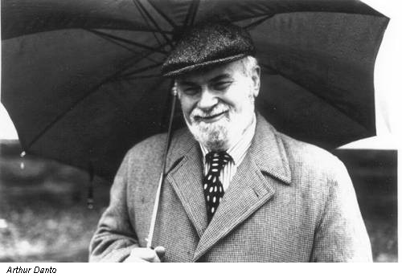
”The artworld”
Arthur C. Danto (1924–2013)
”The Artworld” (1964)
The Transfiguration of the Commonplace (1981)
Art cannot be defined as expression, representation, form or experience, but only through context

Slide 13
Andy Warhol
Brillo Soap Pads Box (1964), silkscreen ink and house paint on plywood
”The Problem of Indiscernible Counterparts”
“a philosophical question arises whenever we have two objects which seem in every relevant particular to be alike, but which belong to importantly different philosophical categories” (1983)

Slide 14
”The artworld”
Art is born only in interpretation
Interpretation is always theoretical
Where do we get the clue for this theoretical gaze? From the artworld
The artworld produces an ”atmosphere of theory” through which objects are looked at in a different way
The artworld changes over time, which allows new things to be art
”Art is the kind of thing that depends for its existence upon theories; without theories of art, black paint is just black paint and nothing more.” (The Transfiguration of the Commonplace, 135)

Slide 15
”The artworld”
Warhol’s boxes belong to a historically developed practice, the artworld – this is the only sufficient and necessary condition for them to be art
(A whole other issue is whether they should be presented in the artworld, or are they good art)

Slide 16
An institutional definition of art
George Dickie (1926–) elaborated on Danto’s theory
“Defining Art” (1969); Aesthetics. An Introduction (1981/1971); The Art Circle: A Theory of Art (1984)
”A work of art in the classificatory sense is 1) an artifact 2) on which some person or persons acting on behalf of a certain social institution (the artworld) has conferred the status of candidate for appreciation.” (DA)

Slide 17
An institutional definition of art
“the artworld is a cultural construction – something that members of society have collectively made into what it is over time. Although perhaps no one has ever consciously decided that dog shows are excluded from the … artworld, it has turned out that way. If the history of culture had been a little different, the artworld might also be different and include dog shows.”
Dickie, Art and Value (2001), 60.
(Danto recognizes this, too)

Slide 18
What do you think?

Slide 19
Context does matter...
Piet Mondrian: Composition II in Red, Blue, and Yellow (1930)
The White Stripes – De Stijl (2000)

Slide 20
Issues
Institutional definitions tell us nothing about the tasks or contents of art, or why we (want to) regard something as art
Keeps art an open concept and doesn’t subject it to the philosopher’s tastes and preferences…
…but gives this power solely to schools, politicians, foundations, curators, critics etc.
→ seemingly gets rid of honorific/essentialist uses of “art” at a high cost

Slide 21
Issues
Why take up a historically specific phenomenon and treat it as universal?
At the root of ”art” (fine art; die Schöne Kunste; les belles arts) are 18th Century upper class European white men’s aesthetic musings
A purely aesthetic object cut off from social life, surrounded with reverent silence at public display is just one among many ethnically specific aesthetic cultures
Max Ryynänen, On the Philosophy of Central European Art: The History of an Institution and Its Global Competitors, 2020

Slide 22
Issues
“Prior to the eighteenth century neither the modern ideas of fine art, artist and aesthetic nor the set of practices and institutions we associate with them were integrated into a normative system, whereas after the eighteenth century, the major conceptual polarities and institutions of the modern system of art were largely taken for granted and have been regulative ever since. Only after the modern system of art was established as an autonomous realm could one ask “Is it really art?” or, “What is the relation of ‘art’ to ‘society’?”
Larry Shiner, The Invention of Art (2001)

Slide 23
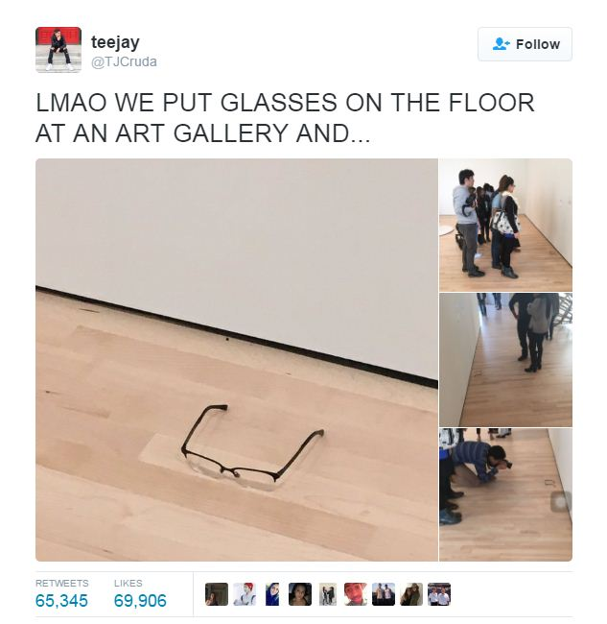
Defining art: a succesfully failed task?
So: maybe Danto’s and Dickie’s theories not so much count as definitions of ”art” rather than descriptions of what kind of thing the institutional art world is
This leads us back to Morris Weitz...

Slide 24
Defining art: a succesfully failed task?
”If we take the aesthetic theories literally, as we have seen, they all fail; but if we reconstrue them … as serious and argued-for recommendations to concentrate on certain criteria of excellence in art, we shall see that aesthetic theory is far from worthless. Indeed, it … teaches us what to look for and how to look at it in art.” (Weitz 1956)

Slide 25
Defining art: a succesfully failed task?
Asking these questions also matter because
in the life of a modern society, ”art” is social contract and always already operates under working definitions: this shows in what one can study in an art school, what and who can get funded (e.g. folk music/popular music), exhibited, written about...

Slide 26
Defending the artworld?
There are crucial differences between e.g. artistic labor and creativity, or narrative literature and narrative marketing etc.; the artworld as a counterforce to neoliberalism?
At the same time though, it encourages artists to brand/commodify their personas, backgrounds, bodies etc.
Why is Art? Why is the artworld so revered? Does it answer to existential needs in modern experience (e.g. catering for religious/transcendental ones), or rather a sense of safety through convention and tradition? A sense of community in a world where mass culture no longer entails a unified mass audience or generational experiences?
Lacking an artworld, how could/should aesthetic labour be organized money-wise? (E.g. art schools legally have a different basis for funding than education in other areas)
All aesthetic cultures have some system-like qualities (styles, values, ideals, connoisseurs, authorities, trendsetters… so maybe the problem is not the content/logic of the artworld but its disproportionate size and colonial weight?)

Slide 27
Thank you!

