Slide 1
Industries, industrial policies and global value chains in Emerging Markets
Svetlana Ledyaeva
Aalto University School of Business

Slide 2
Services versus manufacturing: which matters more for growth in EMs
Which sector, services or manufacturing, could be the main source of growth for developing countries today?
The East Asian middle and high income countries (China, South Korea) globalized through manufacturing-led activities: agriculture ➔ manufacturing ➔ services.
South Asia (particularly India) appears to choose to globalize through service-led activities.

Slide 3
(Export) Manufacturing-led development: The Past
Export-manufacturing-led growth was the model behind the twentieth century growth miracles.
There was unprecedented growth in East Asia, closing the gap in income per capita and standards of living with the advanced countries.
Manufacturing export➔ foreign exchange reserves, tax revenues, learning by doing, technologies, employment in urban sector!
Combined economic and demographic structural transformations, a move from traditional agriculture to more advanced production, from rural to urban, and a movement to a learning economy.
Joseph Stigliz

Slide 4
(Export) Manufacturing-led development: The Future 1
Manufacturing is a victim of its own success: the rate of growth of productivity (output per worker) exceeds that of demand ➔
the share of manufacturing in GDP is declining everywhere.
Productivity increase ➔a smaller and smaller fraction of the labour force is required to produce ➔ Unemployment➔ how to deploy the workers?
Analogy
Agriculture in 19th century: 70% of workers in advanced countries (AMs) were in agriculture ➔ Productivity growth in agriculture ➔ Now around 3% of workforce in Agri sector in AMs! ➔ Workers were deployed in manufacturing sector➔ The situation repeats with manufacturing!
Joseph Stigliz

Slide 5
(Export) Manufacturing-led development: The Future 2
But where to deploy manufacturing workers? Even with emerging markets taking a larger share of global manufacturing jobs, and with a shift of jobs from China to Africa, new manufacturing jobs will absorb only a fraction of new entrants into the labour force in Africa.
It is unlikely that manufacturing export-led growth will have the impact in Africa that it had in China and East Asia.
This is especially so because the advantages of cheap labour will diminish as labour becomes of lesser importance in manufacturing itself, e.g. as robots replace humans.
Joseph Stigliz

Slide 6
(Export) Manufacturing-led development: New strategy 1
The developing countries’ advantage in low labour costs will, at least in many cases, be outweighed by locational disadvantages: an increasing fraction of production will be located near points of consumption.
The solution: the realization of the importance of not just physical capital, but human capital, social capital, and knowledge capital!
➔ Multi-pronged strategy!
Joseph Stigliz

Slide 7
(Export) Manufacturing-led development: New strategy. Role of manufacturing and agriculture
Manufacturing - more limited role and will need to be more directed, where possible taking advantage of natural advantage (such as mineral resources).
Instead of the race-to-the-bottom competition (low labor costs and taxes) ➔ race-to -the-top competition to provide good physical and institutional infrastructure, which enhances the productivity of the economy and returns capital.
Agriculture will continue to provide the most important basis of employment for most developing countries, but should be restructured in ways that are more dynamic, with more learning and learning to learn.
Joseph Stigliz

Slide 8
(Export) Manufacturing-led development: New strategy. Natural resources sector
Mining and hydrocarbons will continue to be important for foreign exchange for those countries that are lucky enough to have these resources.
Can be central to the development of resource abundant countries!
Resource curse – policies to overcome it!
Joseph Stigliz

Slide 9
(Export) Manufacturing-led development: New strategy. Service sector
Services will be the growth sector of the future.
Productivity growth may be more limited. Traditionally, productivity growth in the service sector is lower than in manufacturing ➔ catch up with advanced countries!
There is more need for cooperative and government R&D.
The move towards a service sector economy is likely to be associated with other changes to the structure of the economy, which will require more active government intervention. ➔ increased inequality (compensation is more linked to individual productivity), increased monopoly power.
Joseph Stigliz

Slide 10
Service-led growth in India

Slide 11
GDP shares by sector in China and India, 1978-2004

Slide 12
Service-led growth in India
In India’s case, service-sector growth is widespread across activities.
But the fastest growing activities are business services, communication and banking.
Business services include computer-related services (the fastest growing), machinery rental, research, and accounting, legal, and technical services (where the well-known data-entry and call centers are located).

Slide 13
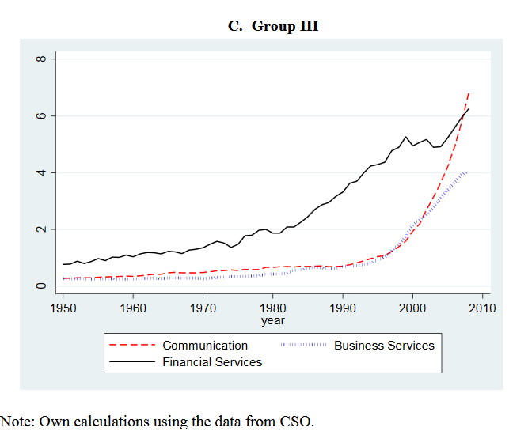
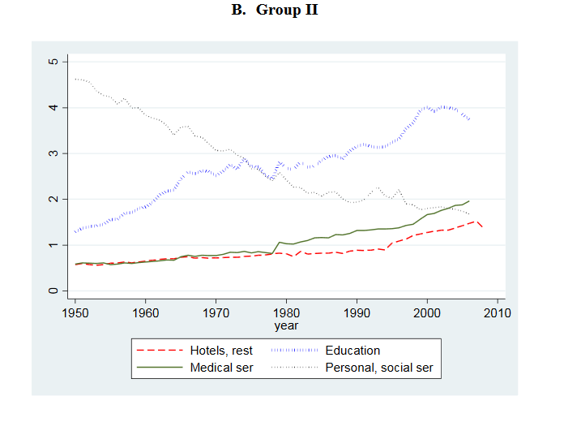
Size of specific services in India

Slide 14
Service-led growth in India. The Future
If service-sector output and employment continue to grow ➔depends on the continued expansion of modern services (business services, communication and banking) + application of modern information technology to more traditional services (retail and wholesale trade, transport and storage, public administration and defense ).
The mix of skilled and unskilled labor in manufacturing and services is increasingly similar. ➔
Economic growth and raising living standards ➔ require shifting labor from agriculture to both manufacturing and services. Labor-intensive manufacturing in India?
(Barry Eichengreen, NBER 2011)

Slide 15
Service-led development
On the one hand, services can be a propulsive force in rural economic development
On the other hand, services are neither independent of, nor a replacement for, older forms of rural industrialization such as agriculture, mining, and manufacturing.

Slide 16
GDP by sector composition, groups of countries, 2016

Slide 17
Manufacturing as % of GDP, advanced EMs

Slide 18
Services, etc. as % of GDP, advanced EMs

Slide 19
Total natural resources rents, % of GDP, advanced EMs

Slide 20
Manufacturing as % of GDP, secondary EMs

Slide 21
Services, etc. as % of GDP, secondary EMs

Slide 22
Total natural resources rents, % of GDP, secondary EMs

Slide 23
Manufacturing as % of GDP, frontier EMs

Slide 24
Services, etc. as % of GDP, frontier EMs

Slide 25
Total natural resources rents, % of GDP, frontier EMs

Slide 26
Manufacturing as % of GDP, advanced economies

Slide 27
Services, etc. as % of GDP, advanced countries

Slide 28
Total natural resources rents, % of GDP, advanced countries

Slide 29
Conclusions from previous graphs
Services (%) have been growing for all types of economies.
Manufacturing have been declining for advanced economies. For EMs trends are rather heterogenous (tend to decline for more advanced EMs).
Resource rents have been fluctuating.

Slide 30
Industrial policies in EMs: Import-substitution
The fastest growing EMs ➔key domestic industries for growth:
import-substituting industrialization (protectionist walls)
or
export-oriented industrialization.
In the 1960s and 1970s: import-substituting industrialisation (ISI).
Latin America, Eastern Europe, and parts of Asia.
ISI was a state-led effort to build domestic industries by requiring foreign manufacturers to replace imports with locally made products.

Slide 31
Industrial policies in EMs: Export-promotion
The death knell for ISI, especially in Latin America, came from the oil shock of the late 1970s and the severe debt crisis that followed it (Urquidi, 1991).
The ISI approach was not very successful ➔ Can it be successful if combined or substituted with export-promotion policies?
Many developing countries made the transition from import-substitution to export-oriented industrialization (EOI) during the 1980s.

Slide 32
Export promotion policies are very popular even nowdays in some EMs – e.g. BRIC
Evenett (2015) reports that since the Global Crisis began three of the BRICS (Brazil, India, and China) have implemented additional incentives to inflate exports. On Figure – number of export incentives per six-digit industry-year in force.

Slide 33
BICs export incentives (cumulative number of implemented incentives in 2008-2015) by type
 | Brazil | India | China
Trade finance (export subsidy) | 2 | 15 | 0
Tax-based export incentive | 5 | 38 | 15
Other export incentive | 0 | 9 | 0
Total | 7 | 62 | 15

Slide 34
Industrial structure of BRIC export incentives per industry-year in force as cumulative in 2009-2016

Slide 35
Summary statistics of export incentives implemented in emerging countries in 2009-2015
Country | Number of export incentives implemented in 2008-2015* | Number of export incentives over six-digit industry-year (in force) as cumulative in 2009-2015
Argentina | 4 | 19,00
Chile | 0 | 0,00
Colombia | 3 | 2796,58
CzechR | 3 | 81,67
Estonia | 3 | 81,67
Greece | 3 | 81,67
Hungary | 3 | 81,67
Indonesia | 1 | 1530,00
Korea | 0 | 0,00
Malaysia | 0 | 0,00
Mexico | 0 | 0,00
Peru | 3 | 81,67
Poland | 1 | 400,00
Thailand | 1 | 39,00
Turkey | 5 | 4398,08
Uruguay | 28 | 560,17
Vietnam | 0 | 0,00

Slide 36
Global Value Chains

Slide 37
What is global value chains?

Slide 38
Global Value Chains and EMs
GVCs have become increasingly important in global trade and investment policies.
With production processes located across different countries, GVCs link firms, workers and consumers around the world providing an important platform for EMs to integrate into the global economy.
EMs are leading the exponential growth seen in the GVC framework, as they are starting from a low base.

Slide 39
GVCs in EMs: recent decades trends: BRIC role
In 90s, faced with slow growth at home, large “lead” firms in GVCs rushed to set up operations in BRIC countries, especially China.
In the 2000s, the industries and activities encompassed by GVCs grew exponentially, driving trade in finished goods and customized intermediates.
China became the “factory of the world”, India the world’s “back office”, Brazil had a wealth of agricultural and primary commodities and Russia possessed enormous reserves of natural resources plus the military technologies linked to its role as a Cold War superpower.
For goods that require shorter supply lines such as “fast fashion” apparel and automobiles, the countries of Eastern Europe joined more traditional “export processing” locations such as Mexico and North Africa.

Slide 40
Deputy Prime Minister Tharman Shanmugaratnam, Singapore, 2016

Slide 41
EMs, manufacturing and GVCs
EMs have become important partners in GVCs especially in manufacturing.
EMs are attractive for labor-intensive manufacturing.
Problem: Jobs are transferred from developed to emerging countries in low-technology and labor-intensive manufacturing.

Slide 42
Value added manufacturing as world share, %
Country Name | 2000 | 2010 | 2016
China | 10,29 | 18,39 | 26,20
United States | 25,40 | 17,28 | 17,55
Japan | 18,14 | 11,35 | 8,46
Germany | 6,65 | 6,52 | 5,83
Korea, Rep. | 2,40 | 2,91 | 3,08
India | 1,26 | 2,57 | 2,82
France | 3,24 | 2,61 | 2,07
United Kingdom | 3,54 | 2,08 | 1,94
Indonesia | 0,62 | 1,59 | 1,55
Brazil | 1,42 | 2,69 | 1,50
Mexico | 2,21 | 1,57 | 1,47
Russian Federation | 0,86 | 1,87 | 1,25
Turkey | 0,84 | 1,11 | 1,16

Slide 43
Production activities go where the markets are
The attractiveness of Brazil, China, India, South Africa – in their large and growing consumer markets.
China and India are World`s most populated markets and have very high GDP growth ➔ growing market potential.
About 85% of middle class growth in the near future is expected to happend in growing Asia.

Slide 44
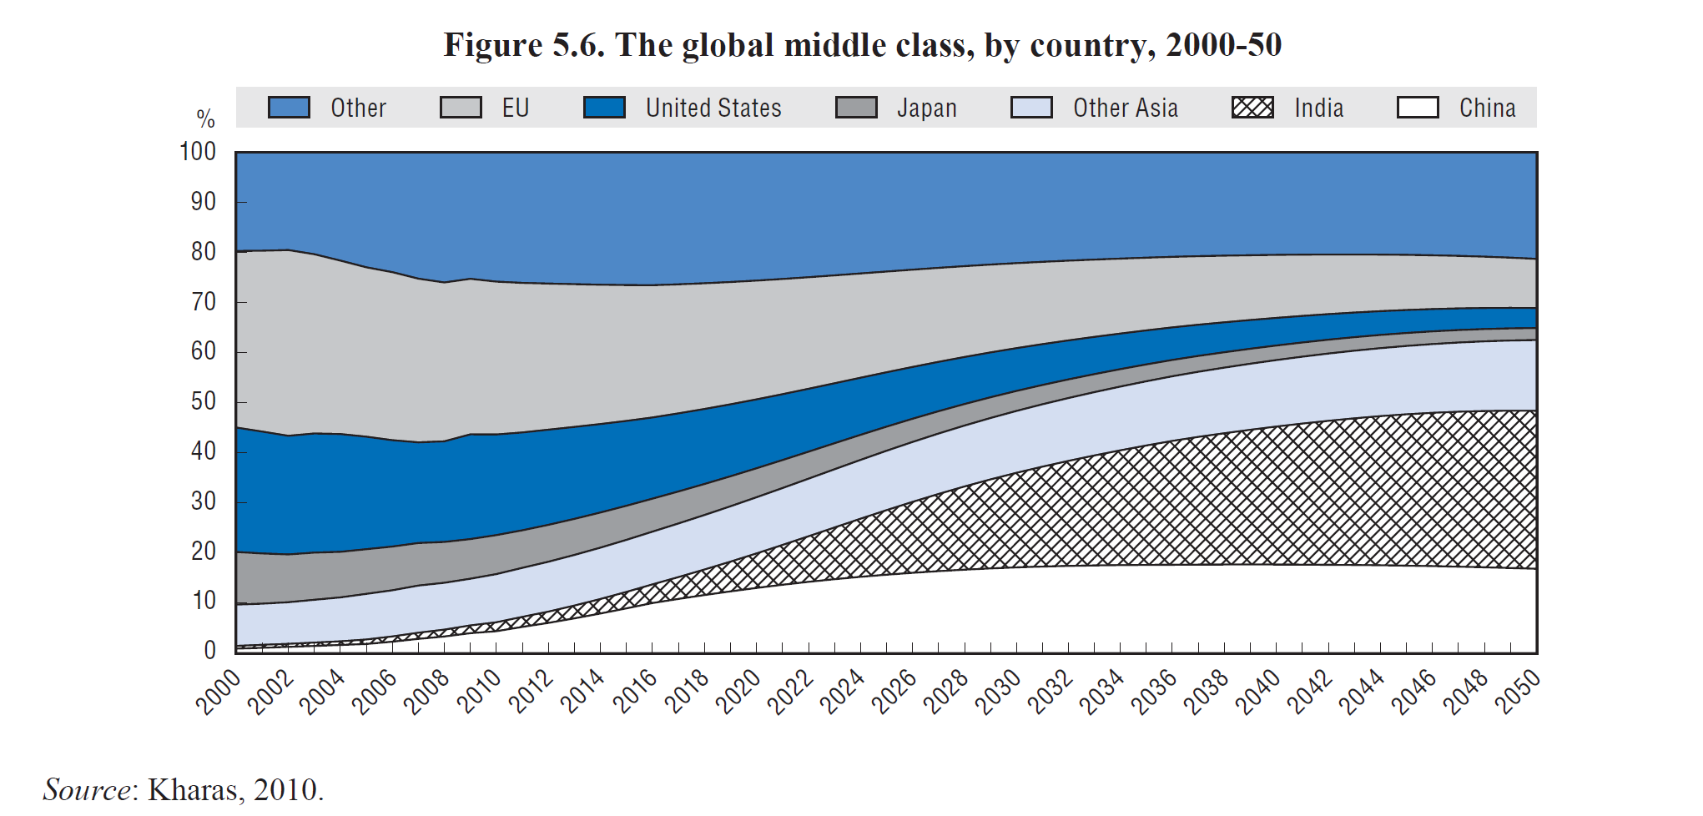

Slide 45
GVCs in EMs: Present
Today the organization of the global economy is entering a new phase, what some have referred to as a “major inflection point” (Fung, 2011).
Slow growth in the global North since the mid-1980s was dampened further by the latest crisis, whereas demand is quickly growing in the global South, particularly in large emerging economies like China, India and Brazil (Staritz et al., 2011).
Over the period 2005–10, the merchandise imports of the EU and the USA increased by 27% and 14%, respectively, while emerging economies expanded their merchandise imports much faster: Brazil (147%), India (129%), China (111%) and South Africa (51%).
These differences represented a shift in end markets to the developing world: in 2010, a full 52 per cent of Asia’s manufactured exports were destined for developing countries
(WTO, 2011).

Slide 46
Indicators of GVCs participation
Backward GVC participation index captures the extent to which domestic firms use foreign intermediate value added for exporting activities in a given country.
Forward GVC participation index captures the extent to which a given country’s exports are used by firms in partner countries as inputs into their own exports.

Slide 47
Backward and forward GVCs participation indices in EMs

Slide 48
GVC participation, 2009

Slide 49
Industrial policies and GVCs in EMs today
The fragmentation of global industries in GVCs complicates industrial policy debates.
Domestic industries in both industrialized and developing countries no longer stand alone and compete mainly through arms-length trade.
Instead, they have become deeply intertwined through complex, overlapping business networks created through recurrent waves of foreign direct investment (FDI) and global sourcing.

Slide 50
Export/production subsidy – common tool in industrial policy
A world without global value chains and input trade:
Export subsidy at final good for domestic producers➔domestic producers-exporters benefit, foreign producers-exporters lose➔governments compete in subsidies, etc.
A global value chains world:
Export subsidy at final goods ➔foreign producers of inputs which are used in production of subsidized goods (as imported) also benefit!
Export subsidy at input ➔ foreign producers who import these subsidized inputs and use them in production of final goods also benefit!

Slide 51
Environmental issues in emerging markets
Rapid growth in the major emerging markets has been accompanied by severe environmental degradation.
Ever-increasing environmental consequences that will eventually constrain growth!
BRICs becoming increasingly responsible for global carbon emissions.
Air and water pollution contribute to numerous ailments, particularly respiratory illnesses, cancer, and breakdowns in the immune system.
Pollution also destroys natural resources required for production, for example, degrading soil and water so that they can no longer be used in agriculture.

Slide 52
Some facts about environment related negative effects in emerging markets
A rough estimate of the fine particulate matter (Atmospheric aerosol particles) in China’s atmosphere averages three times the level deemed unsafe by the World Health Organization (WHO), and 350,000–400,000 Chinese die each year from illnesses related to outdoor air pollution.
More than half of China’s cities are affected by acid rain, and 40 percent of major rivers are so polluted that their water can only be used for industry or landscaping.
Russia’s more than 90 billion tons of solid waste covers 618,000 acres of dump sites, and 90 percent of state-approved sites for waste storage do not meet safety standards.
Some 22,000–28,000 deaths in people over the age of thirty in Russia may be due to road-transport-related emissions.
The WHO estimates that outdoor air pollution in India causes 527,700 deaths a year.

Slide 53
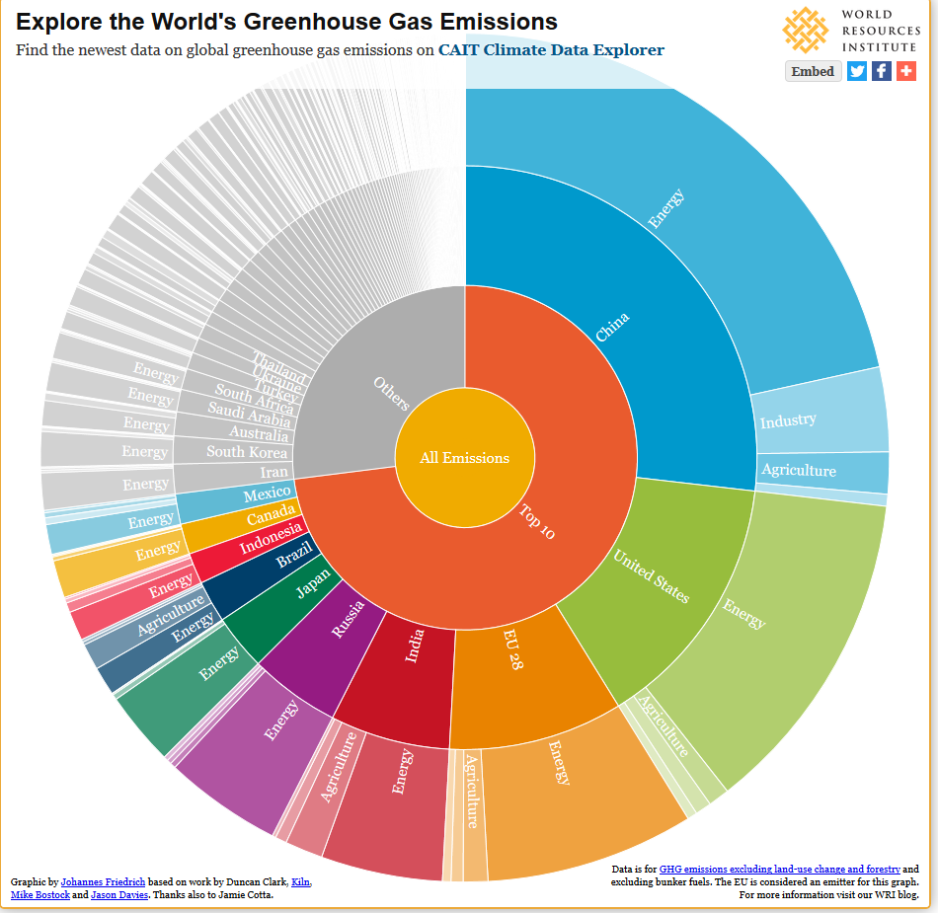

Slide 54
Total greenhouse emissions, % between 1990-2012

Slide 55
CO2 emissions, 1990-2013

Slide 56
Air pollution in emerging economies

Slide 57
Impact investment: Core characteristics
INTENTIONALITY: Investor`s intention to have a positive social or environmental impact through investment.
INVESTMENT WITH RETURN EXPECTATIONS: Impact investments are expected to generate financial return on capital.
WIDE RANGE OF RETURN EXPECTATIONS AND ASSETS CLASSES.
IMPACT MEASUREMENT: The commitment of the investor to measure and report the social and environmental performance.

Slide 58
Examples of impact investment for better environment 1
A EUR 150 million European private equity fund invests between EUR 2-10 million in companies that provide clean electricity to rural communities in developing countries with limited access to energy. The fund targets competitive private equity returns, and has made five investments in Asia and Africa.
Example investment: The fund made a EUR 2 million equity investment in a company that provides solar energy for lighting and refrigeration in rural Indian households, schools, and hospitals that have limited access to the main electricity grid. Enabled by this investment, the company has installed more than 40,000 systems and currently offsets 25,000 tons of carbon dioxide emissions.

Slide 59
Examples of impact investment for better environment 2
An India-based impact investing fund manager started investing in microfinance institutions more than ten years ago. After delivering 14 percent returns to investors, the fund manager decided to raise a second fund to target businesses across a broader set of sectors, including renewable energy, agriculture, health, and education. The fund provides risk capital and support to early stage ventures with investments averaging $50,000 in size.
Example Investment: The second fund invested in a company that sets up water purification plants in rural villages. The plants are owned by the local community and operated by the installation company, which sells the purified water to the village at affordable rates. The installation company also trains local entrepreneurs to develop businesses that deliver water to neighboring villages.

