Slide 1
Interested in writing your Master’s thesis as part of an EU research project GIDPROvis?

Slide 2
EU-project GIDPROvis aims to develop two original breakthrough technologies - Gas Ion Distillation (GID) and Sequential Ion Processing (PRO) – that provide live visualization (vis) of volatile chemicals in ambient environments giving humans access to a molecular world
We are looking for a Master’s student who is enthusiastic to write the Master’s thesis as part of our EU project’s Work Package 3.
Work package 3 aims to determine human reactions to the flow of chemical information of surroundings and establish guidelines to present such information to humans (non-specialists and specialists) visually in layers of augmented reality
Relevance of the technologies that our project develops:
increase of safety in organizations and society

Slide 3
Topic of the Master’s thesis: Human reactions to augmented molecular reality
Literature: Safety/emergency communication, Augmented reality, Human emotional-affective reactions to chemical information
Empirical work: In-depth interviews of users testing GIDPROvis dashboard

Slide 4
Requirements:
Interest in contributing to an ambitious science and technology research project
Ability to meet project deadlines. The thesis needs to be finalized by the end of 2022.
Excellent writing skills in English
We offer:
A possibility to be part of an international, multidisciplinary research project
A discipline leading exploration of the interface between humans and machines with emphasis on human reactions to knowledge of the invisible world of chemical composition of our environment.
Support in writing the Master’s thesis
Compensation: 1283,- euros / month (max 6 months)

Slide 5
Interested?
More information: www.gidprovis.eu
Please, contact: Sari Yli-Kauhaluoma, D.Sc.
(Master’s thesis advisor)
sari.yli-kauhaluoma@aalto.fi

Slide 6
Center for Knowledge and Innovation Research (CKIR)
Project pitch for master’s thesis seminar
Spring 2022

Slide 7
TUNTO2 – Emotional agency in strategy implementation
Duration: 2021-2023
Funded by Finnish Work Environment Fund (Työsuojelurahasto)
Consortium: Aalto BIZ/CKIR & University of Jyväskylä

Slide 8
TUNTO2 – Emotional agency in strategy implementation
An ongoing research project (2021-2023), focusing on emotions and strategy implementation.
An intervention context (an emotion-focused training in 3 organizations), with both qualitative and quantitative data
Qualitative: zoom workshop recordings, interviews
Quantitative: 3 surveys in each organization. Scales developed for this research (emotional agency, strategy implementation, emotional climate), and established measures (commitment to change; work engagement; psychological safety; meaningfulness of work; individual ambidexterity; positive and negative affect schedule)

Slide 9
TUNTO2 – Emotional agency in strategy implementation
Opportunities for students:
Data and support in your master’s thesis.
Research assistance tasks (part-time employment) in analyzing the data and reporting the findings.
All the qualitative data are in Finnish. Surveys were conducted also in English. Project reporting in Finnish.
If you are interested in these topics, please contact Heini Ikävalko, heini.ikavalko@aalto.fi

Slide 10
EDIFY –
Equality, Diversity, Inclusion For improving the quality of Management EDUcation, training and professions
Duration: 2022-2025
Funded by EU
Consortium with 15 European partners
Finnish partners: Aalto BIZ/CKIR & TIEKE

Slide 11
EDIFY
A project to start this summer.
Addresses the skills gap in management education with regards to competencies on equality, diversity and inclusion (EDI).
Target groups: managers in medium-sized companies and students (future managers).
Analyses the EDI training needs and develops modules offered as micro-credentials.

Slide 12
EDIFY
Opportunities for students:
Support in your master’s thesis in the area of skills / competence development in Equality-Diversity-Inclusion.
Research assistance tasks (part-time employment) in building the research framework and collecting data.
Data for your master’s thesis.
If you are interested in these topics, please contact Heini Ikävalko, heini.ikavalko@aalto.fi

Slide 13
Biomimicry and circular business
Review of the biomimicry-related methods in the context of sustainable business and circular economy research (specifically textiles, bioproducts)
Literature review
Case study / interviews of exemplary cases.
The student should specialize in sustainability/circular economy in her/his studies. Previous experience or knowledge of biomimicry is a merit.
Offer: Monetary compensation, support of a research project team (Finix / CircDNet).
Note: Thesis needs be completed by the end of 2022.
Contact: Samuli.patala@aalto.fi

Slide 14
Circular textile ecosystems
This thesis should focus on identifying and analyzing ecosystems/industrial clusters focused on circular economy development in the textile sector
Geographical focus: Northern Europe (excl. Finland)
Listing and analyzing key ecosystems through a desk study phase
Empirical study (i.e. interviews) can focus on a subset of most relevant ecosystems
The student should specialize in sustainability/circular economy in her/his studies. Experience from the textile sector and/or contextual knowledge/language skills from a particular country in the specified region would be considered merits
Offer: Monetary compensation, support of a research project team (Finix / CircDNet).
Note: Thesis needs be completed by the end of 2022.
Contact: Samuli.patala@aalto.fi

Slide 15
Constructing identity through space & materiality
Thesis topic suggestion
Prof. Taija Turunen
Design Management Aalto University, School of Business, Dept. of Management Studies

Slide 16
Briefly
Recently, there has been an increase in the number of studies on organizational space, including physical and virtual “places” where work occurs.
The new normal, new technologies, shifting working conditions, and burgeoning expectations of the contemporary workforce blur boundaries between home and work connecting people and things.
This so called “sociomateriality” is a connection between the material world and social layers that define how we organize and interact or what kinds of identities we construct.
The purpose of this study is to analyze this sociomateriality through literature analysis and visual analysis of organizational space.

Slide 17
What we offer:
Already well thought ands interesting thesis subject that connects to existing literature.
Literature database for analysis, containing 200+ articles.
Extra support as the thesis topic aligns with ongoing research project.
Easy access to empirical data collection and hands on support in data collection and analysis.

Slide 18
IB Unit: Headquarters (HQ) Location Project
A 4,5 year research project on the interplay of physical and social aspects of location. It’s funded by Wallenberg foundation and Academy of Finland, involving:
Faculty, doctoral and master students
Foreign and Finnish companies
Business Finland and other public bodies
The project consists of four work packages, which all will lead to conceptualizing the meaning of location. The project outcomes include:
Identify all foreign firms’ HQ in Finland
Map HQ relocation events in Europe between 2000-2019
Understand the strengths of host locations to attract HQ
More information: https://www.aalto.fi/en/department-of-management-studies/location-research-project
https://yle.fi/uutiset/3-10157369
20.4.2022

Slide 19
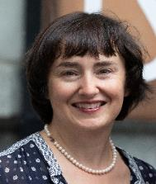
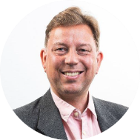
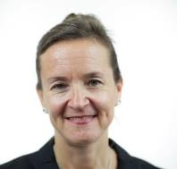
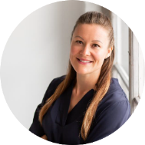
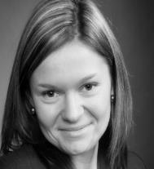
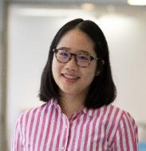
HQ Location Project Team
Perttu Kähäri,
Professor of Practice
Rebecca Piekkari,
Professor, Head of IB Unit
Tiina Ritvala,
Associate Professor,
Head of IB Specialization Area
Iiris Saittakari,
Assistant Professor
Daria Kautto,
Post-doc researcher
Linyu Liu,
Doctoral researcher
20.4.2022
Linyu Liu

Slide 20
HQ Location project MSc thesis group
Headquarters in platform
business
How are HQ organized in a digital world?
Evolution of regional structures
The purpose is to create interaction and provide additional peer support to MSc thesis students.
The group meets once a month, where two students present and everyone gives feedback.
17 MSc thesis completed in 2020-21 and 9 MSc thesis in progress.
Multinational Enterprises’
Headquarters - Sustainability
Aspect
Where are HQ located in Europe?
“They suck at making friends!” – Or what went wrong with Amazon’s stakeholder communications regarding HQ2 in New York
HQ in Africa – locations for expansion
Nordea HQ relocation: How is it represented in media?

Slide 21
The following topics are our suggestions, but we are also open for other interesting thesis topics in this area. We also have Doctoral opportunities in our project.

Slide 22
HQ Location project, WP4 Entrepreneurial behavior in location choices
Two opportunities for your Master’s thesis with the support of the project research faculty:
Thesis 1:
RQ: What importance do start-up entrepreneurs attach to the locational attributes when choosing the initial firm location/relocation? / What are the key decisive attributes in the location choice decisions performed by start-up entrepreneurs?
Web-based conjoint experiment utilizing best-worst scaling technique
Timeframe: data collection in May-June 2022
Thesis 2:
RQ: How do start-ups differ from each other in valuations of the location attributes when choosing the initial firm location/relocation and why?
Web-based conjoint experiment utilizing choice-based conjoint methodology
Timeframe: data collection in September-October 2022
Contact: Daria Kautto
Postdoctoral researcher, IB/Management
daria.kautto@aalto.fi

Slide 23
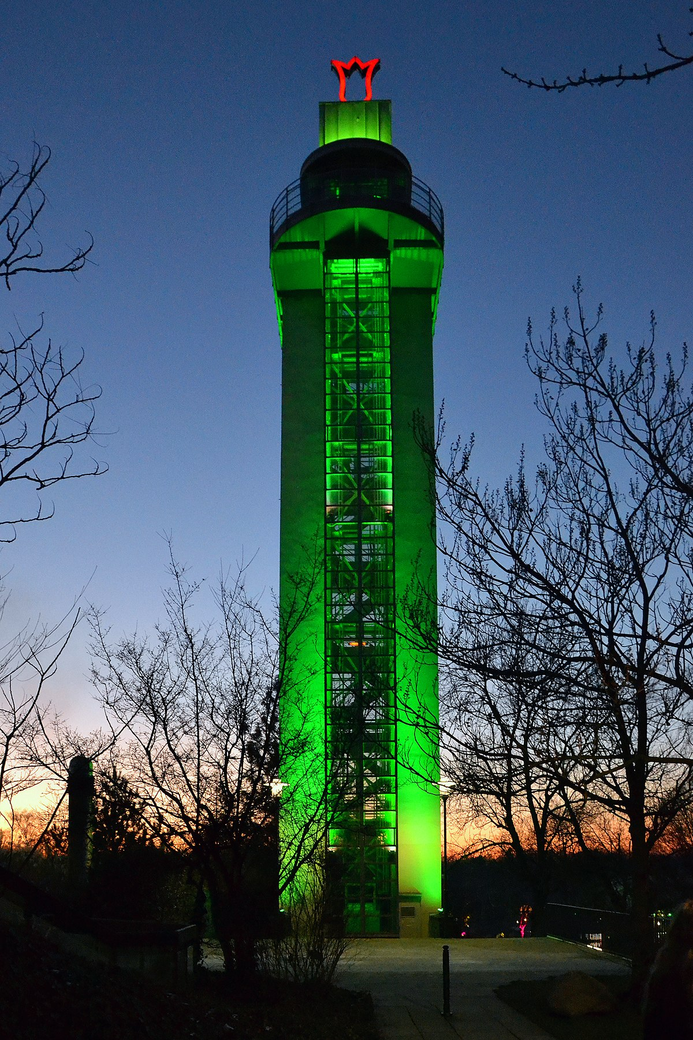
2011: Hamburg
2012: Vitoria-Gasteiz
2013: Nantes
2014: Copenhagen
2015: Bristol
2016: Ljubljana
2017: Essen
2018: Nijmegen
2019: Oslo
2020: Lisbon
2021: Lahti
2022: Grenoble
Sustainable cities & attraction game
Cities – also those that are not capital cities – need to attract high value adding investments and talent in order to thrive
Awards and titles are one way for cities to specialize and brand themselves, e.g. European Green Capital title
How do previous European Green Capitals attract talent and investments?
Material: Cities’ marketing material, interviews with e.g. investment promotion agencies and cities’ directors of economic development
Focus: Select a few cities among the list of current and previous winners: Previous Winning cities (europa.eu)
_______________________________________________
Contact: Assistant Professor Iiris Saittakari (iiris.saittakari@aalto.fi)
This Photo by Unknown Author is licensed under CC BY-SA
This Photo by Unknown Author is licensed under CC BY-SA-NC
Notes:
2011: Hamburg^{[4]}
2012: Vitoria-Gasteiz
2013: Nantes
2014: Copenhagen
2015: Bristol^{[5]}
2016: Ljubljana^{[6]}
2017: Essen
2018: Nijmegen
2019: Oslo
2020: Lisbon
2021: Lahti^{[7]}
2022: Grenoble

Slide 24
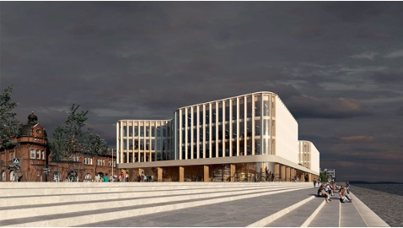
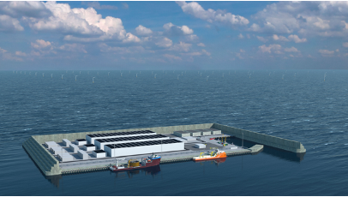
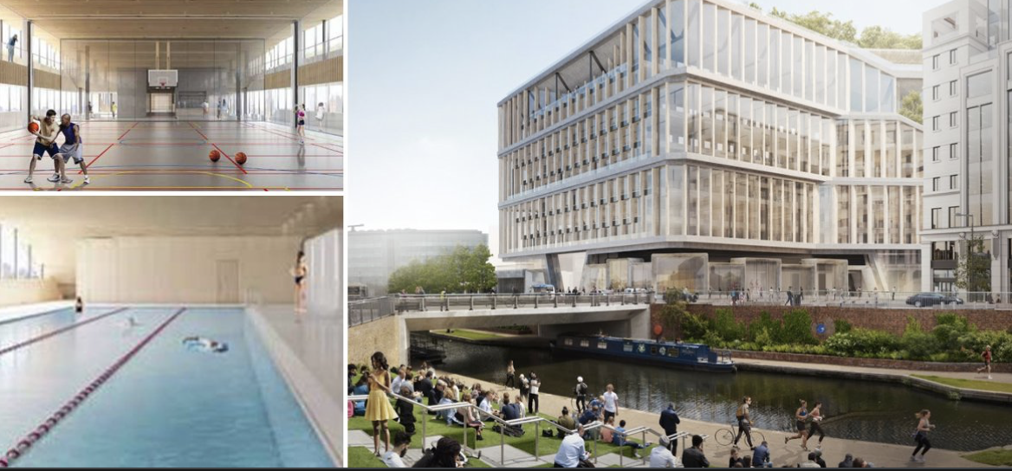
Reimaging the city through sustainability partnerships
How do multinational companies and city/state authorities collaborate in creating more sustainable cities?
Case context 1: Energy islands
Case context 2: Headquarters of the future
Helsinki’s Hot Heart by Carlo Ratti Associati and a team of multinationals, Helsinki 2028?
Stora Enso Headquarters, Helsinki 2024
Digitalization, AI
Sustainability
Inclusive space for citizens
Picture: ANTTINEN OIVA ARKKITEHDIT OY
Denmark’s energy island, 2033
Changing norms
& regulations
Got interested?
Contact:
Tiina Ritvala
tiina.ritvala@aalto.fi
Picture: Google
Picture: DANISH ENERGY AGENCY

Slide 25
Please contact Perttu Kähäri if you are interested in hearing more: perttu.kahari@aalto.fi

Slide 26
Development of Metsähallitus project economy reporting process and HR functions
Subject and wishes regarding the applicant
We are looking for a student intererested in the above topic of Master's thesis. We consider work experience in project economics and HR to be an advantage. Student has studies related to the subject. Knowledge and expertise in financial and PMO systems as well Office software are useful in the task.
We expect the student to have the ability to cooperate, interest and know-how to analyze and document the current status. We expect the student to be able to present the latest development measures related to the topic - that's the most important!
The Master's thesis can be written in either Finnish or English. However, we want to have related discussions in Finnish. Financial materials of Metsähallitus are in Finnish, and the financier's reports are partly in English. We offer a grant for Master's thesis from the Helsinki School of Economics Support Foundation (12,000 euros).
Projects in Metsähallitus
Depending on the time, Metsähallitus manages about 50 to 150 projects - financed with external funding - mainly with different types of EU funding. 5 project finance experts are working in the project finance in cooperation with project managers. We make cumulative project-time (several years) accounting reporting as well as financier reporting (in a format specified by the financier). Projects have many interfaces to HR functions. We want to develop good practices of financial reporting and automate e.g. payroll process for projects.
About Metsähallitus Group
Metsähallitus is a state-owned enterprise with a turnover of approximately 370 meur. Metsähallitus provides natural resource services to a diverse customer base, from citizens to large companies. We use, manage and protect the state’s land and water areas sustainably and reconcile the different expectations of the owner, stakeholders and customers. In this way, we ensure that everyone - including future generations - has the opportunity to enjoy nature and the value it creates.
Metsähallitus Group's areas of responsibility operate as limited companies or financed from the state budget. The accounting is based on accounting law - so the management of Metsähallitus Group's financial affairs is quite normal.
https://www.metsa.fi/en/
Contact: ELLI TURTINEN-HEIKKILÄ
Project financial controller / projektitalouscontroller
Turtinen-Heikkilä Elli
Elli.Turtinen-Heikkila@metsa.fi
+358 (0)206 397627

Slide 27
Metsähallituksen projektitalouden raportointi-prosessin ja HR-toimintojen kehittäminen
Gradun aihe ja toiveet hakijaan liittyen
Etsimme gradutyön tekijää yllä mainittuun aiheeseen. Katsomme graduntekijän eduksi työkokemuksen projektitalous- ja henkilöstöasioissa. Graduntekijän opintopisteissä on aiheeseen liittyviä opintoja. Talousjärjestelmien, PMO-järjestelmien sekä Office-ohjelmistojen tuntemus ja osaaminen ovat hyödyksi tehtävässä.
Odotamme graduntekijältä kiinnostusta, yhteistyökykyä ja osaamista analysoida sekä dokumentoida nykytilaa. Odotamme, että graduntekijä pystyy esittämään uusimpien ratkaisujen mukaisia kehitystoimenpiteitä aiheeseen liittyen - tämä on gradun painopiste.
Gradun voi tehdä joko suomeksi tai englanniksi. Haluamme kuitenkin käydä aiheeseen liittyvät keskustelut suomeksi. Metsähallituksen talousaineisto on suomenkielistä, rahoittajaraportit ovat osaksi englanniksi.
Tarjoamme graduntekemiseen rahoituksena Helsingin kauppakorkeakoulun tukisäätiön apurahan (12.000 eur) kautta. Voit tehdä gradutyön paikkakuntariippumattomasti Suomessa.
Metsähallituksen projektit
Metsähallitus hallinnoi ajankohdasta riippuen n. 50 - 150:ä ulkopuolisella rahoituksella - pääosin EU:n eri rahoitustyypeillä - rahoitettavaa projektia. 5 projektitalousasiantuntijaa hoitaa projektien talousasioita yhteistyössä projektipäälliköiden kanssa. Projekteista tehdään kumulatiivista projektinaikaista (useita vuosia) kirjanpitoraportointia sekä rahoittajaraportointia (rahoittajan määrittelemässä muodossa).
Projekteilla on paljon rajapintoja HR-toimintoihin. Haluamme kehittää talousraportoinnin sujuvuutta sekä automatisoida mm. palkkakirjauksia projekteille.
Metsähallituskonsernista
Metsähallitus on valtion liikelaitos, jonka liikevaihto on n. 370 milj euroa. Metsähallitus tuottaa luonnonvara-alan palveluja monipuoliselle asiakaskunnalle kansalaisista suuryrityksiin. Käytämme, hoidamme ja suojelemme valtion maa- ja vesialueita kestävästi ja sovitamme yhteen erilaisia omistajan, sidosryhmien ja asiakkaiden odotuksia. Näin varmistamme, että kaikilla - myös tulevilla sukupolvilla - on mahdollisuus nauttia luonnosta ja sen luomasta arvosta.
Metsähallituskonsernin vastuualueet toimivat osakeyhtiöinä tai valtion budjettirahoitteisina yksiköinä. Talousasioiden hoitamisen viitekehyksenä on kirjanpitolaki, joten Metsähallituskonsernin talousasioiden hoitaminen on varsin tavanomaista taloudenpitoa.
https://www.metsa.fi/
Contact: ELLI TURTINEN-HEIKKILÄ
Project financial controller / projektitalouscontroller
Turtinen-Heikkilä Elli
Elli.Turtinen-Heikkila@metsa.fi
+358 (0)206 397627

