Slide 1
Deconstructing
Artefacts

Slide 2
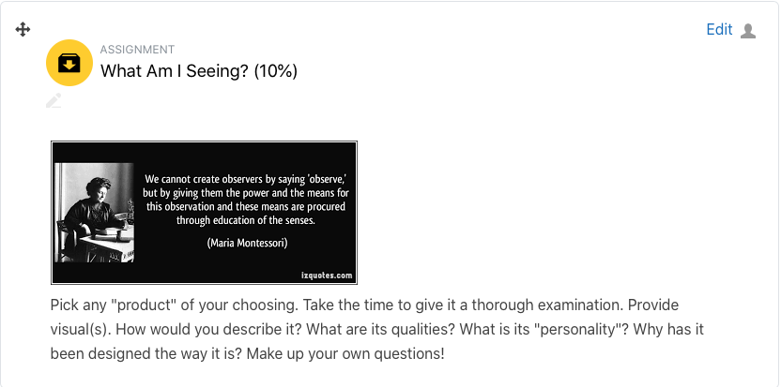

Slide 3
concrete attributes
under the surface aspects
character description
designer’s mindset
user needs
backstory
Notes:
BY UNDERSTANDING THE THING, YOU START TO SEE HOW USERS MIGHT RELATE TO IT (INTERACTION LAYER)

Slide 4
your
research
insights

Slide 5
my
research
insights

Slide 6
concrete attributes
under the surface aspects
character description
designer’s mindset
user needs
backstory
Notes:
BY UNDERSTANDING THE THING, YOU START TO SEE HOW USERS MIGHT RELATE TO IT (INTERACTION LAYER)

Slide 7
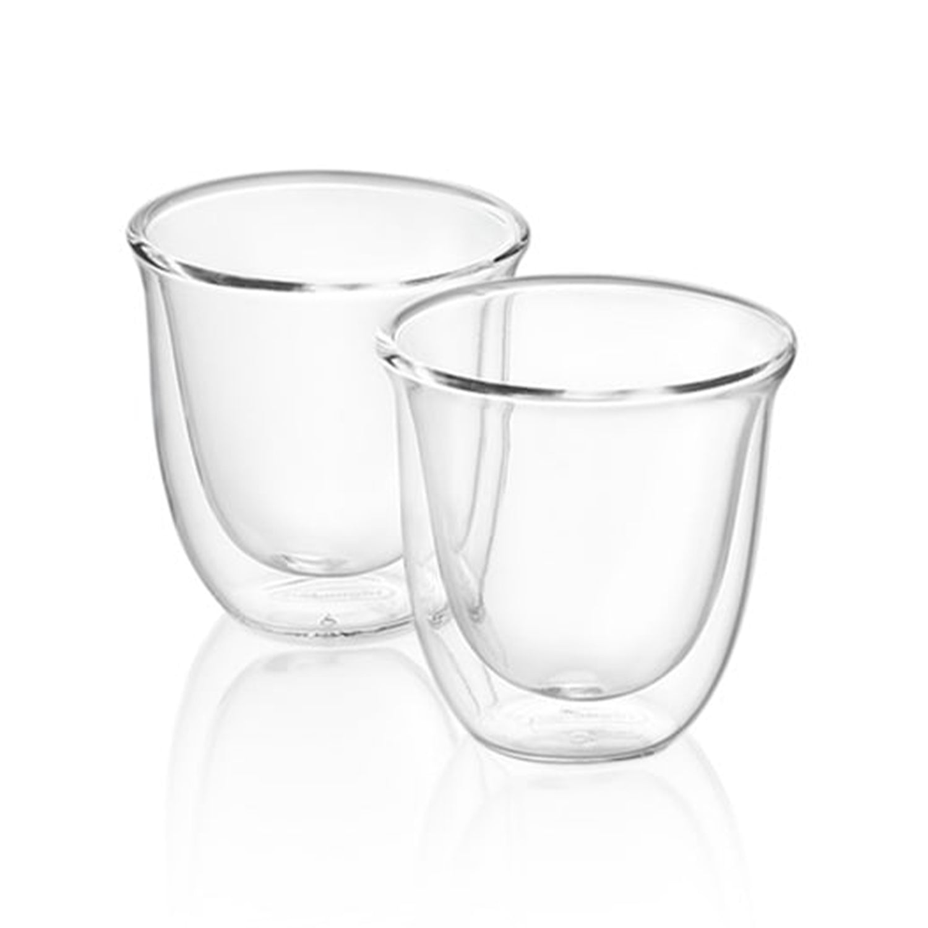
Notes:
THE ITEM I DECONSTRUCTED – HOW WOULD YOU DESCRIBE IT?

Slide 8
stylish
Notes:
HOW SO?

Slide 9
transparent
Notes:
SO WHAT?

Slide 10
functional
Notes:
HOW SO?

Slide 11
fragile
Notes:
WHAT MAKES IT APPEAR FRAGILE?

Slide 12
370 g
200 g
Notes:
TIP THE SCALES

Slide 13
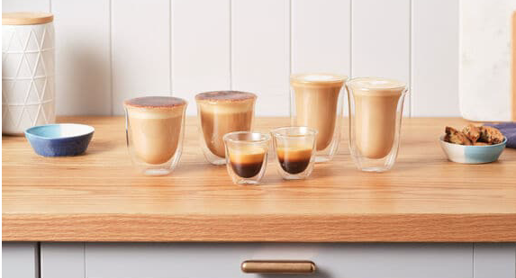
150ml
240ml
30ml
Notes:
IT COMES IT VARIOUS SIZES FOR ESPRESSO, CAPPUCCINO AND LATTE

Slide 14
Notes:
IT LOOKS EXPENSIVE AND YOU CAN SEE THE LAYERS

Slide 15
Notes:
-20C to 150C – IT HANDLES BOTH COLD AND HOT

Slide 16
on further
investigation
Notes:
I WANTED TO KNOW MORE …

Slide 17
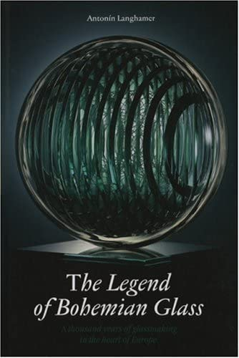
Notes:
DOUBLE WALLED GLASS FIRST APPEARED IN EARLY 1700s – IT IS NOT NEW

Slide 18
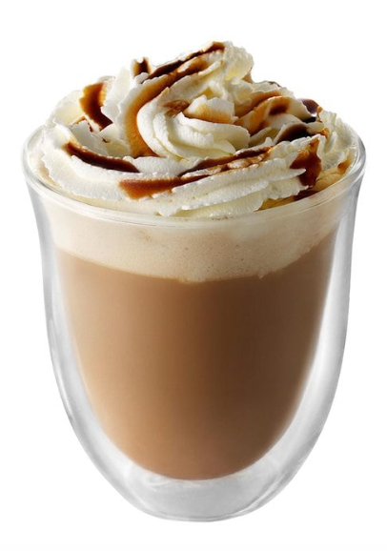
Notes:
LOTS OF FACTORS AND ELEMENTS THAT INTERACT

Slide 19
Notes:
AS OPPOSED TO LIME SODA

Slide 20
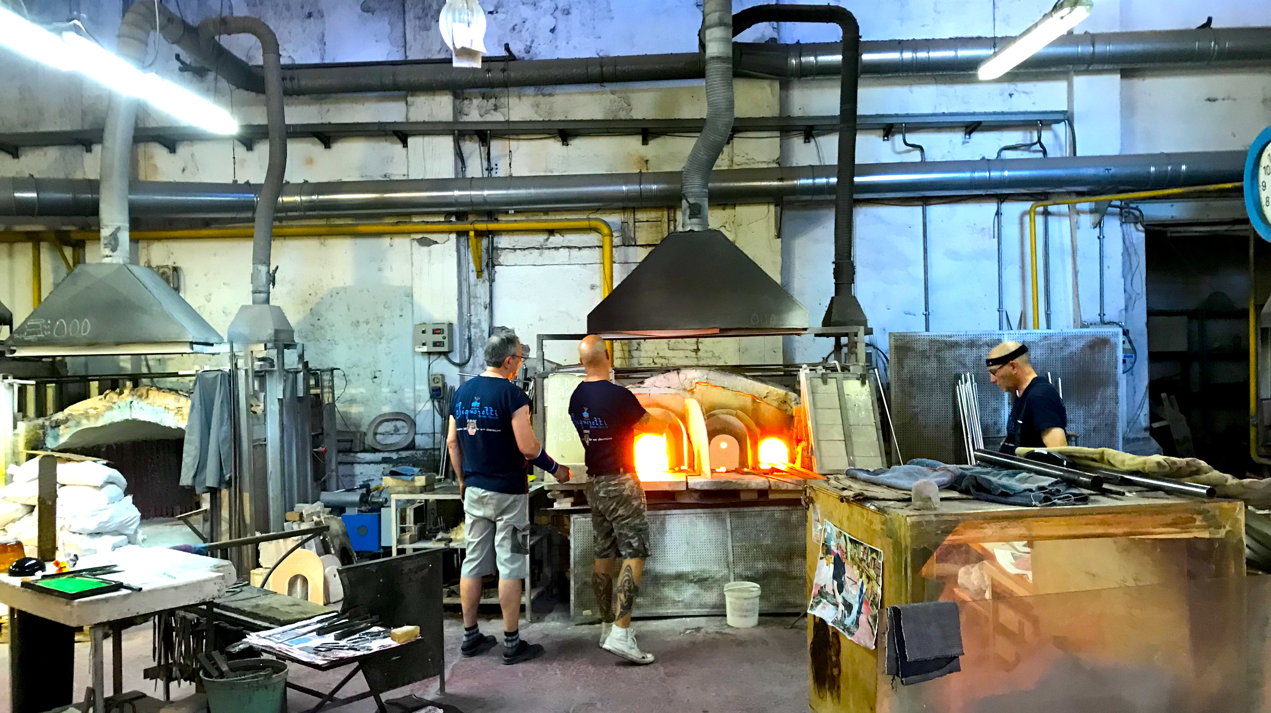
Notes:
IT IS HANDBLOWN
MURANO IS LOCATED IN VENICE REGION AS IS DELONGHI IN TREVISO

Slide 21
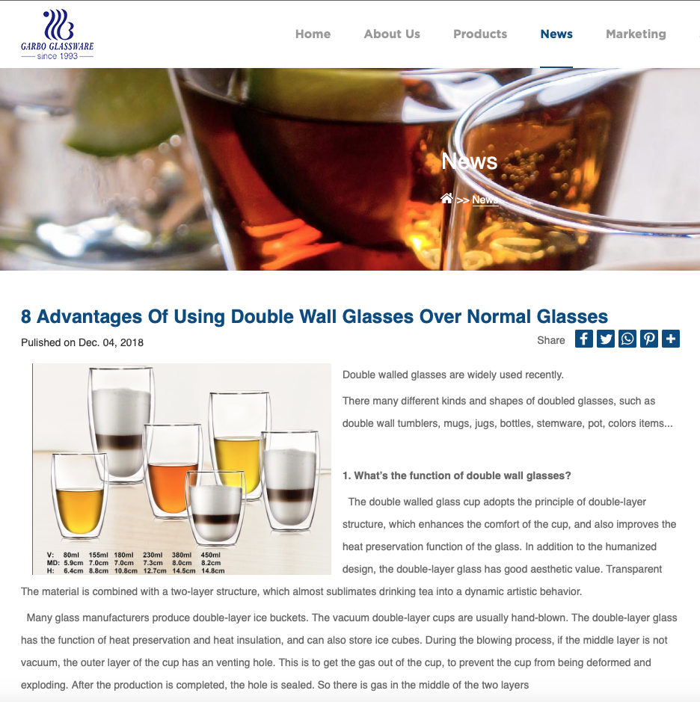
Notes:
IT HAS CERTAIN ADVANTAGES OVER NORMAL GLASS – WHAT IS NORMAL?
REALLY WORRIED WHEN YOU USE FANCY WORDS

Slide 22
How A Ceramic Mug Makes Your Coffee Taste Better
“Using a ceramic cup usually means that you cherish your coffee drinking time of the day
and enjoy a more comfortable environment. Compared to drinking coffee with a paper
cup, drinking from ceramic coffee mugs give you the feeling of a better drinking experience
due to its weight, texture, insulating properties and the location where you usually use it
(home, office, coffee shop). On the other hand, a paper cup feels disposable and temporary
and is most likely used in new environments and unique situations, like an event or an out-
of-state business meeting.”
Notes:
NOTE THE INTERESTS AND WORLD VIEW OF THE POSTER
NOTE WHAT IS NOT COMPARED – NO MENTION OF GLASS

Slide 23
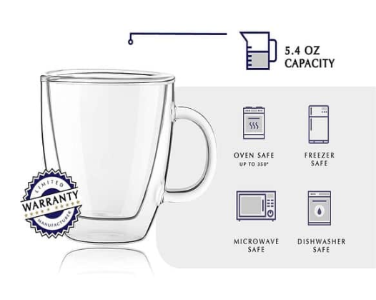
Notes:
STURDY – SOMEWHAT OF A PARADOX GIVEN THE IMPRESSION WHEN IN THE HAND

Slide 24
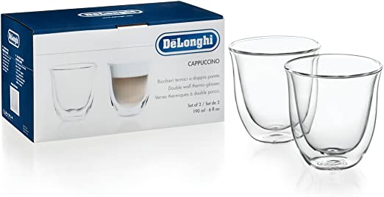
Notes:
BRANDED ON THE BOTTOM – WHAT IS THIS COMPANY ABOUT
WHAT IS THEIR BACKSTORY

Slide 25
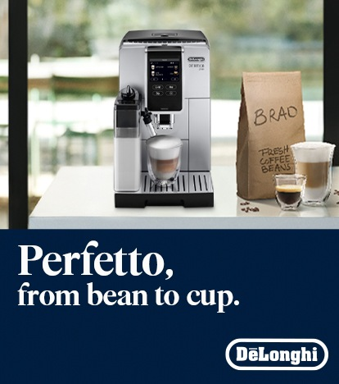
Notes:
FAMILY OWNED BUSINESS ESTABLISHED IN 1902 – 3RD GENERATION – IN TREVISO ITALY NEAR VENICE

Slide 26
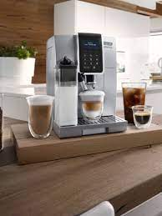
Notes:
FOCUS HAS BEEN ON THE KITCHEN CONTEXT – THERE ARE 34 ITALIAN ESPRESSO MACHINE MANUFACTURERS
AND DELONGHI HAS 36% GLOBAL MARKET SHARE

Slide 27
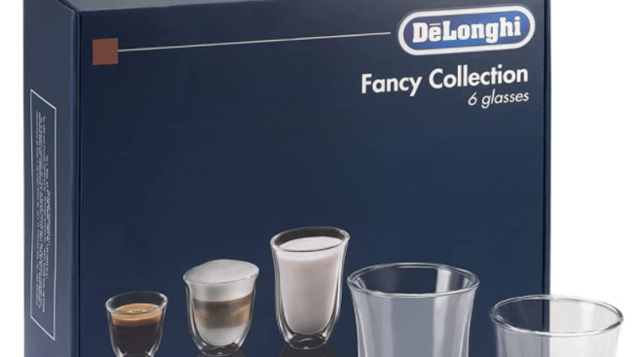
Notes:
I REALIZED THAT I MIGHT NEED TO EXPAND MY COLLECTION – NOT EVERYONE DRINKS CAPPUCCINO (OR COFFEE)

Slide 28
my thoughts
wandered

Slide 29
why all
this fuss?

Slide 30
Notes:
I OFTEN FIND MYSELF STARING AT THE CUP – NUDGE TO SLOW DOWN AND ENJOY

Slide 31
Notes:
LOTS OF FACTORS AND ELEMENTS THAT INTERACT
THE RIGHT MILK AT THE RIGHT TEMPERATURE NEEDS TO INTERACT

Slide 32
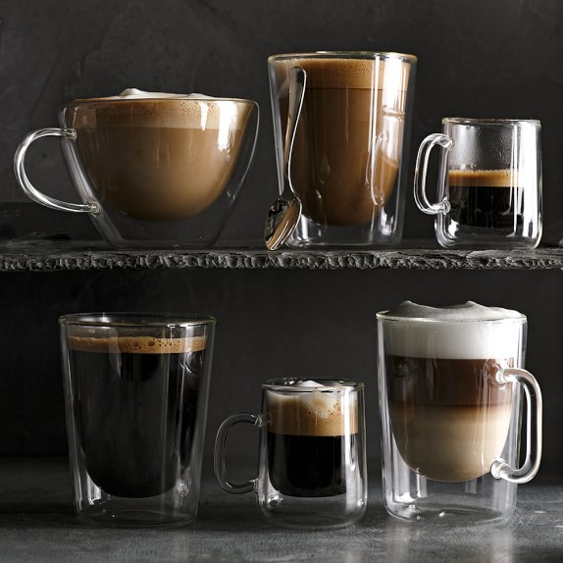
Notes:
LIQUIDS CAN LEAVE LINGERING TASTES TO ”CUP” – MATERIAL NEUTRALITY
THERE IS ALSO COMPLEX SCIENCE INVOLVED BETWEEN THE LAYERS WITHIN A DRINK
BUT NOTICE THE PRESENCE OF FOAM – CREMA FOR ESPRESSO MICROFOAM FOR MILK

Slide 33
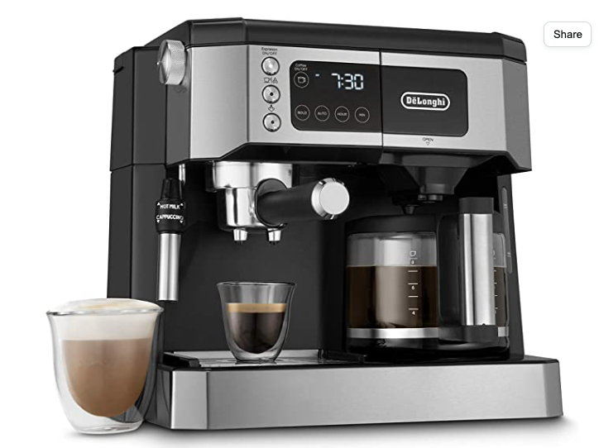
Notes:
FIT – CONGRUENCY ON MANY LEVELS (SPECIAL) – THESE ARE EXPENSIVE SLEEK MACHINES

Slide 34
Notes:
SO THERE IS CONGRUENCE TO THE IDEA OF INVESTING IN GLASSES

Slide 35
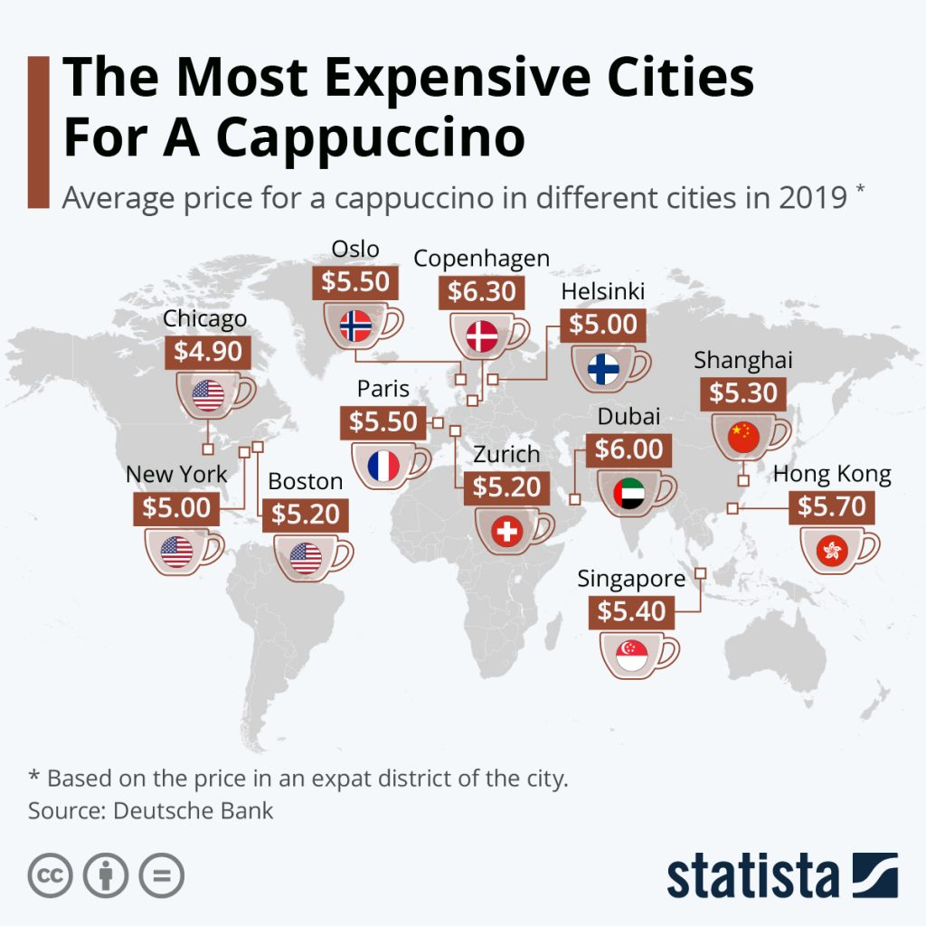
Notes:
CAPPUCCINO IS SPECIAL COFFEE – CONGRUENCE WITH HIGH PRICE POINTS – NICE GLASS

Slide 36
congruency

Slide 37
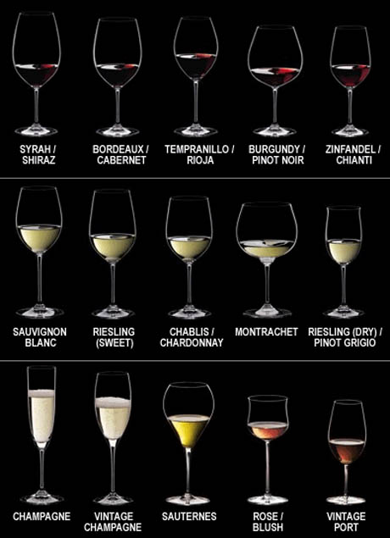
Notes:
RIEDEL HAS DONE THE SAME THING WITH WINE GLASSES

Slide 38
why the
kitchen?

Slide 39
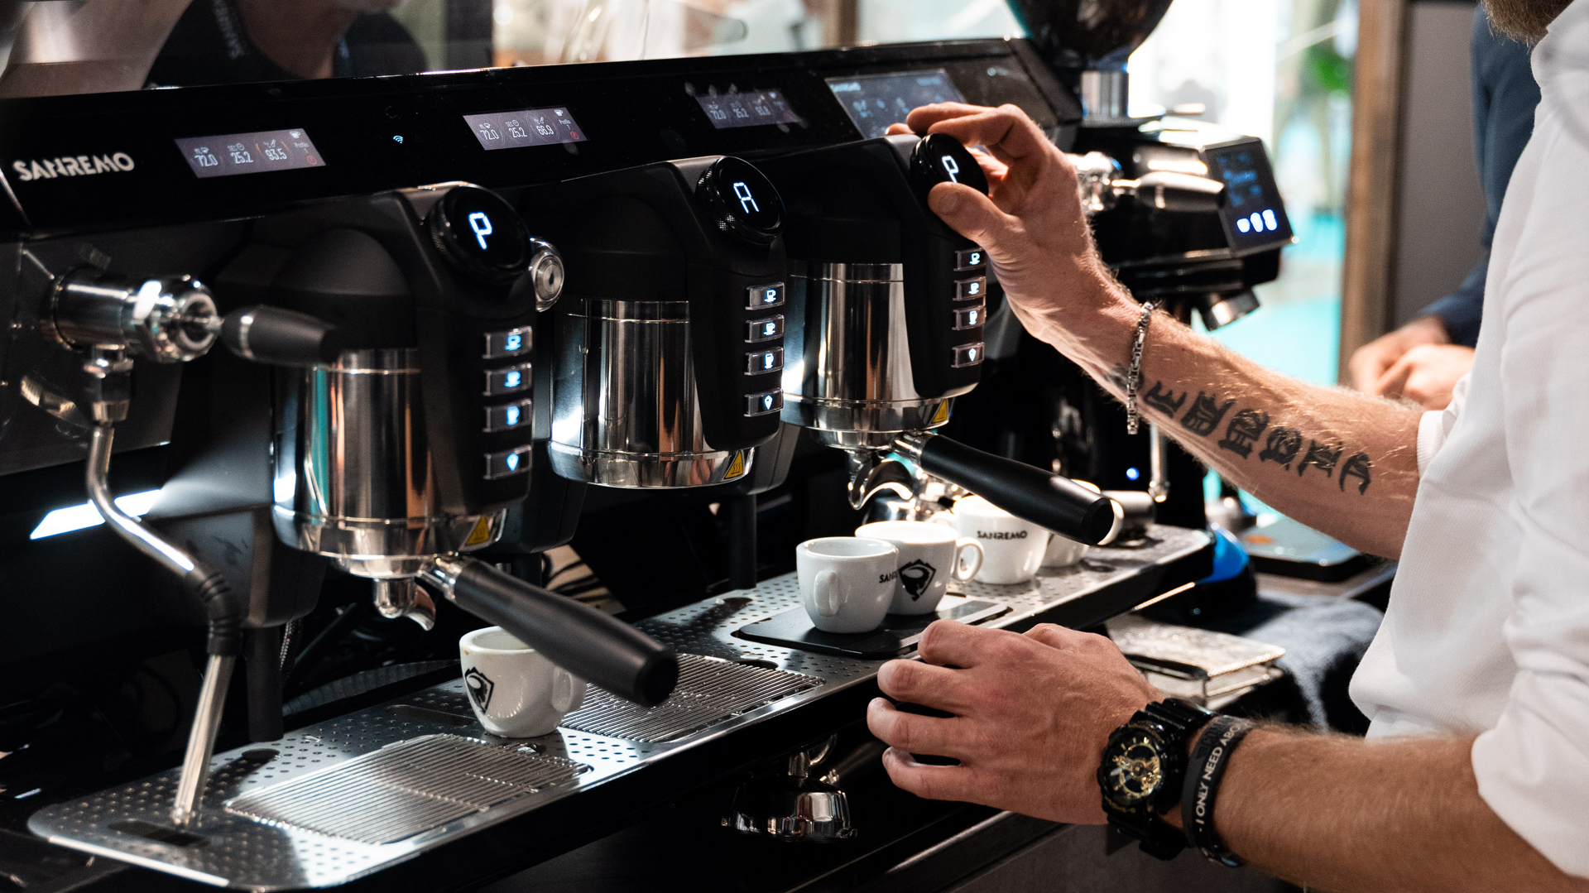
Notes:
FOCUS IS NOT ON THE CONTEXT OF CAFÉS

Slide 40
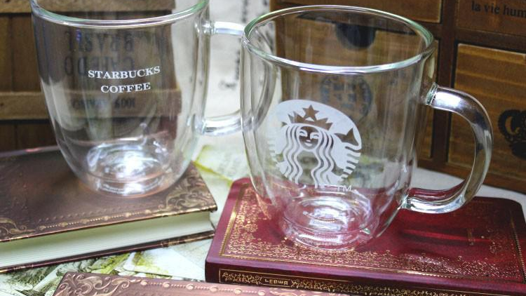
Notes:
WHY DON’T WE SEE THINGS LIKE THIS IN STARBUCKS CONTEXT

Slide 41
interaction is
multilayered

Slide 42
how a product
is used

Slide 43
how it interfaces
with a context
in use

Slide 44
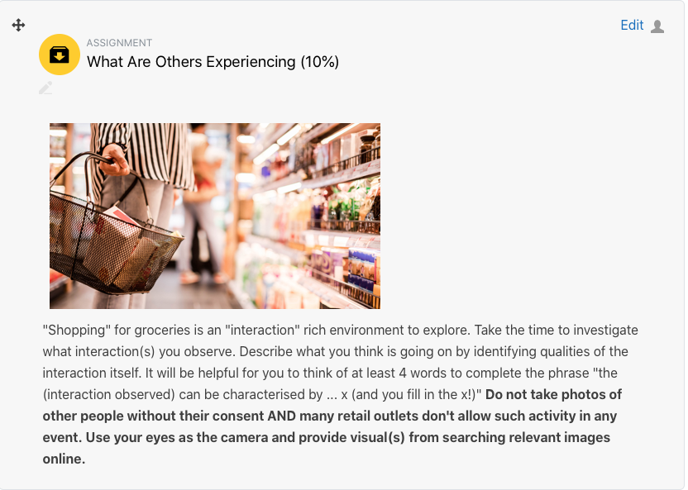
Notes:
20 SEPTEMBER

Slide 45
domains
Phenomenon – a fact or situation that is observed
to exist or happen but whose cause or explanation
is in question (climate change, aging population)
Problems – situations, questions or things that
cause difficulty, stress or doubt (extreme weather,
retirement)
Areas of life – sustainability (healthy living,
financial security)
Notes:
THE FOCUS OF YOUR GROUP ASSIGNMENT

Slide 46
domain choice
pick one that is of interest to you and ask why
is it so interesting?
many domains are saturated with solutions
conformity and rules underpinning many
products today are well past their “sell by date”
forward vision not problem solving in present
trust your intuition but seek out justifaction
Notes:
THE FOCUS OF YOUR GROUP ASSIGNMENT

Slide 47
Notes:
11 OCTOBER

