Slide 1
Introduction to Intellectual Property Rights
Senior Legal Counsel, Certified Information Security Professional (CIPP/E) Maria Rehbinder
Copyright visualizations: Sanna Vilmusenaho

Slide 2
Different types of IP
Legal right
What for?
How?
Trade marks
Distinctive identification of products or services
Use and/or
registration
Registered designs
Registered designs
Registered designs
External appearance
External appearance
External appearance
Registration
Trade secrets
Valuable information not known to the public
Reasonable efforts to keep secret
EPO/OHIM Intellectual Property Teaching Kit - IP Basics
2
Notes:
Trade marks are distinctive signs indicating the source of a product or service. They include, for example, names, logos and colours applied to the owner's products or services, which distinguish them from products and services provided by competitors.
Registered designs protect the external appearance of a product. They do not give any protection for technical aspects. They include new patterns, ornaments and shapes. To be officially registered, designs need to be original and distinctive. The artistic aspects of a design may also be protected by copyright.
Unregistered designs also enjoy some protection. An unregistered design is a free, automatic right that you get when you present a design to the public. It gives you the right to stop anyone from copying your design. The protection afforded by an unregistered design is normally of more limited duration than that available for a registered design.
Trade secrets are an alternative to patents. They cover information not known to the public. If the possessor of the information is careful to keep it confidential, he can sue anyone who steals it.
2

Slide 3
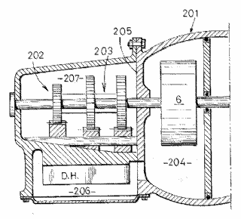
Different types of IP https://oami.europa.eu/knowledge/course/view.php?id=1738
Legal right
What for?
How?
Patents
New inventions
Application and examination
Utility models
New inventions
Application and registration
Copyright
Original creative or artistic forms
Exists automatically
EPO/OHIM Intellectual Property Teaching Kit - IP Basics
3
Notes:
Patents are granted for technical inventions. Applications for patents are examined by the patent office they are filed with, in order to determine whether they meet the stringent requirements for a patent to be granted. Patents generally last for a maximum of 20 years from the date of filing.
Utility models offer simpler protection, for a shorter period of time, but are usually registered and published much more quickly than patents.
Copyright does not need to be registered. It automatically exists when a work is created. It protects any type of original, creative expression, including literature, art, drama, music, photographs, recordings and broadcasts.
3

Slide 4
Intellectual Property (IP) Legislation and Agreements
Legislation defines the scope of intellectual property rights, when they are born and to whom/to what entity
IP rights give the author the right to deny others from using of his /hers exclusive right
Intellectual property legislation is contractual. There are some limits and requirements in legislation, but within that framework
Agreements define how IP rights can be used.
IP can be sold, licensed or inherited.

Slide 5
Intellectual Property that does not have to be registered
Copyright
Related rights (performers, producers, broadcasters rights )
Sui generis database right
Unregistered trademark TM
Unregistered Community Design
Trade secrets

Slide 6
Intellectual Property that has to be registered
Registered trademark
Company name
Domain name
Design Right (national ) ( also called Design Patent in USA and China) in EU Registered Community Design
Social media account
Company name (or association name) trademark, domain name and social media account name the same WORDMARK, is a good IPR startegy

Slide 7
Example: FLOW FESTIVAL
Registered as a wordmark :
Word
Nice Classification
9, 25, 35, 41
Trade mark status:Registered
Owner name
Flow Festival Oy
Registered domain https://www.flowfestival.com/en/

Slide 8
Trademark
Trademark is a distinctive sign used indicate the source of a product and to distinguish products of one trader from another in the market
Registration gives the exclusive right to use mark as a symbol for goods or services
Requirement for registration is that the trademark is distinctive

Slide 9
Trademark
Trademark can be word or a figure, slogan, letters, graphic design, or combination of these
Trademark can be a tune, for example the Nokia Tune

Slide 10
Trademark
International Classification of Goods and Services Nice Agreement 45 classes, Goods 1-34, Services 35-45
http://www.wipo.int/classifications/nice/en/
TMView global trade mark information
https://www.tmdn.org/tmview/welcome

Slide 11
Trademark
The Apple mark can be registered as a distinctive mark in class 9 that includes computers, but could not be registered for class 29 that includes preserved , frozen , dried and cooked fruit, in that class it would not be distinctive.

Slide 12
Trademark
You can use the circled R mark indicating a registered trademark only for registered marks.
You can use TM for unregistered marks that are used as a trademark.
An unregistered trademark can also be established by long and succesful use, much harder to defend than a registered trademark.

Slide 13
Trademark
Can be registered nationally, for example in Finland
Can be registered with one application to whole EU
International registration under Madrid Agreement, requires first EU or national registration.
www.oami.europa.eu
www.prh.fi
http://www.wipo.int/madrid/en/how_madrid_works.html

Slide 14
Trademark
Protection starts from the date of filing an application and protection last 10 years (if application accepted)
Other IPR have limited term, a trademark is forever, as long as renewal is done and fee is paid every 10 years.
In order to remain distinctive a trademark has to be defended against unauthorised use by competitors, other companies offering products or services
Trademark can be diluted for example jacuzzi became a generic word

Slide 15
Wordmark Glastonbury Festival
TypeWord
Filing date15/08/2019
Registration date28/08/2020
Nice Classification
3, 9, 14, 16, 18, 20, 21, 22, 24, 25, 28, 35, 36, 38, 41, 42, 43
Trade mark statusRegistered
Owner ID number 234672
Owner name Glastonbury Festivals Limited

Slide 16
Cpombination of word and figure can be protected as trademark
)Registration office | NO
(111)Registration number | 281213
(151)Registration date | 2015-03-30
(141)Expiry date | 2024-09-09
Kind of IPR | Trade mark
(550)Trade mark type | Combined
(511)Nice classification | 12,16,18,20,21,24,25,35
(531)/(532)Vienna classification | 26.13.25, 26.04.16
Current trade mark status | Registered
Status date | 2015-03-30
Opposition period start date | 2015-04-07

Slide 17
Figurative trademark
Trade mark office | Finland - PRH
(190)Registration office | FI
(111)Registration number | 247847
(151)Registration date | 2009-12-31
(141)Expiry date | 2019-12-31
(550)Trade mark type | Figurative
(591)Claimed colour(s) | Merkin värit ovat punainen, aniliininpunainen, musta, oranssi, valkoinen ja kirkkaanpunainen. Märket utförs i rött, anilintrött, svart, orange, vitt och klarrött.
(511)Nice classification | 9,11,14,16,18,20,21,24,25,26,27,28

Slide 18
Trademark Is Forever Registered Trademark is the legal base of of a brand Coca Cola was first registered as a trademark in 1893

Slide 19
Overlapping IP Protection: The Coca-Cola Contour Bottle
The second design patent for the contour bottle was granted to the Coca-Cola Company 1937
Federal trademark registration for the contour bottle shape granted1960, enabling the company to
safeguard the bottle design indefinitely.

Slide 20
Protection of new design against copying
If you create a new logo for an event or organization, you can both register the logo as trademark and design right. Design right protects new design against copying
Registration of a design right provides an exclusive right, others may not use the design without the consent of the design right owner.
Design right requires that design is new and has individual character
Individual character means that the overall impression of the design differs sufficiently from the overall impression of design already made available to the public

Slide 21
Scope and Period of Protection
EU registration is valid for five years from the filing date and can be renewed for four further periods of five years, maximum 25 years
In the application a Locarno class indicated, but protection is not limited to classes, all uses of design are protected, where as trademark use is only protected in the classes it was registered for (except for wll known marks such as Mercedes Benz ) http://www.wipo.int/classifications/locarno/en/
The registered designs are available in national and OHIM databases

Slide 22
Copyright
Copyright does not need to be registered. It automatically exists when a work is created. It protects any type of original, creative expression, including literature, art, drama, music, photographs, recordings and broadcasts.
In addition to copyright, the Copyright Act protects also related rights of performing artists, producers, broadcasters and photographers and sui generis database right.
Producers, broadcasters and owners of sui generis database right are or can be legal entities

Slide 23
Copyright is born to an author , a natural person

Slide 24
Economic and Moral Rights

Slide 25
Exception rules
In EU there are exception rules that allow use for example for non-commercial scientific uses, these are defined in the Infosoc Directive and implemented in national Copyright legislation.
Exception rules allow for private use , to decipt buildings and artwork permanently placed in public places, art in exhibition catalogues.
Name of the author and the source have to be mentioned and right of integrity respected

Slide 26
Copyright exceptions in Finnish Copyright Act
For thesis or scientific articles it is allowed to publish , also elctronically, pictures, if they illustrate the scientific text. There has to be a link to the text, the artwork on photo has to be discussed and analyzed in the text. Citations can be used according to good scientific practise. Always mention the source and all authors according to good scientific practise.
Notice that if there is an agreement between the university library / or researchers and provider of a database that agreement has to be followed and that can prevent certain uses for example electronic use.

Slide 27
Copyright period of protection
Protection starts from the moment of creation and last the lifetime of the author plus 70 years (USA, EU ) from the year the author died
Gives a longer protection period than Registered Design Right, therefore important for design classics
If there are several authors protection from the year the last surviving author died
Berne Convention minumum 50 years from the year author dies

Slide 28
Originality only requirement for copyright protection
Protection is provided by Copyright Act as soon as the work is original enough to rise above the treshold of originality
No registration is needed to achieve protection
The Berne Convention prohibits registration as a requirement for protection
Copyright can be registered in some countries for example USA and China

Slide 29
Copyright protects original form
Protection of original form, not the idea, information or subject matter
Court of Justice of the Europen Union originality criterion 1. the creation is the author’s own original creation;
2. the creation reflects his or her personality;
3. the author, in conjunction with the creation of his/her work, has been able to express his/her creative ability by making free and creative choices and thus stamping his/her personal touch on the work.

Slide 30
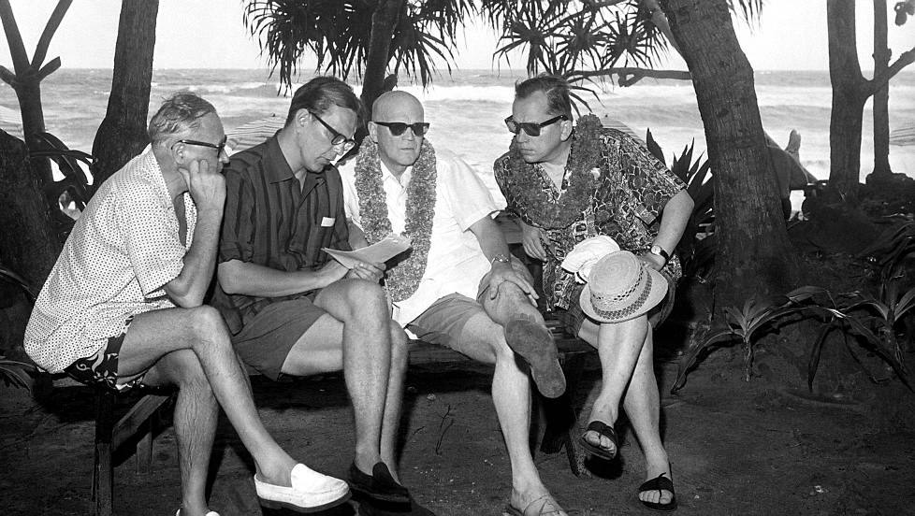
Kalle Kultala: Noottikriisi 1961 original TN 2013:3
Notes:
Kalle Kultala

Slide 31
Photographs protected
In addition to copyright protection, the Finnish Copyright Act also protects all photographs, also those lacking originality with a related right , photographers right that lasts for 50 yeras from the year the photo was taken.
The above photograph by photographer Kalle Kultala had originality above the work treshold and is protected as a work, that is for the duration of lifetime of author + 70 years, Copyright Council statement 2013:3 http://www.minedu.fi/export/sites/default/OPM/Tekijaenoikeus/tekijaenoikeusneuvosto/tekijaenoikeusneuvoston_lausunnot/2013/TN_2013-3.pdf

Slide 32
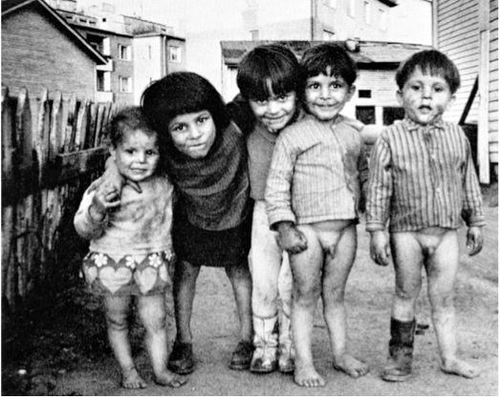
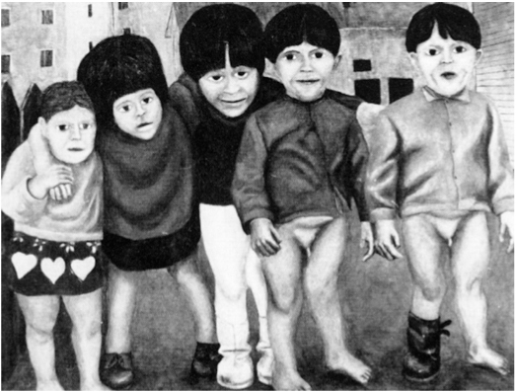
Supreme Court of Finland KKO 1979 II 64
Kalervo Ojutkangas photo was used as starting point
Pekka Viherä painting new original work , not infringing

Slide 33
New original work
According to Finnish Copyright Act 4 §2, if you make a new independent original work, based on a previous work protected by copyright, that use is allowed and not infringing on the previous work.
The Finnish Ministry of Education and Culture has a copyright Council that gives opinions on the interpretation of Copyright law.Copyright Council opinion TN 2014:17 states that the use of a photograph by Maija Louekari to create a pattern for a Marimekko fabric ”Hetkiä”, was not infringing (see next slide)
http://www.minedu.fi/export/sites/default/OPM/Tekijaenoikeus/tekijaenoikeusneuvosto/tekijaenoikeusneuvoston_lausunnot/2014/TN_2014-17_anon.pdf

Slide 34
Nwe original work
According to Finnish Copyright Act 4 §2, if you make a new independent original work, based on a previous work protected by copyright, that use is allowed and not infringing on the previous work.
The Finnish Ministry of Education and Culture has a copyright Council that gives opinions on the interpretation of Copyright law.Copyright Council opinion TN 2014:17 states that the use of a photograph by Maija Louekari to create a pattern for a Marimekko fabric ”Hetkiä”, was not infringing (see next slide, notice that images are not licensed under CC-BY 4.0 )
http://www.minedu.fi/export/sites/default/OPM/Tekijaenoikeus/tekijaenoikeusneuvosto/tekijaenoikeusneuvoston_lausunnot/2014/TN_2014-17_anon.pdf

Slide 35
Notes:
Images are not Creative Commons licensed

Slide 36
Supreme Court of Finland KKO 1988: 82 Krystyna Rudzinsky original work left, infringing work copying original features of Rudzinskys work right

Slide 37
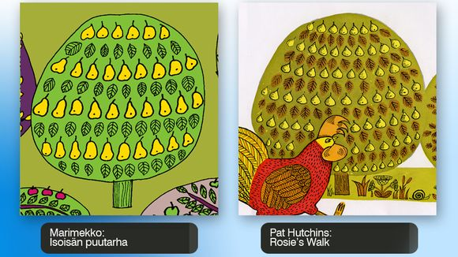
Original work or infringing? http://yle.fi/uutiset/expert_clears_marimekko_of_new_plagiarism_suspicions/6759213
Designer
Teresa
Moorhouse:
Marimekko
”Isoisän puutarha” fabric

Slide 38
Copyright and Design Right
Directive on the Legal Protection of Designs (Article 17) and the Regulation on Community Designs (Article 96) that each individual Member State shall decide to what extent, and on what terms, copyright protection is to be given to objects which also enjoy protection of their design, and what originality is required for this protection.
In Finland originality treshold for design is high.

Slide 39
Intellectual Property Agreements
Intellectual Property can be transferred with an agreement
Ownership of certain intellectual property can be transferred or rights to use can be granted with license
The rights transferred have to be be clearly defined
Also in employment contracts IPR transfer should be clearly defined
Finland does not have an work for hire clause in Copyright Act

Slide 40
IP Agreement
The right transferred can be an exclusive right – author can no longer use his/her work
or a non-exclusive right – possibility to grant rights to several users
or sole right- author can still use the work but cannot transfer right to a third party
According to Copyright Act the right to alter and the right to further transfer to third parties must be specifically mentioned in the agreement

Slide 41
Choosing an Intellectual Property strategy
Choosing one wordmark, a word that is company name, domain name and registered trademark is usually a good strategic decision.
All decisions about registering, enforcement or agreements concerning intellectual property should be done according to IP strategy.
1. WHAT is a company or entity that has similar IP needs and uses ?
2: What is the role of your company in the reference group of your field ?
3: What registered and unregistered IP does the Company have ?
4: How does your company derive income from IP ?
5: What registered or unregistered IP does your company need ?
6: Specify mismatch between IP needed and IP owned or licensed in
7: IP investment needed to match IP needed into IP already at hand?
9. What companies or entities could be usefull to license out IP ?
10: Are there companies that are a threat to your IP ?

Slide 42
More information
http://libguides.aalto.fi/c.php?g=659426&p=4654810
https://libguides.aalto.fi/copyrigh
https://www.prh.fi/en/index.html
https://euipo.europa.eu/ohimportal/en
https://www.iprhelpdesk.eu/SME_Corner
https://www.teosto.fi/en
http://www.gramex.fi/en
https://creativecommons.org/
Questions? maria.rehbinder@aalto.fi

