Slide 1
Playability Evaluation: Day 1
DOM-E5082
Dr April Tyack

Slide 2
About Me
Dr April Tyack (she/her)
Australian
PhD topic: playing games to restore (short-term) wellbeing
2 experimental studies with post-play interviews
similar to playtesting (in some ways)
Co-created and taught game studio classes for 3 years

Slide 3
Schedule
Monday: 9:15am - 4pm
Overview of GUR methods
Participant observation
Tuesday: 12:15pm - 4pm
Heuristic evaluation (Chapter 15)
Wednesday: 10am - 4pm
Interviews (Section 10.1 - 10.6)
Thursday: 10am - 4pm
Surveys (Chapters 9 and 12)
Friday: 10am - 4pm
More surveys / your suggestions

Slide 4
Other Details
Mostly practical material
Show up, do the work, and pass
I don't know what you know
Let me know if you want to learn any other (related) skills

Slide 5
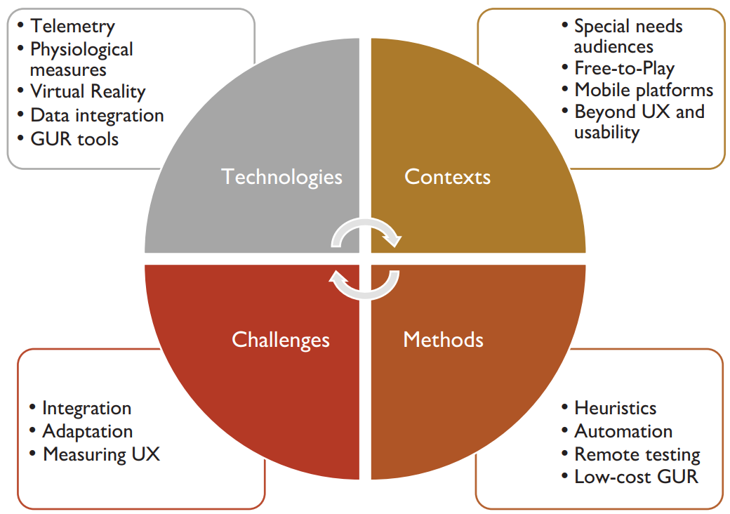
Evidence-driven
Improves player experience
Finds weaknesses in game design
Occurs across all stages of development
Games User Research

Slide 6
Games User Research
Evaluating (how players interact / feel about) games
Observing play
Player interactions with game elements of interest
Telemetry data
Analyse data
Supports iterative development
Reflection on design
Telling (potentially) hard truths to designers
https://taels.net/bentaels/2015/23/05/the-usability-of-bloodborne/

Slide 7
Usability vs. Playability
Usability: interactions are effective, efficient, and satisfying (ISO 9241-11 standard)
Playability: the interface is unobtrusive, design intent is clear, and the game is suitably difficult and engaging (Korhonen, 2016)

Slide 8
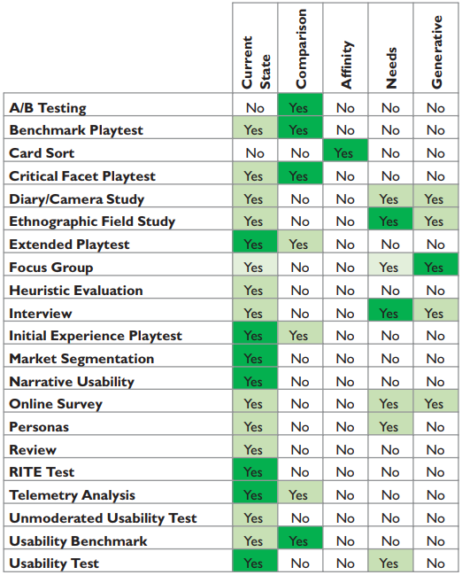
Overview of GUR Methods
Research Questions
Current state: How many times do players get lost?
Compare: Do players perform better with button mapping X, or Y?
Affinity: How should game objects be grouped?
Needs: What do players actually want (consciously or not)?
Generative: Produces new design ideas

Slide 9
Overview of GUR Methods
Common methods:
A/B Testing
Observation
Interviews
Surveys
Heuristic Evaluation
'Common' is relative to the studio size / culture

Slide 10
A/B Testing
Players are randomly assigned to play one of two (or more) slightly different games
The behaviour of interest (e.g., spending, retention) is measured (via telemetry) to compare design performance
Pros
Generates a definitive answer
Quantifies the influence of design changes
One of the few actual experiments (i.e., perceived rigour)
Cons
Requires a large enough player base for confidence in results
Can be difficult / expensive to set up
Designing, coding, and testing each condition takes time / labour
Does not explain why results occurred
Only finds local maxima

Slide 11
Observation
A researcher observes a tester's play behaviour while taking notes
Ideally, a second researcher facilitates the session, and the observer is elsewhere (e.g., watching on a separate screen)
Pros
See how 'typical' players actually behave in the game
Can be done early in development
Can provide specific answers to some questions
Cons
Players are rarely as honest as you might like
Presence of observers can bias results
Behaviour requires interpretation
Can be time-consuming
Outliers may be misinterpreted as trends

Slide 12
Interviews
A researcher asks individual players about the topic(s) of interest, while taking notes and recording audio
Pros
Generates contextual data that can stand alone, or explain other results
Follow-up questions can help generate new insights
An audio record provides a full account for later reference
Cons
Researcher bias is not always obvious
Can be difficult to prepare and run without experience
Considered less rigorous or valid than quantitative data by some

Slide 13
Surveys
A web form (or rarely, paper) with questions on players' attitudes and experiences
May include open text questions
Pros
Relatively easy to deploy
Can be applied to many topics
Standard experience measures already exist
Cons
Statistics knowledge is required to interpret quantitative results
Larger samples (N>100) are typically needed to test hypotheses

Slide 14
Heuristic Evaluation
One or (ideally) more researchers examine a game and evaluate its compliance with recognised design principles (‘heuristics’)
Pros
Comparatively fast and cheap to implement
Maximises value from more expensive methods
Comparing your game to conventional design is useful even if you disagree
Cons
Less comprehensive than they seem on paper
Effectively interpreting and applying heuristics requires some design expertise
Rigid application of 'authoritative' design principles can rob games of unique qualities

Slide 15
Limit These Types of Questions
Questions with no actionable findings
Questions likely to produce ambiguous answers
Sometimes useful (trust your gut), but resources are finite

Slide 16
Be Specific
Instead of:
“How often do players use the sniper rifle?”
Ask:
“How often do sniper rifles win matchups against other weapons?”
Or:
“How often are sniper rifles used in unfavourable matchups?"

