Slide 1
Principles of Empirical Analysis Lecture 12: Recap and wrap-up of part 2
Spring 2024
Miri Stryjan

Slide 2
Causal inference - some important terms
Throughout part 2 of this course: we often want to estimate the effect of some variable, T on some outcome, Y.
T = the independent variable, the variable of interest, the ”treatment”.
Y = the dependent variable, the outcome variable.
Examples:
T= education Y= later earnings
T= attending a certain school Y= Grades
T= exposure to pollution Y= health outcome
T= infrastructure improvement (metro) Y= house prices
T= carbon tax Y= emissions
T= fiscal stimulus Y= unemployment

Slide 3
Observational data
When experimental designs are infeasible, researchers must resort to the use of observational data
Observational data: data that is collected as part of the normal functioning of society's institutions, organizations or firms, e.g. data from administrative records, surveys, sales data, censuses, mobility data from google maps, data from apps….
Observational study draws inferences from a sample of a population where the independent variable (variable of interest, or “treatment”) is not under the control of the researcher
This is in contrast with experiments, such as randomized controlled trials (RCTs), where each subject is randomly assigned to a treatment group or a control group (e.g. MTO)

Slide 4
Natural or quasi-experiments
Sometimes the researcher is “lucky” and a government policy or nature affects households (or firms etc.) in a way that resembles an experiment
These instances are referred to as “natural experiments” or “quasi-experiments”
Historical episodes that provide observable, “almost” random variation in treatment status
These might be law changes that affect some people, but not others => control and treatment groups
“natural/quasi experiments”: Broad term that refers to many different situations and require different research methods (IV, RDD, DID)

Slide 5
Recap and repetition for the exam + additional info
We have posted 4 old exam questions on Mycourses that give a good idea on what the exam will look like.
No stata code-questions in the exam
No need to know how exactly we estimate the approaches (e.g. how do we compute the effect with DID)
Completing the course evaluation before March 1
we will give 1 bonus point to everyone who completes the survey if we can reach a survey response rate of at least 95% (like in the examples from the lectures, we want to avoid sampling bias =).
your answers are anonymous but we can see a list of everyone who did the evaluation.
Exercise 5 posted tomorrow, deadline March 1.
There is an online exercise session with Martta tomorrow related to this last homework.

Slide 6
Course evaluation via Mycourses:

Slide 7
Go to IV slides

Slide 8
General takeaways from part 2 and what to think of and practice for the exam

Slide 9
Recap of Part 2
We will go through the key points of each approach we discussed in part 2. When doing so, we will try to keep in mind how we can know which method to use in a given setting.
As usual, we start with some causal relationship in mind.
We would like to estimate the effect of some treatment, T on some outcome, Y.
But we suspect that there is selection into treatment: treatment status T is correlated with unobservables that also affect Y.
Depending on the type of data that is avalable, and the nature of the “treatment” that we want to measure the effect of, different methods may be more or less suitable for isolating the causal effect of T.
Then talk about some general topics
How to read a regression table
External and internal validity
…

Slide 10
We talked about 4 different research designs (in Part 2 of course)
Plausible selection on observables: treatment and control groups differ from each other only w.r.t. observable characteristics
Natural experiments where the ”treatment” happened in a random way within a well defined population – analysis is the same as in an RCT.
Strong reason to expect selection on unobservables: treatment and control groups differ from each other in unobservable characteristics
Exogenous variable induces variation in treatment – instrumental variables (IV) Lecture 9
Selection mechanism is known – regression discontinuity designs (RDD)
Treatment and controls are observed before and after treatment – difference-in-differences (DID)

Slide 11
For the exam
To know what each method is all about
What are central concepts for this method? What kind of data do we need to use the method?
What are the key assumptions, and how can these be tested?
What are the drawbacks of this method?
How do we know what method is most suitable?
External validity, reading tables, mechanisms…

Slide 12
So we estimated a causal effect – so what #1
In addition to measuring the size of a causal effect, we often want to know what are the mechanisms or channels of the effect. What do we mean by that?
Why does it matter when interpreting results from a study?

Slide 13
So we estimated a causal effect – so what #2
The course has mainly focused on internal validity (properly measuring what we aimed to measure).
We also briefly talked about external validity.
How do you know what the external validity of a study is?
How can understanding the mechanisms or channels of the effect help with external validity?

Slide 14
Choosing the appropriate method
How can we know which method is good?
Knowing how to think about this is an important takeaway from the course. Some of the exam questions can be of the type where we describe some scenario to you and then ask you to suggest what method you would use to measure a causal effect in that scenario and to motivate and explain why!

Slide 15
Regression output tables
This point estimate is statistically significant since
0.0165*1.96<0.123
The point estimate suggests a positive effect, and the entire confidence interval lies on the positive side of zero.
This point estimate is not statistically significant since
0.00999*1.96=0.0196 and
-0.0107 +0.0196>0
The point estimate suggests a negative effect, but the confidence intervalcrosses the value zero.

Slide 16
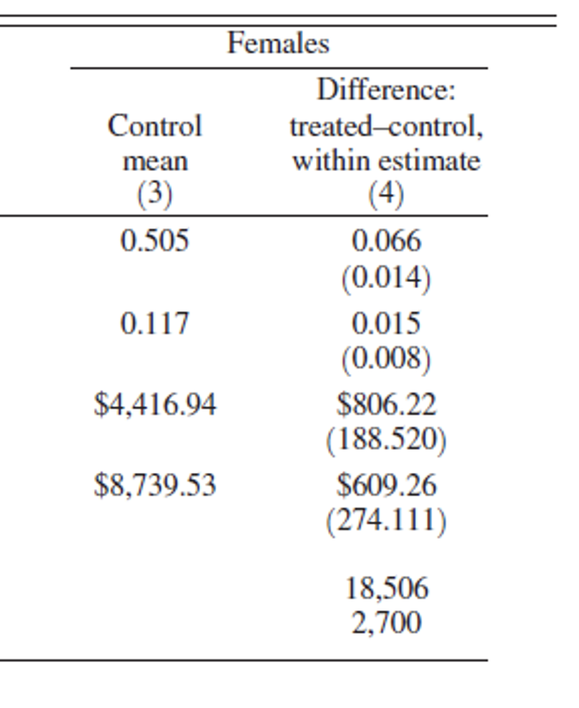
Discussion of Table 4 This is the female columns from prev page
Among females in the control group (kids who did not get displaced) the average employment is just over 50%.
The treatment effect (discussed more on the right side of the table) is 6.6%. If we compare this effect to the control group mean, we see that due to the treatment, the likelihood to be employed increased by 0.066/0.505 = approximately 13%
The point estimate for the treat-control difference is 0.066, i.e. in the treated (displaced) group, the employment rate is 6.6 ppt. higher.
The standard error of this point estimate is 0.014.
In other words, the difference between treatment and control females is significant at the 5% level since
0.066 - (1.96*0.014)= 0.066-0.0274 >0

Slide 17
Statistical significance – from lectures 5-6*
• we typically call estimates ”statistically significant” if p < .05 • i.e. if there was no effect, differences as extreme as the one we observed between treated/control would occur less than 1 out of 20 times
Let’s discuss significance and the 95% CI in the context of Table 4.
The point estimate for the treat-control difference is 0.066.
The standard error of this point estimate is 0.014.
In other words, the lower and upper boundaries of the 95% confidence interval for this estimate are
0.066 - (1.96*0.014)= 0.066-0.0274 = 0.03856
0.066 + (1.96*0.014)= 0.066+0.0274 = 0.09344
Since the entire CI lies above 0, we can conclude that there is a “significant” effect different from 0.

Slide 18
Approaches / Research designs

Slide 19
Natural experiment with selection on observables
If we think that we can measure the aspects that matter for selection into treatment, and that conditional on any such observable differences the treatment assignment is as good as random, we can treat the situation as if it were an RCT:
Comparing outcomes between treated and control group -> the causal estimate
Requirements: We need to have a population of comparable individuals, where part of them are exposed some change or shock – the “treatment”, while the rest are not exposed.
Assumptions: Need to show evidence that exactly who was exposed to the shock was essentially random, i.e. indeed the “treatment” was as good as randomly assigned. Example: housing demolition paper.

Slide 20
Natural experiment with selection on observables - Testing the assumptions
Assumptions: Need to show evidence that exactly who was exposed to the shock was essentially random, i.e. indeed the “treatment” was as good as randomly assigned. Example: housing demolition paper.
How can we test if this assumption is satisfied? Two parts:
Show balance tests where you compare T and C groups before the “treatment” occurred, and show that the two groups were similar on a range of observable variables that we think matter.
Discuss the institutional context, and explain that there is little reason to suspect selection into treatment. In the housing demolition paper: people did not select which building to move into; authorities’ decision on which houses to be demolished was unrelated to the resident’s characteristics.

Slide 21
DID
This strategy can be useful when we observe a change “treatment” that occurs at a given time, only affects some individuals/areas and we have data on our Y variable from before and after that change.
The KEY assumption: in the absence of treatment, the difference between treatment and control groups is constant over time (parallel or common trends)
The KEY assumption needs to hold for DID to be internally valid
With this assumption we can relax the requirement that the treatm and control groups are almost identical/as good as randomly assigned if we have data on each group at several points in time:
use observations in treatment and control groups before and after the treatment to estimate a causal effect

Slide 22
Key assumptions of DID
Parallel trends: The main assumption for any DID strategy is that the outcome in the treatment and control groups would follow the same time trend in the absence of treatment
Note: this does not mean that they must have the same mean (or level) of the outcome

Slide 23
Testing the Key assumptions of DID
Parallel trends: The main assumption for any DID strategy is that the outcome in the treatment and control groups would follow the same time trend in the absence of treatment. Since this counterfactual situation cannot be directly observed, support that this assumption is fulfilled is usually obtained by showing 2 things:
Parallel pre-trends: Show that in the period before treatment, the two groups developed in a similar manner, i.e. followed a parallel trend. Better if we have observations from several points in time.
Common shocks: Show that if other policies or changes coincided with the treatment period, these affected the treatment and control groups in the same way. Alternatively, show that:
Nothing else happens at the same time as the treatment takes place that would affect the control and treatment groups differently

Slide 24
Showing support for parallel trends by looking at pre-treatment trends
y
Treatment happens
Time

Slide 25
Key assumption continued
Even if pre-trends are the same one still must worry about other policies or changes coinciding with the treatment
Nothing else happens at the same time as the treatment takes place that would affect the control and treatment groups differently
How can this be “tested”? By discussing possible threats and showing arguments that they are not a concern: (e.g. there was a recession in the study period, but it affected the control and treatment group equally and is therefore ”netted out” when we compare with the after-before difference in the control group.
It is very important to be familiar with the institutional details of the reform/policy change that you are analyzing
This applies to all empirical research, but is particularly important in quasi-experimental settings

Slide 26
DID recap
Idea:
Even if treated and control groups differ in baseline characteristics, we can use observations on treatment and control groups before and after the treatment to estimate a causal effect.
Assumptions:
The potential outcomes (not observed) would have developed in a parallel manner for both groups in the absence of treatment
Common shocks: There can be no differential changes over time for the treated and control groups.
Testing for design validity:
Visualization and testing: are trends in outcomes parallel before treatment? Discuss: Is there anything else that could have happened to one group but not the other? (know your institutional setting!)

Slide 27
Regression Discontinuity Design, RDD
RDD can be used to isolate the causal effect of treatment in certain situations where Individuals (or units) become treated after crossing some cutoff.

Slide 28
RDD – the setup
RDD has three fundamental components: running variable, cut-off, and treatment
Individuals become treated after crossing some cutoff in the running (or forcing or score) variable
Sharp RDD: treatment received with probability zero below the cut-off (or threshold) and probability one above cut-off
Fuzzy RDD: The probability of receiving the treatment increases discontinuously at the threshold (imperfect compliance)
Assumption: the potential outcomes evolve smoothly across the cutoff. In other words:
If there is no precise manipulation of the running variable, observations just below the threshold are very similar to those just above the threshold and therefore constitute a valid control group.

Slide 29
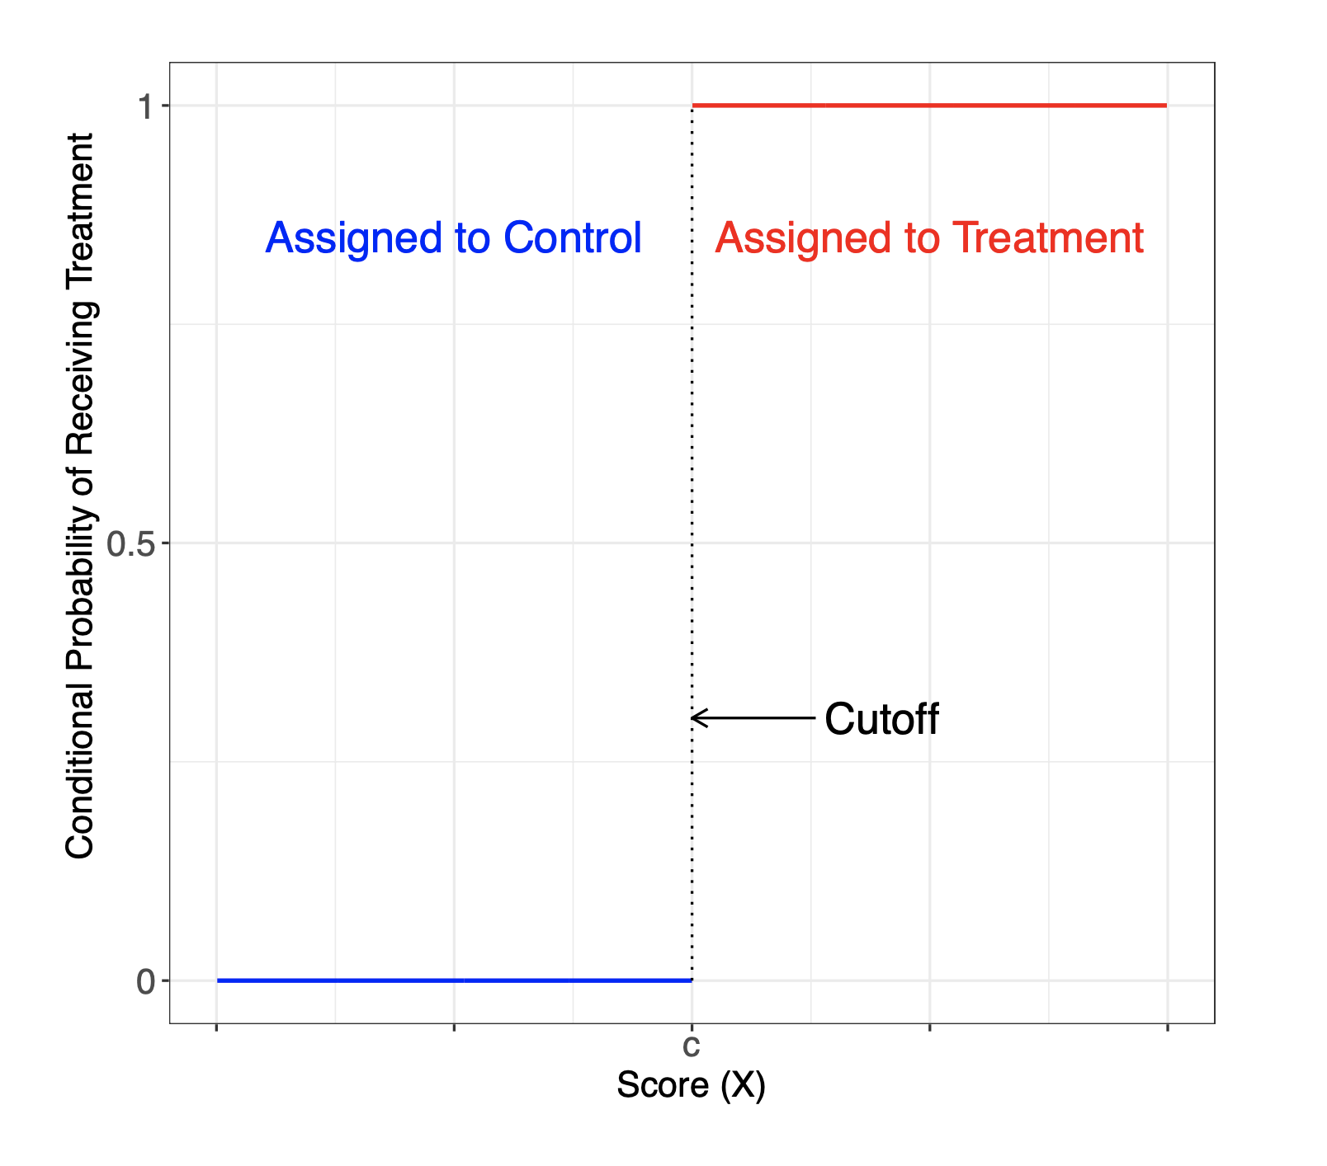
Sharp RDD
Source: Cattaneo et al. (2019): A Practical Introduction to Regression Discontinuity Designs: Foundations.

Slide 30
RDD assumption
The underlying assumption in RDD is that units do not have the ability to precisely manipulate the value of the running variable
Ways to test if this assumption is fulfilled:
Plotting the histogram of the running variable and check for sorting around the threshold.
Checking if observations just above and just below the threshold are indeed similar.
Placebo tests using other cutoffs that are not actually affecting the treatment, such as other ages than 21 for the drinking age paper.

Slide 31
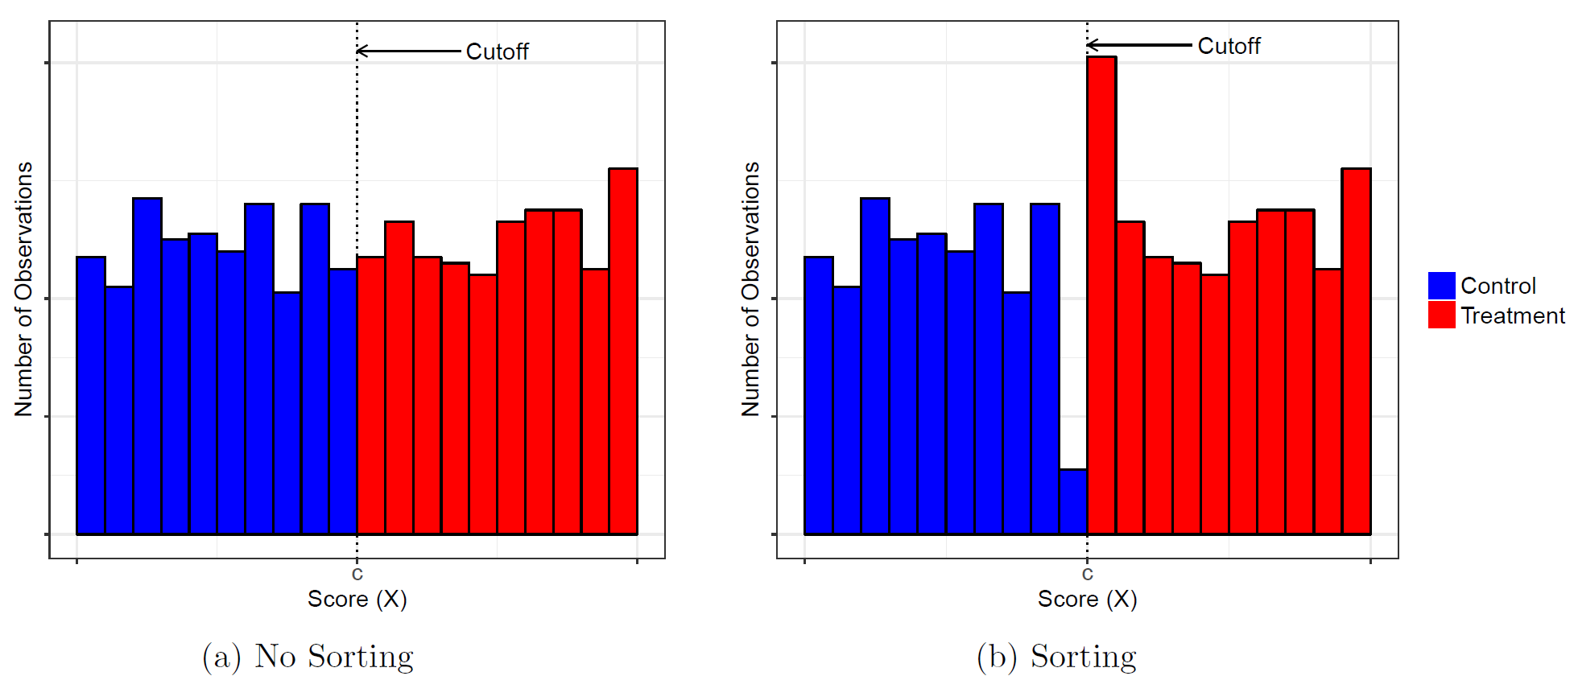
Test for sorting or “manipulation” of the running variable – we should not see irregularities around the threshold.
The figure on the left shows no sign of sorting and is thus suitable for RDD. The figure on the right shows there is sorting around the cutoff, so this settings seems not to be working for an RDD.

Slide 32
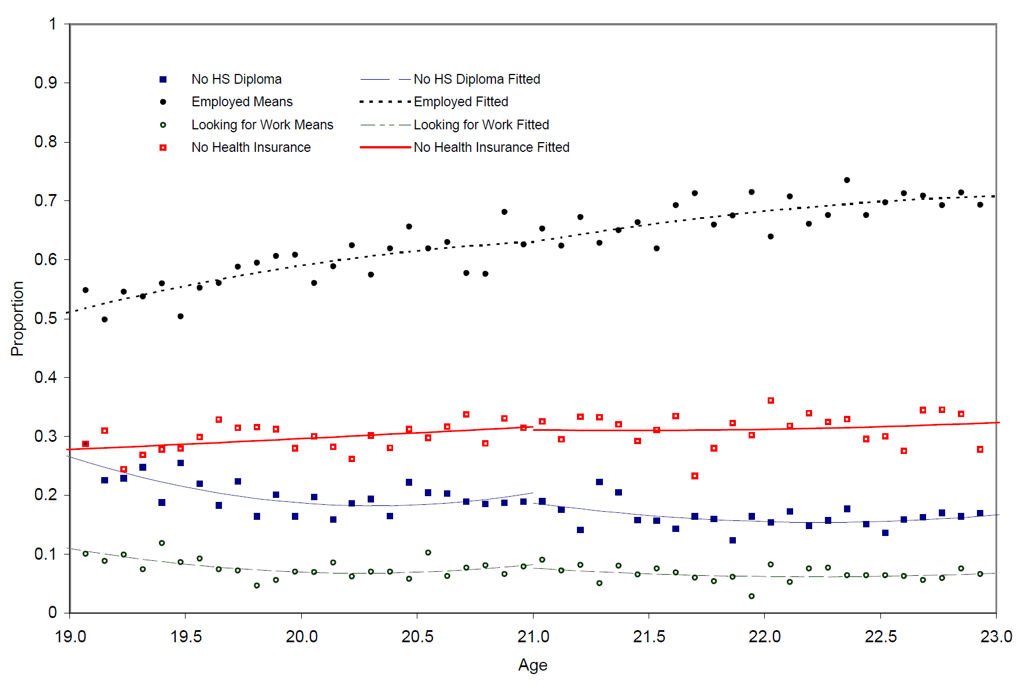
Test of predetermined covariates
A way to test that the two compared groups are similar apart from their treatment status is to check if other variables that should not be affected by the treatment are similar on each side of the cutoff.

Slide 33
Limitations of RDD: Local randomization interpretation
Given that units are unable to precisely manipulate the running variable, the RDD can be interpreted as a randomized experiment inside a window around the cutoff
That is, the treatment assignment is locally random
Results can be generalized to a narrow segment of the running variable: in the case of the MLDA study: young people near age 21.
“zoom in” on points close to the cut-off.
BUT: this requires a lot of data near the cutoff. There is often a tradeoff between having very comparable people (small bandwith around cutoff) and having enough data to get statistical power to detect an effect (larger bandwith around the cutoff).

Slide 34
RDD recap
Idea:
If a rule determines treatment due to a hard to predict cut-off, we can use the rule to estimate a causal effect without an RCT
Necessary criteria for using RDD:
the running variable, treatment, and cutoff must exist and the probability of treatment assignment as a function of the running variable changes discontinuously at the cut-off
Assumption:
Units just below and just above the cut-off are very similar and comparable (Potential outcomes develop smoothly across the cut-off)
Testing for design validity:
Density tests, covariate balance test, placebo tests
Challenges:
Requires a lot of observations near the cut-off
We cannot extrapolate results to units far from the cut-off (local causal effects!)

Slide 35
Instrumental Variable (IV) general idea
Selection on unobservables will usually make it difficult to isolate causal effects:
Why? There are probably factors that we cannot measure that are correlated with both the independent and the dependent variables.
Idea of an ”Instrument”: find something exogenous that we can measure, and that
- affects only the variable of interest T (whose effect on Y we want to estimate) - cannot affect the outcome Y directly

Slide 36
Instrumental variables recap
Instrumental
Variable (IV)
Treatment
Outcome
Pre treatment variables including unobservables like ability, motivation

Slide 37
Instrumental variables recap Previous graph in words:
We face a situation with potential selection problem/OVB: pre treatment characteristics are likely to impact both treatmemt status and outcome.
We find a variable, the “IV” that is correlated with the outcome of interest.
The IV must not affect the outcome directly. [Exclusion restriction – an assumption that must be justified by the researcher]
Assume the IV is as good as randomly assigned [Exogeneity – an assumption that can be partly confirmed with balance tests]
The IV must be strongly correlated with the treatment (the variable of interest) [Relevance – can be tested by the First stage]
-> If 4 holds, the First stage reveals the causal effect if the IV on the treatment status: since the IV is “randomly assigned”, it is not correlated with any other confounders, except the treatmemt.

Slide 38
IV assumptions - Conditions on a valid instrument There are three conditions that need to be satisfied for a variable to work as a good or “valid” instrument:
Relevance condition: the instrument should be correlated with the variable of interest! The instrument has a causal effect on the variable whose effects we’re trying to capture. (also referred to as “first stage” in Mastering Metrics)
Exogeneity The instrument is randomly assigned or “as good as randomly assigned,” in the sense of being unrelated to the omitted variables we’d like to control for if we could (e.g. family background, ability or motivation). (also referred to as “Independence”)
Exclusion restriction the chosen instrument should only affects outcomes through the variable of interest, or the “treatment variable”.
Relevance
Exogeneity condition
Exclusion Restriction
Notes:
See page 85 in MM.

Slide 39
Components in the estimation
First stage
Reduced form
Effect of winning lottery on likelihood to attend
Effect of attending on grades
Effect of winning lottery on grades
If we rearrange this expression we can isolate the effect of enrolling on grades:
Effect of winning lottery on grades
Reduced form
Effect of attending on grades
Effect of winning lottery on likelihood to attend
First stage
LATE
Notes:
See page 85 in MM.

Slide 40
Conclusion: key points about IV
The IV approach rests on 3 conditions,
one can be tested (relevance: the first stage)
One can be partially tested (The exogeneity condition), but onlyfor observable variables, not for unobservable ones.
one is assumed (the Exclusion restriction) but the researcher needs to provide arguments in favor of the assumption being fulfilled.
Problematic aspects of IV:
1. The three assumptions are not always plausibly fulfilled
2. What we estimate with IV is the Local average treatment effect (LATE). It is important to consider who are the compliers: who are the people whose treatment can be expected to be exogenously changed when the instrument is switched on?

Slide 41
Appendix

Slide 42
Technical issues RDD*
In principle, what we do in RDD is comparing means for those just above to those just below the cut-off. Often, we do not have enough data to estimate the treatment effect simply by comparing means at the cutoff so we need to use data away from the cutoff
This can be seen from the RDD regression equation:
$Y_{a}=α+ρD_{a}+γa+e_{a}$
How much data away from the cutoff should we use?
In other words, how large a bandwidth should we use?
The choice involves a bias-variance trade-off:
The closer to the cutoff you are, more likely it is that you are able estimate an unbiased causal effect. But the closer you are, the fewer data points – more noise.
We control both for treatment (Da) and for the running variable, a. If we were just comparing treated and control at the cutoff we would not need to add the control for a.

Slide 43
Difference between LATE and local treatment effect in RDD* (extra! Not for exam)
With IV, LATE is the effect on the compliers. The compliers are the ones that are affected by the instrument we have chosen. The choice of instrument is important for understanding how “general” the effect on compliers is. We still use data from the entire sample to estimate the treatment effect (since we need the reduced form estimate that comes from the whole sample)
With RDD, the local causal effect is estimated in a known window around the cutoff. We (the researchers) decide how wide a window is needed, and it depends on how much data we have close to the cutoff. The assumtion of “as good as randomly assigned” treatment is only plausible close to the threshold. But for that small population we can estimate the ATE.

