Slide 1
Thermodynamics and Heat Transfer Lecture 9: Renewable Energy
Ali Khosravi
Postdoctoral Researcher
Aalto University
Department of Mechanical Engineering
Energy Efficiency and Systems

Slide 2
Learning outcomes:
What Is Solar PV and How Do We Access it?
Penetration and Future of Solar PV
Wind Energy
Renewables Ninja
System Advisor Model (SAM, NREL)

Slide 3
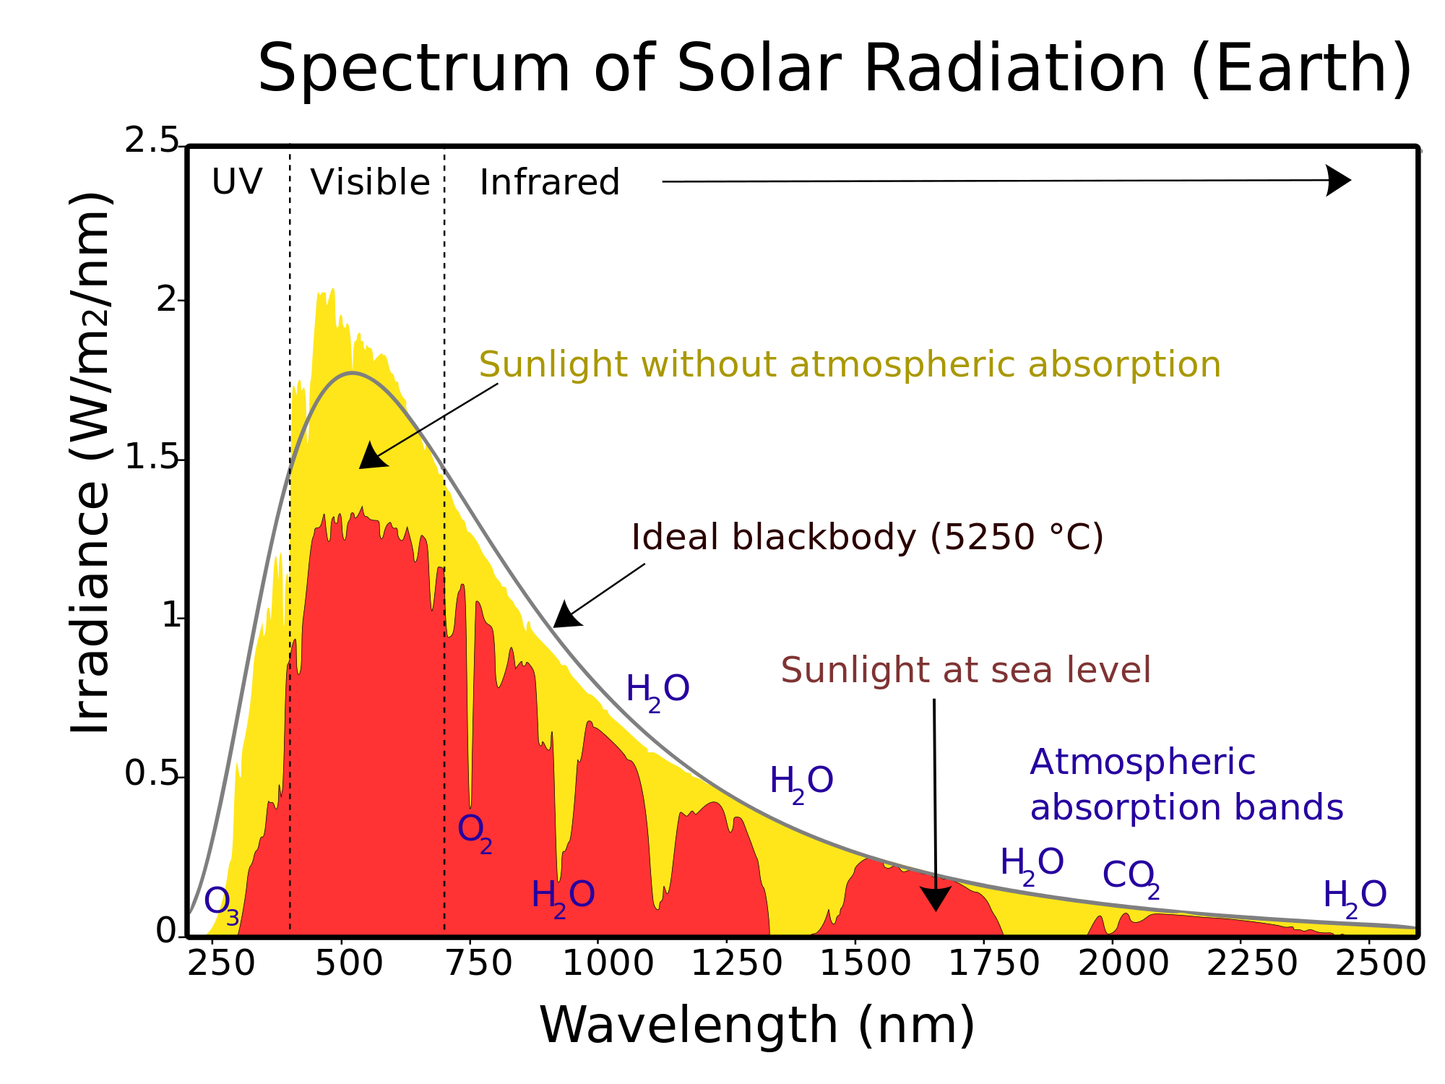
The Basics of Solar
Imagine an energy source that is practically limitless, has no fuel cost, and has no carbon dioxide emissions.
What if I told you that we already have it?!It’s called the sun!
We all know where it comes from, but what is it? And how much of it does the earth receive?
Solar energy comes in the form of electromagnetic radiation, which is basically waves of heat and light radiating from the sun.

Slide 4
Now, how much do we receive?
Every square meter on the earth’s surface receives about 140 Watts of direct sunlight on average.
To put that into perspective, each square meter of the earth’s surface receives, on average, enough power annually to run your average ceiling fan, while two square meters might receive enough to run a plasma TV, and three-square meters might run a small washing machine.
So, we know that we receive an enormous amount of solar energy every day, but how can we harness it?
Well, there are currently several ways: passive use, active use, photovoltaics and concentrated solar thermal.

Slide 5
What Is Solar PV and How Do We Access It?

Slide 6
Penetration of Solar PV

Slide 7
The Future of Solar PV
Accelerated solar PV deployment coupled with deep electrification could deliver 21% of the CO₂ emission reductions (nearly 4.9 gigatonnes annually) by 2050.
Solar PV could cover a quarter of global electricity needs by mid-century, becoming the second largest generation source after wind.
Global capacity must reach 18 times current levels, or more than 8 000 gigawatts by 2050.
Asia would continue to dominate solar PV use, with over 50% of installed capacity, followed by North America (20%) and Europe (10%).
Solar PV project costs, already below marginal fossil-fuel costs in global terms, are set to decline further in the decades ahead.
Mobilising finance will be key, with IRENA’s roadmap estimates implying a 68% increase in average annual solar PV investment until 2050.
Rooftop solar PV systems have spread rapidly thanks to supporting policies, such as net metering and fiscal incentives.
Energy transformation brings socio-economic benefits. The global solar industry could employ over 18 million people by 2050.

Slide 8
Wind Energy

Slide 9
Vide Credit: The University of Queensland, Australia, Full Course at: https://www.edx.org/

Slide 10
Exercises 1:
Designing solar PV system (1 MW) for 5 different locations in Finland:
1. Calculate the best tilt and azimuth angle for each case study
https://www.youtube.com/watch?v=hGPKie9QOBI
2. Compare capacity factor and power generation of the PV system for each case study.
3. Compare tracking system with non-tracking system for each case study.
4. The results can be compared with the other Nordic countries and Germany (optional).
This Photo by Unknown Author is licensed under CC BY-NC-ND

Slide 11
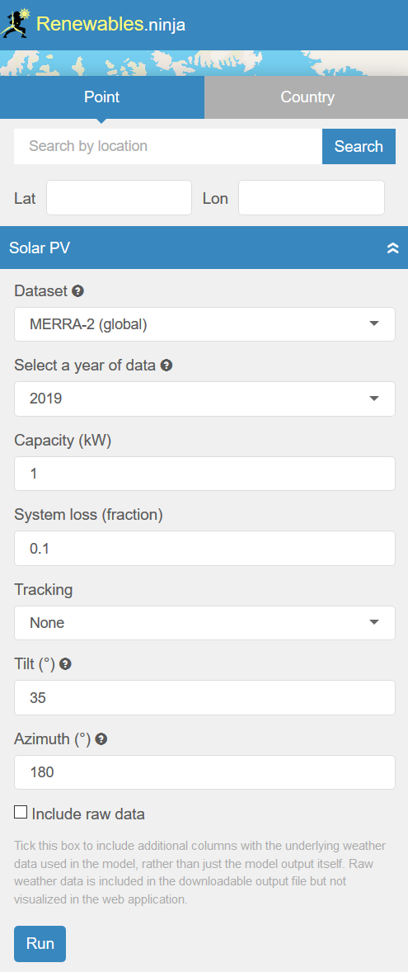
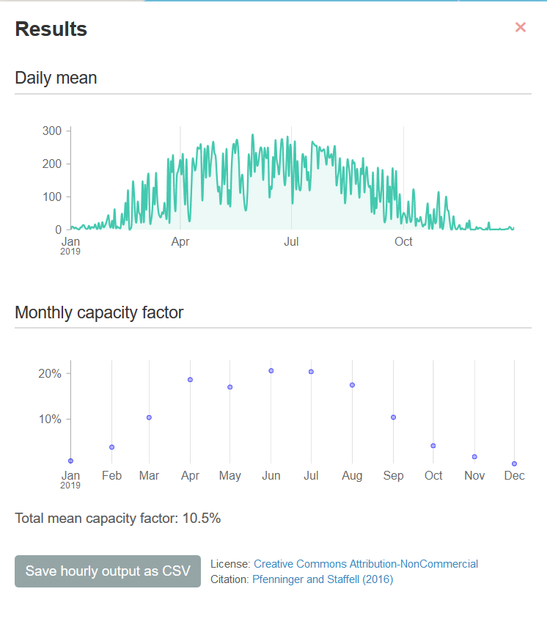
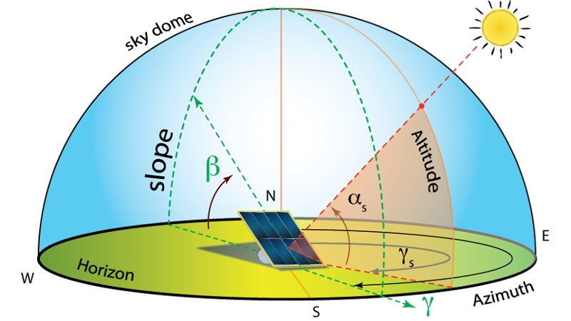
Capacity factor is the ratio between what a generation unit is capable of generating at maximum output versus the unit's actual generation output over a period of time.

Slide 12
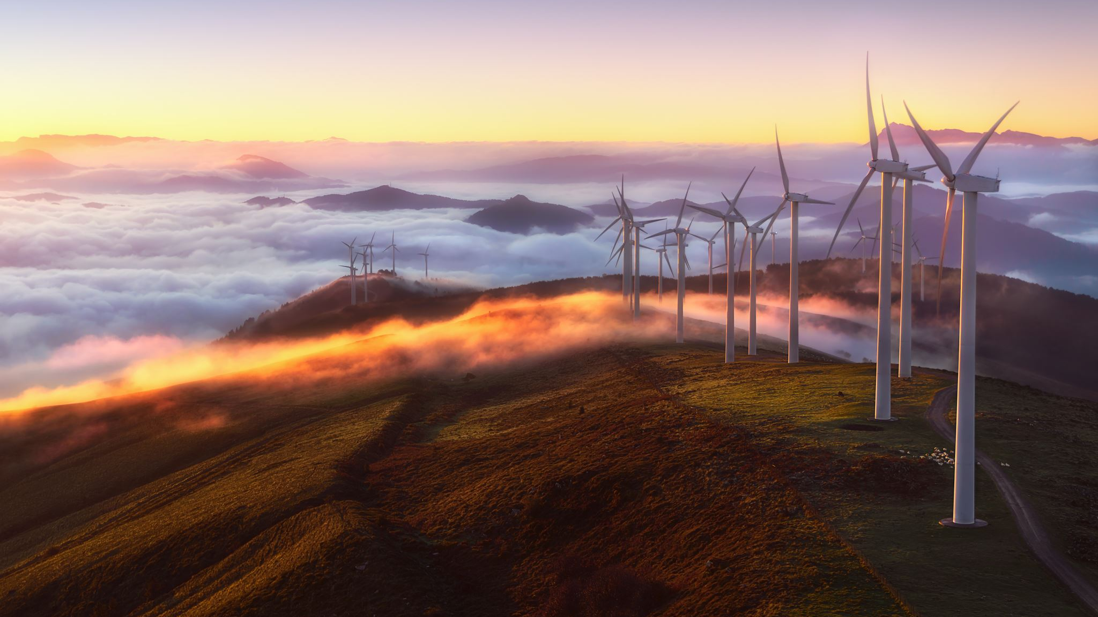
Design a wind farm (1 MW, 3 types of wind turbine) for 3 different locations in Finland: 1. Compare capacity factor and power generation of each wind turbine for each case study. 2. The results can be compared with the other Nordic countries (optional).
Exercises 2:

Slide 13
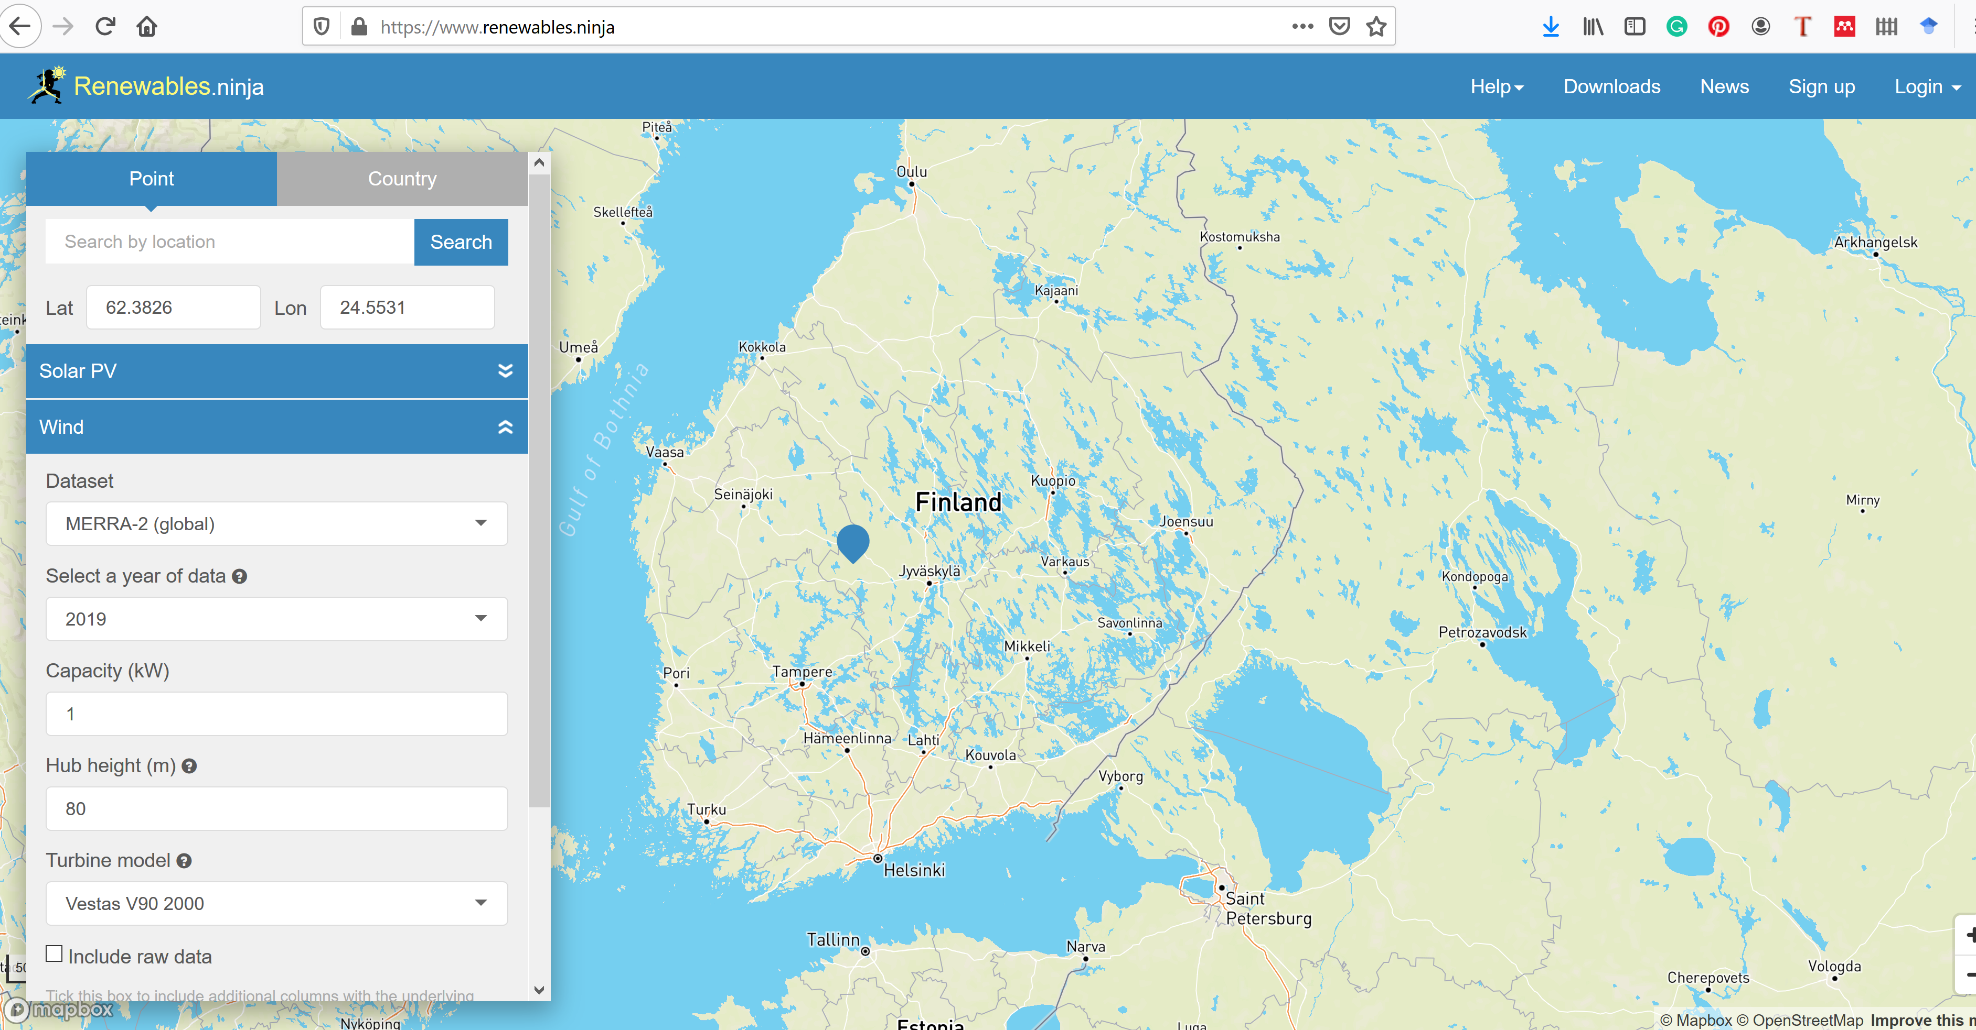

Slide 15
Thank you Ali Khosravi

