Slide 2
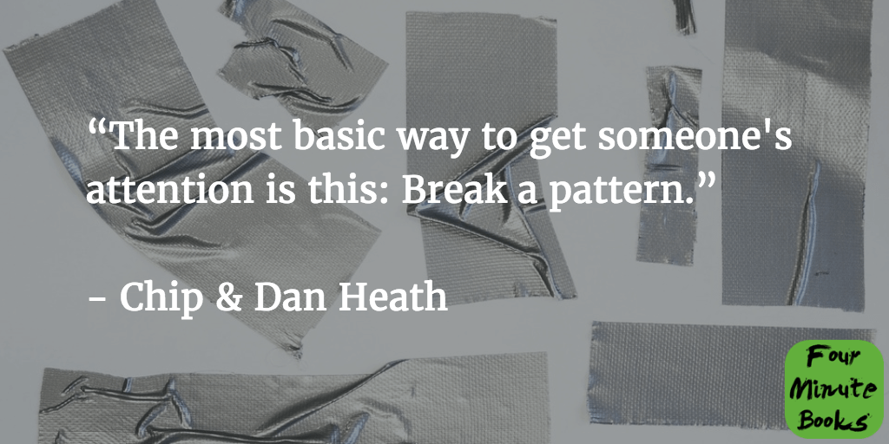
Notes:
IN OTHER WORDS, THE UNEXPECTED TWIST

Slide 3
Notes:
AN LBS MBA STUDENT OF MINE & TEAM WROTE A PLAN – THAT SOUGHT TO EASE THE PAIN OF ARRANGING SKI TRIPS FOR GROUPS OF EUROPEAN TRAVELLERS

Slide 4
Project
Participants
Plan
Pages
Notes:
WENT TO US BUSINESS PLAN COMPETITION, I WAS BROUGHT IN AS MENTOR –
THIS IS OUR CLASS PROJECT, LET ME INTRODUCE THE TEAM, HERE IS OUR AGENDA, AND FOLLOW THE SLIDE
NUMBERS – OH GOD THEY ARE ONLY ON SLIDE 6 OF A 20 SLIDE DECK!

Slide 5
bullet
points
stimulate
reading
Notes:
IS THIS THE BEST WAY TO ENCOURAGE ACTIVE LISTENING

Slide 6
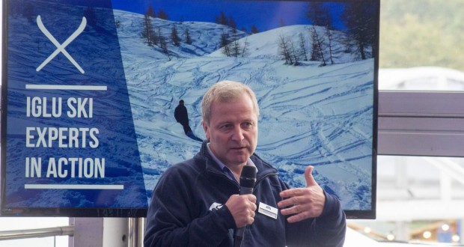
Notes:
RICHARD DOWNS & TEAM CRAFTED A PITCH ON THE LONG PLANE RIGHT TO TEXAS – WE NEED TO SHOCK AN AMERICAN AUDIENCE AND GET A BIT MORE VISUAL – THERE IS A NATURAL APPEAL FOR AUDIENCE MEMBERS THAT ARE INTO SKIING

Slide 7
<2%
Notes:
HE BROUGHT A HUGE PILE OF BROCHURES DROPPED THEM IN FRONT OF THE JUDGES/INVESTORS
HOW MANY OF YOU ARE SKIEERS? HOW MANY HAVE SKIIED IN EUROPE?
HOW MUCH TIME BROWSING BROCHURES? WHAT % OF CHALETS COVERED? ANY IDEA?

Slide 8
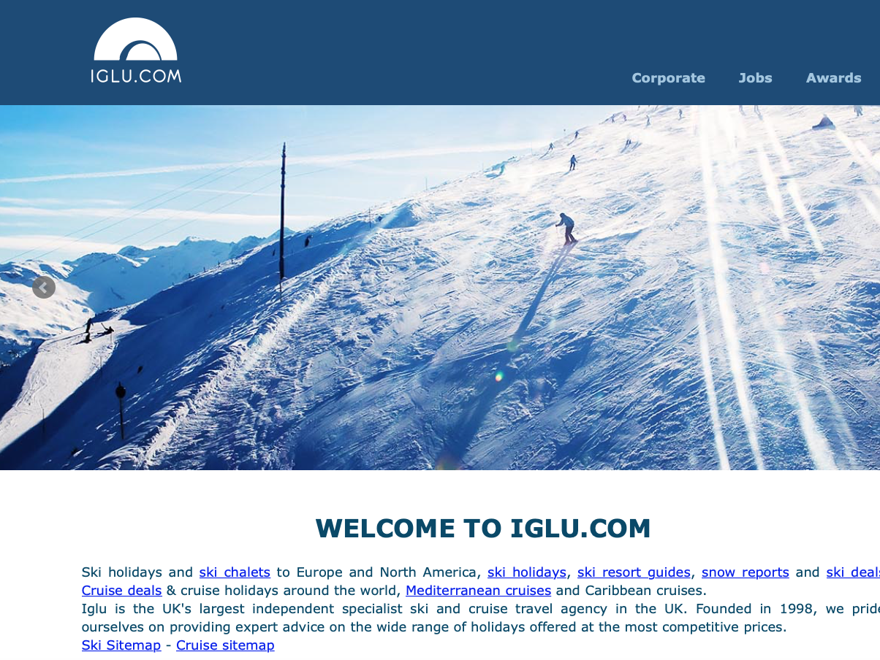
98%
Notes:
AND WE WILL COVER THE 98%

Slide 9
size
Notes:
CONTRAST AND READABILITY
LIKE MY PROXIMITY NETWORKING DEVICE – CUE CARD

Slide 10
Notes:
DEPENDING ON THE AUDIENCE, YOU ARE VERY MUCH THE EXPERT ON STAGE

Slide 11
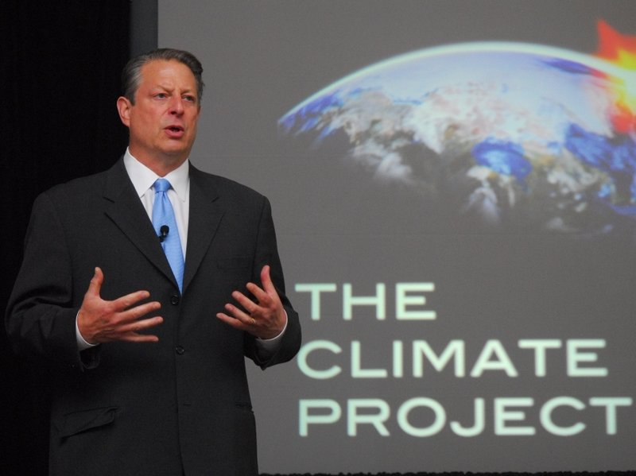
Notes:
HOW SHOULD AL GORE TALK ABOUT HIS CLIMATE PROJECT?

Slide 12
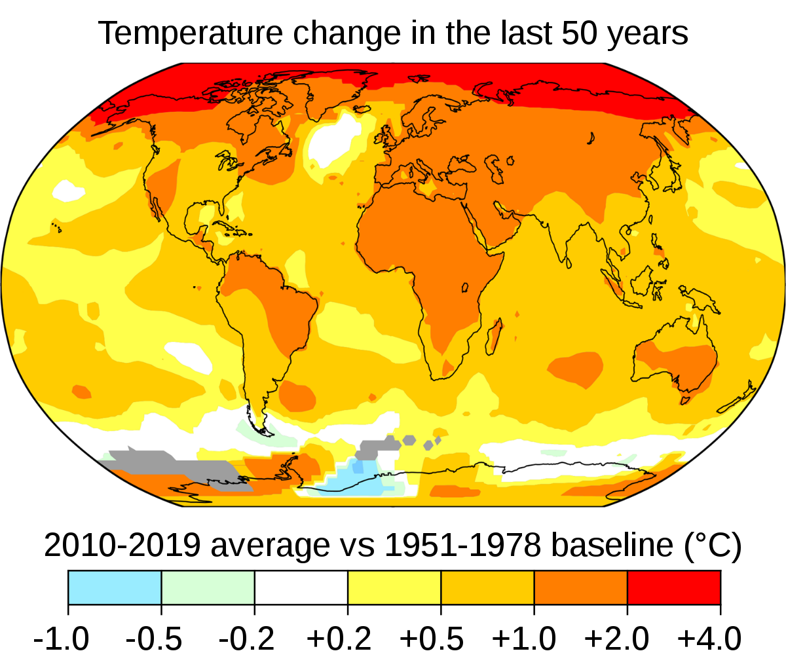
Notes:
FIND YOUR COUNTRY AND SEE HOW WE ARE DOING – BUT NOTICE WHERE THE RED IS …

Slide 13
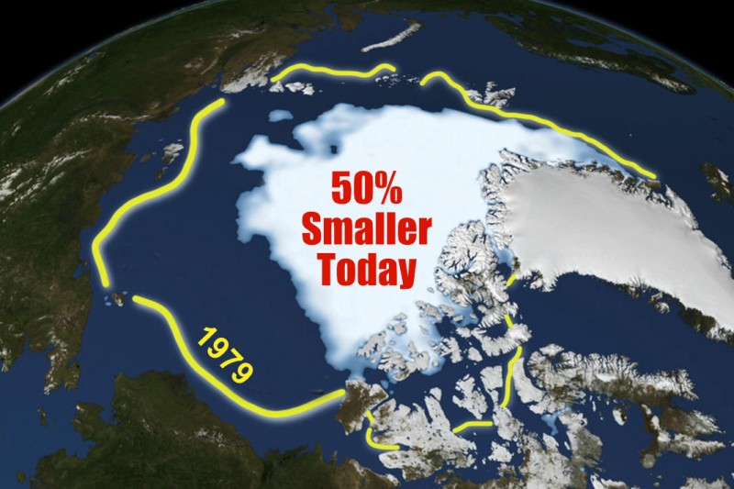
Notes:
ZOOMING IN A LITTLE MORE …

Slide 14
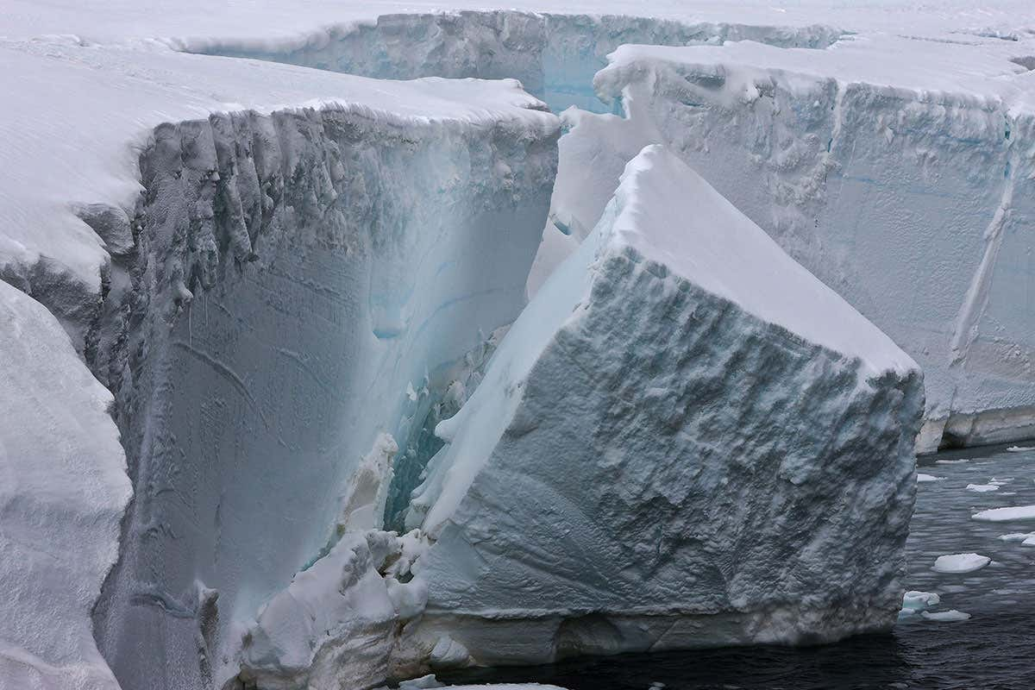
Notes:
AND IN FULL RESOLUTION – IDEALLY YOU WOULD WANT TO ESTIMATE THE VOLUME OF WATER RELEASED

Slide 15
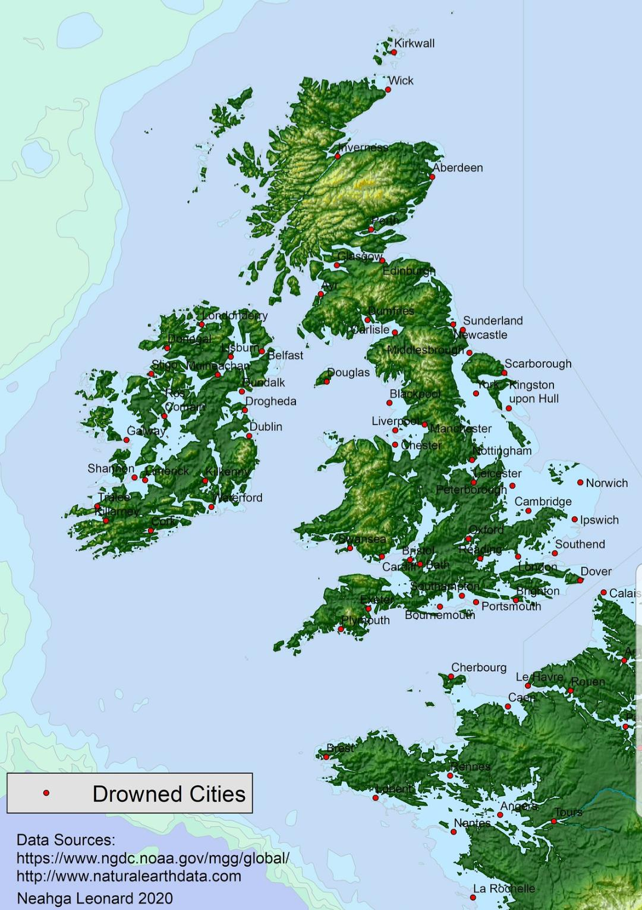
Notes:
WHAT THE UK WOULD LOOK LIKE IF GLACIERS MELTED

Slide 16
Notes:
WHO IS SEEING AND HEARING YOU …

Slide 17
Notes:
FOR AN AALTO AUDIENCE – USE AALTO VISUALS

Slide 18
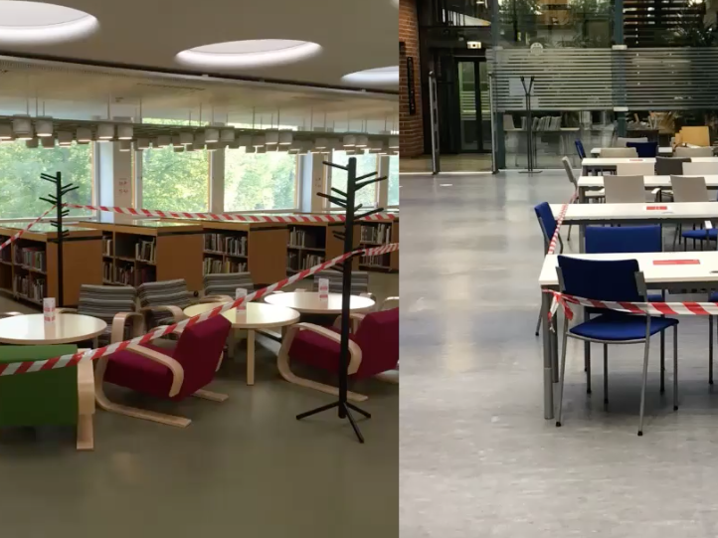
Notes:
SOCIAL DISTANCING AT AALTO
POLICE TAPE – AND OF COURSE I ASK WHO DIED?

Slide 19
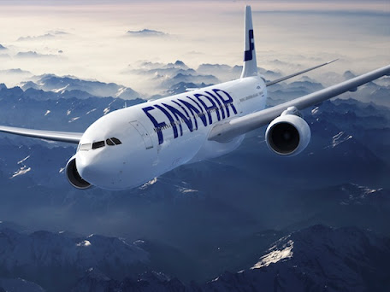
Notes:
OR FOR FINNAIR AND YOU ARE LOOKING AT INTERCONTINENTAL BUSINESS

Slide 20
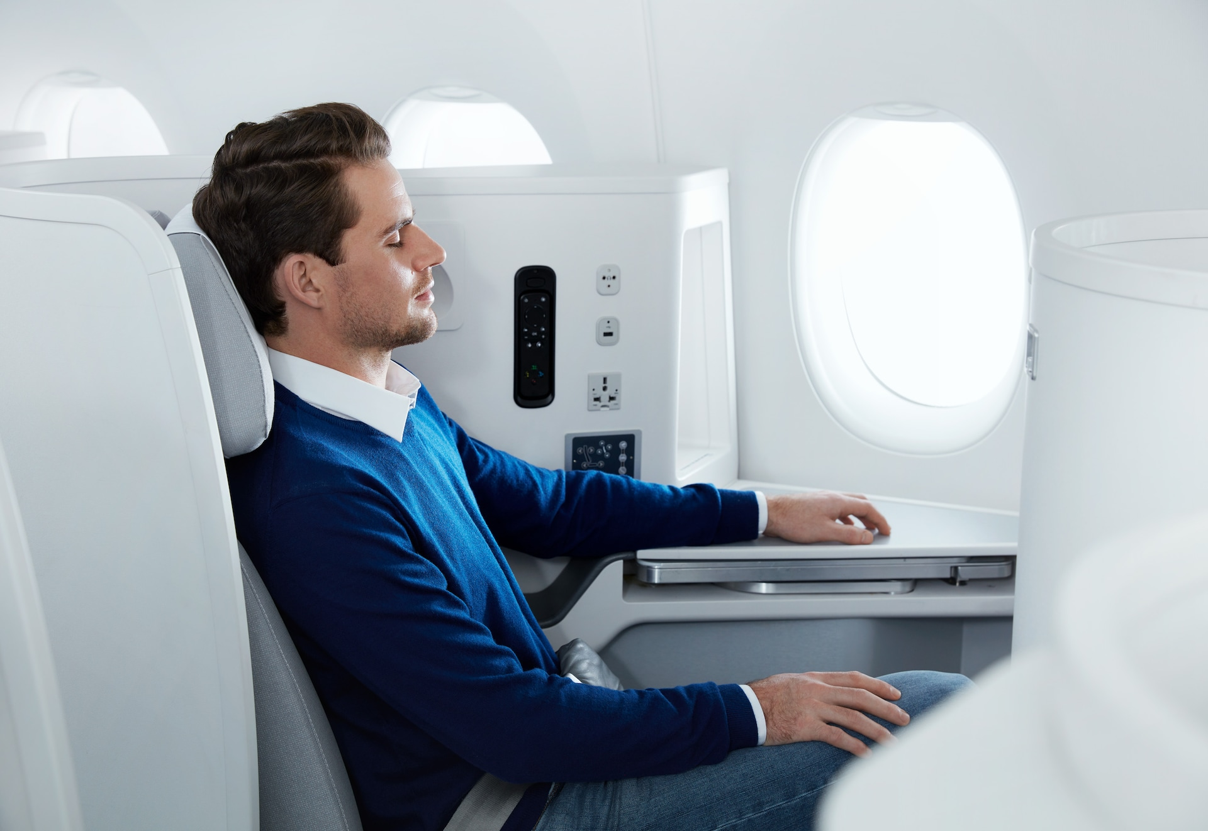
Notes:
THERE IS THE SEAT IN THEIR A350 AND ASSUME WE ARE TALKING ABOUT MEALS

Slide 21
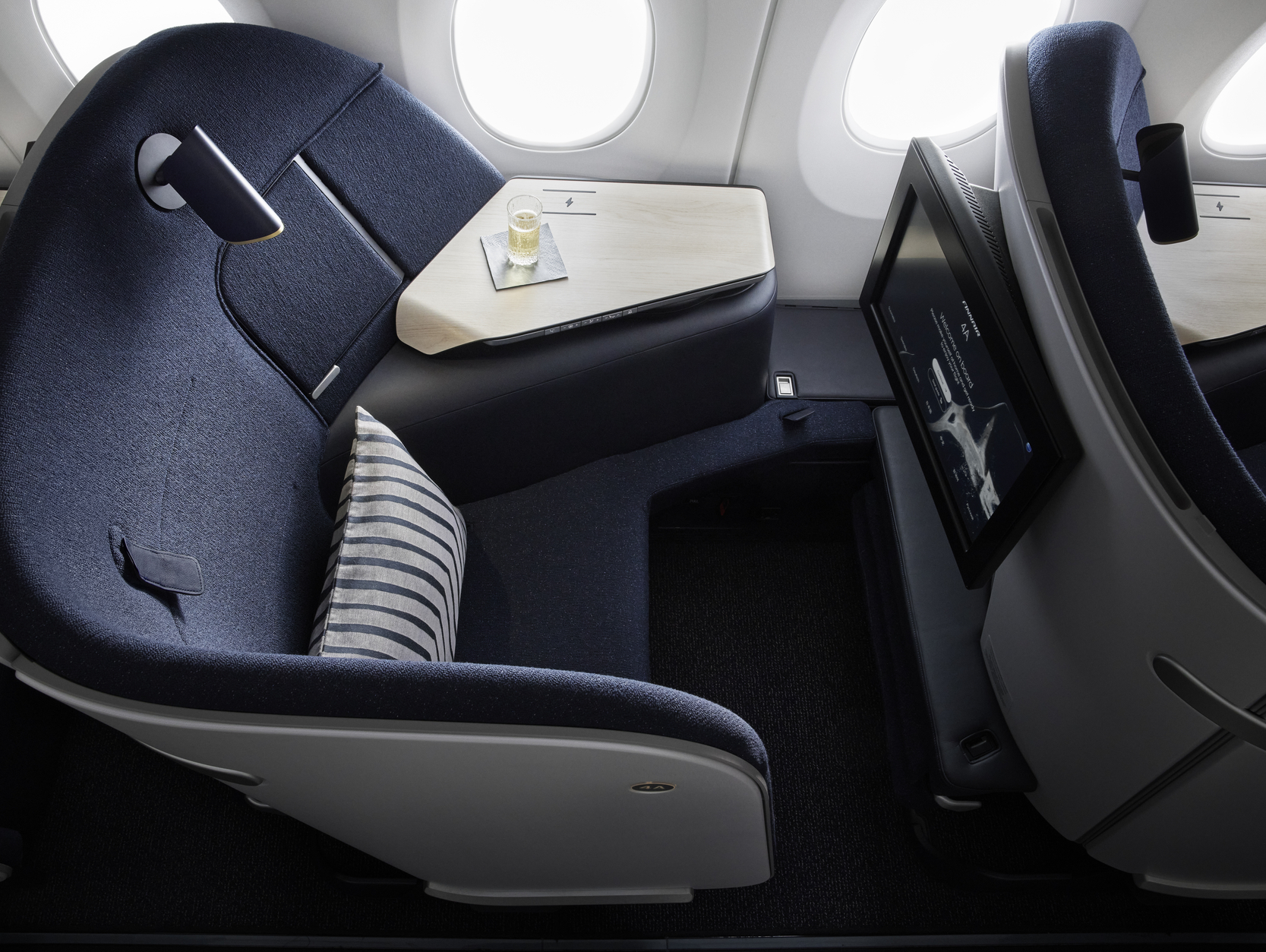
Notes:
BUT NOW THIS SEAT – FINNAIR SPENDING €200M RETROFITTING PLANES --- HAVE YOU DONE YOUR HOMEWORK

Slide 22
Notes:
THIS IS WHAT IS ADVERTISED … PREPARED ON THE GROUND (AND CONSUMED ON THE GROUND

Slide 23
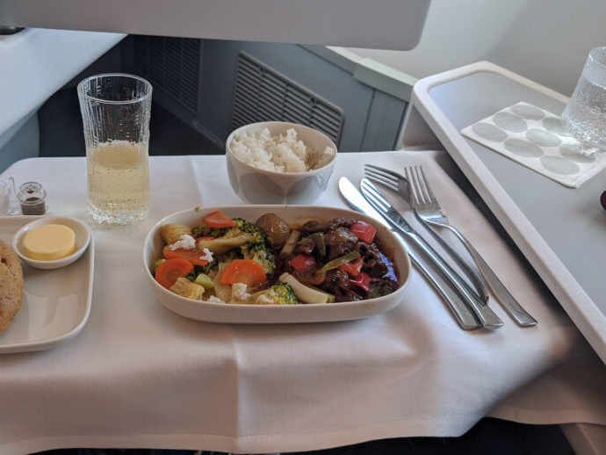
Notes:
THIS IS WHAT IT LOOKS LIKE IN THE AIR - YUM

Slide 24
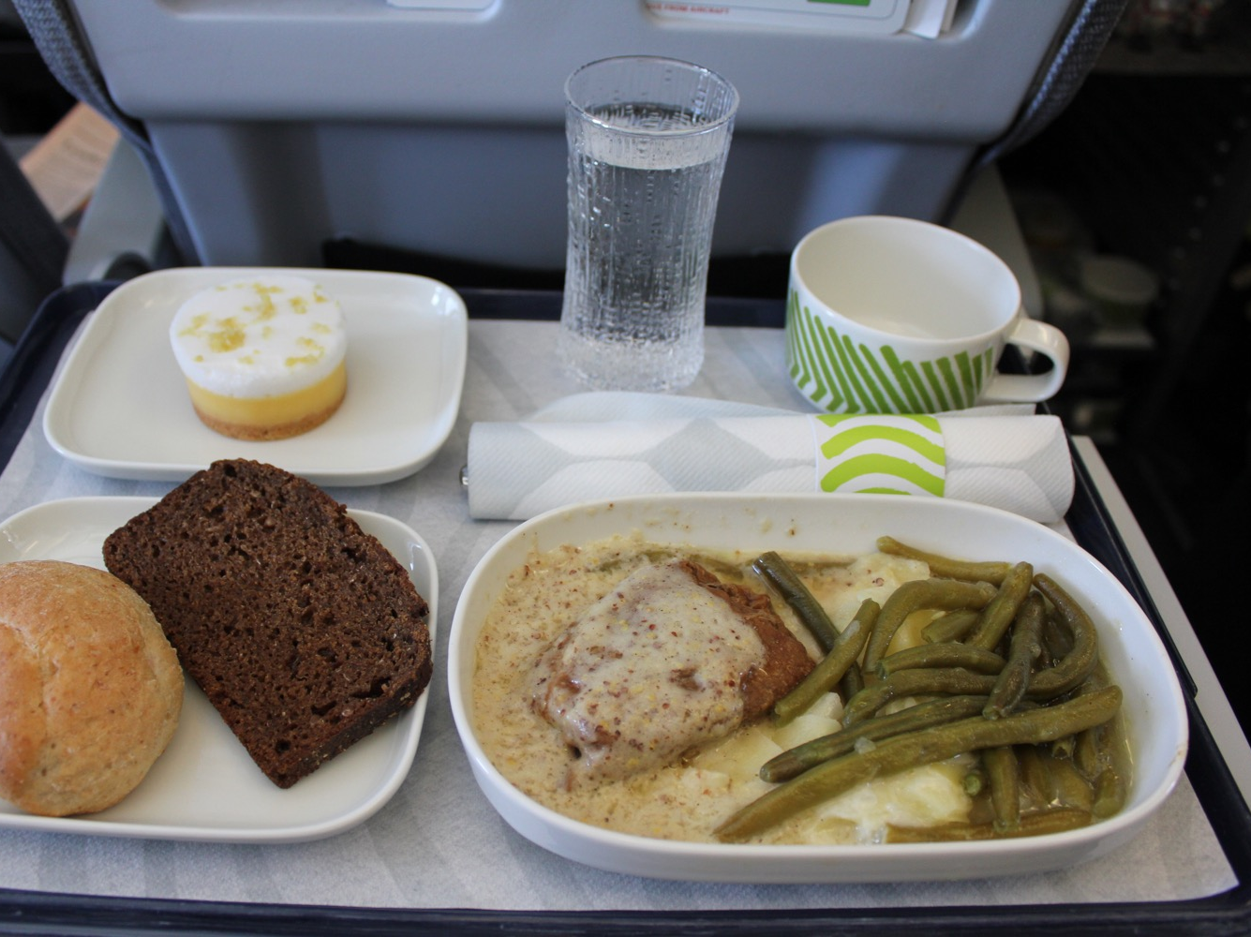
Notes:
OR IN SHORT HAUL BUSINESS

Slide 25
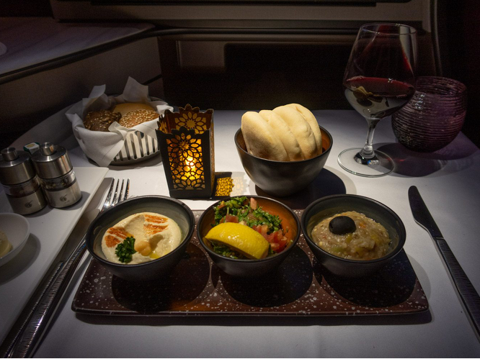
Notes:
AND ON QATAR --- NOT THE INGREDIENTS IT IS THE WAY THEY ARE ASSEMBLED
USE A MIS EN PLACE TECHNIQUE FROM CULINARY WORLD

Slide 26
Notes:
DATA MAKES THE CASE IN THE END, BUT THE STORIES MAKE IT RELATEABLE

Slide 27
tease
don’t
tell
Notes:
MYSTERY NOVELS ENCOURAGE YOU TO TURN THE PAGE – YOU WANT YOUR AUDIENCE TO CONTINUALLY ENGAGE
AND IN THE END MOTIVATING THEM TO SEEK OUT MORE INFORMATION

Slide 28
Notes:
TO AN AALTO AUDIENCE – GREAT YOU HIGHLIGHT PLATFORM AND THAT THEY CURATED THE SEARCH PROBLEM (PERSONAL)
BUT NEVER SHOW CLIP ART – WOULD BE BETTER TO SHOW A PICTURE OF THE PERSON … DRAW AN EMOTIONAL CONNECTION TO STORY
FIRST STEP EXPLORE A MINOR

Slide 29
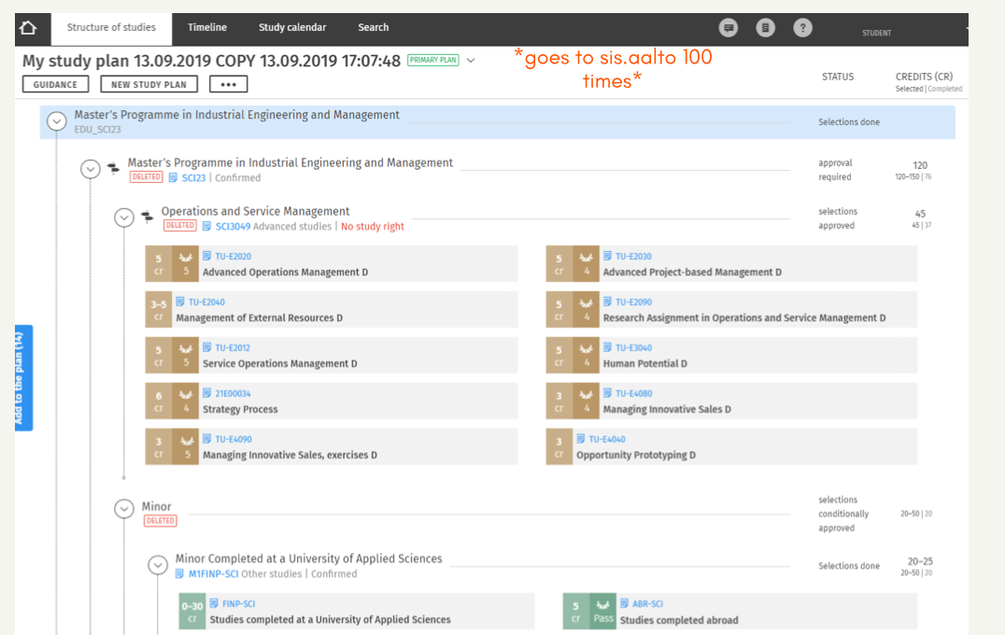
Notes:
SECOND STEP – WHAT FULFILLS THE MINOR – BUT THE SHOCKER HERE IS GOING BACK 100 TIMES – NOT BIG ENOUGH – WHAT WHERE THE TOP 3 BIG CONSUMERS OF TIME …

Slide 30
Notes:
THIS IS A BRILLIANTLY SIMPLE DISPLAY OF COMPLEXITY – I KNOW THERE IS LOTS OF BACKGROUND RESEARCH THERE – IF THE AALTO
AUDIENCE PICKS UP THE MESSAGE – THEN FILL IN THE DETAILS – DOCUMENTING JOURNEYS HELPS BUILD CREDIBILITY

Slide 31
make it personal

Slide 32
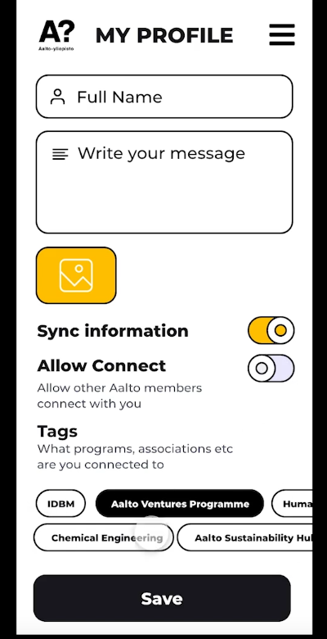
Notes:
STARTED WITH THIS ---

Slide 33
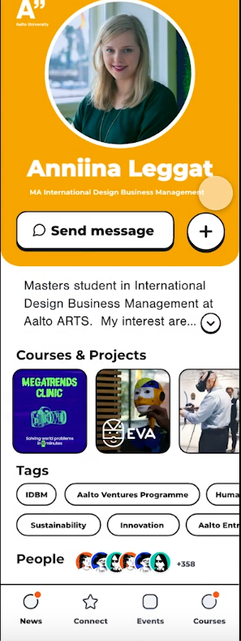
Notes:
A MOCK UP OF A PERSONAL PROFILING APP – AND SHE WAS SPEAKING – AND THE REACTION OF THE AUDIENCE WAS AMAZINGLY POSITIVE
BUT INSTITUTIONAL REFLEX COMES IN – LOOK WHAT YOU CAN WIREFRAME QUICKLY – THE SCHOOL MAY MOVE IN 2 YEARS! (STUDENTS ROCK)

Slide 34
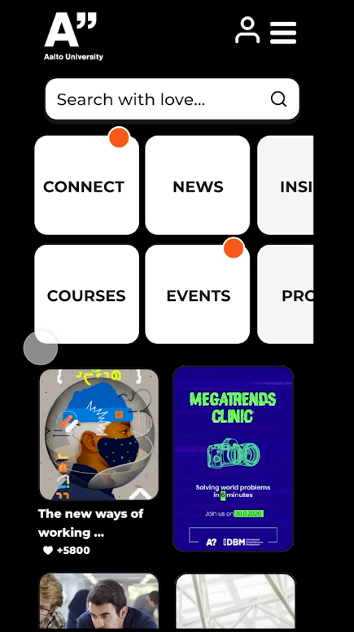
Notes:
WALKED THROUGH SOME OF THE FUNCTIONALITY (CURATED EXPERIENCE)
REMEMBER THE CURSE OF KNOWLEDGE – YOU KNOW MORE ABOUT THE SUBJECT MATTER THAN THE AUDIENCE

Slide 35
pecha
kucha

Slide 36
15 frames
20 seconds
Notes:
FRAMES DOES NOT MEAN POWERPOINT SLIDE

Slide 37
1 minute
3 frames

Slide 38
what the visual is saying

Slide 39
what you
are
saying
Notes:
30 – 35 words – practice, practice and don’t rush
I can always ask for more information

Slide 40
context
before
destination
Notes:
Natural transition point – 6 frames in

Slide 41
step(s)
forward
Notes:
IF YOU WERE IN FRONT OF THE RIGHT AUDIENCE, WHAT WOULD YOU PROPOSE TO ME IS THE NEXT STEP –
AUDIENCE IS ASKING THE NOW WHAT?

Slide 42
simple &
memorable

Slide 43
curating
deep research insights
Notes:
REMEMBER THE CURSE OF KNOWLEDGE

Slide 44
what is said complements what is seen
Notes:
READ YOUR PROPOSED SCRIPT FOR A PARTICULAR FRAME – CAN YOU DO IT AT A COMFORTABLE PACE FOR THE AUDIENCE (30 WORDS)

Slide 45
don’t start with team
introductions

Slide 46
don’t end
with a
Thank You
slide

Slide 47
or
with the
Any Questions
slide

Slide 48
what if the message does not stick?
Notes:
YOUR RESEARCH MAY HAVE UNCOVERED PIVOTS (PLAN B)

Slide 49
visual &
textual
storyboard

