Slide 1
Digital Skins: Understanding Fashion through Technology
Yvonne Förster
yvonne.foerster@gmail.com
Yvonnefoerster.com
Facebook: Technology, Arts and Fashion
Leuphana University Lüenburg, Germany

Slide 2
Digital Skins: Understanding Fashion through Technology
Part 1: Fashion and Technology
Part 2: Wearables, Digital Skins and the Body
Part 3: Fashion as Artistic Experiment – Critique and Novelty

Slide 3
Premisses
Fashion is a body-related cultural practice
Fashion this mediates how we are situated, embedded and extended in the world
Fashion is embodied memory
Theories of Embodiment: The 4 e‘s
Fashion is inherently technological and thus are our bodies
Fashion today is a mediator for new technology and thus relevant for critique and being critiqued

Slide 7
Part 1: Fashion and Technology
Oldest proofs of textiles: around 30.000 years old (Caucasian region)
First spinning techniques around 7000 BC in Turkey
Textile production evolves with the development of manual techniques and tools

Slide 8
Spinning Jenny, James Hargreaves, UK 1767

Slide 9
First Sewing Machines: 1755 Charles Weisenthal, 1790 Thomas Saint

Slide 10
End of 19th century: Industrialization taking up speed – Fashion becomes available for mass market

Slide 11
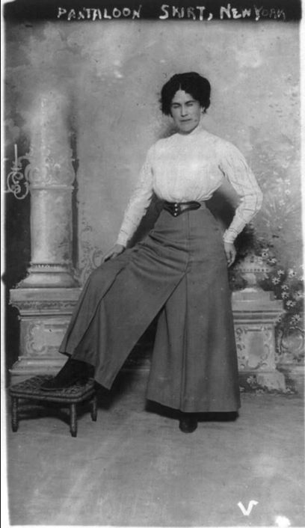
Ubiquity of Fashion in the Beginning of the 20th Century
Industrial production and post-/pre-war condition fueled fashion to become diverse and change quickly
Gender aspect becomes more prominent
with women working

Slide 12
Technology and standardization – Sizes (First half of 20th century)
Quantification of the body starts

Slide 13
Technological standardization of the body: Charlie Chaplin‘s Modern Times (1936)

Slide 14
Technology of sales and dissemination
First fashion magazines:
Das Journal des Luxus und der Moden (1786-1827), Friedrich Justin Bertuch, Weimar, Germany (online available)
The Englishwoman's Domestic Magazine (1852–1897), Samuel Beeton, UK

Slide 15
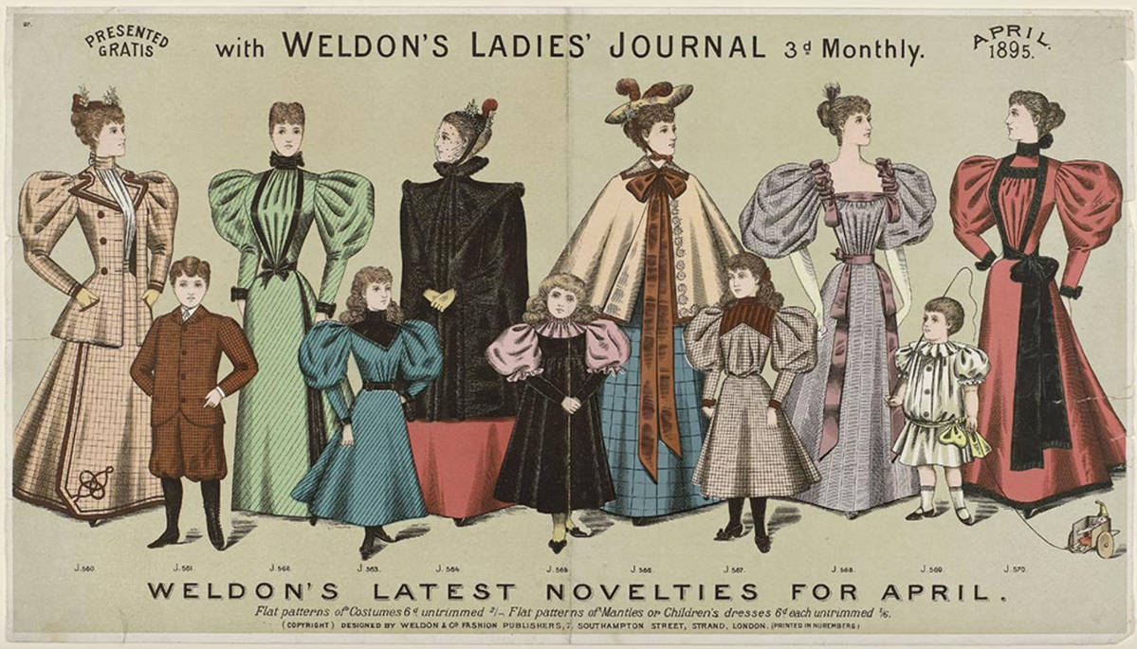

Slide 16
Fashion Houses
Charles Frederick Worth: First Haute Couture fashion house in Paris (1858)
Early 20th century first department stores with prêt-à-porter fashion

Slide 17
Fashion As Media

Slide 18
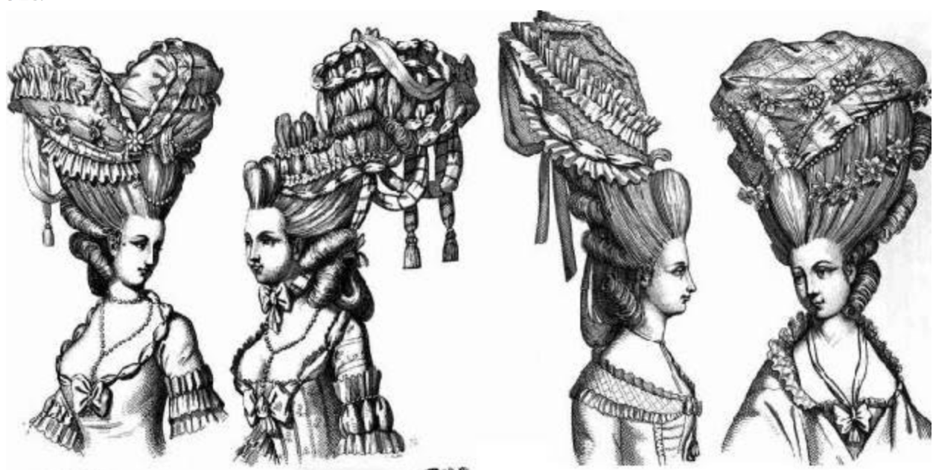
Fashion as Media before and after the French Revolution (1789): From Rococo to the democratic suit

Slide 20
Ludwig XIV. in coronation ostume, Portrait by
Hyacinthe Rigaud (1701; Musée du Louvre)

Slide 21
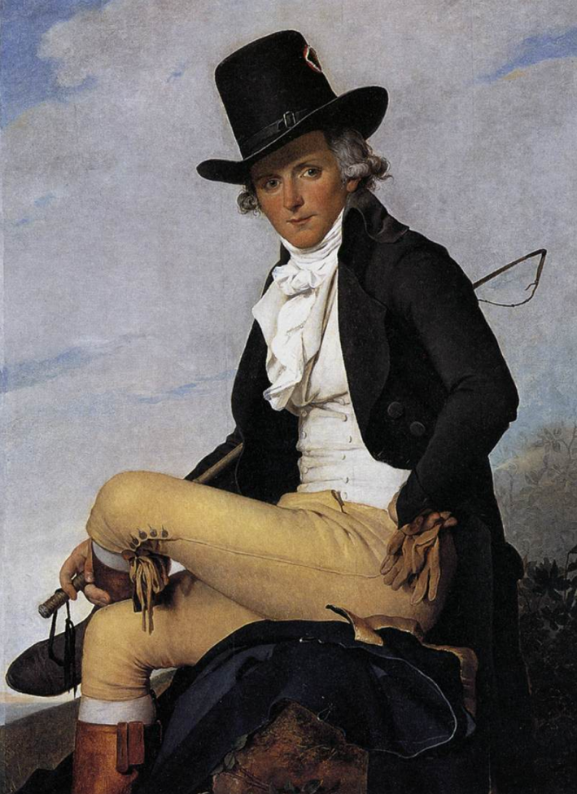
France 1760
Portrait of Pierre Sériziat by Jacques-Louis David (1795).

Slide 22
Napoleon III, painted by Alexandre Cabanel, around 1865

Slide 23
Eduard Fuchs (1912), in Daniel Purdy, Rise of Fashion, Univ. of Minnesota Press, 2004
The fundamental element of bourgeois clothing is uniformity. We are now all just citizens, all possesed of the same rights. Clothing therefore no longer seperates people as it once did by means of particular features, worn by one and forbidden on pain of penalty to another. (319)

Slide 24
Barbara Vinken: Fashion Zeitgeist
Hence it is that in reference to gender relations, we find ourselves in the bourgeois period, if not in a completely new situation, then at least in a radicalized one. The constitutive social divide no longer opposes the noble and the non-noble, but rather the feminine and the masculine. The opposition feminine/masculine is doubled, however, by a second opposition, that of noble and bourgeois. Here noble has become a metaphor for the appearance of power. The bourgeoisie uses its women to exhibit the castration of the nobility. The all-determining opposition that constitutes sexual difference is now that of authentic and inauthentic. Men ‘are’ – they are someone, they are authentic, real; women on the other hand lack essence and are sheer appearance, artificial, inauthentic. Fashion appears as something that is excluded from the apparently non-rhetorical authenticity of the bourgeois masculine collective. Drawing together femininity and nobility on the basis of their shared frivolity of appearance, it thus excludes them from the real world in which men dwell, securely enclosed within the institutions of masculinity. (13)

Slide 25
Georg Simmel, Philosophy of Fashion, in Purdy (2004)
Fashion serves an anthropological function:
Individuation and identification with social group
Accelaration through industrialization
Urban life and conditio nervosa humana

Slide 26
Modern Fashion System develops in 19th century through and with Technology: 1) New means of Production 2) New media for Dissemination 3) new ways of selling (Fashion Houses, Prêt-à-Porter) 4) New Politics – new Fashions

Slide 27
Discussion
How does technology influence fashion today?
Can fashion foster more diversity (against ideas like the quantified self)?
Is fashion (in your perception) today related to morals?

Slide 28
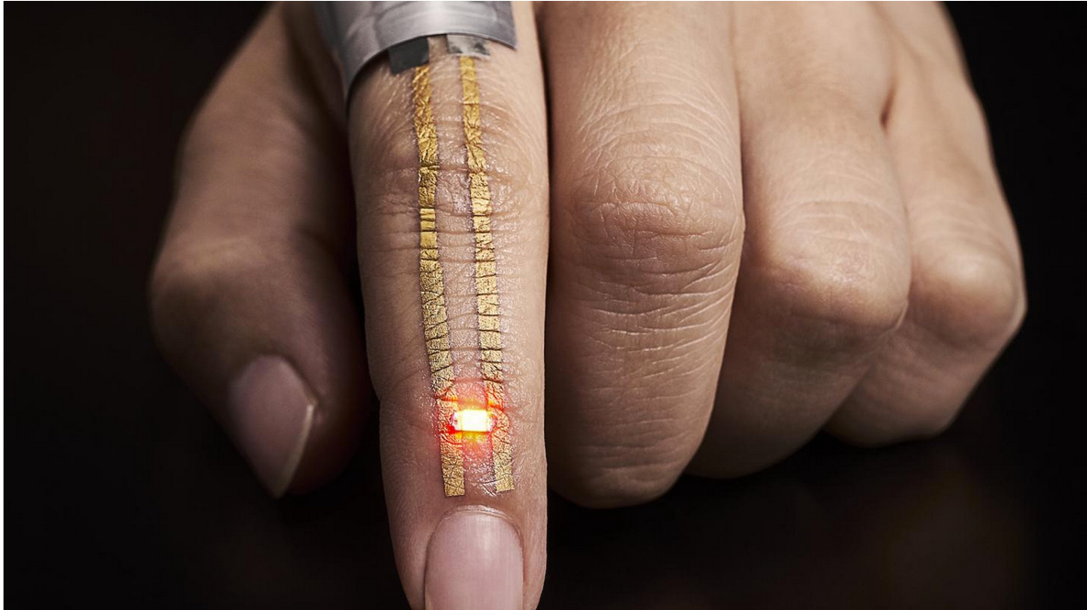
Part 2: Wearbales, Digital Skins and the Body
Technology shapes our relation to the world
Fashion mediates new technologies

Slide 29
Albrecht Dürer, 1525

Slide 30
Fashion and the Future: Walter Benjamin, Arcades Project
For the philosopher, the most interesting thing about fashion is its extraordinary anticipations. It is well known that art will often — for example, in pictures — pre- cede the perceptible reality by years. It was possible to see streets or rooms that shone in all sorts of fiery colors long before technology, by means of illuminated signs and other arrangements, actually set them under such a light. Moreover, the sensitivity of the individual artist to what is coming certainly far exceeds that of the grande dame. Yet fashion is in much steadier, much more precise contact with the coming thing, thanks to the incomparable nose which the feminine collective has for what lies waiting in the future. Each season brings, in its newest creations, various secret signals of things to come. Whoever understands how to read these semaphores would know in advance not only about new currents in the arts but also about new legal codes, wars, and revolutions. — Here, surely, lies the greatest charm of fashion, but also the difficulty of making the charming fruitful. [BI a,I]

Slide 31
Fashion As Mediator of Technology
Technological Environments
Wearables
Smart Fabrics
Digital Skins/Body integrated Technologies

Slide 32
1. Technological Environments: Ikea Future Kitchen

Slide 33
2. wearables: Electirc Girls, NY Times, April 26, 1884

Slide 34
Wearables: Smart jewelleries and Emotion Sensors
Oura Ring

Slide 35
3. Smart Fabrics: Aesthetic and/or Functional
Ted Talk

Slide 36
Smart fabrics: Health and Sustainabilty

Slide 37
4. Digital Skin

Slide 38
Body integrated Technologies Neil Harbisson

Slide 39
Dystopia in SCI/Fi and Popular Culture – Surveillance and the body Black Mirror, Season 4, Ep. 2, Arkangel, directed by Jodie Foster, 2017
Brain implant
for surveillances
and health
momitoring

Slide 40
Utopia in Technology: Tech brand Advertisement Medicine

Slide 41
New Bodies – Dismenbodied Intelligence – Immortalty

Slide 42
Discussion
What about the role of AI in fashion?
How is the body imagined? Is standardization reinforced through new technologies?
Is it personally/for society useful or desirable? A chance for new cultural habits?

Slide 43
Part 3: Fashion as Artistic Experiment – Critique and Novelty
Hussein Chalayan
Coffe Table Skirt
2000, UK

Slide 44
Fashion as Art
What makes artifacts from fashion and design special with regard to their artistic expression?
What kind of reflection is fostered through fashion?

Slide 45
Viktor&Rolf, Fall/Winter 2002/03: Bluescreen
The body as screen/screenculture/vanishing bodies

Slide 46
Nobimichi Asai
Omote
2014
Face recognition
Alterity
Digital skin
The other in you

Slide 47
Iris van Herpen creative potentials of new technologies

Slide 48
Fashion as creative, dynamique Form of Critique
Play with technology
Use material memory of fashion as source
Contemplation
Make invisible visible, touchable

Slide 49
Discussion: From the view point of Design and Fashion, what would be criteria to judge technologies as beneficial? Can fashion take a critical standpoint at all?

Slide 50
Literature
Benjamin, Walter(2003), The arcades project. Cambridge, MA, The Belknap Pr. of Harvard University Press
El Bizri, Nader (2018), Phenomenology of Place and Space in our Epoch: Thinking along Heideggerian Pathways, in: The Phenomenology of Real and Virtual Places, Erik Champion (ed.), London: Routledge, pp. 123-143
Foerster, Yvonne (2018, forthcoming), The Cycle of Seasons: Temporality in Fashion, in: Luke Fischer, David McCauley (Eds.): The Seasons: Philosophical and Environmental Perspectives, New York: SUNY Press.
(2016) Singularities and Superintelligence: Transcending the Human in Contemporary Cinema, in: Trans-Humanities, Seoul: Ewha Institute for the Humanities (EIH), 33-50.
- (2012) The Modern Concept of Fashion and its Origins in Romanticism, in: Franz-Josef Deiters, Axel Fliethmann a.o. (eds.), Australian Yearbook of German Literary and Cultural Studies, Freiburg i.Br., Berlin, Wien: Rombach, 141-157.
(2012) When Fashion becomes Art. Medial Aspects of the Body in Fashion, in: 인문과학연구논총 (The Journal of Humanities, Vol. 33, No.2), Seoul: The Institute of Humanities, Myongji University, 263-281.
Heidegger, Martin (1977), The question concerning technology, and other essays. New York: Harper & Row
Purdy, Daniel L. (Ed.) (2004), The Rise of Fashion. Minneapolis, London: University of Minnesota Press
Vinken, Barbara (2004), Fashion Zeitgeist: Trends and Cycles in the Fashion System. Oxford, New York: Berg.

