Slide 1
Session 8.2
Savings and investment: an important macro equality
Growth theory: what drives long-run economic growth of GDP

Slide 2
Shifting our attention from inequality within an economy to global inequality: rich and poor countries
Growth theory models the causes of increasing per capita GDP over a period of decades or centuries
It formalizes the work we did with the Production Possibilities Frontier on the first day of class
Key concepts: saving and investment, capital accumulation, population growth, technological change

Slide 3
Saving and investment
In Macro, “saving” means refraining from consuming
A negative concept: the “absence” of consuming
If some of the income people earn is not spent, it’s put aside, or saved
If there’s SAVING, then GDP is not made up only of consumer goods
So what else is being made?
CAPITAL GOODS

Slide 4
This diagram is visiting from PS 1 Suppose there are two countries, A and B, with similar PPFs
Consumer goods
A is Argentina. It chooses to produce a lot of consumer goods. Most of hh income is SPENT on consumption. Therefore, saving is low. Necessarily, capital goods production is low. Another way to say that: INVESTMENT is low.
A
B is Brazil. It chooses to produce and buy fewer consumer goods. By definition, it’s saving a lot.
If it’s not producing many consumer goods, it must be producing a lot of capital goods. INVESTMENT IS HIGH.
B
Capital goods

Slide 5
Saving = Investment
This is true even without money, savings accounts, stocks, etc
(Remember there’s no money on the PPF, just production and consumption of goods)
If you think of saving as “NOT buying consumer goods” then it automatically equates with investment (in the two-good world)—because investment is the production of new capital goods

Slide 6
S = I
Basically everyone thinking about the economy agrees that S = I
But people have very different views about how that equality comes about
It’s one of the most interesting things about macroeconomics
In the next section, we look at the Solow-Swan growth model, which links our PPF discussion (micro) with macro issues (investment and GDP growth)
We’ll also invoke S = I in the section after this--the short-run business cycle and Keynesian economics

Slide 7
A high level of capital is the main determinant of a high standard of living around the world
Reminder from
Session 1
More capital to work with means workers are more productive
Labor productivity ≡ Real GDP/# workers ≡ Y/L

Slide 8
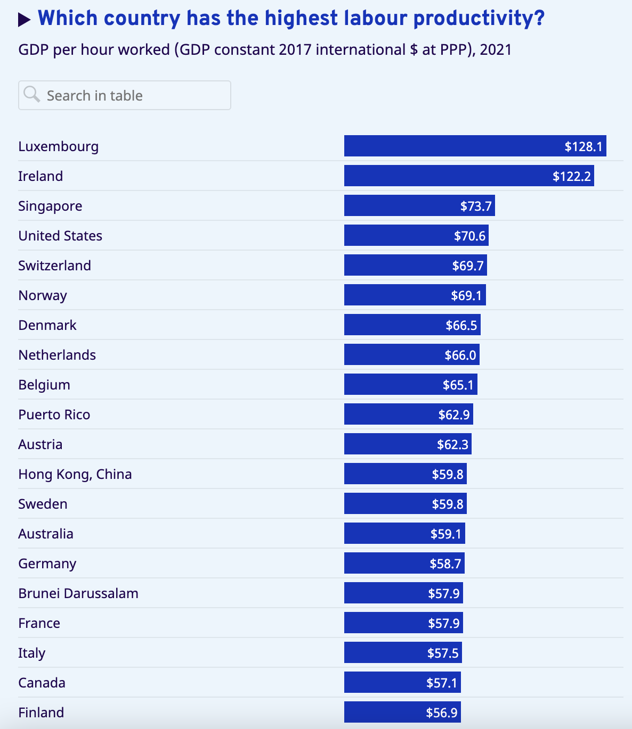
International Labor Organization chart

Slide 9
Why productivity growth is great*
When productivity rises…
Wages can go up without costs rising or profits falling or inflation
GDP can rise while people also take more leisure
A high-wage economy can become more competitive in world markets
*assuming more stuff and more income is a good thing!
Less delightful: extracting more effort/energy from workers will raise productivity as well

Slide 10
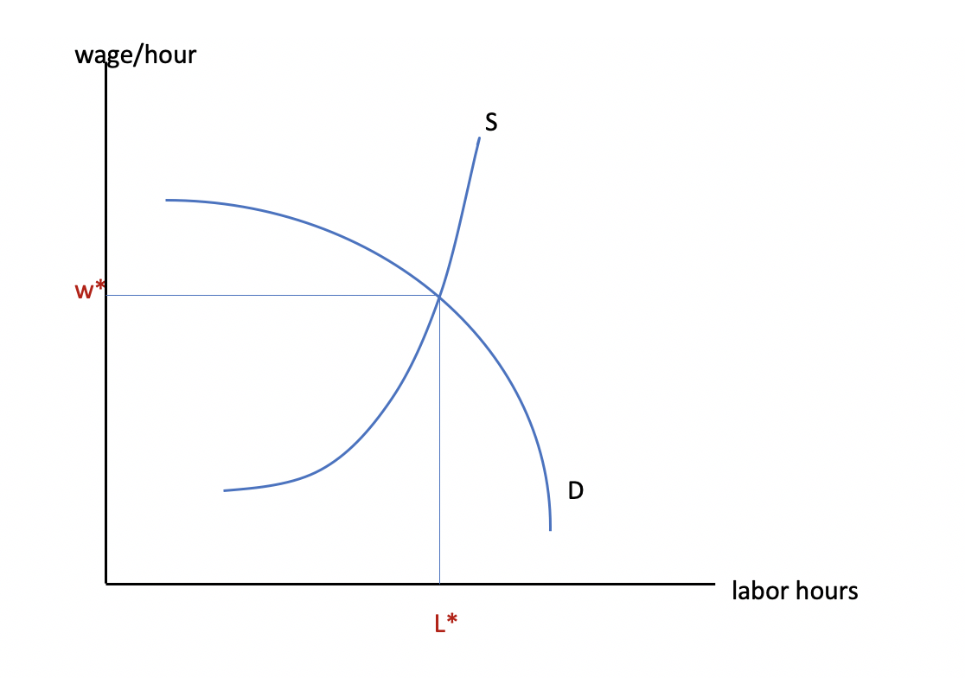
Labor supply & demand
Neoclassical labor market theory predicts that rising productivity, which increases a worker’s value to her employer, will result in a higher equilibrium real wage
On the diagram, the demand for labor shifts up
The labor market is assumed to clear (no unemployment)
W’
D’
L’

Slide 11
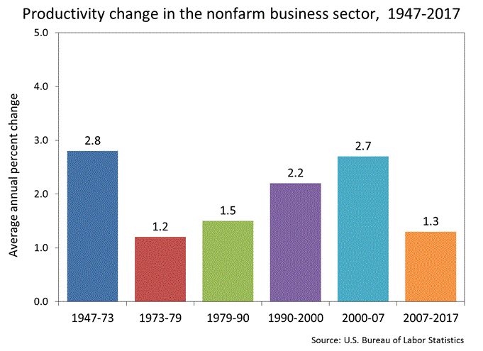
U.S. data

Slide 12
Productivity growth and real wages: they should track!
U.S. Productivity growth
U.S. Real wage growth
Up to about 1970, wage growth was about the same as productivity growth
Since 1970, wage growth has badly lagged productivity growth
A major reason for increasing inequality
It has virtually always been positive
It has fluctuated between about 1%/year and 3.5%/year

Slide 13
Solow-Swan Model of Growth
The Solow model is a framework for understanding the determinants of economic growth
It uses a single production function for the whole economy; the level of output is dependent on the factors of production employed. It’s analogous to a firm production function
Assumptions:
Constant returns to scale
Closed economy (no trade)
Increases in capital and labor are subject to diminishing marginal product when other factors are fixed.

Slide 14
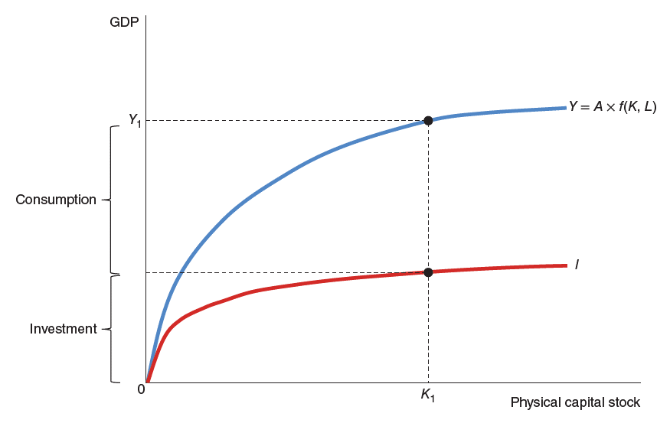
Figure 1. The Aggregate Production Function and Investment.
Assuming technology is given (A), an increasing physical capital stock (K) is associated with a rising GDP (Y), relatively quickly at first but then slowing due to diminishing marginal product.
The level of investment in capital stock is shown by the line I.
The savings rate determines the level of investment. sY = I
Levels of physical capital stock are associated with levels of GDP.
If the capital stock is K₁, for example, GDP will be Y₁.
The distance between the level of GDP at K₁ and the investment level is consumption, and the remainder is investment.
FOR USE WITH MANKIW AND TAYLOR, ECONOMICS 6TH EDITION 9781473786981 © CENGAGE EMEA 2023

Slide 15
Long-run Equilibrium: “Steady State”
Where does this (quite abstract) economy come to rest?
That depends on the (fixed, for now) level of technology
And the rate of saving out of GDP => the level of investment
And the rate of depreciation of capital: by what % do machines wear out every year?

Slide 16
Steady-State Equilibrium
Y/L
(GDP per worker)
Long-run equilibrium:
Investment equals depreciation, so K per worker (K/L) stays constant at K*.
If the economy is at any other level of Y, either I/L > depreciation and K/L grows, or I/L < depreciation and K/L shrinks.
Y/L follows K/L.
Y/L
Y/L = A f(K/L)
∂K/L
This diagram expresses capital and GDP in per-worker units
Consumption per worker
I/L
Investment per worker
0
K* K/L Capital per worker

Slide 17
What’s true in steady state?
If there’s no population growth and no technological change (for now):
Then steady state means
Constant real GDP
Constant per-worker GDP (labor productivity, determines standard of living)
Constant quantity of capital—just enough investment to replace depreciating capital

Slide 18
Causes of growth or decline in the Solow model (Shocks)
A change in the savings rate
Population growth
An improvement in technology

Slide 19
Shock 1: an increase in the savings rate
Y/L
GDP
per worker
Y’/L
Y/L
An increase in savings means higher investment/L.
The capital-labor ratio grows to K** and GDP per worker increases along the blue production function
The economy ends up at a new steady-state equilibrium of K**.
Y/L = A f(K/L)
𝜹 K/L
I’/L
I/L
0
K* K** K/L Capital per worker

Slide 20
Shock 2: Population increases
In the model, if there is ongoing population growth, the capital/labor ratio will fall (assuming there is no shift in investment).
We can show this by rotating up the green depreciation line: the amount of new capital necessary for various levels of K/L
K/L falls and Output/L falls
The negative association between population expansion and output per worker might explain why some developing economies strive to slow down population growth

Slide 21
Shock 2: Population growth
Y/L
GDP
per worker
Population growth means current investment is not enough to keep capital per worker from falling (green line rotates up)
K/L shrinks to K** and GDP per worker falls along the blue production function
The economy ends up at steady state with lower income and consumption.
Y/L
Y’/L
Y/L = A f(K/L)
𝜹K/L
C’/L
I/L
0
K** K* K/L Capital per worker

Slide 22
Shock 3: Technology improves
If factor A increases, the production function Y/L shifts up
GDP per L (labor productivity) increases at every level of K/L
Investment/L shifts up as Saving grows (sY’)
Steady state K/L and steady state Y/L increase (and consumption grows as well)

Slide 23
Shock 3: Technology improves, A ↑
Y/L
Output
per worker
Y’/L
Y/L
Y/L = A’ f(K/L)
A shift in A causes output/L to shift up.
Investment follows along.
The result is a higher capital-labor ratio K** and higher labor productivity and higher consumption
The economy moves to a new steady-state equilibrium of K**.
Y/L = A f(K/L)
C’/L
𝜹 K/L
I’/L
I/L
0
K* K** K/L Capital per worker

Slide 24
Influence of the Solow growth model
Huge importance placed by the model and by policy makers on saving and capital accumulation as the key to development
Some developing economies suppress consumption to keep investment high (which has always happened--not Solow’s doing)
If domestic savings are low due to poverty, can foreign savings (aid or corporate investment) pay for investment? (Esp 1960s, 1980s)
Mixed results on this
Solow assumes full employment. But some developing economies struggle to create jobs and more capital does not always help
Where the capital is, human capital in addition to machines: crucial!

