Slide 1
Negotiation Analytics 30C02000 Jyrki Wallenius
Lecture 1: Fundamentals
Original lecture slides: Pirkko Lahdelma
https://mycourses.aalto.fi

Slide 2
Welcome!
Negotiations play a significant role both in our personal and professional lives. We keep on running into situations where negotiation skills are needed.
We are here to help you improve your negotiation skills and your understanding of negotiation theory.
Jyrki Wallenius, Aalto BIZ jyrki.wallenius@aalto.fi
Johanna Bragge, Aalto BIZ (guest lecture) johanna.bragge@aalto.fi
Jukka Koskenkanto, CEO of Cloudriven Oy
jukka.koskenkanto@clouddriven.fi
Aku-Ville Lehtimäki, course assistant:
aku-ville.lehtimaki@aalto.fi

Slide 3
Objectives of this course
To learn
to understand the negotiation problems you face
to make decisions confidently in complexity
to be able to justify your decisions convincingly to yourself and to others
to conduct negotiations satisfyingly

Slide 4
Content
This course provides a general approach to negotiations, drawing on examples from a variety of industries and contexts
We incorporate ideas from a range of fields and disciplines: economics and decision theory, psychology, organizational behavior, and law
It is meant to
develop your awareness of negotiation, and of yourself as a negotiator;
give you some tools and concepts for analyzing and preparing for negotiations;
enhance your negotiating skills through cases, and feedback; and
teach you how to keep learning from your own negotiation experience

Slide 5
Practical arrangements
Six lectures mainly based on Raiffa’s book
To assist you to adopt the contents of the text book
Guest lecture(s)
Bragge: pseudo mock negotiations (part of my sixth lecture)
Exam May 27th
Counts for 50 % of the grade
Team case exercises
Three team exercises (Harvard cases)
Three assignments based on team exercises
You can be absent maximum one time
However, the absence should be compensated by an extra task (literature review)
Count for 50% of the grade

Slide 6
Schedule
See the syllabus

Slide 7
About grading the cases
The grading of each case assignment is based on
the quality of the analyses
the quality and completeness of the written report
Note! If there is a template for the report of an assignment, you should use it!
Assignments are
team reports (one report per team of three, four or five people)
everyone in the same team will get the same grade
however, the team should assess the input of each member and state if there are clear deviations from the norm
deviations will be examined and taken into account in the grading if considered important

Slide 8
Exam
May 27th, 2019
Covers:
Raiffa’s book (good parts of it)
Lecture slides
Question format can vary but they might include:
Definitions for concepts
Multiple choice or True/False statements
Short questions (possibly requiring small mathematical calculations or graphical presentations)
Essays
What if you fail in the exam? What if you pass the exam but are not satisfied with the grade?
You can retake the exam in Autumn 2019

Slide 9
Final grades
To pass the course
You need to participate in the mandatory team exercises (and compensate a possible absence) and receive a passing grade (sum of case exercise scores, minimum 40%)
You need a passing grade from the exam (minimum 50%)
The grading of the course is the weighted average of the following components:
Exam: 50%
Assignment #1: 16.67%
Assignment #2: 16.67%
Assignment #3: 16.67%
News and general information about the course in mycourses.aalto.fi
Case materials will be posted in mycourses.aalto.fi or distributed in class
Case assignments should be returned via email: aku-ville.lehtimaki@aalto.fi

Slide 10
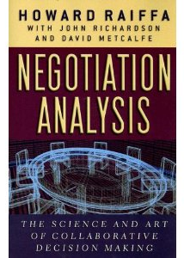
Course literature
Howard Raiffa with John Richardson and David Metcalfe:
Negotiation Analysis: The Science and Art of Collaborative Decision Making, The Belknap Press of Harvard University Press, Cambridge Massachusetts and London England, 2002.
PP-slides
R Fisher, W Ury & B Patton (optional)
Getting To Yes. Negotiating Agreement Without Giving In. Second Edition. Penguin Books, 1991
R Lewicki, D M Saunders, and B Barry (optional)
Negotiation. McGraw-Hill, 2006

Slide 11
Structure of this course
Negotiation
2. Distributive (Win-Lose)
3. Integrative (Win-Win)
4. Many parties
1. Fundamentals

Slide 12
Today’s objectives
To learn about negotiations
To learn about conflicts
To learn how to structure a negotiation process
To learn a bit of decision analysis (one of the fundamentals)

Slide 13
What is a negotiation situation like?
There are two or more parties
There is a conflict of needs and desires
Parties think that they can get a better deal by negotiating

Slide 14
Why do we negotiate?
To agree on how to share or divide a limited resource
To create something new that neither party could attain on his or her own
To resolve a dispute or conflict between the parties, for example:
Between a husband and a wife
Between parents and children
Between teachers and students
Between employers and employees
Between companies, between governments

Slide 15
Why are negotiation skills so important?
They can make a big difference
all parties better!
Look for efficient solutions, where all benefit (if you can)
Negotiation is a fact of life
Socially
Professionally
Way of conflict resolution

Slide 16
To reach good solutions, you need negotiation skills
Soft skills
How to influence others?
How to apply negotiation tactics?
Human psychology
Hard skills
How to analyze the situation?
How to resolve the problem?
With the help of decision analysis
With the help of game theory

Slide 17
Some issues to consider before negotiations
To negotiate or not?
What to do if negotiations fail?
With whom to negotiate?
Two or more than two parties?
Are the parties monolithic?
Is the situation repetitive or one-time?
Are there linkage effects (to other issues)?
Is there more than one issue?
Is an agreement required?
Is ratification required?
Are threats possible or workable?
Are there time constraints or time–related costs?
Are the contracts binding?
Are the negotiations private or public?
What are the group norms? Will they tell the truth? Will they threaten? Will they break the law?
Is third-party intervention possible?
Notes:
Pp. 81 – 96
To negotiate or not?
That was discussed earlier
What to do if negotiations fail?
What are you alternatives
With whom to negotiate?
Sometimes you can select, approach; sometimes professional negitatiotiors
Two or more than two parties?
The more parties, more compiex the negotations will become. Coalitions
Are the parties monolithic?
Often they are not. Think about Finland negotiating in EU. Barganing and concessions internally.
Is the game repetitive?
They often are. How you behave will have an impact in your future negations. Reputations.
Are there linkage effects?
How the outcome will affect other negotitions with other parties. Labor management: Unions even Employees. Customers
Is there more than one issue?
Sometimes it is only price. Often there are more. Again labor-management. Collabiartion between two companies.
Is an agreement required?
Often you can walk away. But for example labour management agreement is required in practice or even by law.
Is ratification required?
Sometimes it is. National agreements in parliament. Board in companies
Are threats possible?
Not only walk away. But I will hurt you. Emprically using power this way will cause poorer results. Kill co-operation.
Are there time constraints or time–related costs?
The party that negotiates in hase has typically disadvantage.
Are the contracts binding?
There are courts for within country. But how about when a multinational company makes an investment I a country. Can it be safe. Not necessarely.
Are the negotiations private or public?
It will have an impact what concencession you make. Think about leader of a country.
What are the group norms?
How open you are, how truthful you are.
Is a third-party intervention possible?
It can help in conflicts but also situations where full open and truthful exchange between parties are not possible, there is no trust yet.

Slide 18
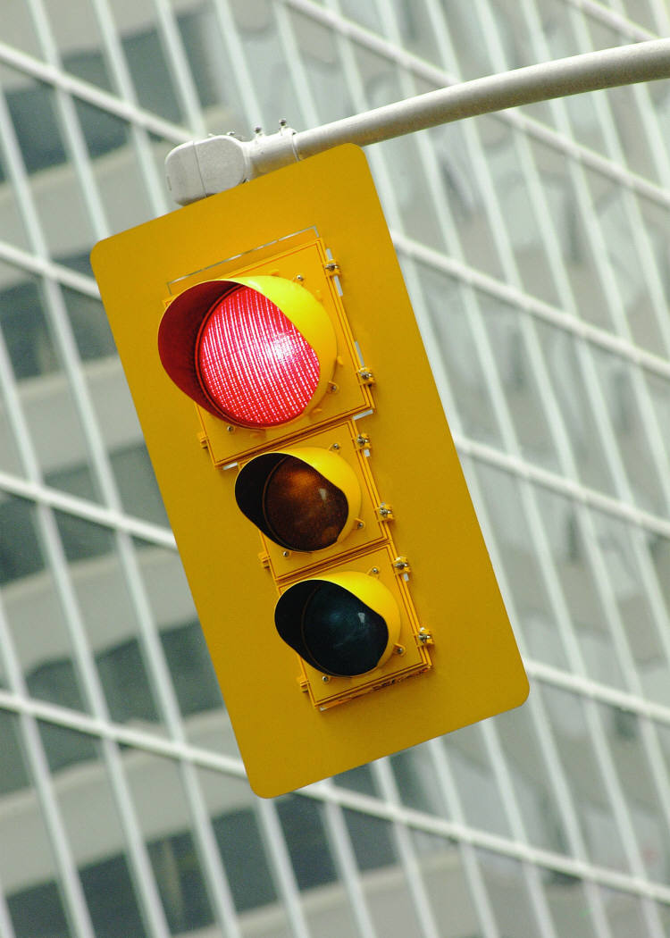
You should also know, when not to negotiate
You would lose a lot by negotiating,
take your chances in court of law
Nothing in stock to sell
The demands are unethical
You don’t care
You don’t have time
They act in bad faith
Waiting would improve your position
You are not prepared
Notes:
Lewicki (p. 7):
You’d lose the farm: you could lose everything.
You’re sold out: you are running at capacity – raise your prices instead
Unethical: illegal, unethical, or morally inappropriate - do not compromise your reputation
You don’t care: why should you bother? You could lose and there is nothing to gain.
You don’t have time: if the time pressure works against you, you will make mistakes when failing to think of consequences
Bad faith: if you can’t trust their negotiations , you can’t trust the agreement
Waiting: if you are about to have a better financial situation soon, so don’t start negotiations now
Not prepared: if you are not ready, just say ‘no’

Slide 19
Conflicts

Slide 20
Conflicts
Result from
strongly divergent needs of the two parties
misperceptions and misunderstandings
Not always a bad thing; instead, a conflict
creates discussion, which makes organizational members more aware and able to cope with problems
promises organizational change (by drawing attention to serious issues)
strengthens relationships and heightens morale (at best)
promotes awareness of self and others
enhances personal development (at best)
can be stimulating and fun
Source: Lewicki, Barry, Saunders: Negotiation. 2010 quoting Tjosvold 1986

Slide 21
Different types of conflicts …and how to resolve them
Conflict
Intra-personal
Inter-personal
Intra- group
Inter- group
Conflict Resolution
Policies
Simple Choice
Negotiation
Third-Party Intervention

Slide 22
Conflict diagnostic model (offers useful dimensions for analysis and suggests how easy or difficult the dispute is to resolve)
 | Viewpoint continuum
Dimension | Difficult to resolve | Easy to resolve
Issue in question | Matter of ”principle” – values, ethics, etc. | Divisible issue
Size of stakes | Large – big consequences | Small – little consequences
Interdependence of the parties | Zero sum | Positive sum
Continuity of interaction | Single interaction – no past or future | Long-term relationship
Structure of the parties | Disorganized | Organized
Involvement of third parties | No neutral third party available | Trusted, powerful third party available
Perceived result of the conflict | Unbalanced | Balanced
Source: Lewicki, Barry, Saunders: Negotiation. 2010 (p.21) quoting Greenhalgh 1986

Slide 23
Conflict management strategies The dual-concern model
Source: Lewicki, Barry, Saunders: Negotiation. 2010 quoting. – quoting Pruitt, Rubin & Kim, 1994.

Slide 24
Problem solving (collaborating or integrating)
Situations where appropriate | Situations where inappropriate
Issues are complex Synthesis of ideas needed to come up with better solutions Commitment and resources are needed from all parties for successful implementation One party alone cannot resolve the problem Time is available | Task or problem is simple Immediate decision is required Other parties are not concerned about outcome Other parties have no problem-solving skills
Source: Lewicki, Barry, Saunders: Negotiation. 2010 quoting. – quoting Rahim, 199o.
.

Slide 25
Yielding (accommodating or obliging)
Situations where appropriate | Situations where inappropriate
You believe you may be wrong Issue is more important to the other party You are willing to give up something in exchange for something from the other party in the future You are dealing from a position of weakness Preserving relationship is important | Issue is important to you You believe you are right The other party is wrong or unethical
Source: Lewicki, Barry, Saunders: Negotiation. 2010 quoting. – quoting Pruitt, Rubin & Kim, 1994.
.

Slide 26
Contending (dominating or competing)
Situations where appropriate | Situations where inappropriate
Issue is trivial Speedy decision is needed Necessary to overcome assertive subordinates Unfavorable decision by the other party may be costly to you Subordinates lack expertise to make technical decisions Issue is important to you | Issue is complex Issue is not important to you Both parties are equally powerful Decision does not have to be made quickly Subordinates possess high degree of competence

Slide 27
Inaction (avoiding)
Situations where appropriate | Situations where inappropriate
Issue is trivial Potential dysfunctional effect of confronting the other party outweighs benefits of resolution Cooling off period is needed | Issue is important to you It is your responsibility to make a decision Issue must be resolved (soon)
Source: Lewicki, Barry, Saunders: Negotiation. 2010 quoting. – quoting Pruitt, Rubin & Kim, 1994.

Slide 28
Compromising
Situations where appropriate | Situations where inappropriate
Goals of parties are conflicting Parties are ‘equally' powerful Consensus cannot be reached Dominating style is not successful Temporary solution to a complex problem is needed | One party is more powerful Problem is complex enough to need a problem-solving approach
Source: Lewicki, Barry, Saunders: Negotiation. 2010 quoting. – quoting Pruitt, Rubin & Kim, 1994.

Slide 29
Fundamentals

Slide 30
Perspectives on decision making
Decision making
Individual
Descriptive
(Behavioral)
Prescriptive
(Decision Analysis)
Plural
Separate and interactive
(Game theory)
Normative
(Decision Analysis)
Joint
(Negotiation theory)
Asymmetrically prescriptive /descriptive
Symmetrically descriptive
Symmetrically normative
Notes:
Pp. 3 – 13
Indivual means a person, company etc. Unitary. Make a decision to buy, invest, surgery
Plular means that there are two or more parties.
Separte and interactive: Separate decisons. The payoff will depend on the decsion of the other party.
Joint negotiation. Joint agreement. Joint consequence and payoffs.

Slide 31
Different orientations – some terminology
Descriptive perspective on decision making
How decisions are made?
Normative perspective on decision making
How decisions should be made by super rational people?
Prescriptive perspective on decision making
How decisions could be made better?
Symmetrical approach
All the negotiators are equal from the analyst’s point of view
Asymmetrical approach
Aiding one party

Slide 32
Descriptive approach: Behavioral perspective
How do people actually think and behave?
How do they perceive uncertainties? How do they learn?
What are their biases, or internal conflicts?
Beware of the biases and decision traps
Do people really act as they say?
Can they articulate reasons for their actions?
How do they resolve their internal conflicts or avoid resolving them?
Do they decompose complex problems? Or do they think more holistically and intuitively?
What is the role of different cultures, subcultures, gender, experience, etc.?
What is the role of tradition?

Slide 33
Behavioral Decision Theory: Decision Traps
The anchoring trap
We stick with the first impression
The status quo trap
We stick with the past
The sunk-cost trap (trying desperately to recover losses)
Look into the future!
The confirming evidence trap
We see what we want to see
The framing trap
How questions are framed impacts your choices
Notes:
Pp. 33 – 37
Anchoring trap high price. Example population of Turkey more or less than 30 million.
Status quo
We hate deciding:
We don’t want to give anything up
We don’t want to make a mistake
We look for quick and partial solutions
Sunk-cost
We have spend so much already. We hate losing! We may take high risks.
The confirming evidence trap
We see what we want to see.
Different frame, how questions area asked.

Slide 34
Prediction Anomalies (Probability Traps)
Conditional ambiguities: P(A/B) different from P(B/A) – eye defect/German measles …
The overconfidence trap (hubris)
The conjunction fallacy (the joint event cannot have a higher probability than one of the events)
The base-rate fallacy: example librarian
When is sample large enough?
Getting mystical about coincidences (gambler’s fallacy)
Notes:
Pp. 37 – 44
Conditional ambiguities
Mixing conditional probabilities. For example patient having certain fatal disease have typically certain symptoms. Now if I have certain symptoms how likely is it that have I have the disease. Very often very low.
The overconfidence trap
We do not calibrate well. We are over confident. For example how may phycisians Low Up
The conjunction fallacy
A joint even is consider more likely than a single event.
Underestimating the value of sample evidence
- Small sample

Slide 35
Normative and prescriptive approaches: Decision analysis for a single person or party
We must decide whether or not to go to court or negotiate (settle)
We must decide whether or not to use a third party (mediator, arbitrator)
We must decide, with whom to negotiate
If we can, develop your BATNA (=Best Alternative to Negotiated Agreement)
Be aware that payoffs are determined also by actions of the other side(s) (payoff is a function of all the player´s choices!)

Slide 36
Case Audrey
A successful author of mystery novels
Searching for a new publisher
Notes:
Case Audrey as an example of PrOACT

Slide 37
Audrey’s problem and objectives
Narrow focus: Which publisher should publish her next book?
Broader focus: What is the best way to communicate this story to her audience? Movie, magazine articles, Internet?
Audrey wants
Money
A publisher with a strong distribution network (narrower focus)
Good editors
Fame and recognition
She recognizes three alternatives:
PPP
QQQ
RRR
Notes:
Identify the problem
Clarity the objectives

Slide 38
Evaluation of alternatives: multiple criteria
 | Audrey's alternatives
Criteria | PPP | QQQ | RRR
Prestige | Good | Ok | Great
Editing help | Fair | Fair | Great
Distribution | Good | Fair | Good
Advance | $600K | $550K | $400K
PPP dominates QQQ → QQQ is out
Trade-offs between PPP and RRR
Notes:
Evaluate the consequences
Make tradeoffs.

Slide 39
Expected monetary value: just money
New alternatives
 | Standard publisher |  | Aggressive publisher |  | Internet publisher
 | Prob. | Monetary value ($000s) | Prob. | Monetary value ($000s) | Prob. | Monetary value ($000s)
 | 0.2 | 300 | 0.2 | 100 | 0.5 | 0
 | 0.6 | 500 | 0.5 | 500 | 0.2 | 500
 | 0.2 | 700 | 0.3 | 1000 | 0.3 | 2000
 | 1 |  | 1 |  | 1
EMV |  | 500 |  | 570 |  | 700
Expected monetary value = EMV = p₁m₁ + … + p_{i}m_{i} + … + p_{n}m_{n}
Notes:
Pp. 21 – 32
Adrey is able to convert to money.
Works when the payofss are small compared to assets. Typical for “standard decisions” in companies. Or out lives with small amounts.
Problem: ignore the value to the indivual. Especially if the difference between high and low is big. For example here 0 and 2 millinon.
Does not take into account

Slide 40
Audrey’s desirability for money
Audrey's desirability for money
Money ($000s) | Desirability
0 | 0
200 | 25
500 | 50
1000 | 75
2000 | 100
Intensity of feeling!
"The first $100.000 will be much
sweeter than the 20th such
increment!"
Notes:
Incenty of feelings. Here is money.
Desirability can be used also for non-money.
Scoring system to individual objectives and consequences. We will come to that later during the course.

Slide 41
Expected desirability value
 | Standard publisher |  |  | Aggressive publisher |  |  | Internet publisher
 | Prob. | Monetary value ($000s) | Desirability value | Prob. | Monetary value ($000s) | Desirability value | Prob. | Monetary value ($000s) | Desirability value
 | 0,2 | 300 | 35 | 0,2 | 100 | 15 | 0,5 | 0 | 0
 | 0,6 | 500 | 50 | 0,5 | 500 | 50 | 0,2 | 500 | 50
 | 0,2 | 700 | 62,5 | 0,3 | 1000 | 75 | 0,3 | 2000 | 100
 | 1 |  |  | 1 |  |  | 1
EMV |  | 500 |  |  | 570 |  |  | 700
EDV |  |  | 49,5 |  |  | 50,5 |  |  | 40
Expected desirability value = EDV = p₁d₁ + … + p_{i}d_{i} + … + p_{n}d_{n}
Notes:
Does not take into account attitude to risk.

Slide 42
Audrey’s utility for money: A way to incorporate risk attitudes into the analysis
Audrey's utility for money
Money ($000s) | Utility
0 | 0.00
150 | 0.25
400 | 0.50
800 | 0.75
2000 | 1.00

Slide 43
Expected utility value
 | Standard publisher |  |  | Aggressive publisher |  |  | Internet publisher
 | Prob. | Monetary value ($000s) | Utility value | Prob. | Monetary value ($000s) | Utility value | Prob. | Monetary value ($000s) | Utility value
 | 0.2 | 300 | 0.4 | 0.2 | 100 | 0.18 | 0.5 | 0 | 0
 | 0.6 | 500 | 0.6 | 0.5 | 500 | 0.6 | 0.2 | 500 | 0.6
 | 0.2 | 700 | 0.71 | 0.3 | 1000 | 0.8 | 0.3 | 2000 | 1
 | 1 |  |  | 1 |  |  | 1
EMV |  | 500 |  |  | 570 |  |  | 700
EUV |  |  | 0.582 |  |  | 0.576 |  |  | 0.42
Expected utility value = EUV = p₁u₁ + … + p_{i}u_{i} + … + p_{n}u_{n}

Slide 44
In Conclusion: It is not uncommon that
We have no structure for thinking about deciding
We are reactive, not proactive
We don’t clarify our objectives, fears, or interests
We don’t generate creative alternatives
We include only what we can handle formally
Quantitative data is privileged over qualitative
We are erratic about discounting the future: we’re more worried about the near future than the far future
Notes:
p 35

