Slide 1
Principles of Empirical Analysis Lecture 10: Regression discontinuity design
Spring 2024
Miri Stryjan

Slide 2
Observational alternatives to experiments
Selection on observables: treatment and control groups differ from each other only w.r.t. observable characteristics
Lecture 8
Selection on unobservables: treatment and control groups differ from each other in unobservable characteristics
Exogenous variable induces variation in treatment – instrumental variables (IV) Lecture 9
Selection mechanism is known – regression discontinuity designs (RDD)
Treatment and controls are observed before and after treatment – difference-in-differences (DID)

Slide 3
Outline
Basic idea of regression discontinuity designs
Recap
Applications
Geographic boundary as regression discontinuity

Slide 4
RDD – the setup
RDD has three fundamental components: running variable, cut-off, and treatment
Individuals become treated after crossing some cutoff in the running (or forcing or score) variable
Sharp RDD: treatment received with probability zero below the cut-off (or threshold) and probability one above cut-off
Fuzzy RDD: The probability of receiving the treatment increases discontinuously at the threshold (imperfect compliance)
Assumption: the potential outcomes evolve smoothly across the cutoff. In other words:
If there is no precise manipulation of the running variable, observations just below the threshold are very similar to those just above the threshold and therefore constitute a valid control group.

Slide 5
Example: Minimum legal drinking age in the US

Slide 6
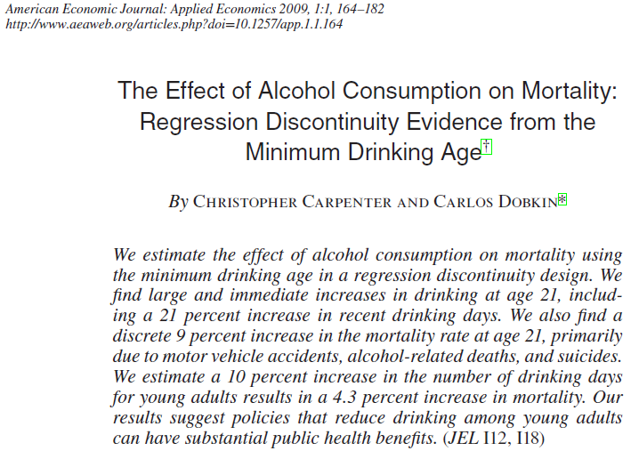

Slide 7
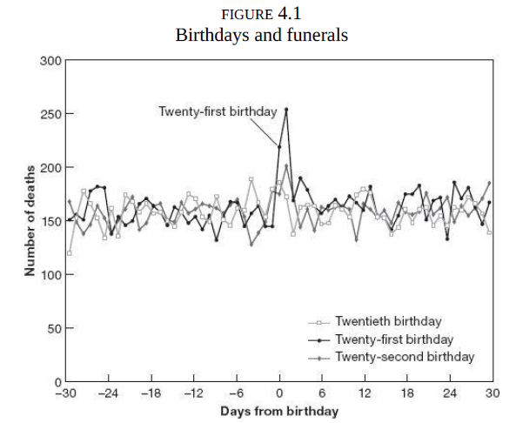
Source: Angrist & Pischke (2015): Mastering Metrics.

Slide 8
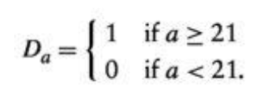
What happens at age 21?
-> Legal drinking age in the US
T: legal access to alcohol (here denoted by D_{a} using Mastering Metrics notation)
Y: likelihood of dying (and specific cause of death)
Running variable?
Cutoff?
Treatment?

Slide 9
Alcohol and deaths
Two important things to notice:
Treatment status is a deterministic function of a, so once we know a, we know D_{a} (treatment status)
Treatment status is a discontinuous function of a, because no matter how close a gets to the cut-off, D_{a} remains unchanged until the cut-off is reached.
“Although treatment is not randomly assigned, we know where it comes from”!

Slide 10
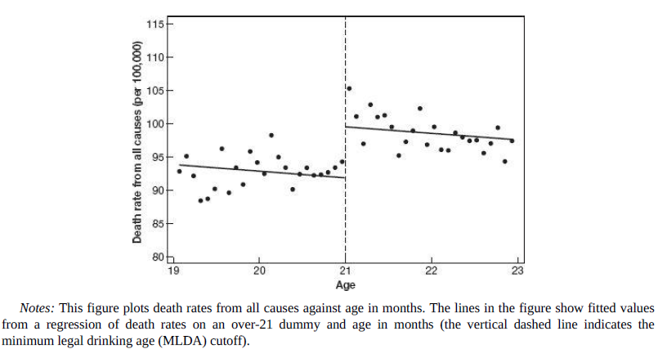
Source for the figure: Angrist & Pischke (2015): Mastering Metrics.

Slide 11
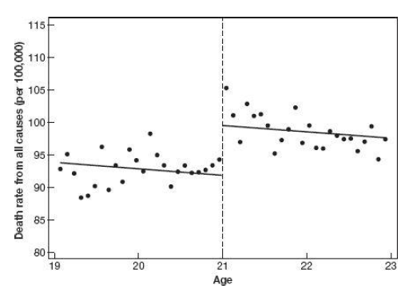
Running variable
Cutoff (sharp!)

Slide 12
Treated
Control
Running variable
Cutoff (sharp!)

Slide 13
Treatment effect at the cutoff
Treated
Control
Running variable
Cutoff (sharp!)

Slide 14
Treatment effect at the cutoff = α₁ – α₀
Regression line from a regression of death rates on age:
E[death rate|age, age > 19 & age < 21 ]
= α₀ + β₀*age,
Regression line from a regression of death rates on age:
E[death rate|age, age ≥ 21 & age < 23]
= α₁ + β₁*age

Slide 15
Treatment effect at the cutoff
Death rates within bins
Instead of showing a scatter plot on individual level data, papers often show a scatter plot where the data is binned into smaller number of groups along the variable on the x axis.
The regression lines are fitted separately for each side of the cutoff using individual level micro data

Slide 16
Mechanisms
There seems to be a jump in death rates after age 21 in the US data. But how do we know that this jump is due to alcohol access and consumption?
We may need additional data. What data?
Data on alcohol consumption by age
Data on the causes of death by age

Slide 17
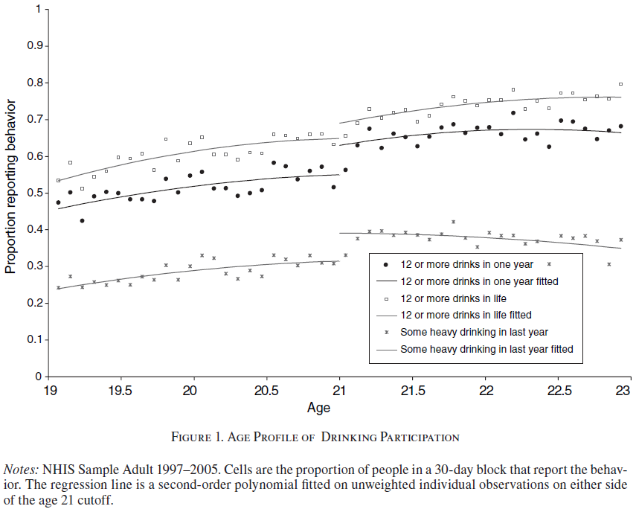
More results – alcohol consumption

Slide 18
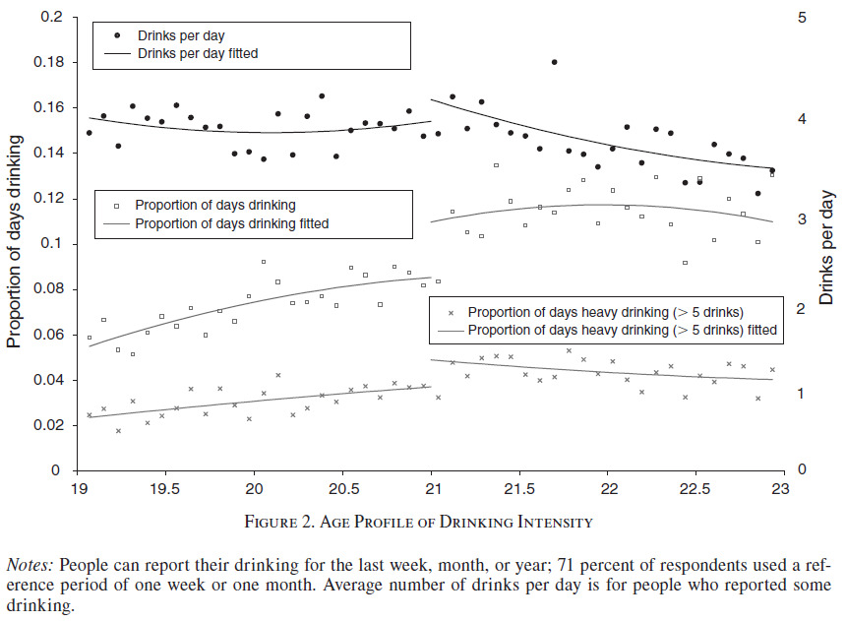
More results – alcohol consumption

Slide 19
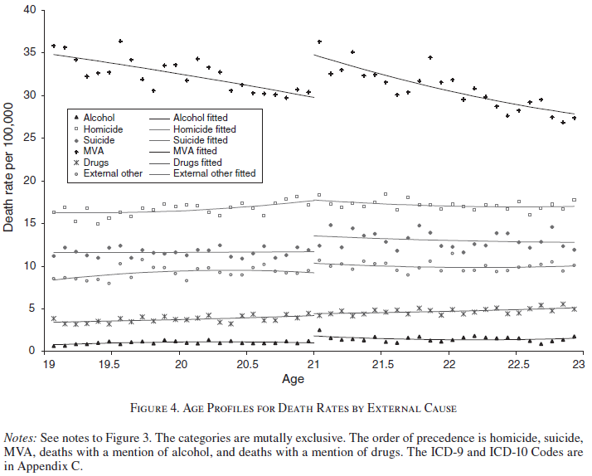

Slide 20
Testing for RDD assumptions

Slide 21
Testing RDD assumptions
The underlying assumption in RDD is that units do not have the ability to precisely manipulate their own value of the running variable
Ways to test if this assumption is fulfilled:
Testing for sorting around the threshold: Plotting the histogram of the running variable to see if observations are evenly distributed around the threshold.
Checking if observations just above and just below the threshold are indeed similar with respect to other observables.
Placebo tests using other cutoffs that are not actually affecting the treatment, such as other ages than 21 for the drinking age paper.

Slide 22
Sorting or “manipulation” of the running variable – distribution of units around the threshold
The underlying assumption in RDD is that units do not have the ability to precisely manipulate the value of the running variable
If they could and the treatment is something beneficial, units would want to receive the treatment and sort on the right side of the cutoff
With no precise manipulation, the number of treated observations just above the cutoff should be approximately the same as the number of control observations below it
Test: plotting the histogram of the running variable and inspecting whether the number of observations are similar near the cutoff
Also, a formal statistical density test (McCrary test)

Slide 23
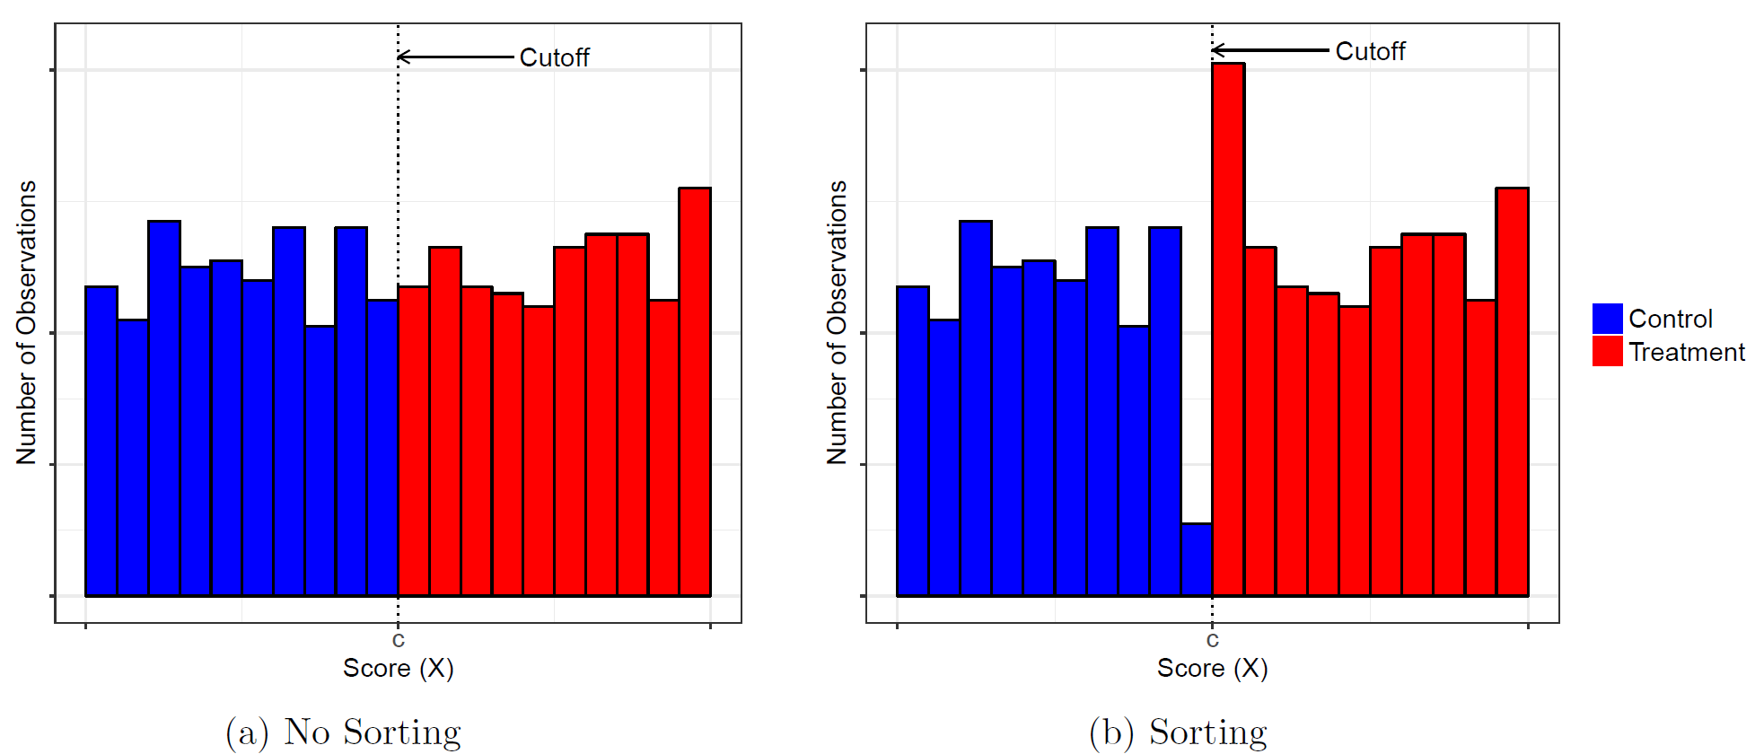
Test for sorting or “manipulation” of the running variable Which graph below shows signs of “sorting”
Source: Cattaneo et al. (2019): A Practical Introduction to Regression Discontinuity Designs: Foundations.

Slide 24
Thinking more about testing RDD assumptions
Suppose you want to estimate the effect of a property tax increase on profits and survival of businesses in a municipality by comparing businesses near the border in bordering municipalities with different property tax rates.
Your running variable is distance to the municipal border
the cutoff is the border
The treatment is facing higher property taxes
Would you be worried that businesses manipulate their running variable? If yes, what would you be worried about? Explain!

Slide 25
Test of observable variables – are units above and below threshold comparable?
One of the most important RDD falsification tests involves examining whether, near the cutoff, treated units are similar to control units in terms of observable characteristics
Idea: if units lack the ability to precisely manipulate their value of the running variable, there should be no systematic differences between units with similar values of the running variable
Thus, except for their treatment status, units just above and just below the cutoff should be similar in all variables that could not have been affected by the treatment (“predetermined”)
Implementation: all predetermined variables should be analyzed using RDD in the same way as the outcome of interest

Slide 26
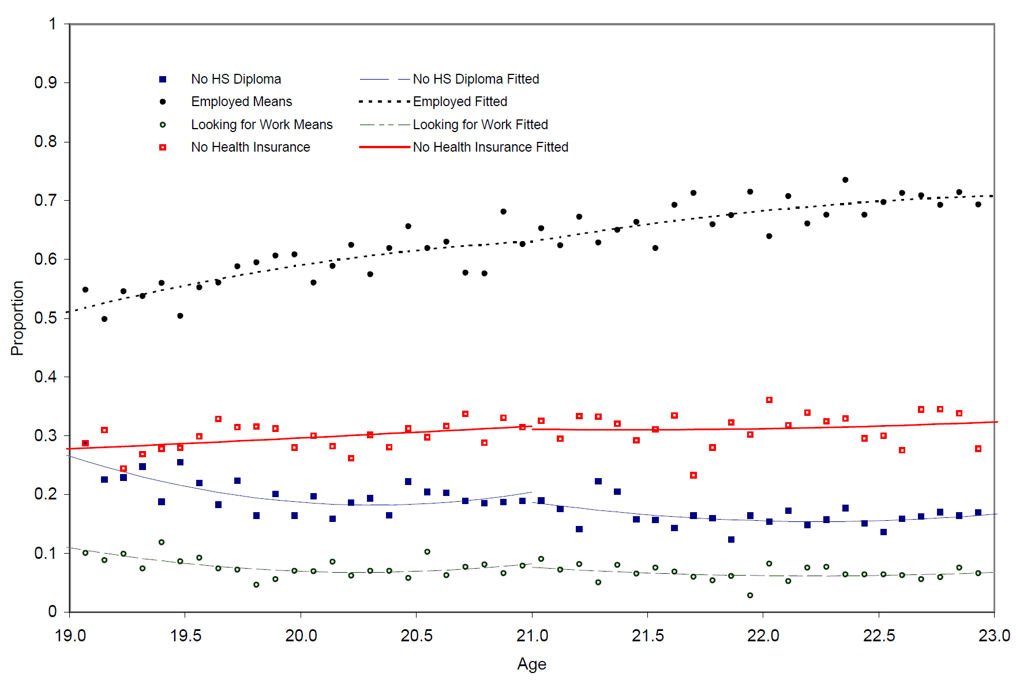
Test of predetermined covariates

Slide 27
Placebo tests – using “fake” cutoffs
Placebo test 1: to replace the true cutoff value with a fake cutoff value in the running variable
A value at which the treatment status does not really change and perform estimation and inference using this “fake” cutoff
A significant treatment effect should occur only at the true cutoff value and not at other values where the treatment status is constant
No jumps in death rates at 18, 19 or 25 etc.
Placebo test 2: run placebos at the true cutoff but replace the outcome Y with other outcomes that should not be affected by the treatment

Slide 28
Limitations of RDD

Slide 29
Local randomization interpretation
Given that units are unable to precisely manipulate the running variable, the RDD can be interpreted as a randomized experiment inside a window around the cutoff
That is, the treatment assignment is locally random
Results can be generalized to a narrow segment of the running variable: in the case of the MLDA study: young people near age 21.
“zoom in” on points close to the cut-off.
BUT: this requires a lot of data near the cutoff.

Slide 30
Technical issues
In principle, what we do in RDD is comparing means for those just above to those just below the cut-off. Often, we do not have enough data to estimate the treatment effect simply by comparing means at the cutoff so we need to use data away from the cutoff
How much data away from the cutoff should we use?
In other words, how large a bandwidth should we use?
The choice involves a bias-variance trade-off:
The closer to the cutoff you are, more likely it is that you are able estimate an unbiased causal effect.
But at the same time variance or the standard error of your estimate is larger as you are using fewer data points – more noise.

Slide 31
Treatment effect at the cutoff
The bandwidth: the share of observations used in estimating the local linear regression:
E[death rate|age, age > 19 & age < 21] = α₀ + β₀*age

Slide 32
Treatment effect at the cutoff
The bandwidth: the share of observations used in estimating the local linear regression:
E[death rate|age , age ≥ 21 & age < 23] = α₁ + β₁*age

Slide 33
How to address limitations - robustness
In an RDD paper, the authors need to show that their results are robust to different modelling and data choices, for example:
different choices of bandwith around the cutoff (within reasonable values)
different specification of the relationship between the running variable and the outcome Y.

Slide 34
Fuzzy RD
When passing the cutoff creates a jump in treatment probabilities or treatment intensity, rather than switching the treatment on or off completely, the resulting RD design is said to be fuzzy.
Example: “exam schools” in the US. Admission if you score high enough on Independent Schools Entrance Exam (ISEE). Different schools have different cut-offs. Suppose there are 3 schools, and school 1 has the highest cut-off for intake.
Scoring > cut-off for school 1: increases your probability of attending an exam school, but not to p=1; some still choose to go elsewhere.
Scoring < cut-off for school 1: decreases your probability of attending an exam school, but not to 0: you cannot go to school 1 but you can still apply to the two other exam schools!

Slide 35
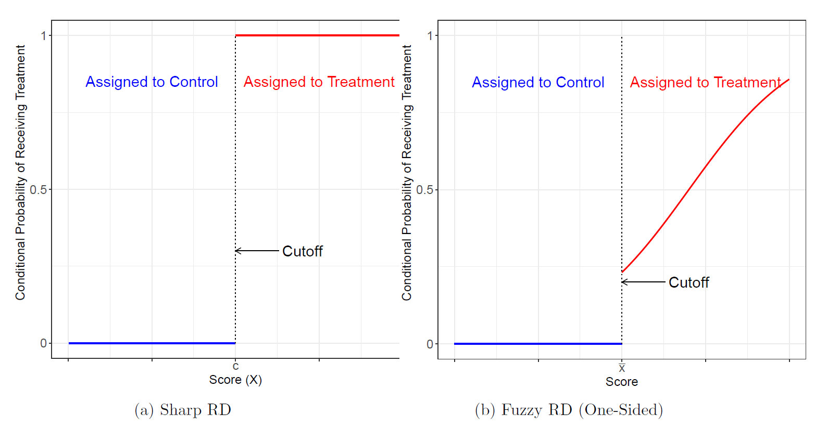
Sharp and fuzzy RDD
”the conditional probability of actually receiving treatment given the score changes discontinuously at the cut-off.” Source: Cattaneo et al. (2019): A Practical Introduction to Regression Discontinuity Designs: Extensions.

Slide 36
Fuzzy RD
Situations where fuzzy RD can be used are situations with imperfect compliance.
Compliance is a topic we will get back to next lecture.
non-compliance introduces complications and typically requires stronger assumptions to learn about treatment effects of interest.
With fuzzy RDD, being above the cutoff is an instrument for being treated: it increases probability of treatment, but not to 1. We will discuss instrumental variables (IV) more next week.

Slide 37
Other applications of RDD

Slide 38
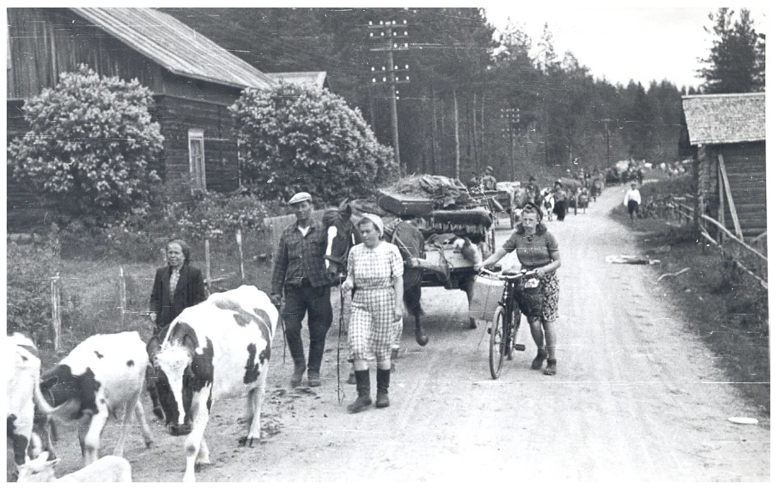
Sarvimäki, Uusitalo & Jäntti (2021)
http://www.aalto-econ.fi/sarvimaki/forced.pdf

Slide 39
Sarvimäki et al. (2021)
After World war II, 11% of the population was forced to migrate and resettled into the remaining parts of Finland
For those working in agriculture – roughly one half of the population – the government attempted to reconstruct the pre-war conditions as closely as possible
Displaced farmers were given land and assistance to establish new farms in areas that had similar soil and climate as the origin regions
Former neighbors were resettled close to each other in order to preserve social networks
Once the resettlement was completed in 1948, the displaced farmers were not subject to any special policies
They received no further subsidies and, like everyone else, were free to sell and buy land and to move across locations and sectors

Slide 40
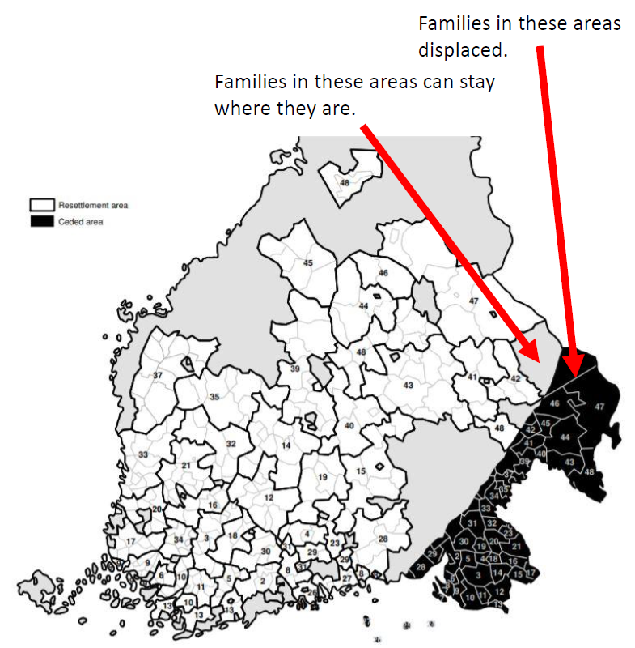
Sarvimäki et al. (2021)
Idea of paper: treated group: those who were on the side of the border ceded to the Soviet Union (black area) and were moved into the white areas on the map.
control group: those who were on the Finnish side of the border and could stay on their farms.
What do you think is the:
Running variable?
Cutoff?
Treatment?

Slide 41
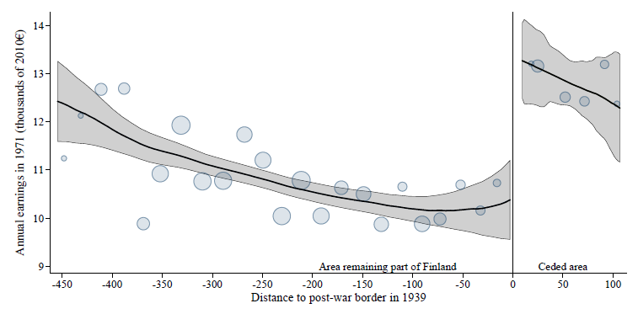
Sarvimäki et al. (2021) – main results

Slide 42
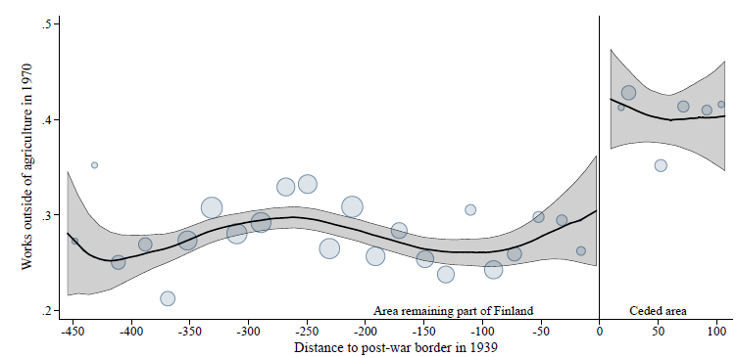
Sarvimäki et al. (2021) – main results

Slide 43
Conclusions – Sarvimäki et al. (2021)
The post war difference between displaced and non-displaced farmers suggests that forced migration increased long term income by 10–29% among men working in agriculture before the war
Forced migration increased the likelihood of leaving agriculture between 1939 and 1970 by 10–16 %-points from a baseline of 28%
Increased the likelihood of moving to a city and to complete secondary education among the displaced farmers
These results suggest that the positive impact of forced migration on the income of farmers can be attributed to an increased likelihood of leaving agriculture

Slide 44
Huttunen et al. 2023

Slide 45
Huttunen et al: the effect of secondary education on criminal behavior.
Focus: Eight cohorts of Finnish male students who graduated from compulsory schooling between 1996 and 2003 and apply to secondary education immediately upon graduation.
Running variable: Grade point average from compulsory school (grade 9)
Cutoff: minimum score for being accepted into sec education, depends on how many apply each year so not known ex ante
Treatment: attending secondary education
Y: Criminal behavior

Slide 46
Huttunen et al. explanation for how they measure “attending any secondary school”
”we use admission cut-offs that are critical in determining the access to any type of secondary education. For each applicant we pick the program that has the lowest cut-off of the programs the applicant listed in his application.
The applicants who are rejected at this margin have been rejected by all secondary schools that they applied to.
They may enroll in optional 10th grade of comprehensive school or in preparatory training, or they may opt out of education altogether.
Rejected applicants can also apply again to secondary education in the following years.“

Slide 47
grade score and secondary school admission

Slide 48
grade score and crime by year 5 after finishing 9th grade

Slide 49
grade score and crime by year 10 after finishing 9th grade

Slide 50
Huttunen et al. conclusion
“Our results show that being successful in gaining access to secondary education decreases the likelihood of committing crimes among young men.”
Men admitted to secondary schools are 52 % less likely to be convicted within 10 years after admission than men that were not admitted.
The crime reducing effect of secondary education is restricted to the extensive margin (= secondary school vs no secondary school)
no effect on crime when examining admission to the general track vs. vocational track, or to the more selective general secondary schools.
Terms: extensive vs intensive margin

Slide 51
Meyersson (2014)
“Using a regression discontinuity design, I compare municipalities where this Islamic party barely won or [barely] lost elections. Despite negative raw correlations, the RD results reveal that, over a period of six years, Islamic rule increased female secular high school education”
Units: Turkish municipalities
running variable: the margin of victory of the (largest) Islamic party in the 1994 Turkish mayoral elections.
Treatment: Islamic party’s electoral victory
Cut-off: zero, since municipalities elect an Islamic mayor when the Islamic vote margin is above zero, and elect a secular mayor otherwise.

Slide 52
Meyersson (2014)
The figure shows that in the municipalities where the Isamic party won the election (win margin >0) there is still a large variation in the Islamic vote share (x axis).
This is interesting because we can then estimate the effect of Islamic rule on municipalities in a range of “preferences” for the Islamic party.
The black dots are the munici-palities close to the cutoff which are the focus of the RCC analsyis.

Slide 53
RDD recap
Idea:
If a rule determines treatment due to a hard to predict cut-off, we can use the rule to estimate a causal effect without an RCT
Necessary criteria for using RDD:
the running variable, treatment, and cutoff must exist and the probability of treatment assignment as a function of the running variable changes discontinuously at the cut-off
Assumption:
Units just below and just above the cut-off are very similar and comparable (Potential outcomes develop smoothly across the cut-off)
Testing for design validity:
Density tests, covariate balance test, placebo tests
Challenges:
Requires a lot of observations near the cut-off
We cannot extrapolate results to units far from the cut-off (local causal effects!)

