Slide 1
Creative Sustainability Kick-off 2021
Mikko Jalas
Aalto University School of Arts, design and Architecture
Department of Design

Slide 2
Creative Sustainability -kickoff
12.30-13.30 Introduction (Mikko Jalas, Leena Lankoski, Mark Hughes)
13.45-15.10 Small group sessions about studies (Check your seating from the map)
4 x20 min: CS BIZ, CS CHEM, CS ARTS, Sustainable Global Technologies
15.20-15.45 Summary together
16.00-16.30 Introduction to the student community (Nicole Grekov)
CS programme student representatives (Andre&Kalle)
ASC
TestSite & home-base space in Väre
…
16.30-17.15 Visit to Test Site
17.15-18.00 Snacks in Mordor hall

Slide 3
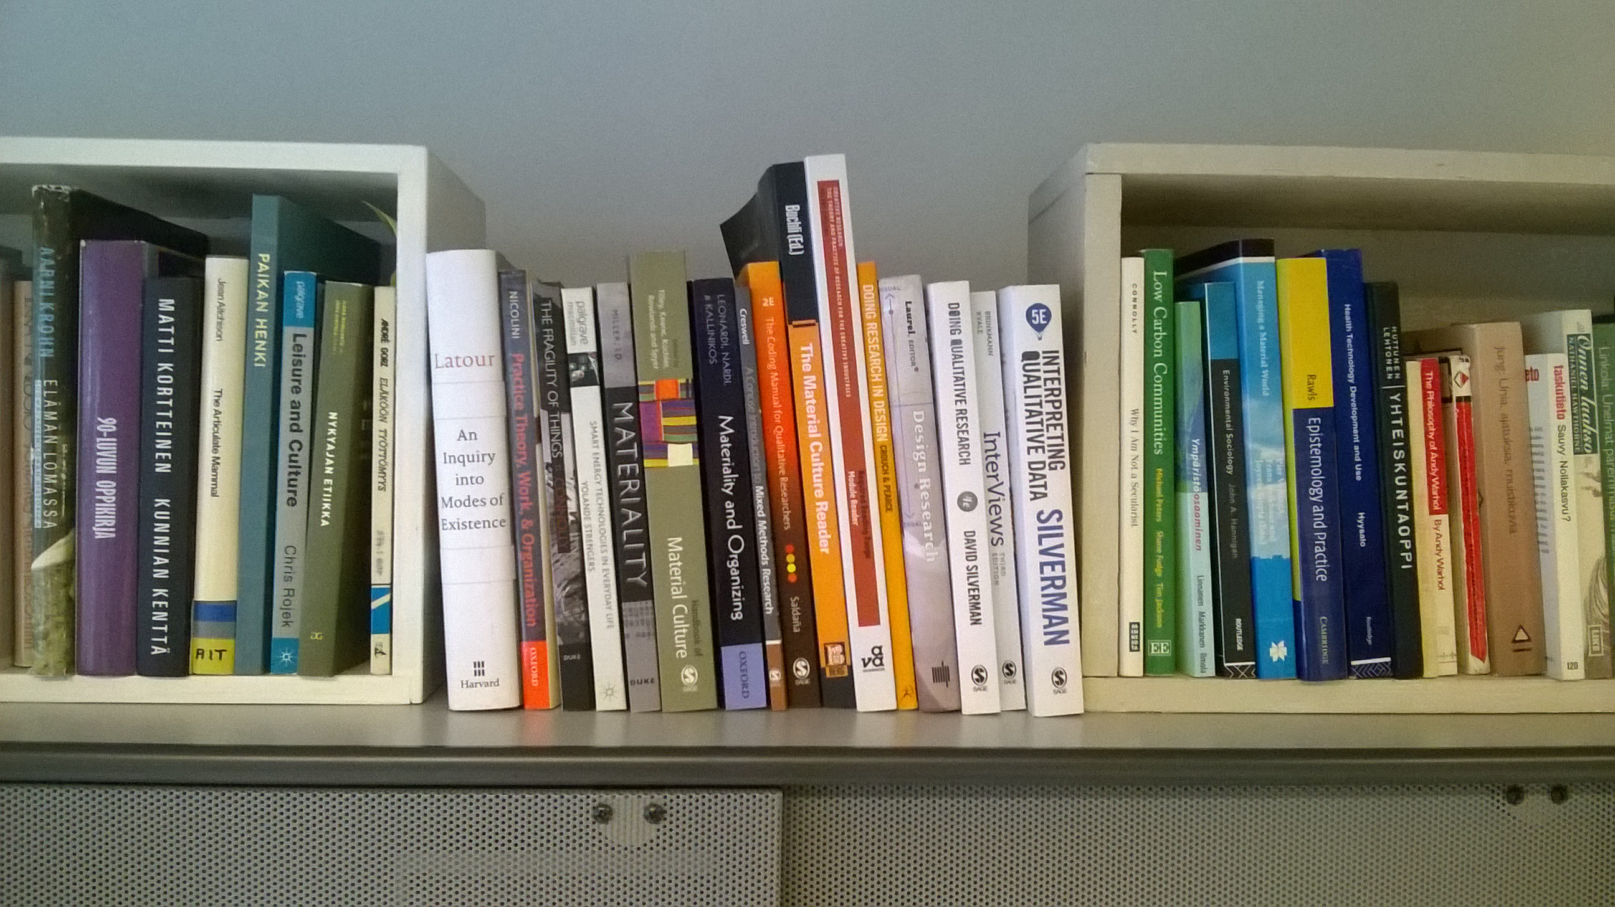
Ready to study?

Slide 4
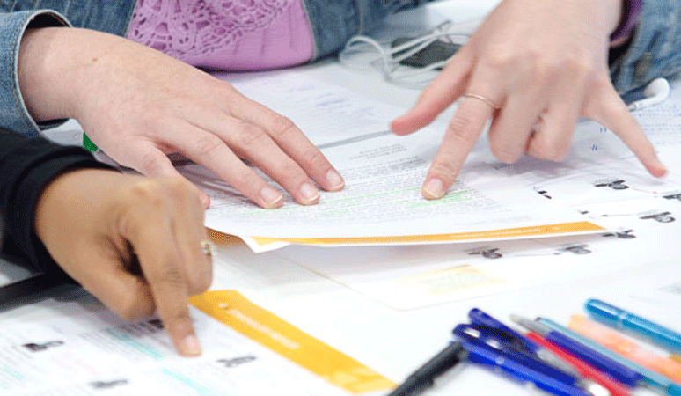
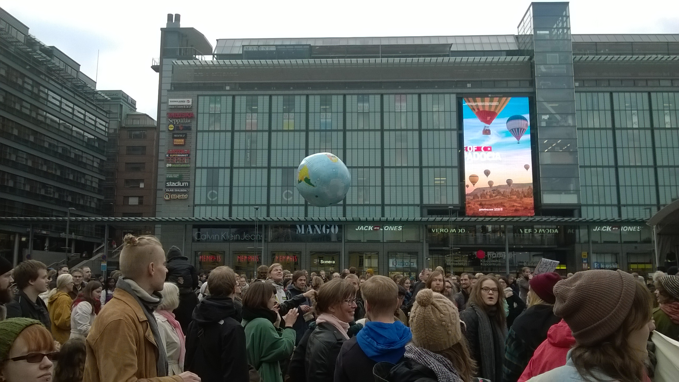
Ready to study?

Slide 5
Higher education
What makes Higher Education different to vocational training is that one also theorises and reflects about … practical experience.
(EIT Handbook for Master and Doctoral Programs)
Mikko: Higher education is about developing the professional practices. This includes understanding their history and possible futures, new areas of work, new tools and new vocabularies.

Slide 6
A dive into Finnish language
Verbs in a frequentative form (verbs ending with -lla/llä)?
Ruokailla, Ajatella, Keskustella, Muotoilla, Suunnitella, Työskennellä
Verbs that are often used in multiple forms?
Katsoa-Katsella
What kinds of things does the frequentative form imply?
What does this tell about the act of studying?
’Opiskella’, and the subjects ’Oppilas’ and ’Opiskelija’

Slide 7
Conducting your studies
P1Y1
P2Y1
P3Y1
P4Y1
P5Y1
P1Y2
P2Y2
P3Y2
P4Y2
P5Y2
Creative teamwork
Sustainability in business
Systems thinking
Capstone
State of the world
Design approaches to sust. consumption
Thesis!!!
Thesis project

Slide 8
Study-related practicalities
HOPS and tutoring: Important - prepare
Interships: self-initiative, check with your own department
Exchange: check with your own department
Give feedback:
On and after the courses
In AllWell
Student representatives (Kalle and Andre in the CS programme committee)
Feedback sessions in the beginning of p3 and end of p5

Slide 9
CS Compulsory & Design electives & SGT
Y2 ARTS: Sust. Transitions and futures 5cr
Y2 BIZ:
Capstone in creative sustainability 6cr
Year 1-2
ARTS: Sustainability Politics 5cr
ARTS: Eco-auditing 2 cr,
Non-Credit support for thesis planning
SGT/
Sustainable Built Environment
5 cr
CHEM: Mat. for a World in Transition 5cr
USP/ Design f. urban governance
5cr
BIZ: Sustainability in business 6cr
Values D. Futures, 5 cr,
ARTS: Design approaches to sustainability 5cr
ARTS: Creativite teamwork 1cr
Design for government 10cr
SGT Studio, 10cr
Period 1
Period 2
Period 3
Period 4
Period 5
Joint
ARTS
Outside of CS
Notes:
Instead of book exam on single book, we can have few and read them in reading groups.

Slide 10
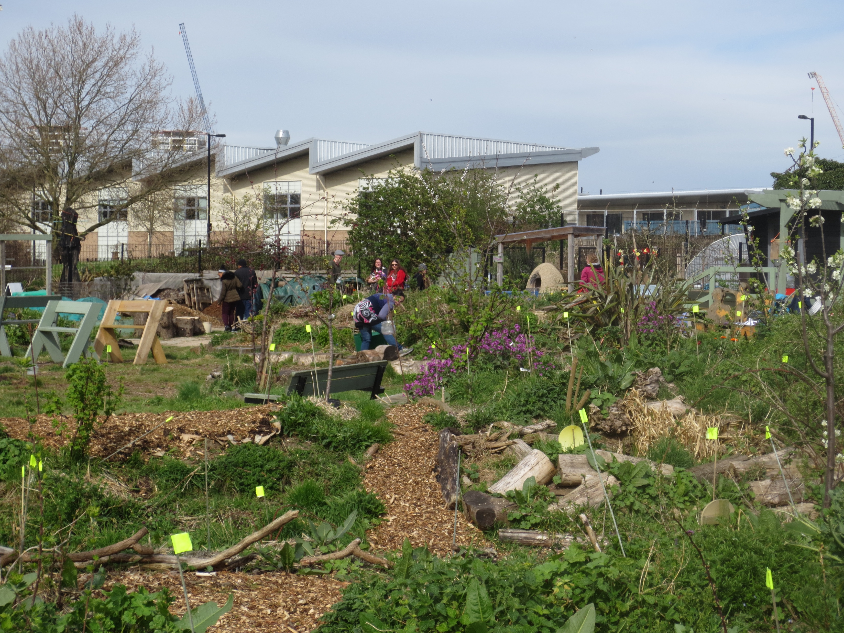
Sustainability Politics Is that politics?! Reading seminar posing critical questions about unsustainability and environmental governance. On institutions and instruments, sociotechnical change and the history and politics of ‘sustainability’.
Period I, Eeva Berglund

Slide 11
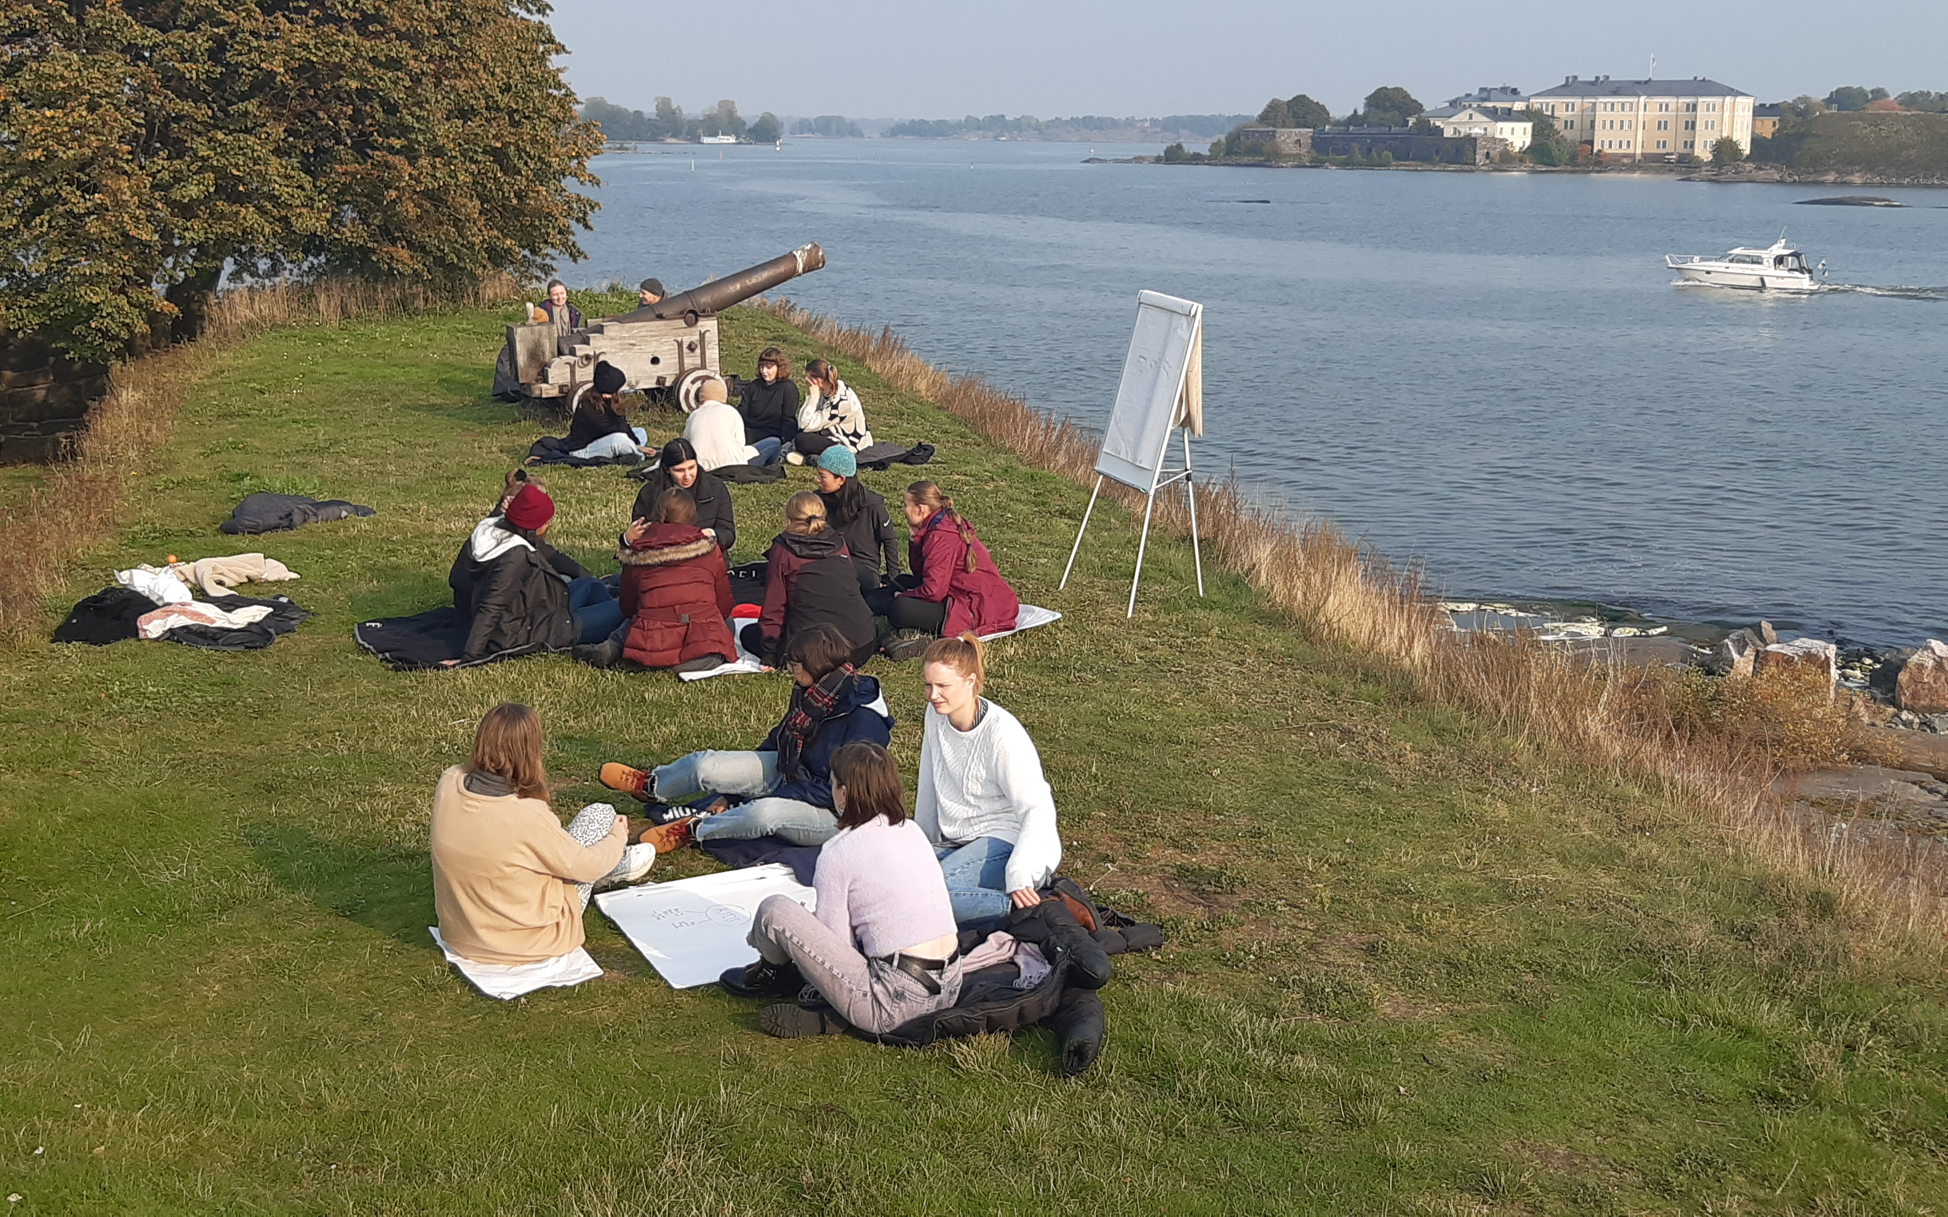
Participatory Methods and Facilitation Skills
Facilitation of creative cooperation
skills, methods and theories -
on the island of Särkkä.
Period I Dr. Paula Siitonen

Slide 12
MUO-E8017 Eco-dauting (2 ECTS)

Slide 14
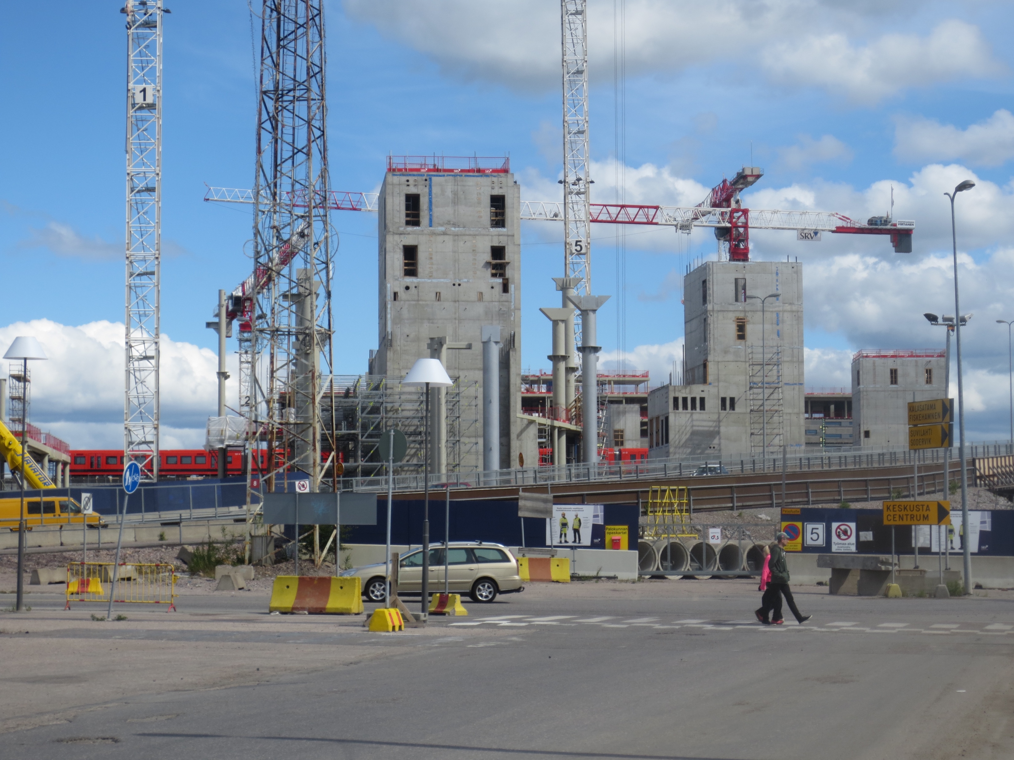
Values in Design Futures Ideas and visions of the future and how these have been and are used to imagine, explore, communicate and steer transitions towards desirable (and more sustainable) futures. What is new about today's debates? Where do they come from? What do the answers mean for public life? Involves lectures, reading, writing, watching films and group work.
Eeva Berglund, İdil Gaziuluzoy, Period V

Slide 16
CS courses at the department of design
MUO-E8018 Sustainability Politics p1, 5cr (Eeva Berglund)
MUO-E8021 Participatory Methods and Facilitation Skills p1, 5cr (Paula Siitonen)
MUO-E8017 Eco-auditing p2-3, 2cr, (Tatu Marttila)
MUO-E8026 Designing for urban governance and services p4, 5cr (Antti Piirinen)
MUO-E8012 Design for Government p4-5, 10cr (Nuria Solsona)
MUO-E8023 Values in Design Futures p5, 5cr (Eeva Berglund & İdil Gaziulusoy)
MUO-E8027 Sustainability transitions and futures p1, 5cr (İdil Gaziulusoy)

Slide 17
CS-BIZ: Approach
“…to promote sustainable development through business…”
“…can leverage these competences to effectively address global and local sustainability challenges as they relate to business…”
“…challenge-based learning, the integration of teaching and research, and a strong connection to practical outcomes…”

Slide 18
CS-BIZ: Courses
General foundations
Sustainability in Business (mandatory except for BIZ)
Functional or sectoral
Accounting for Sustainability
Capabilities
How to Change the World: Innovating toward Sustainability
Capstone in Creative Sustainability (mandatory for all)
Responsibility Management
Energy Business and Innovation
E.g.
E.g.
E.g.

Slide 19
BIZ - Courses offered in 2021-22 (6 cr unless marked otherwise)
Period I | Period II | Period III | Period IV | Period V
21E06050
Responsibility Management, book exam*
(Leena Lankoski) (also I, II)
General foundations
21E16001
Sustainability in Business*
(Samuli Patala)
MNGT-E2005
Sustainability and Global
Value Chains
(Tiina Ritvala)
51E00100
Business Ethics
(Matti Häyry)
35E03000
Sustainable Supply Chains
(Katri Kauppi)
22E29100
Accounting for Sustainability*
(Emma-Riikka Myllymäki)
77E28000
Corporate Responsibility Communication
(Johanna Moisander)
21E16100
Energy Business and Innovation*
(Samuli Patala)
Functional or sectoral
MNGT-E1002
Market-based Development in the Global South
(Patrick Shulist)
25E18000
Sustainable Entrepreneurship*
(Patrick Shulist)
MNGT-E2003
Climate Change Strategy and Negotiations*
(Tiina Ritvala) (3 or 6 cr)
21E10000
How to Change the World: Innovating toward Sustainability*
(Minna Halme)
Capabilities
21E12002
Capstone in Creative Sustainability
(Leena Lankoski)
* = the course is part of the list where you need to pick 18 cr (this applies to CS-BIZ only)

Slide 20
Creative Teamwork at Särkkä Island Friday 17.9.2021 9.30-17.00
Visit and follow the announcements at the MyCourses page
Be at the Café Ursula pier at 9.15, ferry leaves 9.30
Take WARM clothes with you, and bring your own lunch. Water, a kettle and a microwave oven will be available
If you cannot participate physically, attend the Zoom session.

