Slide 1
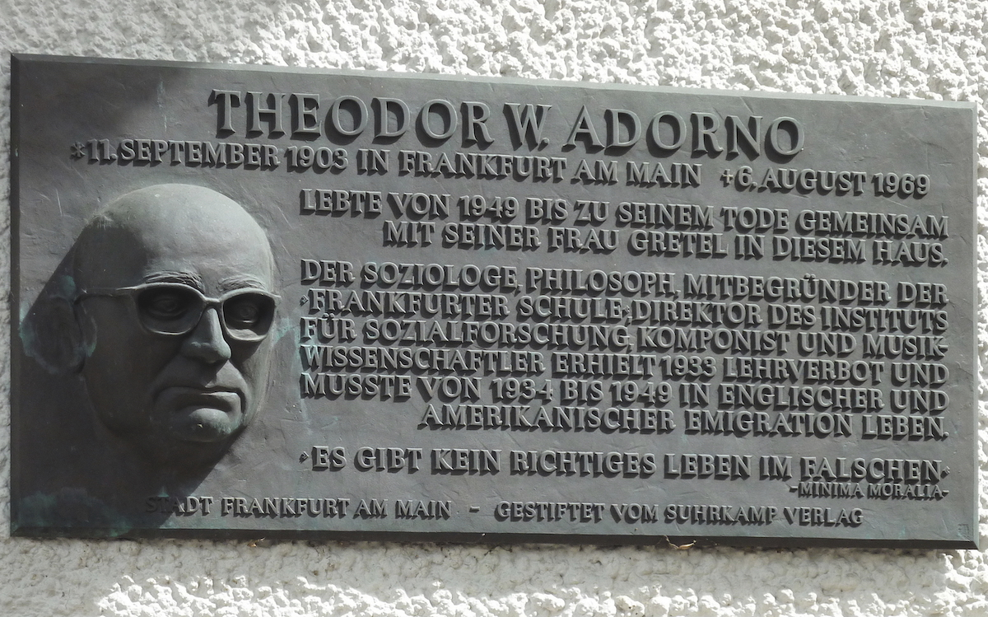
Theodor adorno (1903-1969) and The Frankfurt school (i.e. the birth of critical theory)
Philosophy and theory of art, lecture 2

Slide 2
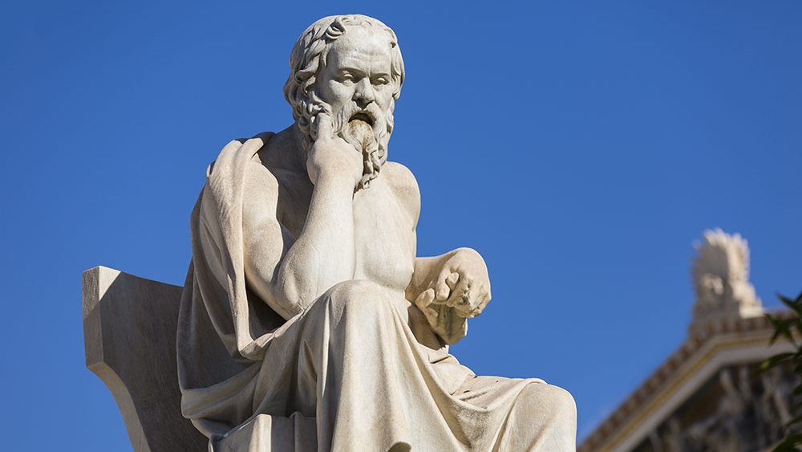
The word dialectic is derived from a Greek prefix dia-and the Greek verb lego, whose verbal noun is the famous word logos (discourse, ground, speech). Dia- means across, apart, or thoroughly and is found in such words as diagnosis, a thorough knowledge or a knowledge through and through.
Socratic method: given hypothesis leads to contradiction
Heraclitus (of Ephesus, today’s Turkey, 500 BC): all things are in process, Fragment DK22b8: What opposes unites, and the finest attunement stems from things bearing in opposite directions, and all things come about by strife.
Middle English dialetik, from Anglo-French dialetiqe, from Latin dialectica, from Greek dialektikE

Slide 3
Basic principles of dialectics (early forms and later)
Opposites do not necessarily exclude each other, but complement each other
The dialogue of affirmation and negation can lead to unification
Development often happens through uniting opposites

Slide 4
Early forms of dialectical thinking in asia
Krishna tells Gita to Arjuna (Mahabharata, author unknown)
Ancient statue of Lao-Tzu

Slide 5
Lao-Tzu
When the people of the world all know beauty as beauty, there arises the recognition of ugliness. When they all know the good as good, there arises the recognition of evil. Therefore: Being and non-being produce each other; Difficult and easy complete each other; Long and short contrast each other; High and low distinguish each other; Sound and voice harmonize each other; Front and behind accompany each other. (Chan translation)

Slide 6
The hegel – marx (engels) development of dialectics
Thesis – Anti-thesis – Synthesis

Slide 7
And Marx’s way of turning it upside down
Development of consciousness
Master and slave
Marx and the role of the proletarians

Slide 8
HEGEL’S IMPACT ON ART
The Treachery of Images (La trahison des images, 1929) and Les vacances de Hegel (1958) are classics in Hegelian painting
Sensuous expression of free spirit
Religion, art, philosophy – (in this historical order) support the development of self-reflective reason and consciousness

Slide 9
Why did the revolution that marx predicted not happen (except for in some countries, and in ways that did not satisfy the European intellectual)?
(Image: Paris Commune, photo, 1871)

Slide 10
Negative dialectics
No synthesis
Development of the spirit stays in the anti-thesis
Marx’s theory was not wrong – but the world changed: the biggest change was the “culture industry”
Key figures: Max Horkheimer, Theodor W. Adorno, Herbert Marcuse, Leo Lowenthal, Friedrich Pollock – and later Albrecht Wellmer and Jurgen Habermas

Slide 11
Theodor W. Adorno
Siegfried Kracauer’s pupil (and Berg’s, see below)
Schoenberg, Berg and the rest of the second Viennese school (of music)
Culture Industry, with Max Horkheimer (1946)
Standards, mechanical repetition, non-identity (the individual is fantasy)
No “aesthetics”, no a priori
Boundaries (LP), ”spare parts of cars”
In a negative reality, art cannot be hedonistic (pleasure)
See e.g. Sabine Wilke’s (laughter and the relationship to Walter Benjamin), Mike Watson’s (memes), Stefano Marino’s, Douglas Kellner’s, Ilona Reiners’s and Martin Jay’s commentaries on Adorno

Slide 12
Schoenberg vs. wagner and Sibelius
Truthful vs. non-truthful to the context (society, culture)

Slide 13
Adorno’s philosophy of mass culture / culture industry
High and lo are two sides of the same coin (discussion with Benjamin)
The phone is interactive, radio negatively democratic (masses)
Tolstoy films nail the problem of the film industry
Electricity (films, records)
Television attempts to create a synthesis of radio and film
Special are effects more important than the whole
Matrix
Only style
Odysseus
Later ”negativists”: the situationists, Chantal Mouffe

Slide 14
Epilogue 1 Angela Davis with her teacher Herbert Marcuse

Slide 15
Epilogue 2 Luce Irigaray

