Slide 1
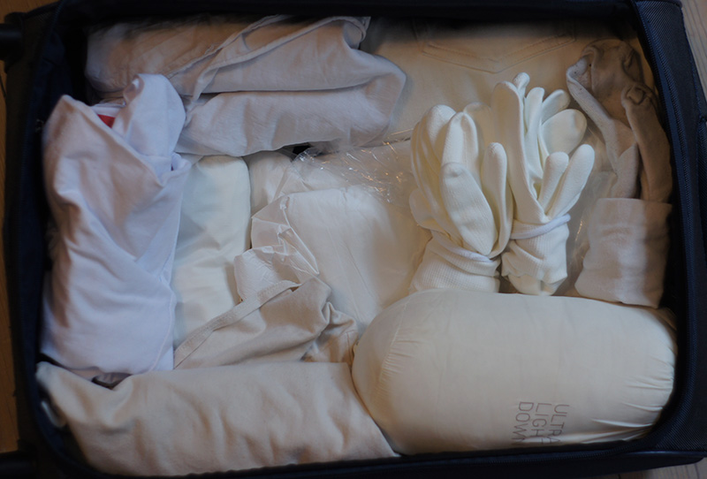
TAI-E1148 Taide ja Tiede
TAI-E3153 Art and Science

Slide 2
3.3. Introduction by Laura & Helena.
Lecture: Maria Manuela Lopes (PT) + discussion
10.3. Lecture: Biofiction films and discussion by Biofaction / Markus Schmidt & Sandra Youssef (MA)
17.3. Lecture: Petteri Nisunen (FI) + discussion
24.3. Lecture: Minna Långström (FI) + discussion
31.3. Lecture: Paula Humberg (FI) + discussion
7.4. Examination day - will be scheduled!

Slide 3
Assessment Methods and Criteria
Presence: 80% on the course. (> one time absence)
Master-level students: Short oral presentation that addresses students’ individual interests/research and their relation to 2-3 topics addressed during the lecture-series and provided readings [ Find 1-3 articles linking to your interests ].
Doctoral-level students: a 2-3 page text that critically addresses students’ individual research in relation to 1-2 topics addressed during the lecture-series and provided readings [ Find 1-3 articles linking to your interests ].

Slide 4
Maria Manuela Lopes
is a visual artist whose practice is transdisciplinary, investigating relations of memory and identity informed by the biological sciences and medical research; her work appears in a varied format within the visual arts resulting in multimedia installations, drawings and performances and biological materials.
Lopes studied sculpture at FBA-UP and did an MA at Goldsmiths College in London. She has a Doctorate in Fine Arts and New Media at the Universityof Brighton and UCA-Farnham in the UK. She has developed a Postdoctoral Art Research Project at the University of Aveiro and Porto - i3S Institute of Research and Innovation in Health. She is currently a researcher at i3S as co-responsible for the Cultural Outreach Art/Science interface. She co-coordinates the European Project Hybrid Lab Network in partnership with the University of Aalto (Finland) with the Alma Matter European University (Slovenia) and with Waag (Netherlands), where creative strategies are developed from the visual arts to envision novel methods and tools to propel various areas of knowledge in higher education. Maria Manuela Lopes has curated several international exhibitions and her work has been shown nationally and internationally. Maria Manuela Lopes is a Professor of the Arts and Multimedia Department of ISCE Douro and is part of the Direction board of the International Music Academy Aquilles Delle Vigne. She is also co-founder and Deputy Director of Portuguese artistic residency programs: Ectopia - Laboratory of Artistic Experimentation and Cultivamos Cultura in the Natural Park of São Luis, Odemira in Alentejo/Portugal.

Slide 5
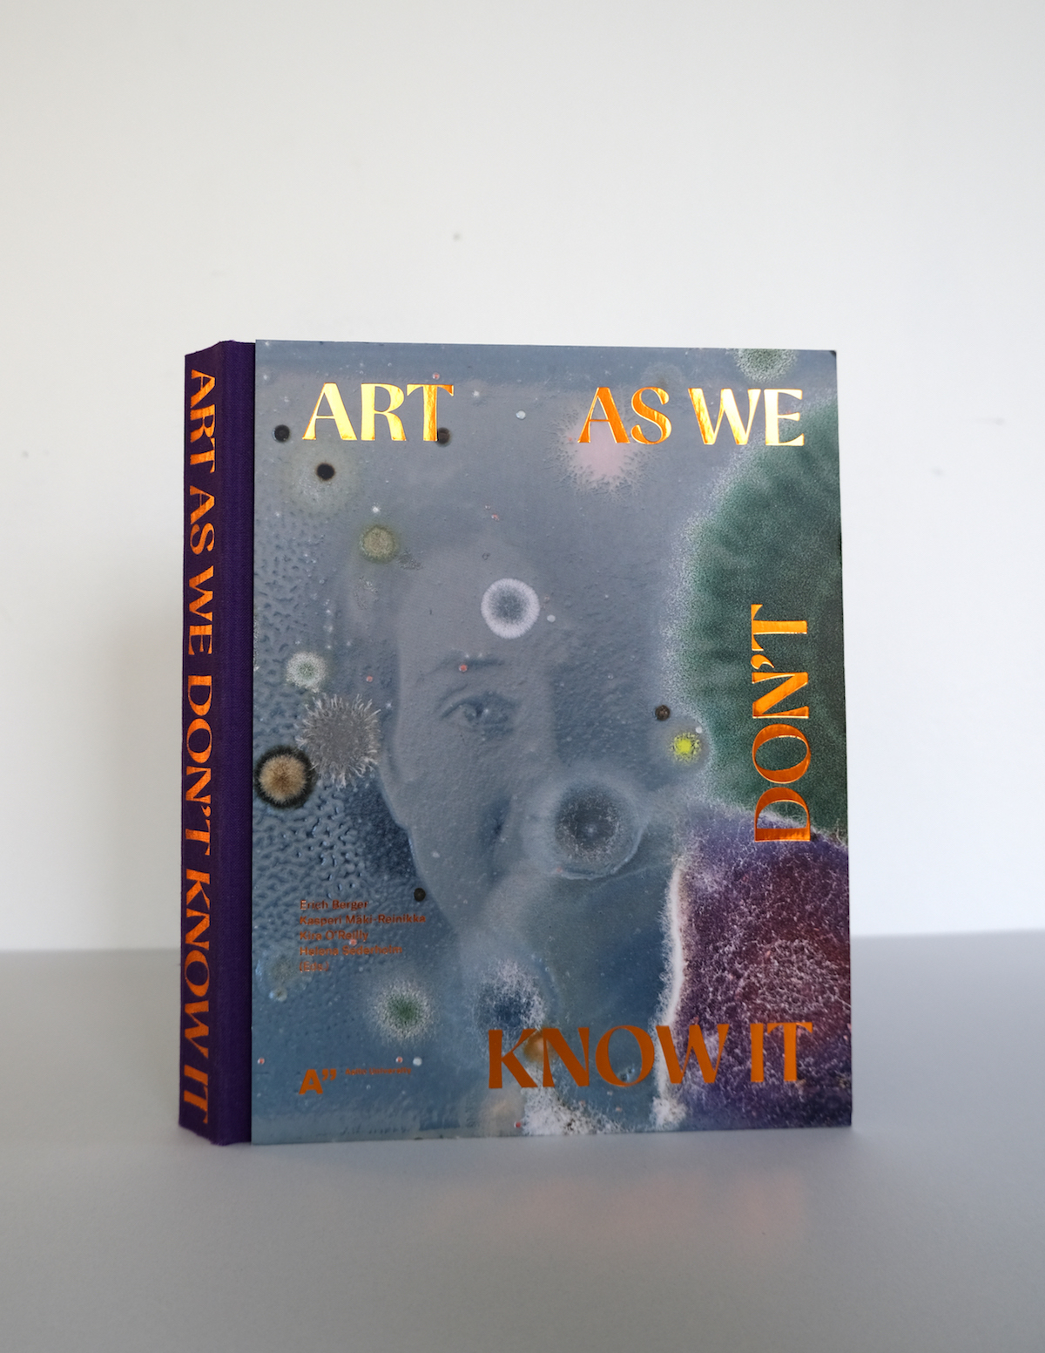
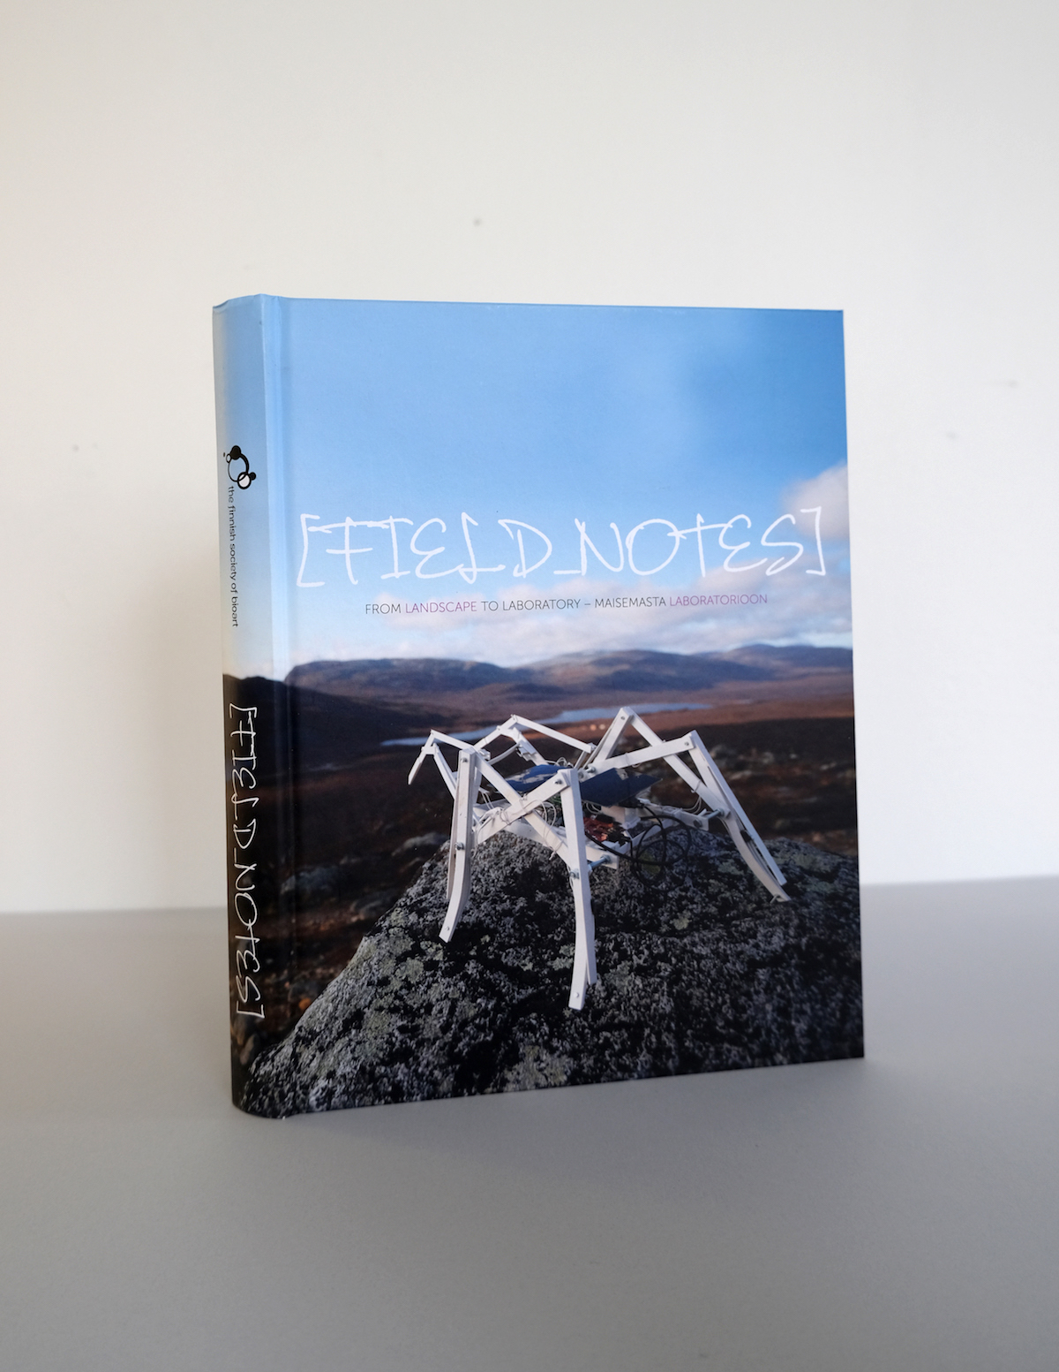
READINGS:
Art as We Don’t Know It - 2020
Edited by Erich Berger, Kasperi Mäki-Reinikka, Kira O’Reilly and Helena Sederholm.
What worlds are revealed when we listen to alpacas, make photographs with yeast or use biosignals to generate autonomous virtual organisms? Bioart invites us to explore artistic practices at the intersection of art, science and society. This rapidly evolving field utilises the tools of life sciences to examine the materiality of life; the collision of human and nonhuman. Microbiology, virtual reality and robotics cross disciplinary boundaries to engage with arts as artists and scientists work together to challenge the ways in which we understand and observe the world. This book offers a stimulating and provocative exploration into worlds emerging, seen through art as we don’t know it – yet. Art as We Don’t Know It showcases art and research that has grown and flourished within the wider network of both the Bioart Society and Biofilia during the previous decade. The book features a foreword by curator and art historian Mónica Bello, and a selection of peer-reviewed articles, personal accounts and interviews, artistic contributions and collaborative projects which illustrate the breadth and diversity of bioart. The resulting book is a tantalising and invaluable indicator of trends, visions and impulses in the field.
https://shop.aalto.fi/media/filer_public/6c/aa/6caa756a-bab7-4d9b-a5f1-07dd1bc171be/aaltoartsbooks_art_as_we_dont_know_it.pdf
Field_Notes – From Landscape to Laboratory – Maisemasta Laboratorioon - 2013
Edited by Laura Beloff, Erich Berger and Terike Haapoja
This publication is the result of “Field_Notes – Cultivating Grounds” field laboratory which took place in 2011 in Kilpisjärvi. It is a hardcover book, bilingual in Finnish and English and contains 17 articles and additional material of Finnish and international contributors on 256 pages.
Every second year the Finnish Society of Bioart invites a significant group of artists and scientists to Kilpisjärvi Biological Station (run by the University of Helsinki) in Finnish Lapland, to work for one week on topics related to art, biology and the environment. “Field_Notes – From Landscape to Laboratory” is the first in a series of publications originating from this field laboratory. It emphasizes the process of interaction between fieldwork, locality and the laboratory. Oron Catts, Antero Kare, Laura Beloff, Tarja Knuuttila amongst others explore the field and laboratory as sites for art&science practices.
https://s3.eu-central-1.amazonaws.com/hybridmatters-production/media/Field_Notes-From_Landscape_To_Laboratory-2013.pdf

