Slide 1
The Financial Crisis – Case 1
Eero Kaikkonen
Case Presentation

Slide 2
Table of contents
Origin, Development and Escalation of the Crisis
Possible Causes of the Crisis
Role of Regulation of the Market and Its Possibilities to Prevent a Crisis

Slide 3
Origin, Development and Escalation of the Crisis
US markets and certain European countries
Housing Booms
Greenspan put – ease monetary policies
Banks could sell their “bad assets” to Fed
Investment banks abused these systems
Market were introduced with new complex instruments
Agency problems and creative Financial Engineering
High Risk Mortgage Lending
Credit Rating agencies

Slide 4
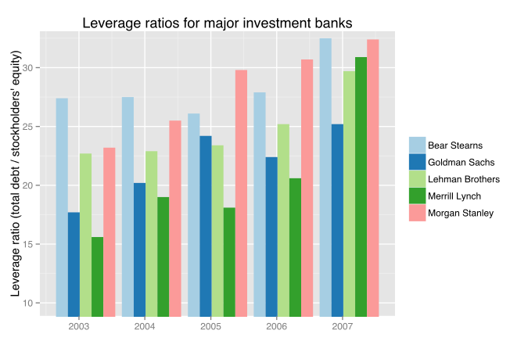
Causes
High debt ratios
Most of the banks had increased
their debt ratios in years before the
Crisis.
Deregulation of Financial Markets
Governments had deregulated the markets due to earlier tech bubble
Failure of regulators to stop mischievous practices
Almost no regulation to shadow banking systems
Mortgage loans were easy to get -> Amount of bad assets increased
Interest rates had started to increase from 2004-> High need for new financing products

Slide 5
Summary of causes
High Risk Lending
Banks pursued high risk loans to obtain higher profits (e.g. WaMu)
These sold for high prices due to being mortgaged backed
Regulatory Failures
Office of Thrift Supervision (OTS) failed to stop banks from pursuing mischevious actions, gave recommendations however did not punish banks
Inflated Credit Ratings
Agencies gave high ratings of AAA to junk quality RMBS and CDOs
Market collapsed -> Credit rating agencies defended by pleading to the freedom of speech
Investment bank abuses
Banks started to take positions against their own sold securities
Investors were unaware of the quality of the new securities

Slide 6
Escalation & Consequences
Shadow banking system fails
Huge liquidity problems due to security values dropping
Asset Prices started to decline
Dow Jones Industrial Average fell by 54%, (89%, GD)
Firms and private households start to observe significant losses
Investments and loans freeze
Bank runs and worldwide recession starts

Slide 7
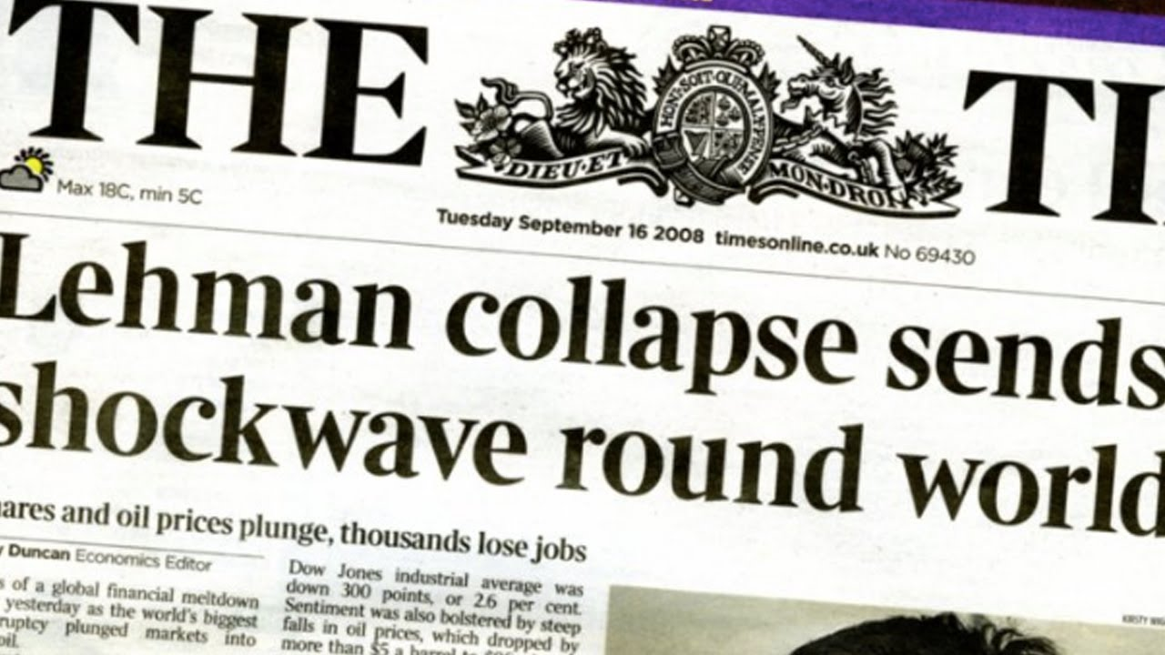

Slide 8
Consequences – Timeline
2007-2008 - Subprime crisis -> Financial market problems arise
2008-2009 - Financial Crisis -> Lehman Brothers bankruptcy
2009-2010 - Recession starts -> Economic downturn
2010-2012 - Government debt Crisis -> Euro debt crisis (e.g. Greece, Ireland, Portugal)
2012-2014 - Trust of Euro falls -> Union afraid of future
2020 -> Covid-19 crisis?

Slide 9
Why not let the banks run?
Schumpeterian destruction ”Creative Destruction”
Bad will fail, but good and more efficient ones survive
However, there is a basic problem in banks runs
Diamond and Dybvig Model (1983)
If consumers expect that the bank will run or expect others to expect that bank will run (compare to K-Level Thinking), they should withdraw together with others
Regarding to model above, banks runs can simply start a vicious cycle -> If one bank runs, consumers expect that other banks run as well, causing the crash of the financial markets.

Slide 10
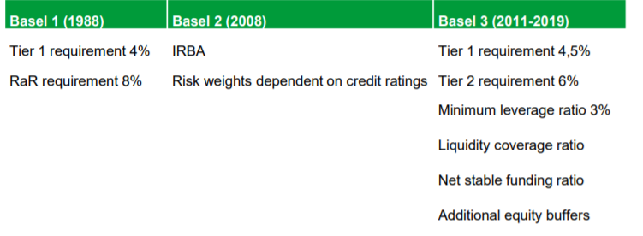
Regulation following Financial Crisis
Capital requirements directive (CRD IV): Comprises Directive 2013/36/EU and Regulation (EU) N° 575/2013.
Amends the original banking directive CRD, CRD II (2008) and CRD III (2009)
CRD mainly concerns the amount of liquidity that banks must hold. Prevents leverage ratio becoming too large.
Sets rules for capital requirements for banks, credit institutions and investment firms – Capital requirements
Closely tied to the basel committee on banking supervision: BCBS
Basel III Framework, Equity ratios etc.

Slide 11
Regulation following Financial Crisis
MIFID II 2014/65/EU and MIFIR – Investor protection and transparency of trades
US Law especially:
Dodd–Frank Wall Street Reform and Consumer Protection Act (2010):
New agencies, Financial Stability Oversight Council, the Office of Financial Research, and the Bureau of Consumer Financial Protection.
Supposed to end taxpayer-funded bail-outs, bail-ins in the future?
“Volcker Rule” – Limits speculative investments – Limits banks abilities to conduct certain investments with their own accounts and hedge funds etc.
Also regulations in US towards: Hedge funds, Credit rating agencies, corporate governance, transparency in derivatives and mortgage reforms, but many more.

