Slide 1
Education system and labor market in Russia
Svetlana Ledyaeva
Aalto University School of Business

Slide 2
Learning outcomes of this lecture
Particularities of Russian education system.
Development of labor market during Russian economic transformation in recent decades.
Current labor institutions in Russia.

Slide 3
Russia`s education system
Part 1

Slide 4
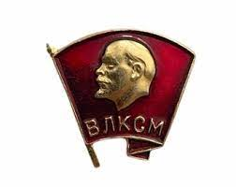
Soviet education and communism ideology
Soviet education was extremely politicized from the very beginning.
Lenin’s famous maxim: “School without politics is nothing but lie and hypocrisy.”
The system exerted ideological control over every aspect of school life. Mandatory participation in communist youth organizations.
Little Octobrists (7-9 y.) Pioneer movement Comsomol
(7-9 y.) (9-14 y.) (14-28)

Slide 5
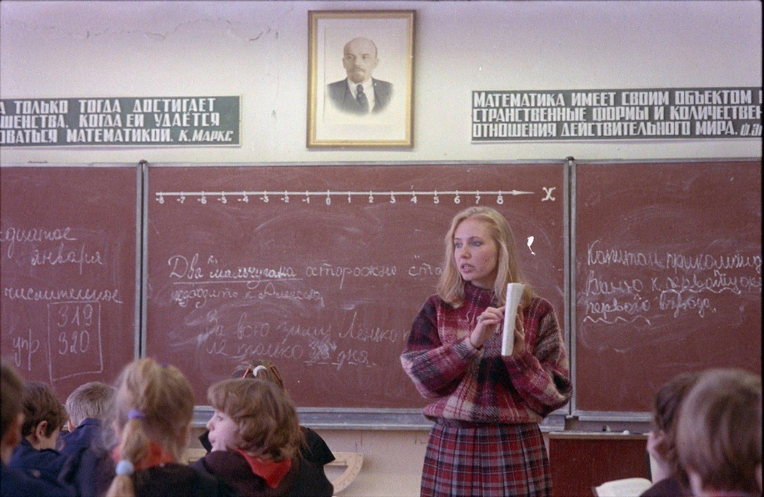
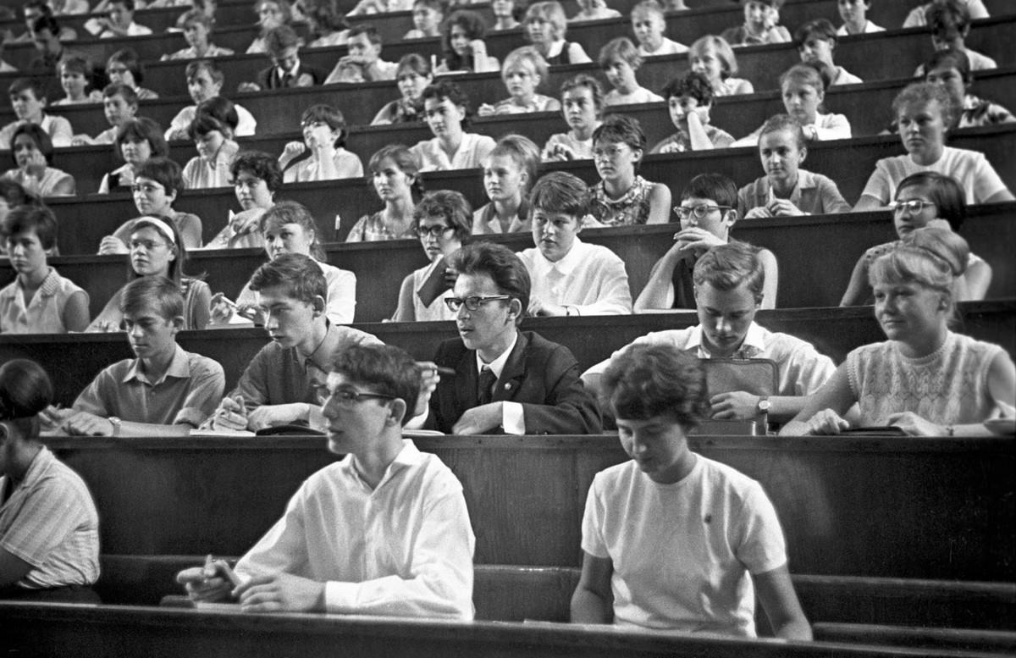
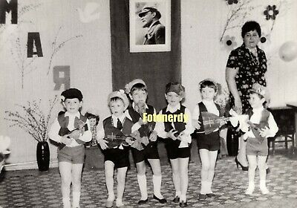
Some pictures: Soviet school and university

Slide 6
Soviet education achievements and performance
HIGH ACHIEVEMENTS IN ALL MEASURES OF EDUCATIONAL ATTAINMENT.
TOTALLY FREE EDUCATION AT ALL LEVELS: FROM KINDERGARGEN TO POST-GRADUATE EDUCATION (SCIENCE DEGREE).
A unique system of publicly funded after-school education, including sport clubs, art and music lessons.
A detailed curriculum with a strong emphasis on science and the early separation of students into academic and vocational/technical tracks.
Equalization principle and a preference for previously disadvantaged groups.
All school students were obliged to wear uniform.

Slide 7
Transformation of education in Post-Soviet period
Rejection of the Soviet legacy;
Modernization of curricula and the reform of the system to respond to the changing needs of Russian society;
Opening education to globalization.

Slide 8
Education reform in transition
The reform of higher education system: the increased level of private funding system.
Two-track admission: tuition-free vs. the full amount of tuition.
Underdeveloped educational credit market.

Slide 9
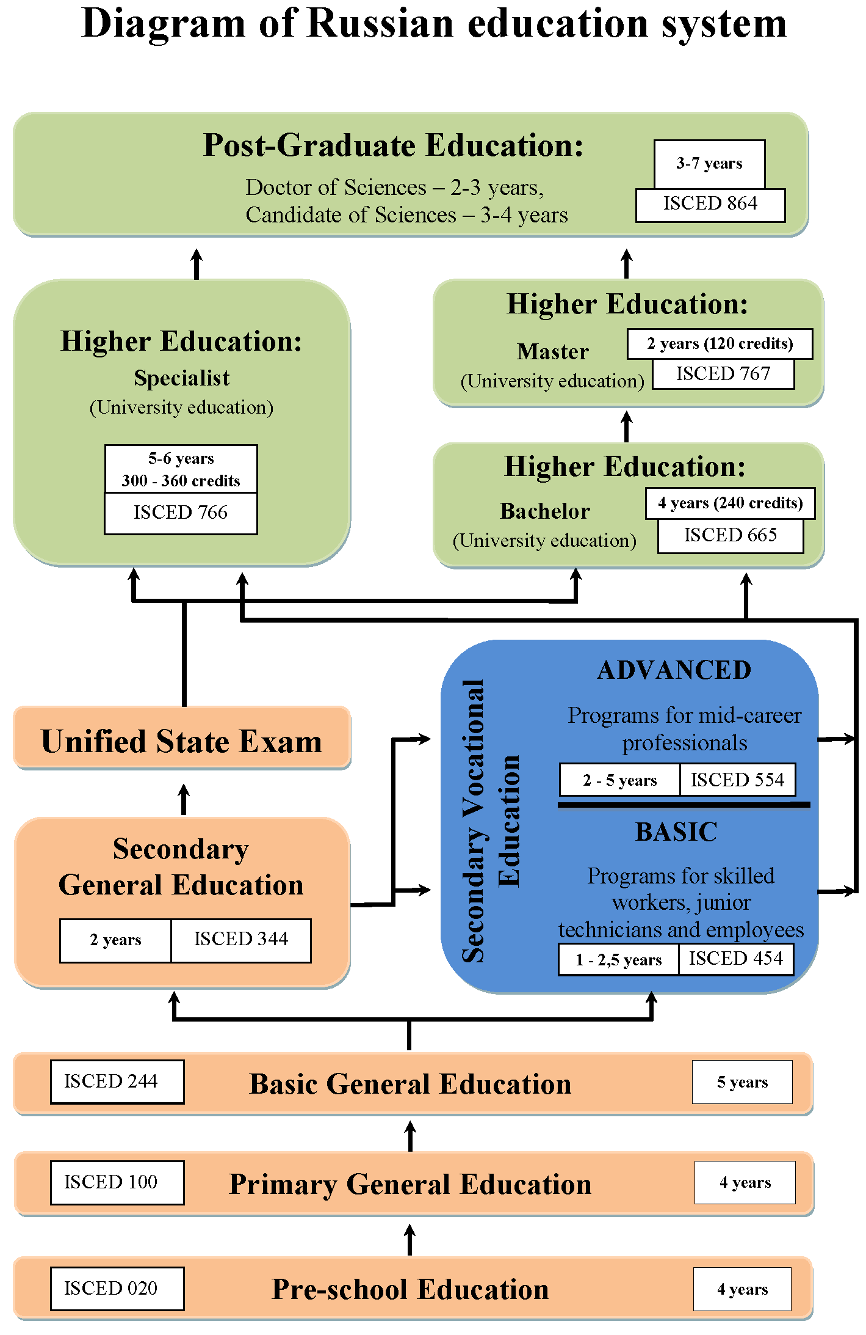
PhD
High school
7 years

Slide 10
University admissions process (from Denisova-Schmidt and Leontyeva 2014)
Until 2009, universities held its own entrance examination ➔
Corruption in this area was the highest of all kinds of corruption in education (about US$455 million per year).
Solution:
Unified State Exam that serves as both a school final examination and for university entrance.
Corruption now:
disseminating exam questions before the examination;
using mobile phones (for Internet searches or SMS);
receiving help from the onsite proctors/inspectors;
reopening sealed test envelopes to correct mistakes.

Slide 11
Higher education in Russia
Higher education is provided by public and private accredited higher education institutions.
Public (State) institutions – significantly higher level of education than in private institutions.
Types of higher education establishments in Russia:
University – all the levels of higher, post-higher and further edu­cation within a wide range of Natural Sciences, Humanities, Technology, and Culture.
Academy/School – the same as university but for one to three specific related areas of science.
Institute - vocational educational curricula in specific areas of science and is involved in scientific research. Can be part of University or Academy.

Slide 12
Population with tertiary education25-34 year-olds / 55-64 year-olds, % in same age group, 2020 or latest available

Slide 13
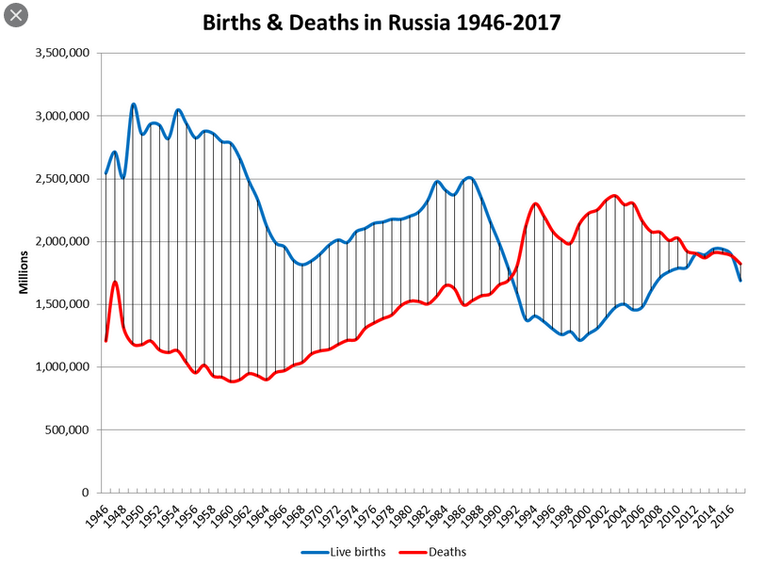
Demographic pitfall

Slide 14
Number of 17 years old young people, thousands of people, Russia

Slide 15
Recent trends in education
Demographic trends have had a profound effect on Russian university system in recent decade: The number of school graduates and students dropped significantly (30-50%). ➔
Government reforms: Significant reduction of the number of higher education institutions.
Financial state funding is redirected from Universities to professional colleges.
Foreign students quotas have increased. However! Compared to countries like China or the United Arab Emirates, Russia is not a major host of foreign universities or branch campuses. Political reasons!

Slide 16
Russia`s labor market
Part 2

Slide 17
Recent history of the Russian labor market
Several stages:
1991 - 1998 - transformational recession in Russia: a decline in employment and labor market performance.
1999 - 2008 - the dynamic post-recession recovery and a rapid improvement in labor market performance.
2008 – 2020 - period of three crises: Global Financial Crisis, Sanctions/Politics-related crisis and COVID crisis.

Slide 18
Employment and unemployment levels in Russia

Slide 19
Employment level discussion
The employment to population ratio has remained unexpectedly high:
Dropped only by 14% in 1992-1998
a little above the OECD average;
and significantly above the average for other post-socialist countries.

Slide 20
Unemployment level discussion
Unemployment did not shoot up in Russia even in the worst economic downturns. No mass layoffs were used.
Total unemployment reached (for a short period) its peak value of 13.3% in 1998.
However, it has never approached peak values typical for some other transition economies (see next slide).
Low sensitivity of employment to fluctuations in output emerges as a major trade mark of the Russian labor market.

Slide 21
Unemployment in transition countries

Slide 22
Question for points
Think and suggest why unemployment in Russia in times of crisis has never reached the levels which would correspond to the crisis level (in terms of production) as it happens in most other countries?
What labor market mechanisms could be used for this?

Slide 23
Explanations for employment stability
Low inter-firm labor mobility and existing barriers, some of which were inherited from the Soviet past.
Flexible working hours.
Flexible wages.

Slide 24
Low inter-firm labor mobility
An equilibrium outcome of the interaction between dependent workers and paternalistic employers:
Russian workers were deeply afraid of entering the external labor market mostly because they highly valued firm-provided social benefits.
Therefore, on the supply side, they did their best to keep the jobs they occupied.
On the demand side, paternalistic employers preserved labor and rejected any downsizing.

Slide 25
Flexible working hours
First 5 years of the transition: The annual duration of working hours in the Russian economy was shortened by 12% (15% in industrial sector).
From the mid-90s on: The duration of working time grew rapidly, increasing by 2008 by about 6% in the whole economy and about 16% in industrial sector.
If hours had been stable, the change in employment would have been twice as large as that observed in the crisis and in the recovery, other things equal.
By contrast, in the CEE countries the cyclical dynamics of hours were much more muted.

Slide 26
Reasons for hours to shrink so significantly: multiple
The Russian authorities used legislative cuts of working hours as social and political cushions against mounting hardships.
Cutting hours was one of the cheapest ways to adjust labor costs for firms. Short-time work and forced vacations.
Fast recovery in working hours and the wide use of overtime work limited employment growth in the boom period.

Slide 27
Flexible wages
Shorter hours brought labor costs down but not enough to accommodate the GDP fall ➔ Downward wage flexibility did the rest.
During the 90s: real wages ―just halved.
The restart of economic growth in 1999 launched a steep recuperation of real wages.
Inflation remained rather high but nominal wages grew even higher.
In 1999-2007 the real wage grew by 10-20% annually and cumulatively tripled over this period!

Slide 28
Wage adjustment
The specific composition of the wage bill that is typical for the majority of Russian firms:
Premiums and bonuses ➔ contingent upon general economic conditions and firm performance ➔This fraction of wage compensation moves pro-cyclically.
In the crisis ridden year of 1998, the most flexible part of the wage made up on average 27%, while in much more prosperous 2007 it reached almost 36%.
Paying late.
Informal payments.

Slide 29
Composition of wage bill by major components, some sectors, 2005, %
Industry | Fixed tariff | Flexible tariff (Extra payments, premiums and bonuses)
Oil and gas | 42 | 58
Metallurgy | 48,4 | 51,6
Electricity, gas and water supply | 52,1 | 47,9
Machine-building | 53,7 | 46,3
Transportation | 59,8 | 40,2
Food industry | 63,7 | 36,3
Construction | 65,2 | 34,8
Healthcare | 65,3 | 34,7
Retail and wholesale trade | 74,2 | 25,8
Education | 75,7 | 24,3

Slide 30
Paying late
Wage arrears/debts grew explosively over the 90s.
They emerged in early 1992 and peaked in mid-1998. At that time, about two thirds of all salary workers were paid late.
During the path of economic growth wage arrears began to dissipate rapidly:
By mid-2008, they made up under 2% of the monthly wage bill, while the proportion of workers affected was less than 1%.

Slide 31
Salary ”in the envelope”
Russian salaries can be white, black and grey.
“Black salary” is the salary from which no taxes were paid. For example, you work somewhere, but not officially, so you get “black salary.” If they fire you, you won't be able to prove you worked there.
“Salary in the envelope”, usually meaning black salary. You receive your salary in cash in an envelope.
“Grey salary”, when part of your salary is legal, white, and the other is not (i.e. black, in envelope).

Slide 32
Salary ”in the envelope”
“Envelope wages” are not used for making overtime payments but, rather, for paying employees a portion of their core wage on an informal basis.
The proportion of total wage received in such a manner can range from 20 to 80 per cent (in the study for Moscow, Williams&Round 2007).
Williams&Round 2007: This is not some minor practice existing in a limited range of occupations or sectors involving small amounts but rather, is a widespread and intrinsic feature of waged employment.

Slide 33
Salary ”in the envelope”
In most organizations and enterprises, job applicants in Moscow will hear at the interview, ‘your formal salary is (some relatively small amount) . . . but your real wage will be higher’.
IT IS BENEFICIAL for the employers: Various social payments (e.g. maternity leave) decrease significantly.
BUT NOT beneficial for employees: It reduces not only their pension and unemployment entitlements, but also their ability to gain access to credit.

Slide 34
Annual changes in output, employment, working hours and real wages, 2009 to 2008, percentage points
 | Output | Employment | Working hours | Real wages
Total economy | -7.9 | -1.7 | -2.4 | -3.5
Industry | -10.0 | -5.9 | -4.8 | -5.7
Manufacturing | -15.8 | -7.2 | -6.2 | -7.2

Slide 35
Corona crisis and employment
One year ago, the forecast for unemployment level in Russia in 2020 has been 7.3-10.5% (from 4.6% in 2019).
Expert: “Again enterprises largely practice paying smaller salaries and administrative holidays instead of job termination ”. ➔
The real unemployment in 2020 was only 5.7%.

Slide 36
Unemployment change due to COVID

Slide 37
Unemployment rate in 2020, selected countries

Slide 38
Preliminary conclusions
The Russian model is more alive than dead though in a slightly modified form.
The Russian labor market demonstrated its ability to accommodate major negative shocks without large losses in employment and drastic increases in unemployment.
However! This does not mean that this persistent adjustment mode is close to the optimal, given all welfare and productivity related considerations.

Slide 39
Labor institutions in Russia
Do the Russian labor market institutions trade off employment against wages? If yes, then how?
The choice of a particular wage-employment trade-off is a political economy problem and reflects particular social and political preferences.
In Russia, this institutional choice seemed to be made early in the transition and was path dependent in relation to the late Soviet period.

Slide 40
Employment regulations
In Russia, the EPL (Employment Protection Legislation): largely the Code of Laws on Labor (KZOT).
By some estimates Russia is first on the list of the countries with the most rigid EPL: job protection for permanent workers gets a score of 2.8 against 2.1 for OECD average.
The rigidity/fixity of employment in Russia 44 vs. 30.8 for OECD average (Doing Business 2007).

Slide 41
Normative Firing Costs in Russia and some OECD countries, number of months and monthly wages
Severance pay: 2-3 months* (+3 months for the Northern and Far Eastern Regions).
*firing costs are constant over the tenure.
For Sweden, Finland, Germany, USA – 0 months!

Slide 42
Minimum wage
The minimum wage sets a wage floor and constrains downward wage flexibility.
In Russia, during most of the transition period, the minimum wage was fixed at a rather low level.
Indexation was irregular, lagged far behind inflation, and had a short-run effect on relative earnings.

Slide 43
Minimum wage per month, USD

Slide 45
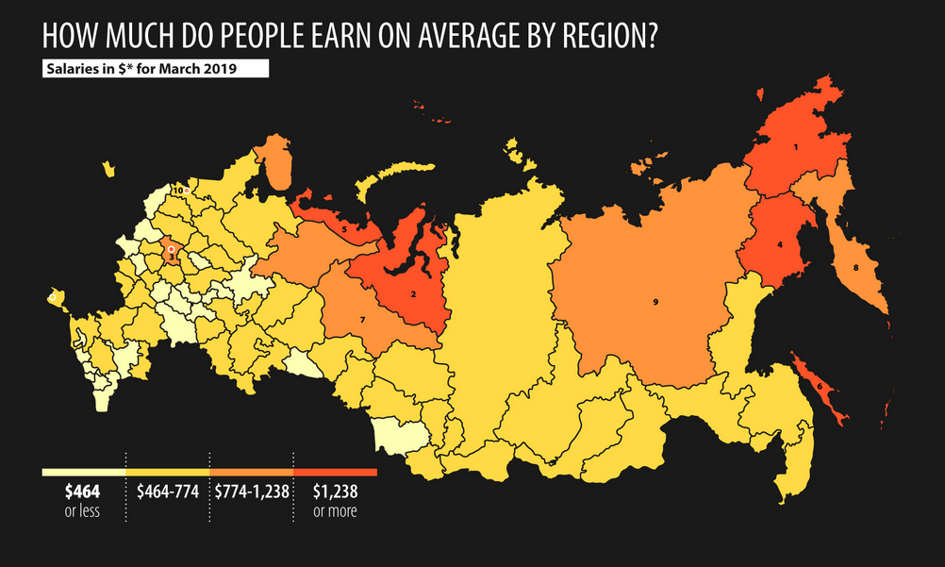

Slide 47
Unemployment benefits
Russia entered the transition: no open unemployment ➔ no social protection targeted at the unemployed.
The safety net to cushion emerging social costs had to be created from scratch and without delay.
Its designers were caught between expectations of high unemployment and fears of being too generous.

Slide 48
Unemployment benefits
Throughout the 90s, the share of annual GDP budgeted for labor market policies remained remarkably low:
Less than 1% in Russia ➔ in Hungary or Poland, e.g., reached 1.3 and 2.25% (UN Commission for Europe, 2003).
In the 2000s, this share became almost negligible.
Total spending on passive and active labor market policies remained less than 0.1% and it only approached 0.2% in the crisis 2009 due to additional spending.

Slide 49
Unemployment benefits in Russia, USD

Slide 50
Ratio “monthly UB/monthly average wage”, %

Slide 51
Unemployment benefits at present
There are more job places in the economy than unemployed people – should be able to find a job quickly.
First year:
3 month – 75% from previous salary;
4 month – 60%; 5 month – 45%.
From the second year – minimum unemployment benefits – about 29 Euros in 2020; changes almost every year.

Slide 52
Trade Unions
TU density was close to 100% at the start of the transition.
Federation of Independent Trade Unions in Russia (was established in 1990).➔
Includes 122 industrial trade unions across the country (20 million members).
Can include both employees and employers which contradicts international experience.
Rival organization – Confederation of Labor of Russia (1995). ➔
much smaller but more dynamic.
includes about 20 national and interregional trade unions (2 million employees).

Slide 53
Trade unions and wage agreements
A very rigid corporatist arrangement inherited from the Soviet past.
The wage setting in Russia seems to be highly centralized and coordinated.
It has a multi-layer bargaining/negotiating structure:
Tripartite agreements – between government, trade unions and employers. Tripartite agreements can be at national, regional and industry levels.
Main tripartite agreement – on national level – between Federal government of Russia, representatives of Russian trade unions and Russian employers.

Slide 54
Trade unions and wage agreements
Firms ➔ completely constrained in their wage policy; almost no room is left for either upward or downward decentralized wage adjustments.
However! This conclusion would be completely misleading since it ignores important nuances concerning the functioning of the system.
Over one third of the total wage is not contracted at all and remains contingent upon performance.
TU initiatives (at any level) are easily blocked by the government and are accepted only if the government agrees.
➔The whole corporatist structure largely decorative and shallow.

