Slide 1
Get to know Finland
Anja Keränen
4th lesson

Slide 2
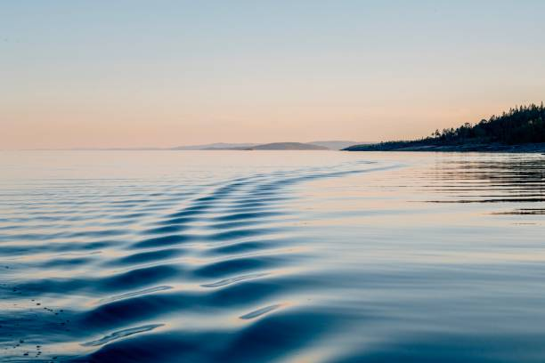
First: Presentations!
Group A:
History of the metro in Helsinki (Niko)
Lakeland region (Marie)
Moomins (Camille B.)
Group B:
Alvar Aalto’s impacts on Finland (Cassandra)
Nakedness as a normal behavior in Finland (Aymane)
Why are there so many bunkers (Julian)
Group C:
Alvar Aalto (Markéta)
Development of architecture of Helsinki (Sarah),
Sauna – (risks of sauna? Camille S.) / Sun and its impact on us in Finland?
1st we will listen to Muhammad’s presentation and then we will go to 3 groups!

Slide 3
Lesson 4: Finnish society and education
Today we will discuss..
… Finland as the happiest country in the world
… Finnish education

Slide 4
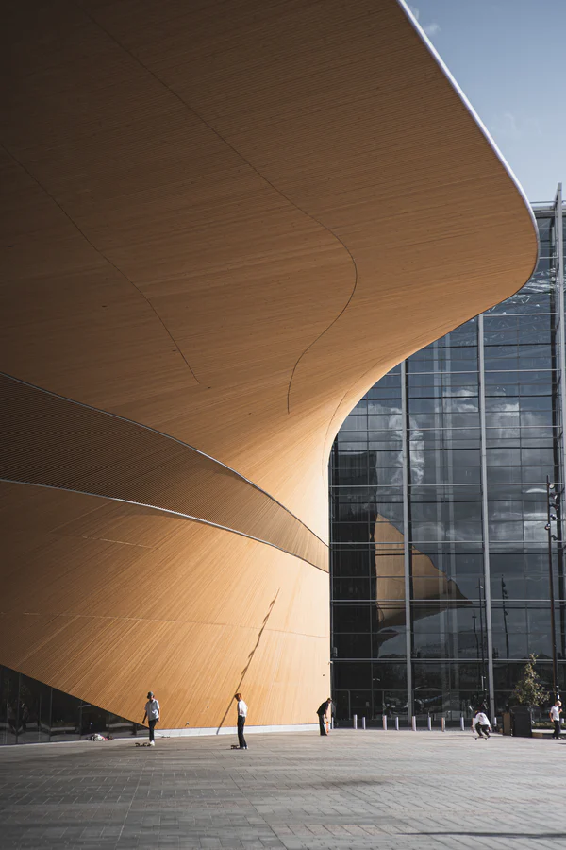
Finland – a welfare system
The society is organized by a broad and effective public sector
Public schools, communal day-care system, public health care
High taxes
Openness across social systems: e.g. yearly tax and income data, possibility to participate in the national core curriculum process
Finland uses almost third of its GDP to support the welfare state
“In Finland, the social security system aims to safeguard sufficient economic security in all life situations.” (www.kela.fi)

Slide 5
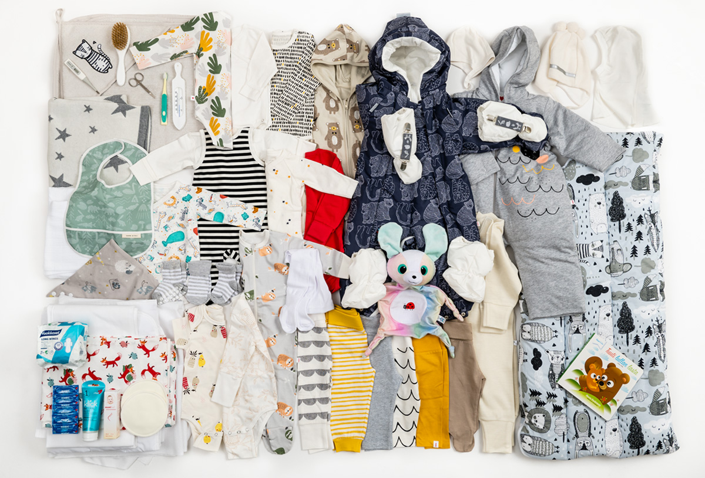
Finland – a welfare system
Äitiyspakkaus maternity package
1937 to disadvantaged mothers (to bring them into social security system)
1949 to all mothers

Slide 6
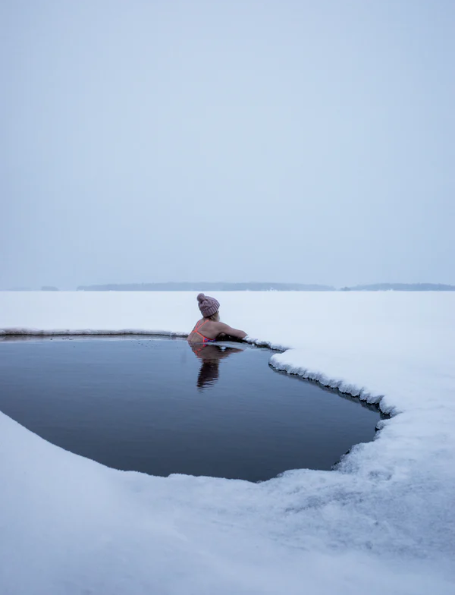
Finland: the happiest country in the world
Group discussion:
What makes a happy country? Discuss based on the pre-task video. Do you agree or disagree with the video?
What makes you happy as a citizen?

Slide 7
Finland: the happiest country in the world
United Nations World Happiness Report 2023: Finland has been crowned the happiest in the world for a record 6th time. While its final score (7.804) is slightly lower than last year's (7.821), Finland is still considerably ahead of other countries.
Some things that are taken into account in the report: GDP, health, corruption, social networks, feelings of joy or happiness, trust in the society
Video: Is Finland really the happiest country in the world?

Slide 8
Finland: the happiest country in the world
According to the World Happiness Report 2021, confidence in institutions was one of factors that supported successful COVID-19 strategies (World Happiness Report 2021, https://happiness-report.s3.amazonaws.com/2021/WHR+21_Ch1.pdf)
“Finland has always ranked very high on the measures of mutual trust that have helped to protect lives and livelihoods during the pandemic.” (In article “In a Lamentable Year, Finland Again is the Happiest Country in the World”, 2021: https://worldhappiness.report/news/in-a-lamentable-year-finland-again-is-the-happiest-country-in-the-world/)
“Trust and the ability to count on others are major supports to life evaluations, especially in the face of crises. To feel that your lost wallet would be returned if found by a police officer, by a neighbour, or a stranger, is estimated to be more important for happiness than income, unemployment, and major health risks.” (World Happiness Report 2021, https://happiness-report.s3.amazonaws.com/2021/WHR+21_Ch1.pdf)

Slide 9
Finland: the happiest country in the world
Happy or just content?
Trust in society: social trust, trust in the government
Welfare system
Safe environments
Healthy life

Slide 10
Finland: the happiest country in the world (?)
Finnish institute for health and welfare (Sep 5, 2018): “Alcohol consumption in Finland has decreased, but over half a million are still at risk from excessive drinking.”
Alcohol consumption in Finland decreased to lowest in the 2000s in the first year of the pandemic (2020)
Suicide rates by country 2022: Finland 25th in the listing
Negative effects of the pandemic: unemployment, mental health issues, wellbeing, polarization in the society, malaise among children and adolescents
Demographic segregation has increased a little

Slide 11
FINNISH EDUCATION

Slide 12
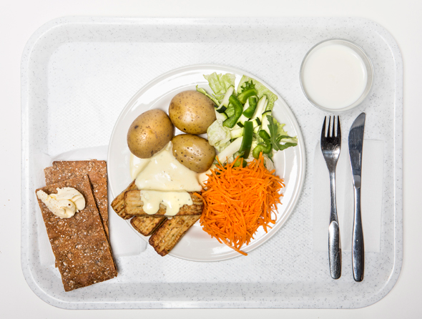
Finnish education
In Finland school meals are free for children / students from pre-school to second degree studies (vocational and high school).
Finland was the first country to enact the law for free school meals (in 1943).

Slide 13
Finnish education
Teacher education: all teachers hold a Master’s degree (except for Early childhood teachers to whom a Bachelor’s degree is sufficient)
Teacher education is competitive: In 2020 apr. 8 % of the applicants were accepted into the teacher education at the University of Helsinki
Video: Pasi Sahlberg, PhD: What can we learn from Finnish education system? 38.40-42.05
But: 6 out of 10 teachers are considering career change (OAJ 2021 https://www.oaj.fi/en/news/news-and-press-releases/2021/alanvaihtokysely-09-21/)
Reasons: increased workload, wages
The number of teachers considering career change has increased during the pandemic

Slide 14
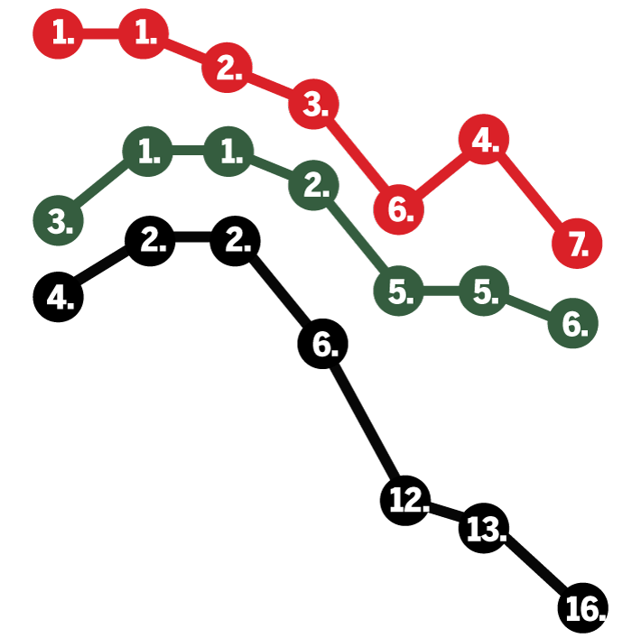
Finnish education
OECD: PISA (Programme for international student assessment in reading, mathematics, and science):
Finnish children performed 7th best in the latest Pisa study (2018)
Results have however lowered in natural sciences, reading as well as in mathematics throughout the 21st century
Finnish children’s literacy is among the best in the OECD countries, but differences in literacy skills between boys and girls is growing
But: Finnish children are both knowledgeable and happy according to the latest study (which is rare compared to other OECD countries)
→ “There is more to life than school”
reading
natural
sciences
mathemathics
Opetus- ja kulttuuriministeriö; Karut luvut paljastavat, että jotain on nyt pielessä – mitä tapahtui Suomen kouluille? - Kotimaa - Ilta-Sanomat

Slide 15
Group Discussion: Discuss the Finnish education system based on the pre-tasks, today’s material and a PDF file “Finnish education system” in the course page.
Discuss e.g.:
What do you find interesting?
What are the key values of the Finnish education system?
What is similar or different to schools that you have gone to? (E.g. public / private school division, teacher education, amount of homework..)

Slide 16
Pre-tasks for lesson 5
Fifth and last lesson already on Tuesday 20th of February!
The lesson will be online on Zoom! The link will be sent to you via MyCourses!
1. Finland Toolbox: Creative Finland. Skim through the brochure on creative industries in Finland.
Concentrate on what interests you the most and take some notes: Did you already know something about the creative industries in Finland? What? What did you find especially interesting in the brochure? Why? What kind of an image does it give of creative industries in Finland? What is your relationship to different forms of art?

