Slide 1
Clarifications for weeks 5-7
Antti’s slides

Slide 2
Group work in the project
How are you dividing the work?
Individual tasks (members can work on their own)
Group meetings (everyone is present)

Slide 3
MOOC problems
There have been (and are) wider problems in the A+ services
Current situation: Some exercises do not give points even if they are correct
MOOC Rounds 3 & 4 deadlines have been postponed
New deadlines for the both: Monday 10 October 23:59
Recommendation:
Do exercises on your own, but test them on your own, without sending them for grading
In the tutoring in the afternoon, ask for clarificications based on the problems that you have on your own computer (not in grading)

Slide 4
MOOC 4 grading
The same limits as in Round 3
Even if Round 4 has max 400 points, not 300
Deadline | MOOC content | Topics | Max MOOC points | 1 course point | 2 course points | 3 course points | 4 course points | 5 course points
W5 Wed 23:59 W6 Mon 23:59 | Round 4 | JavaScript: How page contents can be changed on the fly, Event-based programming, Processing user input | 300 400 | 150 | 180 | 210 | 240 | 270

Slide 5
The building blocks of your evaluation
From the evaluation methods lecture:
Scenario (e.g., storyboard or a story) “onboards” the user to understand the context
Scenario (based on a part of the storyboard)
“Clicking/tapping” (C/T) prototype about the interactions in one (or max two) touchpoints
C/T prototype simulates the interactive experience for the user and concretizes the scenario
Programmed prototype
Separate creation that illustrates interactions in the C/T prototype – not part of the evaluations unless you want to

Slide 6
Storyboard
Clicking/tapping prototype
https://uxplanet.org/user-personas-scenarios-user-stories-and-storyboards-whats-the-difference-cf00315f0799

Slide 7
Putting the methods together: The evaluation should have a story
(Warm-up questions)
Present a believable but fictitious starting point
Interactive task 1 with the prototype
Interactive task 2 with the prototype
Bridging scenario
Follow-up interview
(Maybe including practice in thinking aloud)
“Let’s consider that you are sending a parcel…”
“Here is an app that you would use… How would you…”
“OK, you have successfully sent… Now 2 days will pass and then…”
“You use the app again…”

Slide 8
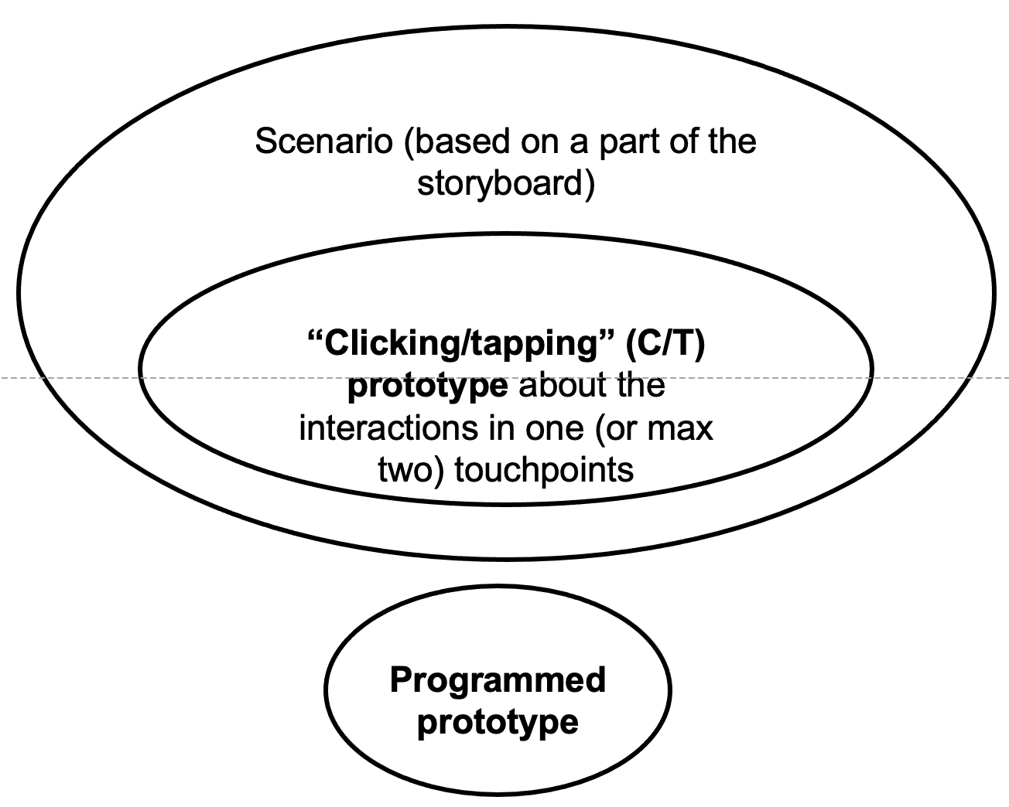
Scope of the programmed prototype
Examples (see next slides)

Slide 9
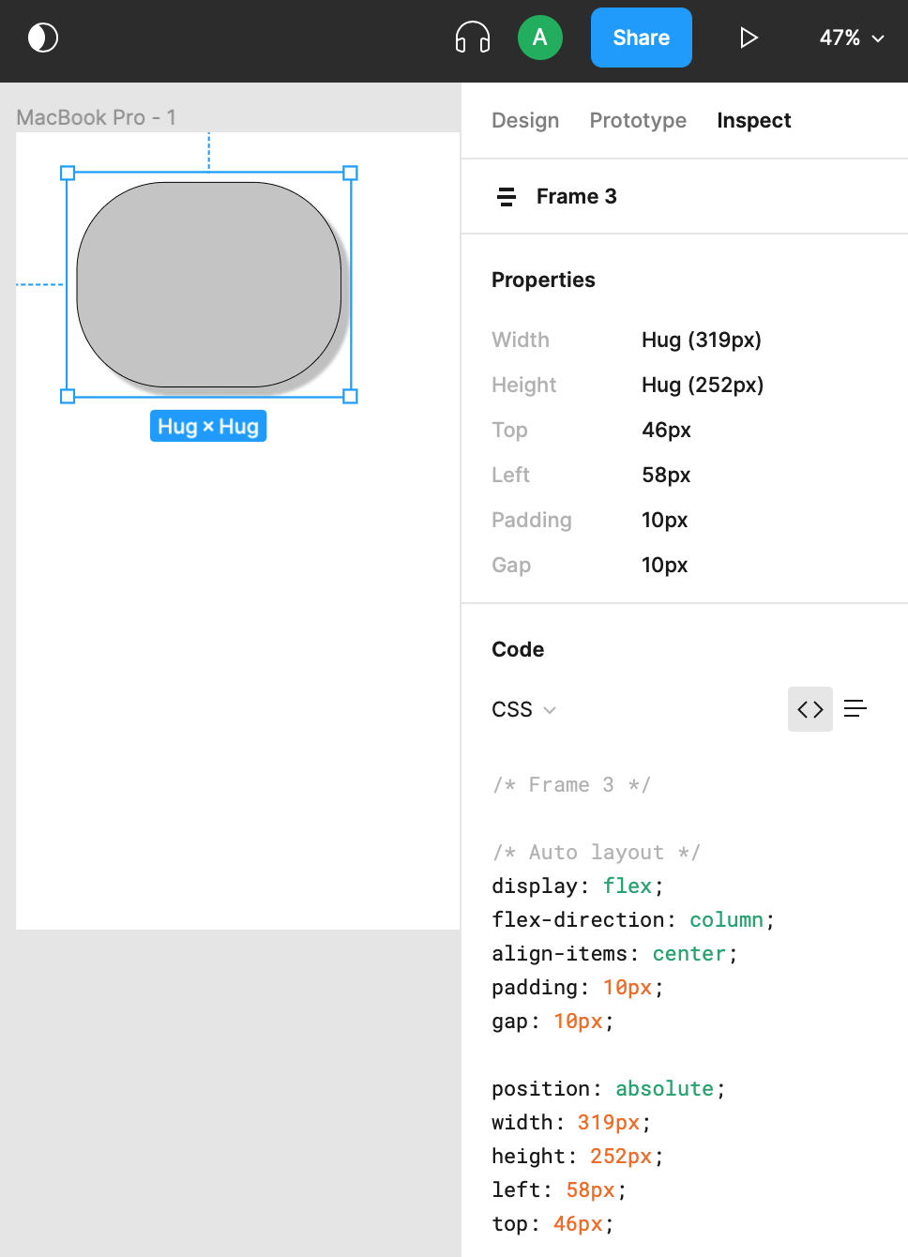
Tip: CSS export in Figma
https://designcode.io/figma-handbook-exporting-css-codes

Slide 10
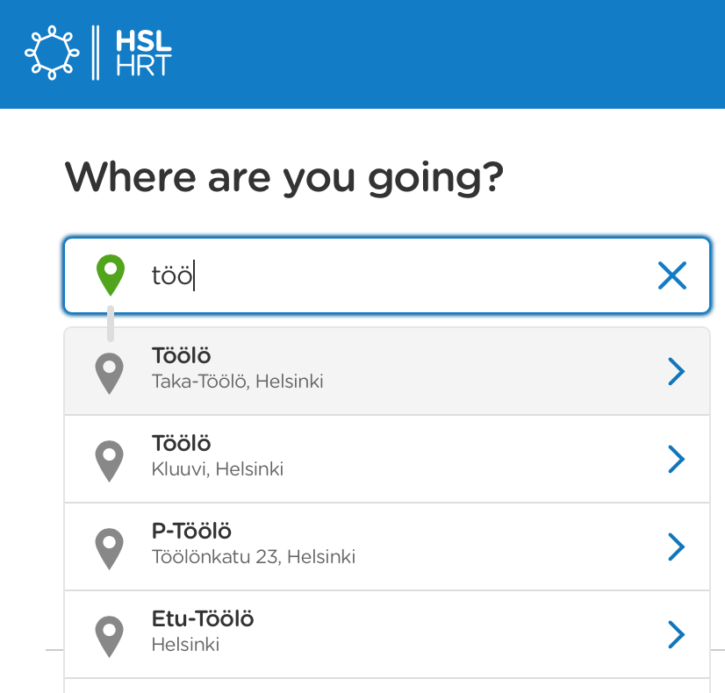
Predictive text input

Slide 11
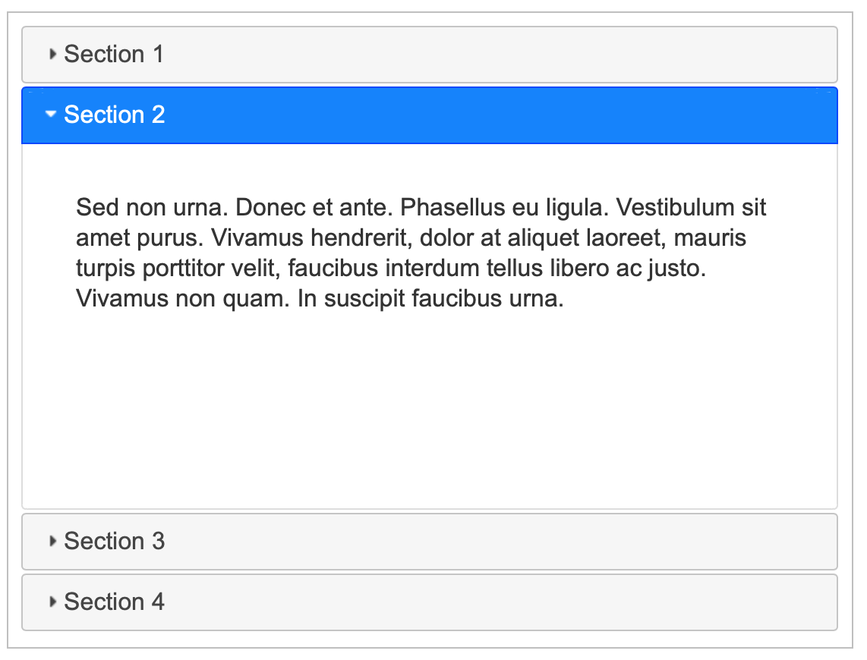
Accordion
Demo: https://jqueryui.com/accordion/

Slide 12
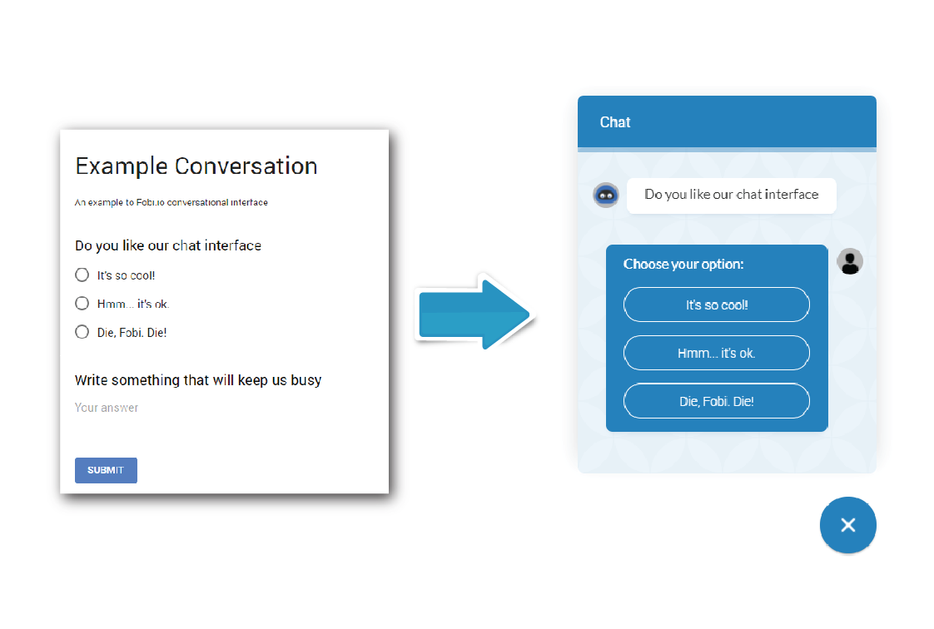
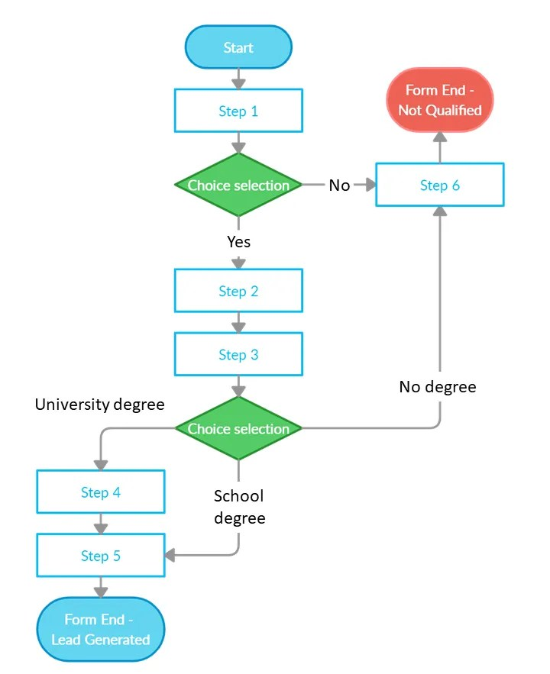
Tree-structured chatbot / questionnaire
https://chatbotsmagazine.com/meet-the-new-conversational-google-forms-28b12a138a72
https://leadgenapp.io/conditional-logic-forms/

