Slide 1
Stress and Time management – Tips from Study Psychologists
Materials by Aalto psychologists, 2021.
Study psychologist Sanni Saarimäki and Alli Mattila
sanni.saarimaki@aalto.fi; alli.mattila@aalto.fi
Mikkeli campus, Zoom-meetings

Slide 2
Agenda for today
16.00-16.10 Getting to know each other and what we gonna do today
16.10-16.20 Flinga: Beginner’s guide to stressing…
16.20-16.30 Sanni: Psychological flexibility
16.30-17.05 Podcast episode about time management
17.05-17.20 Group chat + Flinga: tool-box for university years
17.20-17.35 ABC -Time-management exercise
17.35-17.45 Alli: Scheduling - Points to consider
17.45-17.55 Instructions for group work (2nd workshop)
17.55 Any questions? If not, finishing our workshop today ☺
Notes:
Sanni

Slide 3
Getting to know each other
Write down in Zoom chat:
Introduce yourself to others (your first and last name and eg. where are you from)
Mention one thing you have done for your wellbeing in recent weeks, no matter how small or big act it has been
It’s important to write your name in chat, because it is also the way to confirm that you have taken part in this session today! ☺
Notes:
Sanni

Slide 4
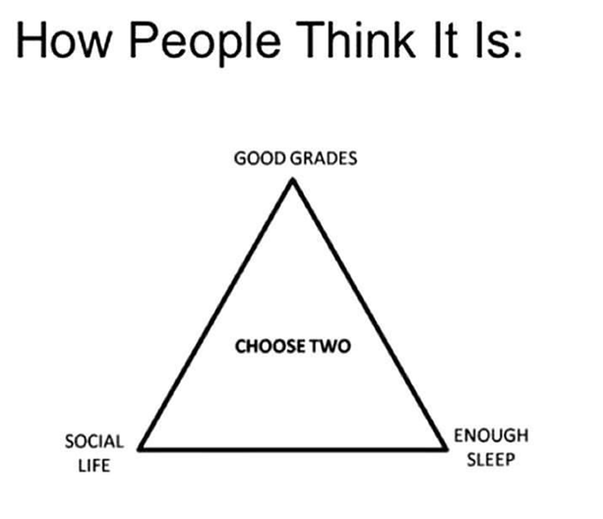
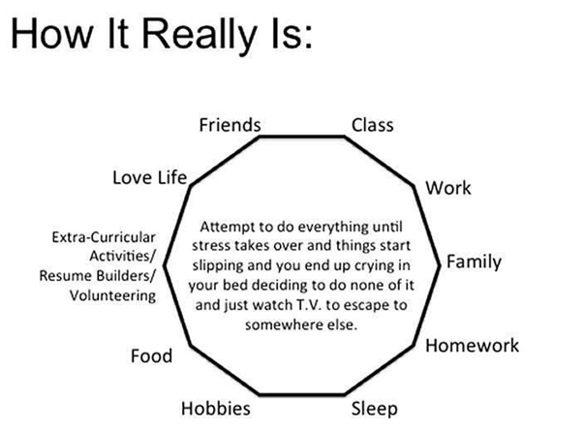
Notes:
Sanni

Slide 5
Beginners’ guide to stressing yourself out…
You got 5 minutes – write down in Flinga: Flinga - Beginners guide to stressing yourself out
How to cause as much stress as possible for
yourself
your study group?
Consire your own and other’s influence (actions) but also situational and other factors you can/ can’t modify.
Notes:
Alli

Slide 6
I’m not sure what my values are, or I’m not truly committed for them, or it’s not possible to follow my values for some reason
I end up following impulses, without no goals, or I start over-doing everything, or became really passive.
I end up living inside my mind, worrying about or glorifying future or past. I don’t really live in this moment.
Psychological inflexibility
Things don’t go as I hope, and I’ll end up blaming myself
I feel really stressed and end up avoiding things I should be doing: I’ll start Netflix-marathon, FB, cleaning my room... Or I ruminate and worry inside my head.
I start to believe my negative thoughs are reality, and end up acting upon them.
©️ Saarimäki & Törnroos,
Aalto University 2021
Source: see e.g.. Lappalainen & al, Hyväksymis- ja omistautumisterapia käytännön terapiatyössä, 2009.

Slide 7
Values:
What is important to me? Now and in the long run?
Acts that are based on my values!
Healthy self-image:
I let go of negative thoughs (this is not the same as avoiding them!)
Psychological flexibility
I am present and kind to myself. I live more in this moment and have compassion towards myself.
Acceptance:
I accept that I have thoughts and feelings, I have a history and that there are things I can’t change. But, I change what I can: my actions.
I don’t let my
mind control me.
I am not the same as my thoughts – I HAVE thoughts.
©️ Saarimäki & Törnroos,
Aalto University 2021
Source: see e.g.. Lappalainen & al, Hyväksymis- ja omistautumisterapia käytännön terapiatyössä, 2009.

Slide 8
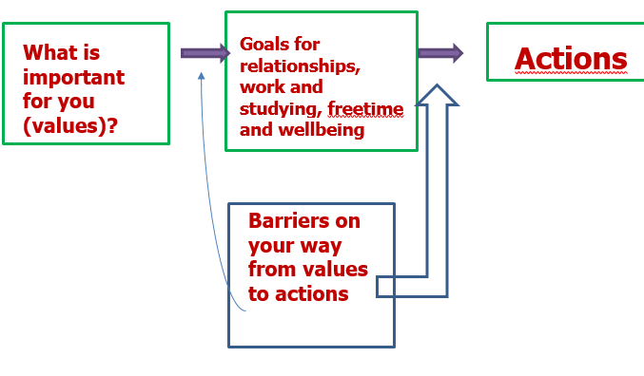

Slide 9
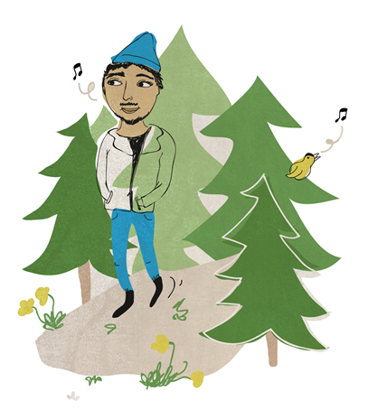
Listen to study psychologists' podcast – The Best thing today
16. Time-management – a skill everyone can learn with time (29min)
https://open.spotify.com/episode/4RGsgTFM3A88lXH3KBGeY0?si=MqvOcUgRT8-pY9FtfftuaA&dl_branch=1
Try to find three points/insights that you would like to remember
Notes:
Alli

Slide 10
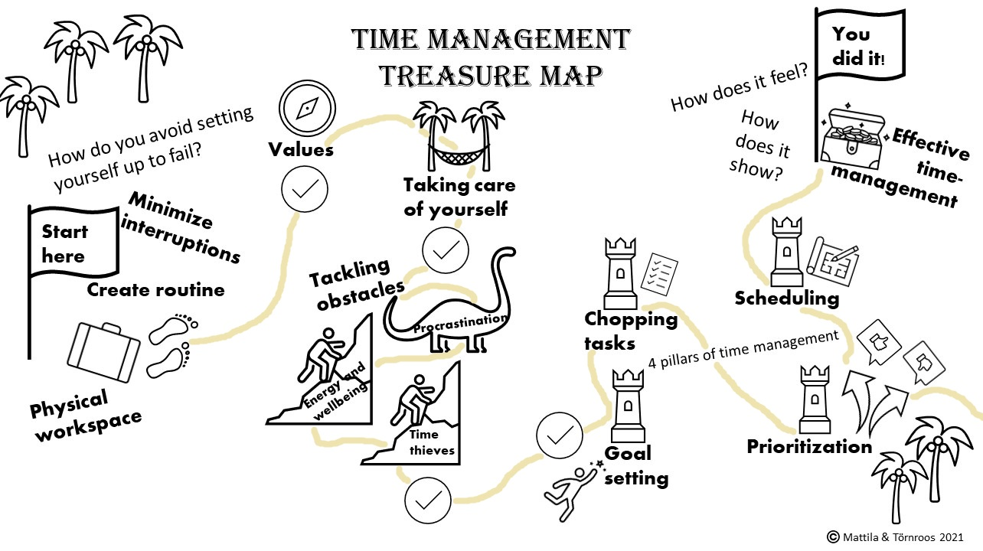

Slide 11
A Tool-box for University Years
Talk about the podcast episode in small groups.
Create your group's tool-box for university years (top 5 study & time management tips).
Share your tool box in Flinga
Flinga - Tool box for university years

Slide 12
ABC- the time management exercise
See instructions:
https://mycourses.aalto.fi/mod/book/view.php?id=802747
Notes:
Sanni

Slide 13
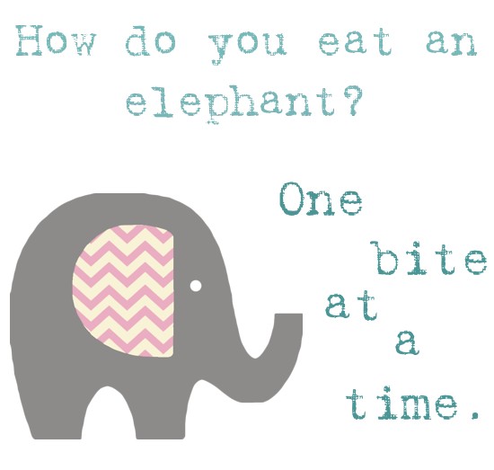
Points to consider
Make a plan
Start with writing down ”big” dates
Longterm / shortterm goals
Devide goals on tasks and devide tasks on smaller tasks – the smaller the better!
Be realistic when you set goals
Don’t leave tasks too close to the ”big” dates
Notes:
Alli

Slide 14
Points to consider
Monitor your use of time
Write down everything. You need to get your brain capacity on working - use calenders, notes, to-do-lists
Consider where you work and when you work - what’s your prime time and place?
What is the best study method for this project?
Practice scheduling and modify your schedules when needed
Protect your freetime and recovery. Plan in advance that you have time for that!
Notes:
Alli

Slide 15
Next steps
Read material from MyCourses and this pp-slide-show in advance and think your own answers for those group-work questions. Then, let’s meet again and start the group-work:
Group A, groupwork:
Wednesday, October 20 at 16-18 (Finnish time, UTC +3)
Group B, groupwork:
Thursday, October 21 at 16-18 (Finnish time, UTC +3)

Slide 16
Introduction to your group work
https://mycourses.aalto.fi/course/view.php?id=34468&section=2
Sanni and Alli will divide you into groups at the beginning of the second workshop, so be there in Zoom on time!
What a balanced (study or work) life means for you? How do you notice if your life is in balance or not? How distant/remote studying and learning can affect your study motivation and wellbeing (positively and negatively)?
What could “balance” mean for you (students) in these times of uncertainty? How can you make your life a balanced-one? Or is it even possible? If yes/not, why? What obstacles or stressors can there be waiting for you?
What helps you when problems might arrive? What can you do in advance to make it easier for you to overcome problems?
How can you support each other's wellbeing and study/work motivation?
From where can you get help/ support/ tips when you or your fellow-students need it?
What kind of stress and time management tips would you recommend to others (what have you tried yourself and found useful) especially for remote/distant studying and promoting your study-wellbeing?
Notes:
Sanni

Slide 17
Tell us one small thing that you could do for your wellbeing right now?

Slide 18
Supporting your study ability in learning remotely Four elements to successful remote studying
Student Services
August 2020

Slide 19
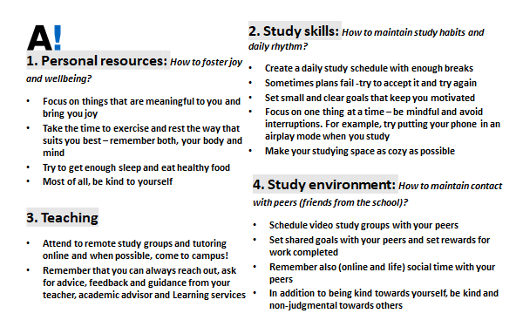

Slide 20
Stress
Stress is natural part of life and learning.
Stress is an experience in which requirements from environment (studying, working, relationships, etc.) are /seem higher than your own resources, right now, for coping
Short term and not too strong stress is important and beneficial and can help you do better.
Stress is not only on your mind. Physiological changes are real part of stress.
Strong or long term stress might reduse your health and/ or performance.

Slide 21
Yerkes–Dodson law

Slide 22
Stress is just an experience?
https://www.uhs.umich.edu/files/uhs/field/image/Mindfulness.jpg

Slide 23
Manage Your Energy!
PHYSICAL ENERGY
Enhance your sleep by setting an earlier bedtime and reducing alcohol use.
Reduce stress by engaging in cardiovascular activity at least three times a week and strength training at least once.
Eat small meals and light snacks every three hours.
Learn to notice signs of imminent energy flagging, including restlessness, yawning, hunger, and difficulty concentrating.
Take brief but regular breaks, away from your desk, at 90- to 120-minute intervals throughout the day.
EMOTIONAL ENERGY
Defuse negative emotions—irritability, impatience, anxiety, insecurity—through deep abdominal breathing.
Fuel positive emotions in yourself and others by regularly expressing appreciation to others in detailed, specific terms through notes, e-mails, calls, or conversations.
Look at upsetting situations through new lenses. Adopt a “reverse lens” to ask, “What would the other person in this conflict say, and how might he be right?” Use a “long lens” to ask, “How will I likely view this situation in six months?” Employ a “wide lens” to ask, “How can I grow and learn from this situation?”

Slide 24
Manage Your Energy!
MENTAL ENERGY
Reduce interruptions by performing high concentration tasks away from phones and e-mail.
Respond to voice mails and e-mails at designated times during the day.
Every night, identify the most important challenge for the next day. Then make it your first priority when you arrive at work in the morning.
SPIRITUAL ENERGY
Identify your “sweet spot” activities—those that give you feelings of effectiveness, effortless absorption, and fulfillment. Find ways to do more of these. One executive who hated doing sales reports delegated them to someone who loved that activity.
Allocate time and energy to what you consider most important. For example, spend the last 20 minutes of your evening commute relaxing, so you can connect with your family once you’re home.
Live your core values. For instance, if consideration is important to you but you’re perpetually late for meetings, practice intentionally showing up five minutes early for meetings.

Slide 25
In groups, share ideas about following questions:
What a balanced (study or work) life means for you? How do you notice if your life is in balance or not? How distant/remote studying and learning can affect your study motivation and wellbeing (positively and negatively)?
What could “balance” mean for you (students) in these times of global uncertainty? How can you make your life a balanced-one? Or is it even possible? If yes/not, why? What obstacles or stressors can there be waiting for you?
What helps you when problems might arrive? What can you do in advance to make it easier for you to overcome problems?
How can you support each other's wellbeing and study/work motivation?
From where can you get help/ support/ tips when you or your fellow-students need it?
What kind of stress and time management tips would you recommend to others (what have you tried yourself and found useful) especially for remote/distant studying and promoting your study-wellbeing?

Slide 26
More information?
Read more about: Self management and time management: https://into.aalto.fi/display/enopisk/Self-management+and+time+management
Condition to study: https://into.aalto.fi/display/enopisk/Condition+to+study
Especially useful for study and work-life are texts titled “Self-compassion” and “Perfectionism”.

