Slide 1
Topic 8: Study on summing amplifiers both in digital and analog neural networks
ELEC-L352001 - Postgraduate Course in Electronic Circuit Design II V D
Konsta Ruotsalainen
Konsta.s.ruotsalainen@aalto.fi
20.04.2022

Slide 2
Content
Introduction
Source material
1. paper
2. paper
3. paper
Comparison
Assignment

Slide 3
Introduction General hardware implementation of CNN

Slide 4
Introduction General hardware implementation of CNN
Parameter
Memory - Constants
MACs

Slide 5
Introduction General hardware implementation of CNN
Constant[b:c]
Input[a]
X
Σ
output[d]
Multiply-ACcumulate (MAC)

Slide 6
Introduction Summing amplifier as MAC
Parameters
Resistor weights
Multiplication
V-I conversion
Accumulation
Weighted sum
Max pooling with diode connection

Slide 7
Source material
1. paper - CMOS Implementation of ANNs Based on Analog Optimization of N-Dimensional Objective Functions.
Medina-Santiago A, Hernández-Gracidas CA, Morales-Rosales LA, Algredo-Badillo I, Amador García M, Orozco Torres JA.
Sensors. 2021; 21(21):7071.
https://doi.org/10.3390/s21217071
2. paper - 16.4 An 89TOPS/W and 16.3TOPS/mm² All-Digital SRAM-Based Full-Precision Compute-In Memory Macro in 22nm for Machine-Learning Edge Applications
Y. -D. Chih et al.
2021 IEEE International Solid- State Circuits Conference (ISSCC), 2021, pp. 252-254,
doi: 10.1109/ISSCC42613.2021.9365766.
3.paper - An Always-On 3.8 µJ/86% CIFAR-10 Mixed-Signal Binary CNN Processor With All Memory on Chip in 28-nm CMOS
D. Bankman, L. Yang, B. Moons, M. Verhelst and B. Murmann,
IEEE Journal of Solid-State Circuits, vol. 54, no. 1, pp. 158-172, Jan. 2019
doi: 10.1109/JSSC.2018.2869150.

Slide 8
CMOS Implementation of ANNs Based on Analog Optimization of N-Dimensional Objective Functions
Medina-Santiago A, Hernández-Gracidas CA, Morales-Rosales LA, Algredo-Badillo I, Amador García M, Orozco Torres JA
Sensors. 2021; 21(21):7071

Slide 9
Complete circuit based on ANN
Application: Classification of digital data
ANN architecture with 9 neurons (configuration 5-3-1)
Summation weights defined by resistors $R_{ij}$
Total power 46.08 mW

Slide 10
Circuit for one neuron
Summing amplifier
Activation function normalizes result to be between 0 to 1 and buffers the complimentary output

Slide 11
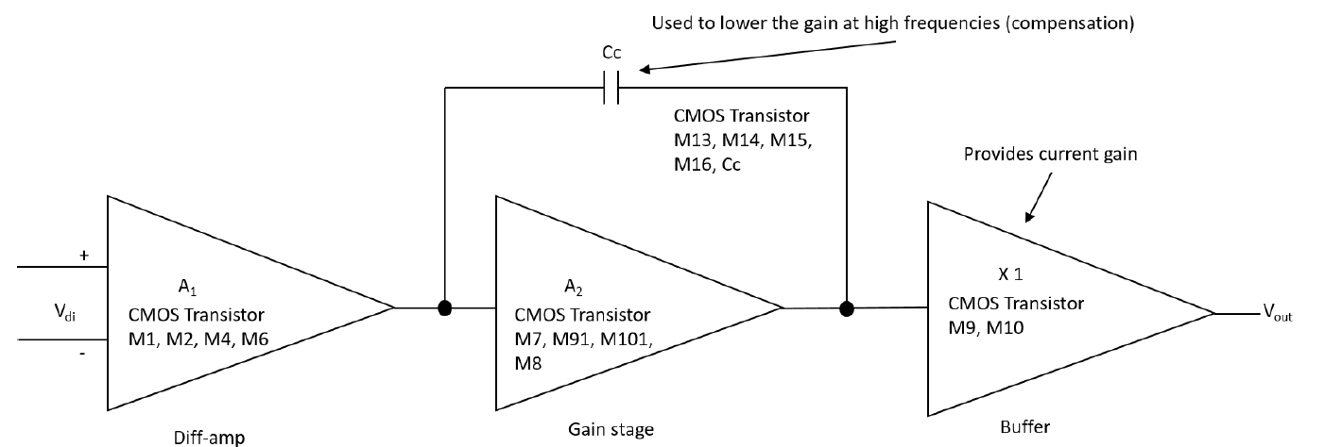
Basic building block - Integrator Circuit
Differential amplifier (M1, M2, M4, and M6)
Gain stage (M7, M91, M101, and M8)
Output stage (M9 and M10)
Compensation (M13, M14, M15, M16 and capacitor CC)
Notes:
Figure 6 is, in detail, the block diagram of the 1.2 μm technology operational amplifier in Figure 4 that shows the operational amplifier with CMOS transistors, formed by the stages of a differential amplifier (M1, M2, M4, and M6), gain stage (M7, M91, M101, and M8) and the output stage (buffer) (M9 and M10). Compensation network M13 and capacitor Cc, where M13 is made up of a polarization network by the transistors M14, M15, and M16.

Slide 12
All-Digital SRAM-Based Full-Precision Compute-In Memory Macro in 22nm for Machine-Learning Edge Applications
Y. -D. Chih et al.,
2021 IEEE International Solid- State Circuits Conference (ISSCC)

Slide 13
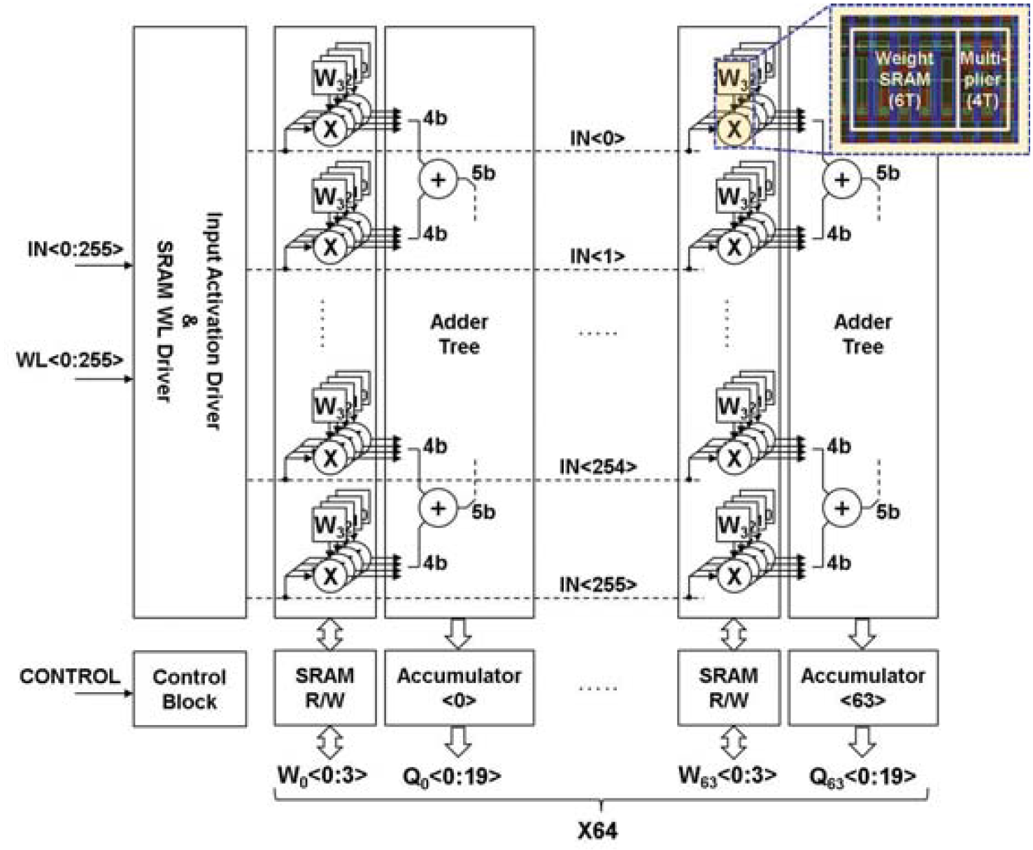
6T SRAM-based all-digital CIM
Application: Generic
Architecture: bit-serial multiplication and parallel adder trees
The CIM macro contains
256 input activations
64 partial-sum outputs
256x64x4bit memory
256x64x4bit multiplier [NOR]
Parallel adder tree

Slide 14
Single column structure
5b adder
5 full adders
1 half adder
5 cycles to accumulate final sum.

Slide 15
Parallel adder circuit
Adder trees structure
28T and 14T full adders

Slide 16
An Always-On 3.8 μJ/86% CIFAR-10 Mixed-Signal Binary CNN Processor With All Memory on Chip in 28-nm CMOS
D. Bankman, L. Yang, B. Moons, M. Verhelst and B. Murmann
IEEE Journal of Solid-State Circuits, vol. 54, no. 1, pp. 158-172, Jan. 2019

Slide 17
Mixed-Signal Binary CNN Processor
Application: Image categorizing
Architecture: bit-serial multiplication, analog addition, SC-neuron
The CIM macro contains
32 × 32 × 256 input
4 bit output
64x1024 bit SC analog neurons

Slide 18
SC neuron – CDAC/comparator
single comparator 1-bit neuron output

Slide 19
Comparison between tree adder and SC
CDAC adder
21µm * 1210µm = 0,025mm²
wallance tree adder
29µm * 910µm = 0,026mm²

Slide 20
Comparison

Slide 21
Comparison
 | 1. | 2. | 3.
Technology | 1.2µm | 22nm | 28nm
Implementation | Analog | Digital | Mixed-signal
Addition function | Summing amplifier | Adder tree with syncronious accumulator | CDAC
Power comsumption | 48mW | 37mW | 0.9mW
Operations | GBW: 2.3MHz | 3.3 TOPS 89 TOPS/W | 237 Frames/s 0.47 TOPS 532 TOPS/W

Slide 22
Assignment

Slide 23
What are the tree different addition architectures presented in different papers.
What is purpose of activation function after the addition

