Slide 1
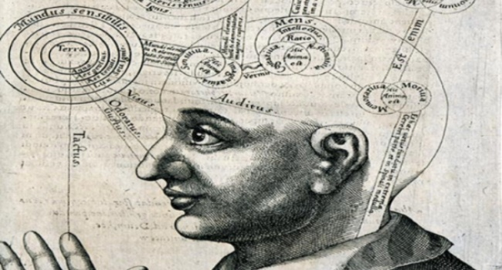
Phenomenology and Hermeneutics
Lecture 4 of Philosophy and theory of art (vicca, aalto arts)

Slide 2
Franz Brentano (1838-1917), Psychology from an Emprirical Standpoint (1874) -the phenomena of inner perception are true in themselves -(commenting on Descartes) the greatest part of the mind’s life is inactive and mental activity does not necessarily involve consciousness (-> Freud) -intentionality

Slide 3
Edmund Husserl (1859-1938) -even more on Descartes -to the things themselves -philosophy has become ‘academic’, should become scientific (again) and provide a base for all sciences -reduction -epokhe (from the Sceptics: suspension of judgement) -intentionality (from Brentano)

Slide 4
Martin Heidegger (1889-1976) -Husserl’s student -political controversy – and banned after the second world war until 1950 -student of Husserl (and fired him from the University during the Nazi regime) -students: Herbert Marcuse (teacher of Angela Davis), Giorgio Agamben, Jean-Paul Sartre, Koichi Tsujimura Hans-Georg Gadamer (teacher of Gianni Vattimo)
Being and Time 1927
The Origin of the Work of Art 1936
Being vs. being

Slide 5
* Being in a mood (Befindlichkeit) * Dasein * Aletheia (disclosure), Lichtung * Being-with (Mitsein) * Das Mann * Being-toward-death * “Equipment”/”Tool” (1927) * (1935-1936) Work of Art * Ge-stell (gathering, collection, essence of tech), Ereignis (an event, coming into view)
Greek Temple, van Gogh’s painting
Historical people
Stoss (thrust)

Slide 6
French phenomenology and its commentators * Jean-Luc Nancy, Luce Irigaray, Maurise Merleau-Ponty
Touch
The body (lacking in Heidegger’s work)

Slide 7
The hermeneutical turn
Hans-Georg Gadamer -> Gianni Vattimo, Giorgio Agamben

