Slide 1
Lecture 7: FDI, multinationals and domestic companies in emerging markets
Svetlana Ledyaeva
Aalto University School of Business

Slide 2
Traditional view of multinational enterprise (from Avinash Dixit public lecture at Oxford)
NORTH MNE invests to NORTH
NORTH MNE invests to SOUTH
MNE is from advanced country – North. Has advantage in R&D, high-tech, management. Information makes it non-contractible.
Southern host country has cost advantage in low-tech production. Also non-contractible.
FDI can reduce contracting costs: FDI is a specific organizational choice made by investing firms to take advantage of opportunities for earning profits in the host country and in response to the challenges posed by the contracting.

Slide 3
Developed countries´ MNEs investing in EMs
For years, economists have been talking about a structural shift in the global economy.
Do you increase spending in the United States, or do you open a new factory and service center in Asia?
That question was answered in 2013: For the first time ever, global corporations invested more in emerging markets than the core economies of U.S., Europe and Japan, according to UNCTAD in their 2013 World Investment Report.

Slide 4
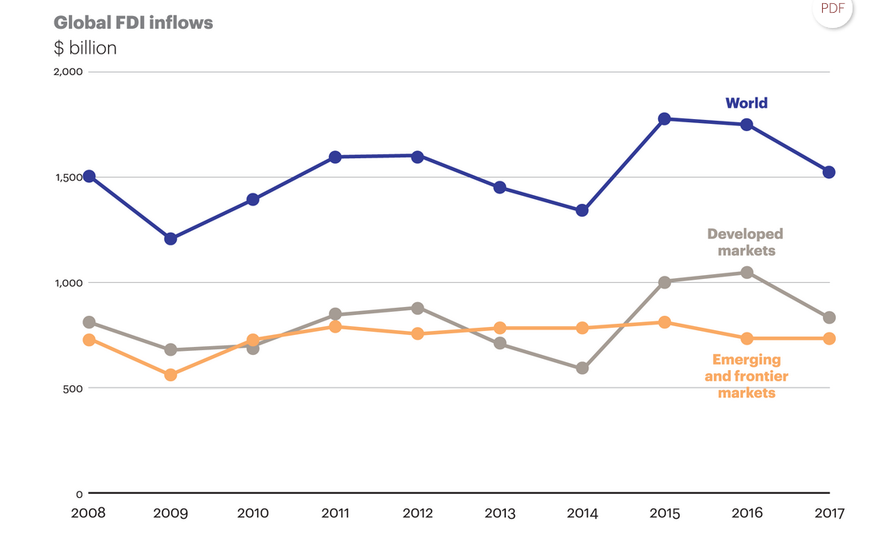

Slide 5
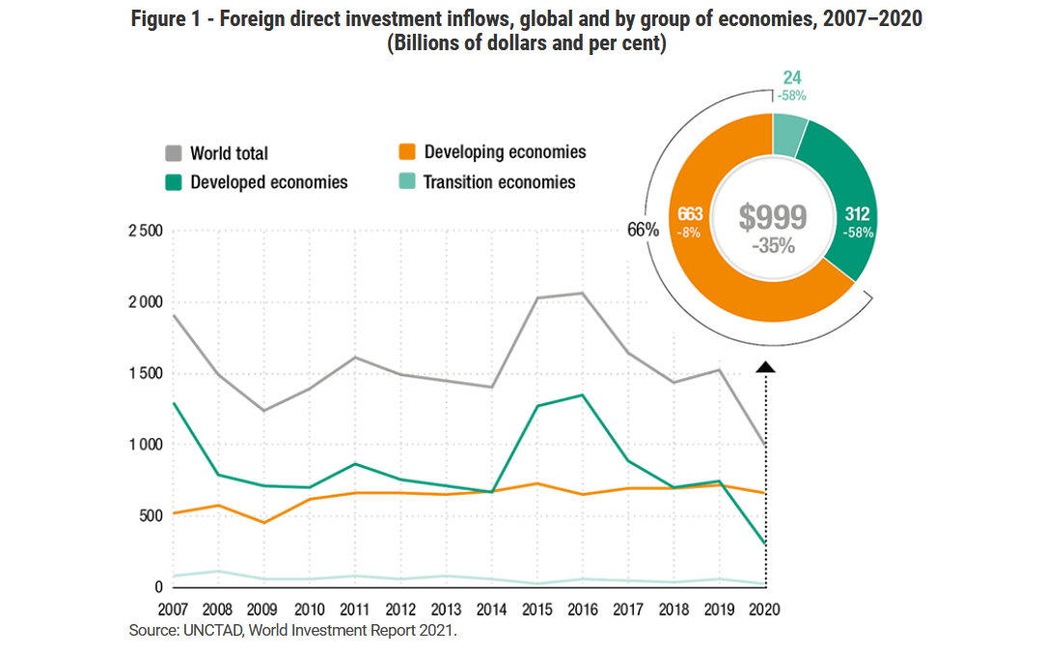

Slide 6
Business/investment strategies of MNCs/investors from advanced markets in emerging markets (London and Hart 2004)
Most MNCs have focused on the wealthy elite at the top of economic pyramid, with products and business models similar to those used in the developed world.
Largely ignored until recently is a huge base of potential customers whose annual purchasing power parity (PPP) is less than $1500 per year.
The four billion customers in these base-of-the-pyramid markets represent a vast potential. ➔ Present both tremendous opportunities and unique challenges.
A growing number of MNCs start to explore the enormous business opportunity at the base of economic pyramid

Slide 7
The base of the economic pyramid: Informal economies (London and Hart 2004)
Base of economic pyramid ➔ largely informal economies that are not recorded in official gross national product (GNP) statistics.
The informal sector includes more than $9 trillion in hidden (or unregistered) assets ➔ equivalent to the total value of all companies listed on the 20 most developed countries' main stock exchanges (de Soto, 2000: 35).

Slide 8
The base of economic pyramid: Opportunities (London and Hart 2004)
The value of economic transactions in these markets may match or even exceed what is recorded in the formal economic sectors in developing countries (Henderson, 1999).
In Mexico, for example, the informal economy represented roughly 30–40% of the economic activity in the country in the late 1980s, and has continued to grow rapidly (de Soto, 2000: 78).
Not necessarily illegal activities! It is simply too costly or complicated for many entrepreneurs to enter the formal economy. For example, de Soto (2000) found that it took (at the time of the study) 289 days and $1231 to register a business in Peru.

Slide 9
Informal employment, % of non-agricultural employment; Emerging markets
Country | Informal employment, % | Year | Type of country (FTSE 2018)
Bangladesh | 91,30 | 2017 | Frontier
Cote d'Ivoire | 87,70 | 2016 | Frontier
Ghana | 83,18 | 2016 | Frontier
Indonesia | 78,55 | 2017 | Secondary Emerging
India | 74,82 | 2012 | Secondary Emerging
Pakistan | 71,23 | 2015 | Secondary Emerging
Peru | 59,01 | 2017 | Secondary Emerging
Vietnam | 56,06 | 2017 | Frontier
Colombia | 55,78 | 2017 | Secondary Emerging
Egypt, Arab Rep. | 50,57 | 2016 | Secondary Emerging
Argentina | 47,93 | 2017 | Frontier
Chile | 41,13 | 2017 | Secondary Emerging
Brazil | 38,27 | 2015 | Advanced Emerging
South Africa | 34,47 | 2017 | Advanced Emerging

Slide 10
Informal employment, % of non-agricultural employment; other countries
Country | Informal employment, % | Year | Type of country
Nepal | 99,01 | 2008 | NC - developing
Benin | 94,54 | 2011 | NC - Offshore jurisdiction
Mali | 92,09 | 2015 | NC - Offshore jurisdiction
Senegal | 90,44 | 2015 | NC - developing
Cambodia | 90,20 | 2012 | NC - developing
Mozambique | 86,71 | 2015 | NC - developing
Niger | 86,36 | 2011 | NC - developing
Uganda | 83,24 | 2012 | NC - developing
Bolivia | 78,72 | 2017 | NC - developing
Myanmar | 78,08 | 2017 | NC - developing
Liberia | 77,58 | 2010 | NC - developing
Nicaragua | 74,91 | 2012 | NC - developing
Honduras | 73,84 | 2016 | NC - developing
Guatemala | 73,50 | 2016 | NC - developing
Tanzania | 71,79 | 2014 | NC - developing
Yemen, Rep. | 68,41 | 2014 | NC - developing
Gambia, The | 68,19 | 2012 | NC - developing
Paraguay | 65,42 | 2017 | NC - developing
Ecuador | 64,85 | 2017 | NC - developing
El Salvador | 63,15 | 2016 | NC - Offshore jurisdiction
Zimbabwe | 62,50 | 2011 | NC - developing
Namibia | 61,07 | 2016 | NC - developing
Timor-Leste | 53,70 | 2013 | NC - Offshore jurisdiction
Eswatini | 53,40 | 2016 | NC - developing
Dominican Republic | 53,20 | 2016 | NC - offshore jurisdiction
Mauritius | 52,87 | 2016 | NC - Offshore jurisdiction
West Bank and Gaza | 51,96 | 2017 | NC - developing
Samoa | 50,22 | 2012 | NC - Offshore jurisdiction
Maldives | 47,03 | 2016 | NC - Offshore jurisdiction
Panama | 41,21 | 2016 | NC - Offshore jurisdiction
Costa Rica | 35,45 | 2017 | NC - offshore jurisdiction
Albania | 33,11 | 2013 | NC-developing
Brunei Darussalam | 32,99 | 2014 | NC - offshore jurisdiction
Mongolia | 30,08 | 2016 | NC - developing
Armenia | 24,88 | 2016 | NC-Transition, Post-Soviet
Uruguay | 23,64 | 2017 | NC - developing
Serbia | 16,11 | 2017 | NC - Transition

Slide 11
The base of economic pyramid: challenges (London and Hart 2004)
Entering low-income markets in emerging economies may require a different strategic approach.
bridging the formal and informal economies.
relationships are grounded primarily on social, not legal, contracts.
Increasing pressure for corporations to take a greater role in addressing global societal issues such as eradicating poverty and environmental protection in developing countries.
firms without a capacity to appreciate and create social value or to become locally embedded in the social infrastructure that dominates low-income markets may struggle to overcome their liability of foreignness.

Slide 12
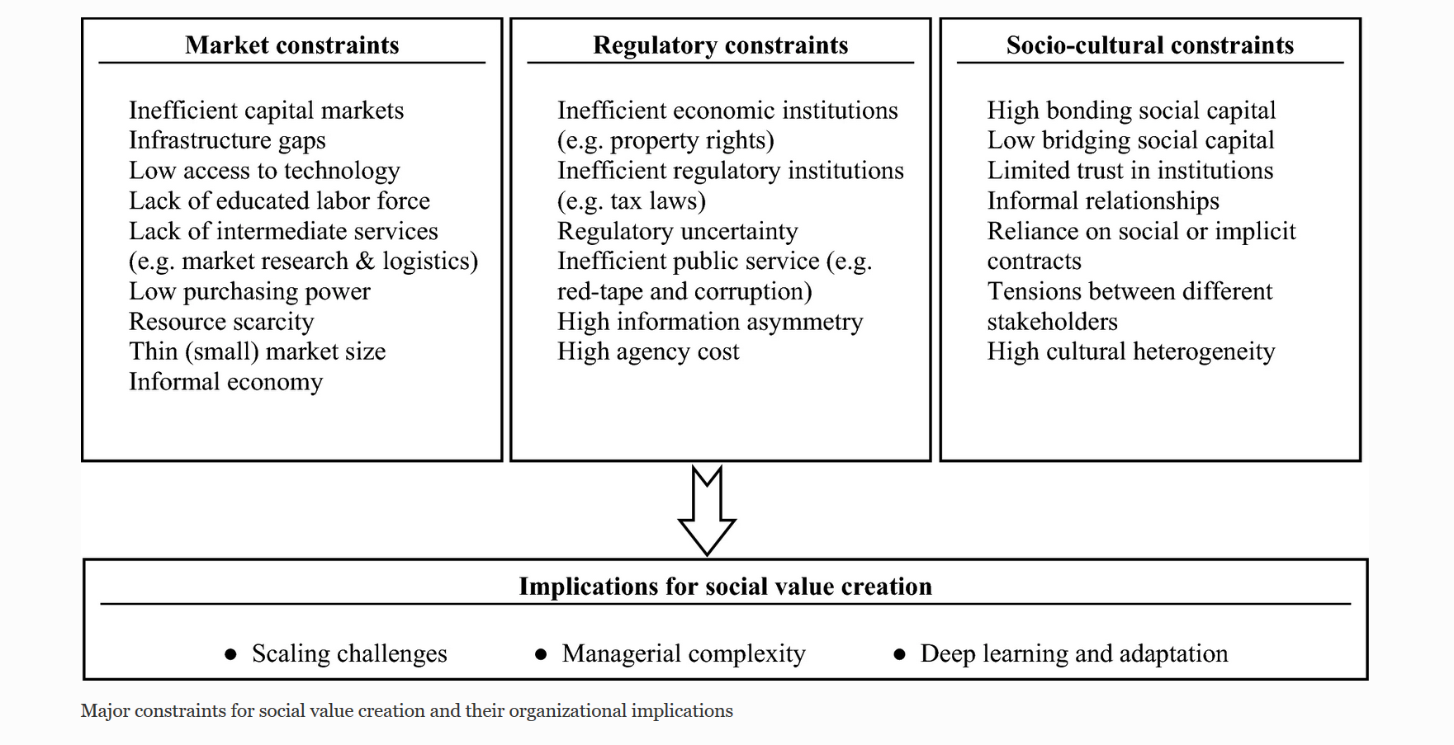

Slide 13
Bonding and bridging social capital definitions (note to previous slide)
Bonding social capital is a type of social capital that describes connections within a group or community characterised by high levels of similarity in demographic characteristics, attitudes, and available information and resources. Bonding social capital exists between ‘people like us’ who are ‘in it together’ and who typically have strong close relationships. Examples include family members, close friends, and neighbours.
Bridging social capital is defined as the connections between individuals who are dissimilar with respect to socioeconomic and other characteristics.
Bonding social capital is within a group or community whereas bridging social capital is between social groups, social class, race, religion or other important sociodemographic or socioeconomic characteristics.

Slide 14
Ordinary/previous EM strategy (London and Hart 2004)
Looking for partner organizations that have substantial capability to fill voids in the business environment.
Firms can address gaps in the business environment through forming alliances, joining network, using interpersonal ties.
Some prominent scholars emphasize that developing country adaptation to Western practices is crucial to attracting investment by MNCs from the developed world.
Other prominent scholars say that “MNC managers and academics must move beyond the ‘imperialist mindset’ that everyone must want to look and act like Westerners”.

Slide 15
Perspective EM strategy (London and Hart 2004)
It might be more appropriate to develop separate strategies for wealthy, rising middle class, and poor customers across country markets.
Entry into base-of-the-pyramid markets may require:
a global capability beyond the adaptive skills ➔
a market entry strategy that moves past a reliance on imported business models.

Slide 16
Video: A new model for emerging markets
https://hbr.org/video/2226586957001/a-newmodelfor-emerging-markets

Slide 17
Advice for essay-report from the above part, i.e. multinational strategies
Assess the presence of foreign MNCs in your chosen country: Names, industries, size. Would there be a room for new investments? Which sectors?
Assess the income inequality; the share of shadow economy; “the base of pyramid” size. What segments of population are targeted by already presented investors/MNCs?
➔
This analysis can help you to make conclusions about the perspective investment in this country.

Slide 18
Emerging Giants: Local companies in Emerging Markets
Entrepreneurs and domestic companies in EMs are aggressively pursuing growth opportunities at home and overseas.
Successful emerging companies regularly register double-digit annual revenue growth.
Some of these local companies go global.
A small but growing set of these companies has built world-class capabilities to challenge global rivals in their home countries and even in developed markets.

Slide 19
Fortune global 500, 2020, World
Brazil

Slide 20
Fortune global 500, 2020, World
Singapore

Slide 21
New development in MNEs over last four decades (from Avinash Dixit public lecture at Oxford)
MNEs from Southern home countries investing in both Northern and Southern host countries.
Prominent recent examples:
Chinese Lenovo buys IBM PC.
Mittal, Tata invest in steel.
Tata, Geely invest in autos in UK, Sweden.
Chinese resource investments in Africa.

Slide 22
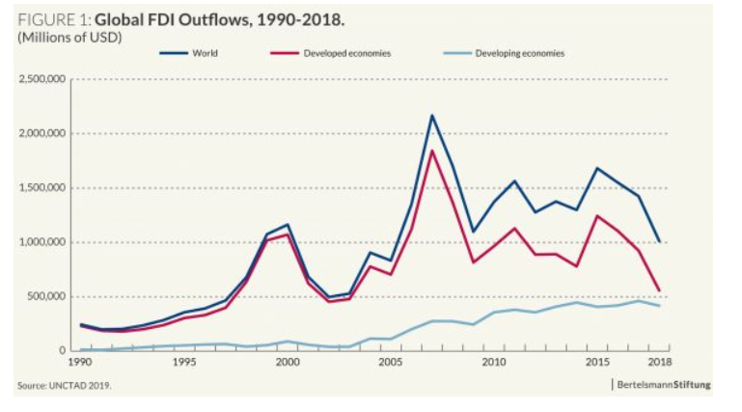

Slide 23
Foreign direct investment outflows, top 20 home economies

Slide 24
It is now just like any other FDI, or does it still require separate analyses, explanation?
Outward FDI from EMs growing fast and now important part of World FDI.
Special features still important but may become less so in coming decades if EMs improve their governance, integrate into world economy.

Slide 25
Previous explanations (not mutually excluded) (from Avinash Dixit public lecture at Oxford)
Poor home-country governance makes FDI more attarctive
Southern host country firms or governments preferred Southern non-colonial investors
Use FDI to acquire modern technology: More relevant for Southern FDI into North
To acquire natural resources or land rights (especially relevant for Chinese investments in Africa, etc.)
Home governments encourage or subsidize FDI

Slide 26
New features of South to North FDI (from Avinash Dixit public lecture at Oxford)
From Thite et al (2016) book on Indian MNEs.
Newer Emerging Markets MNEs:
Have higher ambitions – not marginal players.
Less constrained by foreign exchange.
Less constrained by home regulations.
More adaptable, nimble, have no scared cows!
Great heterogeneity of firms in EMs. Not all have these strengths; FDI from selected subset.

Slide 27
Weak home environment turns into strength abroad (from Avinash Dixit public lecture at Oxford)
”One of the core strengths of Indian firms is to extract maximum value from even ailing business by applying innovative and cost effective methods that they have developed over the years in an extremely resource constrained and uncertain domestic environment … [to] extract value from the bottom of the [income] pyramid” – Thite, Wilkinson, Budhwar (eds.) 2016
”If you can make money in India, you can make it anywhere” – The Economist, 22 Oct. 2011

Slide 28
Skills for coping with bad governance (from Avinash Dixit public lecture at Oxford)
Bad governance in host country creates new kind of non-contractability
Southern MNEs have skill, experience at home; can better handle similar issues in host countries:
Technology, management better adapted to cope.
Know-how to build and use relationships.
Have better ethnic, linguistic networks.
More willing and able to bribe.
Asymmetric: Easier if host governance better than home.

Slide 29
Advice for essay-report
Analyze the presence of other emerging markets MNCs in your chosen emerging country. Analyze local largest companies.
Stress the following:
Their competitive advantages and disadvantages;
Their sectoral patterns;
The niches they occupy: middle class, base of pyramid or elite consumers?
Link the above analysis to investment perspectives in your chosen country.

Slide 30
Lecture 8: Industries, industrial policies and global value chains in Emerging Markets
Svetlana Ledyaeva
Aalto University School of Business

Slide 31
Services versus manufacturing: which matters more for growth in EMs
The East Asian middle- and high-income countries (China, South Korea) have grown and globalized through manufacturing-led activities: agriculture ➔ manufacturing ➔ services.
South Asia (particularly India) appears to choose to globalize through service-led activities skipping manufacturing.

Slide 32
(Export) Manufacturing-led development: The Past
Export-manufacturing-led growth was the model behind the twentieth century growth miracles.
There was unprecedented growth in East Asia, closing the gap in income per capita and standards of living with the advanced countries.
South Korea: from 67 USD to around 30 000 USD GDP per capita from 1950s to present!
Manufacturing export ➔ foreign exchange reserves, tax revenues, learning by doing, technologies, employment in urban sector!
Combined economic and demographic structural transformations, a move from traditional agriculture to more advanced production, from rural to urban, and a movement to a learning economy.
Joseph Stigliz - Nobel laureate

Slide 33
(Export) Manufacturing-led development: The Future 1
Manufacturing is a victim of its own success: The rate of growth of productivity (output per worker) exceeds that of demand ➔
the share of manufacturing in GDP is declining everywhere.
Productivity increases ➔a smaller and smaller fraction of the labor force is required to produce ➔ Unemployment➔ how to deploy the workers?
Analogy
Agriculture in 19th century: 70% of workers in advanced countries (AMs) were in agriculture ➔ Productivity growth in agriculture ➔ Now around 3% of workforce in Agri sector in AMs! ➔ Workers were deployed in manufacturing sector➔ The situation repeats with manufacturing!
Joseph Stigliz

Slide 34
(Export) Manufacturing-led development: The Future 2
Where to deploy manufacturing workers? ➔ Service sector
And what about menufacturing-led development in emerging markets?
Even with emerging markets taking a larger share of global manufacturing jobs, and with a shift of jobs from China to Africa, new manufacturing jobs will absorb only a fraction of new entrants into the labor force in Africa.
It is unlikely that manufacturing export-led growth will have the impact in Africa that it had in China and East Asia.
This is especially so because the advantages of cheap labor will diminish as labor becomes of lesser importance in manufacturing itself, e.g., as robots replace humans.
Joseph Stigliz

Slide 35
(Export) Manufacturing-led development: New strategy. Role of manufacturing and agriculture
Manufacturing - more limited role and will need to be more directed, where possible taking advantage of natural advantage (such as mineral resources).
Agriculture will continue to provide the most important basis of employment for most developing countries, but should be restructured in ways that are more dynamic, with more learning and learning to learn.
Joseph Stigliz

Slide 36
(Export) Manufacturing-led development: New strategy. Natural resources sector
Mining and hydrocarbons will continue to be important for foreign exchange for those countries that are lucky enough to have these resources.
Can be central to the development of resource abundant countries!
Resource curse – policies to overcome it!
Joseph Stigliz

Slide 37
Service-led development: New strategy
Services will be the growth sector of the future.
Productivity growth may be more limited. Traditionally, productivity growth in the service sector is lower than in manufacturing
➔ catch up with advanced countries!
The move towards a service sector economy is likely to be associated with other changes to the structure of the economy, which will require more active government intervention.
➔ increased inequality (compensation is more linked to individual productivity), increased monopoly power.
Joseph Stigliz

Slide 38
Service-led growth in India

Slide 39
GDP shares by sector in China and India, 1978-2004

Slide 40
Service-led development: Conclusion
On the one hand, services can be a propulsive force in rural economic development
On the other hand, services are neither independent of, nor a replacement for, older forms of rural industrialization such as agriculture, mining, and manufacturing.

Slide 41
GDP by sector composition, groups of countries, 2016

Slide 43
Industrial policies in EMs: Import-substitution
In the 1960s and 1970s: import-substituting industrialization (ISI) –protectionist walls.
Latin America, Eastern Europe, and parts of Asia.
ISI was a state-led effort to build domestic industries to replace imports with locally made products.

Slide 44
Industrial policies in EMs: Export-promotion
The death knell for ISI, especially in Latin America, came from the oil shock of the late 1970s and the severe debt crisis that followed it (Urquidi, 1991).
The ISI approach was not very successful ➔ Can it be successful if combined or substituted with export-promotion policies?
Many developing countries made the transition from import-substitution to export-oriented industrialization (EOI) during the 1980s.

Slide 45
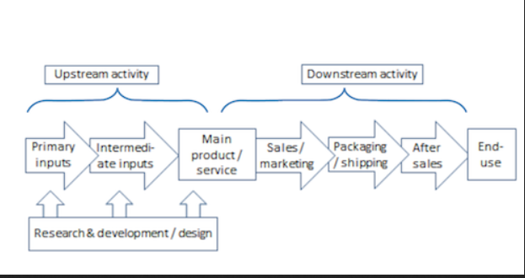
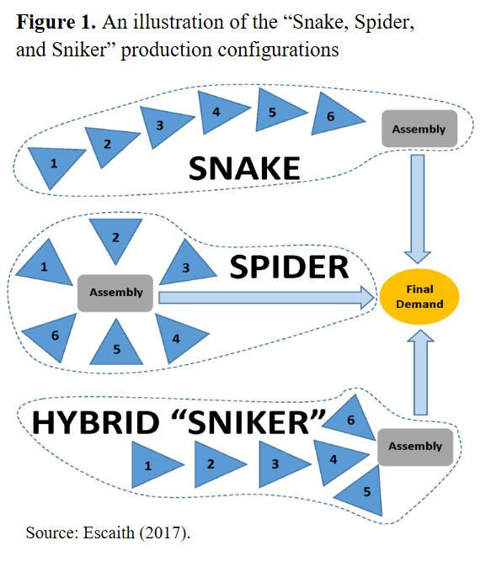
Global Value Chains

Slide 46
What is global value chains?

Slide 47
Global Value Chains and EMs
GVCs have become increasingly important in global trade and investment policies.
With production processes located across different countries, GVCs link firms, workers and consumers around the world providing an important platform for EMs to integrate into the global economy.
EMs are leading the exponential growth seen in the GVC framework, as they are starting from a low base.

Slide 48
GVCs in EMs: recent decades trends: BRIC role
In 90s, faced with slow growth at home, large “lead” firms in GVCs rushed to set up operations in BRIC countries, especially China.
China became the “factory of the world”,
India the world’s “back office”,
Brazil and Russia had a wealth of commodities/natural resources.
For goods that require shorter supply lines such as “fast fashion” apparel and automobiles, the countries of Eastern Europe joined more traditional “export processing” locations such as Mexico and North Africa.

Slide 49
EMs, manufacturing and GVCs
EMs have become important partners in GVCs especially in manufacturing.
EMs are attractive for labor-intensive manufacturing.
Problem: Jobs are transferred from developed to emerging countries in low-technology and labor-intensive manufacturing.

Slide 50
Value added manufacturing as world share, %
Country Name | 2000 | 2010 | 2016
China | 10,29 | 18,39 | 26,20
United States | 25,40 | 17,28 | 17,55
Japan | 18,14 | 11,35 | 8,46
Germany | 6,65 | 6,52 | 5,83
Korea, Rep. | 2,40 | 2,91 | 3,08
India | 1,26 | 2,57 | 2,82
France | 3,24 | 2,61 | 2,07
United Kingdom | 3,54 | 2,08 | 1,94
Indonesia | 0,62 | 1,59 | 1,55
Brazil | 1,42 | 2,69 | 1,50
Mexico | 2,21 | 1,57 | 1,47
Russian Federation | 0,86 | 1,87 | 1,25
Turkey | 0,84 | 1,11 | 1,16

Slide 51
Production activities go where the markets are
The attractiveness of Brazil, China, India, South Africa – in their large and growing consumer markets.
China and India are World`s most populated markets and have very high GDP growth ➔ growing market potential.
About 85% of middle class growth in the near future is expected to happend in growing Asia.

Slide 52
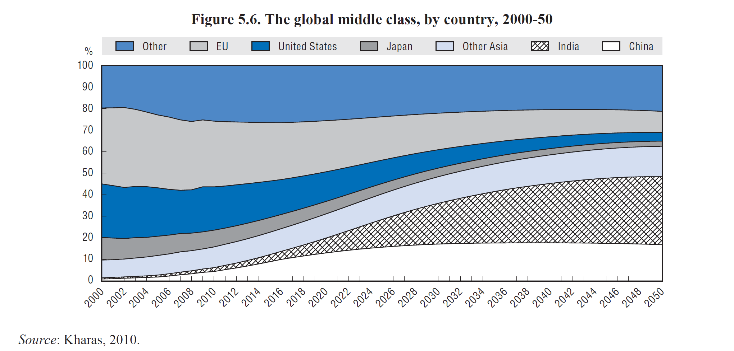

Slide 53
Indicators of GVCs participation
Backward GVC participation index captures the extent to which domestic firms use foreign intermediate value added for exporting activities in a given country.
Forward GVC participation index captures the extent to which a given country’s exports are used by firms in partner countries as inputs into their own exports.

Slide 54
Backward and forward GVCs participation indices in EMs

Slide 55
GVC participation, 2009

Slide 56
Environmental issues in emerging markets
Rapid growth in the major emerging markets has been accompanied by severe environmental degradation.
Ever-increasing environmental consequences that will eventually constrain growth!
BRICs becoming increasingly responsible for global carbon emissions.
Air and water pollution contribute to numerous ailments, particularly respiratory illnesses, cancer, and breakdowns in the immune system.
Pollution also destroys natural resources required for production, for example, degrading soil and water so that they can no longer be used in agriculture.

Slide 57
Environment related negative effects in emerging markets: China example
350,000–400,000 Chinese die each year from illnesses related to outdoor air pollution.
More than half of China’s cities are affected by acid rain.
40 percent of major rivers in China are so polluted that their water can only be used for industry or landscaping.

Slide 58
Environment related negative effects in emerging markets: Russia and India examples
Russia’s more than 90 billion tons of solid waste covers 618,000 acres of dump sites, and 90 percent of state-approved sites for waste storage do not meet safety standards.
Some 22,000–28,000 deaths in people over the age of thirty in Russia may be due to road-transport-related emissions.
The WHO estimates that outdoor air pollution in India causes 527,700 deaths a year.

Slide 59
