Slide 1
Quantum Labs, 2022 / Period I
Course overview
Lecturers: Ilkka Tittonen, Laure Mercier de Lépinay
Assistants: Aashish Sah, Timm Mörstedt, Aarne Keränen,
Lassi Hällström, Vladimir Kornienko
12.09.2021

Slide 2
General info
Period I (05.09.-23.10.2022)
4 different experiments
Groups of 4 students
3 Steps for each experiment: Labwork (all), report (choose one) and presentation (choose one)
Time slots for Labwork can be booked in MyCourses/Scheduling, 3h/experiment
A presentation session for each group with a talk from each experiment (in total four talks in each session)

Slide 3
Scheduling
The experiments can only be done during the following dates:
Experiment 1: 13.09 - 04.10.2022
Experiment 2: 14.09 - 05.10.2022
Experiment 3: 14.09 - 02.10.2022
Experiment 4: 14.09 - 05.10.2022

Slide 4
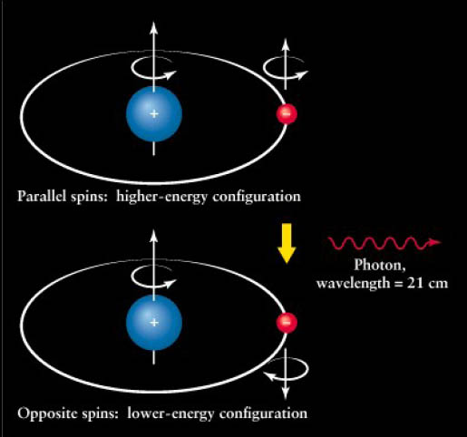
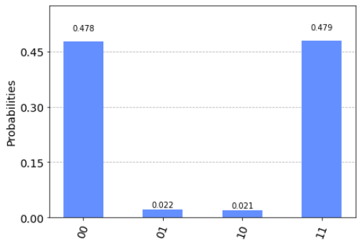
Experiment 1: Quantum Measurement with Qiskit
Responsible TA: Aashish Sah
Measuring the energy levels of the hydrogen ground state using IBM simulator and quantum computer
Key concepts
Hyperfine splitting
Single Qubit Gates
Multiple Qubits and Entangled States
Mitigating Noise on Real Quantum Computer

Slide 5
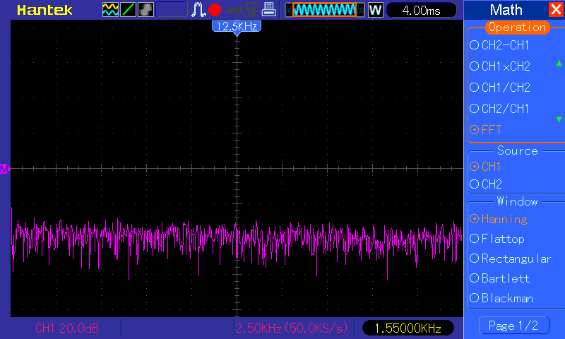
Experiment 2: Temperature-dependent noise measurement
Responsible TA: Timm Mörstedt
Measurement of noise spectra of different resistors using a spectrum analyzer
Measurements at RT and in liquid nitrogen
Key concepts
Noise spectrum
Johnson-Nyquist noise
RF analysis: averaging, RMS
Boltzmann constant

Slide 6
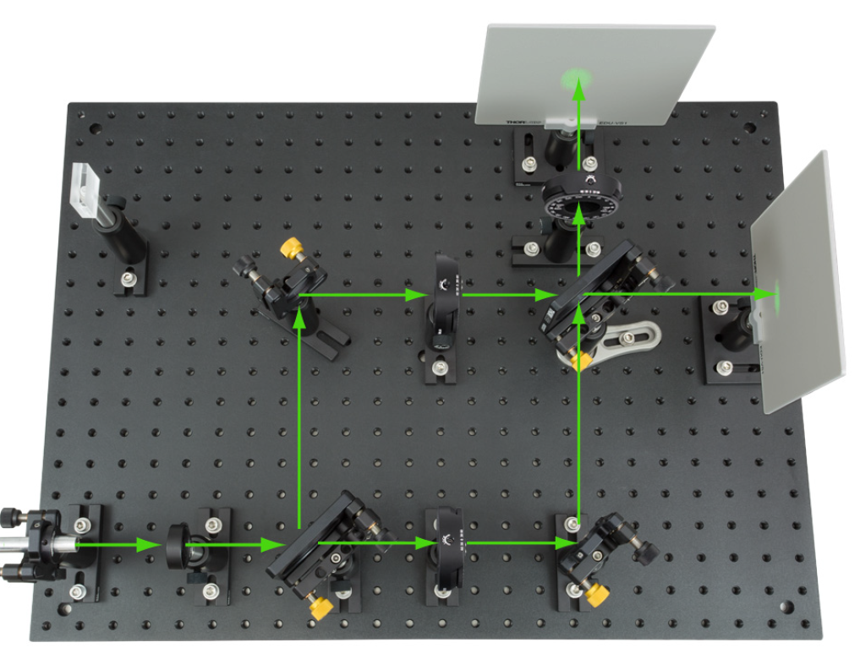
Experiment 3: Dual path interference
Responsible TAs: Lassi Hällström, Vladimir Kornienko
$$iℏ\frac{∂}{∂t}\left.\left|Ψ\right.(t)\right\rangle =\hat{H}\left.\left|Ψ\right.(t)\right\rangle$$
Key concepts
Wave-particle duality
Superposition
Interference

Slide 7
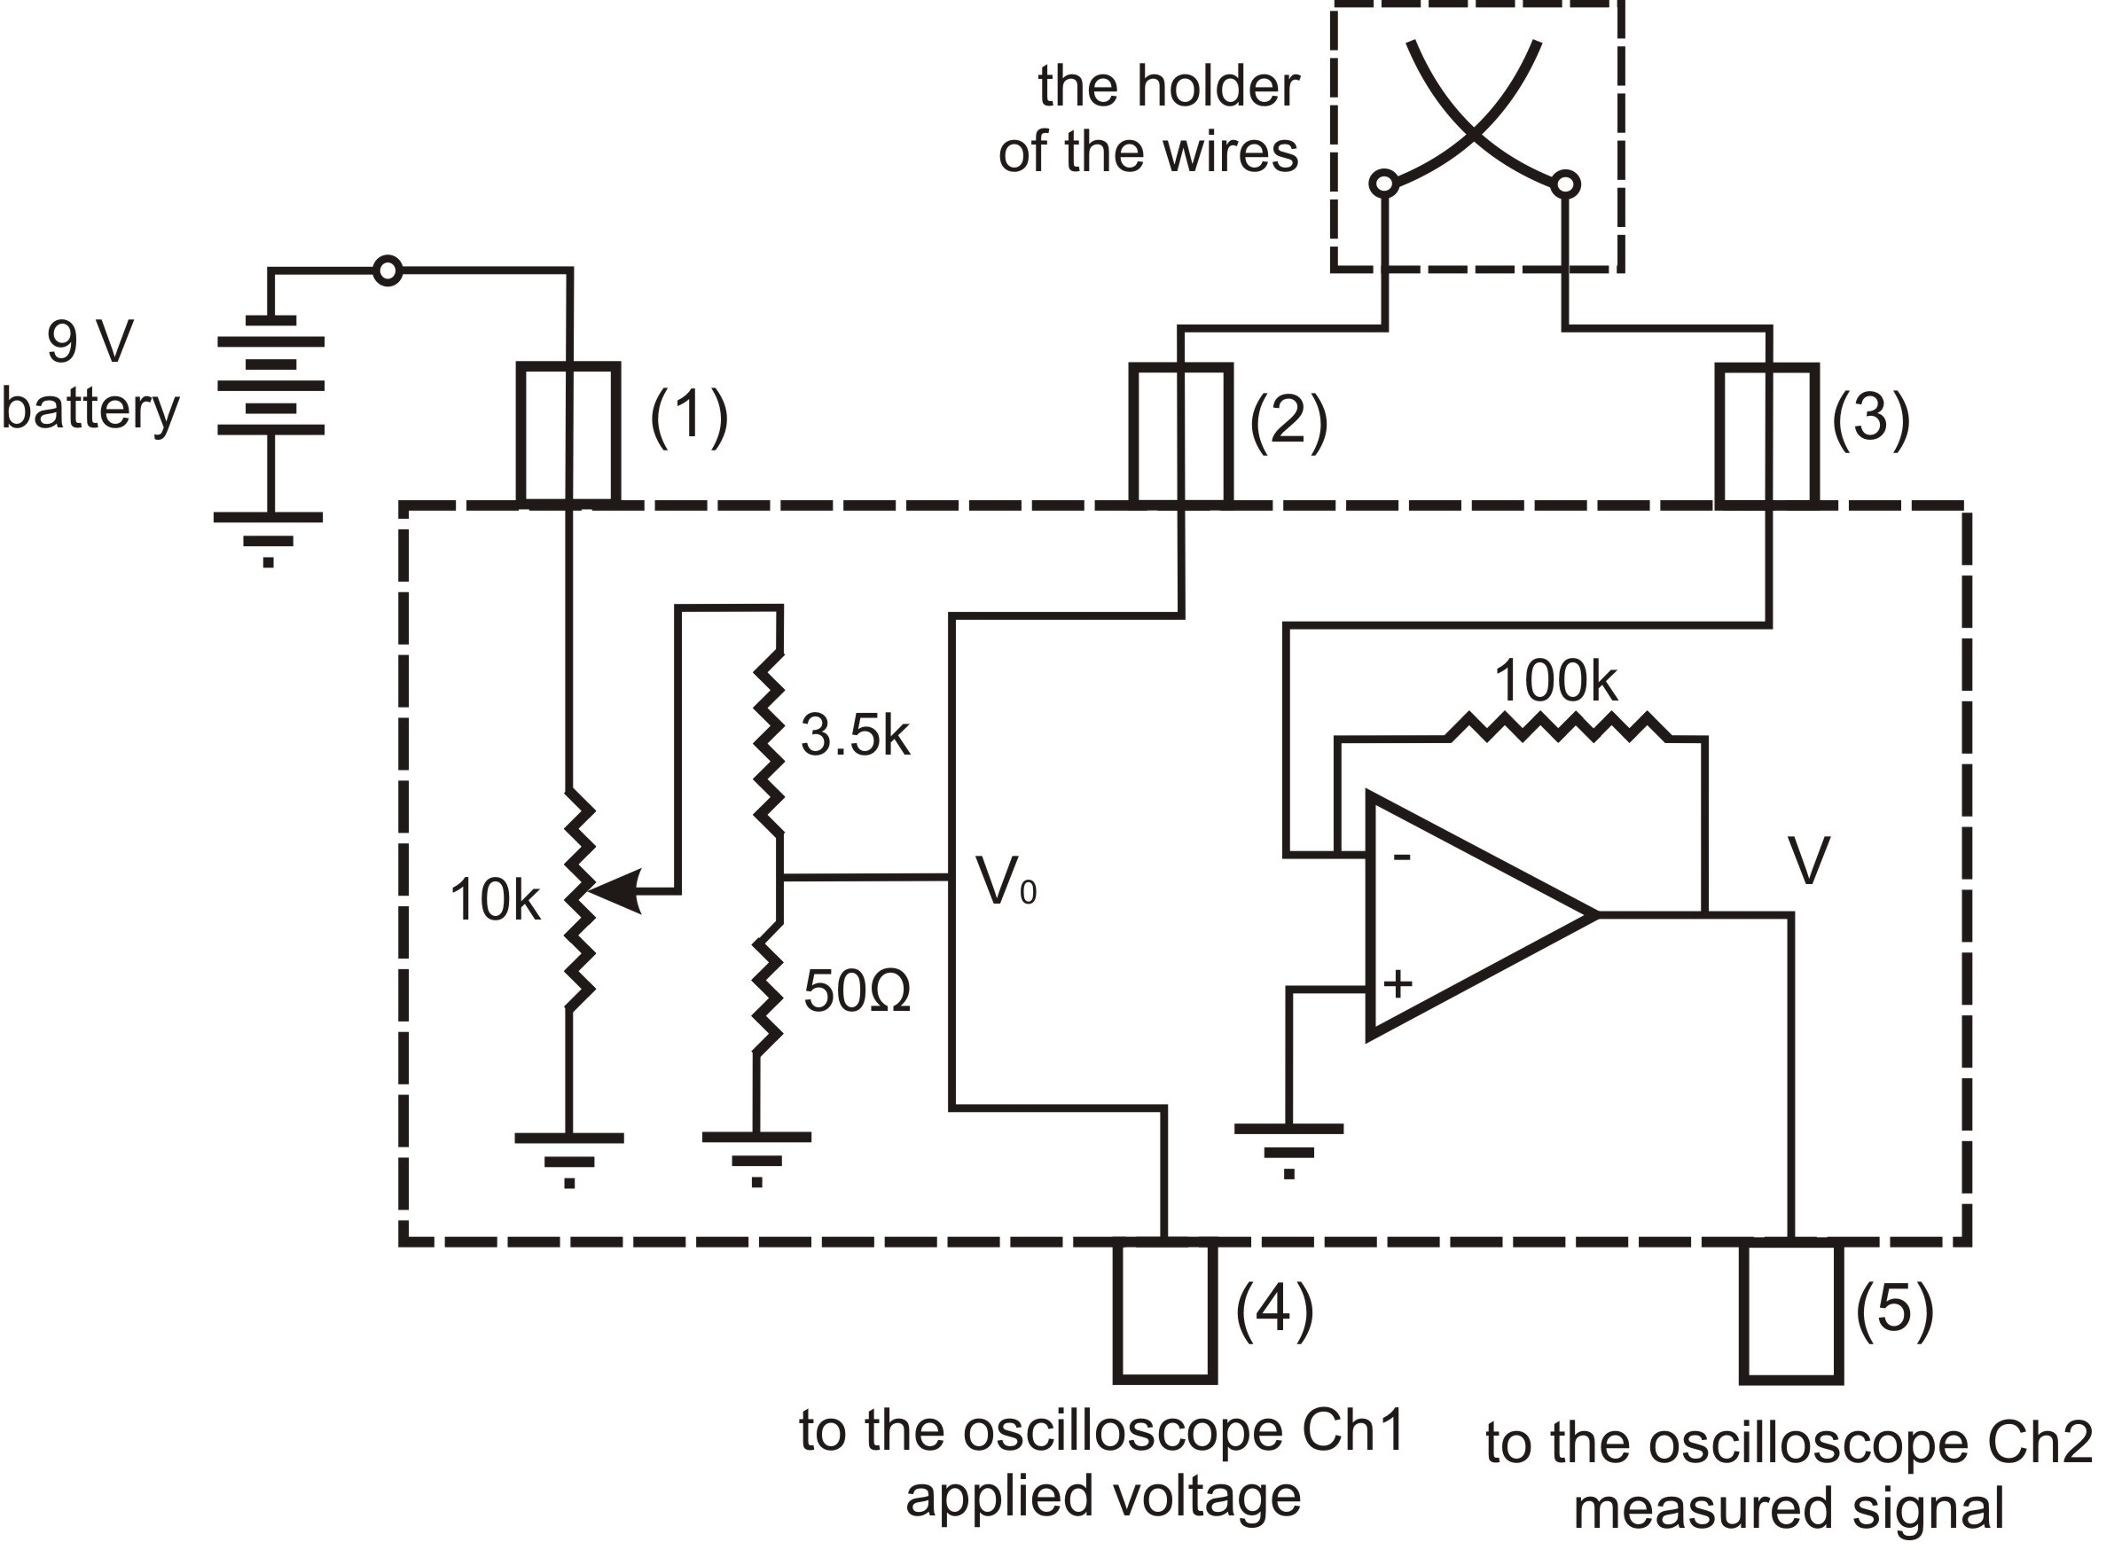
Experiment 4: Conduction quantization
Responsible TA: Aarne Keränen
Creation of gold nanowire
Observing quantisation of conductance in gold nanowire
Key concepts
Schrödinger equation
Particle in square well
Quantization of conductance

Slide 8
Report and presentation guidelines
Each group member writes a report on a single experiment (four reports in total per group covering all four experiments)
Length 4–5 pages
1 revision possible after feedback
(if not a serious attempt, will be given back as such with comment: “finish report”)
DL one week after experiment, revision DL one week after feedback
One talk per student (all four experiments covered in each group)
8 min talk + 2 min questions
Templates and instructions on MyCourses

Slide 9
Teamwork
Each group has 4 persons and does 4 experiments:
Each member of the group is the main responsible for 1 of the reports (on 1 of the 4 experiments)
but ALL group members should be involved in each experiment
1 person's job ≠ 1 experiment
1 person's job = 4 experiments + writing (most of) one report + checking/giving feedback on all reports of the group
Do not assign roles in advance in case one person is sick one day
Communicate between yourselves
For experiments in Micronova: don't be late

Slide 10
Report content
Focus the report on your work, rather than on theory
No need to reexplain everything (for this course at least)
Present briefly what you did/the way you did it
Present results with care (see next slides)
Discuss results
can you draw some conclusion from the result?
Is the result lower, higher, different than expected, why (do you think)?
Is the uncertainty particularly low or high, why?
Is there a systematic error, what is it, what could you do to cancel it?
What can be done better and how would it improve the experiment?
What other related experiment could you do?...
Do not copy-paste anything from any source (even Wikipedia).
Try to rephrase (sometimes difficult). At least do not ever write something you do not understand.

Slide 11
Uncertainty and error
Uncertainty characterizes the estimated possible deviation between the measured and actual values. Two different types of uncertainty:
Type A (or statistical uncertainty): Uncertainty in this category is evaluated using statistical tools such as mean and standard deviation. Experiments are repeated several times under similar conditions and the outcomes are recorded.
Statistical analysis is performed on the recorded data to quantify the Type A uncertainty in the measurement.
Type B: Uncertainty of this category is based on previous measurement data, manufacturer's specification, instrument calibration, etc.

Slide 12
Uncertainty estimation
When measuring a variable, always consider measurement uncertainty
Gauss distribution
Standard deviation $σ$, 68% confidence interval
Repeated measurement (N times)
Standard Error $SE=\frac{σ}{\sqrt{N}}$
$$G\left(x\right)=\frac{1}{σ\sqrt{2π}}e^{−(x−μ)/(2σ^{2})}$$
Error propagation
$$X=a+b →σ_{X}=\sqrt{{σ_{a}}^{2}+{σ_{b}}^{2}}$$
$$X=ab →\frac{σ_{X}}{\left|X\right|}=\sqrt{{\left(\frac{σ_{a}}{a}\right)}^{2}+{\left(\frac{σ_{b}}{b}\right)}^{2}}$$
$X=a^{b} →\frac{σ_{X}}{\left|X\right|}=\left|b\right|$ $\frac{σ_{a}}{\left|a\right|}$

Slide 13
Presenting measurement results
A measurement result should have a unit (in most cases)
Use consistent units throughout the report (avoid conversions back and forth between radians and degrees)
Use "reasonable" units:
SI if possible (m, s, A, kg, K, … Newton, Joule, etc).
Numbers should be readable by humans (1300000 Hz -> 1.3 MHz)
Alternatively: 1.3 x 10⁶ Hz
Present the uncertainty at least on important results: 10.4 ± 0.2 V
Round numbers as necessary:
134.567354 ± 1.2 V
134.6 ± 1.2 V

Slide 14
Presenting graphs
label both axes in a clear way:
"Voltage" might be confusing if there are 2 relevant voltages in your experiment that this graph could represent. Use:
"Excitation voltage (V)" OR
"V_{a} (V)" if you have defined V_{a} elsewhere
Do not count on the text to replace the labels on the axes:
"The graph above represents the current as a function of the voltage"
"As can be seen on the graph above, the voltage is a linear function of the magnetic field"
You can write such sentences if you like but the axes of the graph still need to be labeled.
Include the units in the axis label whenever relevant, e.g.:
"Excitation voltage (V)" or "V_{a} (V)" if you have defined V_{a} elsewhere
"Number of occurrences" (no need for a unit, unit is "1")

Slide 15
Feedback

