Slide 1
Add image(s) about your week here
Synthesis for WAT-E1100 course week X
Your names (indicate clearly if someone missing)

Slide 2
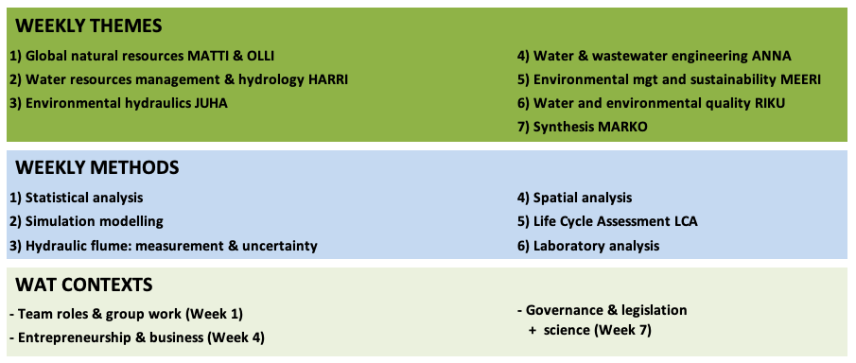
ALL WEEKLY THEMES + METHODS

Slide 3
Weekly theme: XXX
Synthesise your weekly theme here:
you can use as many slides as you need but keep it clear and concise
Use synthesising text, but also figures and other visualisations, so that your presentation is easy to follow

Slide 4
Weekly method: XXX
Synthesise your weekly method here: you can use as many slides as you need but keep it clear and concise
Use synthesising text, but also figures and other visualisations, so that your presentation is easy to follow

Slide 5
Weekly context: XXX
If your week had a context, synthesise it here: you can use as many slides as you need but keep it clear and concise
Use synthesising text, but also figures and other visualisations, so that your presentation is easy to follow

Slide 6
General notes on the week
Write here general notes about the week
What worked and what not?
What was special about this week?
Other points you want to raise?

Slide 7
Link to WAT
Write here a short view on how this week and its theme and method (+ possible context) links to the field of water and environmental engineering, and to the three study themes of our WAT Master’s Programme
Which study theme the week mainly links to?
Is the weekly theme general or more specific?
How is the weekly method relevant in our field?

