Slide 1
Macroeconomic Development in Emerging Markets
Svetlana Ledyaeva,
Aalto University School of Business
January 2019

Slide 2
Lecture plan
Economic growth in emerging markets
Business cycles in emerging markets
Income distribution in emerging markets

Slide 3
Does economic growth attract FDI?
Meta-regression analysis - Iamsiraroj and Doucouliagos (2015).
946 estimates from 140 empirical studies:
47 percent of the estimates are positive and statistically significant,
27 percent of the estimates are positive and statistically insignificant,
7 percent of the estimates are negative and statistically significant,
19 percent of the estimates are negative and statistically insignificant.
The authors show that there is a robust positive correlation between growth and FDI.

Slide 4
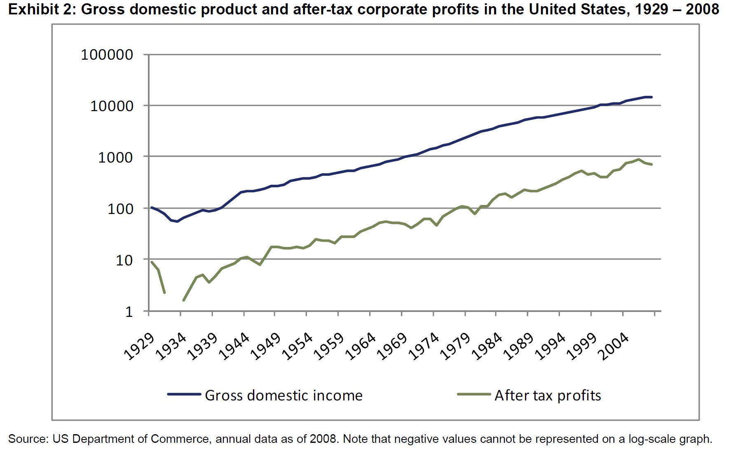
Is There a Link Between GDP Growth and Equity Returns? MSCI Barra Research
Supply-side theoretical models Step 1: Over the long run, aggregate corporate earnings tend to grow at the same pace as GDP.

Slide 5
Step 2: Aggregate corporate earnings growth translates into earnings per share (EPS) growth. MSCI Barra Research
This assumption may be somewhat hasty/preliminary/rash (Bernstein and Arnott [2003]).
There is indeed a distinction between growth in aggregate earnings of an economy and the growth in earnings per share to which current investors have a claim.
These two growth rates do not necessarily match, since there are factors that can dilute/weaken aggregate earnings. A portion of GDP growth comes from capital increases, such as new share issuances, rights issues, or IPOs (initial public offering), which increase aggregate earnings but are not accessible to current investors.
This dilution causes the growth in EPS available to current investors to be lower than growth in aggregate earnings.

Slide 6
Step 3: EPS growth translates into stock price increases MSCI Barra Research
This is only true however, if there are no changes in valuations (the price to earnings ratio) as illustrated by the equation below:
Some research claims that there are no reasons for valuations to change over the long term, which supports the supply-side models.
However, empirical tests show that valuations have generally expanded over the last 40 years (see ‘What Drives Long Term Equity Returns?’ MSCI Barra [2010]).
due to different regimes (declining inflation),
better market and information efficiency,
improved corporate governance.

Slide 7
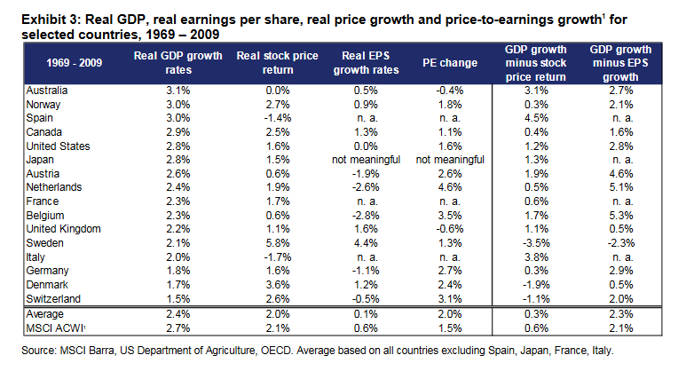

Slide 8
Conclusions of analysis MSCI Barra Research
We may intuitively think of stock returns as a result of the underlying real economy growth.
However, long term real earnings growth fell behind long term GDP growth in many countries.
Several factors may explain this discrepancy:
in today’s integrated world we need to look at global rather than local markets.
a significant part of economic growth comes from new enterprises and not the high growth of existing ones; this leads to a dilution of GDP growth before it reaches shareholders.
expected economic growth may be built into the prices and thus reduce future realized returns.

Slide 9
GDP growth and investment decisions http://investing.covestor.com/2012/04/the-importance-of-gdp-to-an-investor
It can help you think about asset allocations when you compare GDP growth rates in one country relative to those in other countries.
The long-term trend of GDP is worth watching, especially when the trend becomes bad enough to raise speculation about quantitative easing (monetary stimulation), which has shown to have a strong effect on risk assets including stocks, gold and oil.
QE leads to low interest rates. Low interest rates encouraged investors to buy stocks as opposed to traditional investments like savings accounts, certificates of deposits (CDs) and money market accounts since their rate of return are low due to low Federal/government/state rates.
There are a lot of nitty-gritty details by sector. And those can help you figure out what’s going on in the broader business cycle, as well as with sector-specific investments.

Slide 10
Real GDP growth, IMF data

Slide 11
GDP growth in advanced emerging markets

Slide 12
GDP growth in secondary emerging markets

Slide 13
GDP growth in frontier markets

Slide 14
GDP growth in advanced countries

Slide 15
Recent growth slowdown in emerging markets (Kose, Ohnsorge, Ye VoxEU 2016)

Slide 16
What are the main characteristics of the slowdown? (Kose, Ohnsorge, Ye 2016)
The slowdown has been unusually synchronous and protracted/longlasting.
It has affected a sizeable number of emerging markets, especially large ones.
By 2014, the number of emerging markets slowing for three consecutive years reached the levels seen during the Global Crisis of 2008-09.
Growth rates of investment and exports suffered especially sharp cutbacks, falling to less than half of their 2003-08 average levels.

Slide 17
What are the key drivers of the slowdown? (Kose, Ohnsorge, Ye 2016)
The emerging market growth slowdown was initially driven by external factors but domestic factors have increasingly weighed on growth since 2014.
External factors: weak world trade, low commodity prices, and tightening financial conditions.
Domestic factors: a steady slowdown in productivity growth, bouts of policy uncertainty, and an erosion of policy buffers that has made it difficult to support activity with fiscal and monetary stimulus.

Slide 18
Recent growth slowdown in emerging markets: Conclusion (Kose, Ohnsorge, Ye 2016)
Emerging markets have come a long way over the past two decades – they have been able to improve their macroeconomic policy frameworks, reduce debt and inflation levels, diversify their production and exports, and establish stronger global trade and financial linkages.
While the growth slowdown since 2010 could simply be a rough patch/bad luck, it could also signal the start of an era of slow growth given the persistent nature of the factors that have driven the slowdown so far.
In light of the significant global risks going forward, emerging markets urgently need to put in place an appropriate set of policies to address their cyclical and structural challenges and promote growth.

Slide 19
Source: IHS Economics

Slide 20
According to the World Bank, by 2050 both China and India will have GDPs exceeding that of the United States.

Slide 21
Top 10 Country GDP Ranking History (1960-2017)

Slide 22
Share in World GDP, 2017
Country | GDP in billion U.S. dollars | %
United States | 19 362,13 | 24,24
China | 11 937,56 | 14,95
Japan | 4 884,49 | 6,12
Germany | 3 651,87 | 4,57
France | 2 574,81 | 3,22
United Kingdom | 2 565,05 | 3,21
India | 2 439,01 | 3,05
Brazil | 2 080,92 | 2,61
Italy | 1 921,14 | 2,41
Canada | 1 640,39 | 2,05
Korea | 1 529,74 | 1,92
Russia | 1 469,34 | 1,84

Slide 23
Professor opinion: Anil Gupta, University of Maryland
Long-term growth in EMs: base 10% growth has gone. Approx. 6% can be. Still 3 times higher than in developed countries.
Fastest growth rates: India, Indonesia, Nigeria. Slowest growth rates: Russia, Brazil.
China is becoming more developed and, hence, growth slows down.
India and Indonesia – per capita income is lower than e.g. in China and Russia ➔ they (India and Indonesia) will grow upside.
High growing sectors in EMs: Commodities ➔ because of high demand for commodities in China.
Manufacturing driven by domestic consumption demand not by export.

Slide 24
Expert opinion: David Riedel, founder of Riedel research company
In Emerging markets – should find something with hypergrowth, not moderate growth because risks are very high.

Slide 25
Where will be the highest growth of GDP next? Video of March 2018

Slide 26
If not GDP growth?
The trendline of GDP growth is not going to tell you for sure where the markets may be headed.
Other economic indicators that have a strong tie to market direction, including initial jobless claims, inflation, government policies, Central Bank policies.
Broader issues including natural disasters, wars, broad changes in the government policies, other events that cannot be planned or avoided.

Slide 27
Business cycles and investment decisions
The business cycle is a long-term pattern of changes in Gross Domestic Product (GDP) that follows four stages: expansion, prosperity, contraction, and recession.
The phases of the business cycle are characterized by changing employment, industrial productivity, and interest rates.
As a result the economic cycle provides the strategic framework for economic activity and investing. The business cycle affects employees, employers and investors.

Slide 29
Business cycles and investors
The business cycle has implications for markets and investors.
Recession ➔ weak stock prices (stock prices fall), or a bear market.
Expanding economy that keeps inflation from rising too quickly ➔ a bull market (stock prices rise or are expected to rise), or period of sustained market growth.
Investors anticipate losses in a bear market and selling continues
A bull market is a financial market of a group of securities in which prices are rising or are expected to rise.

Slide 30
Some economists believe that stock price trends precede business cycle stages

Slide 31
Business cycles and investment strategies: Sectoral approach
There are investment strategies for all parts of the cycle.
Companies that do well when the economy is experiencing good times are called cyclical stocks:
Travel and leisure companies, airlines, consumer electronics firms and jewelry
makers.
Companies that make goods that are necessities, such as food and health care are called non-cyclical stocks. These stocks tend to provide more stability during an economic downturn.
During an economic expansion one should invest in cyclical stocks.
During an economic contraction one should consider investing in non-cyclical stocks.

Slide 32
Business cycles in emerging markets
García-Cicco et al., American Economic Review 2010:
The volatility of business cycles in industrialized countries fell significantly in the second half of the twentieth century.
In sharp contrast, in EMs business cycles do not appear to moderate after the Second World War.
Aguiar and Gopinath, Journal of Political Economy 2007:
EMs on average have a business cycle twice as volatile as that of their developed counterparts.
A striking feature that distinguishes the business cycles in the two is the strongly countercyclical nature of the trade balance for EMs as compared to developed markets.
A second regularity is that consumption is 40 percent more volatile than income at business cycle frequencies for EMs, as compared to a ratio of little less than one for developed markets.
In addition, income growth and net exports are twice as volatile in EMs.

Slide 33
Shocks to trend in emerging markets (Aguiar and Gopinath, JPE 2007)
EMs, unlike developed markets, are characterized by frequent regime switches, a premise/condition motivated by the dramatic reversals in fiscal, monetary, and trade policies observed in these economies.
Consequently, shocks to trend growth are the primary source of fluctuations in these markets as opposed to transitory fluctuations around the trend in developed countries.
Developed markets are characterized by a relatively stable trend.

Slide 34
Characterizing the business cycles of emerging economies (Calderon and Fuentes, World Bank Policy reserach working paper, 2010)
Greater volatility in EMs’ business cycles:
the excessive dependence on a few (and volatile) sectors, a narrow tax base, weak
institutions and poor economic policies.
More recently, the focus has been gradually shifted towards the external (exogenous) environment faced by EMs —say, real shocks (e.g. shocks to commodity prices and to the country’s external demand), financial shocks (sudden stops of capital inflow due to changes in global liquidity conditions) and natural disasters (Calderon and Levy‐Yeyati, 2009).
A quarterly database for 23 EMs and 12 developed countries over the period 1980.Q1–2006.Q2:
They find that recessions are deeper and more frequent among EMs (especially, among LAC countries) and that expansions are more sizable and longer (especially, among East Asian countries).

Slide 35
Business Cycles In Emerging Economies General conclusions (Neumeyer and Fabrizio, Journal of Monetary Economics 2005)
EMs display high, relative to developed economies, output volatility, and the volatility of consumption relative to income is on average greater than one and higher than in the developed economies.
Finally, net exports appear much more strongly countercyclical in emerging economies than in developed economies.
i.e. net export tends to rise during recessions and offset some of the falls in the output.

Slide 36
Business cycles in emerging markets: Some examples

Slide 39
Business cycles in developed countries for comparison

Slide 40
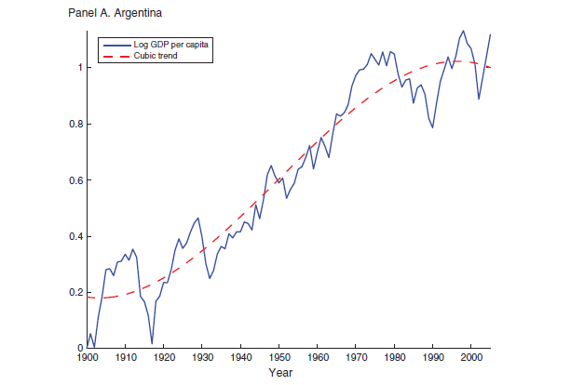
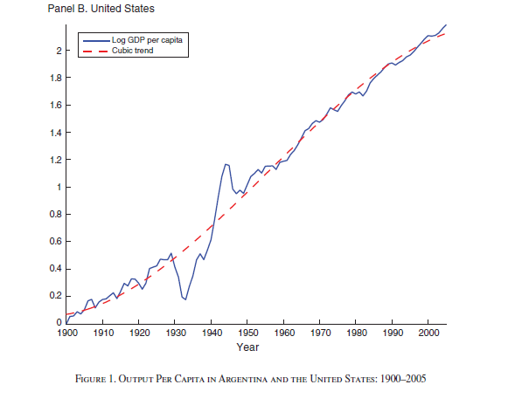
Business cycles in emerging economies: Illustration
García-Cicco et al. AER, 2010.

Slide 41
More data… Log GDP per capita, deflated by US GDP deflator, USD

Slide 42
More data… Log GDP per capita, deflated by US GDP deflator, USD

Slide 43
More data… Log GDP per capita, deflated by US GDP deflator, USD

Slide 44
More data… Log GDP per capita, deflated by US GDP deflator, USD

Slide 45
More data… Log GDP per capita, deflated by US GDP deflator, USD

Slide 46
Professor opinion: Paul Marsh, London Business School
EMs are only marginally more volatile than developed ones and are becoming increasingly less volatile
Typical EM is probably 10-15% more volatile than average developed market. EMs have developed and risk has reduced.

Slide 47
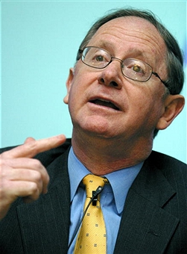
Expert opinion: John Greenwood, chief economist at Invesco
Developed market – a long extended slow recovery from recession.
Emerging market – can have much shorter and sharper cycles within a single cycle of the developed countries.

Slide 48
Professor opinion: Eswar Prasad, Professor at Cornell University
Recessions in EMs generally deeper & more protracted/longstanding than those in advanced countries.
Co-movements between emerging and advanced economies in business cycles went up in 1985-2008 versus 1960-1984.
Financial markets do Tango together. Stronger linkages & spillovers among global financial markets, especially equity.

Slide 49
Professor opinion: Eswar Prasad, Professor at Cornell University
What changed for EMs business cycles?
-Stronger global trade&financial linkages
-More diversified economic structure: Production, trade.
-Stronger linkages among EMs.
-Better policies.
EMs are more exposed to global cycles than before.

Slide 50
Income distribution among emerging markets
Why should we care about cross-country income differences?
High income levels reflect high standards of living.
Income per capita differences are strongly associated with differences in consumption and in health.
Thus the richest countries are not only producing more than 30 times as much as the poorest countries, but are also consuming 30 times as much.
Similarly, cross-country differences in health are quite remarkable; while life expectancy at birth is as high as 80 in the richest countries, it is only between 40 and 50 in many Sub-Saharan African nations. These gaps represent huge welfare differences.

Slide 51
Purchasing Power Parity (PPP) exchange rates – important in comparison of living standards
Monthly income of 150 USD is USA – you will live in the closet.
Monthly income of 150 USD in China - pretty good live.
Comparison of PPP GDP/Income per capita is more justified.
PPP dollar takes into account the fact that it is cheaper to live in some countries than others. The idea is that we don't care how many actual dollars somebody is paid in, say, China, but we care about what sort of stuff those dollars can buy.

Slide 52
PPP dolar
ILO economist Patrick Belser explains:
"If someone in China takes their salary of 1,500 yuan per month and they go to the bank, they will actually get $200,"
"But this is not what we use to compute this global average, because what is important here is what people are able to buy with these 1,500 yuan, and this is where we compare to the purchasing power of the US dollars and find that it is actually equivalent to around $400."

Slide 53
PPP adjusted GDP per capita, 1990 and 2015, distribution histogram, The World, USD

Slide 54
Discussion
There is great inequality in income per capita across countries as shown by the highly dispersed distributions.
Most countries have their per capita incomes in the lowest part of income per capita distribution.
Smaller concentration of countries in the ”poor” tail in 2015.
More equal GDP per capita distribution in 2015.
Note: in 1990 we include 166 countreis and in 2015 – 182.

Slide 55
What factors are responsible for current GDP per capita differences between the countries?
Initial gap
Growth rates
Conditional convergecne

Slide 56
The lower GDP per capita…
➔The higher the potential growth rate.
“If all economies were intrinsically the same, except for their starting capital intensities (which is determined by GDP per capita), then convergence would apply in an absolute sense; that is, poor places would tend to grow faster per capita than rich ones.”
“However, if economies differ in various respects —including propensities to save and have children, willingness to work, access to technology, and government policies— then the convergence force applies only in a conditional sense.”
“The growth rate tends to be high if the starting per capita GDP is low in relation to its long–run or steady state position; that is, if an economy begins far below its own target position.”
(Barro, NBER WP, 1996)

Slide 57
Initial gap between countries (Acemoglu 2007)
“Western Offshoots” consist of the United States, Canada, Australia and New Zealand.

Slide 58
Initial gap between countries (Zhang and Gao 2015 IMF Working Paper)

Slide 59
PPP adjusted GDP per capita, current international dollars, advanced emerging countries

Slide 60
PPP adjusted GDP per capita, current international dollars, secondary emerging countries 1

Slide 61
PPP adjusted GDP per capita, current international dollars, secondary emerging countries 2

Slide 62
PPP adjusted GDP per capita, current international dollars, developed countries

