Slide 1
Rhino 7 - Essentials
1. Rhino interface basics
2. Navigating viewports
3. Curve basics
4. Surfaces
5. 2d and 3d primitives

Slide 2
2d primitives

Slide 3
3d surfaces

Slide 4
3d primitives

Slide 5
Rhinoceroes
Rhino can create, edit, analyze, document, render, animate, and translate NURBS.
NURBS, Non-Uniform Rational B-Splines, are mathematical representations of 3‑D geometry that can accurately describe any shape from a simple 2‑D line, circle, arc, or curve to the most complex 3‑D organic free-form surface or solid.

Slide 6
NURBS = Non-Uniform Rational Basis Splines
Before computers, designs were drawn by hand on paper with various drafting tools.
Rulers were used for straight lines, compasses for circles, and protractors for angles.
But many shapes, such as the freeform curve of a ship's bow, could not be drawn with these tools.
https://www.rhino3d.com/nurbs

Slide 7
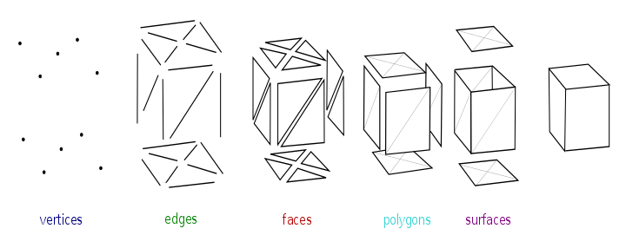
Mesh – polygon mesh
A polygon mesh is a collection of vertices, edges and faces that defines the shape of a object in 3D computer graphics and solid modeling.

Slide 8
Polygons
Polygon is a plane bounded by straight line segments. Line segments are called edges.
Edges must form a closed loop.
Polygons plane is called face.
Points where edges meet are the polygon's vertices.
Edge
Vertex, vertices
Face

Slide 9
Mesh smoothing or reducing

Slide 10
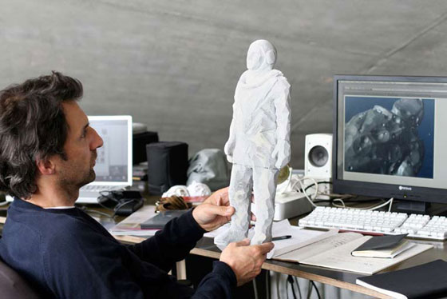
Xavier Veilhan ( 1963- )
Paris-based sculptor Xavier Veilhan creates steel and aluminum sculptures that evocatively mimic the look of digitally-rendered images in three-dimensional space.
Veilhan’s geometrically abstracted renderings of people and animals refer to the ways that digital technologies have rewired the way we see the world.
http://www.veilhan.com

Slide 11
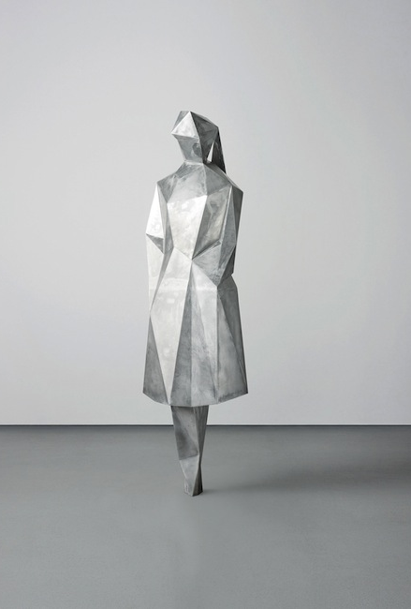
Low polygon sculptures
Sophie Number 1, 2007
Materials; Aluminium and steel
Size: 197 x 51 x 42,5 cm

Slide 12
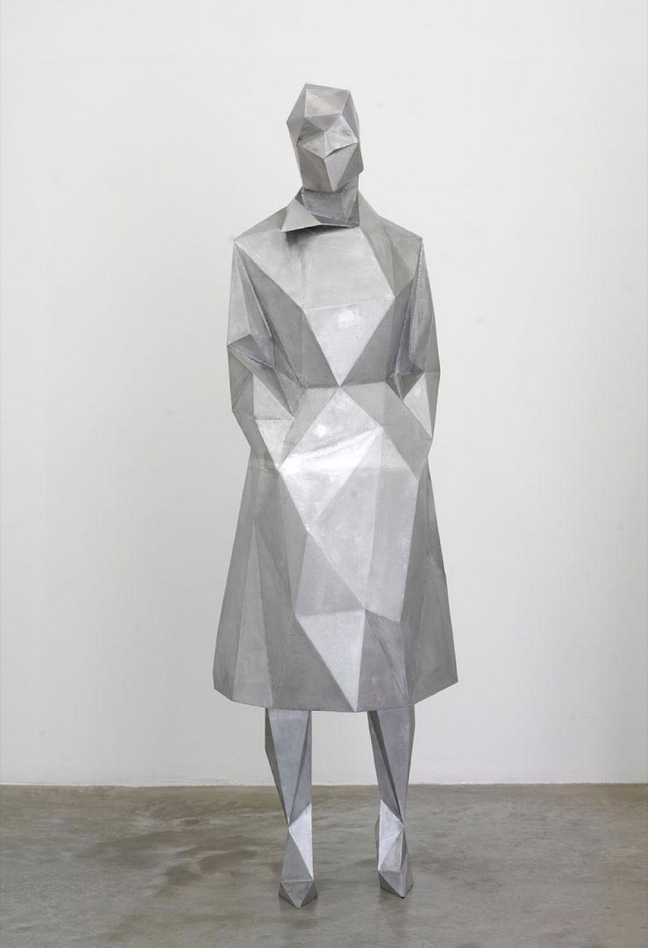
Sophie Number 2, 2007

Slide 13
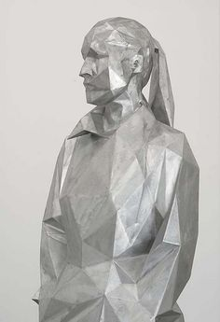
Sophie number ?, 2007

Slide 14
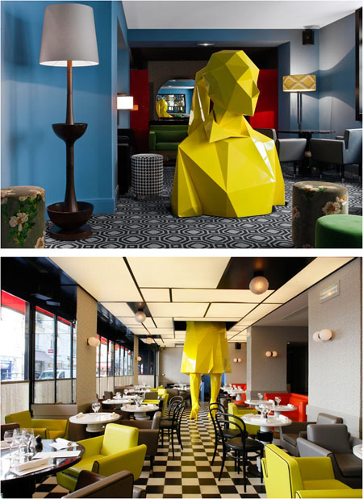
Sophie sculpture in Le Germain restaurant 2009
The sculpture penetrates the ceiling of the restaurant and reappears in the upstairs lounge.

Slide 15
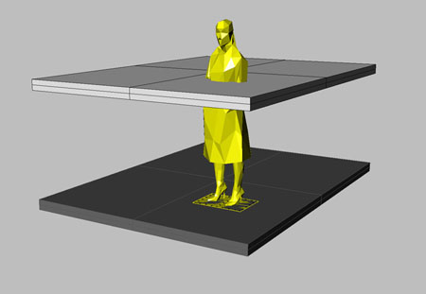
Sophie sculpture in 3d modelling view:

