Slide 1
WW I to 1950s
Period costume & style
17.3.2022

Slide 2
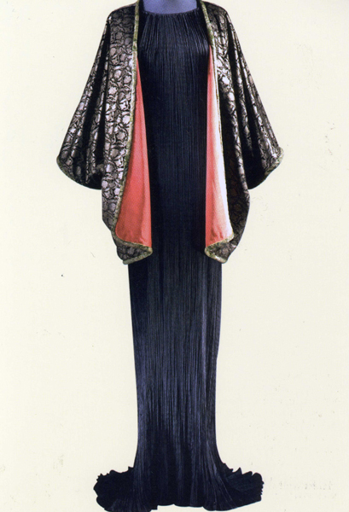
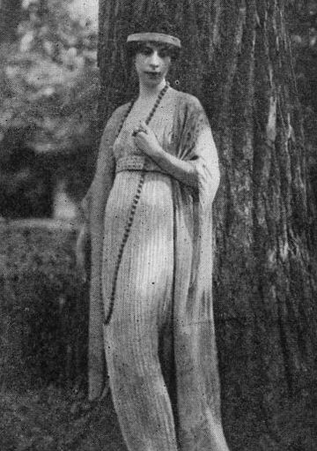
1909 Fortuny unveils the Delphos Gown
Gown from 1920
Retains its influence until 1949

Slide 3
The patent which Fortuny sent out in 1909 for his Delphos gown

Slide 4
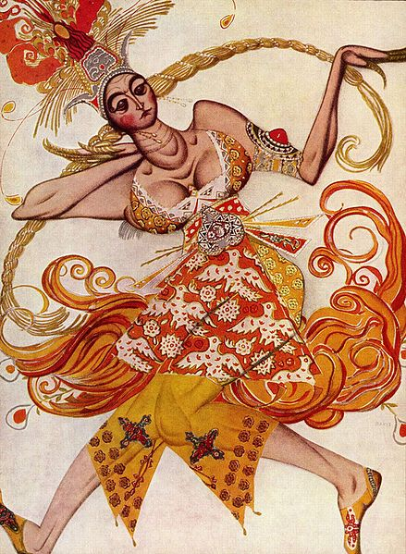
The Ballets Russes is a sensation in Paris
Sergei Diaghelev producer
Russian Dancers from Saint Petersburg
Many Russians go to Paris prior the Russian Revolution in 1917
Designers Alexandre Benois (scenery) & Leon Bakst influence fashion in color and form
Michel Fokine was the first star choreographer
Sketch by Bakst for the principle female
dancer in Firebird, Paris in 1910.
Notes:
France & Russia are allies against Germany.
Upper class Russians still speak French.

Slide 5
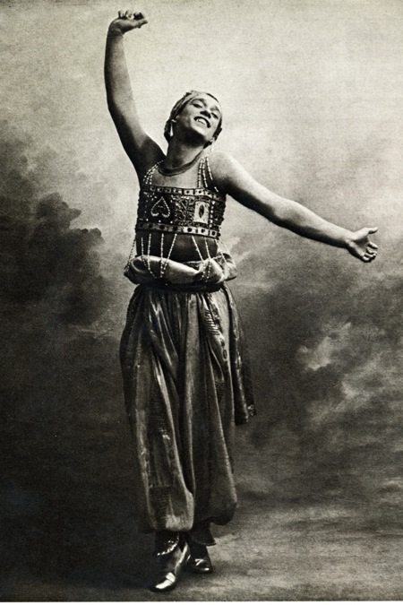
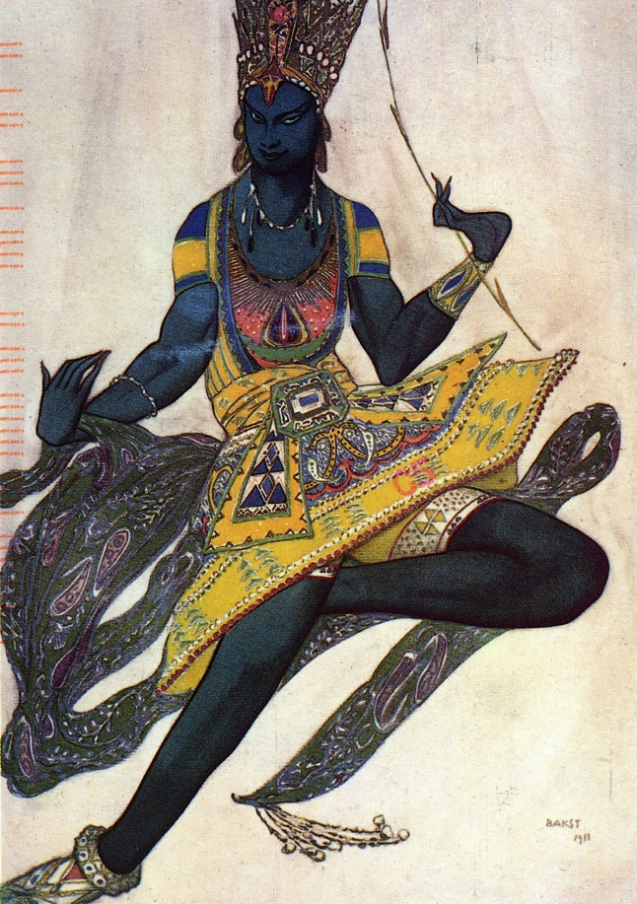
Leon Bakst Costume Design for the Ballet Russes
Notes:
Image of
Nijinsky 1910
and a sketch
for
La Bayadere
from 1911.
A new free and emotional form of expression.

Slide 6
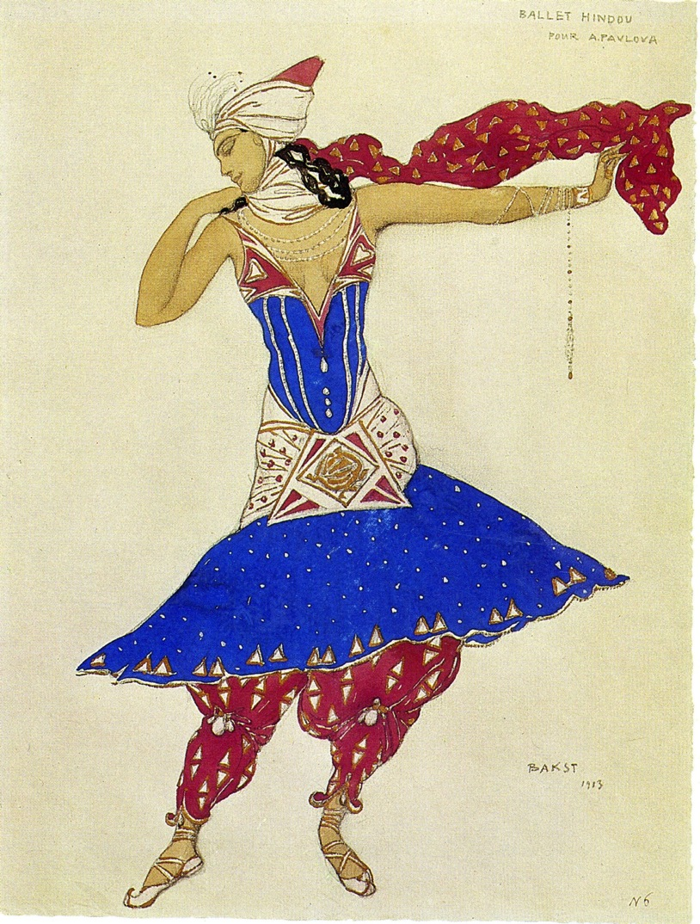
1913 Leon Bakst and the Ballets Russes
Design by Bakst for Anna Pavlova that inspired the Fashion world with color and new shapes. The harem pants were particularly sensational.

Slide 7
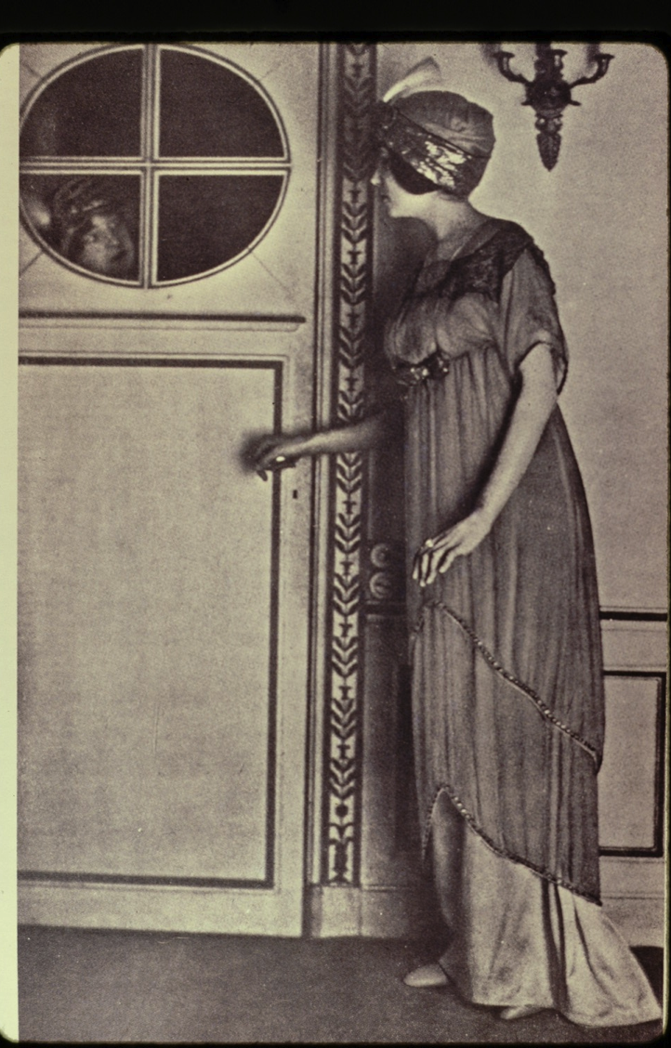
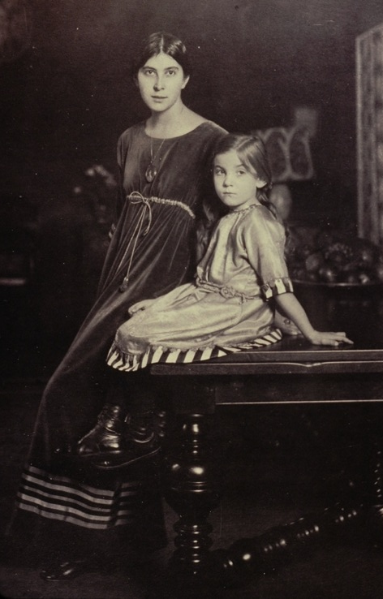
1912 Paul Poiret Fashion modeled by his wife. She was his favorite mannequin and was very petit.

Slide 8
1913 Illustration by Georges LePape showing a version of Poiret’s Lampshade dress called “Le Sorbet.”
Illustration from The Gazette du Bon Ton

Slide 9
Poiret’s new slim line, no corseted and high-waisted look takes off
The skirt is off the ground, no train
Women take to the streets in slim lines and large hats
Shopping becomes popular

Slide 10
1913, Sleek Silhouette
White satin embroidered blouse with the new sleeve cut with a softer armhole and a longer graceful length meant to be worn outside of the skirt.
Draped skirt
New delicate pumps come into fashion as ankles are exposed.
Fashion plate from Les Costumes Parisiennes.

Slide 11
Some of the day dresses are growing bulkier with kimono inspired sleeves, the evening dresses stay slim.
This illustration by Georges Barbier in 1914 shows an evening gown with roses.

Slide 12
Suit, 1914
Walking suit, short cropped jacket.
Skirt is bone straight with slit front for walking ease.
Spats are worn with boots
Gentleman has similar silhouette with high waist, above knee coat and spats showing beneath shorter trousers.
Georges Barbier Illustration done for Costumes Parisiennes

Slide 13
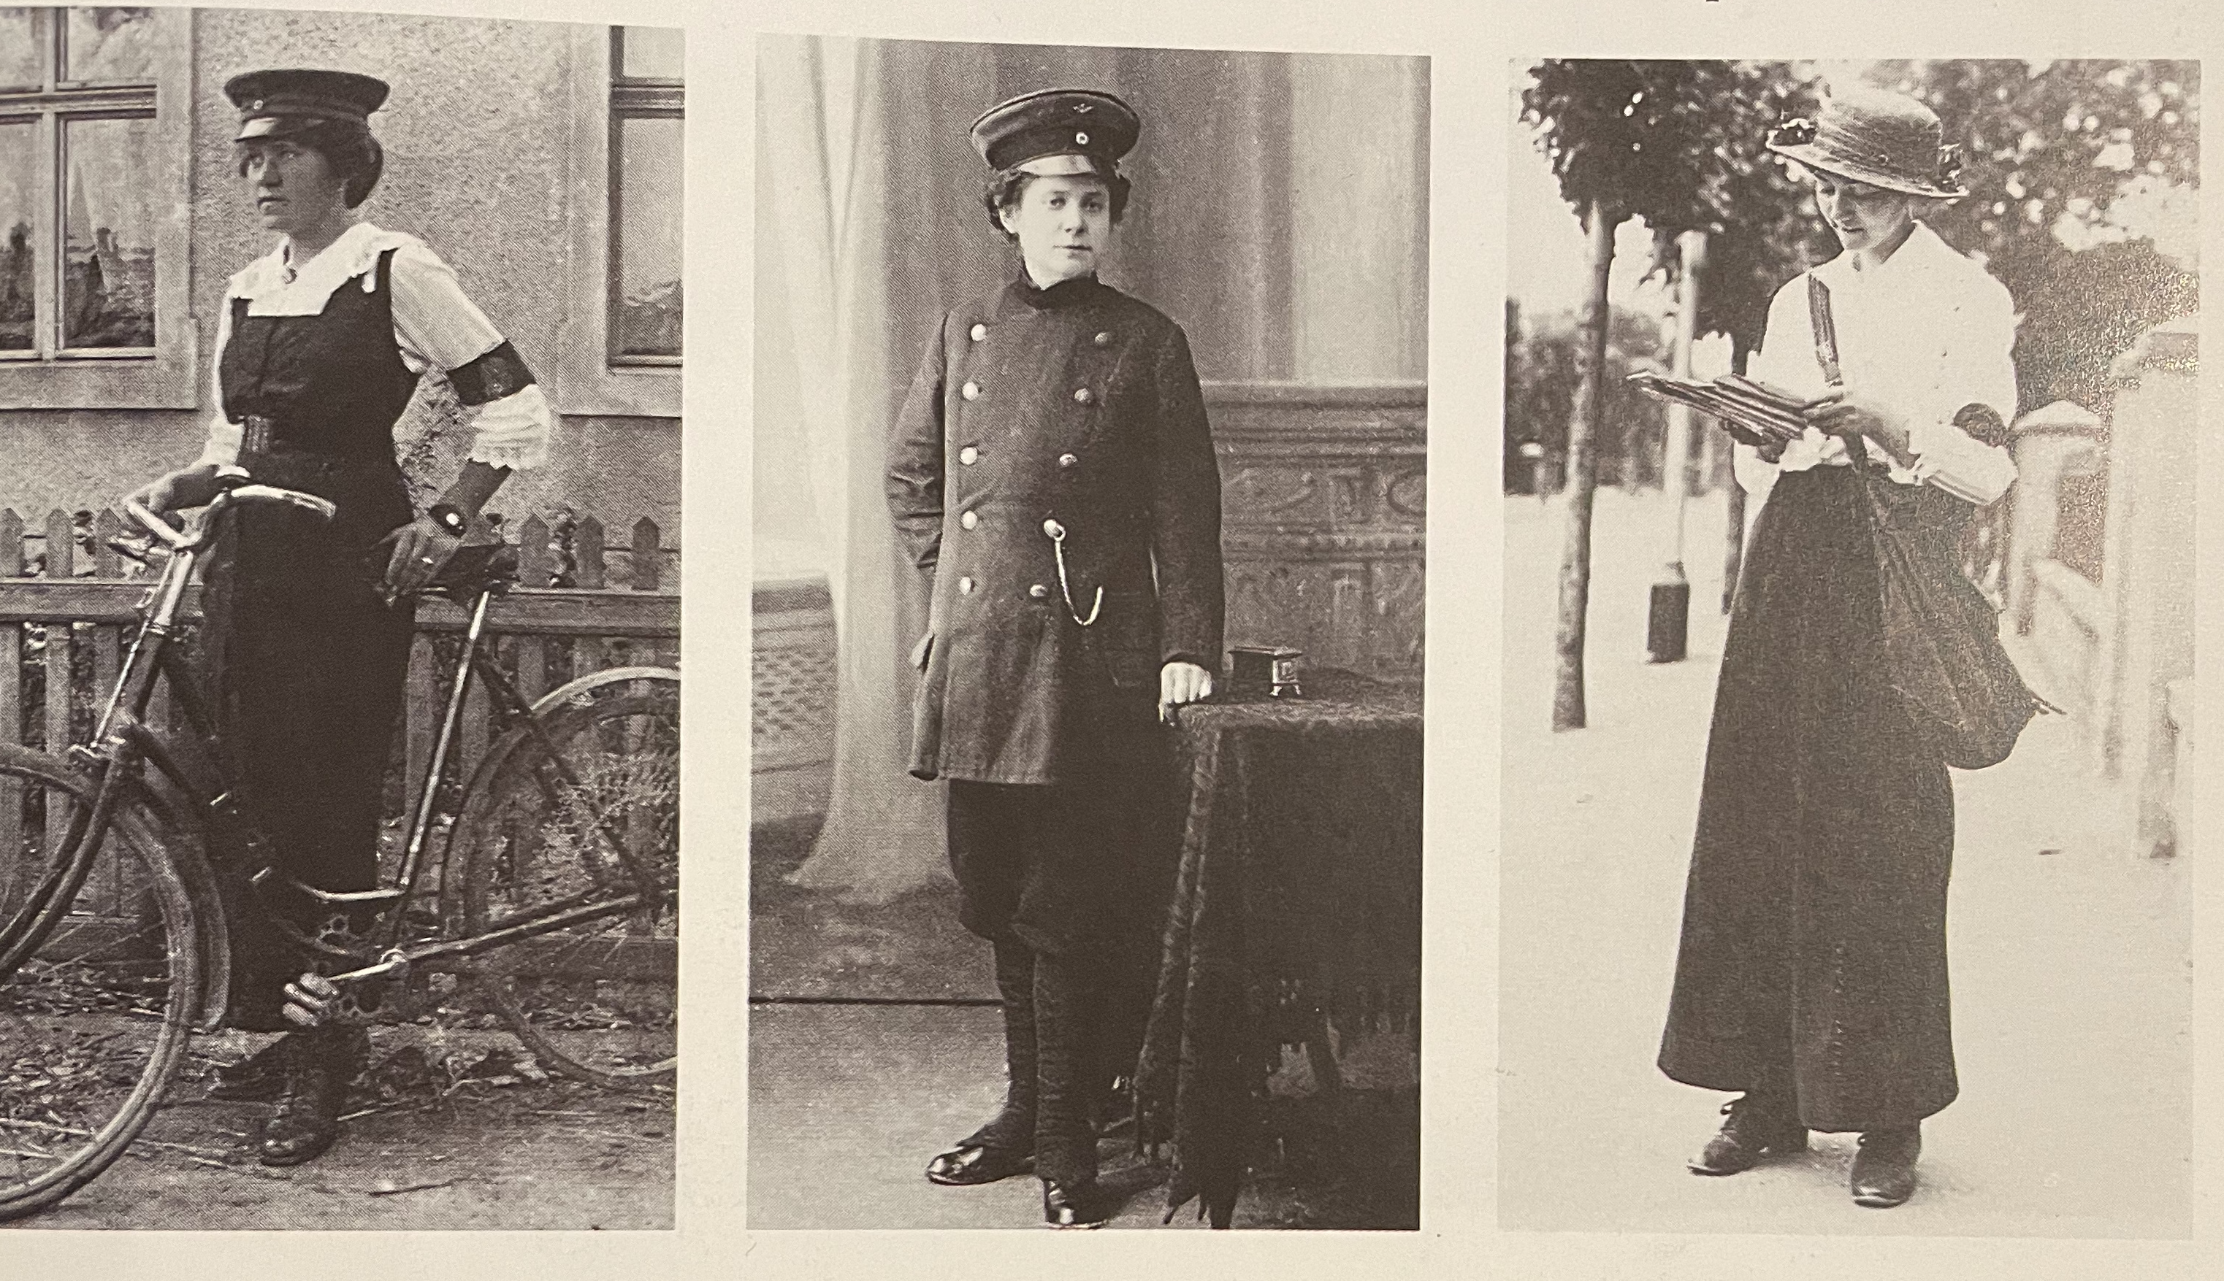
World War I
Women take over men’s work which changes the style of dress
German postwoman and rail conductress and English postwoman

Slide 14
Mail Order still popular
1916 Mail order catalogue showing furs.
Bellas-Hess Co., Inc is large company out of New York City
The jackets and boots are similar, but the skirt is a new fuller garment
Furs are also popular in the USA.

Slide 15
1913 Mail order company Bellas Hess, New York

Slide 16
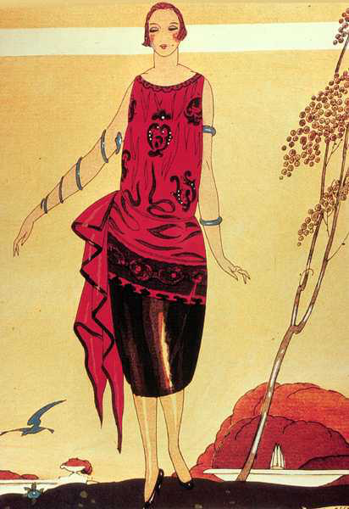
New Silhouette
In 1918 - End of WWI
- New Silhouettes developed by Paul Poiret in 1912, now finally popular
- Boat neck, waistline drops to hips
- The corset is replaced by the brassiere and girdle
- Alternative underwear is the “Step-in” Chemise

Slide 17
In 1917, this is described as semi-fitted “tailored” costume.
Cording as emphasis to the side hips
Hats push down on the head

Slide 18
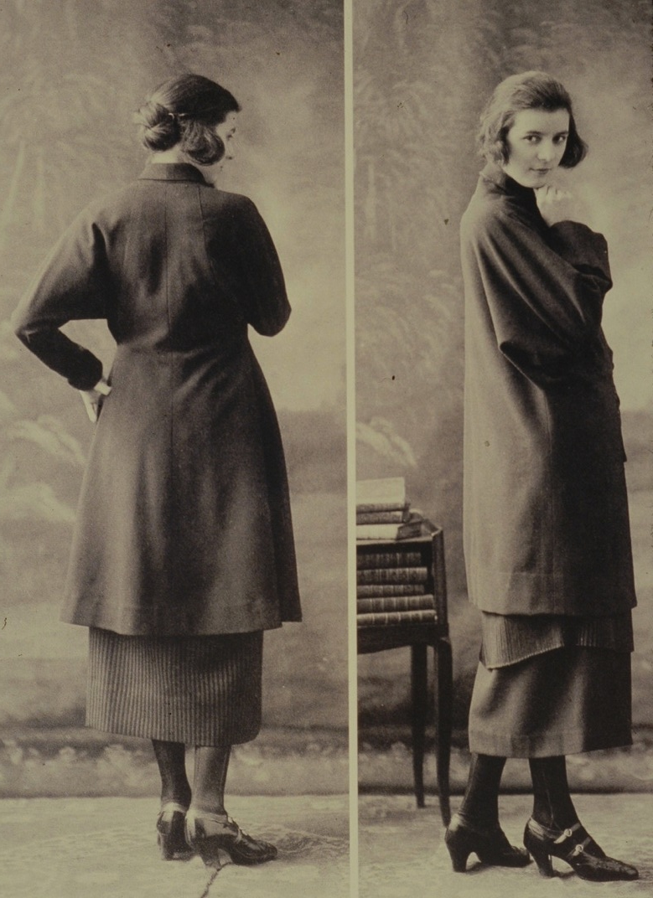
Vionnet 1919
Madeleine Vionnet, who has her own fashion house since 1912, was forced to close during the first World War.
She re-opened again after the war and built her business up to over 1000 employees. She works for women’s rights and for her employees.
Vacation time
Health care
Maternity leave
The Practical Post War Woman

Slide 19
Isadora Duncan was part of liberating women from the restrictive clothing

Slide 20
French couture designers 1920 - 1947
Notes:
French couture designers 1920 - 1947

Slide 21
1919 – The Bauhaus is established in Germany & the beginnings of Art Deco
Started much earlier, but delayed by World War I
Grows out of the Arts & Crafts Movement. Frank Lloyd Wright in Germany creating Folios in 1910 and is profoundly influenced.
Geometric style Influenced by Cubist movement.
1919 Marthe Romme is inspired by Leon Bakst, the designer from the Ballets Russes to make these new hip expanded evening gowns.

Slide 22
Loose 20s styles – kimono sleeves, shawl collars, waist drops out, hips shown off, boat necklines
Skirts shortens until mid decade, then gets longer again

Slide 23
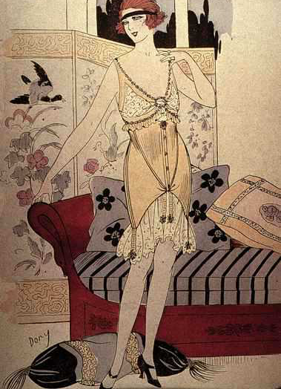
1920’s - new softer and less restrictive girdie underwear for women

Slide 25
Flapper dresses for 20s women who partied, danced, drank and smoke

Slide 26
Paul Poiret’s design 1926
Shoking Harem trousers and open backless halterneck gown, popular in the 30s

Slide 27
1927 - First bias cut dresses appear
Madeleine Vionnet is the leader of the bias cut dresses

Slide 28
Vionnet’s bias cut dresses
Style lead to 1930s women’s main fashion style

Slide 29
In 1930’s the dress length drops down and waistline appears
Bias cut popular to create draped look

Slide 30
1930 Madeleine Vionnet evening gown

Slide 31
Chanel’s little black dress
Huge impact – still one of the key items in women’s wardrobe

Slide 32
1930 Chanel invents Costume Jewelry with Duc di Verdura, from Italy. Ivory covered metal with faceted crystals.

Slide 33
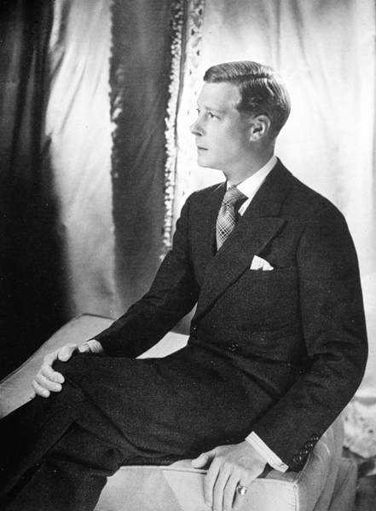
Prince of Wales becomes popular fashion icon with his wife Wallace Simpson
He gives up of his throne and marries divorced Simpson
Their love story was spread around the world

Slide 34
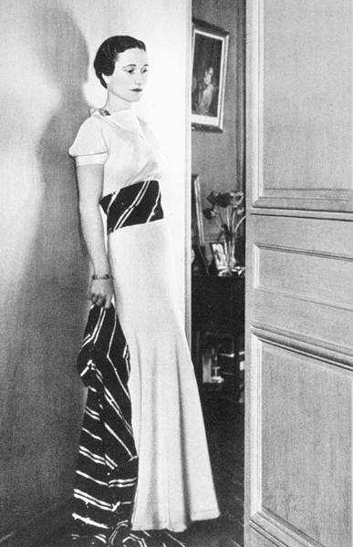
Mrs Wallace Simpson had the perfect body figure of late 1930s
Slim hips and sleek dresses were in fashion

Slide 36
1930 street view of New York’s Garment District
Nearly all men in fedora hats

Slide 37
Mainbocher kept a separate design book especially for the Duchess of Windsor, who was his most important client
Notes:
Long slim dresses, never low cut, usually with sleeves

Slide 38
Film stars had a huge impact on fashions: public followed what they wore

Slide 39
Macy’s department sold 500,000 copies of her dress in Letty Lynton (1932)
From that on, nearly all her principal clothes were mass produced

Slide 40
Ginger Roberts and Fred Astaire were Hollywood’s dream couple

Slide 41
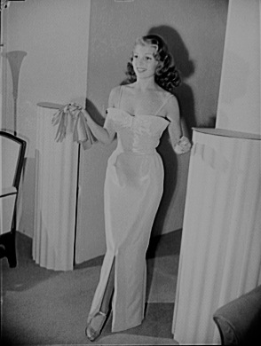
Rita Hayworth in 1941
A Hollywood Star, dress by Howard Greer
Fashionable hair is longer
Figure curvier

Slide 42
Floral Crepe de Chine Dress, 1940
New fabric rayon (viscose) was invented
Printed rayon floral dresses are the popular fashion for the masses
Rayon fibers show colors very bright

Slide 43
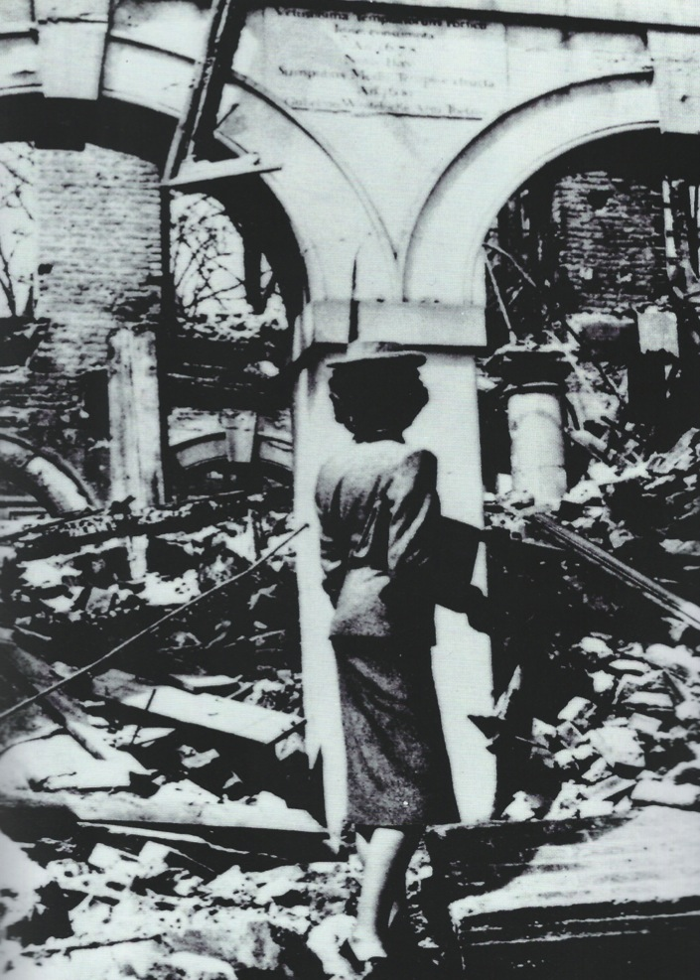
Photograph from Vogue taken in Berling during WW II
Fashionable woman with tailored suit, high heels, hat and a handbag

Slide 44
War-Time Fashion
This young lady is wearing military inspired fashionable dress
Wool blazers are popular and new suits made of Dad’s old 30’s suits

Slide 45
Model showing 1942 designs in a small fashion show in Lyon
International visitors were allowed to travel for this kind of events regardless of the war

Slide 46
Nylon Stockings
Silk stockings are too expensive luxury in war time
Women paint lines up their legs to look like they have on stockings
Note the very popular wedge soled shoes

Slide 47
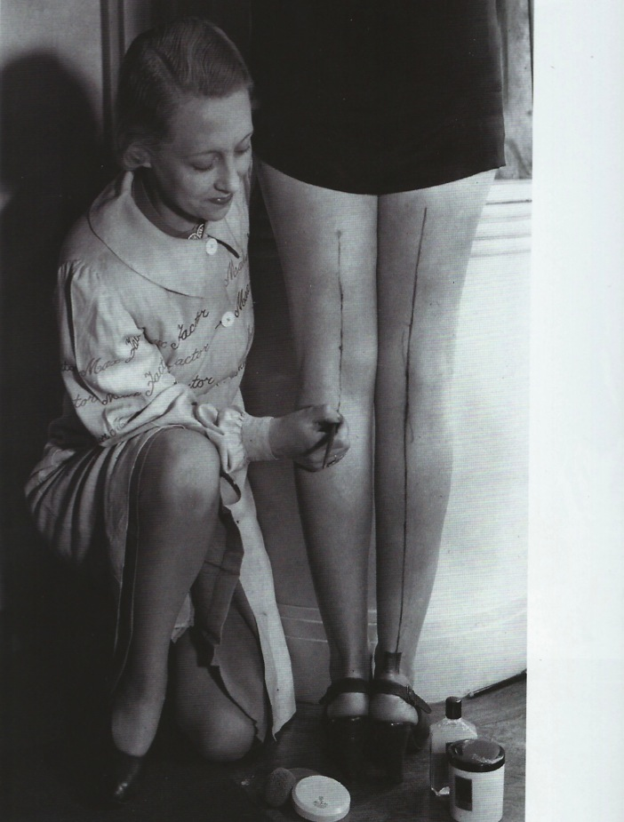
Marker pens were used to paint the line
By the end of the war, nylon stockings take over.

Slide 48
War Time Fashion
During WWII, the Duke and Duchess of Kent and their children embody the spirit of the British.
He is in military uniform and she wears the more simple modest dress of the war time wife.
Dresses have less fabric and are made of artificial fibers saving the wool for men’s uniforms.
Hemline goes up again – for practical reasons

Slide 49
1946 Pin Up Girl
Troops abroad are bolstered by provocative
images of the girls back home
The turban hat is in fashion
The 30s shoulder pads continue as women
have a tailored look
Suiting fabrics are popular
Nylon stockings and garter belts with high
heels

Slide 50
Tweed suits for women 1943
Typical tweed suits during the war
Women need to run the country while the men go to the front

Slide 51
Trousers for Women, 1942
Trousers worn during the war
and after war worn for leisure wear
Started in 30s –
Popularized by Katherine Hepburn, Hollywood star who lived in Connecticut, US
Smithsonian Museum in Washington, D.C.

Slide 52
The Home Front
Lauren Bacall, a young woman modeling as the perfect home front girl.
Her hair is long again with natural soft curls. Marcel waves are gone and combs holding up side hair

Slide 53
Two women wearing shoking trousers and backless beach tops at the Thorpe Bay, UK

Slide 54
Zip’s were invented in late 19th century but did not become functional until in the 40s
In the 1920s, B. F Goodrich bought zippers as closures in boots – term ”zipper boots”
He registered the word zipper in 1925
mid 30s it was known devise, although not worn in clothes until in the 40s

Slide 55
Sporting Attire
Skiing attire is improved during the war and becomes a popular sport after WWII.
This outfit from 1940 is at the Smithsonian Museum in Washington, D.C.

Slide 56
War time Swimsuit
An early two piece swimsuit from the 1940s.
The trunks lace up the sides and the top has a halter closing.
Bandanas are a popular way to control the hair during the war.

Slide 57
Leisure wear
This little white and coral play suit from the 1940s would often be worn with a skirt over it, then removed at the beach.
Shorts are beginning to be seen in resorts and at tennis clubs
At the Smithsonian Museum, displayed with wedge slides.

Slide 58
The late 40s Suit
The new elongated man’s Hollywood suit with only two buttons. The fashion was to button only the top button.
Pocket hankie is still fashionable.
The fedora hat is still in fashion
Cuffs and creases still in the trousers, but fewer pleats

Slide 59
Automobiles influenced in the length of women’s dresses
No need for parasols anymore
Use of wristwatches – impractical to use pocket watches while driving
Walking sticks went out of style

Slide 60
Hats in all shapes were fashionable
During and after the war, women’s wear was a mix of practicality and style

Slide 61
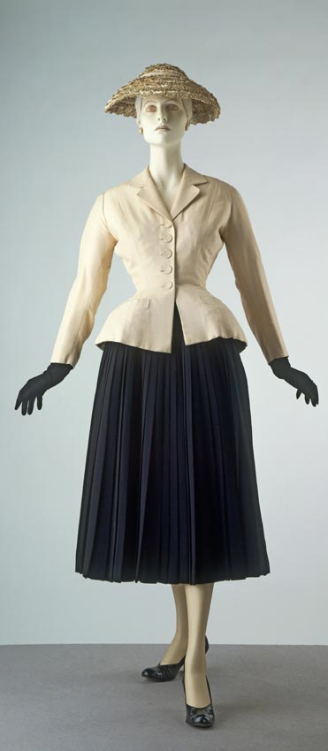
Christian Dior Creates the “New Look” in 1947 Dior opened his house in December of 1946 just after WWII with a full ray pleated skirt and a trim jacket that has lost the shoulder pads and has a new wasp waist and a peplum that curves out below from a circular cut. Sleeves are slightly short to show off the new coat length gloves. She wears plain court pumps

