Slide 1
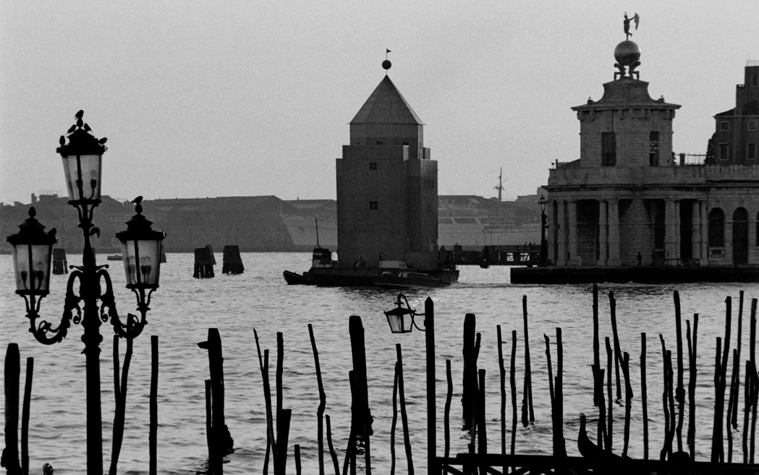
SIS.ARK. KULTTUURI JA KÄYTÄNTÖ 2023 POMO

Slide 3
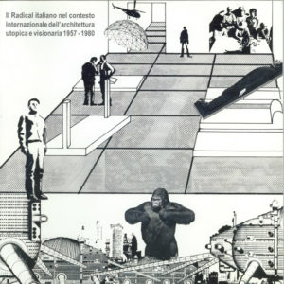
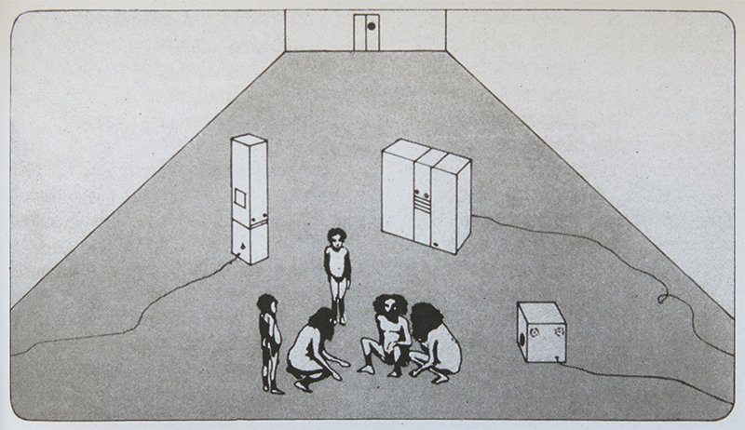

Slide 4
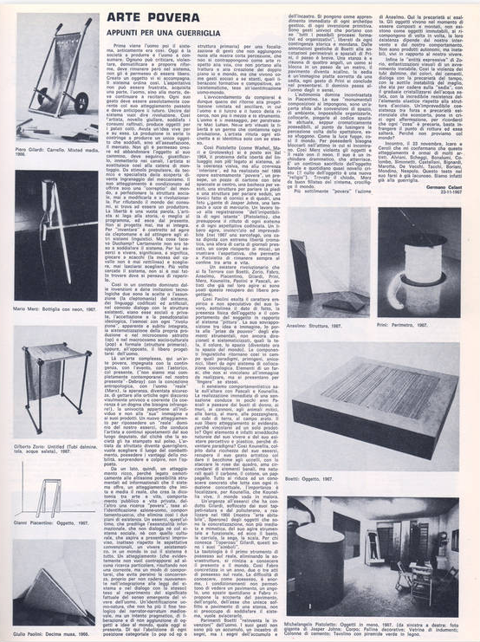
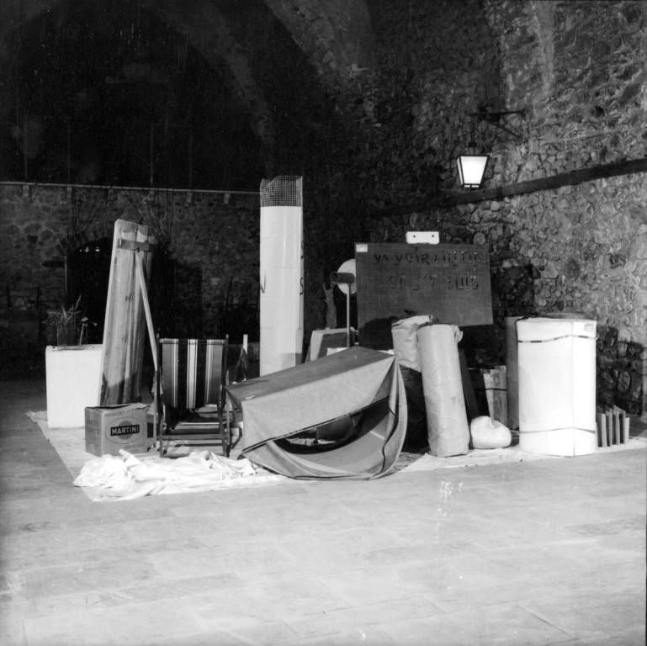

Slide 5
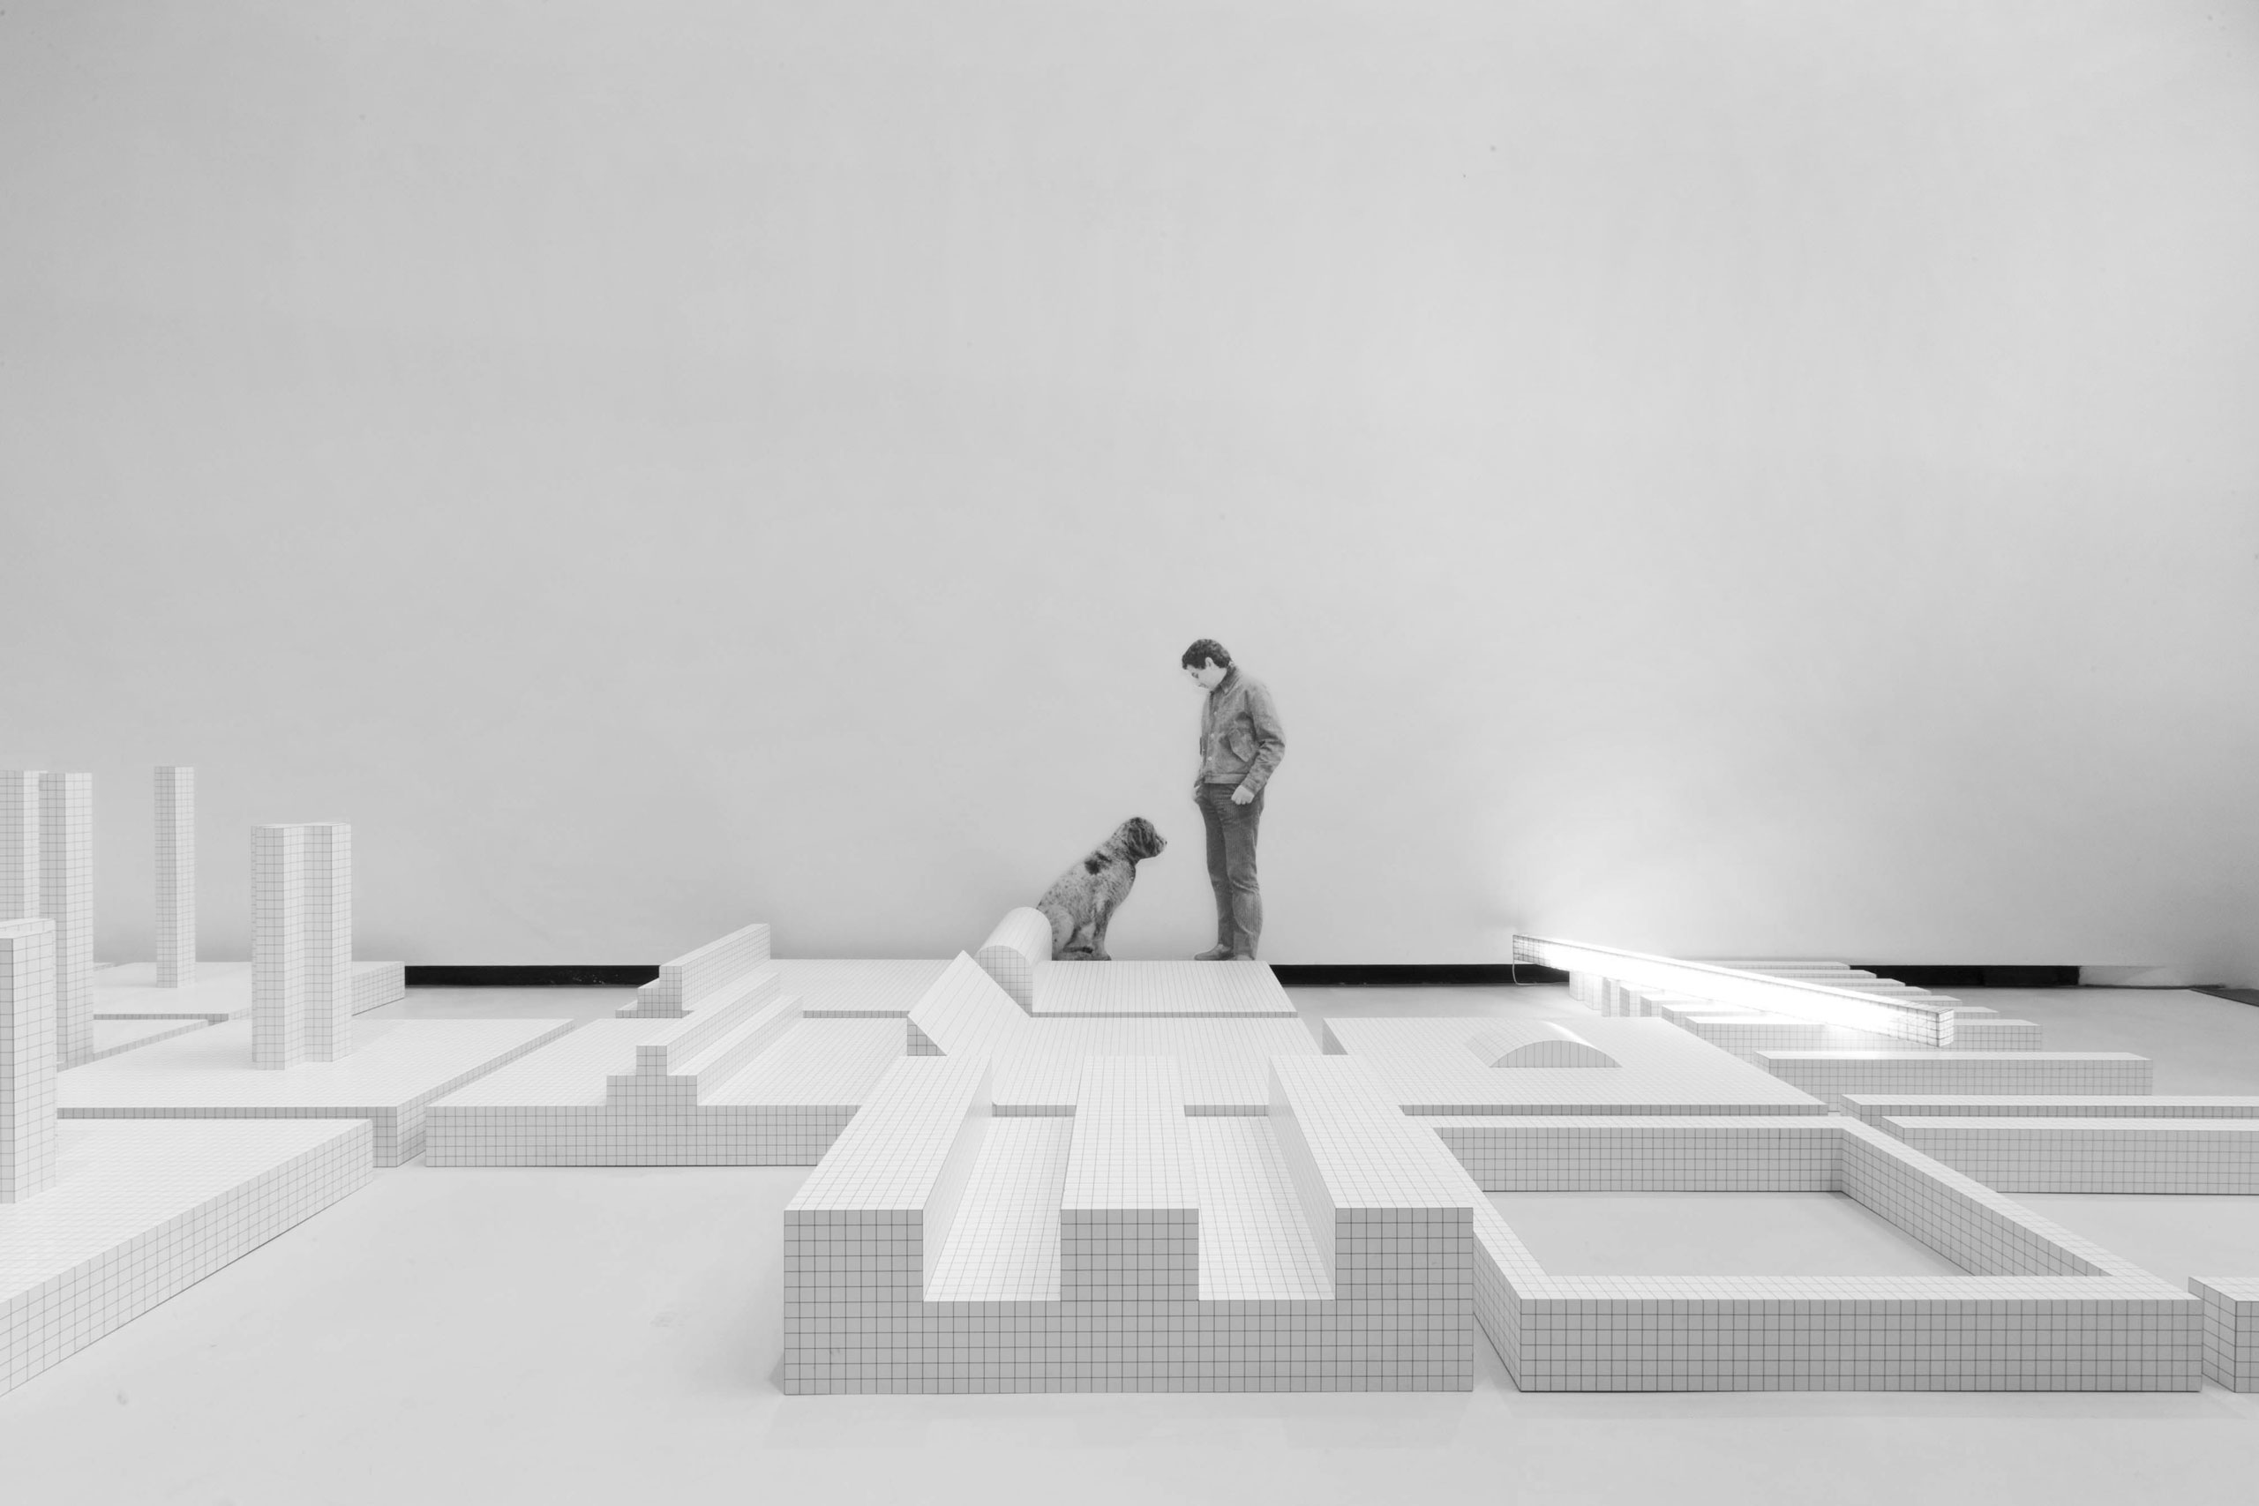

Slide 7
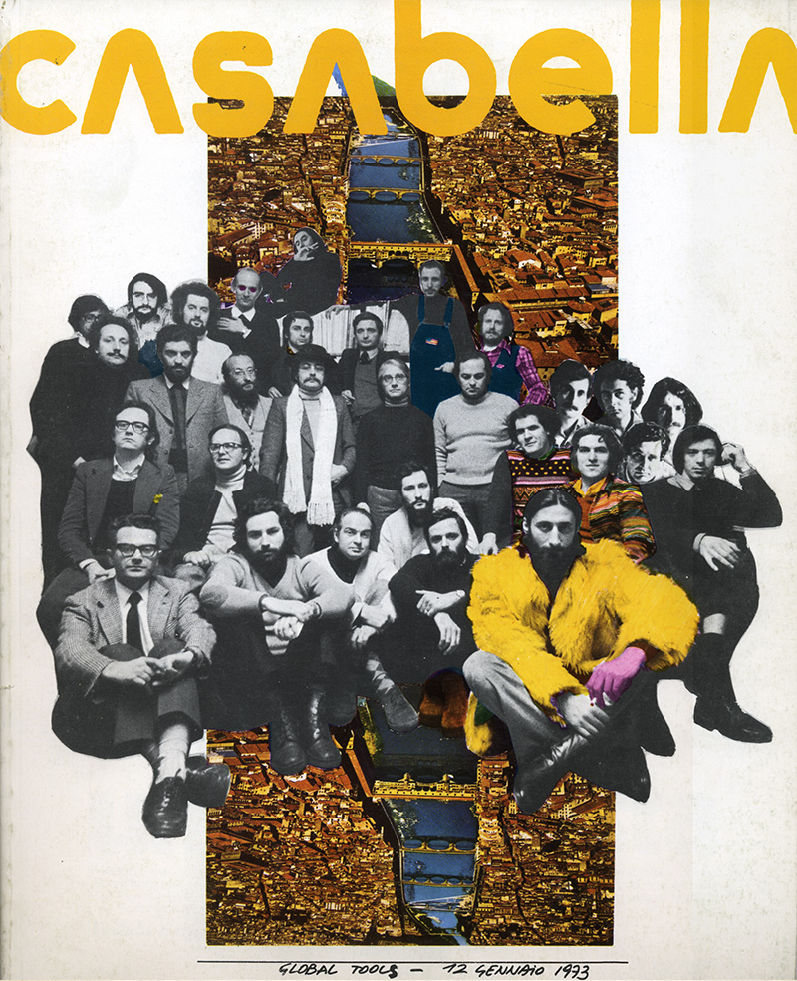

Slide 8
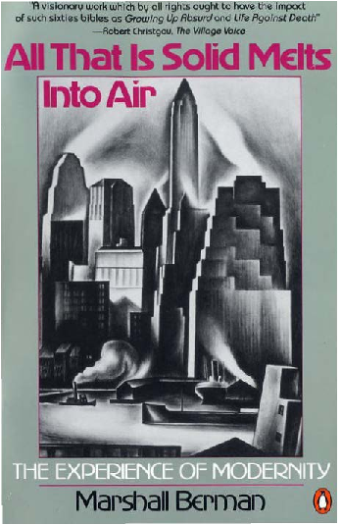

Slide 9
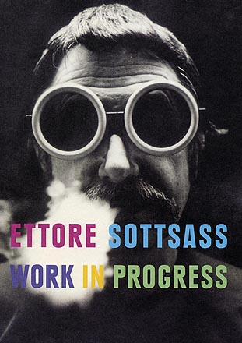
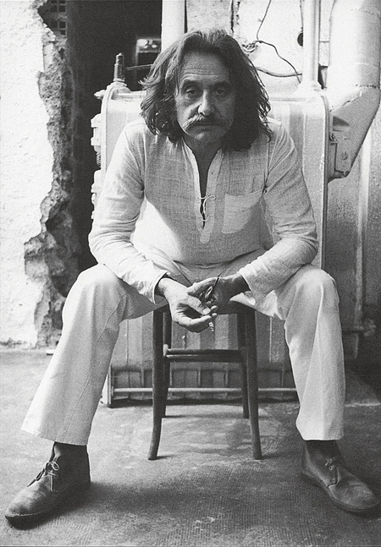

Slide 10
Ettore Sotsass 1958
Console de commande du supercalculateur
Olivetti Elea 9003

Slide 11
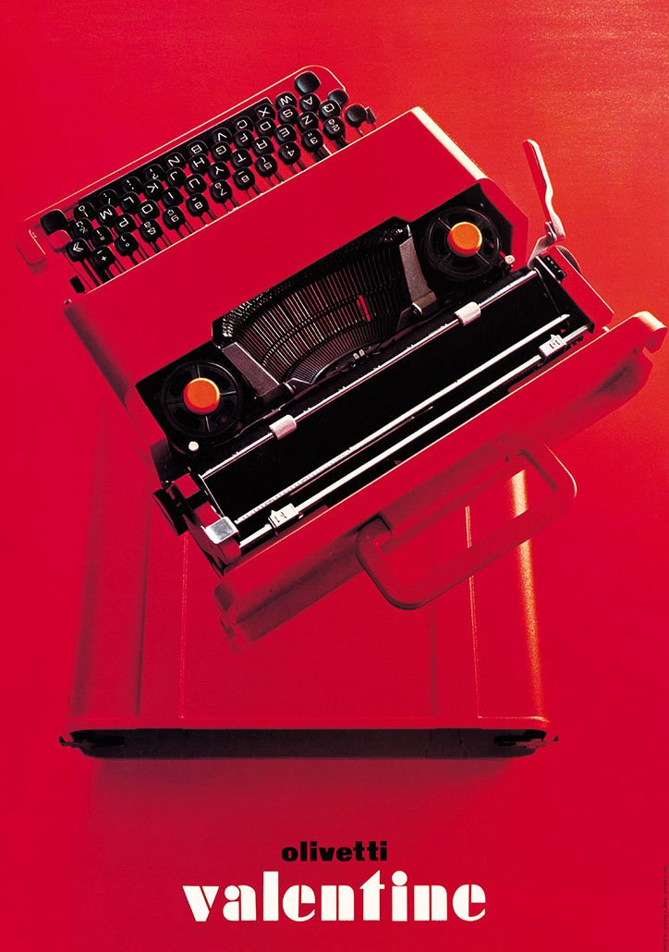
Ettore Sotsass 1968
Valentina Portable Typewriter
Olivetti Elea 9003

Slide 15
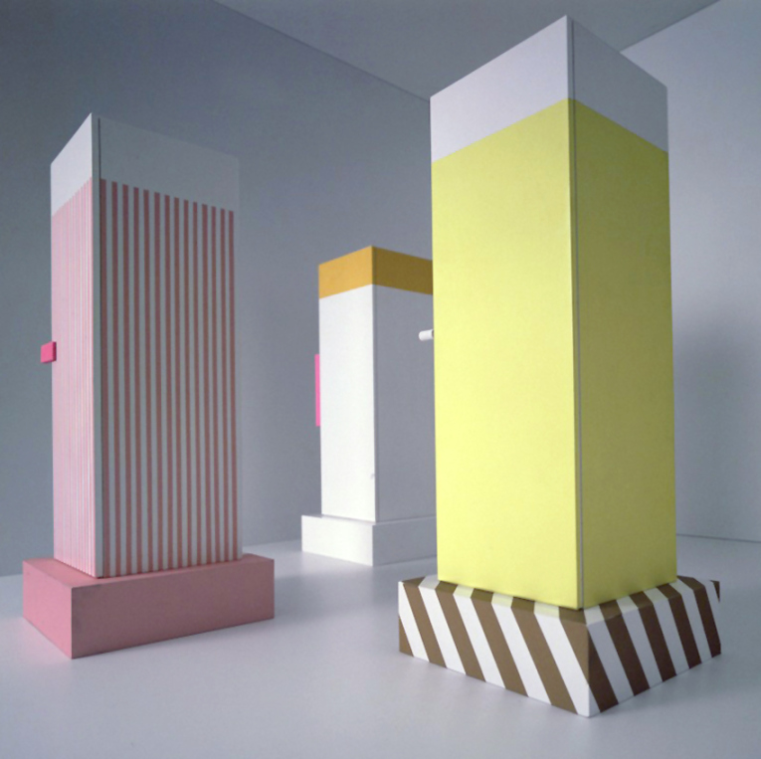
Ettore Sottsass, Superboxes Cupboards, 1966

Slide 16
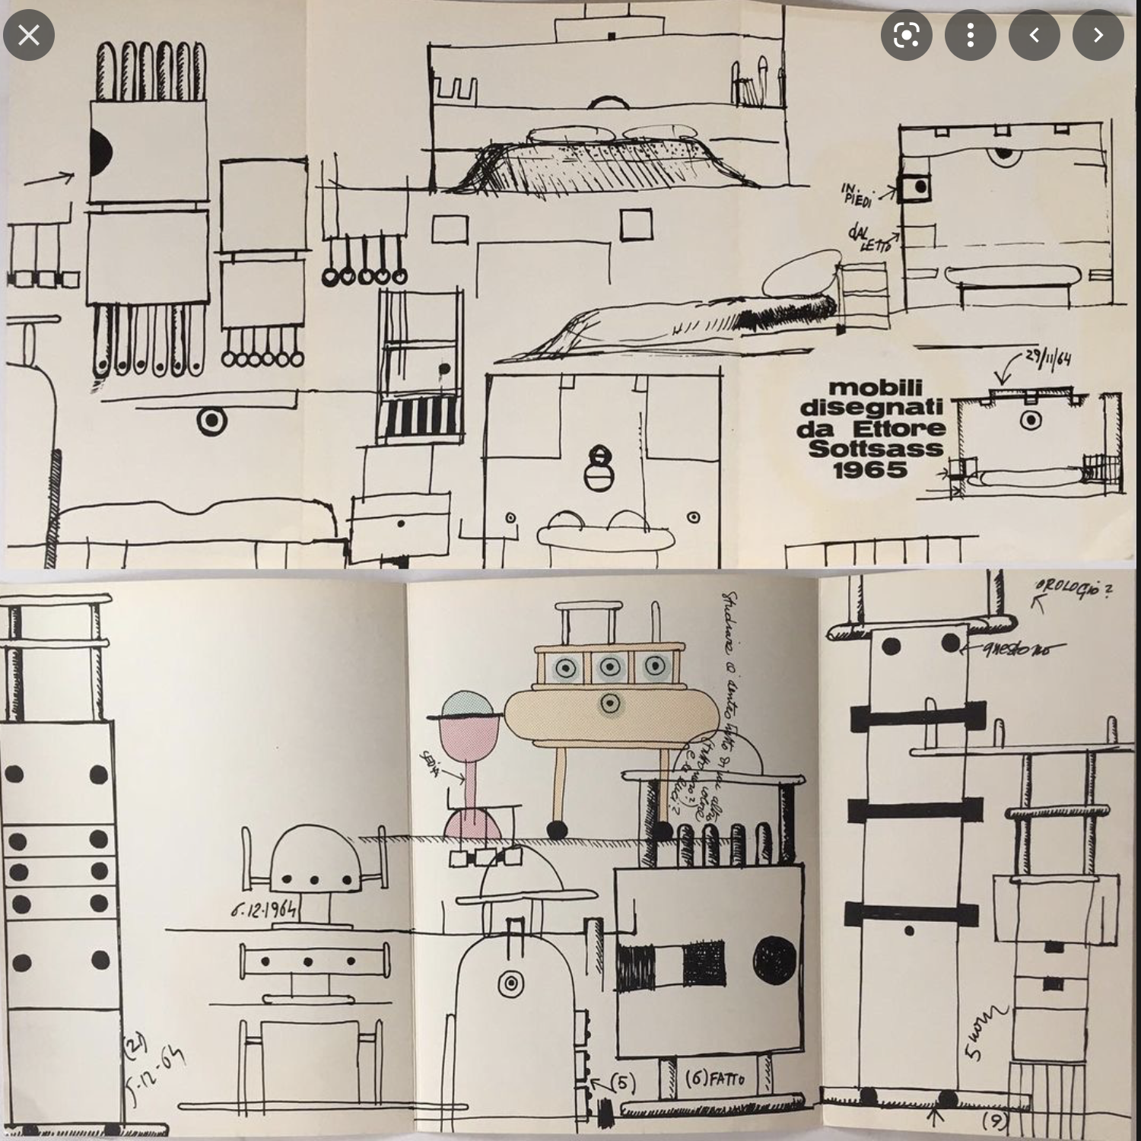

Slide 20
Memphis groupe 1982

Slide 21
Alessando Mendini, 1931-2019 Casabella Modo Domus

Slide 23
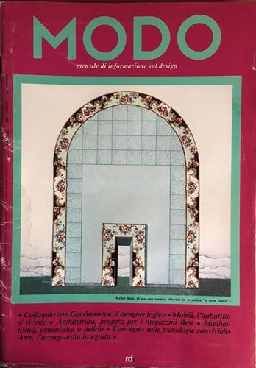

Slide 24
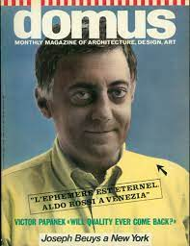
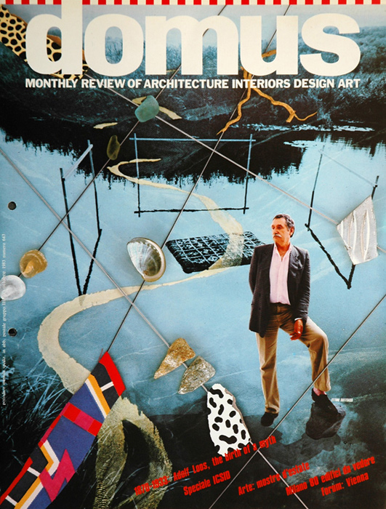

Slide 25
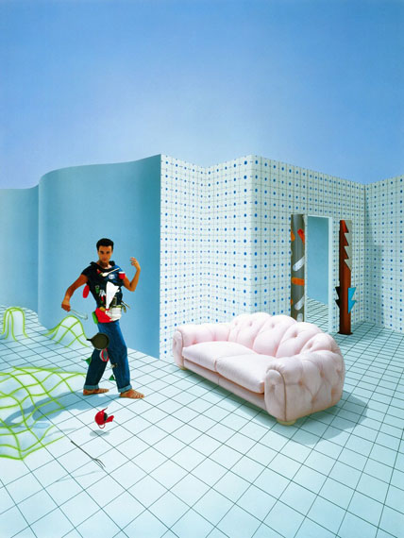

Slide 26
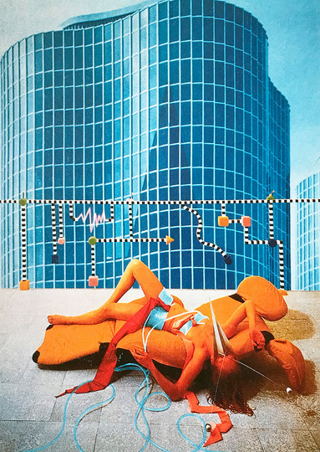

Slide 29
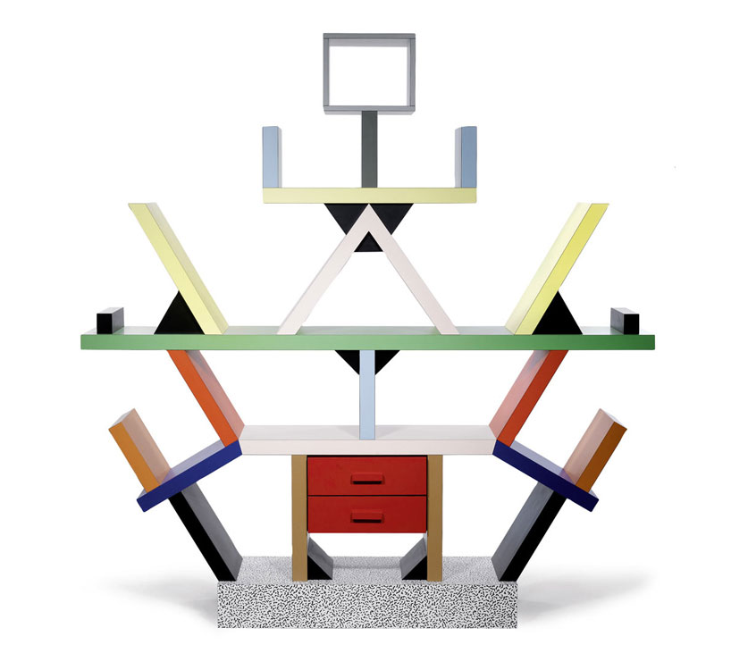
Ettore Sottsass, Memphis 1982

Slide 31
Aldo Rossi, Il Teatro del Mundo, Venezia 1981

Slide 38
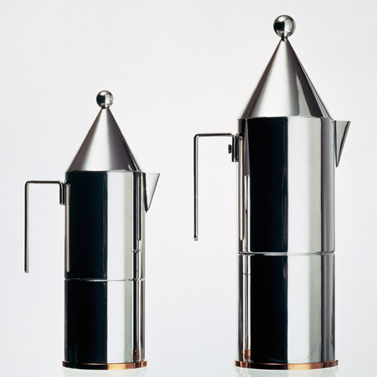
Aldo Rossi, Alessi

Slide 39
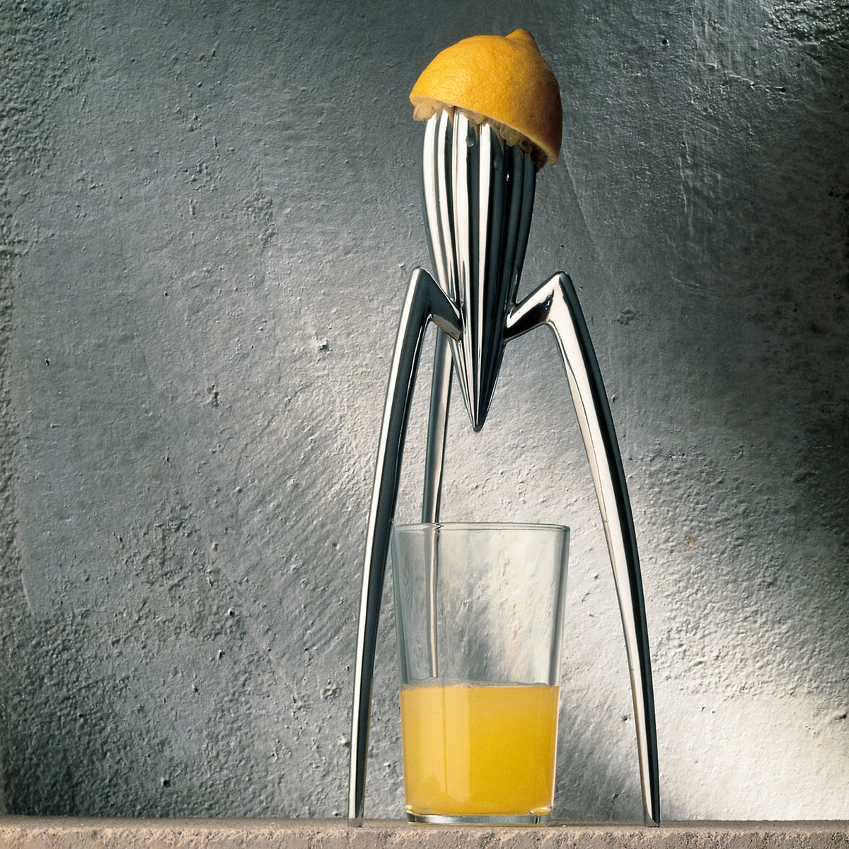
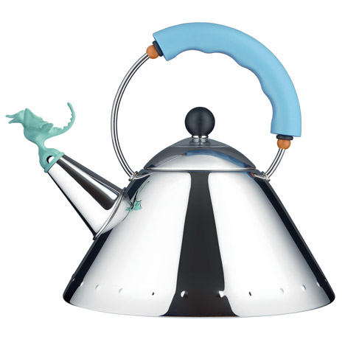

Slide 40
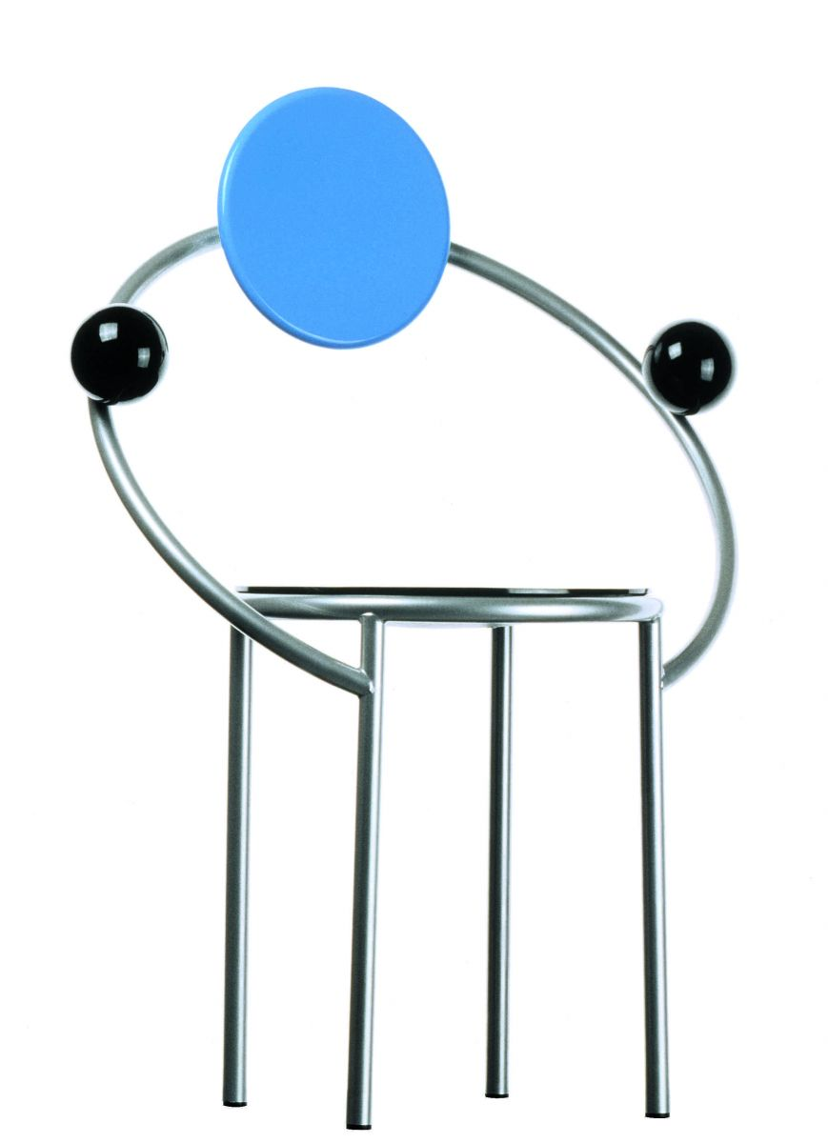
Michele De Lucchi,First, Mephis 1983

Slide 41
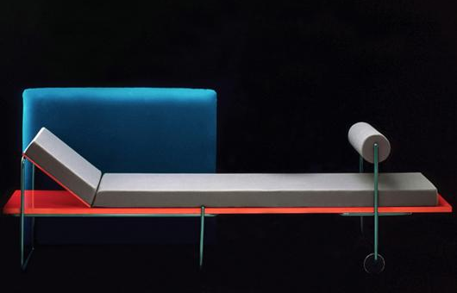
Andrea Branzi, Sofa Century, Driade

Slide 42
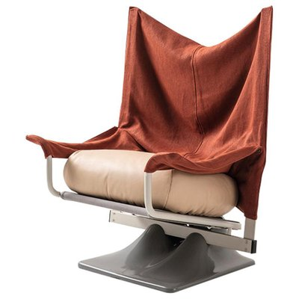
AEO 1973 + Torso 1980 / Paolo Deganello & Archizoom Group / Cassina

Slide 43
Squash Sofa / Paolo Deganello / Cassina 1980

Slide 44
Coop Himmelbau, Vodöl 1988, Vitra

Slide 45
Yrjö Kukkapuro / Experiment / Avarte 1980

Slide 51
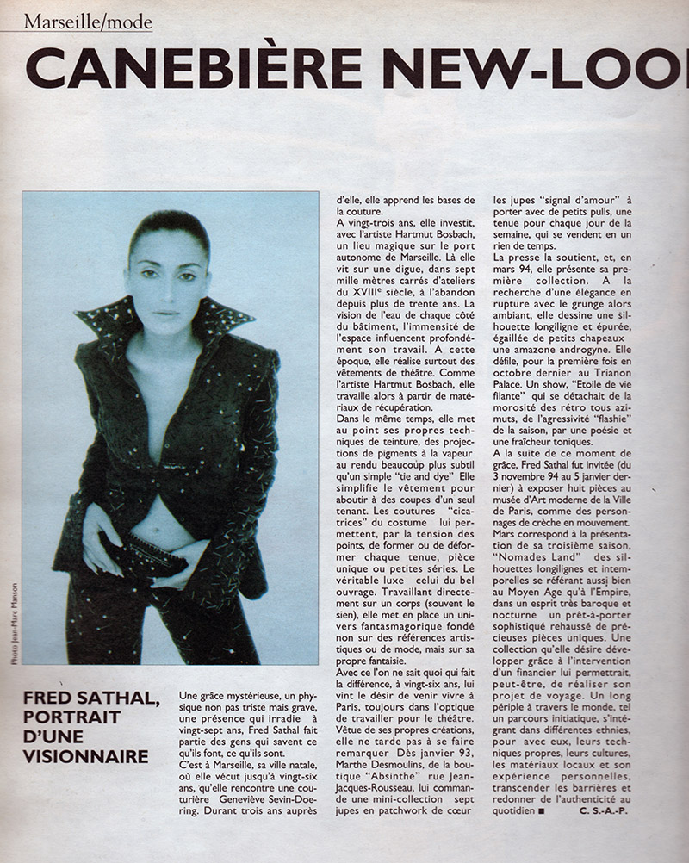

Slide 52
François Mitterrand / President de la Republique (1981-1995) Jack Lang / Ministre de la Culture (1981-1986/1988-1992)

Slide 53
Institute du Monde Arabe / Paris / Jean Nouvel 1987

Slide 56
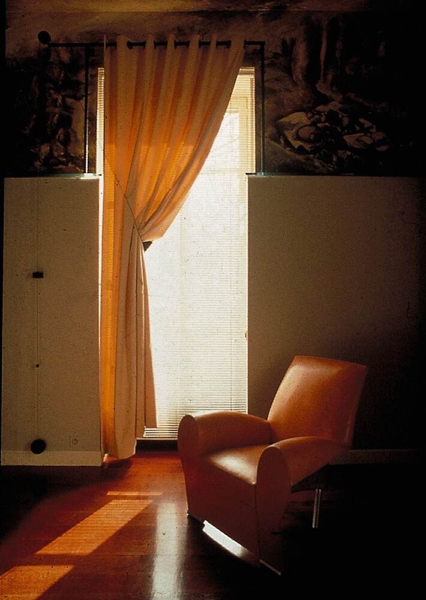
Philippe Starck / Palais de l’Elysée 1983-84 / Paris

Slide 57
Philippe Starck/Café Costes / Paris 1984

Slide 59
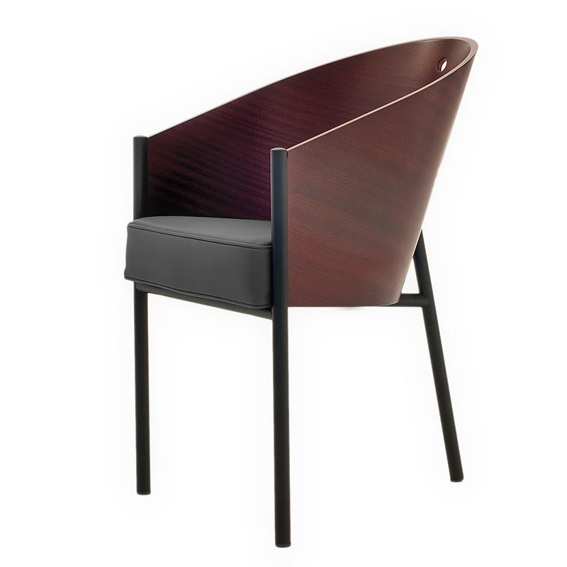
Philippe Starck, Café Costes , Alep Driade 1984

Slide 60
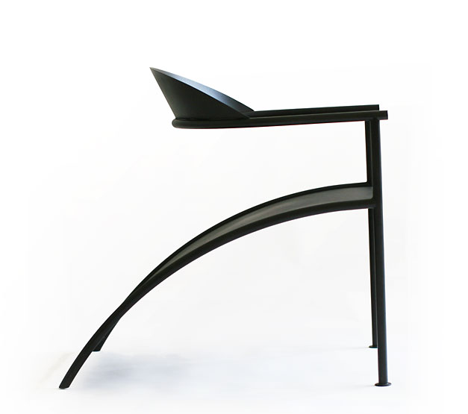
Philippe Starck , Pat Conley II, X.O. 1984

Slide 61
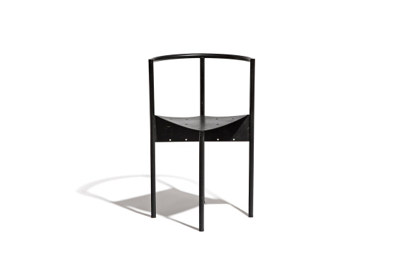
Philippe Starck Wendy wright, Disform 1982

Slide 62
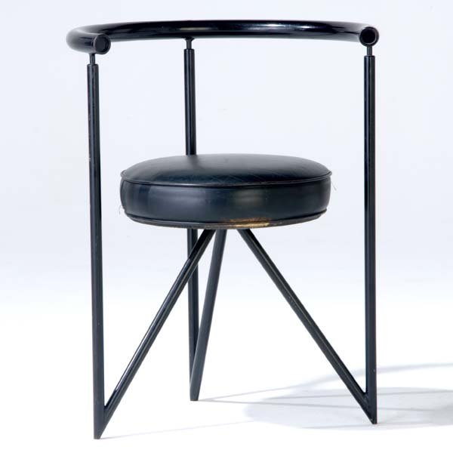
Philippe Starck, XO

Slide 65
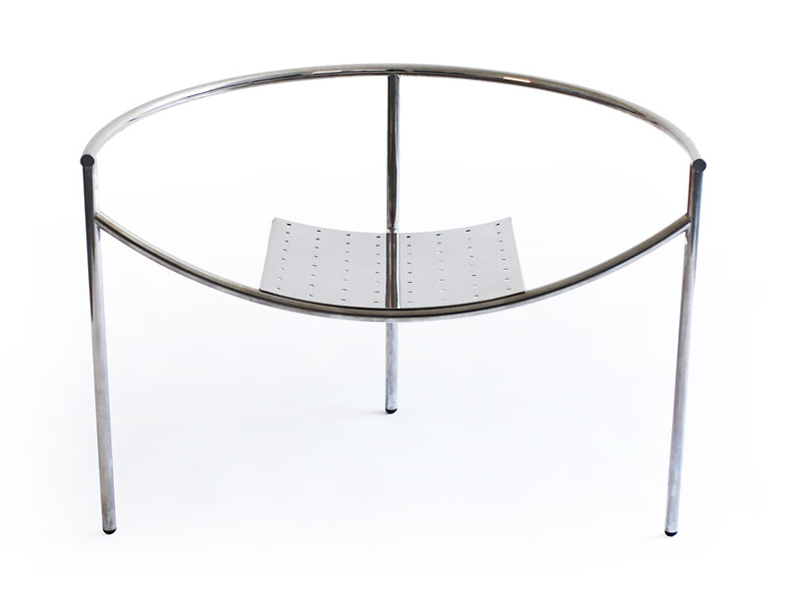
Philippe Starck, Armchair“Dr. Sonderbar”, X.O. 1983.

Slide 66
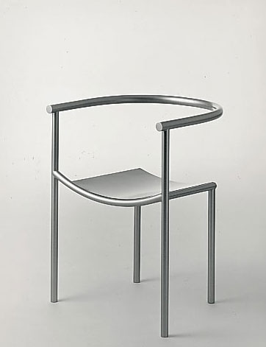
Philippe Starck, Driade

Slide 68
Philippe Starck / Laguiole / Aubrac 1986

Slide 72
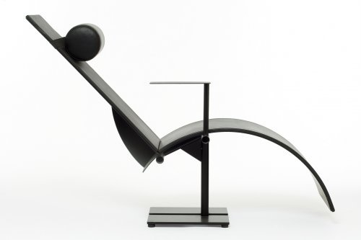
Martin Szekely, Chaise longue Pi, 1983

Slide 73
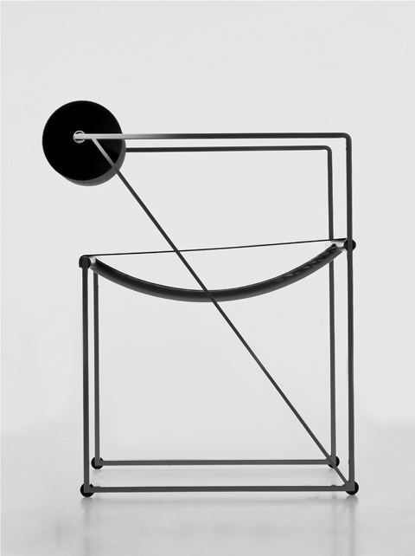
Mario Botta, Seconda Chair 1982, Alias

Slide 74
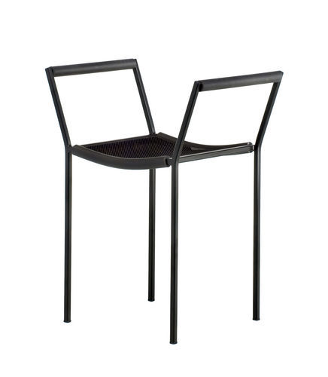
Maurizio Peregalli, Savonarola Chair, Zeus, Italy

Slide 75
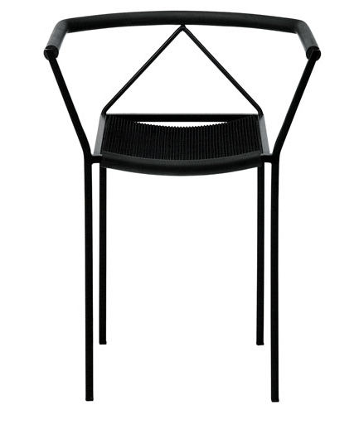
Maurizio Peregalli, Savoarolo, Zeus, Italy

Slide 76
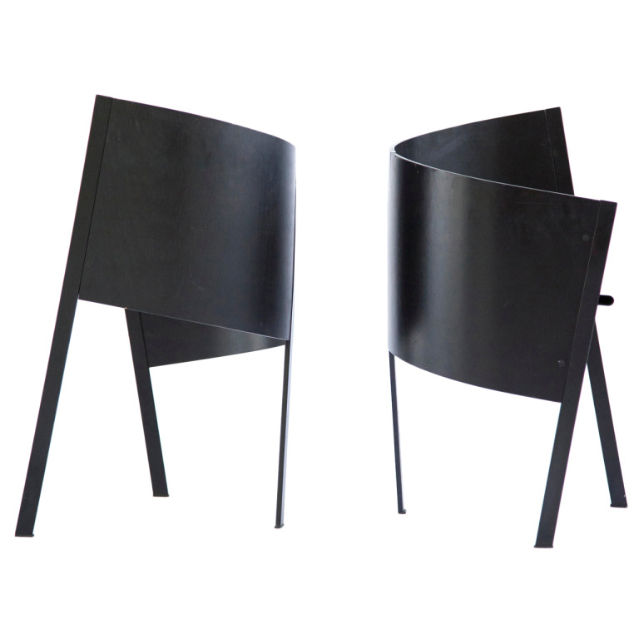
Three legged chair, Paolo Pallucco, Mery go around, Pallucco 1983

Slide 77
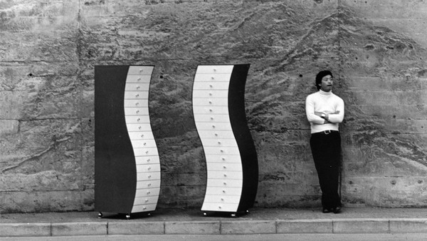

Slide 78
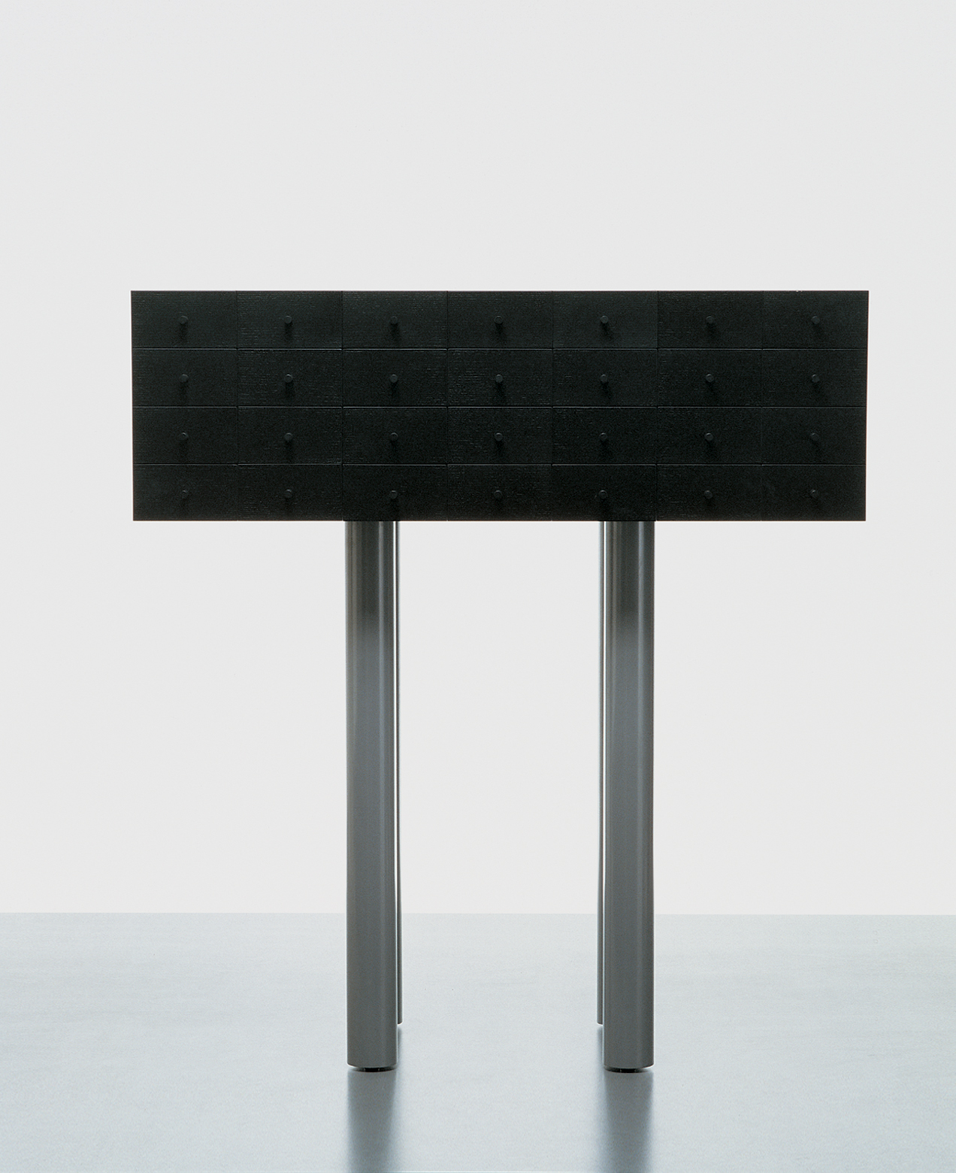
Shiro Kuramata / Solaris / Capellini 1977

Slide 79
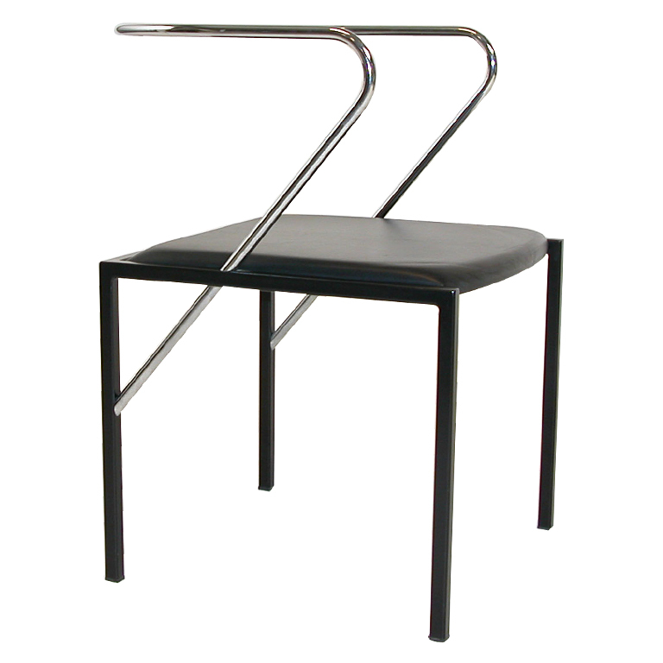
Shiro Kuramata, Apple Honey chair, Pastoe 1986

Slide 80
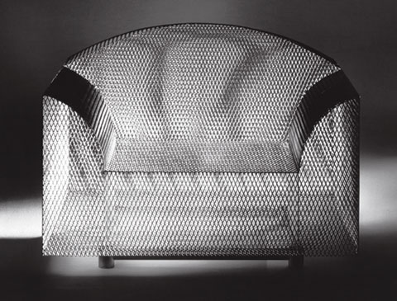
Shiro Kuramata / How High the Moon / Vitra 1986

Slide 81
Shiro Kuramata / Issey Miake Showroon 1987 Seibu / Tokyo

Slide 82
Shiro Kuramata / Issey Miake Showroon 1985 / Tokyo

Slide 84
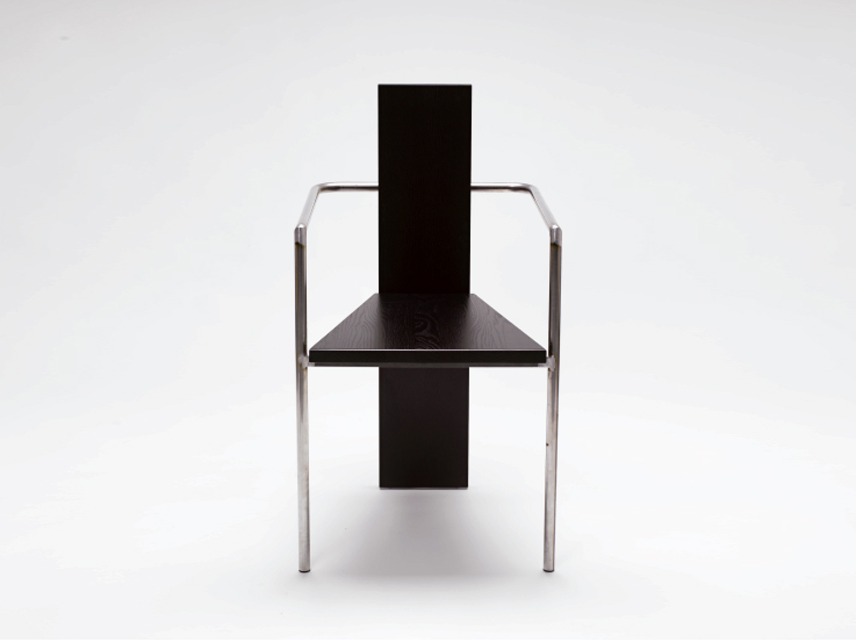
Jonas Bohlin, Conkret, Källemo 1980

Slide 86
Jonas Bohlin & Thomas Sandell Rolfs Kök / Stockholm 1984

Slide 87
Jonas Bohlin / Sturehof / Stockholm 1995

Slide 90
Pentti Hakala, Inno 1983

Slide 91
Pentti Hakala, Lilly River Inno 1984

Slide 93
For Sottsass, the Memphis aesthetic of 1981 wasn’t necessarily meant to last. His aim was to free design from the burden of the Modern movement mantra, to demonstrate that form doesn’t have to follow function, and then to move on.
He left Memphis in 1986. “Every strong idea lasts a very short time,” he said later. “Strong ideas are strong, but they cannot be developed, they are what they are. They come down like bolts of lightning, they are there, but finite.”

Slide 94
FIN

