Slide 1
ARTS-A0412 Digital Sculpture 1 – 3D Modelling for Sculpture 3 ECTS / 13.9.-19.10.2021 / Mon & Thu 13.15-17.00 Väre M101 except 12.10. R102 Teacher: Satu-Minna Suorajärvi Learn Rhinoceroes, Grasshopper, and Blender for creating 3d printable sculptures
www.satuminna.com

Slide 3
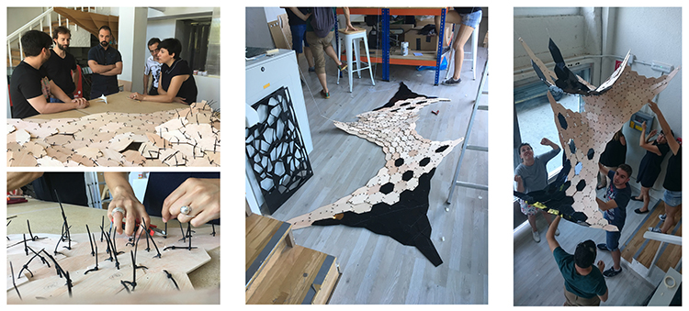
Paradigm shift
Digital fabrication
Globalisation
Dualism surfaces
Handmade - machine made
Collaboration – companies
Loosing works – new works
Climate change
Forces change
New biomaterials
https://en.controlmad.com/training/parametric-design-fabrication

Slide 4
Learning outcomes
The student will be able to use 3D graphics software to create models suitable for digital fabrication like 3D printing and laser cutting.
Credits: 3
81 hours / 3op (Afternoon class 48 hours + independent homeworks)
Teacher in charge (applies in this implementation): Antti-Ville Reinikainen, Satu-Minna Suorajärvi
Sanna Väisänen
3D print workshop:
Homework
It is important to complete the online intro course before they staring 3D print workshop:
https://mycourses.aalto.fi/course/view.php?id=23273

Slide 5
Schedule:
13.09.2021 Introduction
13.09.2021 3D modeling with Rhino – Interface
14.09.2021 3D modeling with Rhino – Tony Cragg, Zaha Hadid and Xavier Veilhan
20.09.2021 3D modeling with Rhino – Nurbbs, Polygons and Mesh
20.09.2021 3D modeling with Rhino – Boolean operations
21.09.2021 3D printing and printers – Prepairing models for 3d printing
Basics of Gcode and Ultimaker printers
27.09.2021 3D Print workshop and 3D printing
28.09.2021 3D modeling with Rhino – Grasshopper
04.10.2021 3D modeling with Blender – Basics
05.10.2021 3D modeling with Blender – Nick Ervink
11.10.2020 3D Print workshop and 3D printing
12.10.2021 3D modeling with Blender
3D printing models repairs
18.10.2021 3D modeling with Blender
19.10.2021 Checking 3D models , prints and discussion

Slide 6
3D modeling for sculptors
Introduction to 3D softwares such as Rhino, Blender and Grasshopper.
Learn basic methods for creating and modelling objects suitable for producing actual sculptures using 3D printing and (laser cutting) techniques.
Series of hands-on exercises that highlight 3D modeling.
Introduction to the same techniques as sculptors and architectural offices apply such as Tony Cragg, Nick Ervink and Zaha Hadid.

Slide 7
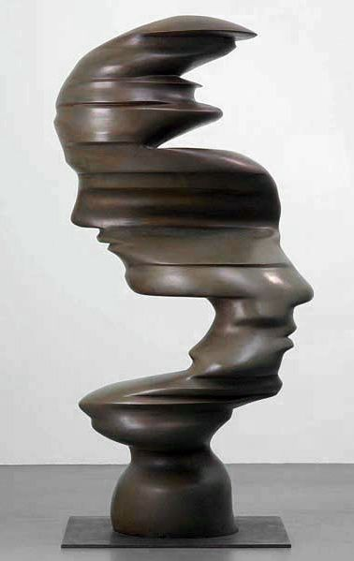
Tony Cragg
Born in Liverpool, 1949
As the son of an electrical engineer, who was involved in the development of the Concorde airplane, Cragg became familiar with technology.
Line of Thought, 2002

Slide 8
Cragg came in contact with these new techniques, when he got commissions for large outdoor sculptures, such as The Bent of Mind in Taipei.
Engineers came along in his studio to perform a stress test on his sculptures. Engineers scanned the scale models, and when Cragg saw them appear on the computer screen, he came to realize the value of the computer for making things.

Slide 9
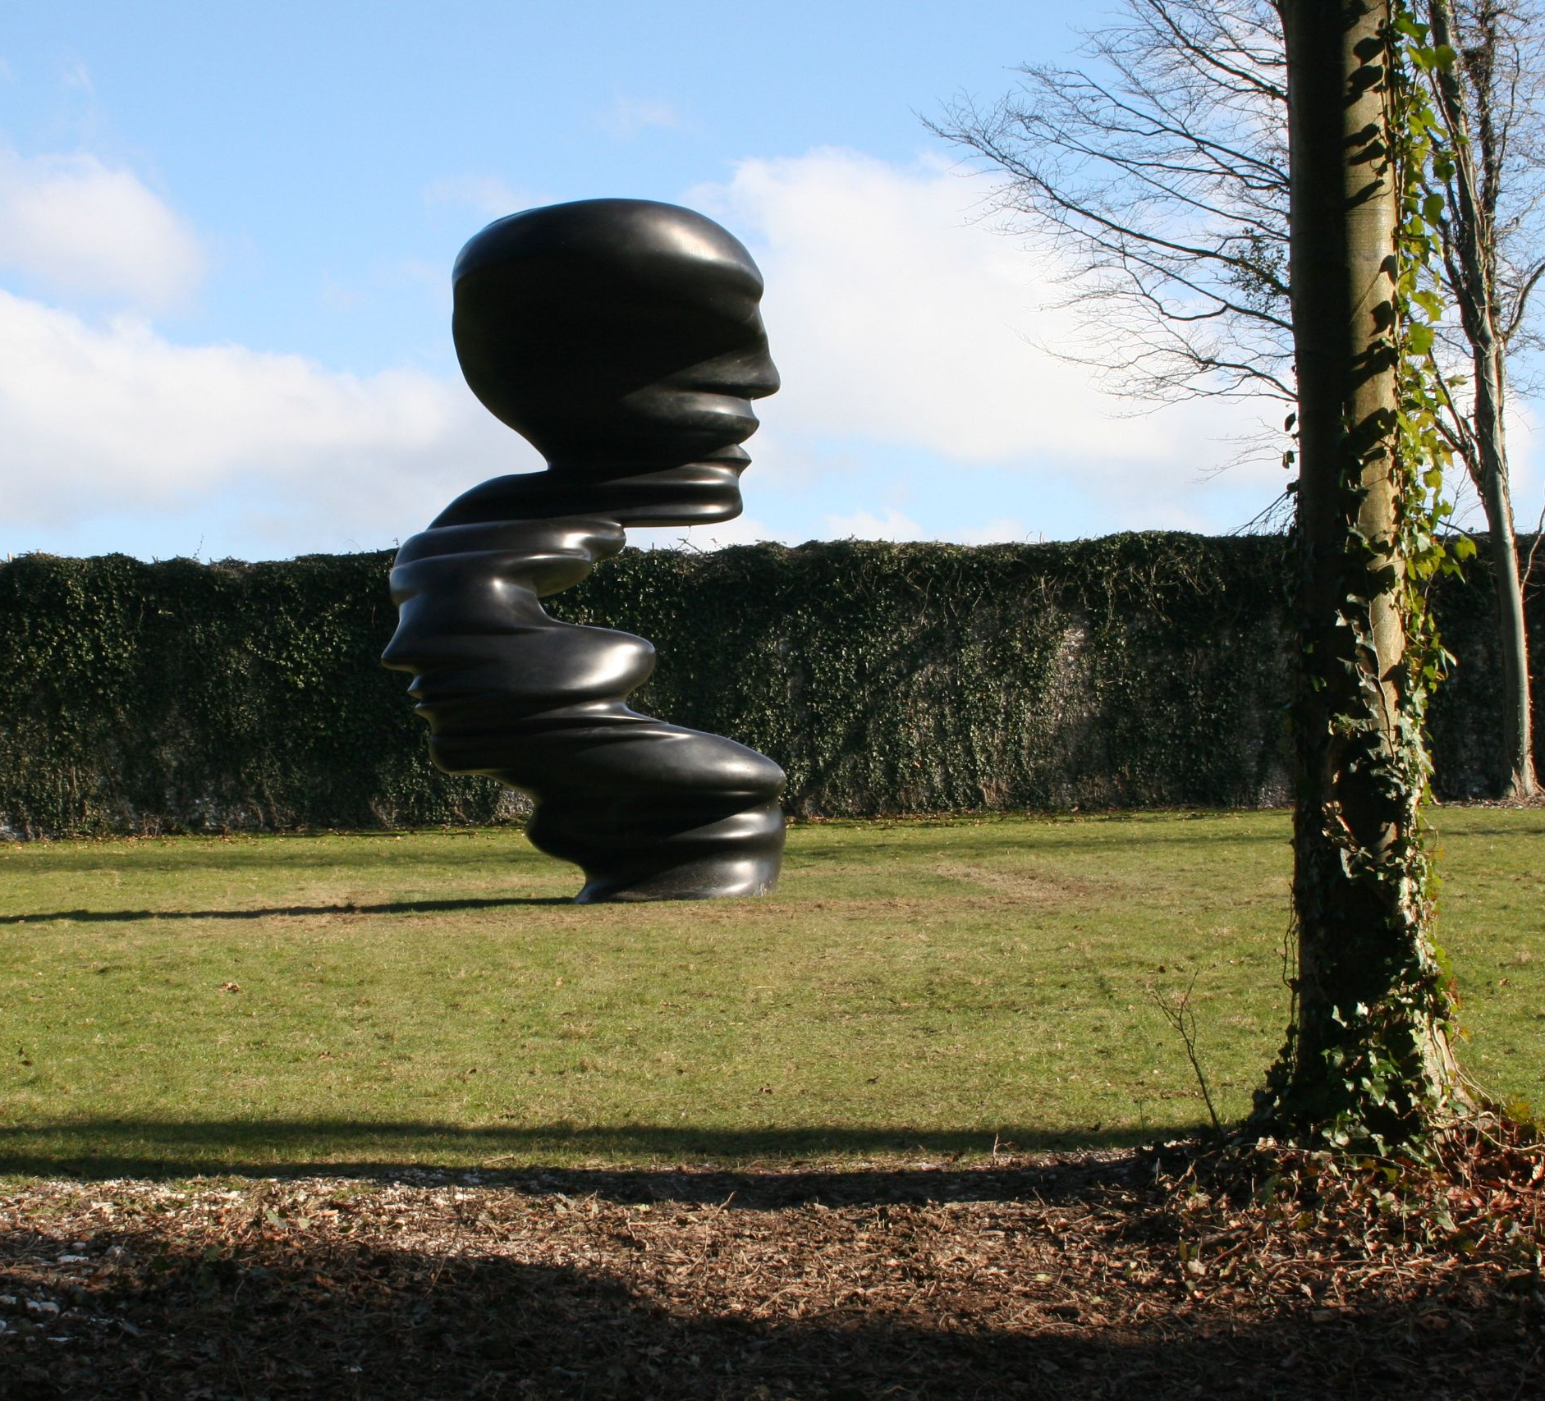
Tony Cragg
Bent of Mind (2005) alters continually as the viewer moves around it, drawing the eye to its extremities as one attempts to make sense of the shifting and distorted forms.

Slide 11
Tony Cragg Versus, 2010 Materials: Bronze Size: 56 x 61 x 22 cm

Slide 13
Tony Cragg
Homework:
Shape Shifter, the computer in the oeuvre of Tony Cragg by Anne Berk, 2012:
“To what extent did the computer enable him to create these complex shapes?”
http://anneberk.nl/articles-english/tony-cragg/
Anne Berk is a respected Dutch art critic, curator, educator and lecturer. She is actively involved in the European sculpture network.
https://sculpture-network.org/en/corporate#team

Slide 14
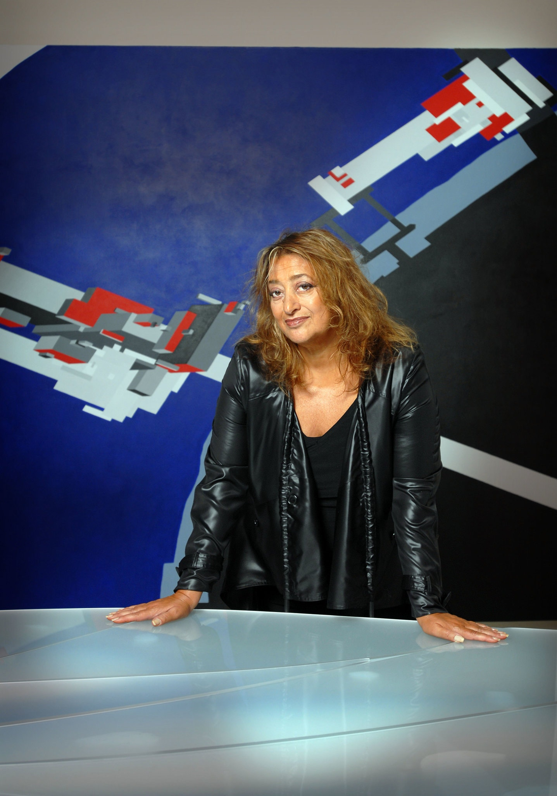
Zaha Hadid (1950-2016)
Born in Bagdad, Irak
Iraqi-British architect
"Queen of the curve”
Homeworks
https://drawingmatter.org/zaha-hadid/
https://aestheticamagazine.com/zaha-hadid-early-paintings-and-drawings/

Slide 15
The Serpentine Sackler Gallery Hyde Park, London, 2013

Slide 16
The Heydar Aliyev Center, Baku, Azerbaijan, 2012

Slide 17
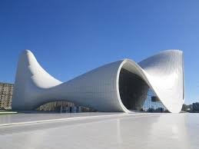
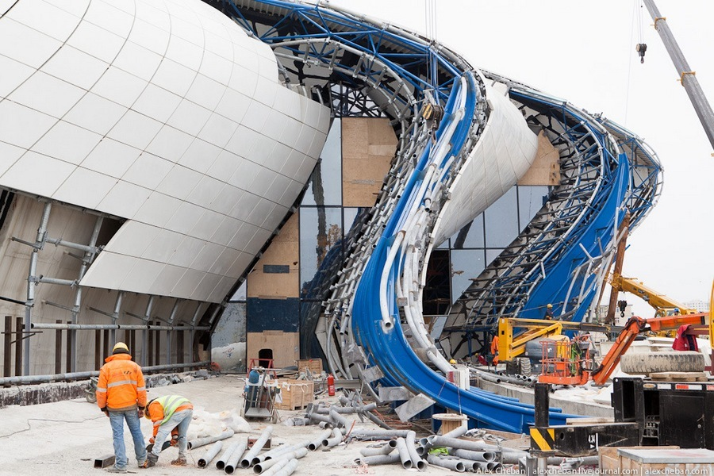

Slide 20
Aura, 2008

Slide 21
Serac, 2013

Slide 22
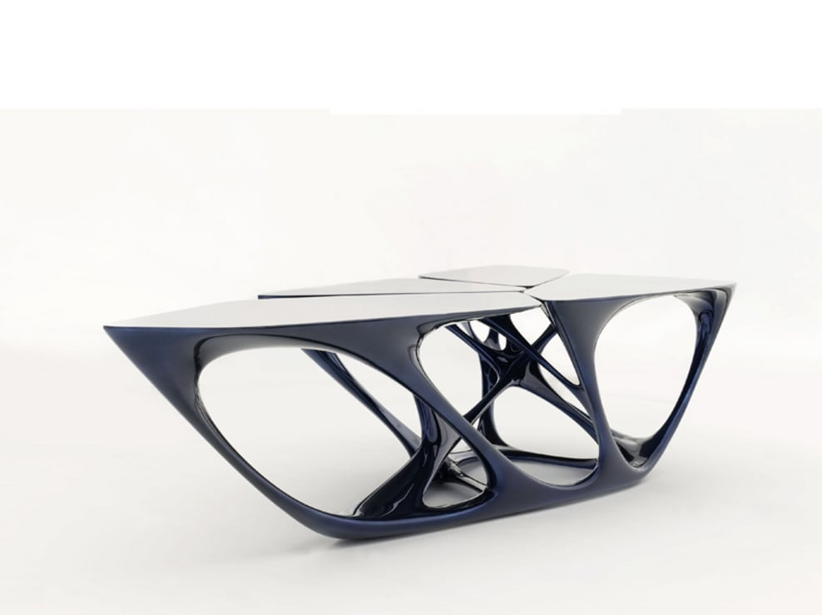
Zaha Hadid Architects
Mesa, 2008
Homework:
https://divisare.com/projects/62836-zaha-hadid-architects-mesa

Slide 23
Parametric 3D modeling
Parametricism and Patrik Schumacher (Zaha Hadid Architects)
Homework:
https://www.youtube.com/watch?v=Cfg_7ihB0YU

Slide 24
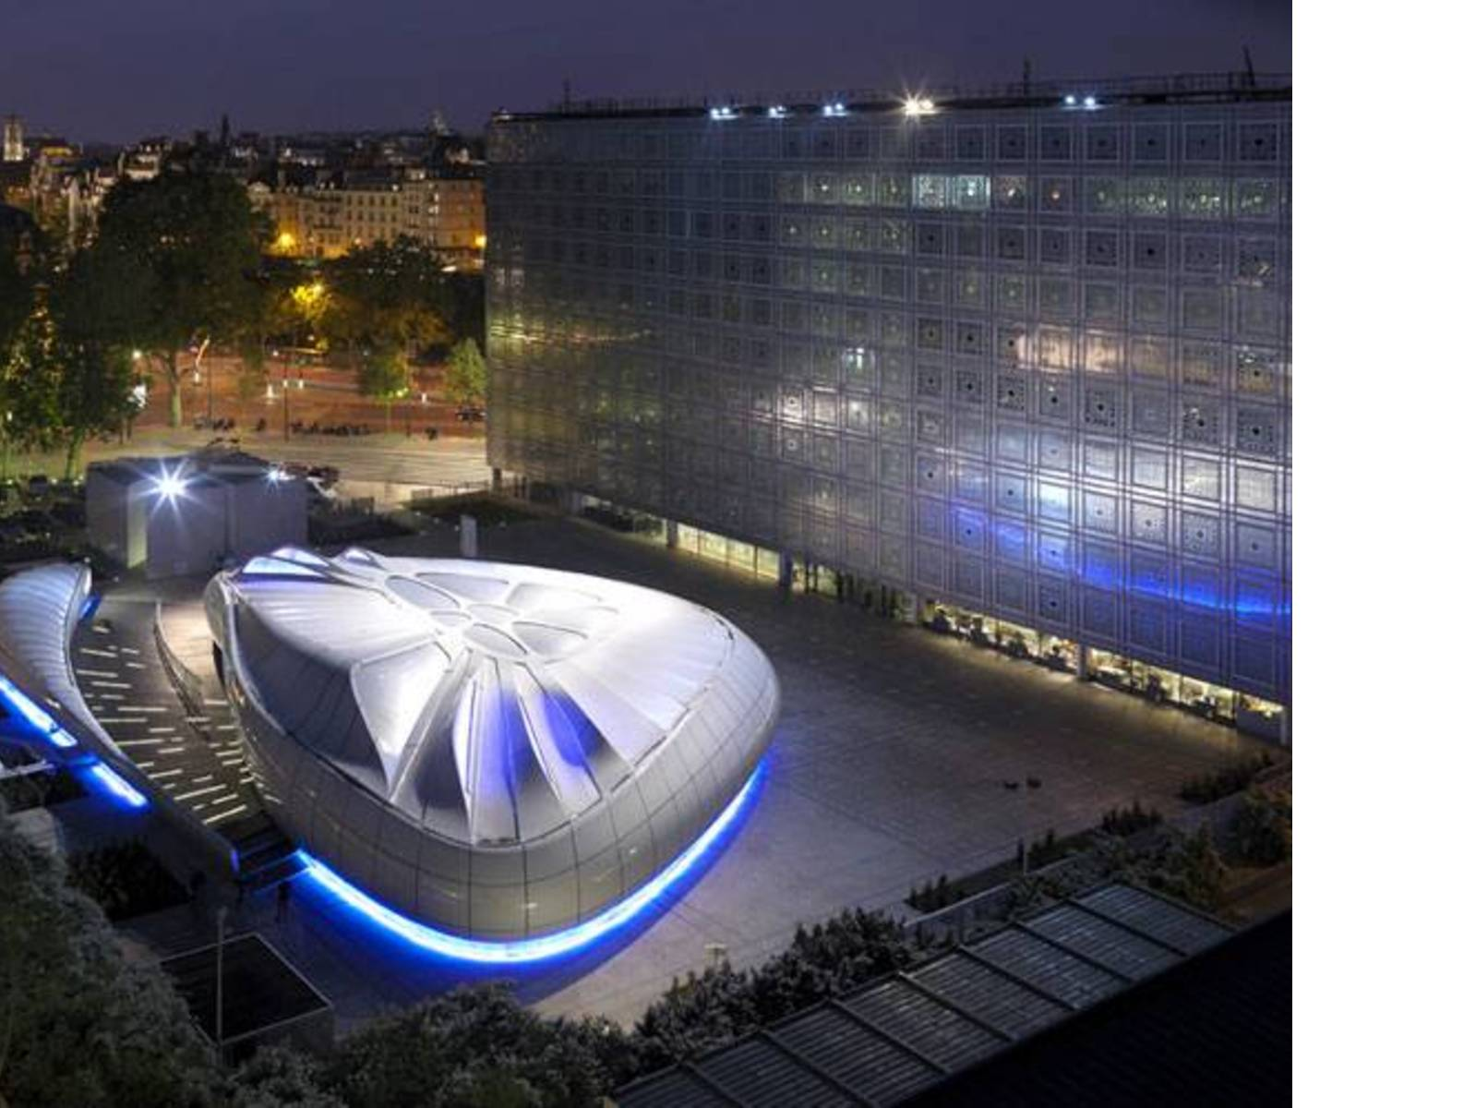
Zaha Hadid mobile art pavilion,
outside the Institute du Monde Arabe, Paris
Homework:
https://www.zaha-hadid.com/design/zaha-hadid-une-architecture/

Slide 25
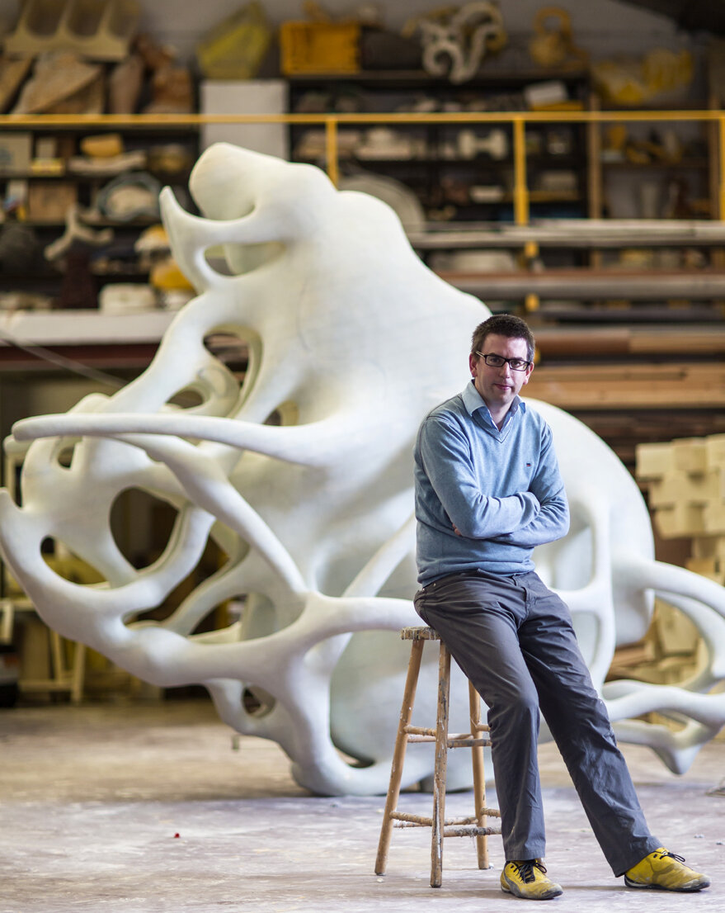
Nick Ervinck (1981)
1981, Belgium
http://nickervinck.com/en
Exhibition Now Hämeenlinna:
Nick Ervinck – GNI-RI may2021
https://www.kansallismuseo.fi/fi/naeyttelyt/nick-ervinck-gni-rimay2021

Slide 26
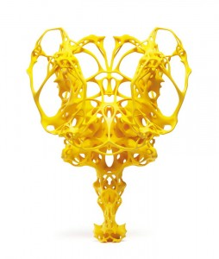
Ikrasim, 2009
Materials: SLS 3d print
Size: 60 x 46 x 35 cm

Slide 27
Agrieborz, 2009 - 2010
Materials: SLS 3d print Size: 53 x 34 x 33 cm

Slide 28
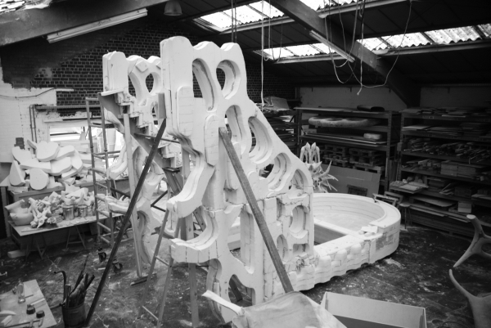
Nick Ervinck in his sudios:

Slide 29
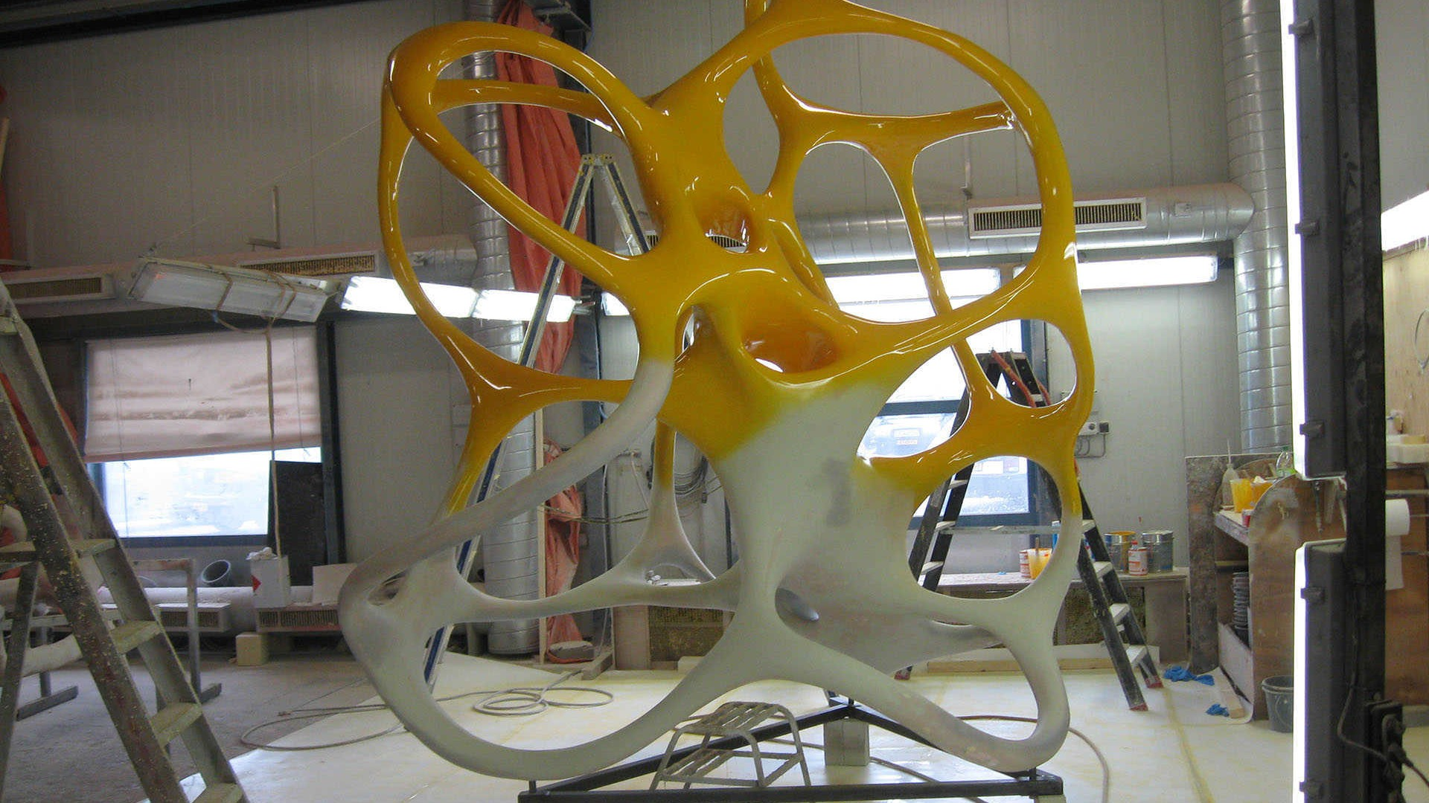

Slide 30
Warsubec, 2009 Materials: Polyester, polyurethane, wood and steel Size: 2 X 314 x 1222 x 647 cm Place: Stichting Liedts-Meesen Zebrastraat Gent

Slide 31
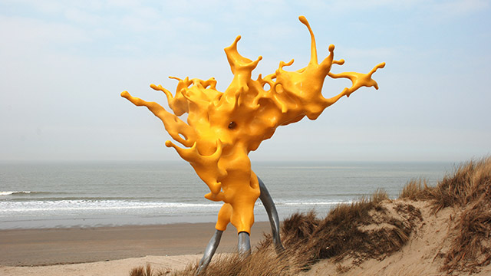
Olnetop, 2012
Size: 820 x 705 x 615 cm
http://www.hln.be/regio/nieuws-uit-middelkerke/kunstwerk-van-nick-ervinck-is-al-verhuisd-a2505086/

Slide 33
Niargtzag, 2012, Maselis - Roeselare

