Slide 1
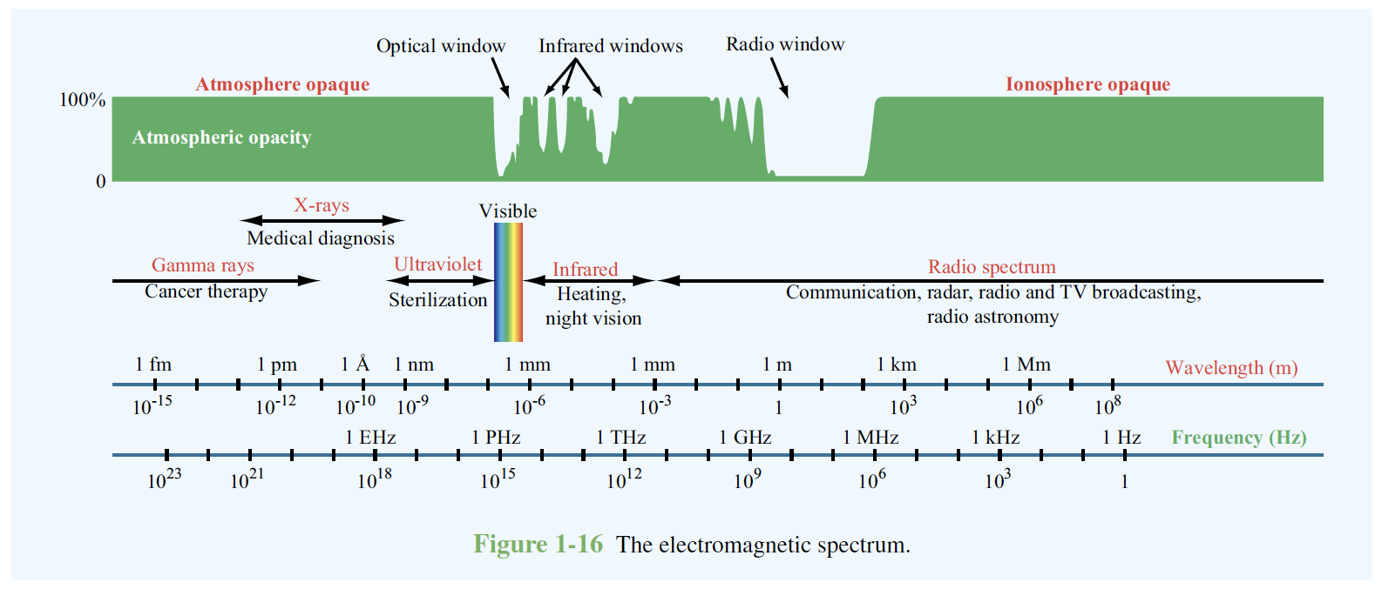
(Ulaby: Fundamentals of Applied Electromagnetics, p. 32)

Slide 2
Villard
1900
Roentgen
1895
Ritter
1801
Long ago
Herschel
1800
1960-s
Hertz
1887
(Ulaby: Fundamentals of Applied Electromagnetics, p. 32)

Slide 3
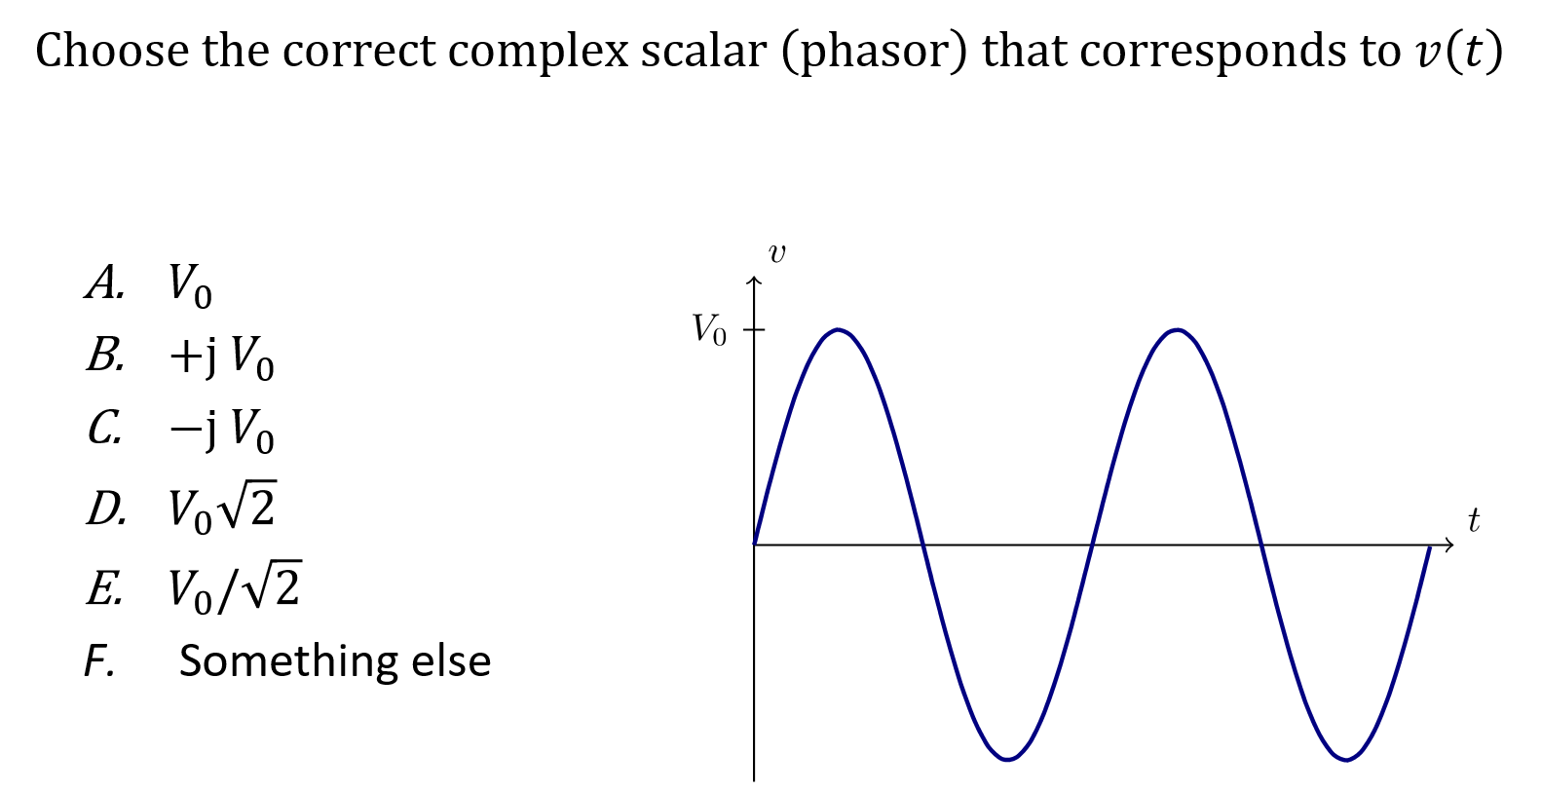

Slide 4
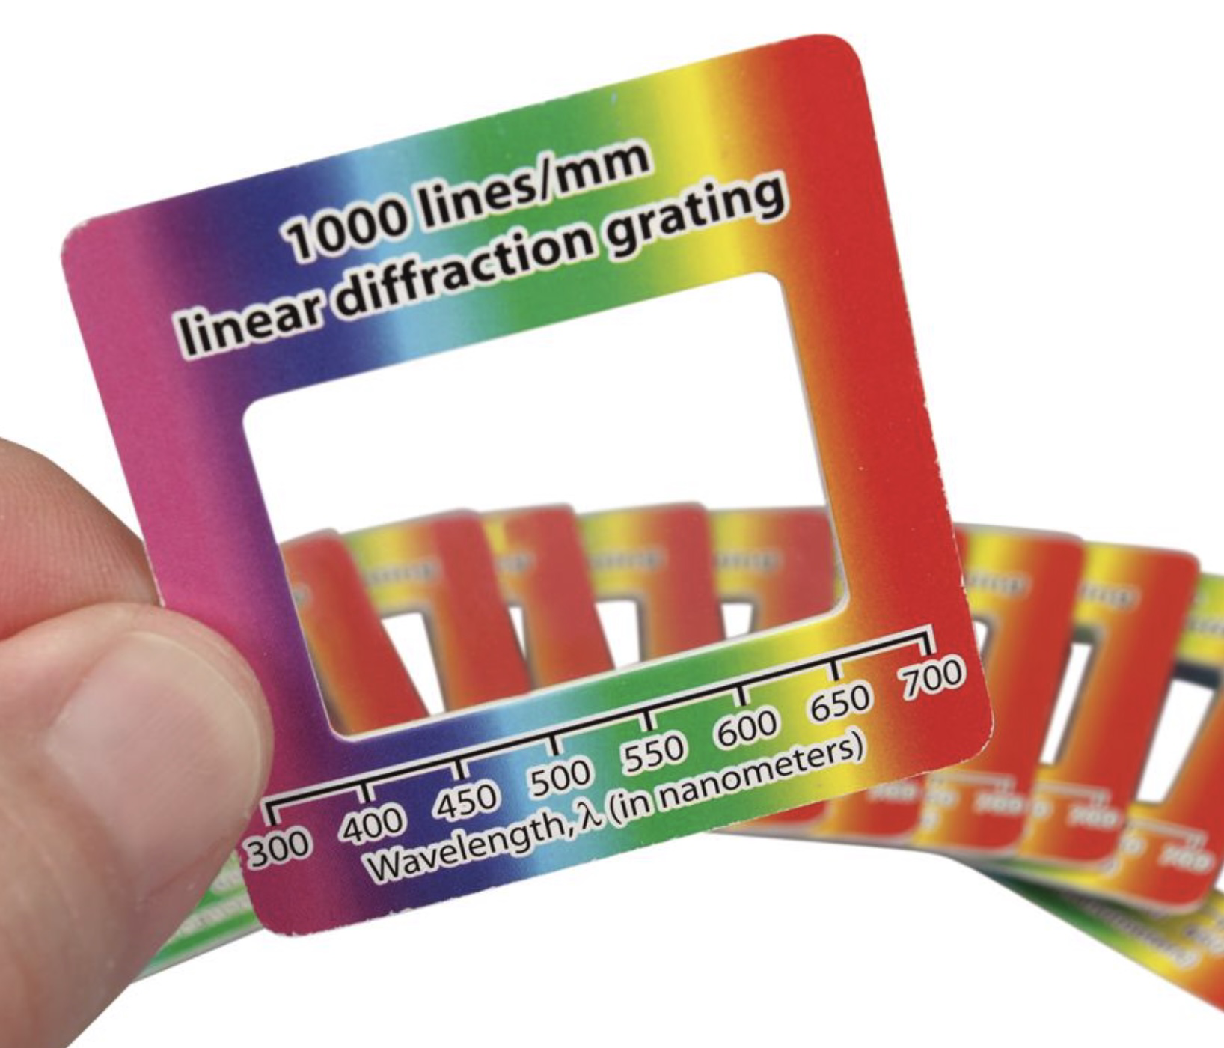
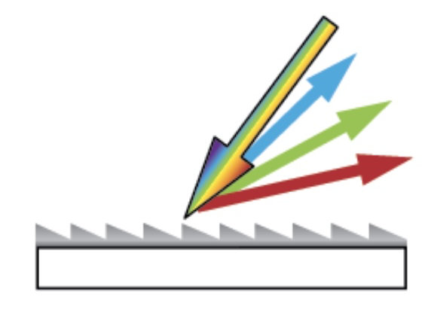

Slide 5
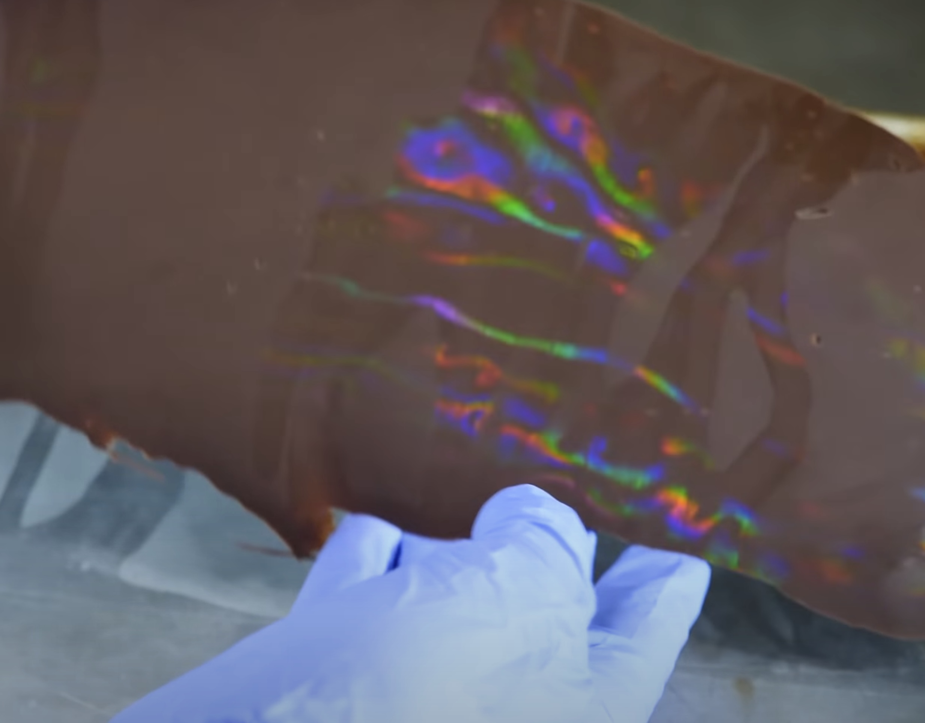
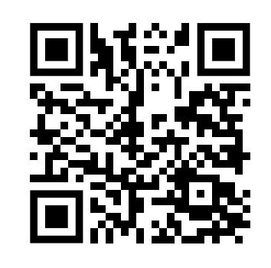
Diffraction grating on chocolate

Slide 6
Useful link with animations:
https://emanim.szialab.org/index.html

Slide 7
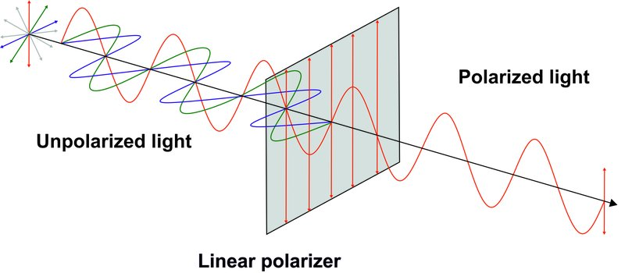
Almost no light passing in both cases
Almost no light passing only in case 1 (2nd glasses in front)
Almost no light passing only in case 2 (2nd glasses behind)

Slide 8
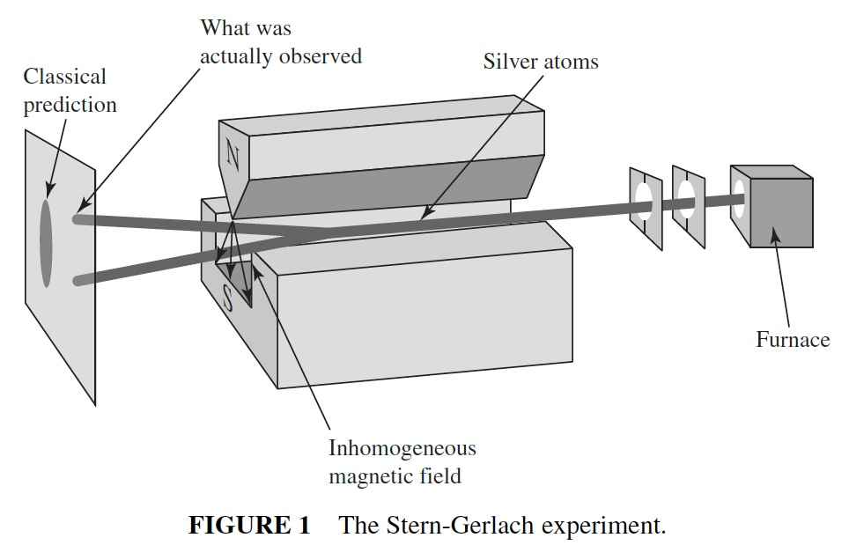
Jun John Sakurai, Jim Napolitano - Modern quantum mechanics-Pearson (2014). Chapter 1

Slide 9
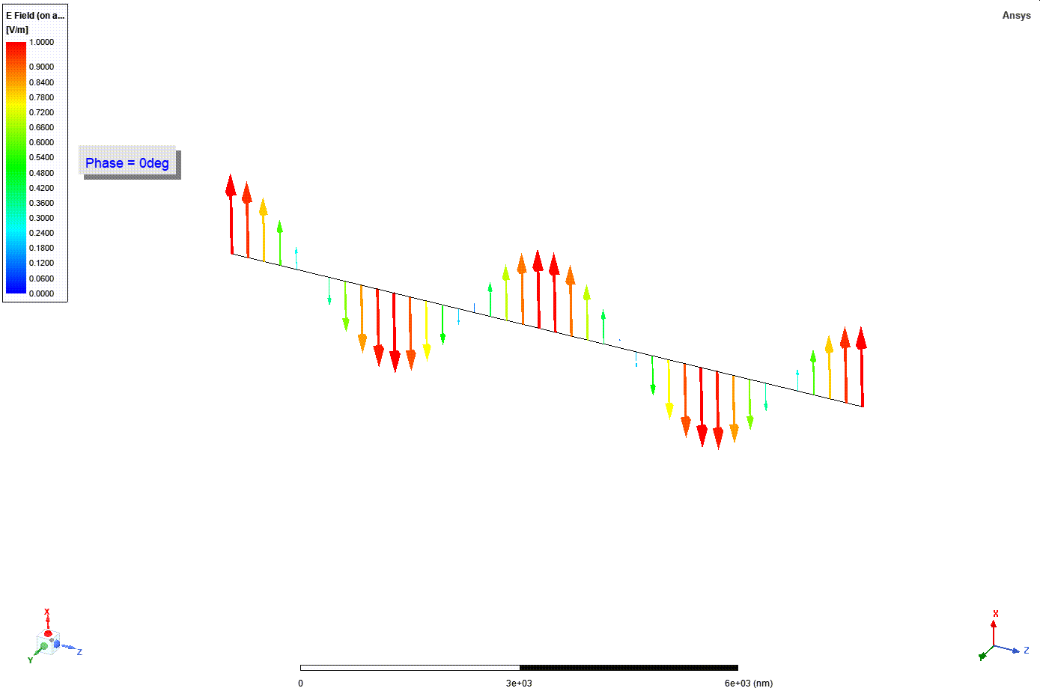
$$E\left(z,t\right)=a_{x} Re[E_{0} e^{j\left(ωt−kz\right)}] (E_{0}=1)$$

Slide 10
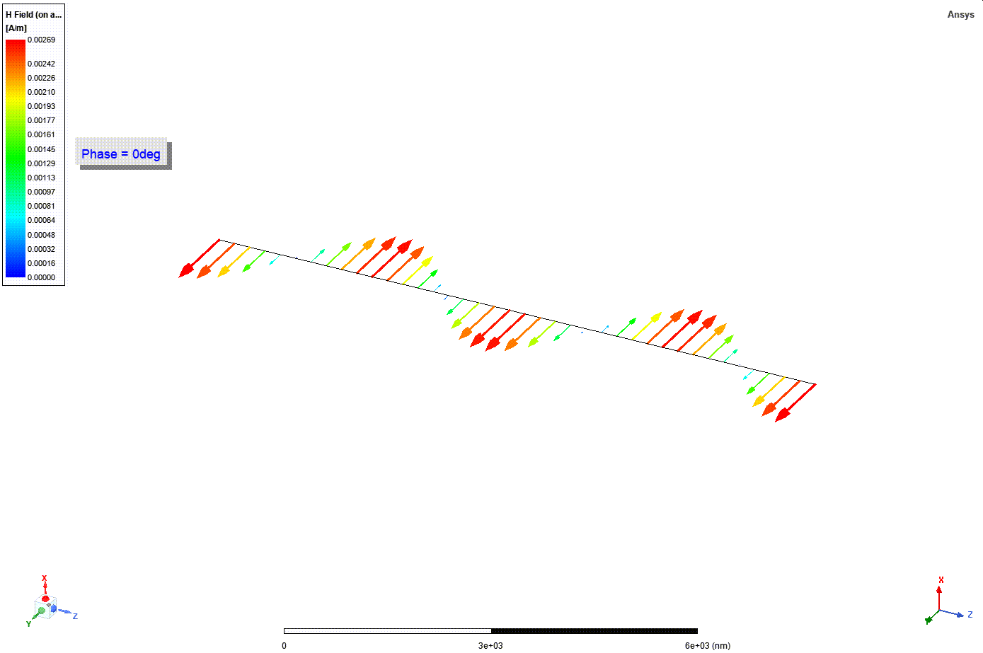
$$\frac{1}{η_{0}}=\frac{1}{377}$$
$$H\left(z,t\right)=a_{y}\frac{1}{η_{0}}Re[E_{0} e^{j\left(ωt−kz\right)}]$$

Slide 11
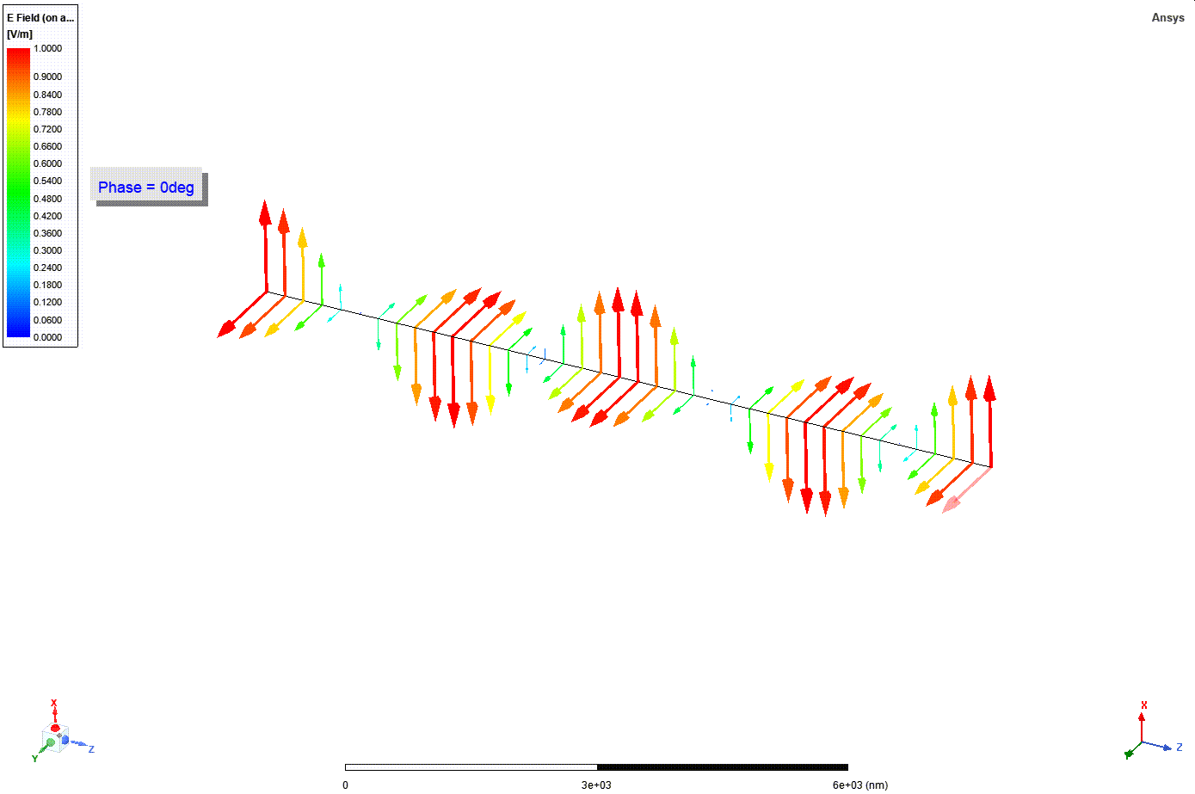
$$E\left(z,t\right)$$
$$H\left(z,t\right)$$

Slide 12
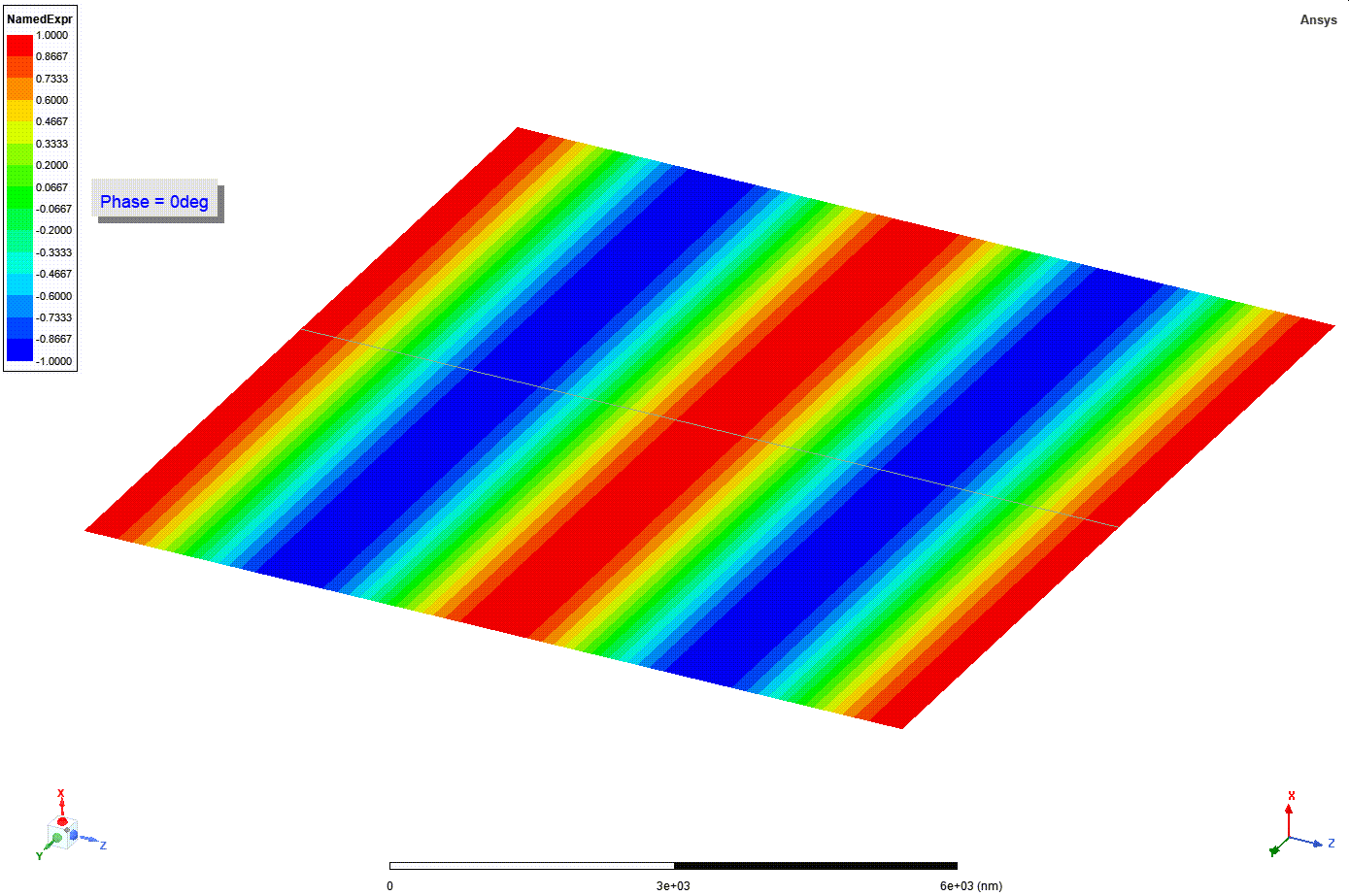
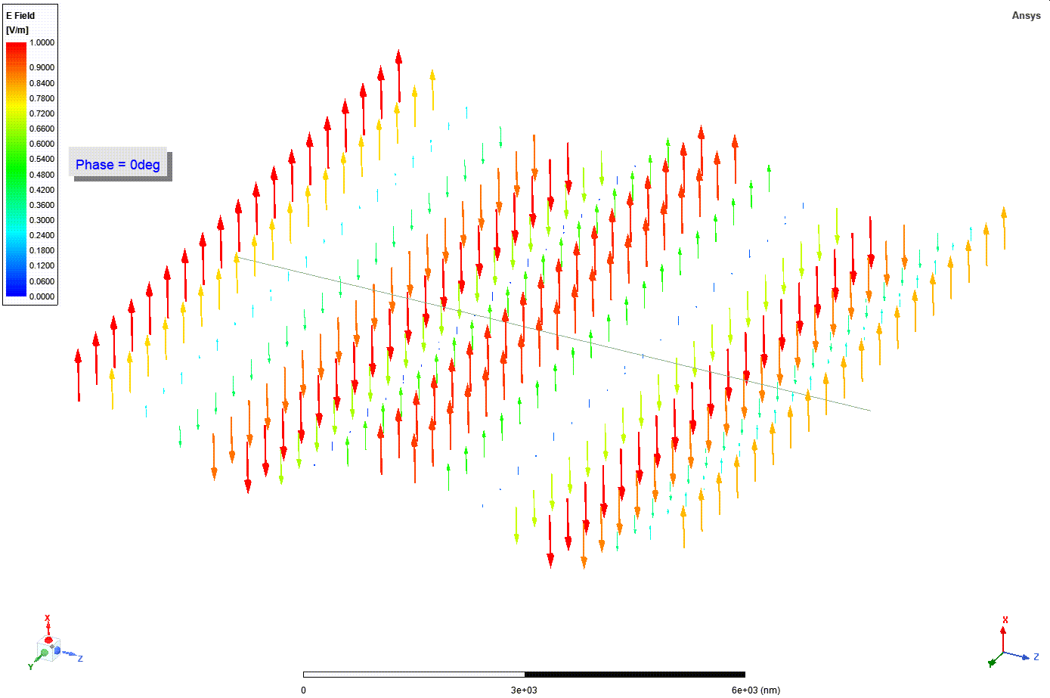
$$E\left(z,t\right)$$
$$E_{x}\left(z,t\right)$$

Slide 13
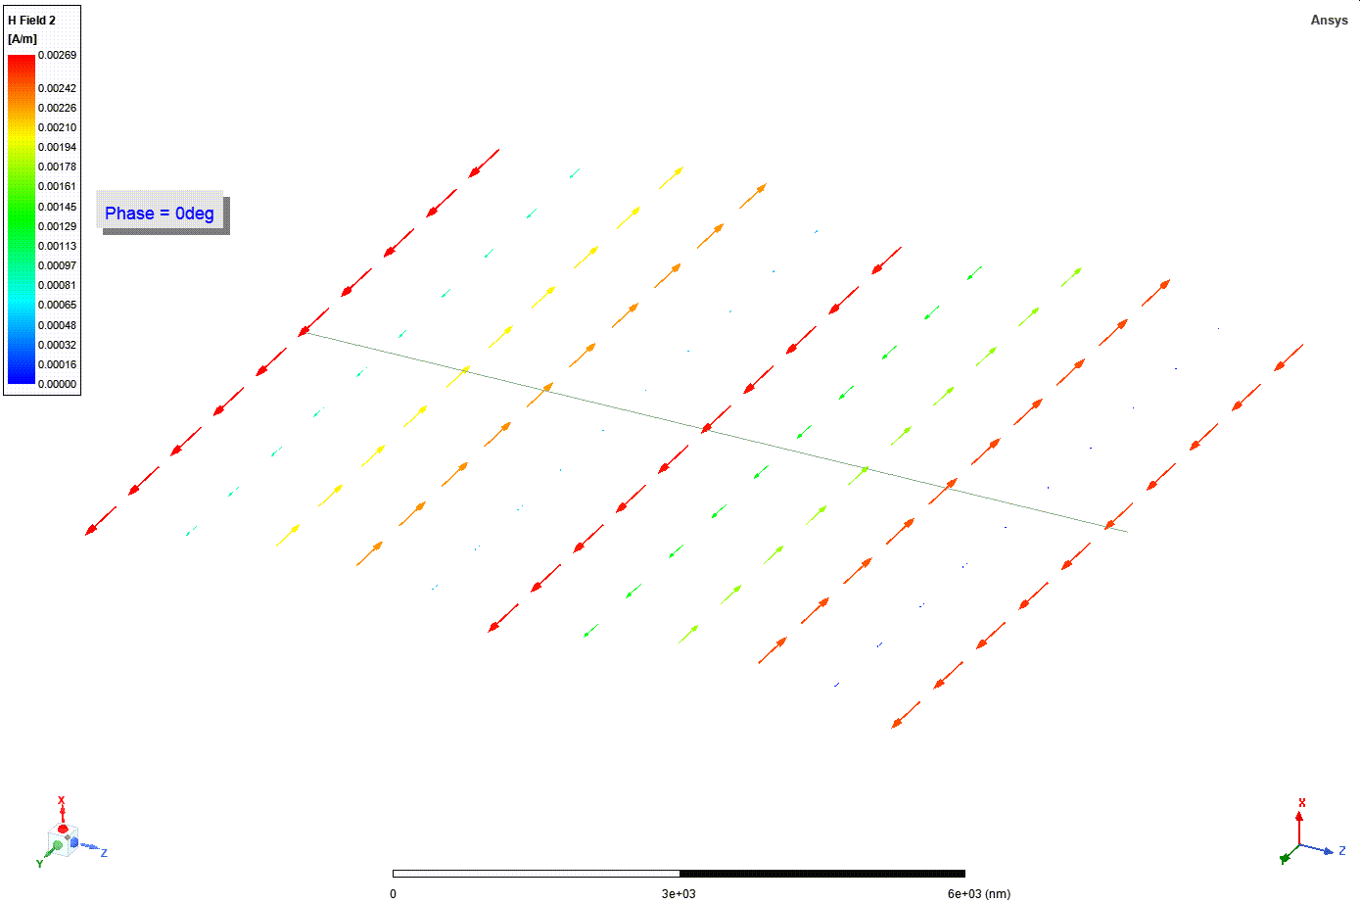
$$H\left(z,t\right)$$

Slide 14
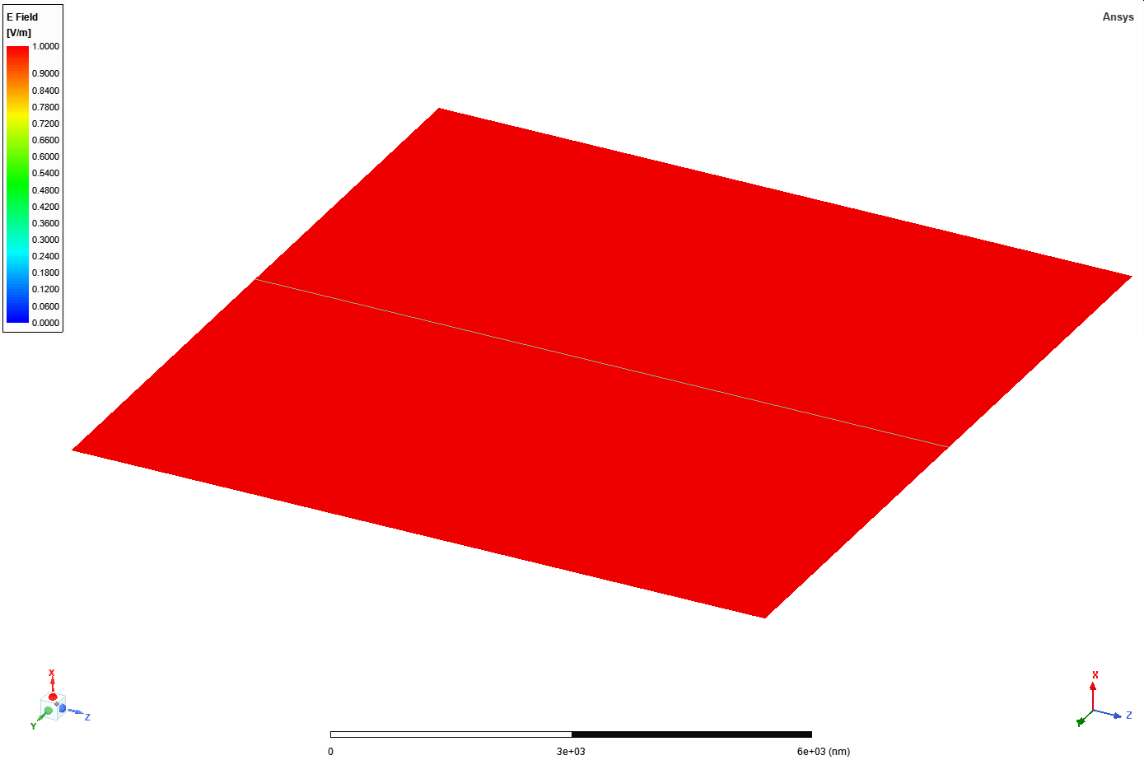
$\left|E_{0} e^{−jkz}\right| −$magnitude of the phasor

Slide 15
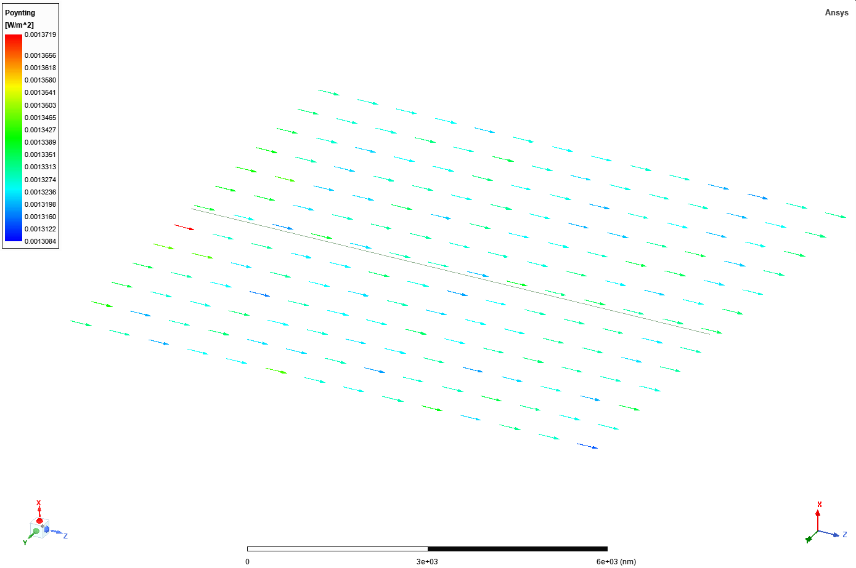
$$\frac{E_{0}^{2}}{{2η}_{0}}=\frac{1}{2⋅377}$$
$$<S>$$

Slide 16
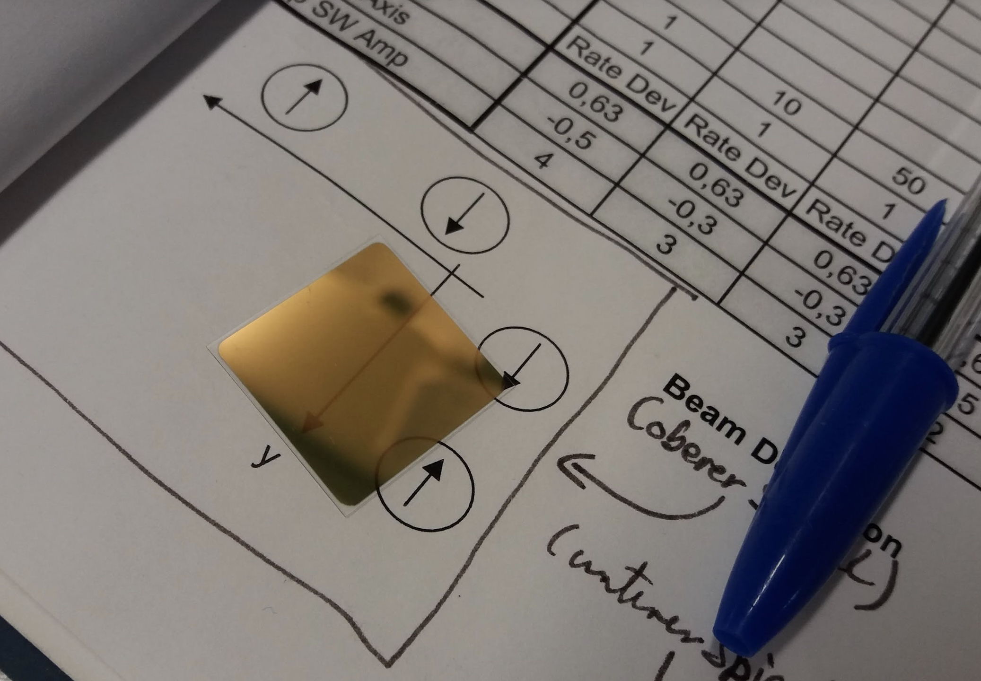

Slide 17
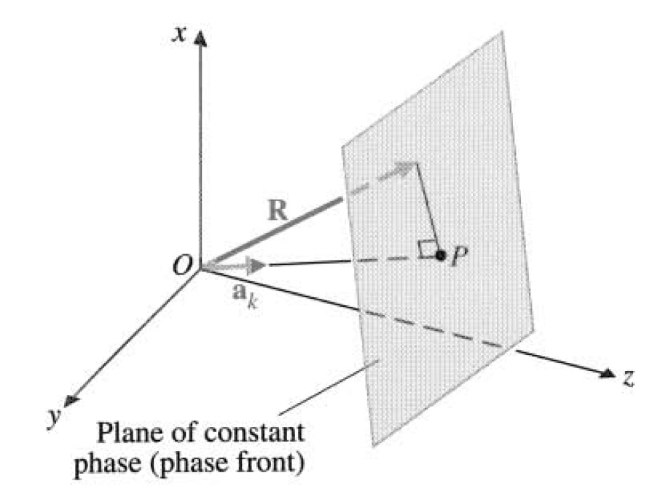
From the coursebook. Chapter 7-2.2

Slide 18
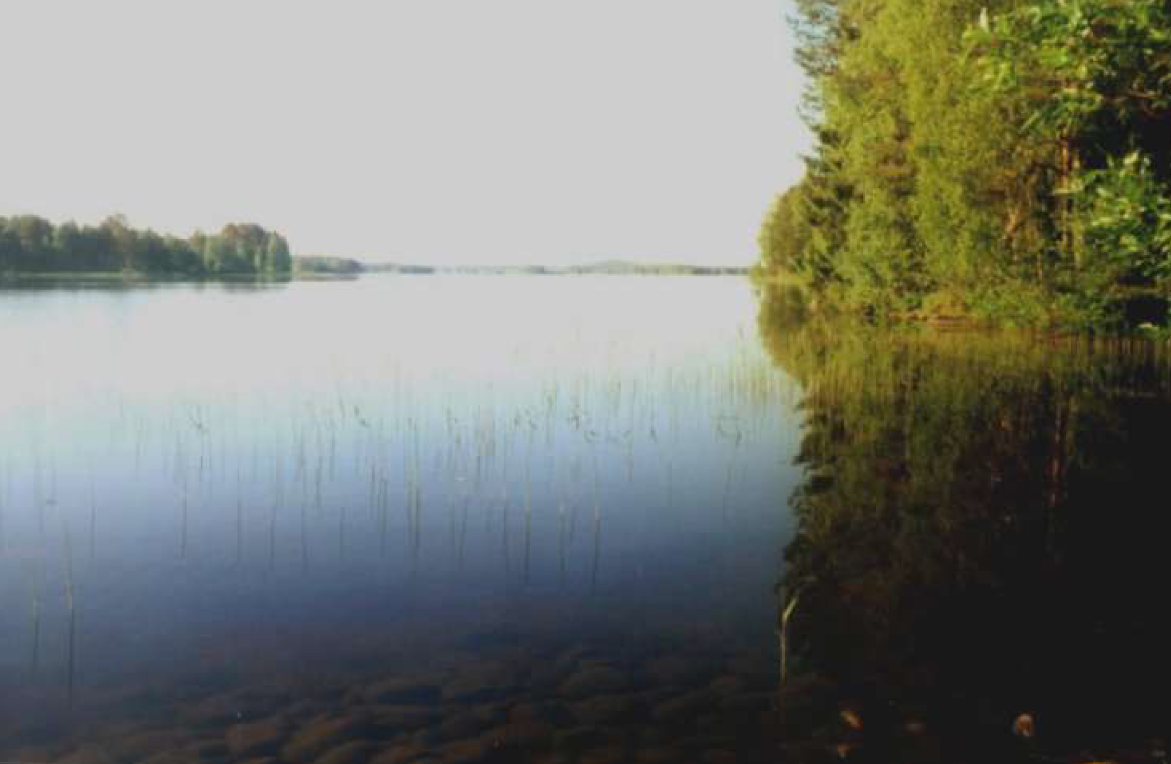
Brewster’s angle

