Slide 1
TAKING HISTORICAL EMBEDDEDNESS SERIOUSLY: THREE HISTORICAL APPROACHES TO ADVANCE STRATEGY PROCESS AND PRACTICE RESEARCH
Eero Vaara
Juha-Antti Lamberg

Slide 2
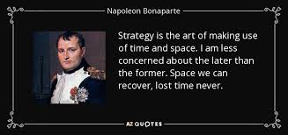
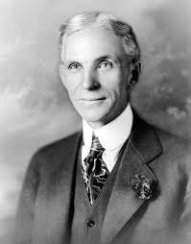
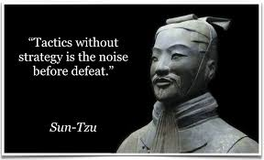
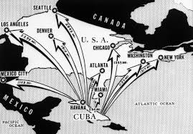
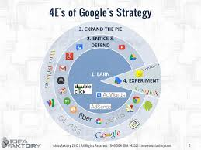
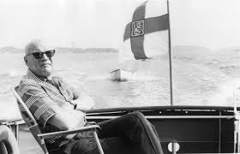
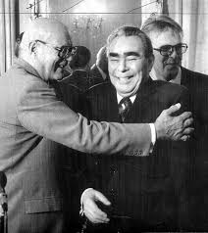
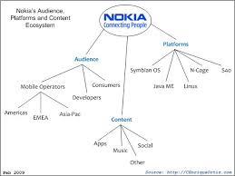

Slide 3
Introduction
Management research has generally been criticized for ignoring history
This is also the case with research on strategic management
– which is ironic as history has played an important since the very beginning of strategic management research (Chandler, 1962) and that landmark studies include longitudinal cases (Burgelman, 1983; Pettigrew, 1985)
Strategic management and business, economic, and social history have remained largely separate areas of research with few intersections (Ericsson et al., 2015; Kipping & Üsdiken, 2014)
This has hampered our understanding of key issues such as the historical embeddedness of strategic processes and practices

Slide 4
Historical embeddedness
History is not only a temporal variable or historical analysis mere use of archival data
Historical embeddedness: the ways in which strategic processes and practices and our conceptions of them are embedded in, and defined by, socio-historical environments
Strong form of historical embeddedness: One should not merely place processes and practices in context, but also understand their inherent historical nature and construction

Slide 5
Strategy process and practice research
Focus on the forms and dynamics of strategy-making in and around organizations, including intentional strategic decision-making, planning or implementation and also other forms of strategy work processes and practices

Slide 6
Strategic processes
Strategy scholars have focused attention on the social and organizational processes through which strategies have been realized since the 1970s
Some studies (Pettigrew’s 1973, 1985; Burgelman’s research on strategy-making, 1983, 2002) reflect an historical orientation by virtue of their longitudinal approach
Child (1972) has elaborated on outer structuration, Mintzberg (1977) conceptualized strategy-making as an historical process, and Pettigrew explicated on the ‘outer’ context (Pettigrew, 1997, 2012)
Nevertheless, historical aspects of strategic processes are only partially understood

Slide 7
Strategic practices
A growing interest in the detailed activities and practices of strategy has led to a proliferation of strategy-as-practice research (Golsorkhi et al., 2015)
Context has played an important role in these studies in the sense that case analyses and especially ethnographic methods have gained ground
With few exceptions (Whittington et al., 2011), history has played a limited role in this stream of research
In particular, the historical embeddedness of strategic practices has remained poorly understood in this stream of research

Slide 8
Strategic discourses
Critical reflections explicitly or implicitly linked with strategy process and practice research - often drawing from discourse analysis (Grandy & Mills, 2004; Ezzamel & Willmott, 2008, 2010; Knights & Morgan, 1991)
Recent critical work that has focused attention on the role of history in strategy (Carter, 2013)
Nevertheless, the impact of this research has remained limited

Slide 9
Three historical approaches
Realist history
Interpretative history
Poststructuralist history

Slide 10
Realist history: Embeddedness of strategic processes
Onto-epistemological basis:
Foundations in scientific realism: focus on historical structures, processes and mechanisms
Exemplary method:
Comparative historical analysis (Mahoney & Rueschemeyer, 2003):
causal relationships, processes over time and comparisons
Example: Murmann’s (2013) study of industrial coevolution
Contribution: Historical embeddedness of strategic processes
Historical conditions and triggers of strategic processes
Historical mechanisms and causality in strategic processes
Historically embedded agency of strategic actors
Comparison of patterns and characteristics of strategic processes across historical contexts

Slide 11
Interpretative history: Embeddedness of strategic practices
Onto-epistemological basis:
Social constructionism and interpretative traditions in history
Exemplary method:
Microhistory (Ginzburg, 1993; Stewart, 1959): close analysis of specific events, actions or practices
Example: Stiles’s (2009) biography of Cornelius Vanderbilt
Contribution: Historical embeddedness of strategic practices:
Historical construction of strategic practices (layers of embeddedness)
Enactment of strategic practices in historical contexts
Historically constructed roles and identities for strategic actors

Slide 12
Poststructuralist history: Embeddedness of strategic discourses
Onto-epistemological basis:
Radical social constructionism and poststructuralism
Exemplary method:
Genealogy (Foucault) – not “history”
Example: Knights & Morgan (1991)
Contribution: Historical embeddedness of strategic discourses:
Historical construction of strategic discourses and their inter-discursive features
Recontextualization of strategic discourses
Historical production of strategic truths and fashions
Historical construction of the strategy profession
Construction of forms of participation including resistance
Development of strategy tools as key part of strategic discourses

Slide 13
Epistemological and Methodological Alternatives
Fundamentally different conceptions of:
Historical narratives
Accurate description
Focus on meaning
Problematization/deconstruction
Temporality:
Long-term strategy processes
Episodes of strategy-making
Evolution and its impact
Historical truths:
Discovery of strategic phenomena and their dynamics
Meaning in situ
Discursive (de)construction

Slide 14
Facets of Historical Embeddedness and Implications
Forms of strategic processes and practices across socio-historical settings
Opening up our conceptions of what is strategic or considered as such
Looking beyond contemporary cases
Strategic emergence in context
Historical conditions for emergence
Dynamics of emergence in context
Discursive construction of strategic truths and changes in them
Strategic agency in context
Contrasting strategic actions and decisions with other cases and counterfactuals
Roles and identities of strategist in context
Subjectivity of strategists in discourse-historical contexts

Slide 15
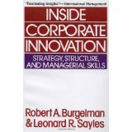
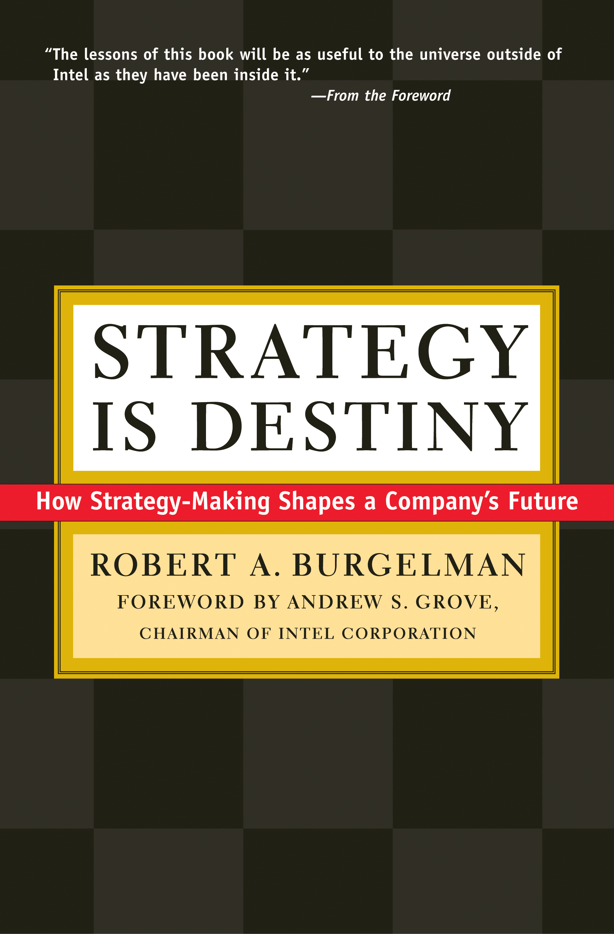
Application: Intel Case
Burgelman’s (1983, 2002) historical case analyses:
provide insights into the processes and mechanisms of strategy-making
(e.g., ‘ecological model’ and ‘vector model’)
Comparative historical analysis could:
juxtapose Intel’s case with other companies in the US or Japan in both eras and highlight how Intel’s decisions differed from those of its direct or indirect competitors
elucidate the ‘strategic nature’ of specific decisions and provide possibilities for counterfactual scenarios, i.e., reflecting upon what Intel’s development could have been without specific key decisions
help to understand ‘strategic agency’ in context
Microhistory could:
illuminate episodes of strategy-making and associated strategic practices (meetings, tools) within their historical context
further elucidate the ‘mundane’ aspects of strategy work and roles and identities of various actors, including middle managers
help to understand the contextual underpinnings of emergence
Genealogy could:
illuminate how Intel’s case relates to the dominant strategic truths or fashions
help to understand how and under what terms others such as middle managers were able to emerge as key strategists
problematize commonly held conceptions about Intel’s and other high tech companies’ strategic history

Slide 16
Conclusion
We offer concrete examples of the potential of specific approaches and methods to advance historically-informed strategy process and practice research
Focus on historical embeddedness - which can also help to understand differences in forms of strategic processes and practices, strategic emergence and strategic agency
Implications for processual and practice-based theories of organizations
Contributions to history research?

