Slide 1
Notes:
IT MIGHT BE 2024 BUT WE ARE GOING TO BLOW THE DUST OFF AN A CLASSIC FROM 1942
CREATIVE DESTRUCTION – BREAKING THINGS (DISRUPTION), FIXING THINGS (ADAPTATION)
OR THROWING THINGS OUT (DEATH)

Slide 2
revolutions occur in discrete rushes
separated by spans of comparative quiet …
there always is either revolution or
absorption of the results of revolution …
which together form business cycles
Notes:
UPSETTING THE STATUS QUO (RULE BOOKS, CONVENTIONS)
OFTEN HEAR WORDS LIKE OVERTHROW

Slide 3
revolutions occur in discrete rushes
separated by spans of comparative quiet …
there always is either revolution or
absorption of the results of revolution …
which together form business cycles
Notes:
THINK TORNADO (AIR) OR WHIRLPOOL (WATER)
IN VENTURE CAPITAL CIRCUITS WE SPEAK OF THE “HERD”

Slide 4
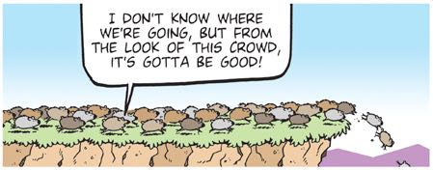
Notes:
THE HERD MENTALITY – WINCESTER DISC DRIVE INDUSTRY
OR FOOD DELIVERY!

Slide 5
Or in today’s parlance …
move fast and
break things
Notes:
THE SENTIMENT CAPTURED SUCCINCTLY

Slide 6
revolutions occur in discrete rushes
separated by spans of comparative quiet …
there always is either revolution or
absorption of the results of revolution …
which together form business cycles
Notes:
IN THESE KINDS OF CONDITION – YOU CAN PLAN (STABILITY)

Slide 7
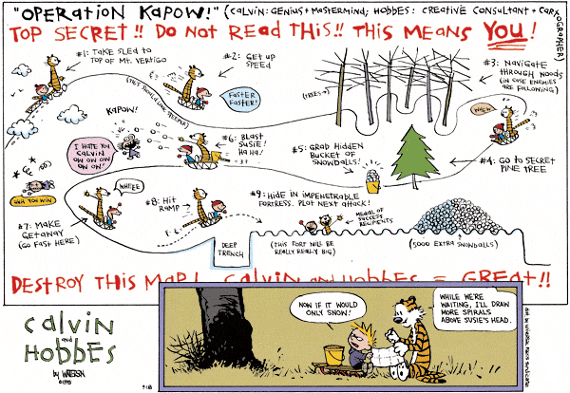
Notes:
STABILITY LURES YOU INTO PLANNING MODE ….

Slide 8
revolutions occur in discrete rushes
separated by spans of comparative quiet …
there always is either revolution or
absorption of the results of revolution …
which together form business cycles
Notes:
CYCLICAL (INCESSANT AND THE WORD IS PLURAL)
TIMING IS A CRUCIAL FACTOR

Slide 10
Notes:
MY LATEST READ HOT OFF THE PRESS (2023)

Slide 11
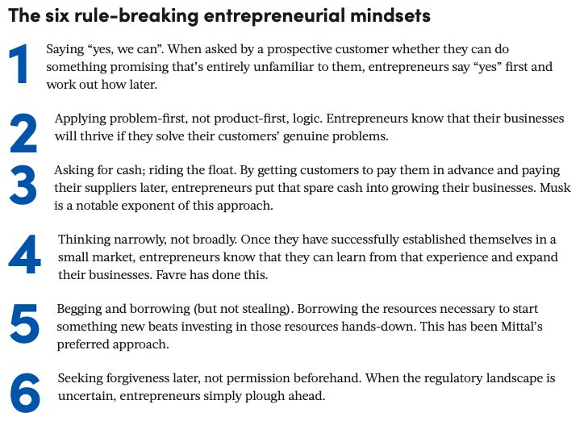
Notes:
MY LATEST READ HOT OFF THE PRESS (2023)

Slide 12
and in startup finance circles …
timing matters

Slide 13
Notes:
LET’S GO BACK 4 YEARS

Slide 14
Notes:
THERE WAS SOMETHING IN THE AIR …
JAN 13/20 1ST CASE US, 16 DAYS LATER FINLAND

Slide 15
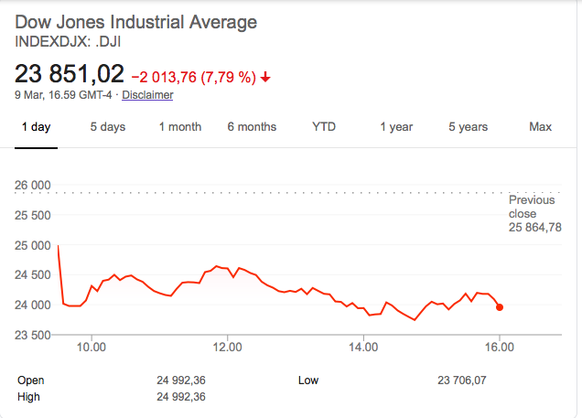
-37%
Notes:
BY NOW COVID GAINING TRACTION
DOW HIT A RECORD 29551 ON FEB 12TH
AND CONTINUED TO DROP TO 18592 BY MAR 23RD

Slide 16
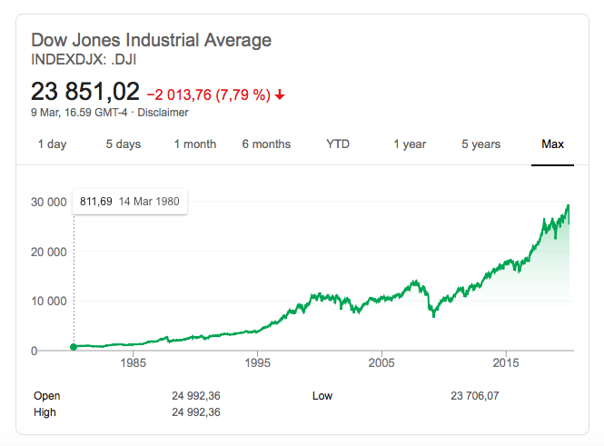
Notes:
SHORT TERM PERSPECTIVE CAN FOOL YOU … LETS LOOK OVER LONGER TERM

Slide 17
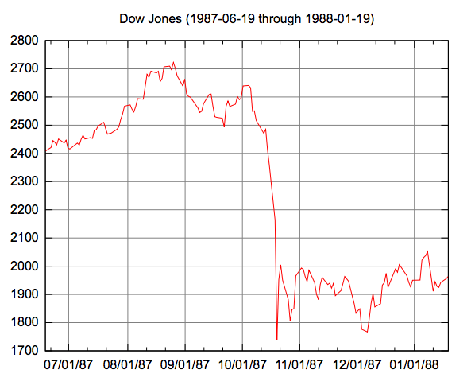
2722
Notes:
CORPORATE AND INVESTMENT BANKER IN CANADA
25 AUGUST 1987 – 5 YEAR STOCK HIGH

Slide 18
Wednesday October 14
unfavorable tax changes pass Congress
rising trade deficit reported
interest rate hike announced
value of the $ falling
Notes:
WHICH LEADS TO WHAT KIND OF SENTIMENT IN MARKETS?
US PRIME LENDING RATE 9%

Slide 19
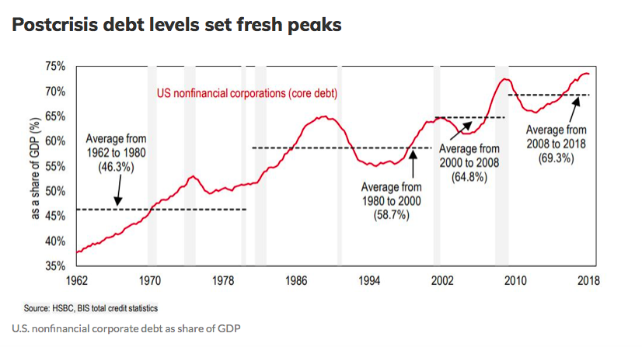
Notes:
AND REMEMBER THAT INTEREST RATES HAVE BEEN HIKED AND GOING HIGHER

Slide 20
Market close Friday October 16
2246,74
Notes:
-11% FROM WEDNESDAY
-18% FROM ALL TIME HIGH
OVER WEEKEND – COMPUTER MODELS START PLACING SELL ORDERS &
MANY MUTUAL FUNDS HAVE ESTABLISHED PRACTICE OF ALLOWING THEIR CUSTOMERS TO REDEEM OVER WEEKENDS
AT FRIDAY CLOSING PRICES ---

Slide 21
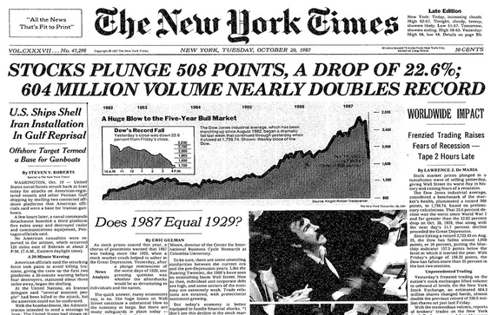
Notes:
SELL ORDERS DWARFED BUY ORDERS BY AN UNPRECEDENTED MAGNITUDE
AND I KNEW A GUY ON THE TRADING FLOOR WHO SHORTED THE MARKET ON FRIDAY …

Slide 22
Notes:
THIS WAS THE PERIOD WHEN GOOGLE (1992), APPLE (1985), EBAY (1995)
PAYPAL (1998), AMAZON (1994), NETSCAPE (1994) AOL (1985) PALM (1992)
BLACKBERRY (1994) WERE FORMED

Slide 23
Notes:
INTEREST RATES START TO CREEP UP A LITTLE

Slide 24
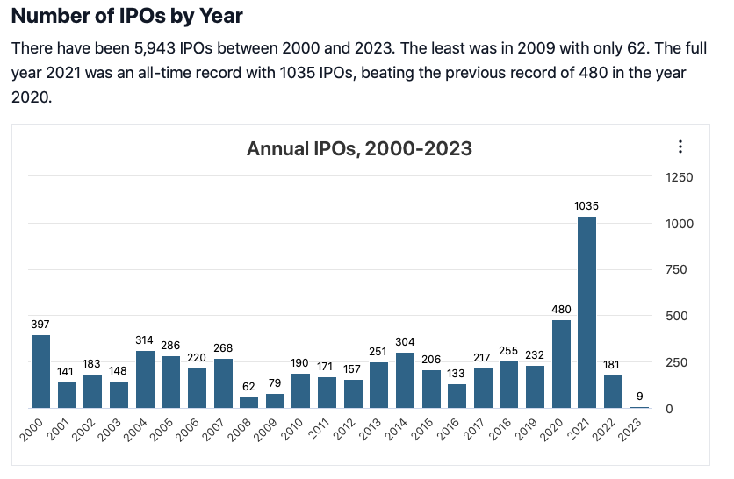
Notes:
APPETITE FOR ENTREPRENEURIAL RISK OFF THE CHARTS
A RECORD NUMBER OF COMPANIES WENT PUBLIC IN 2000 – WHAT WAS KNOWN AS THE DOT.COM BOOM

Slide 25
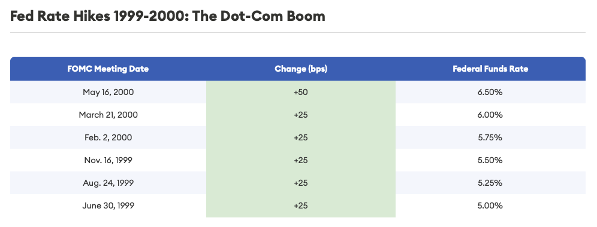
Notes:
US PRIME RATE HOVERING AT 8% - 9,5%

Slide 26
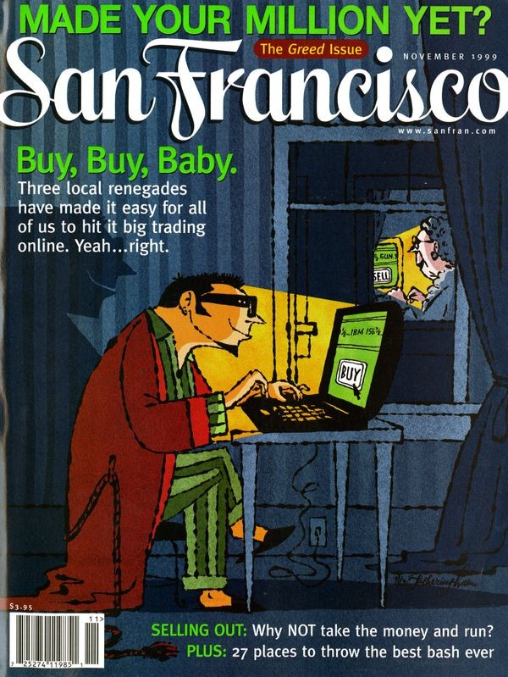
Notes:
WHEN YOU SEE COVERS LIKE THIS, HEAD FOR THE HILLS

Slide 27
Notes:
AS INTEREST RATES RISE, DEMAND FOR LOANS PEAKS

Slide 28
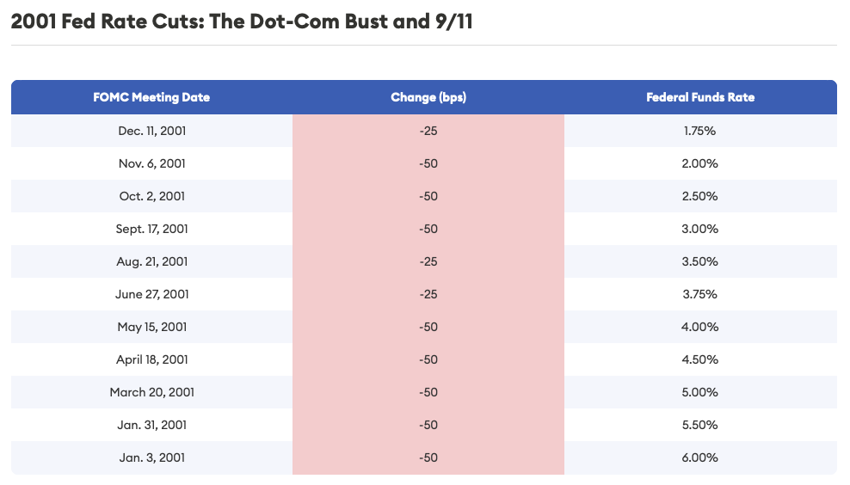
Notes:
US PRIME RATE DROPPING FAST FROM 9,5% - 4,75%

Slide 29
Notes:
DROP OF 2/3

Slide 30
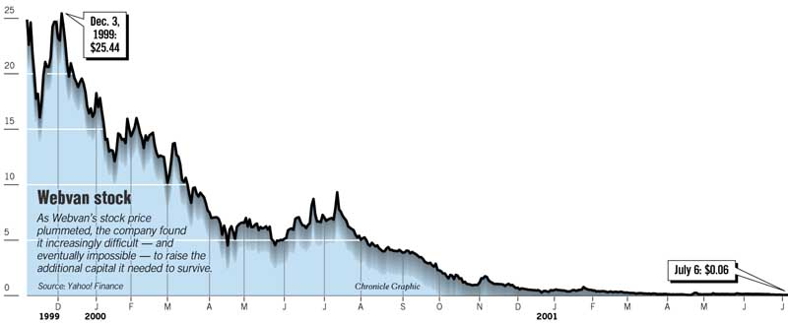
“revolutionize the way people
buy groceries”
Notes:
RAISED $400M IN VC (SOFTBANK, SEQUOIA & BENCHMARK) 1989-99
RAISED $400M IN IPO LATE 1999
IN 2000 CUSTOMERS BOUGHT $179M IN GROCERIES, WEBVAN LOST $525M FILLING THOSE ORDERS!

Slide 31
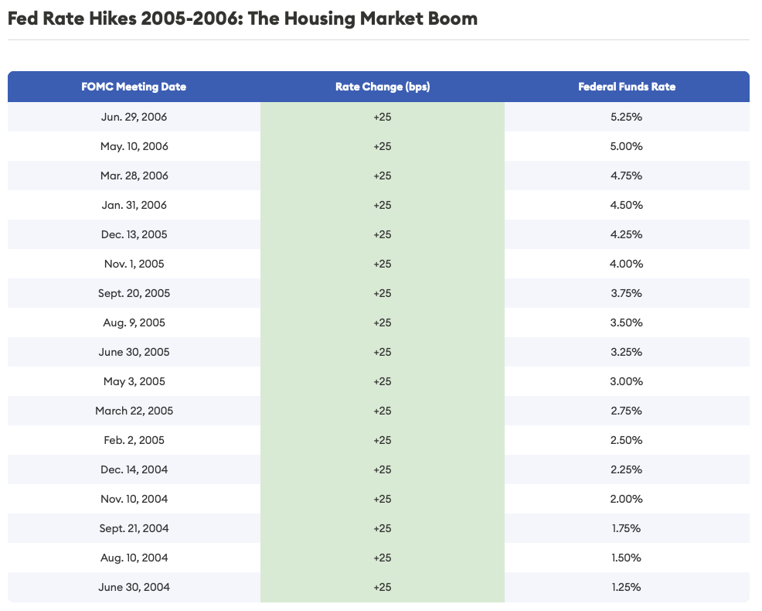
Notes:
2005 5,25% BY END 2006 8,25%

Slide 32
Notes:
AT BEGINNING OF 2004 DEBT LEVELS FALLING .. BUT SOON RISE

Slide 33
Notes:
NOT QUITE AT DOT COM BOOM LEVEL BUT SOLID RECOVERY TO ”NORMAL” TREND

Slide 34
Notes:
UPWARD SLOPE AGAIN BEFORE FALLING OFF A CLIFF – WHAT HAPPENED?

Slide 35
Notes:
DEBT LEVELS ON THE RISE

Slide 36
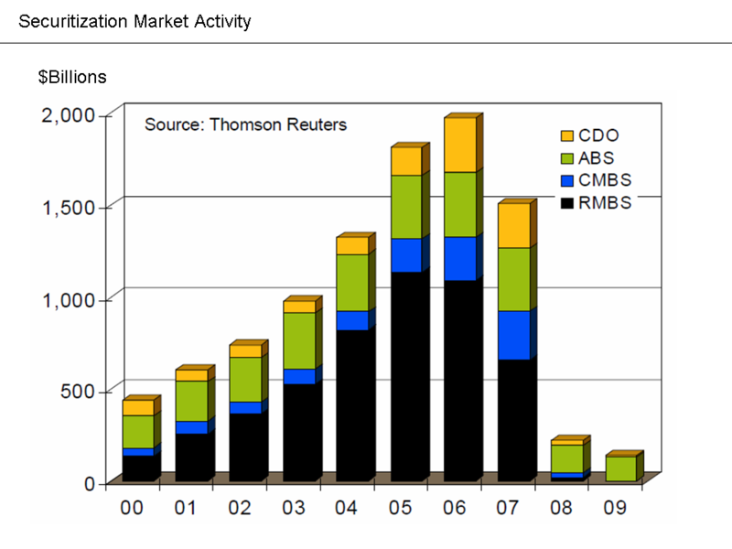
Notes:
CDO = COLLATERAL DEBT OBLIGATIONS (COLLATERAL OTHER THAN WORKING CAPITAL OR SOME TYPES OF REAL ESTATE)
ABS = ASSET BACKED SECURITIES (INCOME GENERATING ASSETS)
CMBS = COMMERCIAL MORTGAGE BACKED SECURITIES
RMBS = RESIDENTIAL

Slide 37
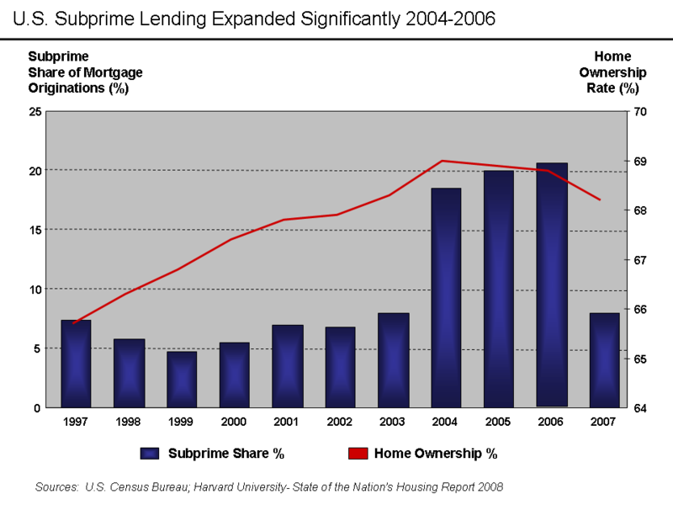
Notes:
WHAT IS THE VALUE OF A RESIDENTIAL MORTGAGE IF HOMEOWNER IS ???

Slide 38
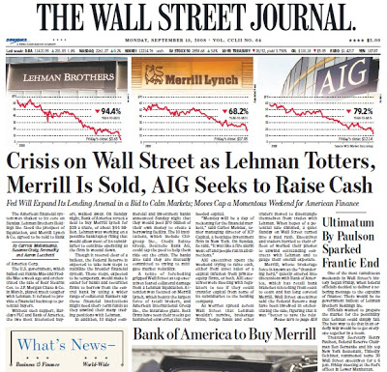
Notes:
HOUSING MARKET AND RMBS COLLAPSE, INTERBANK RATES RISE, BANKS STOP LENDING EACH OTHER
CONGRESS FAILED TO PASS A RELIEF BILL (29 SEP 2008 PASSED ON 3 OCTOBER 2008)
LEHMAN (BUST), MERRILL (BOUGHT) AND AIG (BACKED UP)

Slide 39
Market close October 9, 2007
14164,53

Slide 40
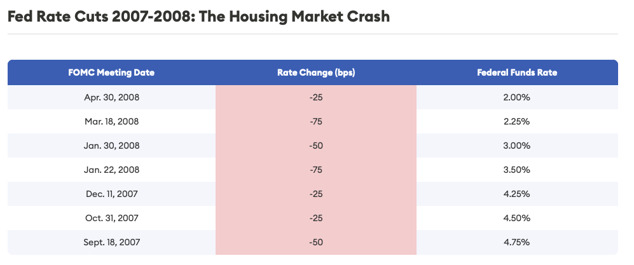
Notes:
RATES STARTED 2007 8,25% BY END OF 2008 3,25%

Slide 41
Notes:
3,25%

Slide 42
Market close March 6, 2009
6443,27
Notes:
-55% FROM THE HIGH ESTABLISHED OCTOBER 2007
-45% OF THE LEVEL FROM 12 SEPTEMBER 2008 (PRE LEHMAN)

Slide 43
Notes:
THE IPO MARKET COLLAPSES

Slide 44
Market close December 31, 2009
10428,05
Notes:
62% UP SINCE MARCH

Slide 45
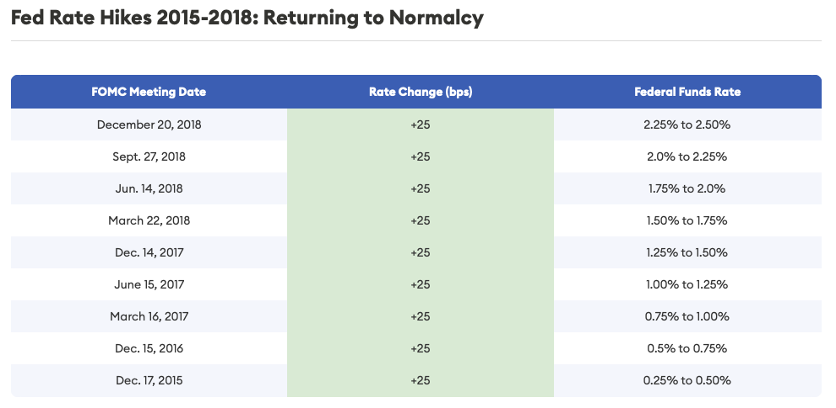
Notes:
STABLE PRIME RATE AT 3,25% 2009-2014
RATES STARTED AT 3,25% IN BEGINNING OF 2015
BY END OF 2018 5,5%

Slide 46
Market close December 31, 2015
17425,03
Notes:
67% INCREASE OVER 6 YEARS

Slide 47
Notes:
MARKETS CONTINUE ALONG THE ASCENT POST BANKING CRISIS

Slide 48
Notes:
FAIRLY STABLE AROUND THE “NORM”

Slide 49
Market close December 31, 2019
28538,44
Notes:
+64% IN THE 4 YEAR PERIOD

Slide 50
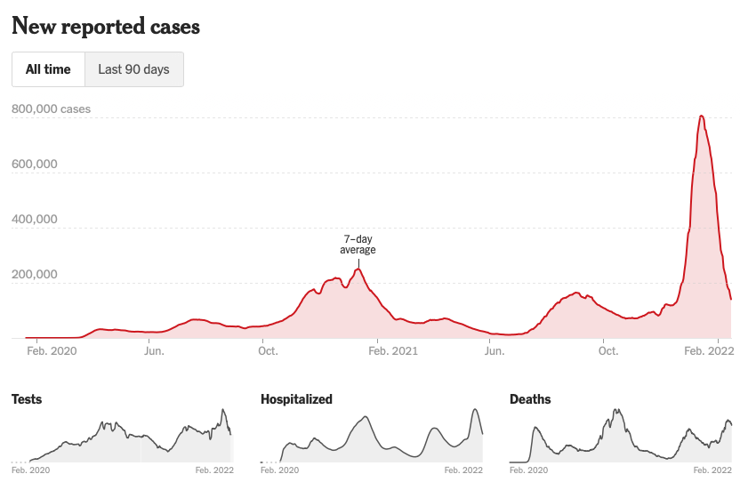
Notes:
PANDEMIC TAKES HOLD AND OPERATION WARP SPEED – VACCINE DEVELOPMENT
WHAT WOULD YOU THINK HAPPENS TO AN ECONOMY?

Slide 51
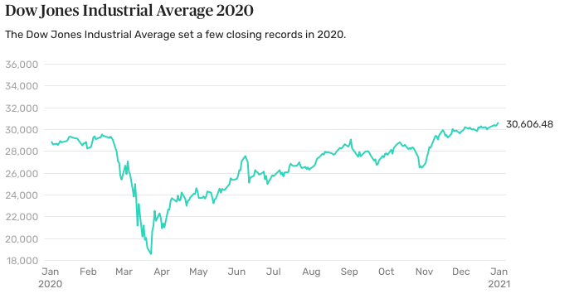
Notes:
FEBRUARY 12, 2020 (29551)
BY MARCH 23, 2020 (18592) -37%
FINNAIR -40% ROYAL CARRIBEAN CRUISE LINES -82% STARBUCKS -35%
DISNEY -40% IWG -65% NORDEA -40%

Slide 52
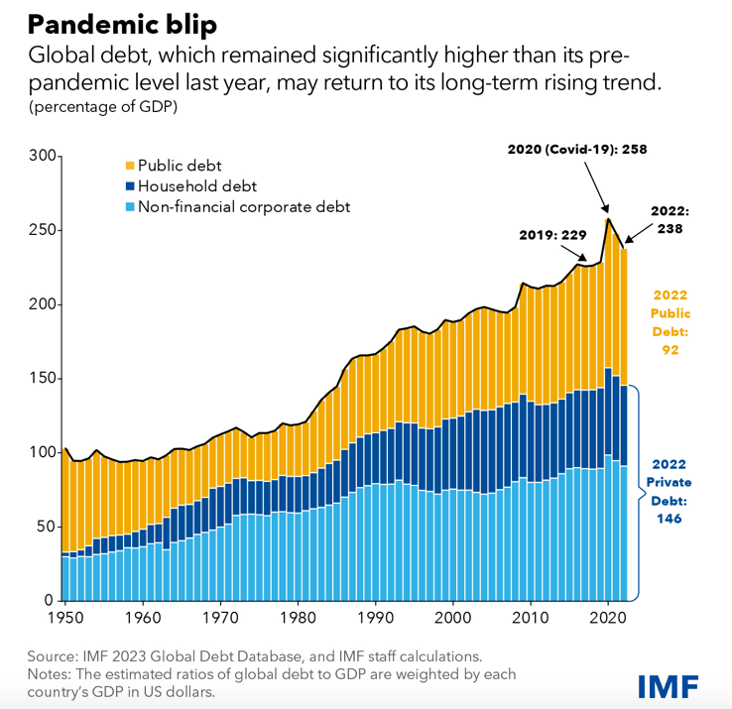
Notes:
DIRECTION

Slide 53
US Government Debt
$34+12 0’s

Slide 54
US Interest Expense
$1,5+12 0’s
Notes:
BEGINNING OF 2000 30 YEAR TREASURY BONDS YIELDED 1,2%
CURRENTLY 4,4% (IN OTHER WORDS INTEREST RATES HAVE MORE THAN TRIPLED)

Slide 55
Every US citizen owes …
$102000

Slide 56
A university student owes …
$38000
Notes:
$1,7T

Slide 57
average credit card debt is …
$8.000
Notes:
HOUSEHOLD BASIS

Slide 58
Notes:
RATES DROP FROM 5,25% TO 3,25%

Slide 59
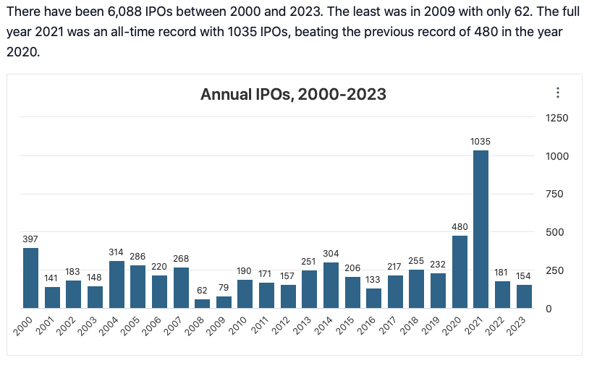
Notes:
2020 WAS BEST YEAR FOR IPOS SINCE DOT.COM BUBBLE OF 2000

Slide 60
Notes:
STOCK MARKETS ON FIRE

Slide 61
Market close December 31, 2020
30606,48
Notes:
+65% SINCE THE LOW POINT REACHED IN MARCH!

Slide 62
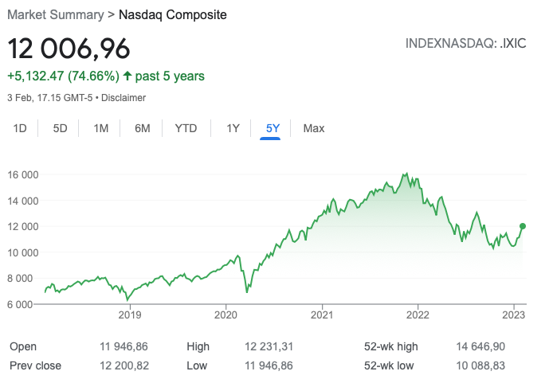
Notes:
TECH HEAVY NASDAQ HIT LOW OF 6879 ON 20 MARCH 2020
2020 INCREASED BY 90% TO 12888
2021 INCREASED BY 20%+

Slide 63
Notes:
VACCINES GET DEPLOYED BUT LOOK AT THE FOURTH WAVE HOCKEY STICK –
A SHAPE FAMILIAR TO ENTREPRENEURS WHEN PITCHING VENTURE CAPITALISTS

Slide 64
Notes:
2021 WAS ONE FOR THE RECORD BOOKS
MORE THAN 26% OF ALL THE IPOS OVER 22 YEAR PERIOD WERE DONE IN 2020-1

Slide 65
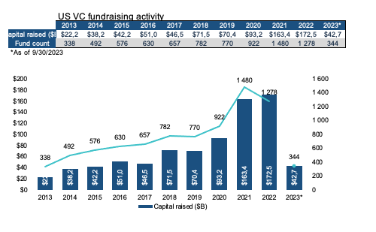
Notes:
WHAT DO YOU THINK HAPPENS WHEN IPO MARKETS ARE FROTHY?
41% OF ALL THE FUNDS RAISED ($820B) WERE RAISED IN 2020 AND 2021

Slide 66
Venture capital dry powder…
$303 billion
Notes:
AFTER THE BINGE - THEN COMES THE GLUT

Slide 67
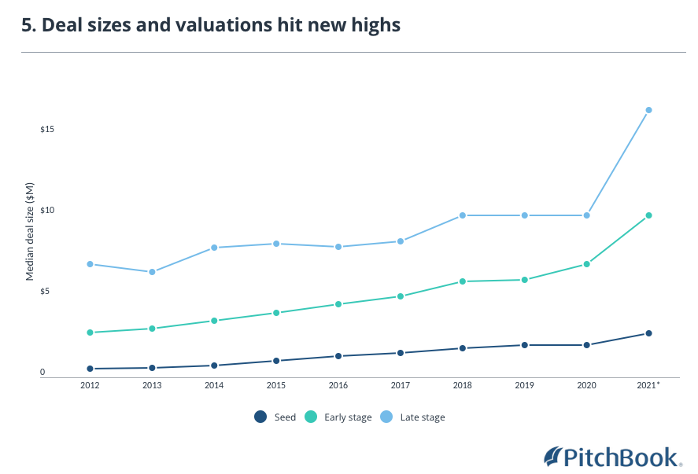
Notes:
2012 LATE (7M) EARLY (2,8M) SEED (,0,5)
2020 10M, 5M AND 2M
2021 16,5M, 10M AND 2,7M

Slide 68
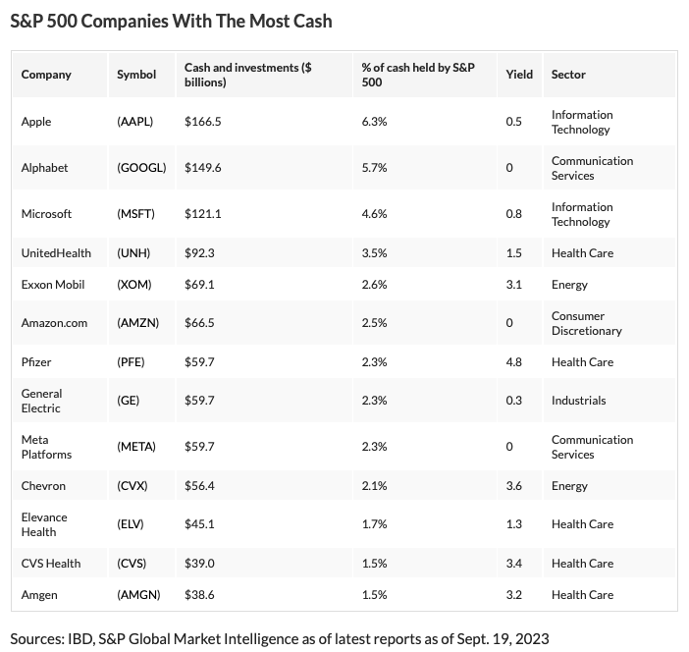
Notes:
THIS LIST TOTAL $1 TRILLION –
$564 BILLION HELD BY APPLE, ALPHABET, MICROSOFT, AMAZON, META

Slide 69
Market close December 31, 2021
36338,30
Notes:
´19% FOR THE YEAR

Slide 70
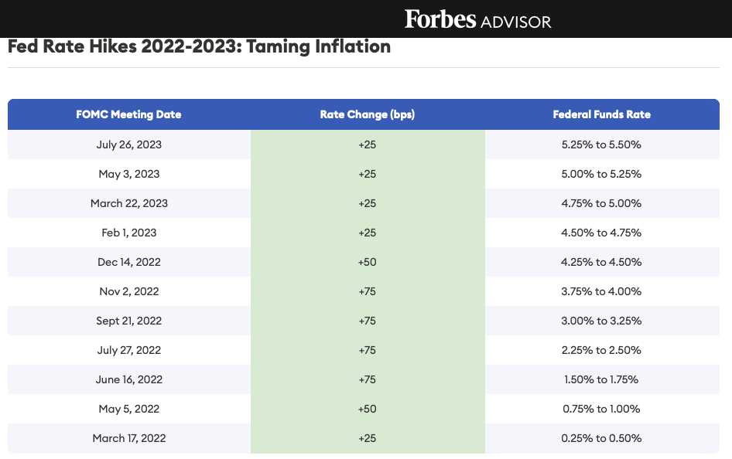
Notes:
US PRIME RATE HAS MOVED FROM 3,25% TO 8,5%
WHY HAVE THEY BEEN ON THE INCREASE?

Slide 71
US Prime Lending Rate
8,50%
Notes:
HAVE NOT SEEN LEVELS LIKE THAT SINCE 2007/8 BANKING CRISIS

Slide 72
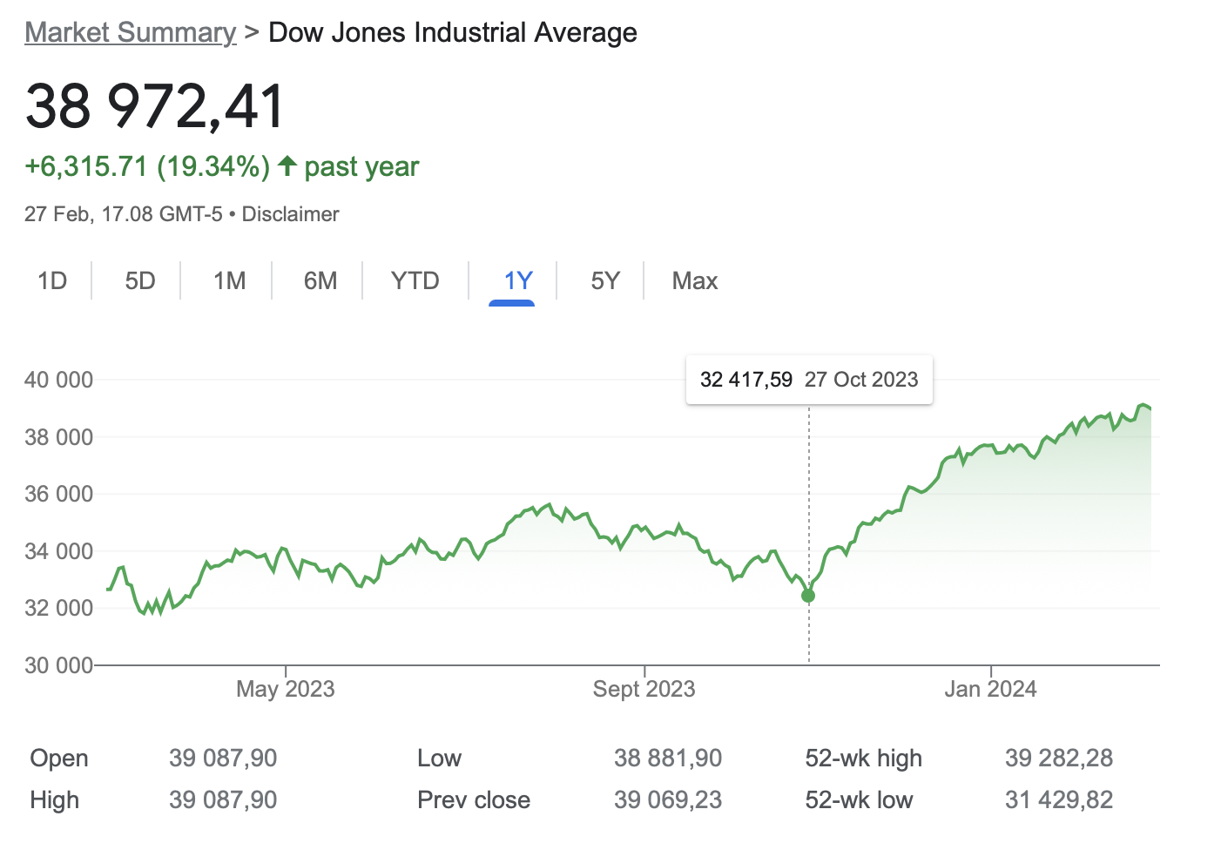
Notes:
DOW ROLLER COASTER
BUT UP 20% IN LAST 4 MONTHS

Slide 73
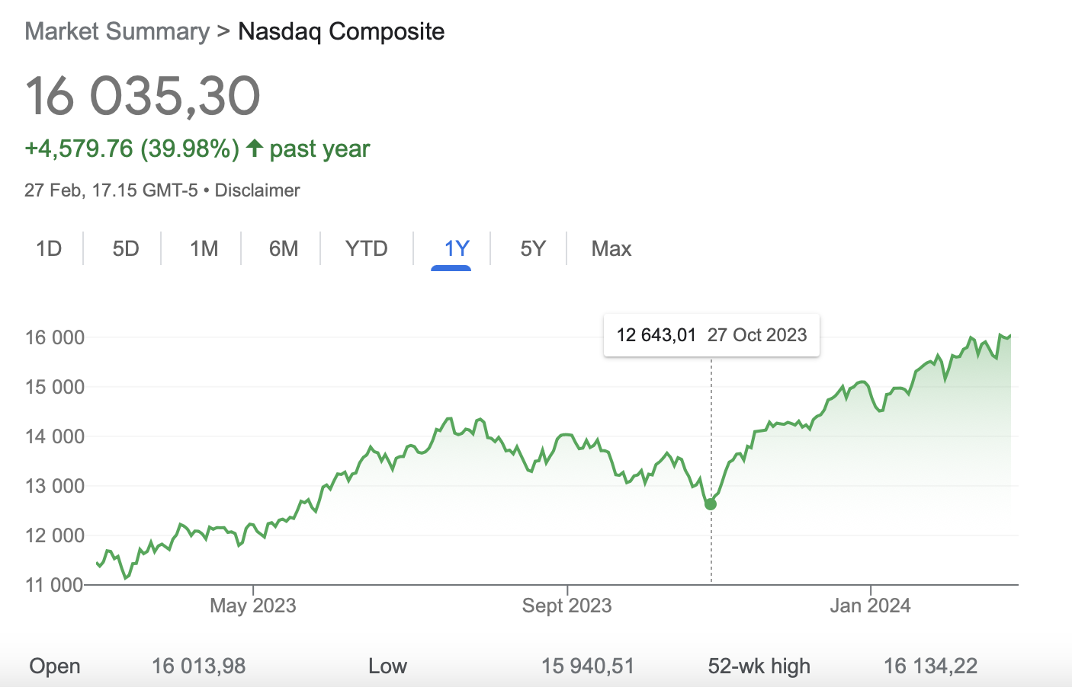
Notes:
+27%

Slide 74
Notes:
IPO MARKET HAS IMPLODED
UPDATE AS OF YESTERDAY 31 IPOS IN 2024

