Slide 1
Vehicle Mechatronics: Control
Everybody loves ROS
Slides: Jari Vepsäläinen & Pavithra Gopalakrishnan
July 1, 2020
Notes:
Reference: Mike Ross or Ross Geller ;) Or everybody loves Raymond!

Slide 2
Contents
These lecture slides have been inspired by
ROS wiki (wiki.ros.org)
Stanford ASL course AA274: Principles of Robot Autonomy 1
Robot Ignite Academy: ROS Basics
ROS Basics
What is ROS?
ROS Tools
ROS Architecture
Master, Nodes, Messages, Workspace, Packages and Launch Files
ROS Development
Packages and ROS program files (Node, launch files, …)
ROS Applications
Example application
ROS Debug

Slide 3
ROS Basics

Slide 4
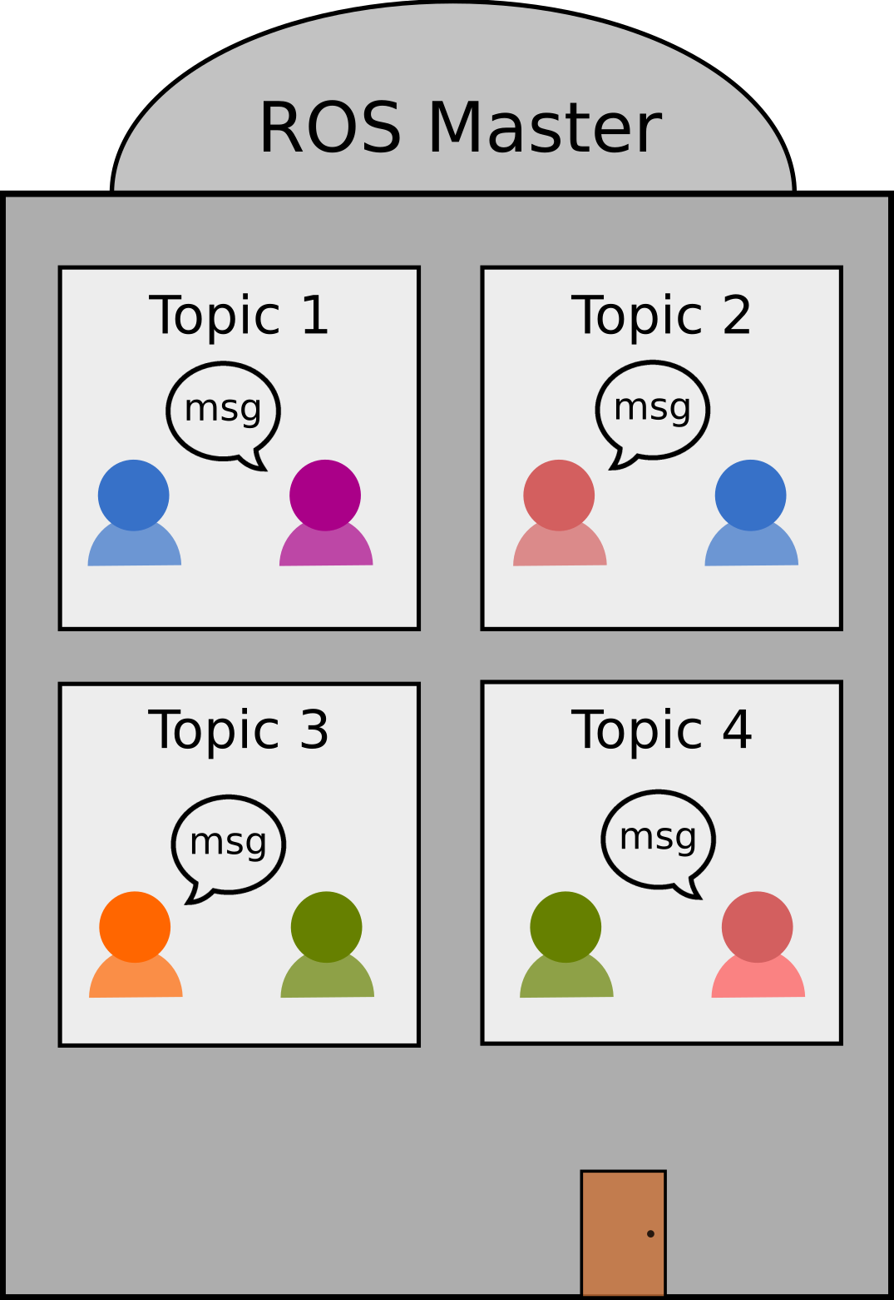
What is ROS?
A modular system environment for robotics
Robots require a lot of complex software that communicates between computers, actuators and sensors
Modularity: components and processes are independent
Publisher/Subscriber enables modular communication
Notes:
Point 2
Would some example help – what is this modularity you are talking about? Not clear.
Point 3
Is it too soon to talk about Pub/Sub at this level – just to introduce up for non beginners

Slide 5
Modularity
ROS Nodes are independent software building blocks that compose your robot’s perception, path plan and control
Drivers (sensors, actuators,…)
Processes (read sensor data, move forward,…)
Services (fetch a ball, jump and roll in place,…)
Easy to add and remove
Reduces code complexity compared to monolithic systems
Notes:
Modify, Produce or Use information
Modularity is still not clear – add a clarifiying picture and/or change the content
Maybe this and the slide before (What is ROS?) could be as a summarying slides for he end of this introductory section.
Modularity: helps people work alongside each other

Slide 6
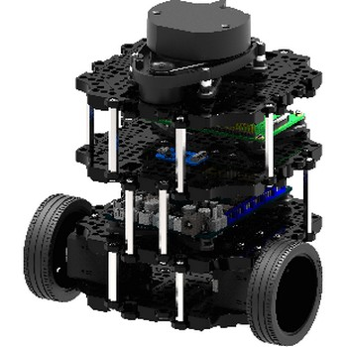
Modularity in practice
Processes
Components
Camera
Drive in a circle
LiDAR
Move forward
Odometry
Turn
left
Motors
TurtleBot

Slide 7
Pub/sub communication
A Topic is a message channel between nodes
Publisher is the “talker” and Subscriber is the “listener”

Slide 8
Why ROS?
No need to start to build from the ground up
ROS is 12 years old
Well-known
Open source
The closest to an “industry standard”
There are alternatives (LCM, YARP, Drake, Player, …)
Notes:
May include interesting pictures :)

Slide 9
Why ROS?
1) Communication
Between PC, robot and nodes (with pub/sub)
2) Packages
Predefined robot functions (sensor drivers, navigation, IMU)
3) Tools and Software
(Gazebo, Rviz, Rqt, OpenCV,…)
Notes:
Comments:
Should we have slides of Gazebo abd RViz after this? (slide 6)

Slide 10
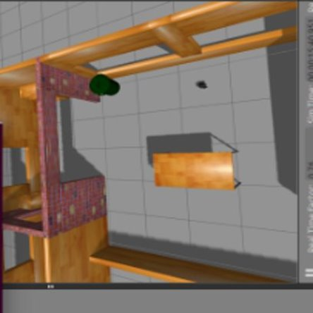
Tools
Gazebo (Simulator)
Real-world physics simulator
Meant for simulating your robot and its behavior with ROS commands
Rviz (Visualizer)
Visualization of what the robot sees and feels
Supports both real robot and Gazebo

Slide 11
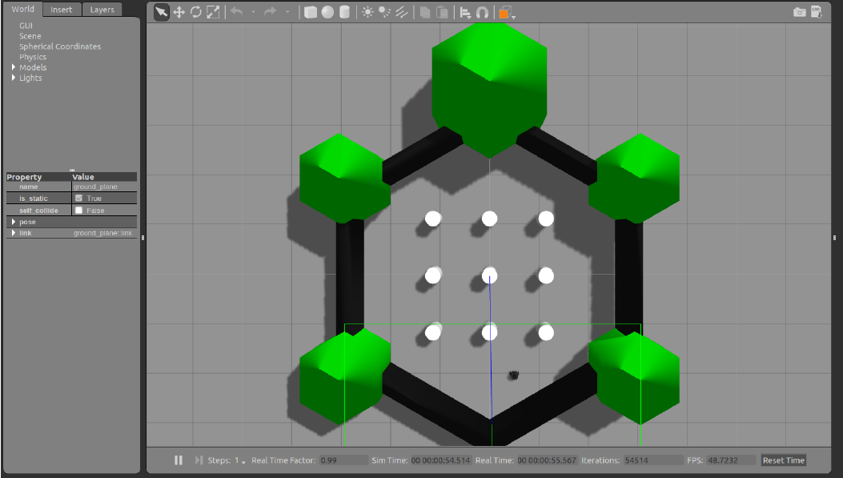
Gazebo example
$ roslaunch turtlebot3_gazebo turtlebot3_world.launch
Starts master
Opens Gazebo
Has a T-bot
T-Bot

Slide 12
Rviz example
$ roslaunch turtlebot3_slam turtlebot3_slam.launch slam_methods:=gmapping
Requires a simulated (Gazebo) or real robot to show what it sees
Opens RViz
Shows SLAM view
T-Bot
Notes:
Secret behind this picture :)

Slide 13
ROS Architercture

Slide 14
Main components
Master
Nodes
Topics
Messages
Notes:
Slide has been shifted up.
Question:
Can we rename the slide as ROS Architecture?

Slide 15
ROS Master
ROS Master
A server that coordinates nodes
Without master, nodes cannot find each other or exchange messages
Start with $ roscore or $ roslaunch
Only one ROS Master can be running
Node1
/Topic1
Node2
Node3
Notes:
Update the picture!

Slide 16
ROS Node
Smallest computation process, written with Python or C++ (rospy or roscpp)
The “fundamental” building block
Enables modularity
$ rosrun <package> <node>
Nodes can act as …
Drivers (LiDAR)
Functions (move forward)
Servers (service server)
Clients (client to a server)
Notes:
Comments:
Add a descriptive picture

Slide 17
Topic communication
Most common type of communication method between nodes
Topic communication is used in continuous data streams
Sensor data
Robot state
Node
Node
Node
Topic
Node
Node
Notes:
Add more technical details about topic communication

Slide 18
Publisher/Subscriber
Also referred to as Pub/Sub
Each node can both
Publish: send information, regardless of who is receiving it
Subscribe: receive information, regardless who is sending it
Notes:
Question:
Point 2 could be placed after a convincing definition of Pub/Sub

Slide 19
Pub/Sub example
LiDAR
LiDAR node
publishes laser scan msgs
Motion controller
publishes odometry values
subscribes to motion control msgs
Navigation node
publishes motion control msgs
subscribes to LiDAR & odometry msgs
\scan
Navigation
\odom
\cmd_vel
Motion Controller (SCB + ECU + IMU)
Odometry: coordinates (x,y,z), linear & angular velocities
Msg: short for message
Notes:
Make sure the arrows are connected to the boxes

Slide 20
Topics
\scan
(LaserScan) – an array of distance data
\odom
(Odometry) – position and orientation data
\cmd_vel
(Twist) – set linear and angular velocities
Notes:
Comments:
Conceptual correctness, difference between message and topic could be slightly misleading

Slide 21
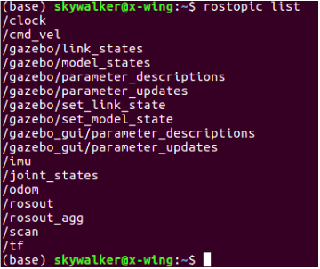
Topic monitoring
$rostopic list
Provides list of active topics
$rostopic info <topic>
Obtain publisher and subscriber information of the topic

Slide 22
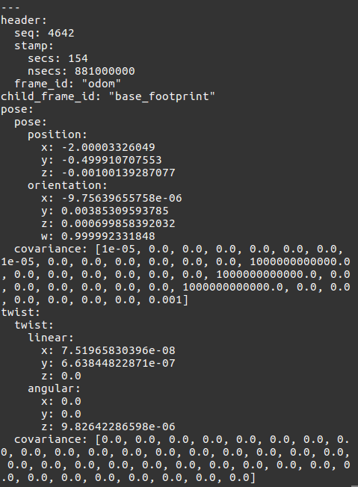
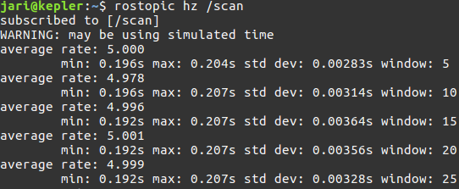
Topic monitoring
$ rostopic echo <topic>
Shows all messages received on <topic>
$ rostopic hz <topic>
Shows the publishing frequency of the <topic>
Notes:
Add pictures of terminals

Slide 23
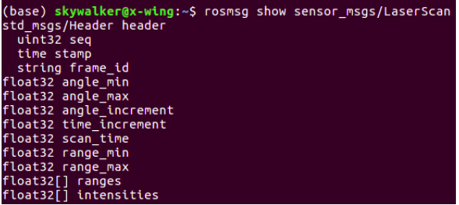
Message
Topics handle information through messages
.msg files are simple text files that describe the fields of a ROS message
Example
Info in LaserScan msg:

Slide 24
More communication methods
In addition to Topic communication, these special communication types are all based on Topics
Service – ask for a predefined function
Action – ask for a predefined function
Parameter – set and get global parameters

Slide 25
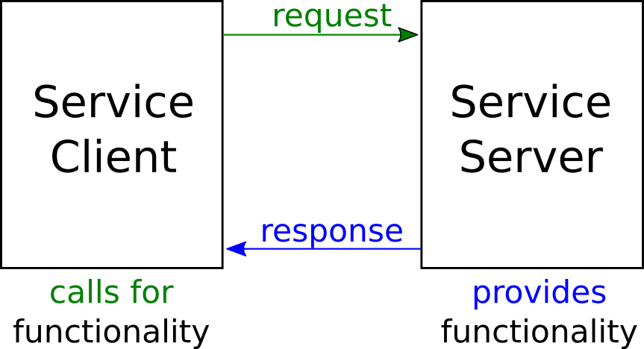
Services
Service examples for a drone...
“Liftoff”
“Fly in a circle one lap”
“Land”
Server/Client structure
Services are Synchronous – while active, robot cannot answer to requests/calls/commands to do something else
While “Liftoff” is happening, cannot start to “Fly in a circle …”

Slide 26
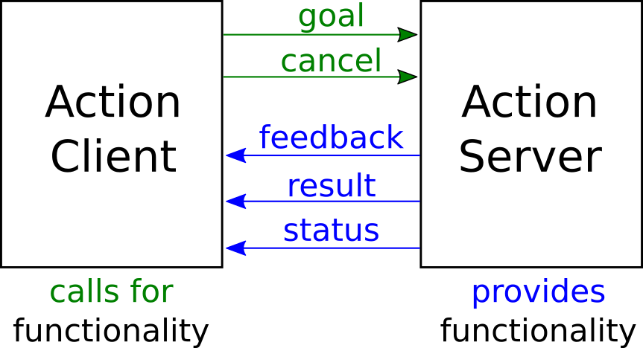
Actions
Actions are commands
Liftoff
Fly in a circle
landing
Server/Client structure
Actions are Asynchronous – while active, robot can receive more commands and do them while also performing the original action
While “Liftoff” is happening, can start to also “Fly in a circle …”

Slide 27
Parameter communication
Parameter server is shared place for global parameters
Nodes can store and retrieve parameters
Meant for configuration parameters, such as PID gains

Slide 28
End of first ROS session
– Thank you!

