Slide 1
Case study teams
Team 1: topic 4
Ahonen
Cai
Huber
Maukonen
Team 2: topic 1
Ansaharju
Basol
Pirhonen
Michalovic
Team 3: topic 1
Du
Goedhart
Häikiö
Song
Team 4: topic 3
Abildsten
Haapavaara
Putkinen
Friman
Team 5: topic 4
Pitkänen
Sato
Yan Thi Ni
Team 6: topic 2
Liu, H
Mukhopadhyay
Mäkipää
Siren
Team 7: topic 3
Aggarwal
Mittler
Juntura
Kynsilehto
Team 8: topic 2
Laakso
Liu, J
Rentto
Steen

Slide 2
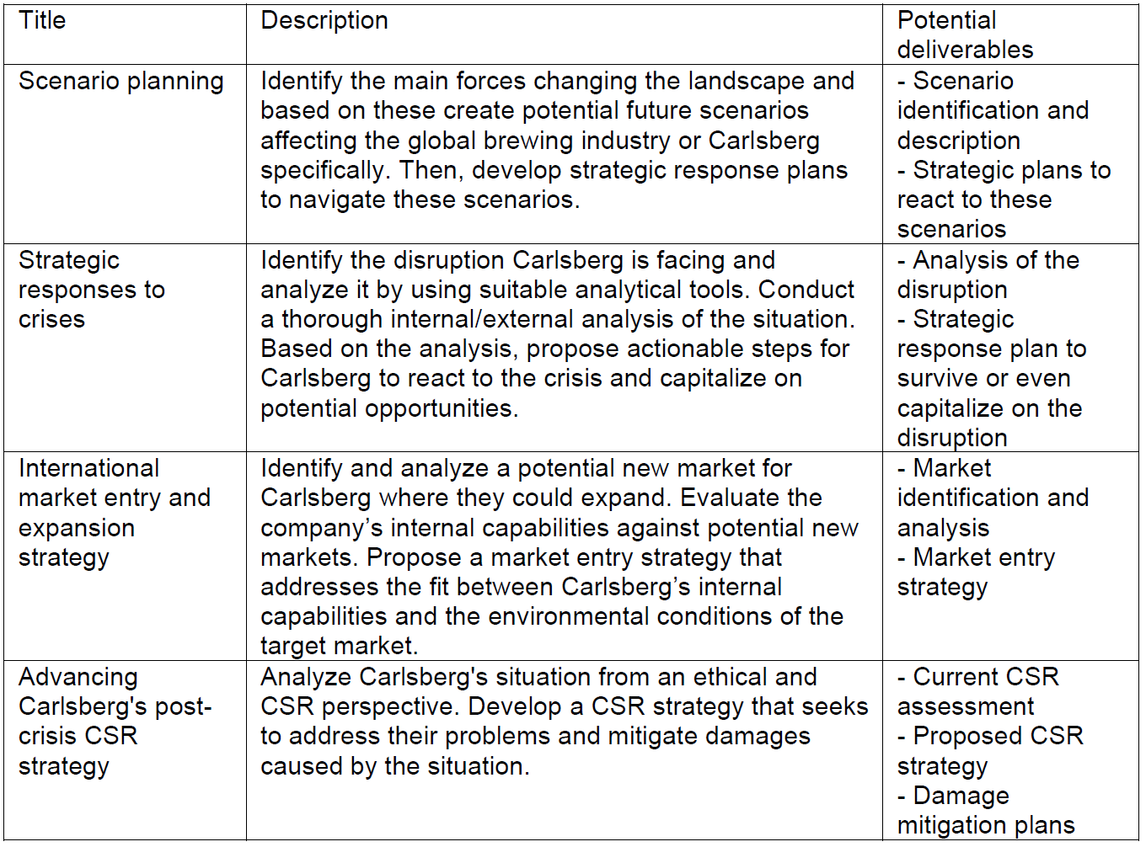
Assignment 2: Topics; choose one

