Slide 1
Assistant training
Jani-Petri Martikainen
14.1.2021

Slide 2
Take away message
You are important!
Consider the amount of student contact and peer status!

Slide 3
Substance is important!

Slide 4
Being a human is (more) important!

Slide 5
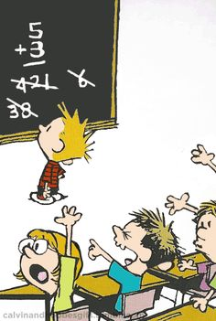
Teaching assistant: exercise sessions

Slide 6
Teaching assistants: lab exercises

Slide 7
Teaching assistants: project work

Slide 8
Something different?

Slide 9
Teaching assistants: different teachers
Service teaching:other schools?
Teaching for majors/minors?
Professor vs. lecturer?
variation exists

Slide 10
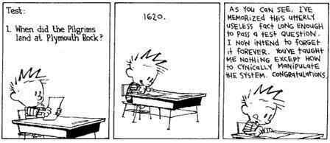
Different learners…different goals…
Learning

Slide 11
Corona, remote teaching
Hard to get feedback
Passive audience, black screen, yelling to the void?
On the positive side everyone making videos (bad ones)
Learned Zoom, Teams, etc.
My own experience…mostly sucks, but larger toolbox.
Can adapt better in the future
Travels, sickness…

Slide 12
Where we would like to go?
All assistants have some training.
Vibrant TA community giving peer support
Great feedback channels between students, TA’s, and teachers
Everybody feels confident they can develop
Amazing motivation everywhere
Positive TA’s contribute to student community wellbeing
…

Slide 13
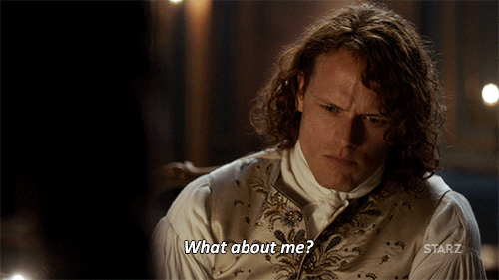
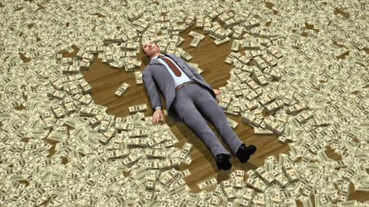
Use teaching as an opportunity to develop yourself
Learn the substance!
Learn presentation!
Learn social skills!
Money!

Slide 14
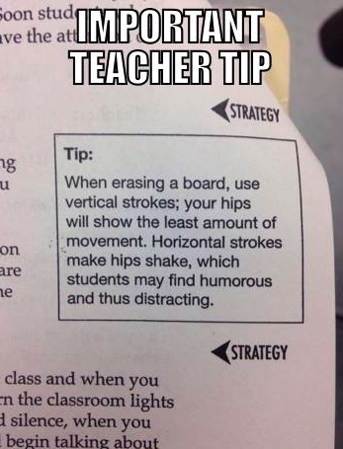
Some goals for today?
Meet your peers
Reflect
Discuss
Network, build
a community

